Slide 1
VeExpress-Lite V1
Getting Started:
VeExpress-Lite is a light version for VeExpress, customers like “colt” should supposed to use Lite version instead of the old client.
It’s an Angular based web client ,could be easily ported to other platforms.
It’s mobile-friendly web client (currently we are focus on tablet version , will try porting to mobile later).
For the first edition, five epics (features) are included:
Common GUI library.
User Authentication
License Management
Test set Management
License Operation History
The going is slow on this project because of I am the only one who knows about the Angular in Chengdu site, and I am used to be interrupted by other emergencies quite often , when making ETA. in Redmine ticket, please do considering the workload I being face at.
©2020 VeEX Inc. - All Right Reserved
Calvin
1

Slide 2
1.Common GUI library
Stories:
Theme
Smart Table
Widgets
I18n (Only framework, first edition is English only)
VeExpress WebAPI ODataV4 compatible client
©2020 VeEX Inc. - All Right Reserved
Calvin
2

Slide 3
2.User Authentication
Stories:
Token based authentication
User login
Forgot password
Session timeout mechanism
Under Construction/Coming Soon page
Global warning message system
©2020 VeEX Inc. - All Right Reserved
Calvin
3

Slide 4
3.License Management
Stories:
View
Assign/Release
Bundle
Conflicts resolution
©2020 VeEX Inc. - All Right Reserved
Calvin
4

Slide 5
4.Test set Management & 5. License Operation History
Stories:
View
Search
©2020 VeEX Inc. - All Right Reserved
Calvin
5

Slide 6
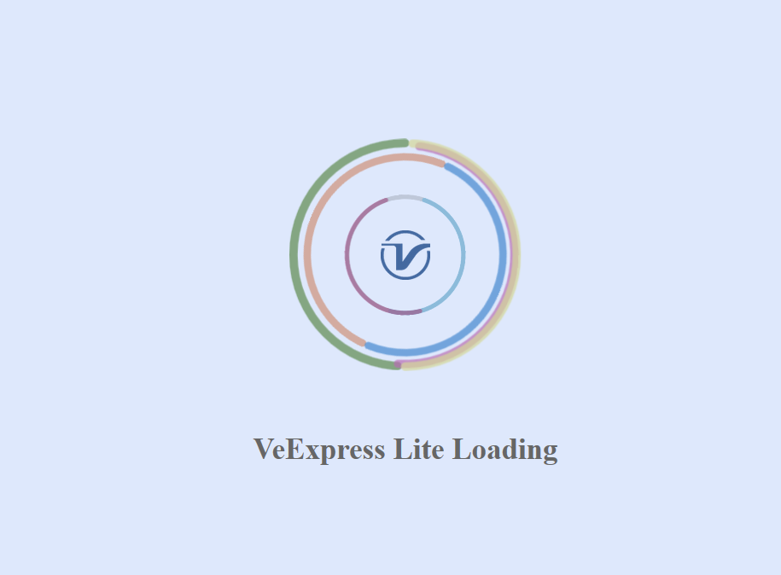
Progress – Logo
©2020 VeEX Inc. - All Right Reserved
Calvin
6

Slide 7
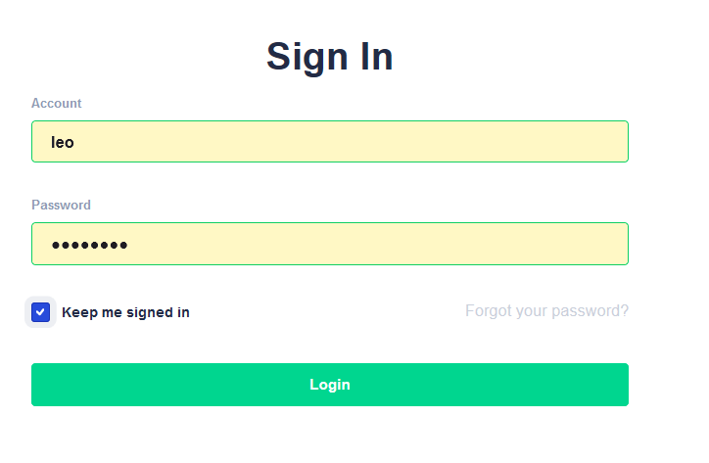
Progress - Login
©2020 VeEX Inc. - All Right Reserved
Calvin
7

Slide 8
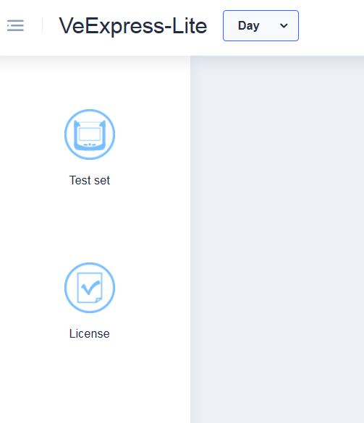
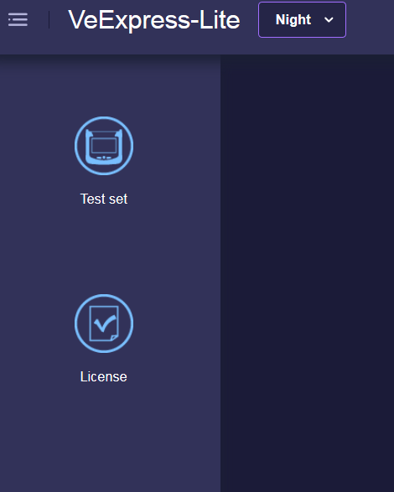
Progress – Theme & Menu
©2020 VeEX Inc. - All Right Reserved
Calvin
8

Slide 9
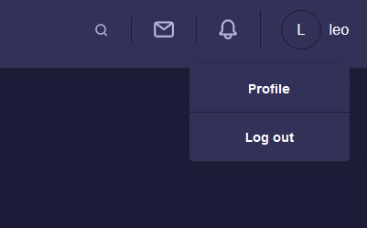
Progress – Web Header & Shortcut
©2020 VeEX Inc. - All Right Reserved
Calvin
9

Slide 10
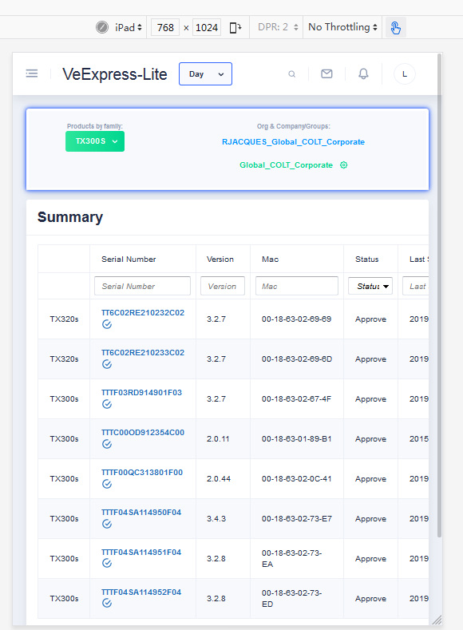
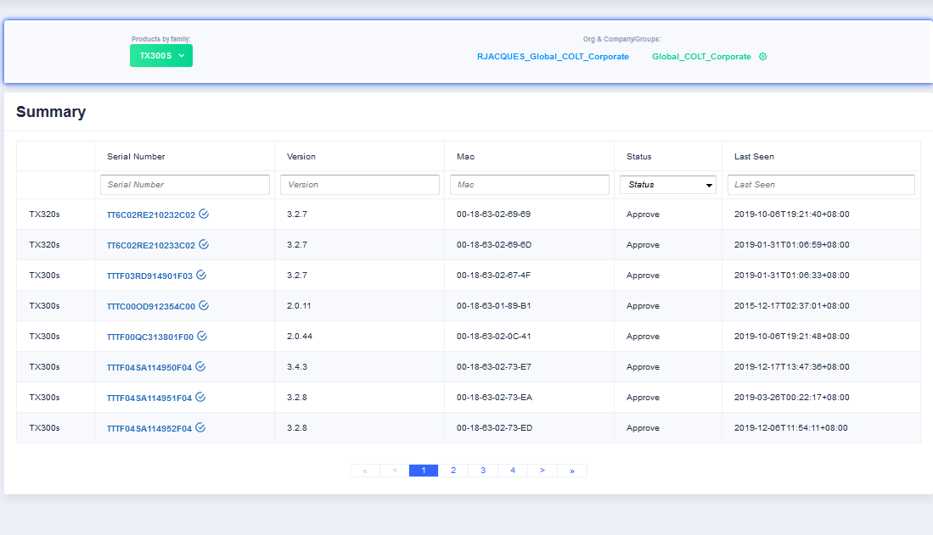
Progress – Test set & Mobile Auto-fit
©2020 VeEX Inc. - All Right Reserved
Calvin
10

Slide 11
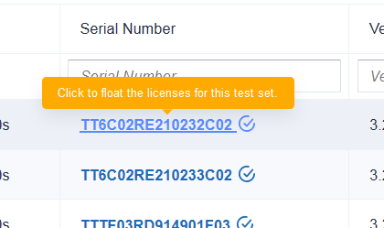
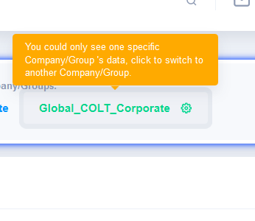
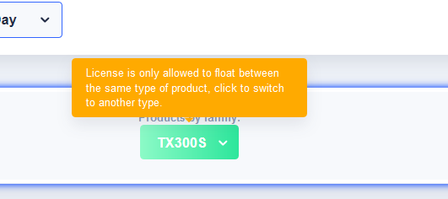
Progress – Tip system & Self-documented
©2020 VeEX Inc. - All Right Reserved
Calvin
11

Slide 12
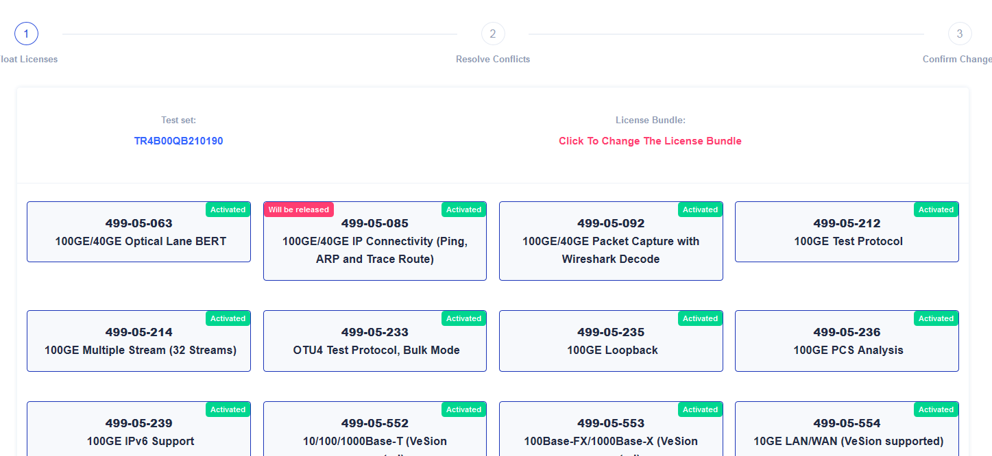
Progress – Stepper component for easy operations 1
©2020 VeEX Inc. - All Right Reserved
Calvin
12

Slide 13
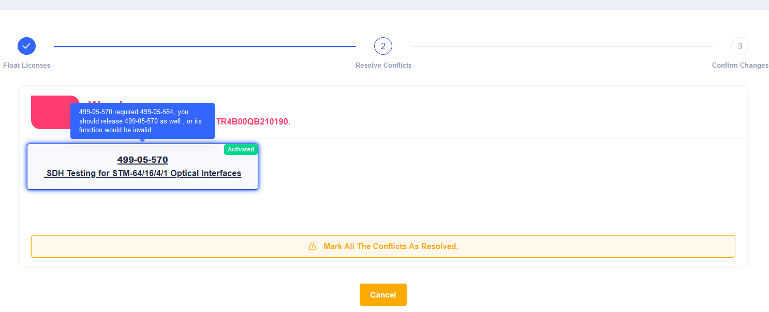
Progress – Stepper component for easy operations 2
©2020 VeEX Inc. - All Right Reserved
Calvin
13

Slide 14
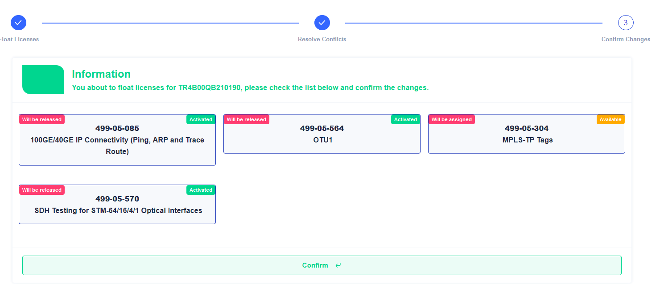
Progress – Stepper component for easy operations 3
©2020 VeEX Inc. - All Right Reserved
Calvin
14

Slide 15
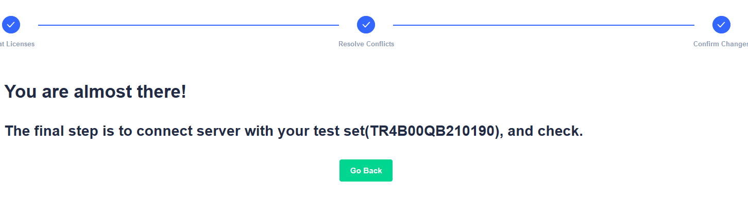
Progress – Stepper component for easy operations 4
©2020 VeEX Inc. - All Right Reserved
Calvin
15

Slide 16
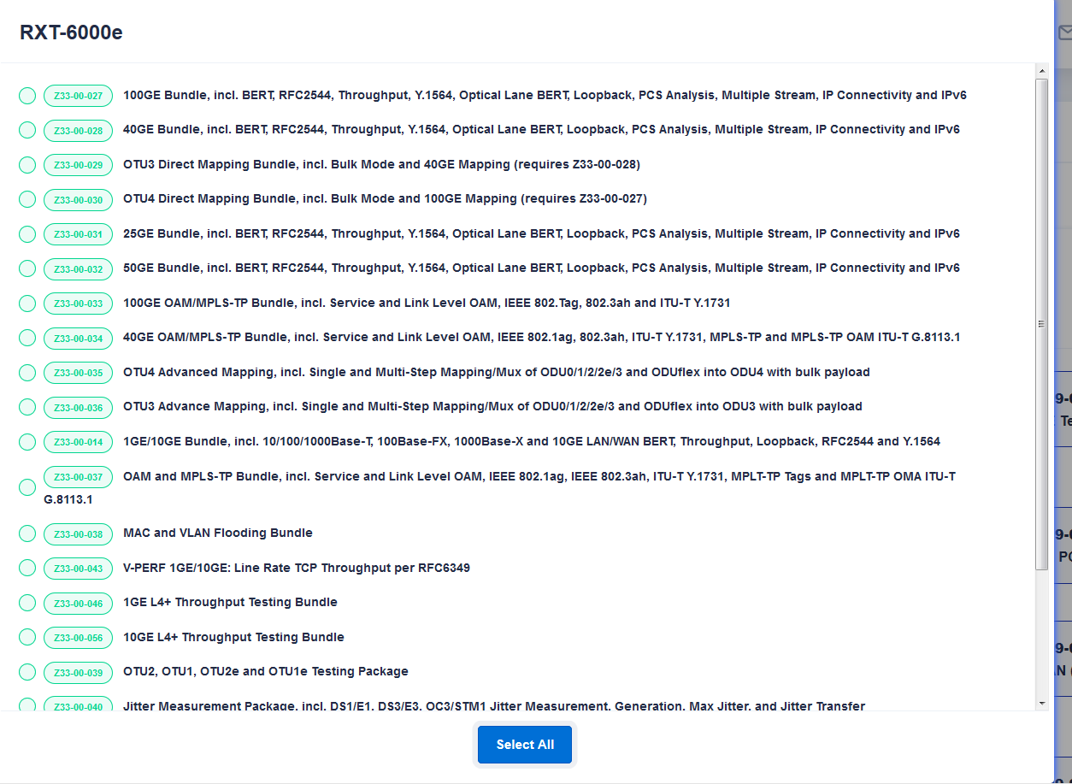
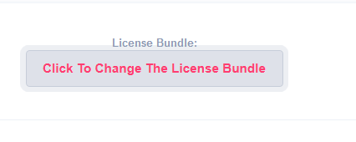
Progress – License Bundle 1
©2020 VeEX Inc. - All Right Reserved
Calvin
16

Slide 17
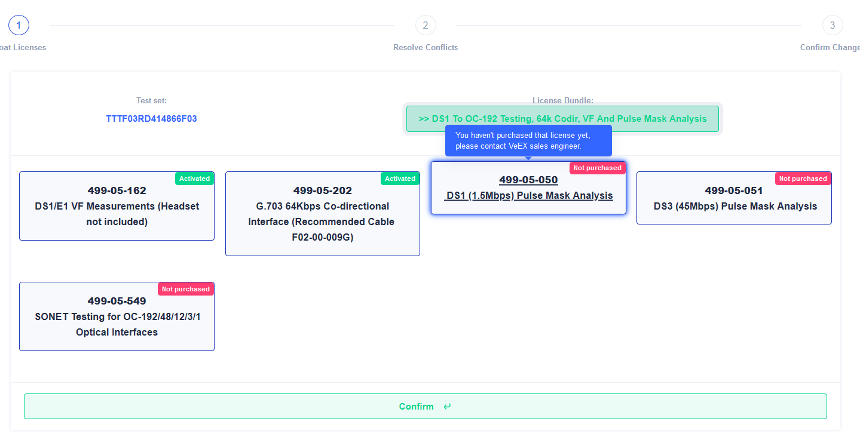
Progress – License Bundle 2
©2020 VeEX Inc. - All Right Reserved
Calvin
17

Slide 18
Progress – Demo
192.168.68.128:8084/progress/index.html
For inspiration, you could check our demo site in Chengdu
This demo site is for debug propose, please ignore any of the problems you met.
©2020 VeEX Inc. - All Right Reserved
Calvin
18

