Slide 1
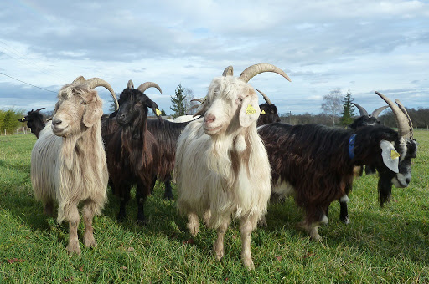
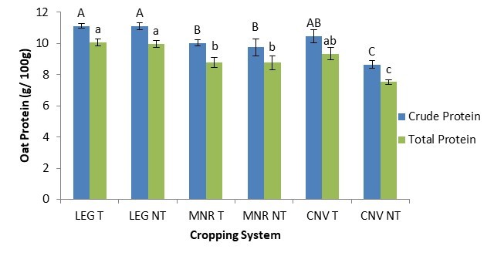
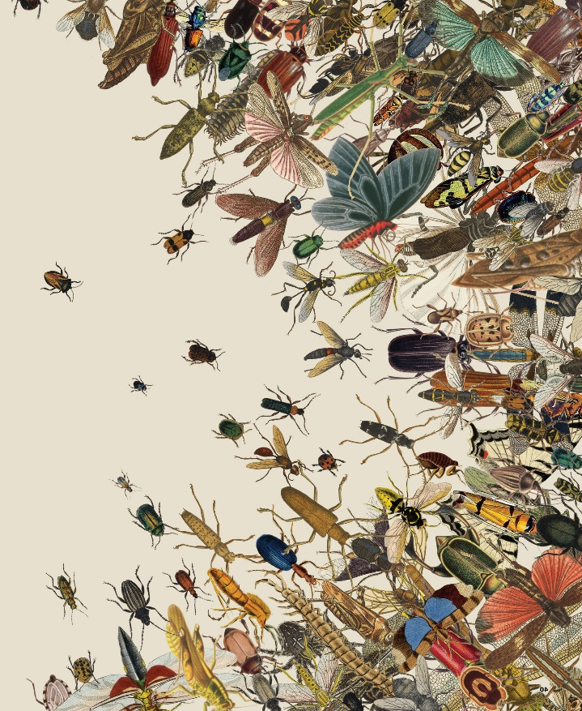
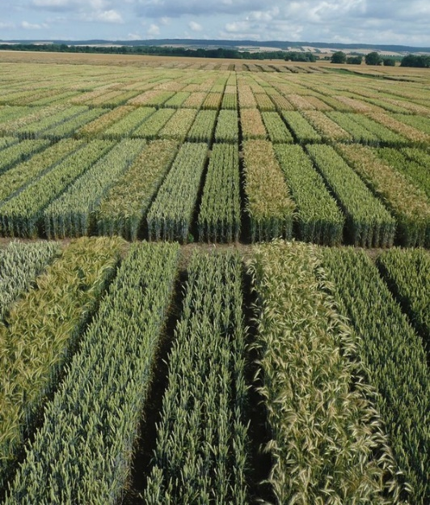
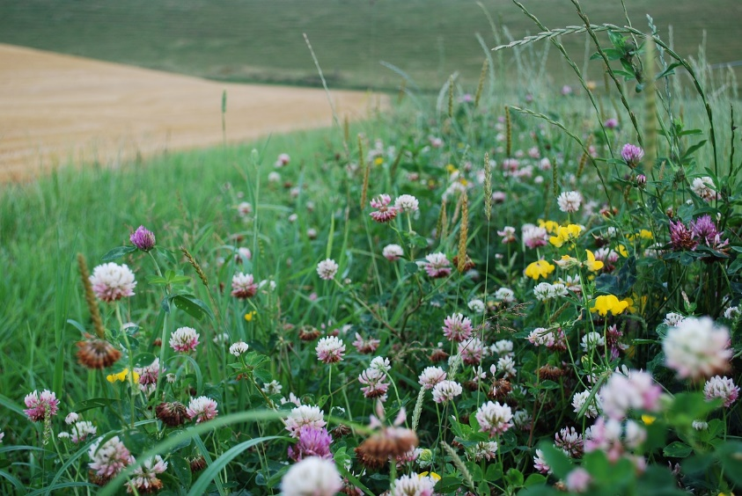
C7041 Experimental Design and Analysis
Ed Harris

Slide 2
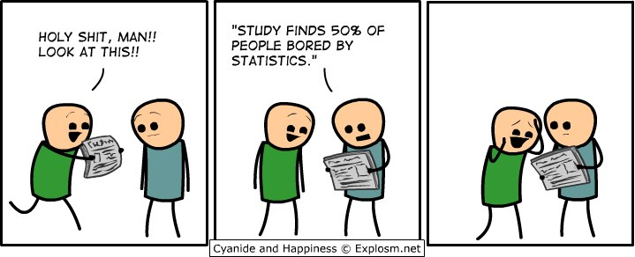
1.00 Module introduction

Slide 3
1.00: Module introduction
About the Module
Module objectives
About the instructors
Why R?
Organizing data for analysis
Review of some basic concepts in statistics
First discussion paper

Slide 4
About the Module
Lectures (recorded): Topic by topic, suggested schedule on Moodle
Live sessions: (9:30-10:30a, and labs 2-6p Mon-Fri)
Morning: Intro to topics led by me, lab help as long as there are Qs
Questions and other philosophical discourse
R labs: Topic by topic, suggested schedule on Moodle
Assignment: Assignment brief (your work on this begins after this week)
Suggested readings (explain reading lists and texts)
Other stats and R Resources available, many online; see Moodle

Slide 5
Live session each morning:
Morning session Intro to topics for the day (led by me)
-Touching base on the topics
-General problems, issues, questions
-Slack Q roundup – problem solving for lab questions

Slide 6
Live session each Afternoon:
Lab and R code questions, other questions
- Help is available
- Prepare to “receive help and be given help”
- ”Minimal Reproducible Example” (works for Slack too)
Minimal reproducible example concept
More detail on MRE with examples

Slide 7
Labs:
You have several per day to get through
Should have latest R and RStudio installed (Rstudio Cloud is also an option).
Work through problems with your own code for each lab.
Code buddies
Aim to make a good script!
Use the R Bootcamp and R tutorial pages as reference as needed.
Try solving by yourself. If it is not working, ask your code buddy for help. Then ask for help in Slack. Don’t be afraid to admit that you are stuck. You are not alone.
Each lab should take approximately 2 or more hours. There is no specified portion of labs that must be completed. The further you go, the more you will learn. You control that.

Slide 8
Assignment brief:
Assignment brief available on Moodle
Find a dataset you are interested in and analyse it reproducibly demonstrating the use of tools and principles we cover in this module
Tidy data + Report + Documented R Code (100%)

Slide 9
Web sites, info, resources
C7041 module HAU moodle
Bootcamp
labs

Slide 10
The module
Was developed to meet needs for MSc students, for research project, etc.
Challenge: huge range of background experience amongst students
Assume Bootcamp material background
Feedback is welcome, especially the thoughtful, constructive kind
Resources
No required textbook
Suggested readings and papers from on Moodle
Literally 1000s of resources on the web (burden of choice, audience, correctness, completeness)
Possibly consider getting a textbook as a reference. Some good modern ones I like
Diez. 2019. OpenIntro Statistics 4ed
Whitlock and Schluter. 2015. The analysis of biological data.
Quinn and Keough. 2002. Experimental design and data analysis for biologists

Slide 11
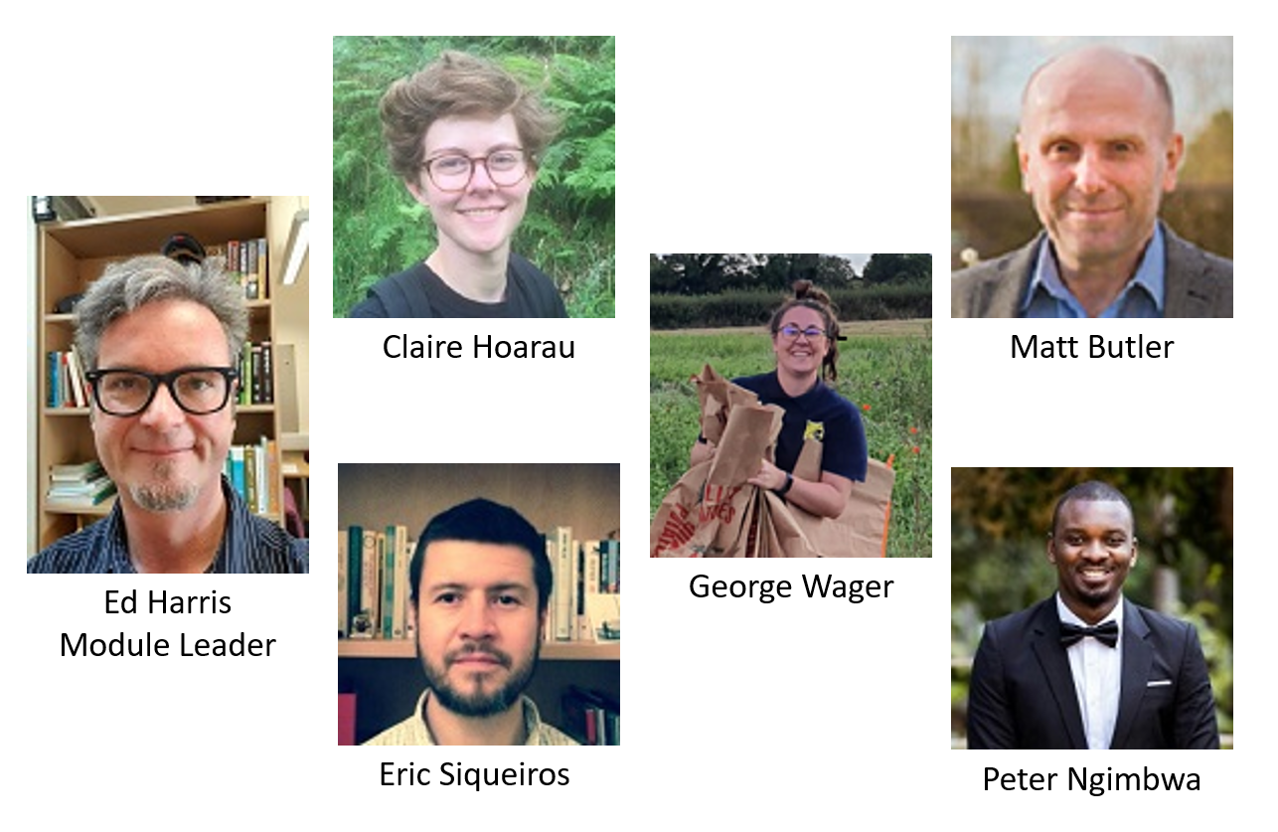

Slide 12
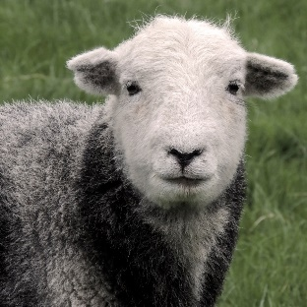
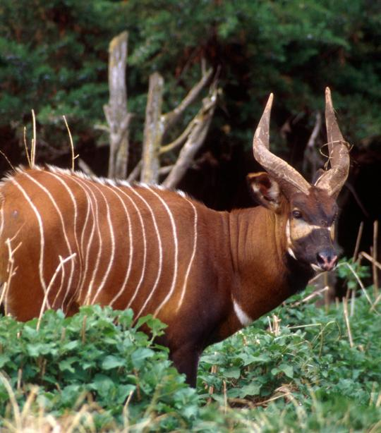
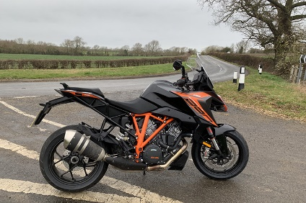
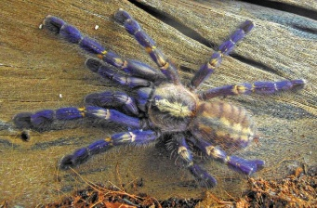
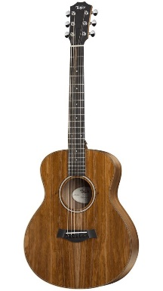
About Ed
BSc Genetics, PhD Biostatistics, R programming, practice of statistics, Artificial intelligence and data science
Research interests: Conservation, ecology, biodiversity, genetics, experimental design, machine learning, statistics teaching and literacy
Current research: deep learning in computer vision applications, like noise impact on bird/bat/insect biodiversity, measuring crop yield from pictures/drones/satellite data, identifying land use impacts on plant and insect biodiversity, many others…
Other interests

Slide 13
Module aims:
Help prepare you for research project: reviewing basic principles for designing good studies, gathering and organizing data, and properly analyzing those data
Think about patterns in data differences (“effect size”), not just P-values
To show you an amazing statistical environment in which to analyze data: R.
Coverage of modern methods, building on basic foundations (like 1-way ANOVA and simple regression)
For your research you may need to delve more deeply into particular methods that turn out to be most appropriate
“Linear models” will be the framework, and we will start there and generalize
This is a practical module: learn by doing

Slide 14

What is R?
R is a language and software for statistical computing and graphics.
R is a GNU Project, free (as in “free beer”, also liberty…) under the terms of the Free Software Foundation GNU General Public License.
R was inspired by the S environment, developed at Bell Laboratories (formerly AT&T, now Lucent Technologies) by John Chambers and colleagues.
R was initially written by Robert Gentleman and Ross Ihaka (also, lmnop, q… R… S…)
R is the result of a collaborative effort involving contributors from all over the world – 1000s and 1000s of packages of “solutions”.

Slide 15
Good things about R
Powerful and flexible.
Free!
Runs on all computer platforms.
HUGE community and resources, very popular in business, research and teaching
R skills are impressive and can help you get a job or academic position (employability)
Many extensions (packages). New ones always coming online.
{agricolae} – experimental design for ag experiments
{ape} – phylogenetic comparative methods
{emmeans} – magnitudes for linear model fits
{ggplot2} – graphics tools
{mra} – analysis of mark-recapture data
{shapes} – geometric morphometrics
{vegan} – ordination in community ecology
{visreg} – visualize linear model fits

Slide 16
Good things about R
Superb data management and manipulation capabilities
Superb ability to analyse large datasets quickly.
Superb graphics capabilities.
-Visualize data and model fits
-Produces vectorized graphs (pdf or eps format), permitting editing in a graphics package (e.g., Inkscape)
Reproducibility of analyses. R uses scripts to execute commands rather than menus…
It can be easy to do things that are difficult or impossible to do in other packages.
You can write your own functions to speed up your specific needs.
It is also a great programming tool.
Someone has already solved your problem. Google is the encyclopedia of everything R.

Slide 17
Bad things about R
Steep learning curve: R uses scripts to execute commands rather than menus and a mouse
It can sometimes be difficult to do simple things.
It is not a great spreadsheet.
-Use a dedicated spreadsheet program to make and edit data (.xlsx or .csv) files.
There are several kinds of data objects to remember.
-Vectors and data frames are most common.
-You will learn others more gradually (list and matrix).
Some variation in command "syntax“ style (plot vs ggplot, the “tidyverse”).

Slide 18
activity: Each student shares one question they wrote in answer to one of the bootcamp pages (as you know every page has a 'write your own' style question).
Be prepared to share your screen and demonstrate the answer.
Paste the complete question and answer in teams chat when it is your turn

