Slide 1
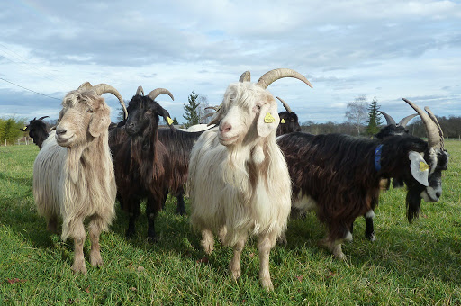
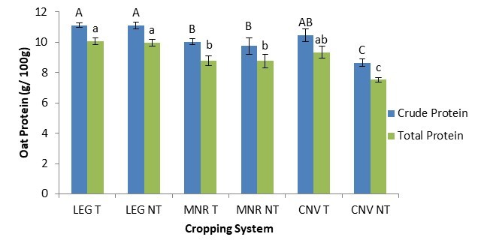

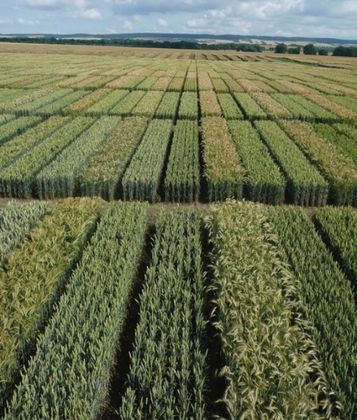

C7041 Experimental Design and Analysis
Ed Harris

Slide 2
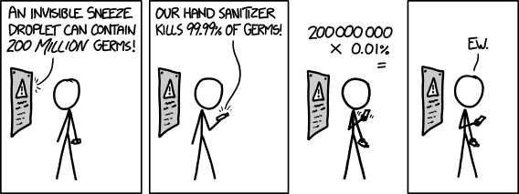
1.07 Analysing proportions

Slide 3
Proportions data
A proportion is the fraction of individuals having a particular attribute.

Slide 4
Proportions data
Example:
2092 adult passengers on the Titanic;
654 survived
Proportion of survivors = 654/2092
≅ 0.3

Slide 5
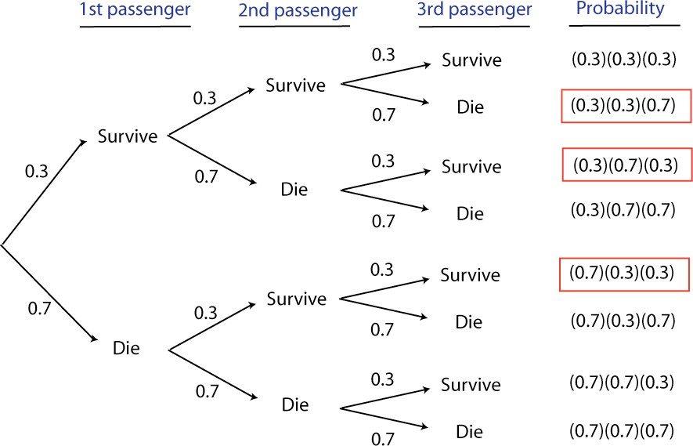
Probability that two out of three randomly chosen passengers survived

Slide 6
Binomial distribution
The binomial distribution describes the probability of a given number of "successes" from a fixed number of independent trials.

Slide 7
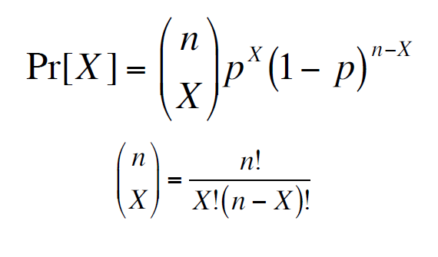
Binomial distribution
p probability of success
n trials
X number of successes

Slide 8
Binomial distribution
We read n! as “n factorial”
n! = n × n–1 × n–2 ×... 3 × 2 × 1
6! = 6 × 5 × 4 × 3 × 2 × 1 = 720
0!=1
1!=1

Slide 9
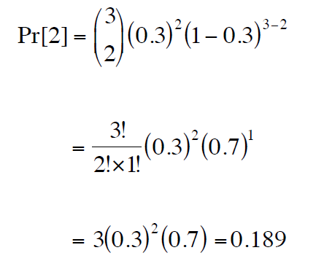
Binomial distribution
Probability that two out of three randomly chosen passengers survived the Titanic
Probability of 1 death
Number of ways to get 2 survivors out of 3 passengers
Probability of 2 survivors

Slide 10
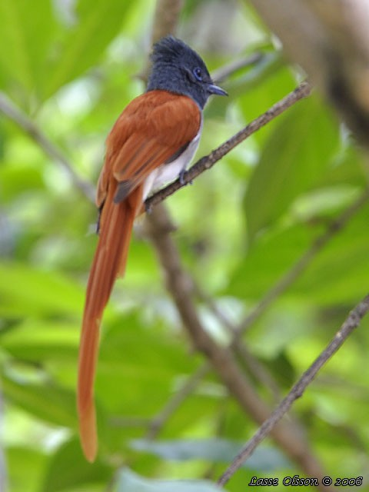
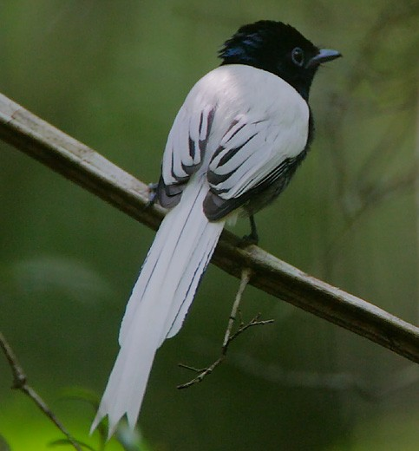
Example: Paradise flycatchers
A population of paradise flycatchers has 80% brown males and 20% white. You capture 5 male flycatchers at random.
What is the chance that Exactly 3 of those are brown and 2 are white?

Slide 11
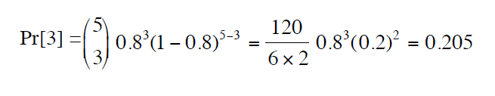

Example: Paradise flycatchers
p(brown)
p = 0.8
n birds caught
n = 5
X brown caught
X = 3
Math way:
R way:

Slide 12
Example: Paradise flycatchers
Flash challenge:
Calculate the probability that you capture 3 or more are brown?

Slide 13
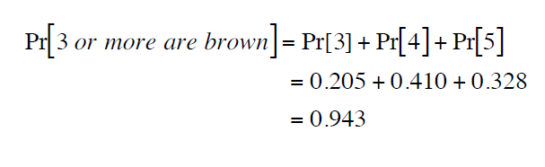
Example: Paradise flycatchers
Flash challenge:
What is the probability that 3 or more are brown?

Slide 14
Properties of the binomial distribution: Mean and variance of number of successes
μ = np
σ ² = np(1− p)
p probability of success
n trials

Slide 15
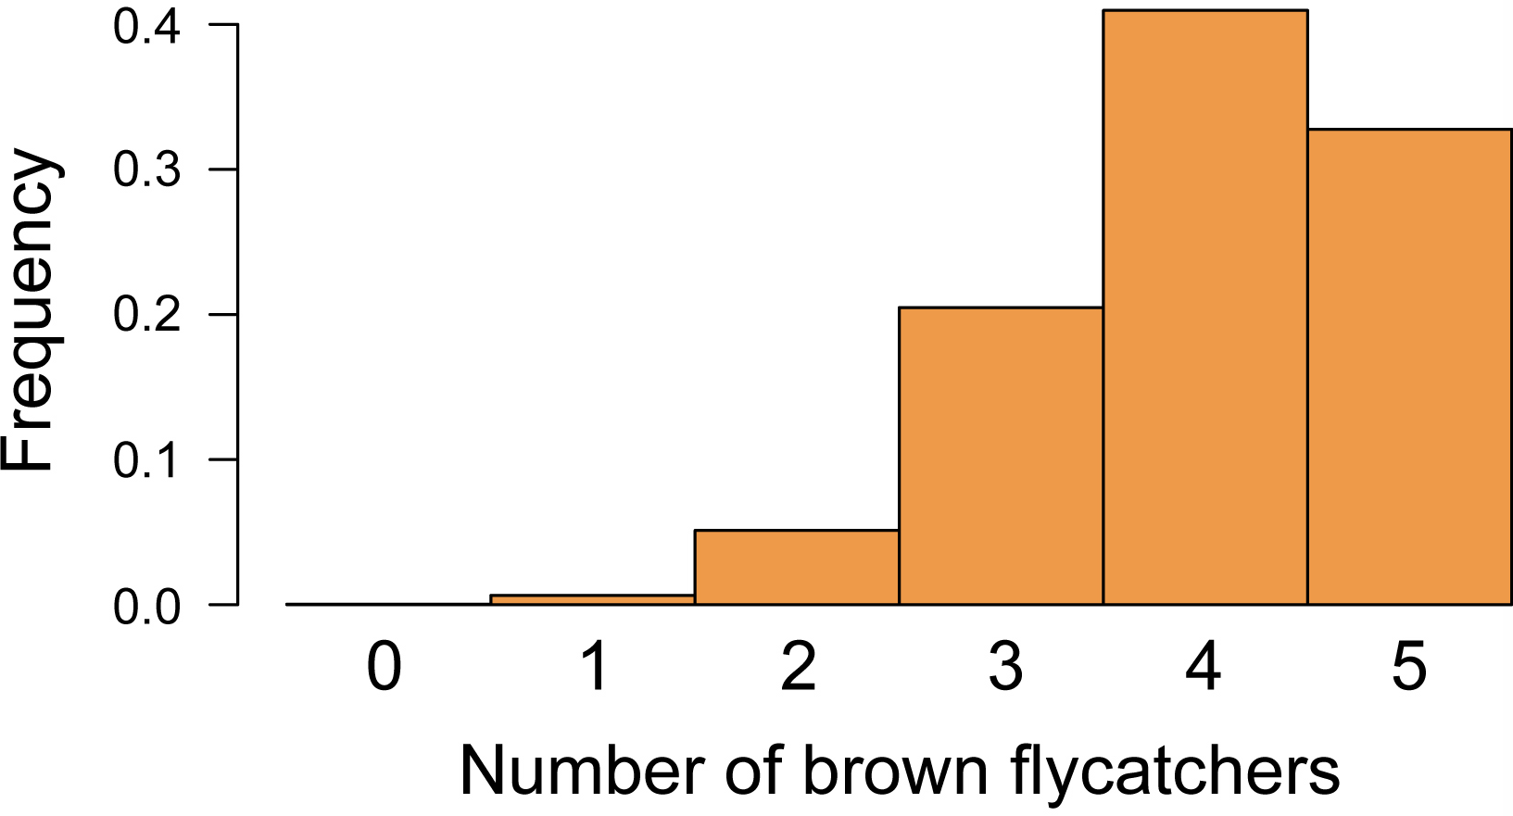
Example: Paradise flycatchers
Binomial distribution for
P = 0.8, n = 5
μ = np

Slide 16
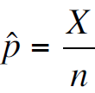
Proportion of successes in a sample
The hat (^) indicates that this is an estimate of p.

Slide 17
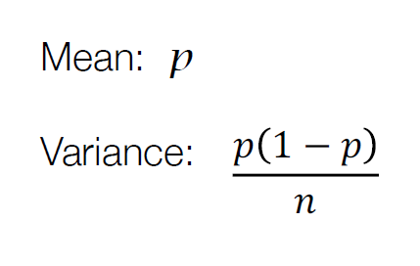
Properties of sample proportions

Slide 18
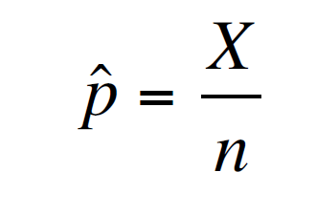
Estimating a proportion
The number of “successes” divided by the total sample size

Slide 19
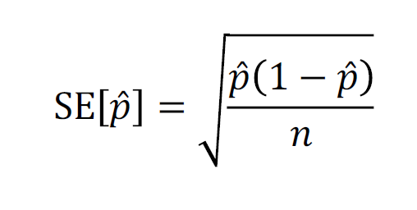
Standard error of the estimate of a proportion

Slide 20
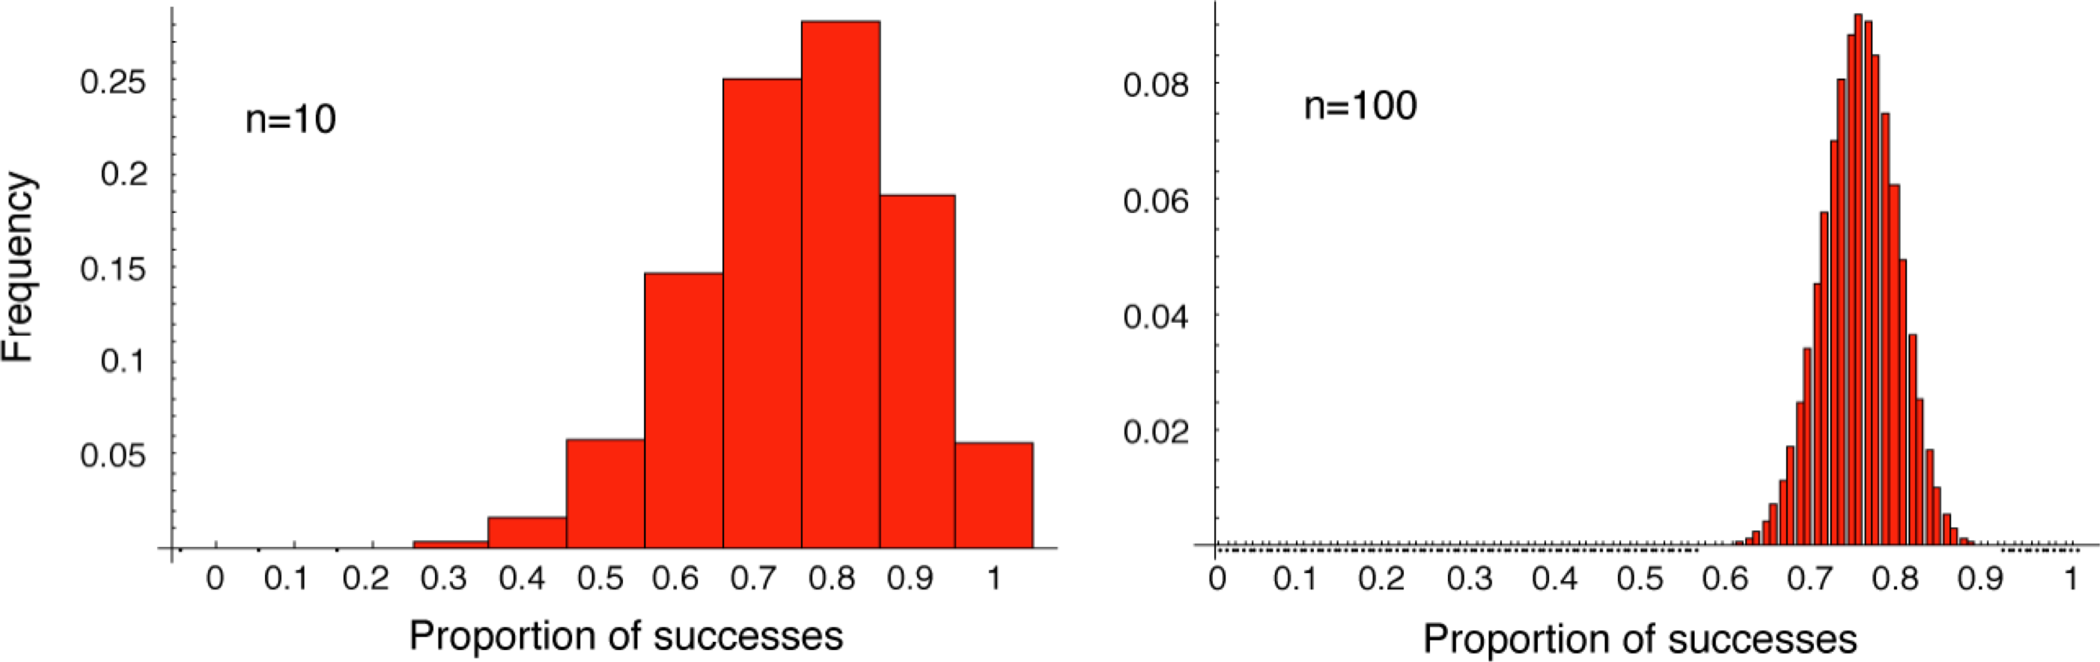
A larger sample has a lower standard error

Slide 21
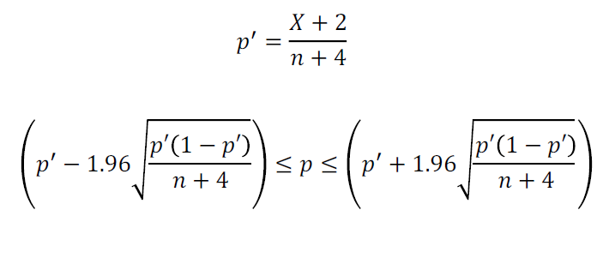
95% confidence interval for a proportion
This is called the "Agresti-Coull" confidence interval.

Slide 22
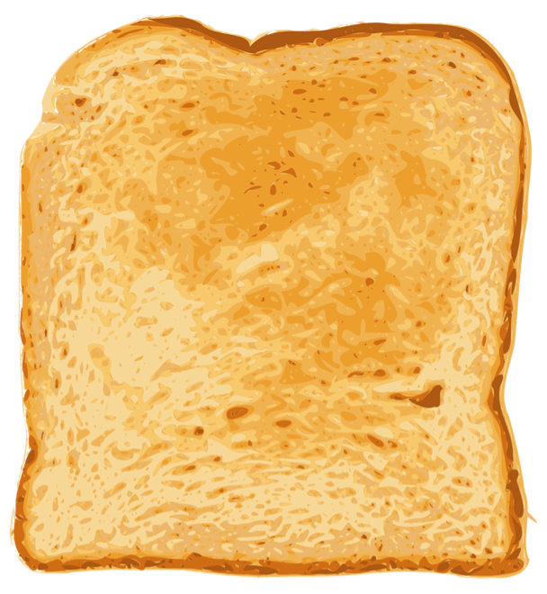
Example: Murphy’s Law of toast falling butter-side down
British students dropped 9821 pieces of toast. 6101 of these landed butter-side down; 3720 landed butter-side up.
How often does toast land butter-side down, as “predicted” by Murphy’s Law?
http://www.counton.org/thesum/issue-07/issue-07-page-05.htm

Slide 23
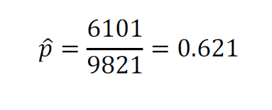
Example: Murphy’s Law of toast falling butter-side down
British students dropped 9821 pieces of toast. 6101 of these landed butter-side down; 3720 landed butter-side up.
How often does toast land butter-side down, as “predicted” by Murphy’s Law?

Slide 24
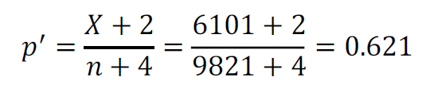
Example: Murphy’s Law of toast falling butter-side down
What is the 95% confidence interval for this estimate?
"Agresti-Coull" confidence interval

Slide 25
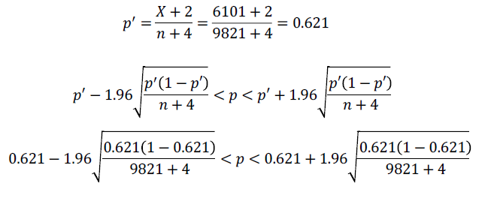
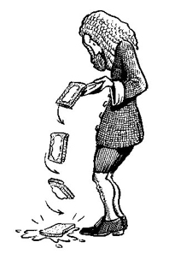
Example: Murphy’s Law of toast falling butter-side down
What is the 95% confidence interval for this estimate?
0.611 < p < 0.631
It seems true!!

Slide 26
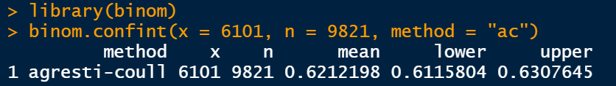
Agresti-Coull confidence intervals in R
Math way:
0.611 < p < 0.631
R way:

Slide 27
Hypothesis testing on proportions
Binomial test
The binomial test uses data to test whether a population proportion p matches a null expectation for the proportion.
H₀: The relative frequency of successes in the population is p_{0 .}
H_{A}: The relative frequency of successes in the population is not p_{0 .}

Slide 28
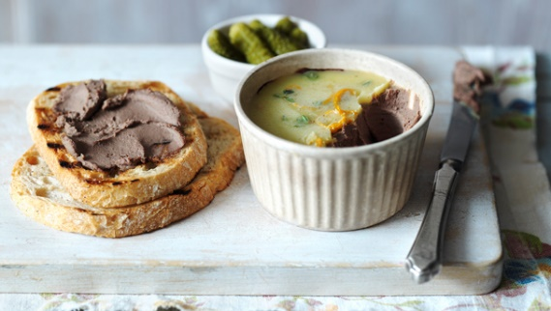
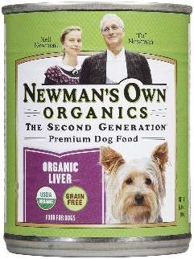

Example
Hypothesis testing on proportions
Human volunteers were asked to try five types of meat products. One of these was dog food; the others were various types of paté. The volunteers were asked which of the five was their favorite.
Two out of 18 volunteers chose the dog food. Is there evidence that people prefer human food over dog food?
Bohannon, J., R. Goldstein, and A. Herschkowitsch. 2010. Can people distinguish pâté from dog food? Chance 23: 43–46.

Slide 29

Hypothesis testing on proportions
Hypotheses
H₀ : Dog food is chosen as best 20% of the time.
H₀: p₀ = 0.2.
H_{A}: Dog food is chosen as best different from 20% of the time.
H_{A}: p₀ > 0.2

Slide 30
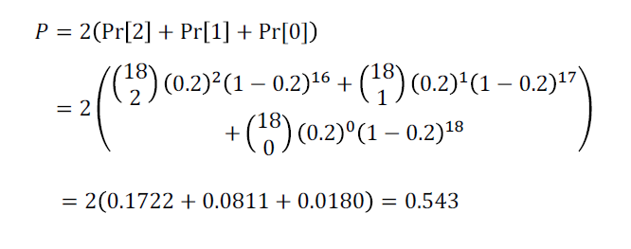
Hypothesis testing on proportions
N =18, p₀ = 0.2,
X = 2 in the sample chose dog food
Note: The capital P here is used for the P-value, in contrast to the population proportion with a small p.

Slide 31
Hypothesis testing on proportions
N =18, p₀ = 0.2,
X = 2 in the sample chose dog food
P = 0.54
This is greater than the α value of 0.05, so we would not reject the null hypothesis.
It is plausible that people do not prefer paté over dog food.

Slide 32
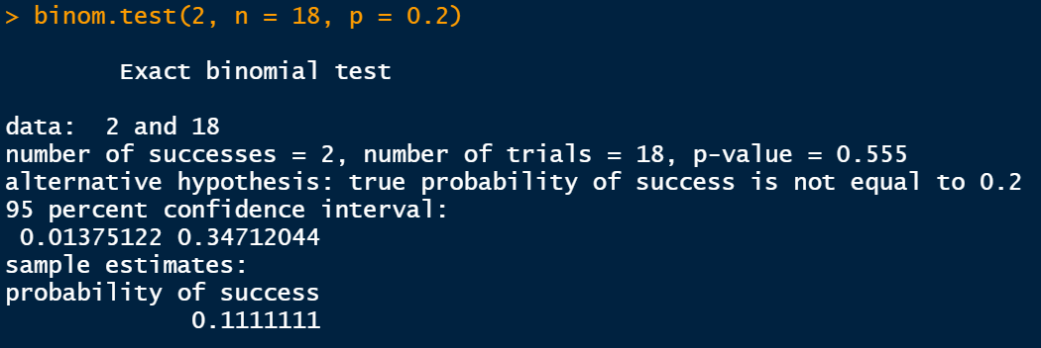
Binomial test in R
Hypothesis testing on proportions
Math way:
R way:

Slide 33
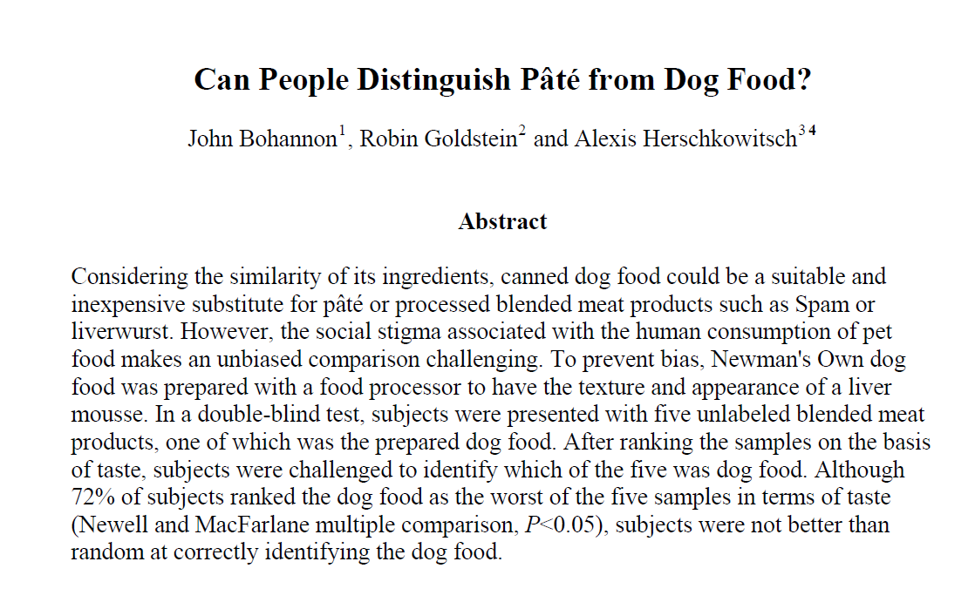
Suggested reading
Bohannon, J., Goldstein, R.C., Herschkowitsch, A., 2010. Can people distinguish Pâté from dog food.

