Slide 1

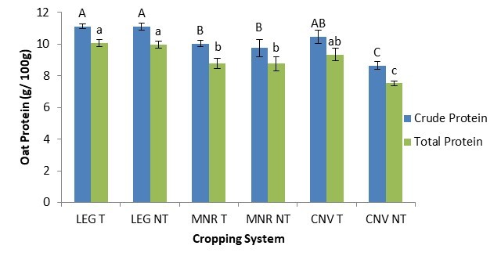
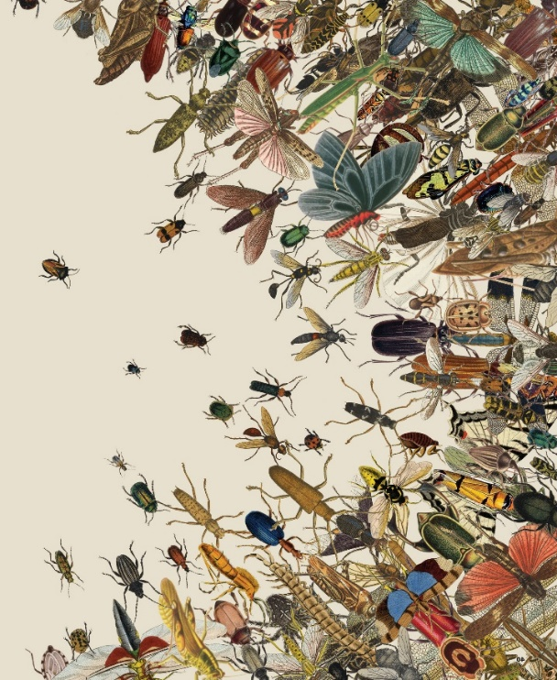


C7041 Experimental Design and Analysis
Ed Harris

Slide 2
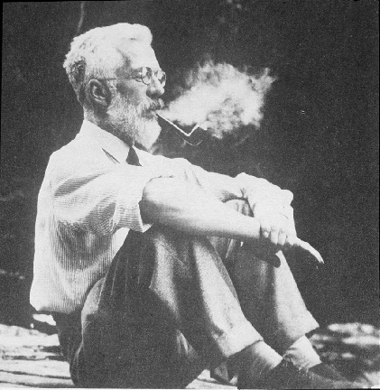
1.14 Experimental design
“A dataset is like gold ore. The finest statistical analysis can never increase the amount of gold, but a good experimental design can.”
-R. A. Fisher

Slide 3
Goals of experiments
Eliminate bias
Reduce sampling error (increase precision and power)

Slide 4
Design features that reduce bias
Controls
Random assignment to treatments
Blinding

Slide 5
Controls
A group which is identical to the experimental treatment in all respects aside from the treatment itself

Slide 6
Example: placebo
Some illnesses, e.g. pain and depression, respond to fact of treatment, even with no pharmaceutically active ingredients.
Control: "sugar pills"

Slide 7
Example: independent recovery
Patients tend to seek treatment when they feel very bad
As a result, they often visit the doctor when they are at their worst. Improvement may be inevitable, even without treatment
Therefore, we need a control, untreated group to compare with, if we want to measure the effects of a new therapy

Slide 8
Random assignment averages out the effects of confounding variables

Slide 9
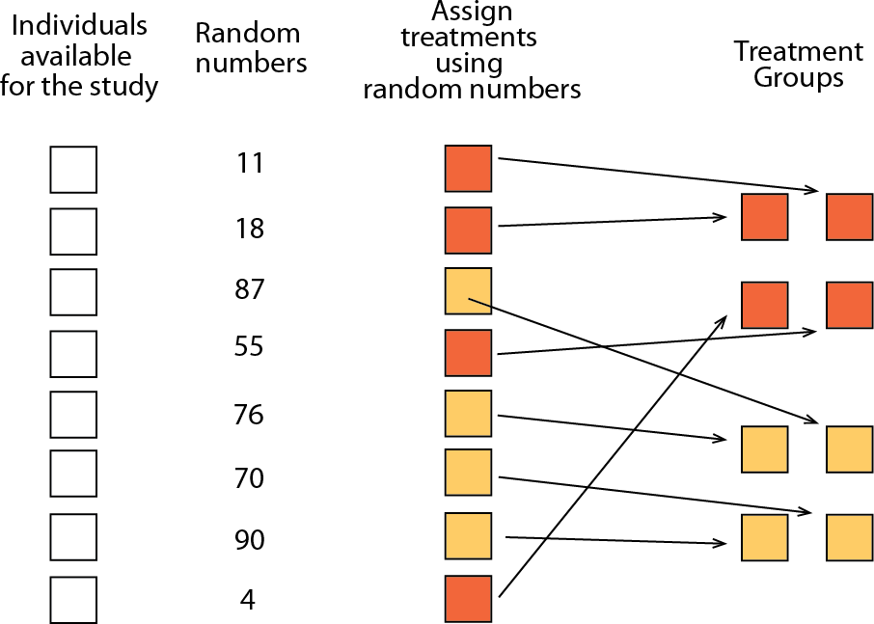
Experiment: individuals are randomly assigned to treatments

Slide 10
Blinding
Preventing knowledge of experimenter (or patient) of which treatment is given to whom
Unblinded studies usually find much larger effects (sometimes threefold higher), showing the bias that results from lack of blinding.

Slide 11
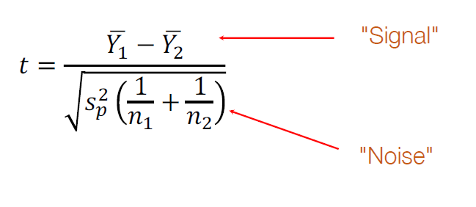
Reducing sampling error
Increasing the signal to noise ratio

Slide 12

Reducing sampling error
Increasing the signal to noise ratio
If the "noise"
is smaller, it is
easier to detect a given "signal".
Can be achieved with smaller s or larger n.

Slide 13
Design features that reduce the effects of sampling error
Replication: carry out study on multiple independent objects.
Balance: nearly equal sample sizes in each treatment.
Blocking: grouping of experimental unit; within each group, different experimental treatments are applied to different units.
Extreme treatments: stronger treatments can increase the signal-to-noise ratio.

Slide 14
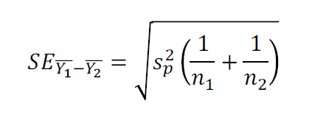
Balance increases precision
For a given total sample size (n₁ + n₂),
the standard error is smallest when n₁ = n₂.

Slide 15
The value of blocking
Imagine we are testing the effects of a new drug (compared to a placebo) on survival time.
We’ve done the study on multiple patients spread over 5 hospitals.

Slide 16
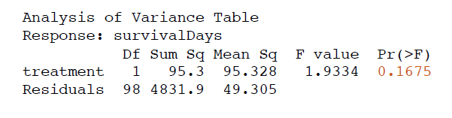
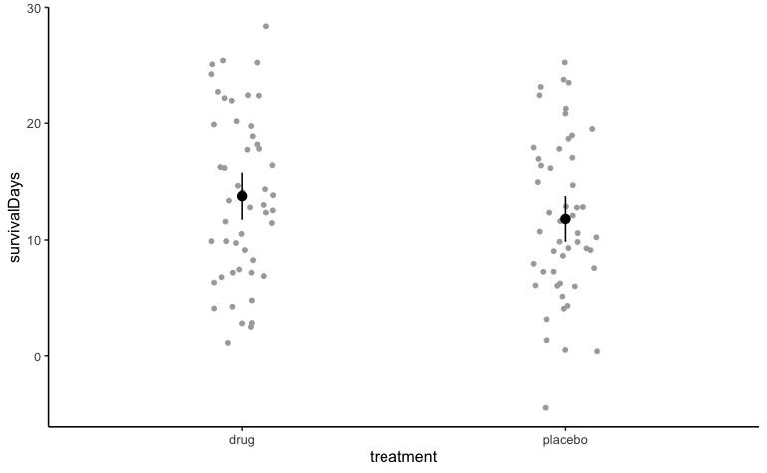
The value of blocking
No significant effect of the drug when just comparing treatment and controls

Slide 17
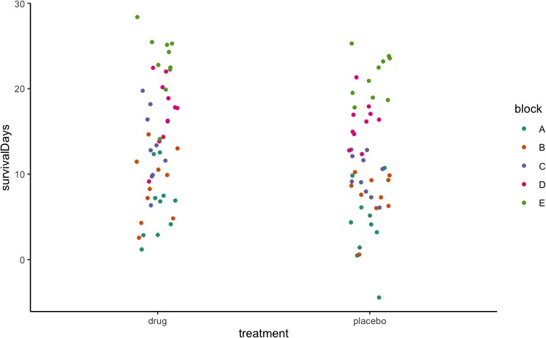
The value of blocking
But let’s look at which hospital they were at:

Slide 18
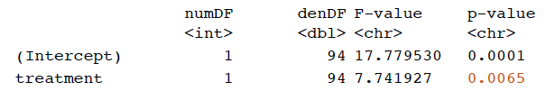
The value of blocking
But let’s look at which hospital they were at:
Accounting for hospital as a block

Slide 19
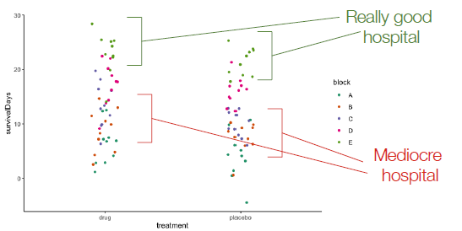
The value of blocking
But let’s look at which hospital they were at:

Slide 20
Blocking allows extraneous variation to be accounted for.
It is therefore easier to see the signal through the remaining noise.

Slide 21
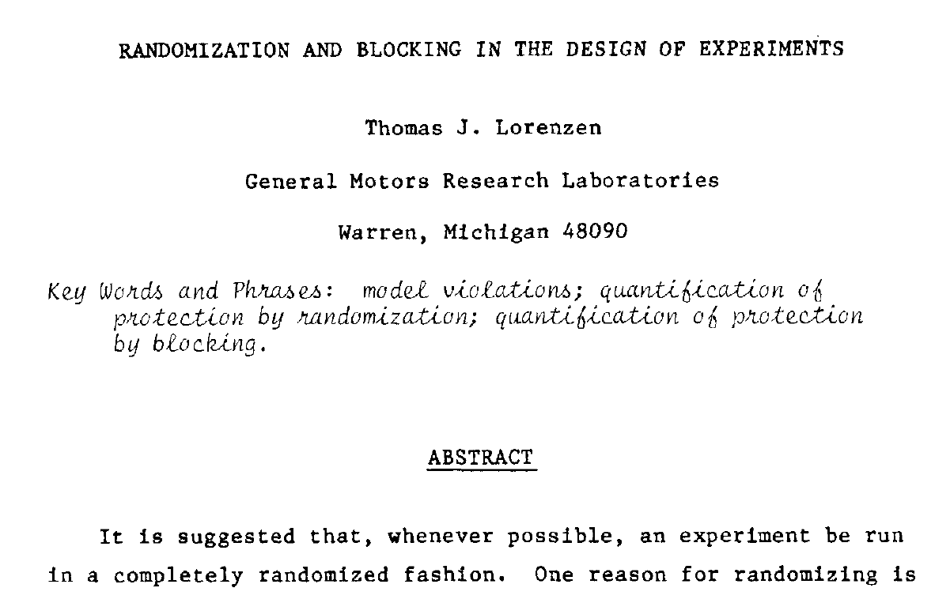
Suggested reading
Lorenzen, T.J., 1984. Randomization and blocking in the design of experiments. Communications in Statistics - Theory and Methods 13, 2601–2623. https://doi.org/10.1080/03610928408828847

