Slide 1
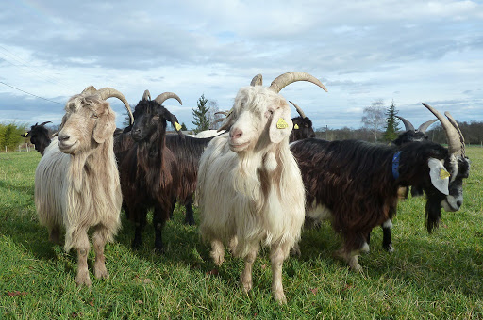
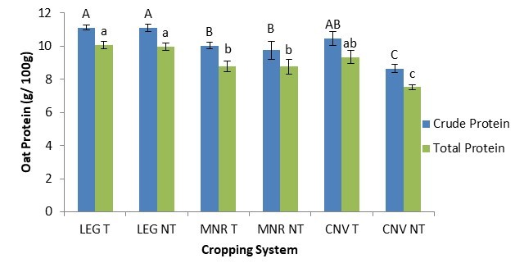
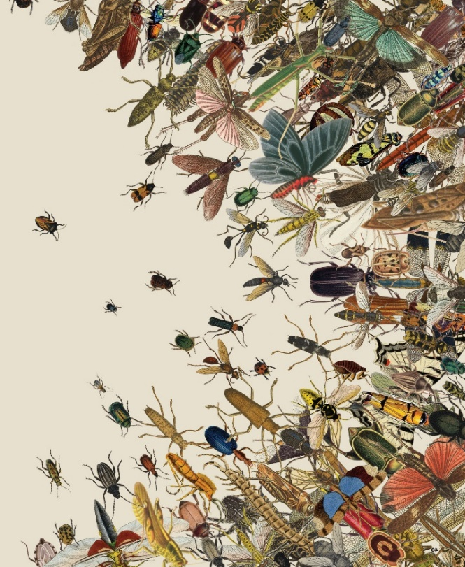
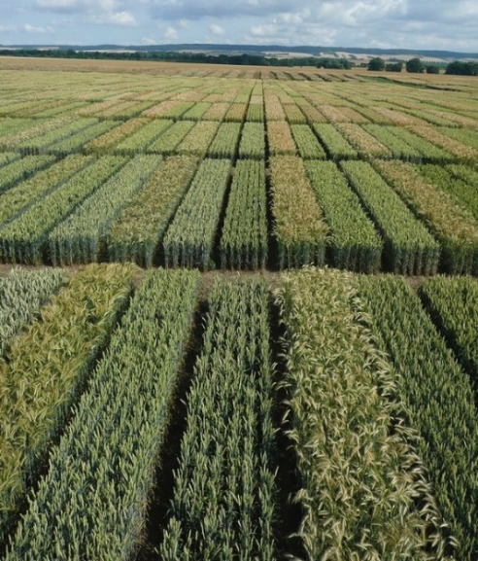

C7041 Experimental Design and Analysis
Ed Harris

Slide 2
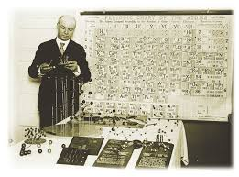
2.02: Graphics
“There is a magic in graphs. The proﬁle of a curve reveals in a ﬂash a whole situation — the life history of an epidemic, a panic, or an era of prosperity. The curve informs the mind, awakens the imagination, convinces.”
-Henry D. Hubbard

Slide 3
Why make graphs?
Principles of effective display
Types of graphs to achieve these principles
Why some graphs fail, and what can be done
Some thoughts about tables
Interactive graphs
Motion

Slide 4
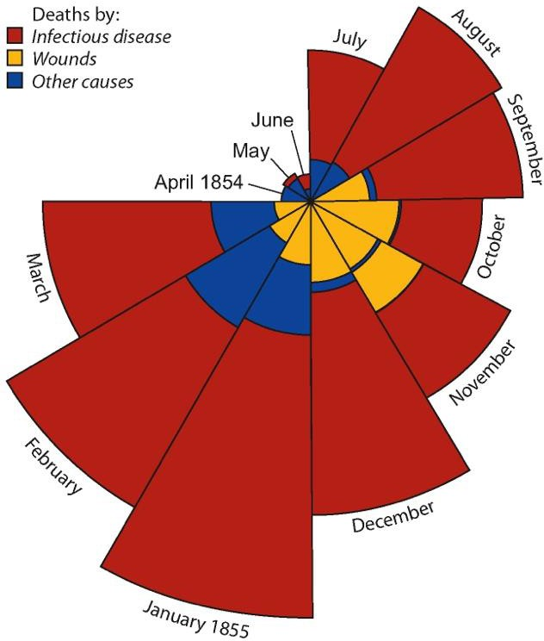
Why make graphs?
Because they can change the world!
The human eye is a natural pattern detector.
Graphs enable visual comparisons of measurements between groups and expose relationships between variables.
They are the best method available for discovering patterns in your data.
They are the best method for communicating results to a wider audience
Causes of deaths in the British Army during the Crimean War (F. Nightingale 1858) (area of pie = number of deaths)

Slide 5
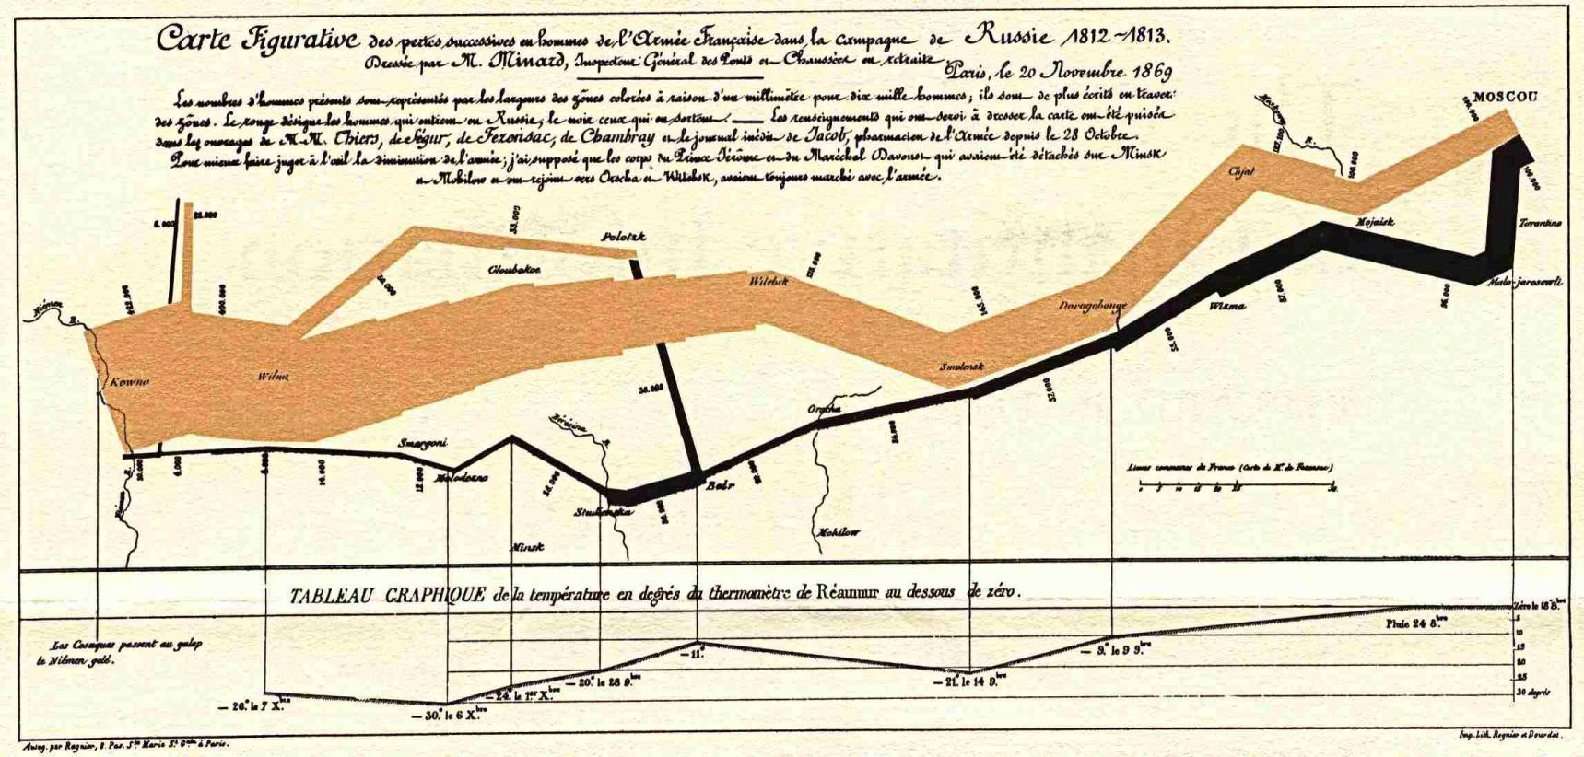
The best statistical graphic ever drawn (according to Edward Tufte)
This map by Charles Joseph Minard portrays the losses suffered by Napoleon's army in the Russian campaign of 1812. Beginning at the Polish-Russian border, the thick band shows the size of the army at each position. The path of Napoleon's retreat from Moscow in the bitterly cold winter is depicted by the dark lower band, which is tied to temperature and time scales.
This graph vividly depicts relative magnitudes in a way that the raw numbers alone cannot.

Slide 6
Graphs should make the viewer goes “Oh!” and not “Huh?”
How to achieve graphical excellence?
“Graphical excellence is that which gives to the viewer the greatest number of ideas in the shortest time with the least ink in the smallest space” – Tufte (1983)

Slide 7
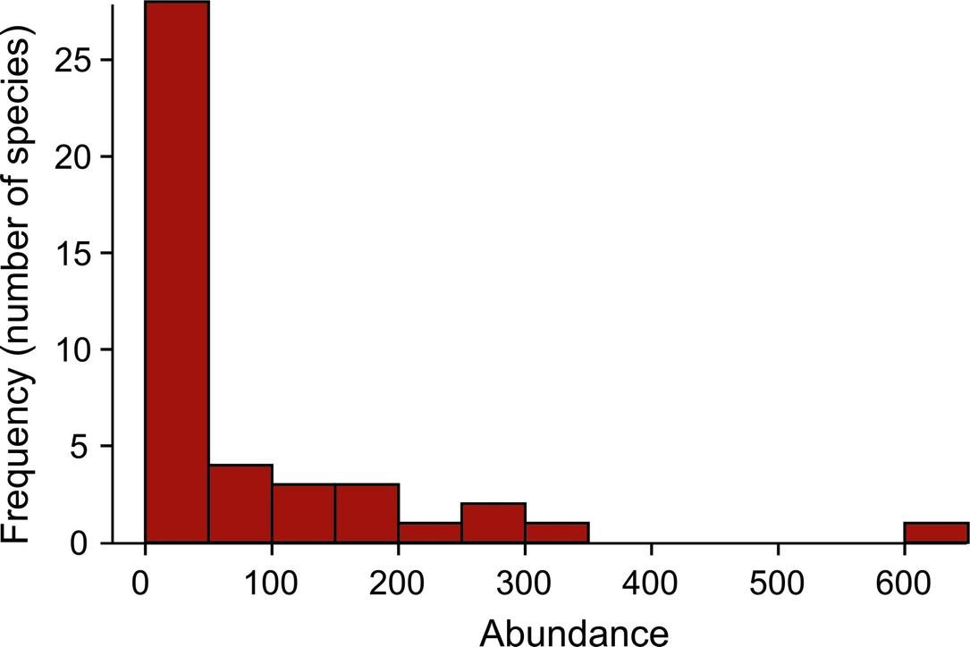
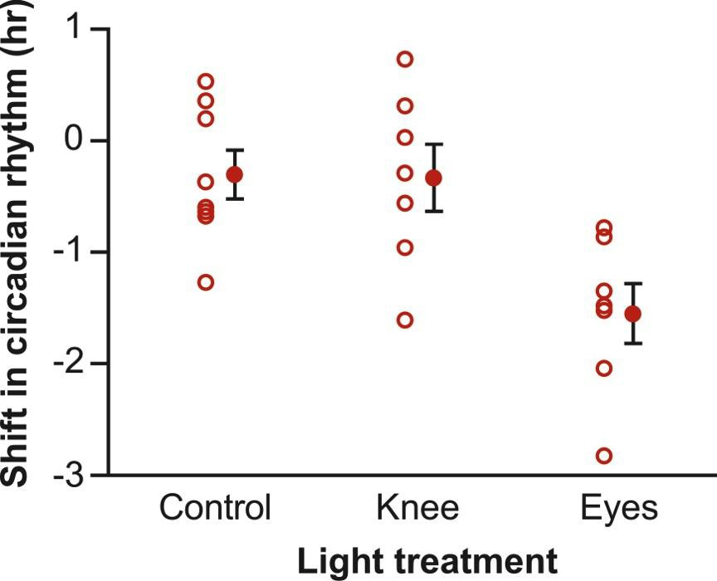
Why do we use graphs?
To reveal/show patterns in data.
“...gives to the viewer the greatest number of ideas in the shortest time…”
Frequency distributions
The location, spread, shape of distribution
Associations between variables
The relationship between two or more variables
Differences between groups

Slide 8
Best practices to achieve this goal
Four useful principles to increase the effectiveness of your graphs:
Show the data
Make patterns in the data easy to see
Represent magnitudes honestly
Draw graphical elements clearly, minimizing clutter

Slide 9
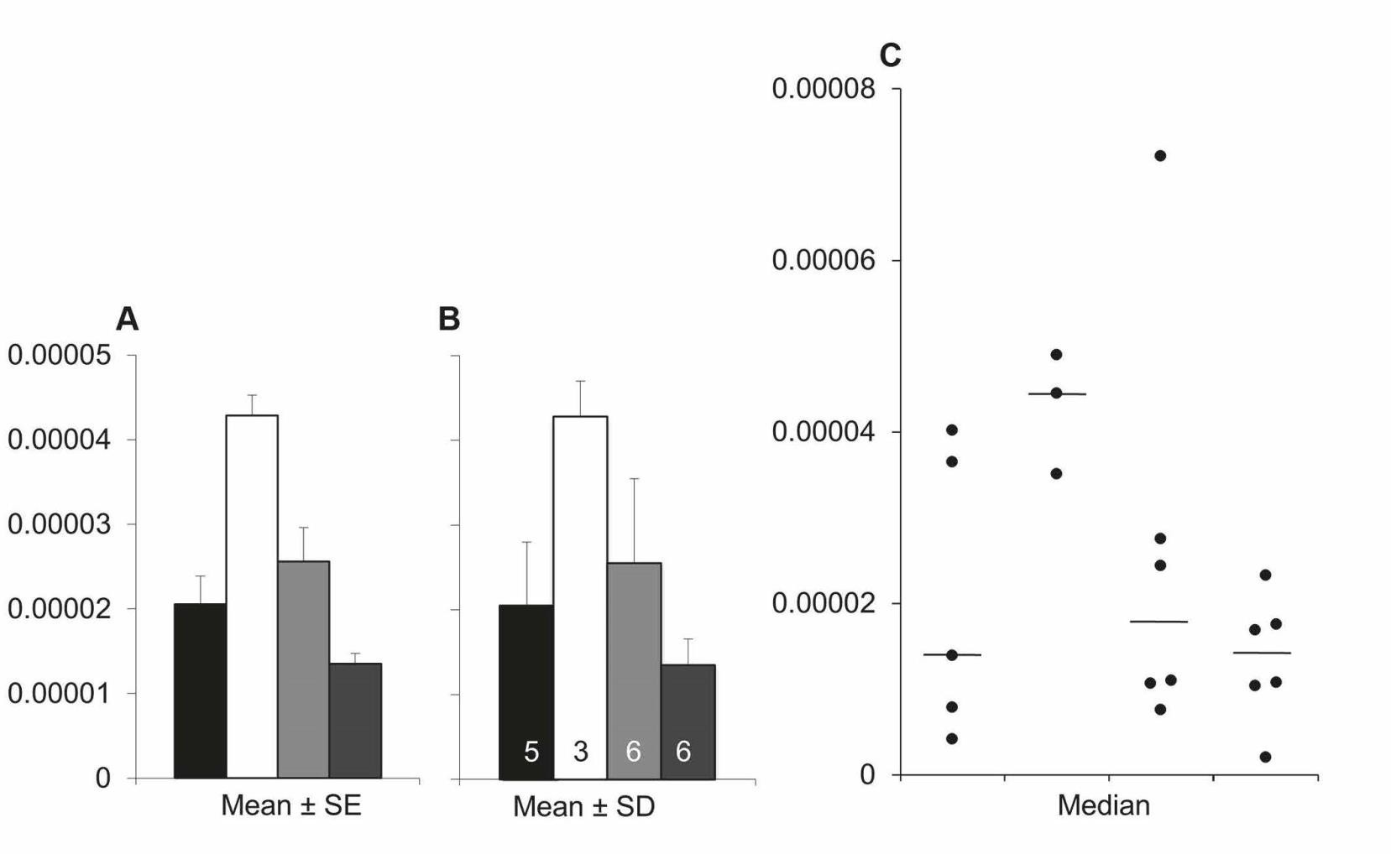
1. Show the data
“Above all else show the data” – Tufte (1983)
E.g., a strip chart reveals patterns that are hidden in the bar graph.
The sample sizes are small, group one is highly variable, and there is an outlier in 3rd group.
Weissgerber et al. (2015) Beyond bar and line graphs: time for a new data presentation paradigm. PLoS Biol.
DOI:10.1371/journal.pbio.1002128
“While scatterplots prompt the reader to critically evaluate the statistical tests and the authors’ interpretation of the data, bar graphs discourage the reader from thinking about these issues”

Slide 10
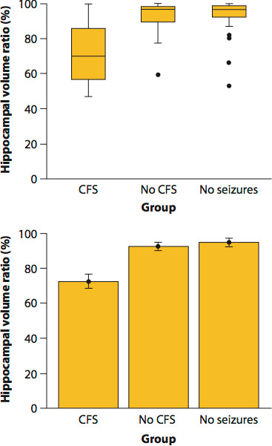
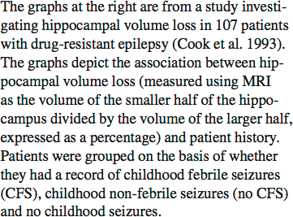
1. Show the data
E.g., box plots can substitute for strip chart when there are many data points.
Which graph is more effective? Why?

Slide 11
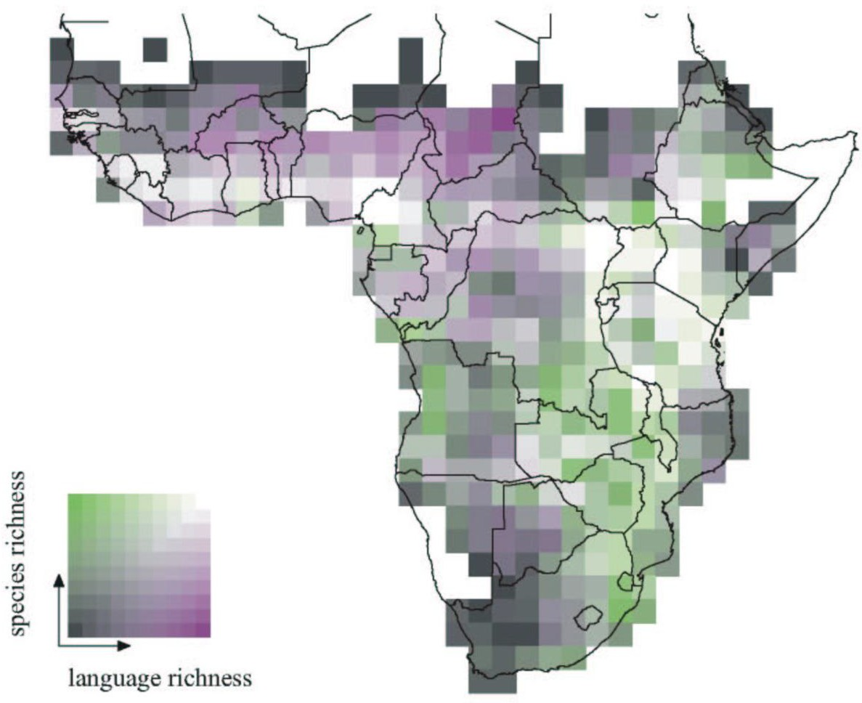
2. Make patterns in the data easy to see.
“Graphical excellence consists of complex ideas communicated with clarity, precision and efficiency” – Tufte (1983)
Map displaying the number of bird species and the number of distinct human languages present in each square of a grid of continental Africa. Reproduced from Moore et al. (2002).
What is the pattern in these data? How long did it take you to “see”? Is it easy to appreciate how strong the relationship is between the variables?

Slide 12
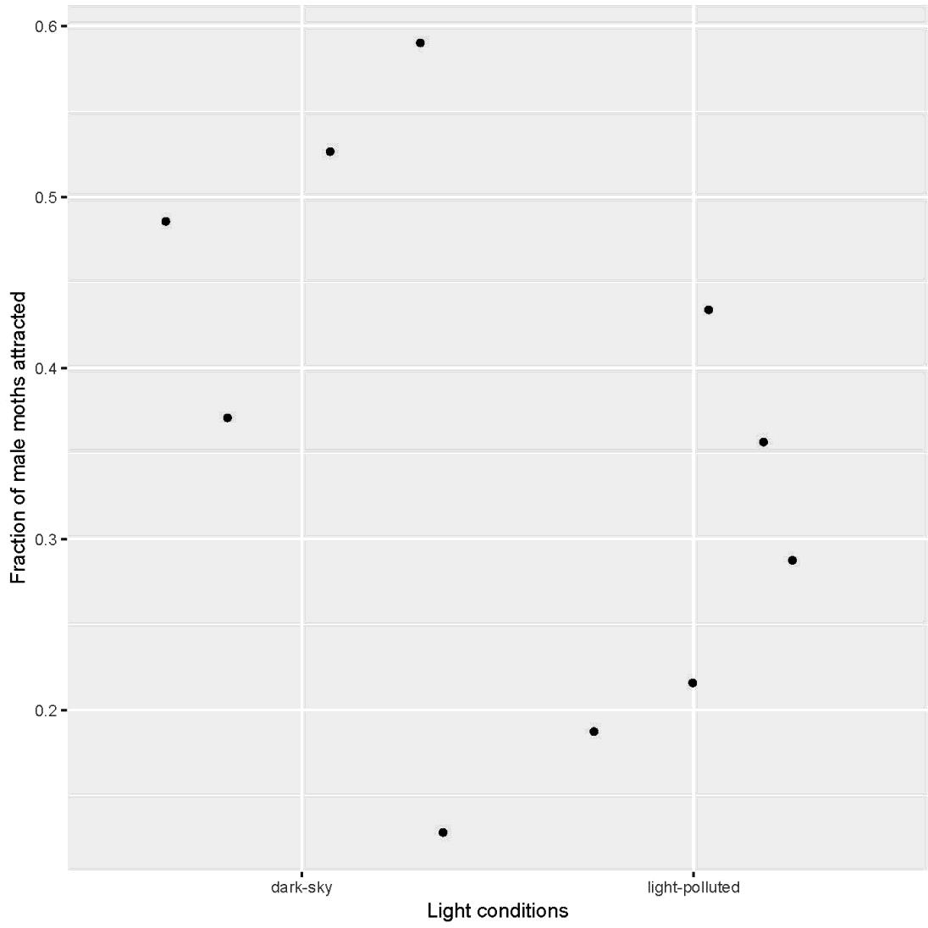
3. Draw graphical elements clearly, minimizing clutter
“Maximize the data-ink ratio, within reason” – Tufte (1983)
Strip chart made with ggplot() using default graphical options.
Altermatt and Ebert (2016) measured light attraction of ermine moths (Yponomeuta cagnagella) from 10 different populations. Five of the populations were located in urban areas with plenty of human lights. The other 5 populations were located in pristine areas with no light pollution.

Slide 13
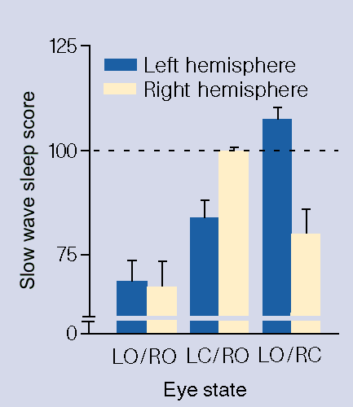
4. Represent magnitudes honestly
“A graphic does not distort if the visual representation of the data is consistent with the numerical representation” – Tufte (1983)
Slow wave sleep in the brain hemispheres of mallard ducks sleeping with one eye open. From Rattenborg et al. (1999) Nature.
Are the bars “consistent with the numerical representation”?
Is 0 a reasonable baseline for evaluating sleep score?
Are there other issues with the graph?

Slide 14
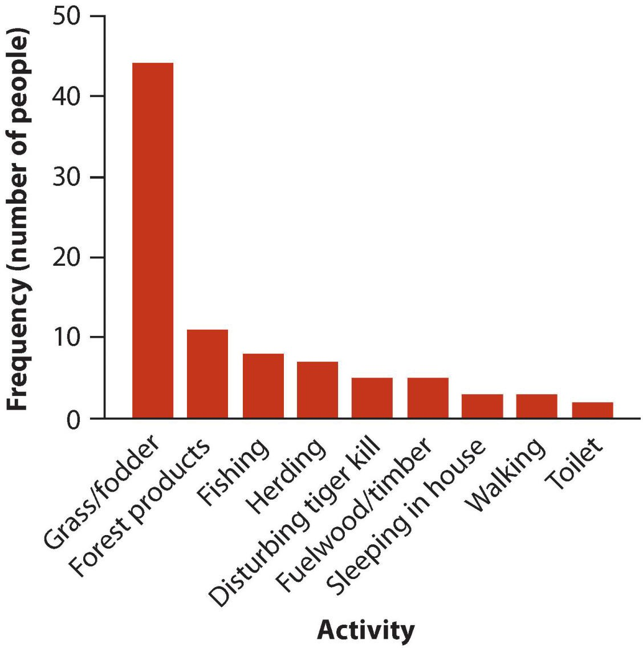
How to display category frequencies
Bar graph
Activities of people at the time they were attacked and killed by tigers near Chitwan National Park, Nepal, between 1979 and 2006.
Uses height of bars to display the frequency distribution of a categorical (grouping) variable
Zero baseline
Space between bars emphasize height
Order of categories – most to least frequent is usually best

Slide 15
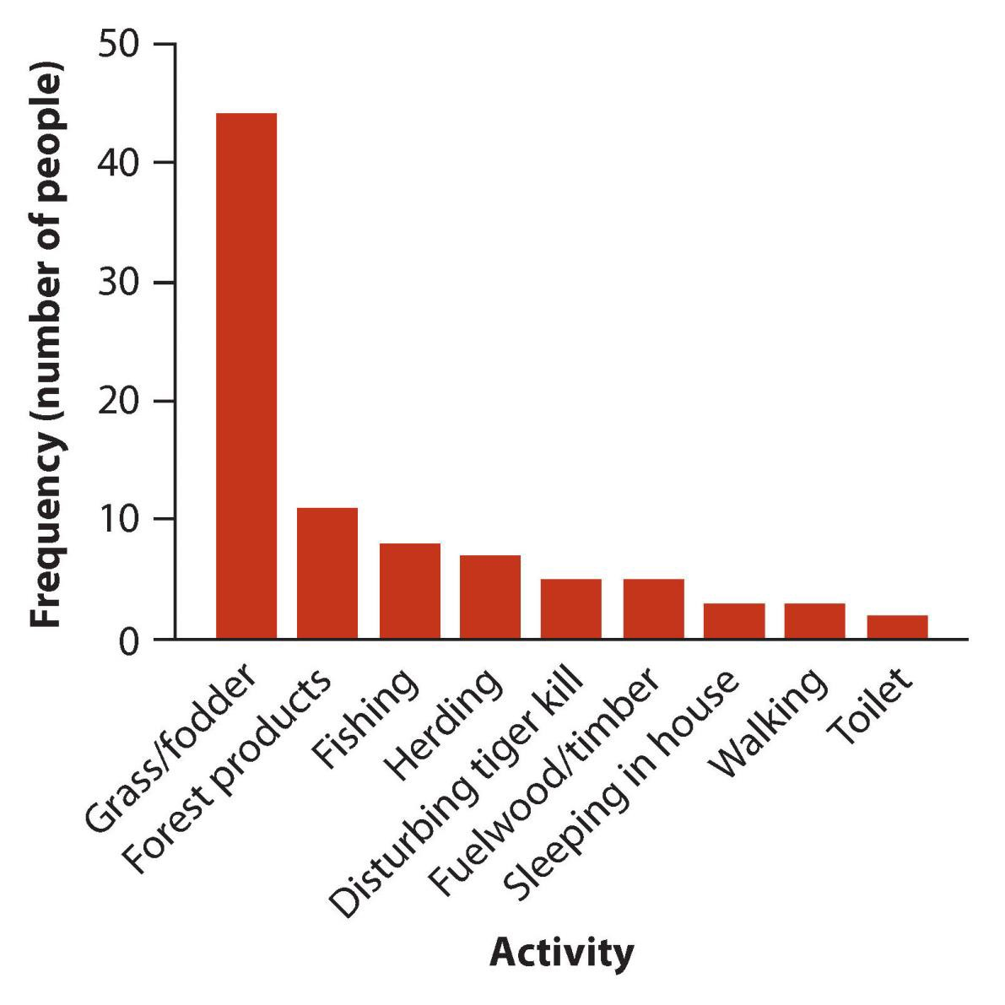
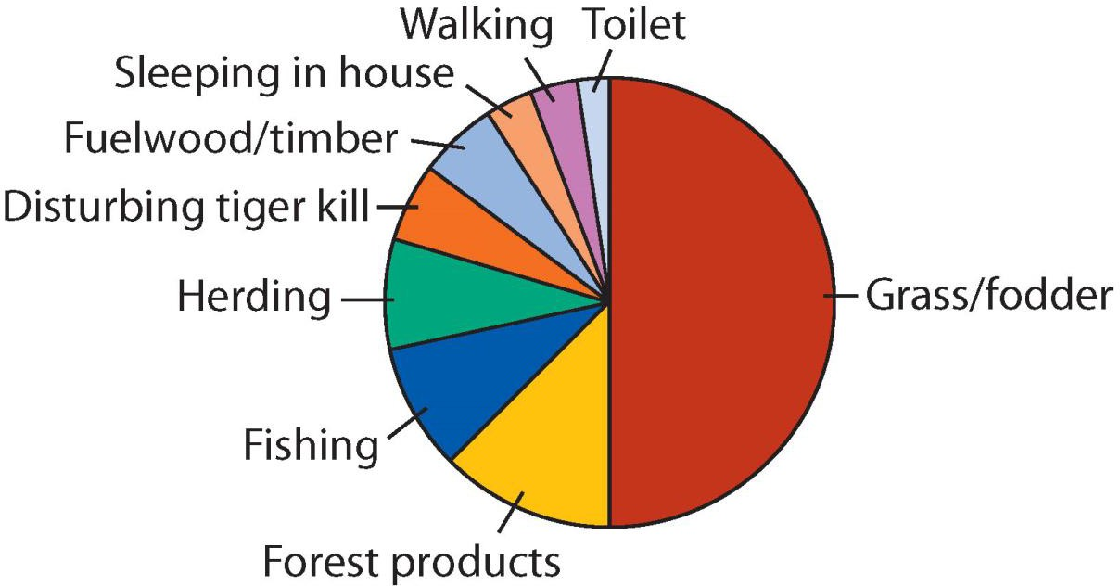
How to display category frequencies
Bar graph vs. Pie chart: which is more successful?
Some evidence that humans are better at comparing relative areas in bar graphs than pie charts.

Slide 16
How to display frequency distribution for numeric variable
Histogram
The frequency distribution of bird species abundance at Organ Pipe Cactus National Monument. n = 43 species
Uses area of bars to display frequency distribution of a numerical variable
Zero baseline
No spaces between bars
Choice of number of bins and bin width

Slide 17
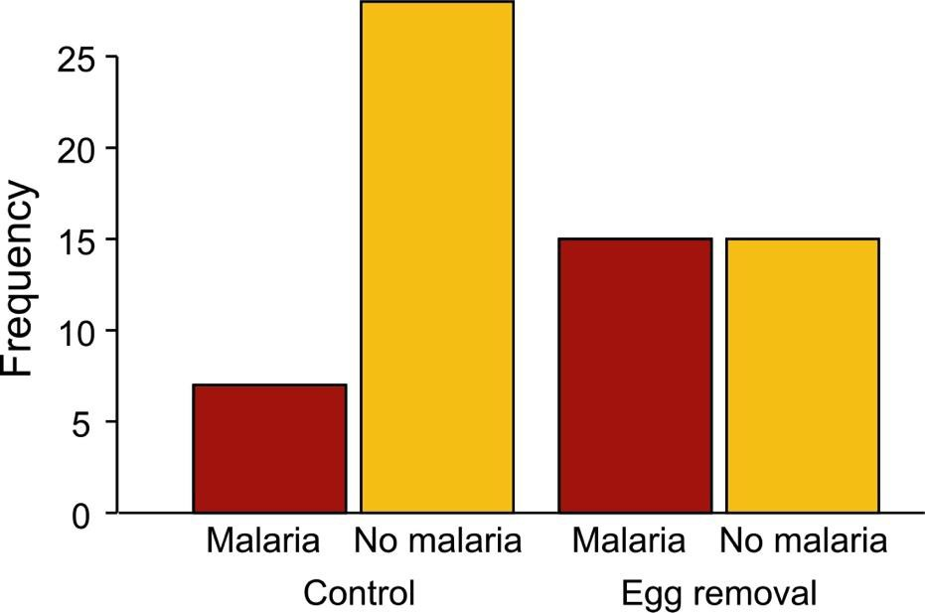
How to display association between categorical variables
Grouped bar graph
Incidence of malaria in female great tits in relation to experimental treatment. n = 65 birds.
Uses height of bars to display association between two (or more) categorical variables
Explanatory variable = outer groups; response variable = inner groups
Zero baseline (so that height is proportional to frequency)
Spacing between bars wider between outer groups

Slide 18
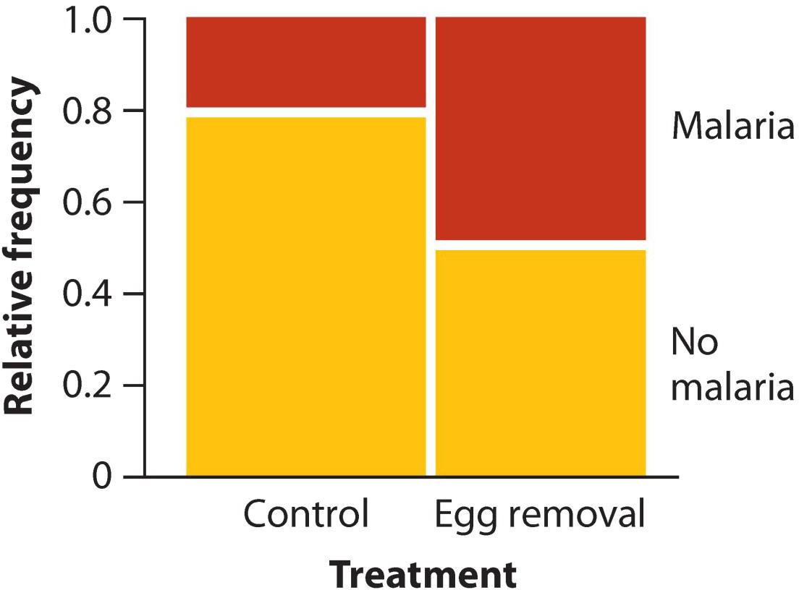
How to display association between categorical variables
Mosaic plot
Incidence of malaria in female great tits in relation to experimental treatment.
n = 65 birds.
Uses area of rectangles to display association between two (or more) categorical variables
Explanatory variable along horizontal axis; response variable stacked
Area proportional to frequency
Like a graphical representation of a contingency table

Slide 19
Grouped bar graph vs mosaic plot
Q: Which is more successful?

Slide 20
How to display association between numerical and categorical variable
Strip chart
Phase shift in the circadian rhythm of melatonin production in 22 subjects given alternative light treatments (open circles). Group means ± 1 SE also shown.
Displays differences between groups
Shows the data points
Non-zero baseline often ok (goal is association not magnitude or frequency)
Points fill the space available

Slide 21
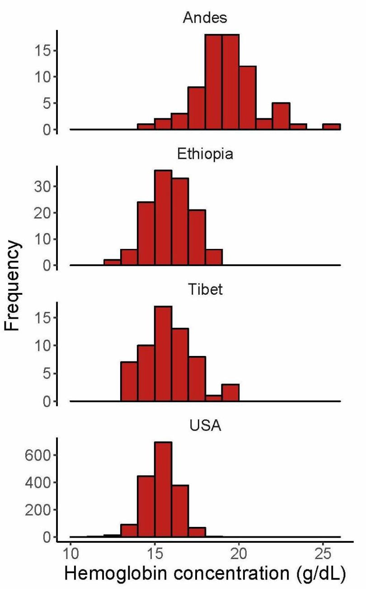
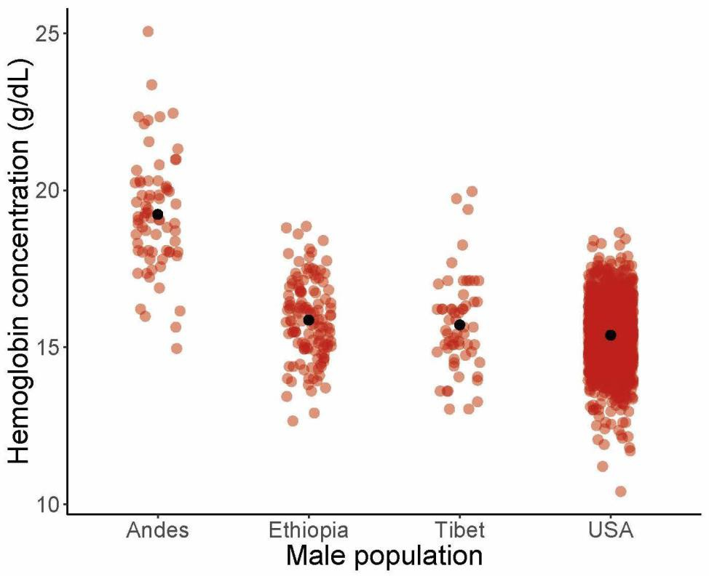
How to display association between a numerical and a categorical variable
Strip chart vs multiple histograms
Hemoglobin concentration in blood of males living at high elevation compared to sea-level USA control.
Too many data points for a strip chart. Stack histograms vertically to best compare

Slide 22
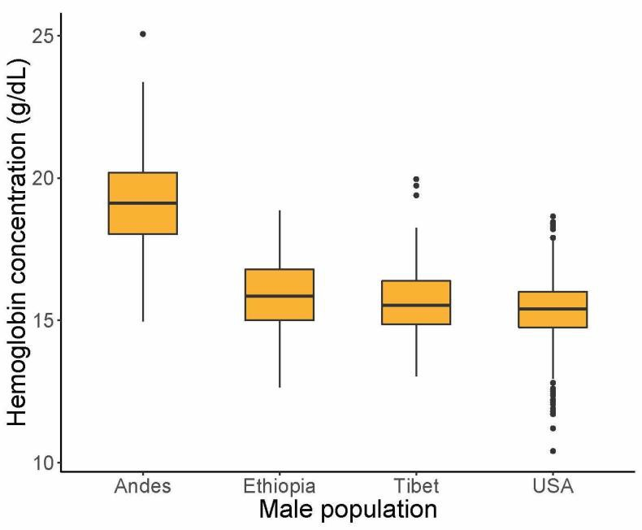
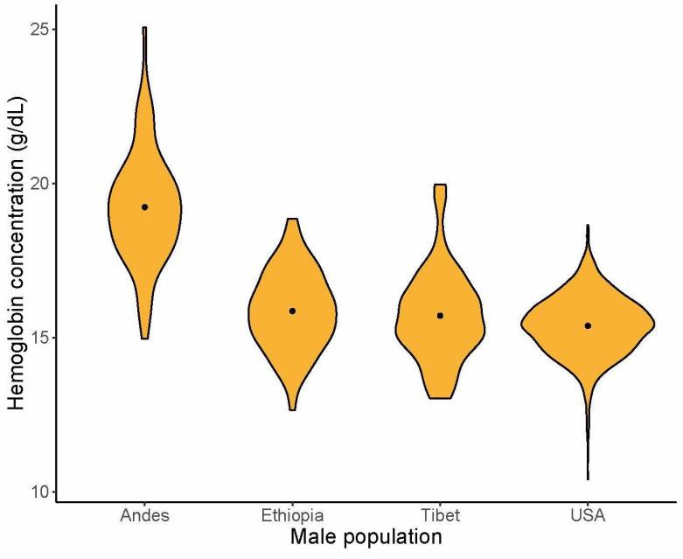
How to display association between a numerical and a categorical variable
Strip chart vs box plot vs violin plot
Box plot displays median, first and third quartile, range, and extreme observations
Violin plot estimates probability density of each group using “kernel smoothing”
Non-zero baseline often ok (goal is to show differences not amounts)
Q: which is more successful?

Slide 23
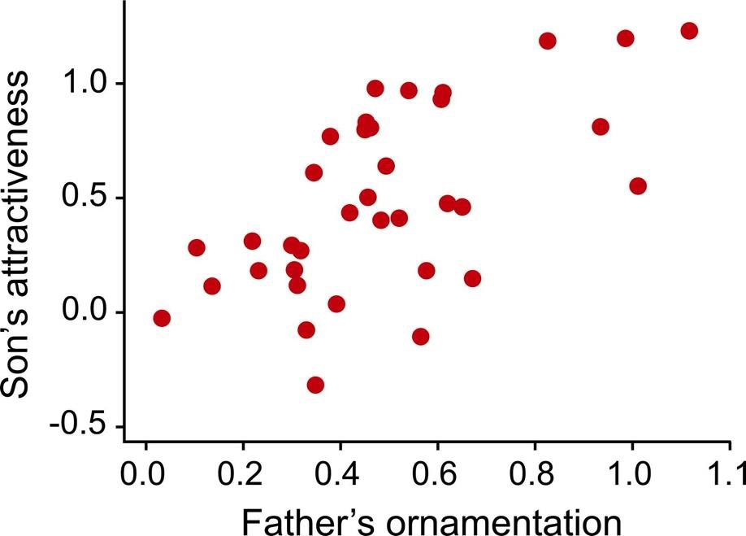
How to display association between two numerical variables
Scatter plot
The relationship between the ornamentation of male guppies and the average attractiveness of their sons. n = 36 families.
Non-zero baseline often ok (goal is to show association, not height above 0)
Points fill the space available

Slide 24
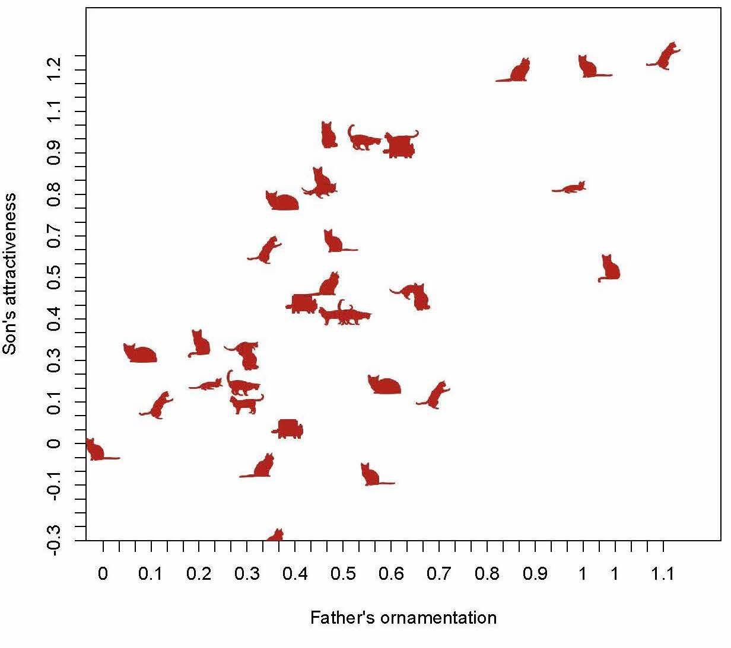
Catterplot
Because we can

Slide 25
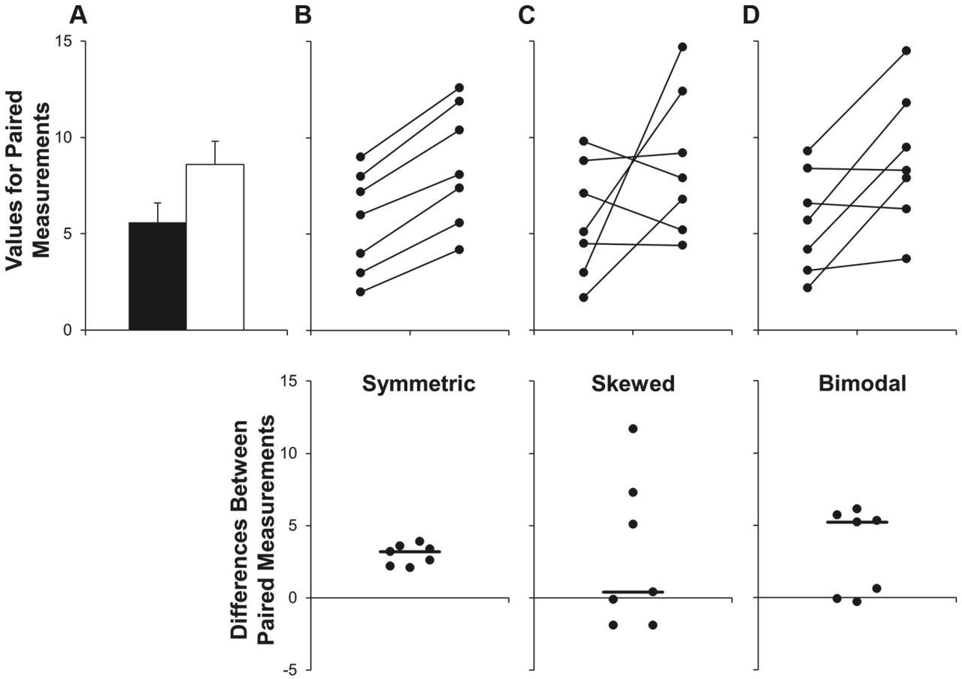
How to show repeated measures data (e.g., paired data)
Interaction plots
Strip charts of differences
Connect the dots to show pairing; or plot the differences.
Weissgerber et al. (2015) Beyond bar and line graphs: time for a new data presentation paradigm. PLoS Biol. DOI:10.1371/journal.pbio.1002128

Slide 26
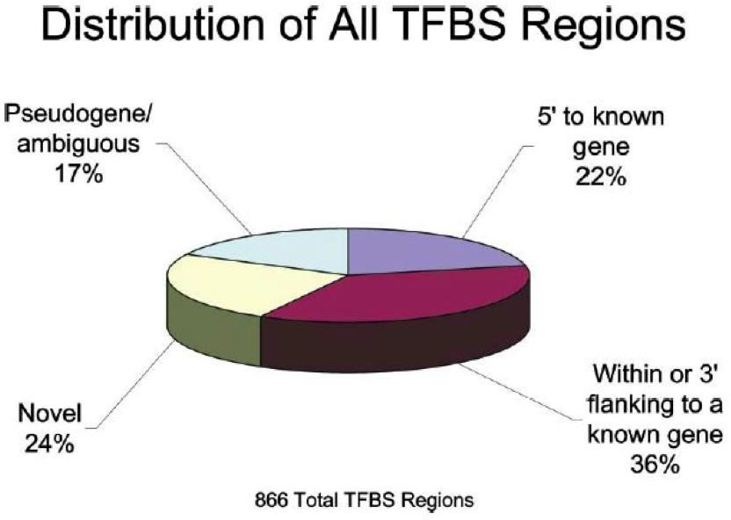
Don’t use 3D graphs to display frequencies
3D rendering is gratuitous
It makes it more difficult to see area, and hence the frequencies
A graph that is meaningful only with numbers added must be recognized as a failure.
Cawley S, et al. (2004) Unbiased mapping of transcription factor binding sites along human chromosomes 21 and 22 points to widespread regulation of noncoding RNAs. Cell 116:499-509, Figure 1

Slide 27
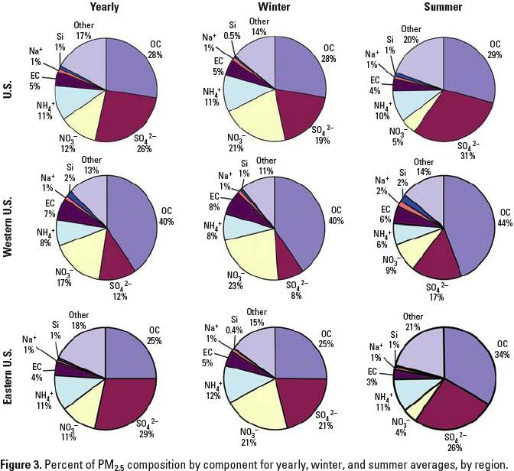
2D pies can also bewilder
The main patterns of interest were the change in NO3 and SO4 between winter and summer, and the consistency of change between geographic regions.
This is not easy to see
(“Huh?” not “Oh!”)
Design a graph to show the change from summer to winter in NO3 and SO4, rather than try to display everything.
Bell ML, et al. (2007) Spatial and temporal variation in PM2.5 chemical composition in the United States for health effects studies. Environmental Health Perspectives 115:989-995, Figure 3

Slide 28
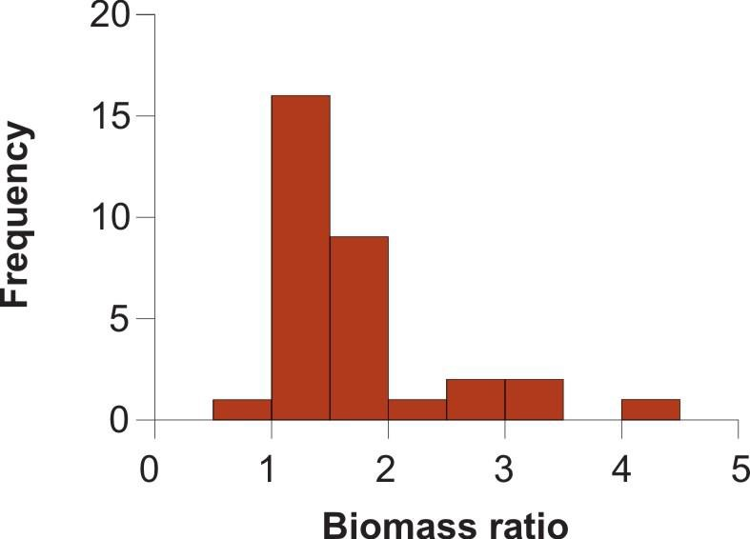
Handling ratio data
Biomass ratio is the total mass of all marine plants and animals per unit area of marine reserve divided by the same quantity in the unprotected control. N = 32 pairs (reserve and control). Data from Halpern (2003)

Slide 29
Handling ratio data
Problems:
Ratios less than 1 are sandwiched between 0 and 1, distorting magnitudes
Possible solutions:
Use log of ratio so that ratios above and below 1 have the same scale.

Slide 30
What about tables?
Like graphs, tables are used to compare measurements between groups and expose relationships between variables.
For some kinds of data, they may be the best way to communicate results to a wider audience.
Use tables to illuminate patterns.
Make your tables so that they cause the viewer to go “Oh!” and not “Huh?”
Put tables for storing numbers into Appendix or Supplement

Slide 31
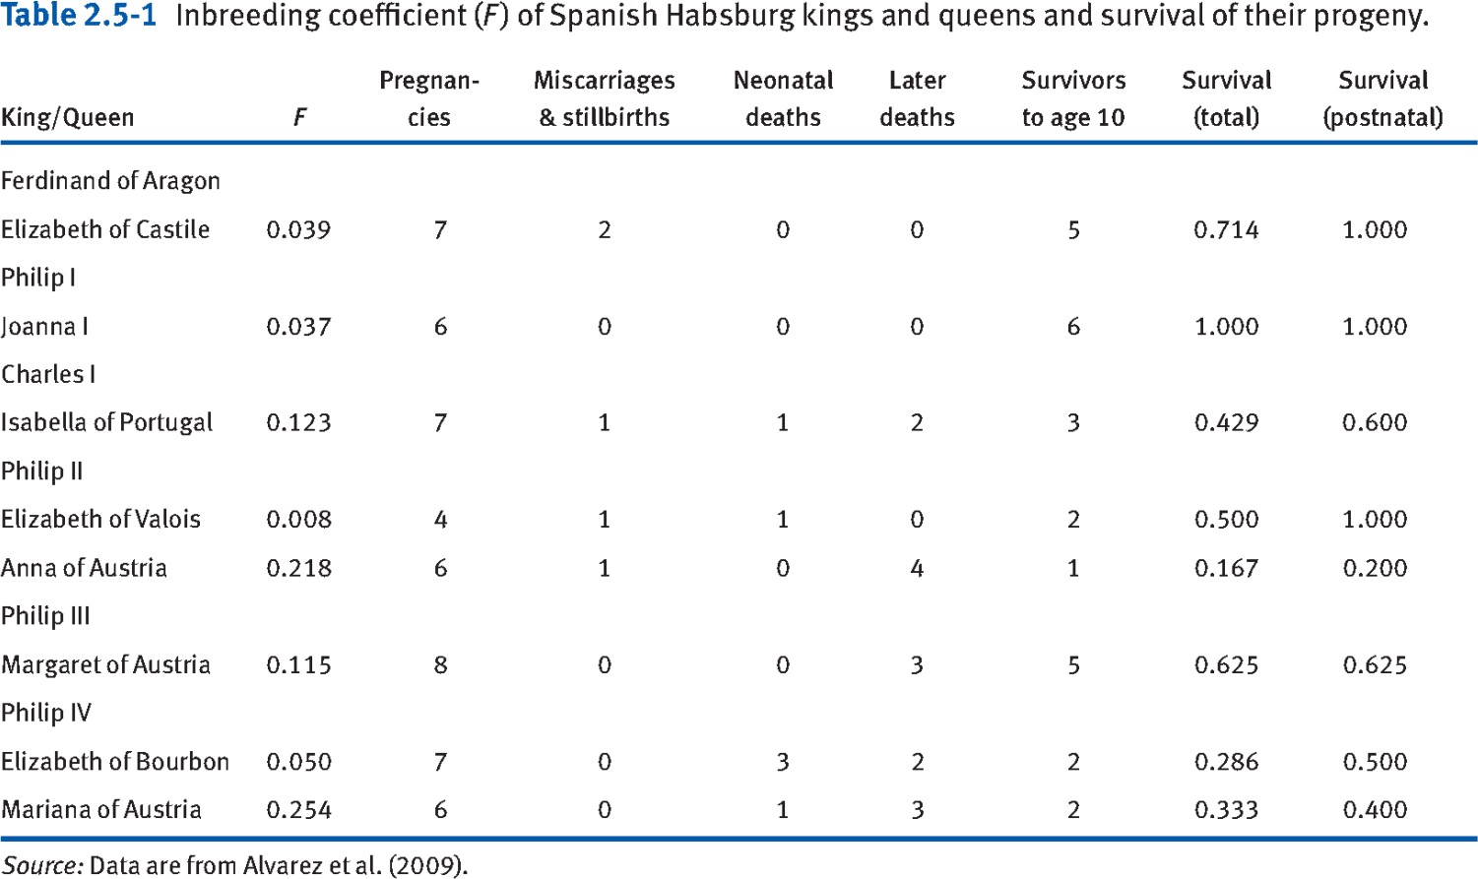
Improving tables - example
Difficult to see a relationship between F and survival.
Uneven line spacing, the gaps break up patterns.
Too much empty space.
Too many decimals.

Slide 32
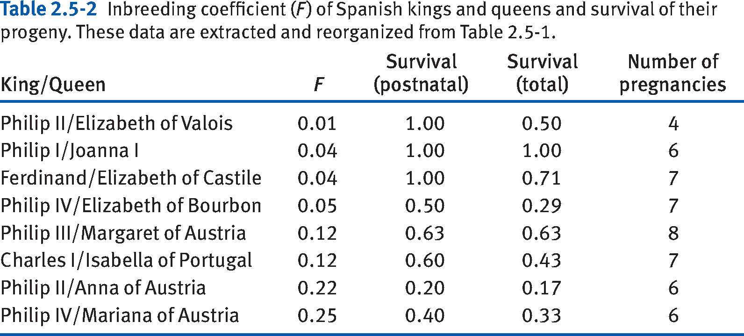
Improving tables - example
Always use vertical stacking of numbers you most want to compare.
Put columns adjacent that you want to show associations between. Sort one of the columns.

Slide 33
Interactive plots
Graphs that allow the viewer to manipulate the image.
Line plot with basic “hover”
https://rstudio.github.io/dygraphs/
Interactive scatter plot:
https://cengel.github.io/R-data-viz/interactive-graphs.html#plotly

Slide 34
Data that moves
Video graphs for displaying data are becoming more common http://www.r-graph-gallery.com/3-r-animated-cube/ https://ebird.org/science/status-and-trends/
Measles outbreak simulation
https://www.theguardian.com/society/ng-interactive/2015/feb/05/-sp-watch- how-measles-outbreak-spreads-when-kids-get-vaccinated
The Atlantic Slave Trade in Two Minutes http://www.slate.com/articles/life/the_history_of_american_slavery/2015/06/ani mated_interactive_of_the_history_of_the_atlantic_slave_trade.html?wpsrc=sh_all
_dt_fb_top
The fallen of WWII: https://vimeo.com/128373915

Slide 35
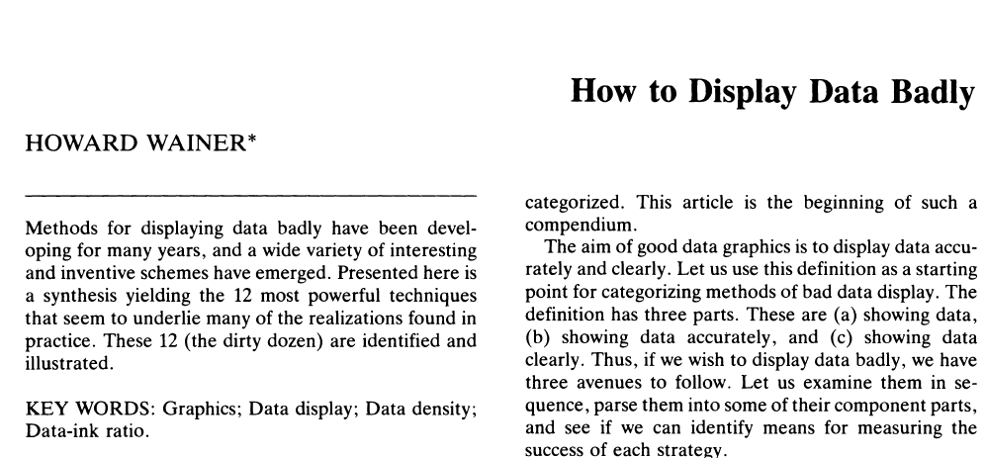
Suggested reading:
Wainer (1984) How to display data badly
Wainer, H., 1984. How to Display Data Badly. Am. Stat. 38, 137–147. https://doi.org/10.1080/00031305.1984.10483186

