Slide 1
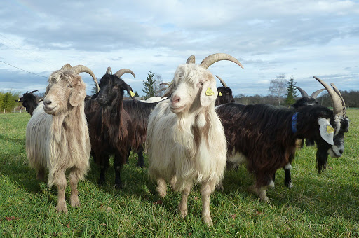
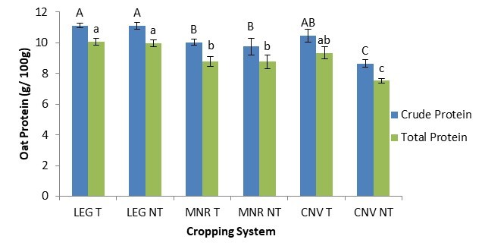
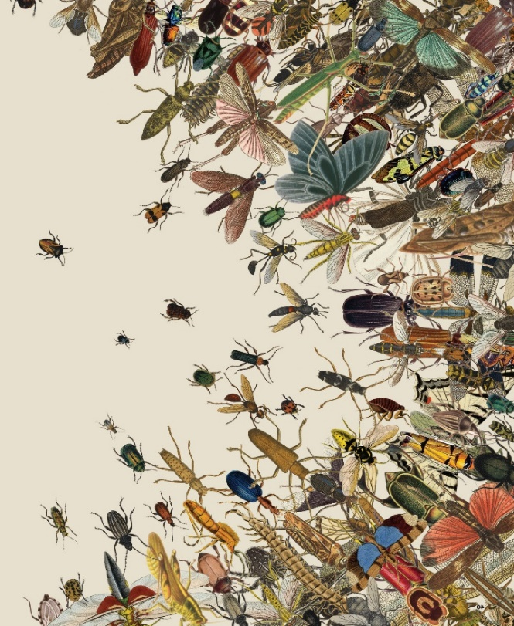


C7041 Experimental Design and Analysis
Ed Harris

Slide 2
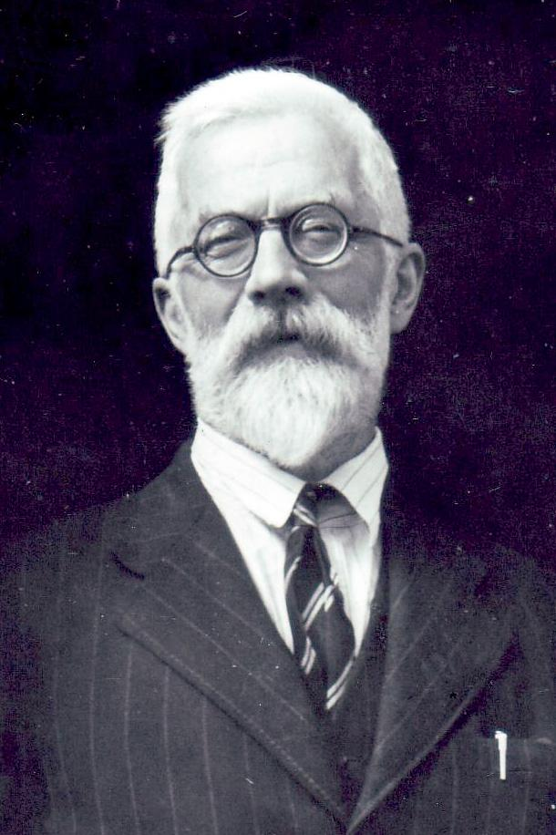
2.03: Experimental Design 2
“To consult the statistician after an experiment is finished is often merely to ask him to conduct a post mortem examination.
He can perhaps say what the experiment died of.”
-R. A Fisher

Slide 3
Outline
Plan your sample size
Experiments vs observational studies
Why do experiments?
Clinical trials: experiments (on people)
Design experiments to minimize bias and effects of sampling error
Analysis follows design
What if you can’t do experiments: think like an experimentalist

Slide 4
Power and sample size
Statistical Power can be defined as:
The probability you CONCLUDE you are right when you statistically analyse an experiment, when in reality you are ACTUALLY right
You conclude: there is a difference
Yes
No
Yes
Correct
Error!
Statistical Power is the probability you get this
Reality: there is a difference
No
Error!
Correct

Slide 5
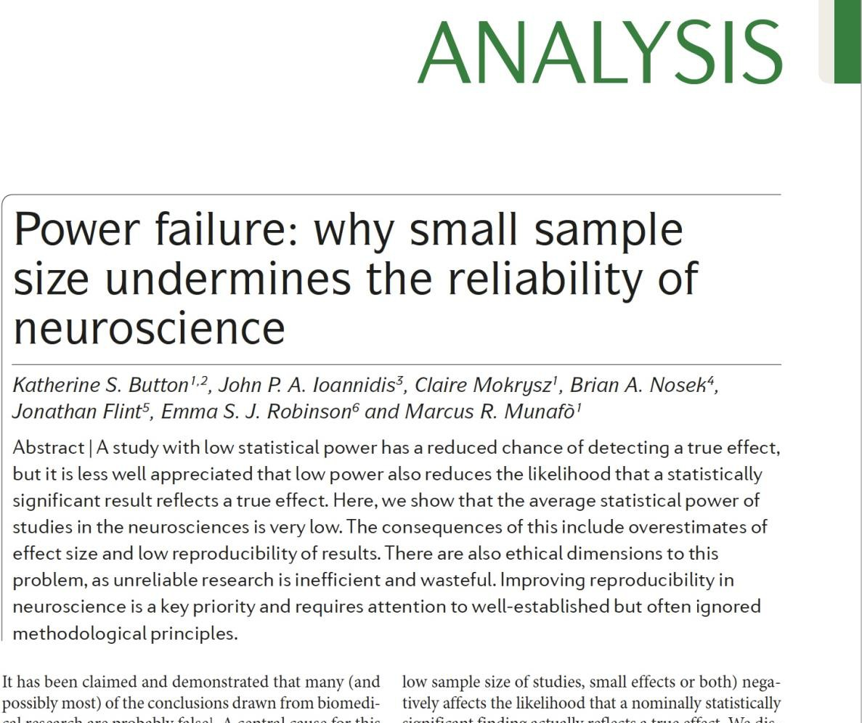
Plan your sample size
Ethics boards and animal care committees require researchers to justify the sample sizes for proposed experiments on humans and other animals.
Science is expensive: a low-power study is a waste of resources, and so is a study that is larger than necessary.
Power (probability of detecting a true effect) of studies is often low in biology.
“We optimistically estimate the median statistical power of studies to be between ~8% and ~31%.”
Button et al (2013) Nature Neuroscience

Slide 6
Problems with low power studies
High chance of a false negative: failing to detect a true effect.
Results of low-power studies have low reproducibility. (Low power from small sample sizes was regarded as the main reason behind the low reproducibility discovered in the Science study that repeated 100 psychology studies.)
A high fraction of low-power studies that do reject the null hypothesis are false positives.
If a statistically significant result is obtained in a low power study, there is a worryingly high chance that the estimated effect is in the wrong direction.
Estimates of effect size are highly uncertain (wide confidence intervals) in studies with small sample size.

Slide 7
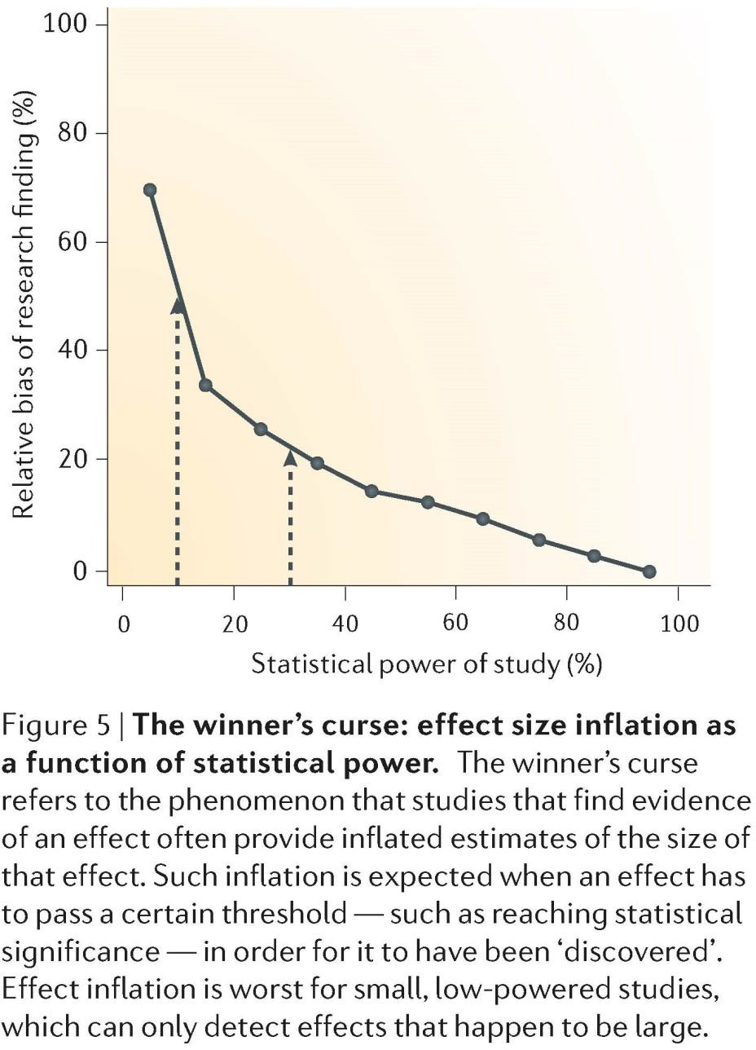
Problems with low power studies
If a statistically significant result is obtained in a low power study, the estimate of effect is likely to be exaggerated (“winner’s curse”).
This “curse” can affect the design and conclusions of replication studies
We saw this effect in the Science study that repeated 100 psychology studies.
Button et al (2013) Nature Neuroscience

Slide 8
Goals when planning your sample size
Plan for precision. Choose a sample size that yields a confidence interval of specified width when estimating magnitude. A narrow confidence interval means we have a magnitude estimate of high precision.
Plan for power. Involves choosing a sample size that would have a high probability of rejecting H0 (≥ 80%) if the absolute magnitude of the difference between the means, |μ1 − μ2|, is at least as great as a specified value D.
Compensate for data loss. Some experimental individuals may die, leave the study, or be lost between the start and the end of the study. The starting sample sizes should be made even larger to compensate.

Slide 9
More hard decisions
How to allocate replicates to different levels of the experiment: Is it better to have more plots, or more plants within plots? Is it better to have more small families, or fewer, larger families?
Power calculations are available in R for standard experimental designs (e.g., pwr package).
R is an amazing tool for simulating data to help plan sample size for any experimental design (lab!).

Slide 10
Challenges of planning sample size
Key quantities to plan sample sizes, such as the within-group standard deviation, σ, are not known
Typically a researcher makes an educated guess for these unknown parameters based on pilot studies or previous investigations
Parameter estimates based on the published literature may be biased, if they are derived from low power studies
If no information is available then consider carrying out a pilot study first, before attempting a large experiment
post-hoc power calculations are useless (reading)

Slide 11
Experiment vs observational study
What is an experimental study?
In an experimental study the researcher assigns treatments to units or subjects so that differences in response can be compared. There must be at least 2 treatments (or treatment and control).
Animal trials, field trials, reciprocal transplant experiments, factorial experiments on competition and predation, etc. are examples of experimental studies.
In an observational study, nature does the assigning of treatments to subjects. The researcher has no influence over which subjects receive which treatment.
Common garden “experiments”, QTL “experiments”, etc, are examples of observational studies (no matter how complex the apparatus needed to measure response).

Slide 12

Why do experiments?
An observational study cannot distinguish the CAUSE behind an association between an explanatory variable and a response variable
Survival of climbers to Mount Everest is higher for individuals taking supplemental oxygen than not. Perhaps supplemental oxygen (explanatory variable) increases survival (response variable)
Or, supplemental oxygen has little or no effect. Survival and oxygen are associated because other variables affect both (e.g., greater overall preparedness). Variables (like preparedness) that distort the causal relationship between the measured variables of interest (oxygen use and survival) are called confounding variables
http://www.everest-2002.de/home_e.html

Slide 13
Why do experiments?
With an experiment, random assignment of treatments to subjects allows researchers to tease apart the effects of the explanatory variable from those of confounding variables.
With random assignment, no confounding variables will be associated with treatment except by chance.
If a researcher could assign supplemental oxygen/no-oxygen randomly to Everest climbers, this will break the association between oxygen and degree of preparedness. Random assignment will roughly equalize the preparedness levels of the two oxygen treatment groups.
In this case, any resulting difference between oxygen treatment groups in survival (beyond chance) must be caused by treatment.

Slide 14
Clinical trials, animal trial, field trials
An experimental study in which two or more treatments are assigned to human subjects.
The design of clinical or animal trials has been refined because the cost (tangible, ethical) of making a mistake with human subjects is so high.
Experiments on nonhuman subjects are simply called “laboratory experiments” or “field experiments”, depending on where they take place.

Slide 15
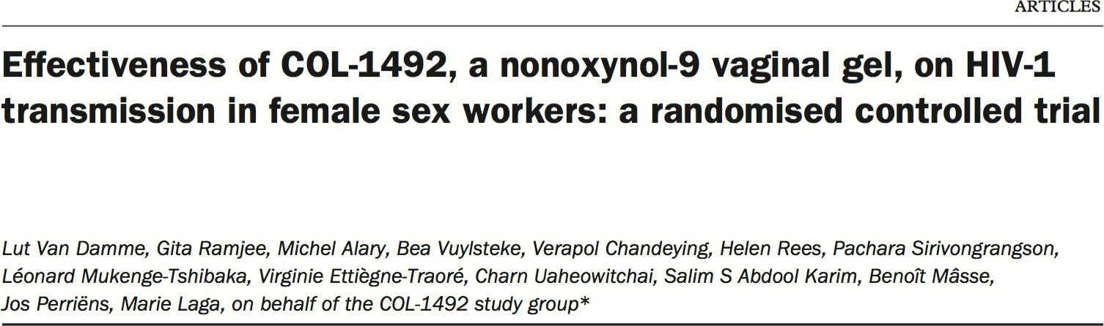
Example experiment (clinical trial)

Slide 16
Example experiment (clinical trial)
Transmission of the HIV-1 virus via sex workers contributes to the rapid spread of AIDS in Africa.
The spermicide nonoxynol-9 had shown in vitro activity against HIV-1, which motivated a clinical trial by van Damme et al. (2002). They tested whether a vaginal gel containing the chemical would reduce the risk of acquiring the disease by female sex workers.
Data were gathered on a volunteer sample of 765 HIV-free sex-workers in six clinics in Asia and Africa.
Two gel treatments were assigned randomly to women at each clinic. One gel contained nonoxynol-9 and the other contained a placebo (an inactive compound that subjects could not distinguish from the treatment of interest).
Neither the subjects nor the researchers making observations at the clinics knew who had received the treatment and who had received the placebo. (A system of numbered codes kept track of who got which treatment.)

Slide 17
Example experiment (clinical trial)
Results of the clinical trial:
 | Nonoxynol-9 |  | Placebo
Clinic | n | Number infected | n | Number infected
Abidjan | 78 | 0 | 84 | 5
Bangkok | 26 | 0 | 25 | 0
Cotonou | 100 | 12 | 103 | 10
Durban | 94 | 42 | 93 | 30
Hat Yai 2 | 22 | 0 | 25 | 0
Hat Yai 3 | 56 | 5 | 59 | 0
Total | 376 | 59 | 389 | 45
“This study did not show a protective effect of COL-1492 on HIV-1 transmission in high risk women. Multiple use of nonoxynol-9 could cause toxic effects enhancing HIV-1 infection.
This drug can no longer be deemed a potential HIV-1-prevention method.”

Slide 18
Example experiment (clinical trial)
To reduce bias, the experiment included:
Simultaneous control group (the women receiving the placebo).
Randomization: treatments were randomly assigned to women at each clinic.
Blinding: neither the subjects nor the clinicians knew which women were assigned which treatment.
To reduce the effects of sampling error, the experiment included:
Replication: the study was carried out on multiple independent subjects.
Balance: the number of women was nearly equal in the two groups at every clinic.
Blocking: subjects were grouped according to the clinic they attended, yielding multiple repetitions of the same experiment in different settings (“blocks”).

Slide 19
Simultaneous control group
A study lacking a control group for comparison cannot determine whether the treatment of interest is the cause of any of the observed changes.
E.g., the health of (human) subjects often improves after treatment merely because of their expectation that the treatment will have an effect, a phenomenon known as the placebo effect.
Control subjects should be perturbed in the same way as the other subjects, except for the treatment itself (as far as ethical considerations permit). The “sham application”, in which surgery is carried out without the experimental treatment itself, is an example.
In field experiments, applying a treatment of interest may physically disturb the plots receiving it and the surrounding areas, perhaps by trampling the ground by the researchers. Ideally, the same disturbance should be applied to control plots.

Slide 20
Randomization
The researcher should randomize assignment to units or subjects
Randomization means that treatments are assigned to units at random, such as by flipping a coin or using random numbers. Other ways of assigning treatments to subjects are inferior. “Haphazard” assignment is prone to bias
Randomization breaks the association between possible confounding variables and the explanatory variable, allowing the causal relationship between the explanatory and response variables to be assessed
Randomization doesn't eliminate variation contributed by confounding variables, only their correlation with treatment
A completely randomized design is an experimental design in which treatments are assigned to all units by randomization

Slide 21
Blinding
Blinding is the process of concealing information from participants (sometimes including researchers) about which subjects receive which treatment.
In a single-blind experiment, the subjects are unaware of the treatment that they have been assigned. Not much of a concern in non-human studies.
In a double-blind experiment the researchers administering the treatments and measuring the response are also unaware of which subjects are receiving which treatments.
Blinding prevents subjects and researchers from changing their behavior, consciously or unconsciously, as a result of knowing which treatment they were receiving or administering.

Slide 22
Blinding
Medical studies carried out without double-blinding exaggerated treatment effects by 16% on average, compared with studies carried out with double-blinding (Jüni et al. 2001)
Experiments on non–human subjects are also prone to bias from lack of blinding
Bebarta et al. (2003) reviewed 290 two-treatment experiments carried out on animals or on cell lines. The odds of detecting a positive effect of treatment were more than threefold higher in studies without blinding than in studies with blinding (Experiments without blinding also tend to have other problems such as a lack of randomization)
Blinding can be incorporated into experiments on nonhuman subjects using coded tags that identify the subject to a “blind” observer without revealing the treatment (and who measures units from different treatments in random order)

Slide 23
Minimizing the effects of sampling error
The goal of experiments is to estimate and test treatment effects against the background of variation between individuals (“noise”) caused by other variables
One way to reduce noise is to make the experimental conditions constant. Fix the temperature, humidity, and other environmental conditions, for example, and use only subjects that are the same age, sex, genotype, and so on. In field experiments, highly constant experimental conditions might not be feasible
Constant conditions might not be desirable, either. By limiting the conditions of an experiment, we also limit the generality of the results—that is, the conclusions might apply only under the conditions tested and not more broadly
Another way to make treatment effects stand out is to include extreme treatments

Slide 24
Replication
Replication is the assignment of each treatment to multiple, independent experimental units.
Studies that use more units (i.e., larger sample sizes) will have smaller standard errors and a higher probability of getting the correct answer from a hypothesis test.
Larger samples mean more information, and more information means better estimates and more powerful tests.

Slide 25
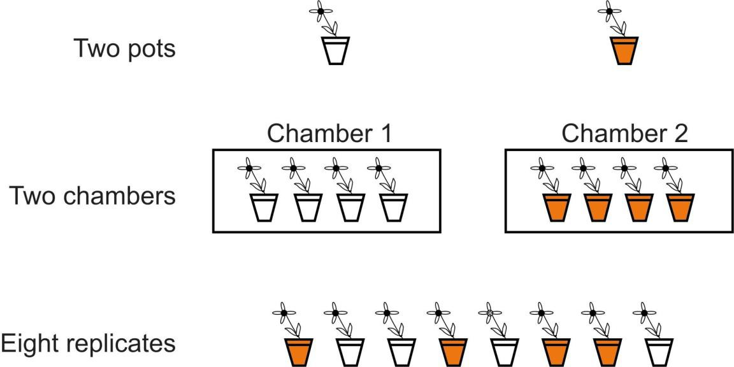
Replication
Replication is not about the number of plants or animals used, but the number of independent units in the experiment. An “experimental unit” is the independent unit to which treatments are assigned (typically, the unit that is interspersed).
The figure shows three experimental designs used to compare plant growth under two temperature treatments (indicated by the shading of the pots). The first two designs are unreplicated.

Slide 26
Replication
An experimental unit might be a single animal or plant if individuals are randomly sampled and assigned treatments independently
Or, an experimental unit might be made up of a batch of individual organisms treated as a group, such as a field plot containing multiple individuals, a cage of animals, a household, a Petri dish, or a family
Multiple individual organisms belonging to the same unit (e.g., plants in the same plot, bacteria in the same dish, members of the same family, and so on) should be considered together as a single replicate. This is because they are likely to be more similar to each other, on average, than to individuals in separate units (apart from the effects of treatment)
Erroneously treating the single organism as the independent replicate when the chamber or field plot is the experimental unit is pseudoreplication

Slide 27
Balance
A study design is balanced if all treatments have the same sample size
Balance helps to reduce the influence of sampling error on estimation and hypothesis testing. To appreciate this, look at the equation for the standard error of the difference between two treatment means. For a fixed total number of experimental units, n1 + n2, the standard error is smallest when the quantity
⎛ 1 1 ⎞
⎜ +
n n
⎝ 1 2 ⎠
is smallest, which occurs when n1 and n2 are equal (assuming equal variances)
Balance has other benefits. For example, ANOVA is more robust to departures from the assumption of equal variances when designs are balanced or nearly so
However, greater balance is not as important as greater replication (i.e., n1 + n2)

Slide 28
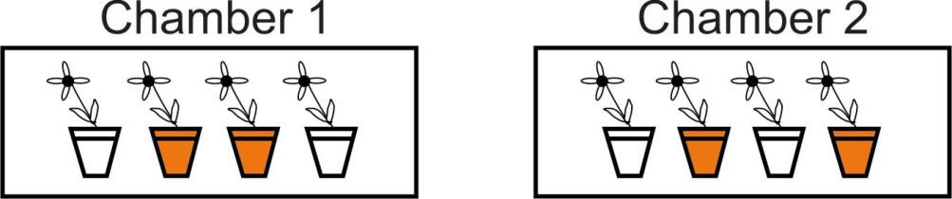
Blocking
Blocking is the grouping of experimental units that have similar properties. Within each block, treatments are randomly assigned to experimental units
Blocking essentially repeats the same, completely randomized experiment multiple times, once for each block
Differences between treatments are only evaluated within blocks, and in this way the component of variation arising from differences between blocks is discarded
Block (here, chamber) must be included as a (random) factor in the statistical analysis. Analysis follows design. The structure of the analysis should mimic that of the experiment. (Looking ahead to “mixed effects models”)

Slide 29
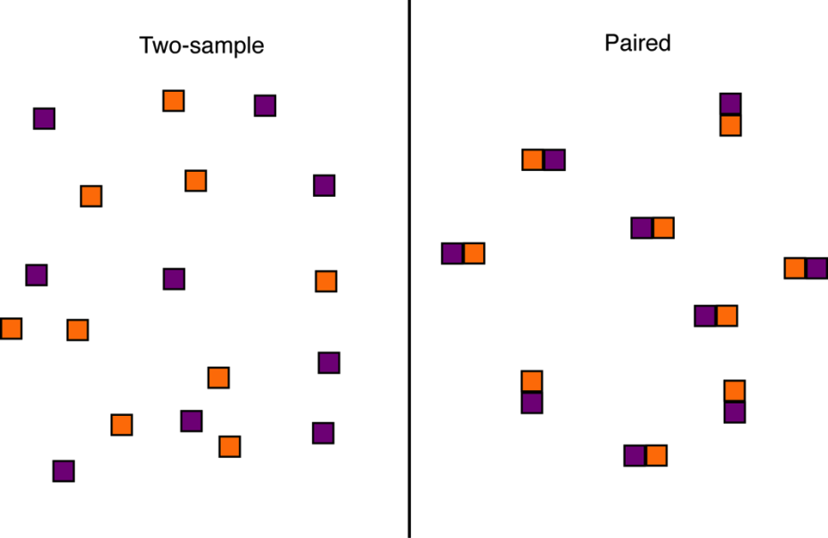
Blocking: Paired design
Consider the design choices for a two-treatment experiment to investigate the effect of clear cutting on salamander density
In the completely randomized (“two-sample”) design we take a random sample of forest plots from the population and then randomly assign either the clear-cut treatment or the no clear-cut treatment to each plot
In the paired design we take a random sample of forest plots and clear-cut a randomly chosen half of each plot, leaving the other half untouched.

Slide 30
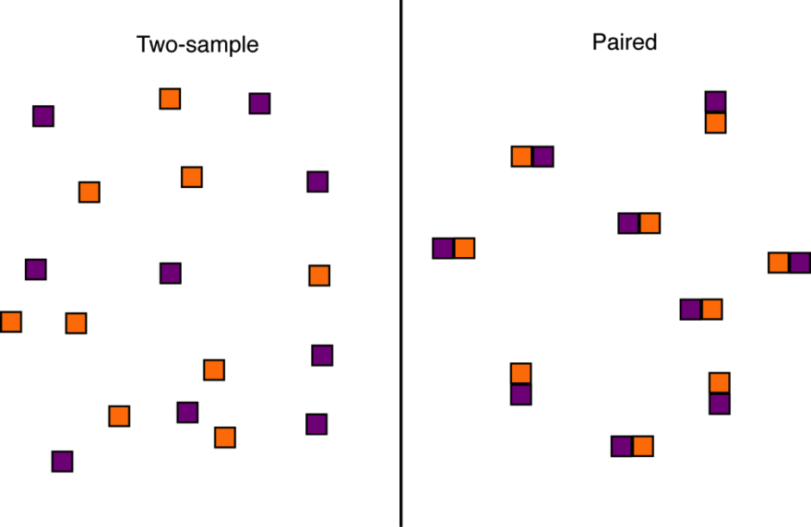
Blocking: Paired design
In the paired design, measurements on adjacent plot-halves are not independent. This is because they are likely to be similar in soil, water, sunlight, and other conditions that affect the number of salamanders
As a result, we must analyze paired data differently than when every plot is independent of all the others, as in the case of the two-sample design
The paired design is usually more powerful than completely randomized design because it controls for a lot of the extraneous variation between plots or sampling units that might obscure the effects we are estimating

Slide 31
Blocking: Randomized complete block design
The paired design is a special case of the RCB design, which allows more than two treatments. Every block receives each treatment.
By accounting for some sources of sampling variation, such as the variation among sites, blocking can make differences between treatments stand out.
Blocking is worthwhile if units within blocks are relatively homogeneous, apart from treatment effects, and units belonging to different blocks vary because of environmental or other differences.
In the example of a clinical trial, “Clinic” was a blocking variable.

Slide 32
Experiments with more than one factor
A factor is a single treatment variable whose effects are of interest to the researcher
The factorial design is the most common experimental design for more than one treatment variable, or factor. In a factorial design every combination of treatments from two (or more) treatment variables is investigated
The main purpose of a factorial design is to evaluate possible interactions between variables. An interaction between two explanatory variables means that the effect of one variable on the response depends on the state of a second variable
Even if there are no interactions, a factorial design can be an efficient way to collect information on the effects of more than one treatment variable

Slide 33
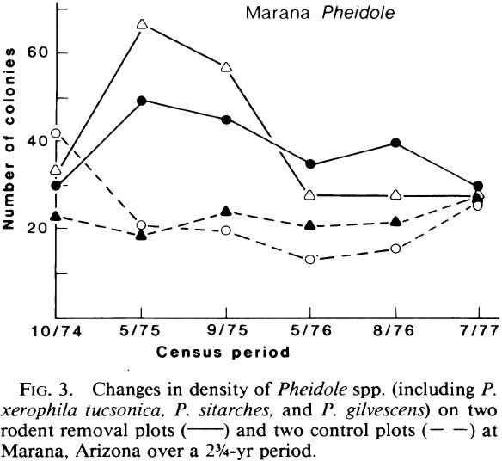
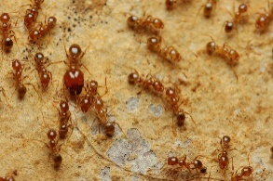
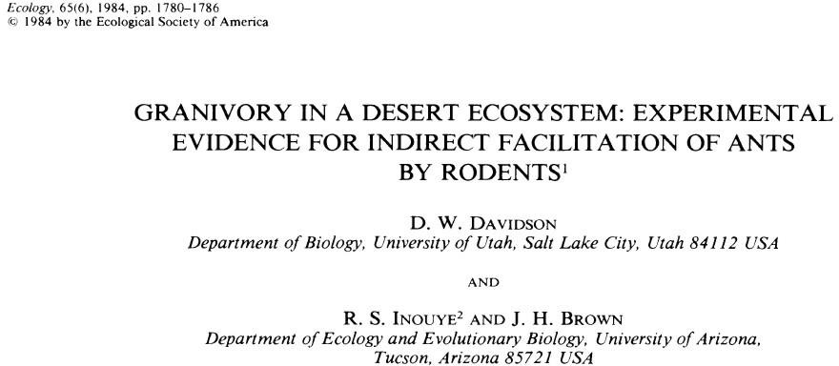
Warning about experiments with time as a factor
Example experiment in desert ants
Involves repeated measures of the same subjects (plots)
Modeling time as a factor likely violates independence assumption of ANOVA

Slide 34
Many experimental designs have been developed
How to choose the best design for your purposes?
R package Agricolae will help model most of the designs typically used in agricultural research (e.g., completely randomized design, randomized complete block design, balanced incomplete block designs, split-plot design, factorial design, latin square design).
You can specify the randomization algorithm (and the random seed, to make it reproducible).
The package claims to generate information about parameters, the resulting field book, summary statistics on the design like efficiency index, and even a sketch showing the distribution of plots in the field.
Let me know if you try it!

Slide 35
Analysis follows design
The structure of your analysis should reflect the structure of study design.
Pseudoreplication is a problem of analysis, not design. It happens when the structure of the analysis doesn’t match that of the experimental design.
For example, if subjects are grouped (fish in aquaria; colonies in a petri dish; repeated measurements of the same individuals), then your analysis needs to include a (random) group level variable in the statistical model. This will avoid pseudoreplication.
Grouping variables are incorporated using “mixed effects models”, which we
will learn about in a few weeks.

Slide 36
Analysis follows design
Recognizing how you will analyze the data when you design your study is a prerequisite for planning the sample sizes you will need.
To plan an experimental design and the sample sizes required to achieve goals, use R to simulate data according to parameters you provide. Then use R to analyze the simulated data.
Repeat this many times and you will acquire estimates of power and precision for alternative plans.
We will attempt this in the workshop in the lab.

Slide 37
What if you can't do experiments?
Experimental studies are not always feasible, in which case we must fall back upon observational studies.
The best observational studies incorporate as many of the features of good experimental design as possible to minimize bias (e.g., simultaneous controls, blinding) and the impact of sampling error (e.g., replication, balance, blocking, and even extreme treatments) except for one: randomization. Randomization is out of the question, because in an observational study the researcher does not assign treatments to subjects.
Two strategies are used to limit the effects of confounding variables on a difference between treatments in a controlled observational study: matching; and statistically adjusting for known confounding variables.

Slide 38
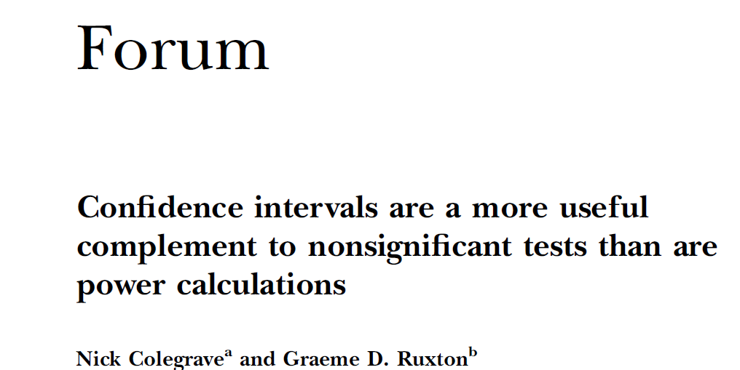

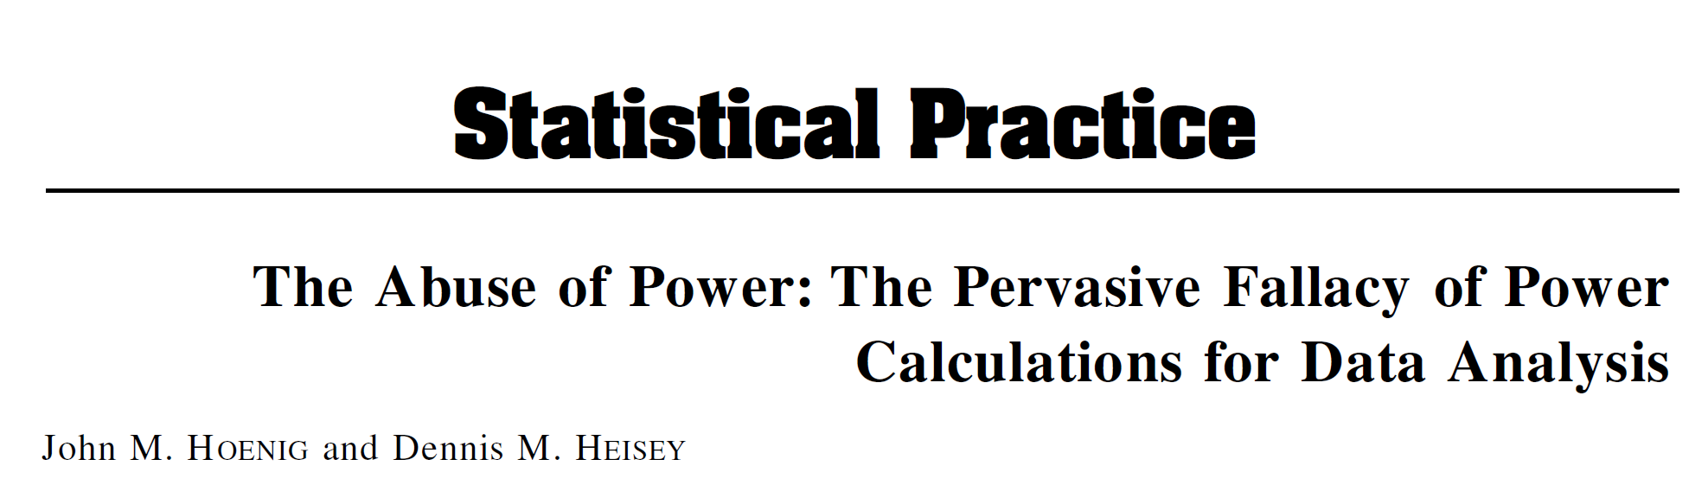

Suggested readings:
Colegrave, N., Ruxton, G.D., 2003. Confidence intervals are a more useful complement to nonsignificant tests than are power calculations. Behav Ecol 14, 446–447. https://doi.org/10.1093/beheco/14.3.446
Hoenig, J.M., Heisey, D.M., 2001. The Abuse of Power. The American Statistician 55, 19–24. https://doi.org/10.1198/000313001300339897
Muhlhausler, B.S., Bloomfield, F.H., Gillman, M.W., 2013. Whole Animal Experiments Should Be More Like Human Randomized Controlled Trials. PLOS Biology 11, e1001481. https://doi.org/10.1371/journal.pbio.1001481

