Slide 1
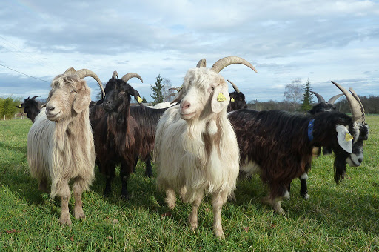
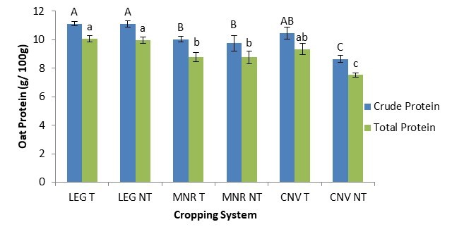
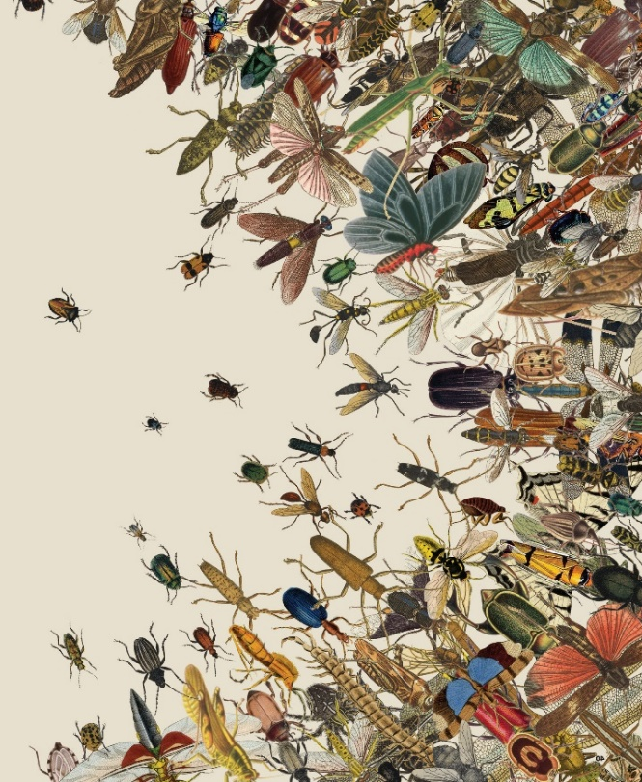


C7041 Experimental Design and Analysis
Ed Harris

Slide 2


2.05: Fixed and random effects
“Asking students to use mixed effects models without teaching them about them is like handing shotguns to toddlers”
-Norman Matloff (attributed)

Slide 3
Outline
Random vs fixed effects
Two-factor example
Why the calculations are different with random effects
Unbalanced designs with random effects
Examples of experiments with random effects
Linear mixed-effects models
Example: Estimating repeatability of a measurement
Assumptions of linear mixed-effects models
An example violating assumptions, with solutions

Slide 4
What are fixed effects?
Fixed effects are predetermined categories of a variable, of direct interest, and are repeatable. An experiment with the same treatment levels could be repeated.
For example:
medical treatments in a clinical trial
predetermined doses of a toxin
diet or fertilization treatments
age groups in a population
habitat, season
Any conclusions reached in the study about differences among groups can be applied only to the groups included in the study. The results cannot be generalized to other treatments, habitats, etc. not included in the study.

Slide 5
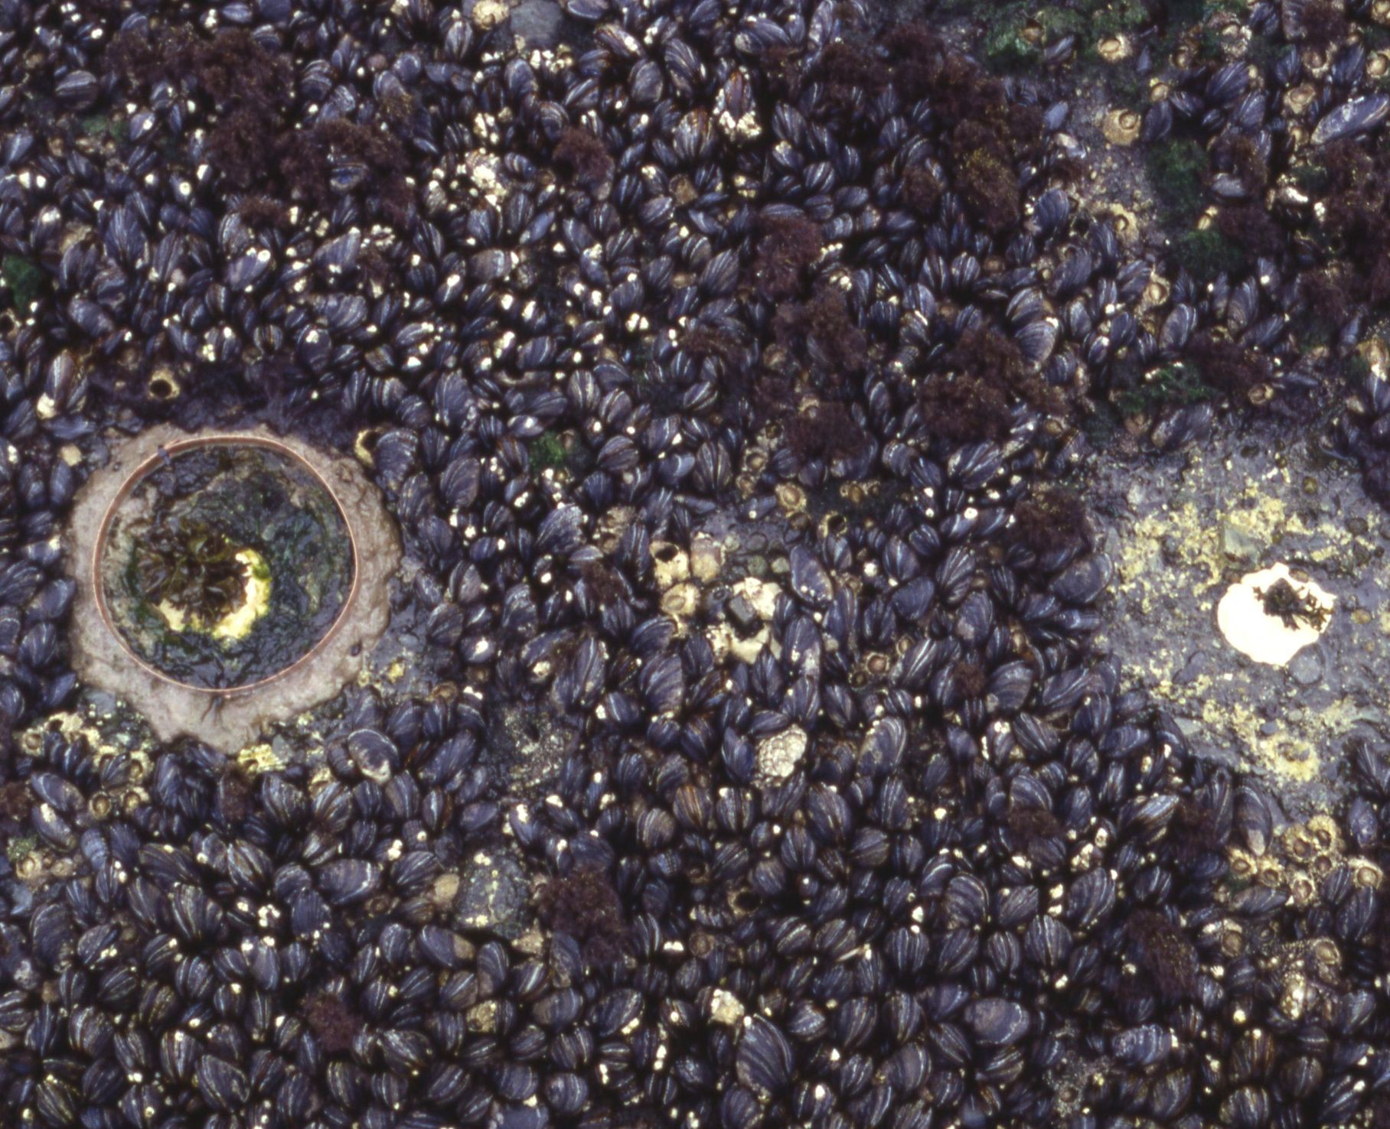
Factorial experiment with fixed effects
Field transplant experiment to investigate how herbivores affect the abundance of the red alga, Mazzaella parksii in the intertidal habitat (Harley 2004).
herbivory treatment
 | present | absent
low | n = 16 plots | n = 16 plots
mid | n = 16 plots | n = 16 plots
intertidal zone
N = 64 plots in a completely randomized design

Slide 6
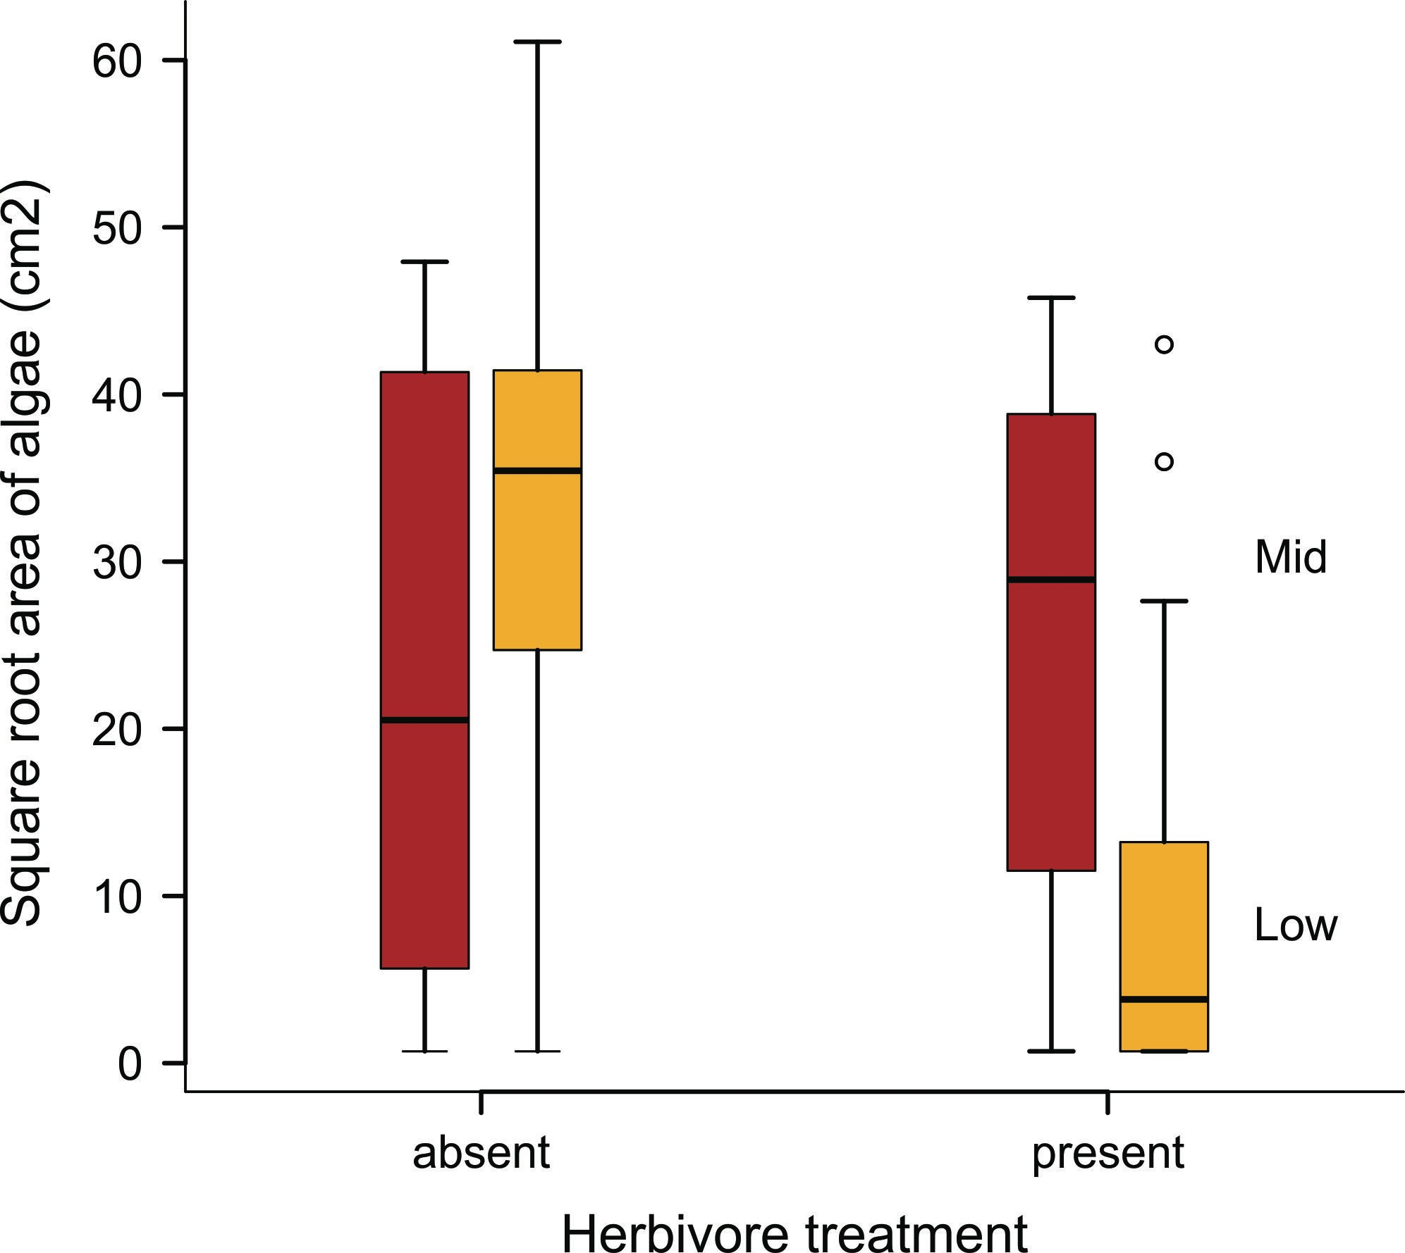
Factorial experiment with fixed effects
Response variable: surface area of red alga, Mazzaella parksii in plots.
Y = β0 + β1X1 + β2X2 + β3X3

Slide 7
Linear model for factorial experiment with fixed effects
z <- lm(sqrtarea ~ herbivores * zone)
The denominator of the F statistic for the treatment effect is MSresidual
Source | SS | df | MS | F | P
zone | 89 | 1 | 89 | 89/238= 0.37 | 0.54
herbivory | 1512 | 1 | 1512 | 1512/238= 6.36 | 0.01
zone*herbivory | 2617 | 1 | 2617 | 2617/238= 11.0 | <0.01
residual (error) | 14271 | 60 | 238
The residuals represent the sole source of random variation in the analysis.
The residual mean square (MSresidual) is the appropriate quantity to use as a reference when asking whether treatment mean squares are larger than random variation (chance), i.e., whether F ≫ 1.

Slide 8
What are random effects?
Randomly sampled categories of a variable, representing groups or clusters of measurements or units. An experiment with the same treatment levels could not be repeated. For example:
randomly sampled families made up of siblings
randomly sampled subjects measured repeatedly
randomly placed transects each of multiple quadrats in a sampling survey
arbitrary field plots each growing multiple plants
arbitrary environment chambers each containing many aquariums
Groups are assumed to be randomly sampled from a population of groups.
Therefore, conclusions reached about groups can be generalized to this population.

Slide 9
What are random effects?
In some cases, random effects are of no interest, but are a nuisance…
field plots each with many plants
environment chambers containing aquariums
In other cases, measuring the variance associated with each level of random groupings is a major point of the study.
Families of siblings (to estimate heritability, etc)
Subjects measured repeatedly (to estimate repeatability)
transects each of multiple quadrats (to estimate α- and β-diversity)
Repeated measurements of groups are not independent.
Failing to model random effects leads to pseudoreplication. Modeling random effects properly (using mixed effects models) avoids pseudoreplication.

Slide 10
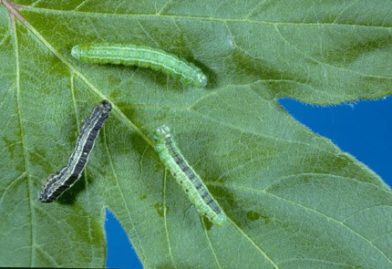
Factorial experiment when one of the factors is random
Futuyma and Philippi (1987)
Fall cankerworm, Alsophila pometaria
http://cfs.nrcan.gc.ca/subsite/glfc-sugarbush/alsophila-pometaria-images
Caterpillars of the fall cankerworm feed on the leaves of hardwood trees. Adult female moths are wingless. Many reproduce clonally, producing only daughters genetically identical to themselves.
Research question: What is the effect of tree species on growth; and how much do clones vary in growth? This is a not a question about individual clones but about the population of clones.

Slide 11
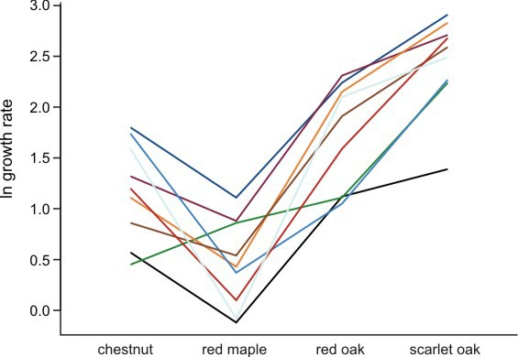
Factorial experiment when one of the factors is random
Design: Sample 9 female moths from a population in NY. Raise larvae from 9 clones on leaves of 4 tree species. Measure growth after 15 days.
Two factors: Tree species (fixed), Clone (random)
Interaction plot:
Mean growth of caterpillars from 9 families (clones) raised on four tree species.
N = 326 caterpillars total.

Slide 12
Factorial experiment when one of the factors is random
Caterpillars from the same clone are not independent. There are 326 caterpillars but only 9 clones. In this case the residual mean square (MSresidual) from a linear model fit is no longer the appropriate quantity to use as a reference when asking whether treatment mean squares are larger than expected by chance. To do so would commit pseudoreplication.
Instead, the variance among clones is the key to testing treatment effects
(Always report df with the test statistics F!)

Slide 13
Factorial experiment when one of the factors is random
Presence of a random factor represents another source of random variation
The mean effect of tree species on caterpillar growth is modeled as the mean of clone means ± variation among clones.

Slide 14
More reasons why analysis is different with random effects
Unlike fixed groups, the means of the specific random groups (e.g., clones) are
not of direct interest. Instead, interest is focused on the variance among the random groups. A goal of the Futuyma and Philippi experiment was to estimate
these variances.
When a design including random effects is unbalanced, the standard formulas for F statistics (as calculated in the above ANOVA table of fixed effects) are not F- distributed. Standard ANOVA table calculations don’t work with unequal sample sizes. Sorry!
With unbalanced designs, mixed models calculate approximate F-statistics and degrees of freedom for tests of fixed effects. Results are approximate.

Slide 15
How to know when you have random effects in your study
You have random effects:
When your sampling design is nested:
quadrats within transects; transects within woodlots; woodlots within districts.
When your measurements are clustered spatially or temporally within randomly sampled units i.e., in blocks, which are typically analyzed as random effects.
When you divide up plots, or families, clones, ponds, etc, and apply separate fixed treatments to subplots, or siblings, pond-halves, etc.
When you take measurements on related individuals.
When you measure subjects or other sampling units repeatedly.

Slide 16
Caution when analyzing random effects
Use linear mixed effects models to analyze random effects.
Many statistical packages assume that all factors are fixed unless you instruct otherwise (e.g., Genstat, SPSS, JMP).
Designating factors as random takes extra work and probably a read of the manual. In R, lm() is for fixed effects only. Do not use if you have random effects
In R, use lmer() (in the lme4 / lmerTest package) or lme() (in the nlme package) to analyze models containing random effects. These packages model the variance structure of random effects explicitly.
Tests of treatment effects using the Kenward-Roger or Satterthwaite approximations for degrees of freedom are most accurate (available in lme4 / lmerTest package).

Slide 17
Attributes of linear mixed-effects models
They are linear models that include both fixed and random effects.
They model different error variance for each level of random variation.
Estimation and testing are based on restricted maximum likelihood (REML), which can handle unequal sample size.
P-values for tests of fixed effects are conservative when designs are unbalanced.
Implemented in the lme4/lmerTest and nlme packages in R.

Slide 18
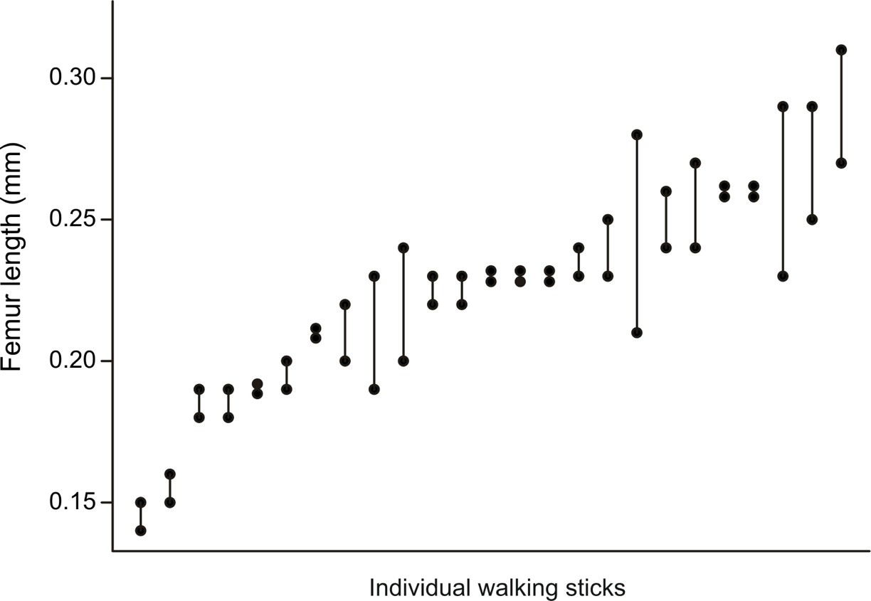
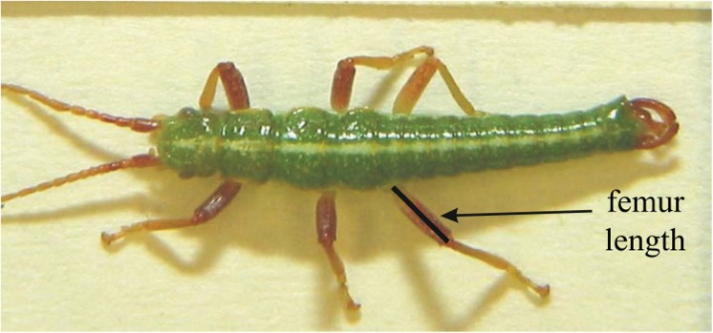
Example 1: Study of measurement repeatability (simple nested design)
The walking stick, Timema cristinae, is a wingless herbivorous insect on plants in chaparral habitats of California. Nosil and Crespi (2006) measured individuals using digital photographs. To evaluate measurement repeatability they took two separate photographs of each specimen. After measuring traits on one set of photographs, they repeated the measurements on the second set.

Slide 19
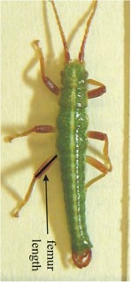
Example 1: Study of measurement repeatability (simple nested design)
Fit the data with a linear mixed model: Yi = β0 + bi + error
individual bugs i
…..
1 2 3 4 5 6 7 8 9 10 (measurements)
The individual bugs are the random groups in this study, with two repeated measurements per group.
Model has two parts, each with its own source of error variance:
Random part: the measurement of individual bug i: bi ± measurement error.
Fixed part: the mean of bug means: β0 ± bug error (i.e., variation among bugs)

Slide 20
Example 1: Study of measurement repeatability (simple nested design)
library(lmerTest)
z <- lmer(femurlength ~ 1 + (1|individual))
Fixed part of the formula:
femurlength ~ 1
Random part of the formula
+ (1|individual)

Slide 21
Example 1: Study of measurement repeatability (simple nested design)
The fixed part of the formula instructs R to fit a constant (intercept) based on the fitted values of the random groups (individual bugs)
femurlength ~ 1
The random part of the formula instructs R to fit a constant (an intercept) to the two measurements within each individual. This yields a fitted value for each individual walking stick.
+ (1|individual)

Slide 22
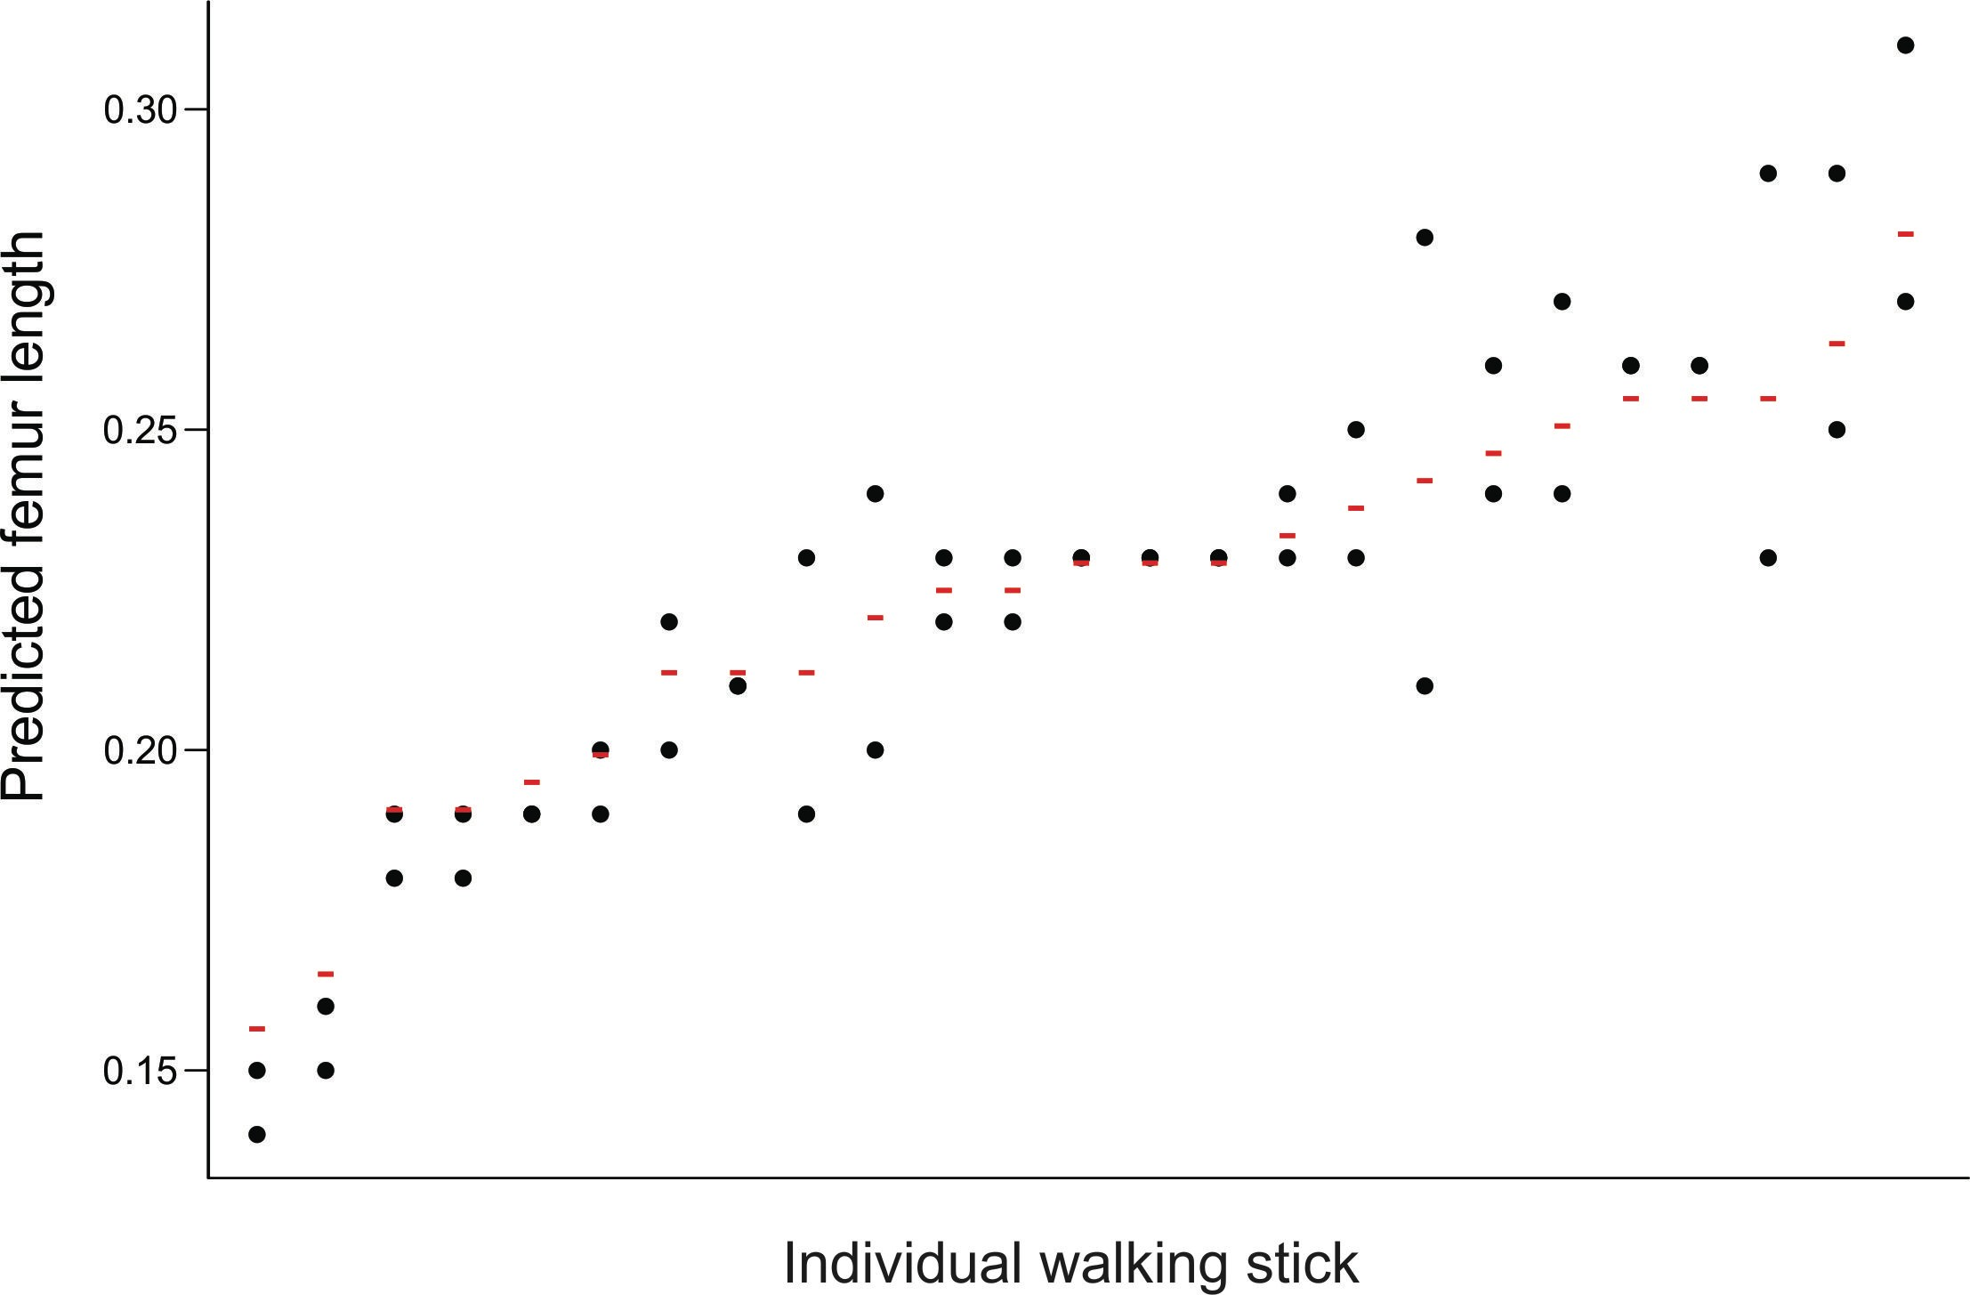
Example 1: Study of measurement repeatability (simple nested design)
z <- lmer(femurlength ~ 1 + (1|individual)) fitted(z) # yields best linear unbiased predictors (BLUPs): R fits them all together,
rather than in two stages, yielding variance components and BLUPs.
Note BLUPs are not the means for each insect. They tend to be “shrunk” towards the centre compared with the group means.

Slide 23
Example 1: Study of measurement repeatability (simple nested design)
VarCorr(z) extracts the variance components (square the standard deviations to obtain the variances)
Groups | Name | Std.Dev. (σ)
individual Residual | (Intercept) | 0.032464 = variation among random groups (individuals) 0.018868 = variation within random groups
We can use these quantities to calculate the fraction of variation that is among individuals (repeatability):
repeatability = σ² / (σ² + σ² )
among among within
estimate of repeatability = 0.032464² / (0.032464² + 0.018868²)
= 0.75

Slide 24
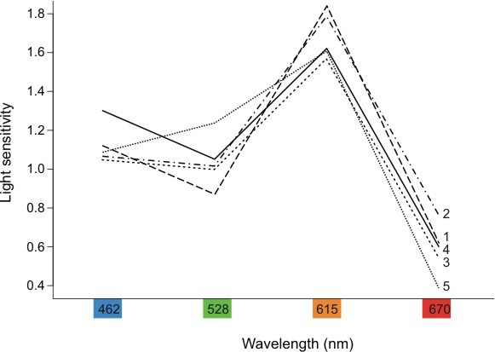
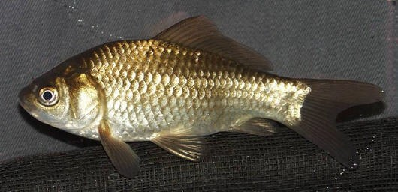
Example 2: “Subjects by treatment” repeated measures design
Cronly-Dillon and Muntz (1965) used the optomotor response to measure color vision in goldfish. Each fish was tested at different wavelength in random order.
A large value indicates that the fish has high sensitivity --- it can detect a low light intensity.
Factors:
Wavelength (fixed, repeated measure) Fish (random)
Light sensitivity of 5 goldfish to specific wavelengths of light.

Slide 25
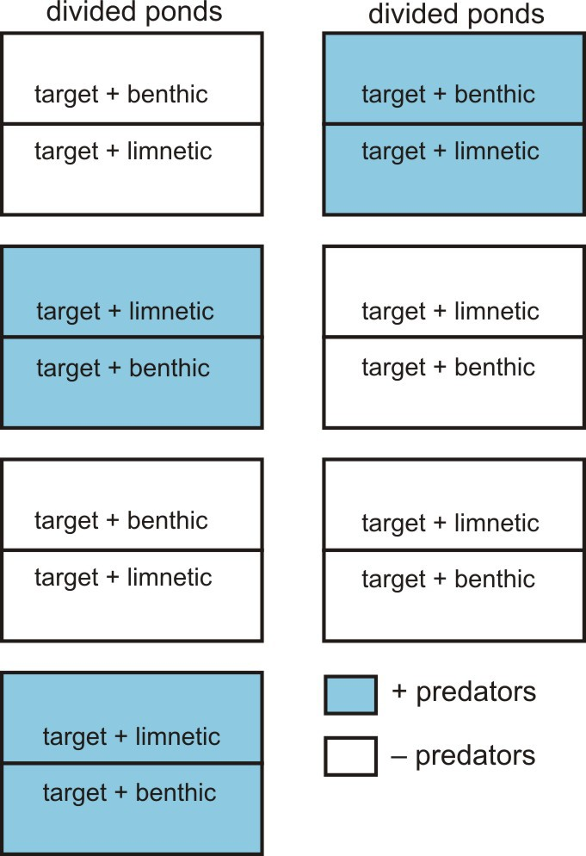
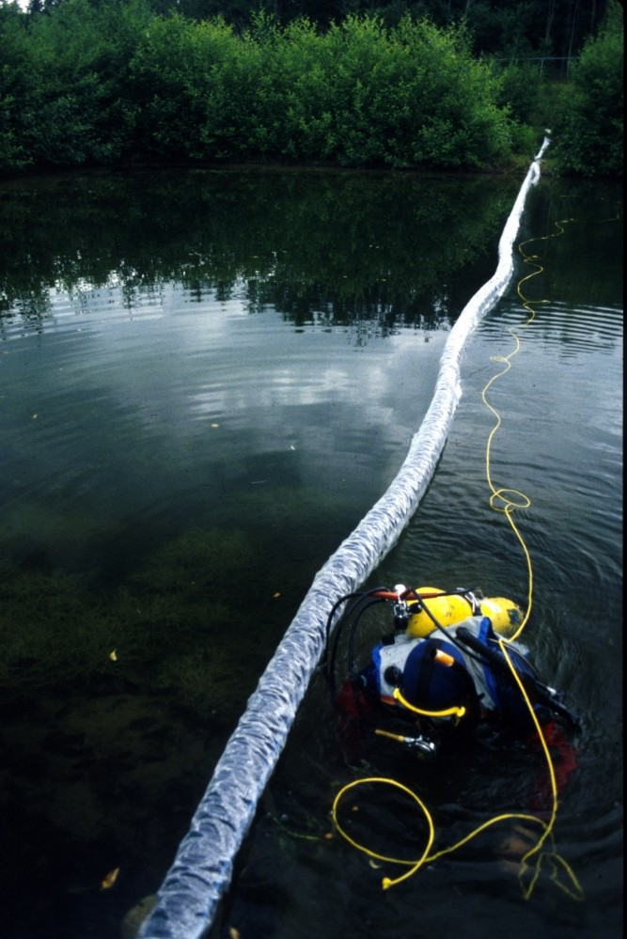
Example 3: Split plot design
Factors:
Predation treatment (fixed), whole ponds Competition treatment (fixed), split ponds Pond (random)

Slide 26
Assumptions of linear mixed-effects models
Variation within groups follows a Gaussian distribution with equal variance among groups.
Groups are randomly sampled from a “population” of groups (i.e., are independent and sampled without bias).
Group effects have a Gaussian distribution.
Replicates within groups are also randomly sampled (i.e. independent and sampled without bias).
No carry-over between repeated measurements on the same subject.
Sphericity: the variances of the differences between all pairs of factor levels are equal. (Problems can arise when one of the factors is time.)

Slide 27
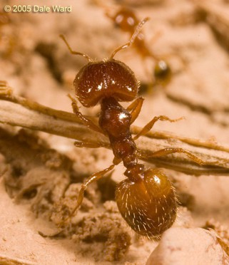

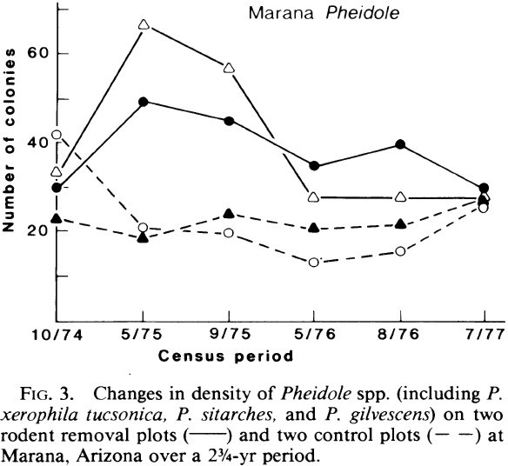
Example 4: “Subjects by trials” repeated measures design
Factors:
Rodent treatment (fixed) Date (fixed)
Plot (random)

Slide 28
Example 4: Warning about “subjects by trials” repeated measures design
Factors:
Rodent treatment (fixed) Census date (fixed)
Plot (random)
Tempting to analyze these data using a linear mixed-effects model:
Fixed part of formula:
ncolonies ~ treatment + date
Random part of formula:
+ (1|plot)

Slide 29
Example 4: Warning about “subjects by trials” repeated measures design
Problem: Including Census date as a factor would likely lead to a violation of the sphericity assumption: among plots, the variance of the pairwise difference between values of the response variable will be lower between nearby dates than dates that are farther apart.
Increases Type 1 errors (P-values inaccurate)

Slide 30
Example 4: Warning about “subjects by trials” repeated measures design
Analyses of growth curves in time might have the same problem.
Any repeated measures experiment in which the treatment levels are given in the same sequence (i.e., not in random order) might have the same problem.
Sphericity correction is possible.
Anova() in car package: Mauchly test for Sphericity
Greenhouse-Geisser and Huynh-Feldt corrections to P-values.

Slide 31
Where to get further advice
Quinn & Keough is very useful in understanding design and assumptions of mixed-effects models (though it won’t help you with modeling using maximum likelihood in R).
Quinn & Keough 2002. Experimental design and data analysis for biologists
Other books on mixed-effects models in R (see Books tab at course web site): Pinheiro and Bates (2000). Mixed-effects models in S and S-PLUS.
Zuur et al (2009). Mixed effects models and extensions in ecology with R.
Article:
Bates, Douglas, et al. 2015. Fitting Linear Mixed-Effects Models Using lme4. Journal of Statistical Software 67: 1-48.

Slide 32


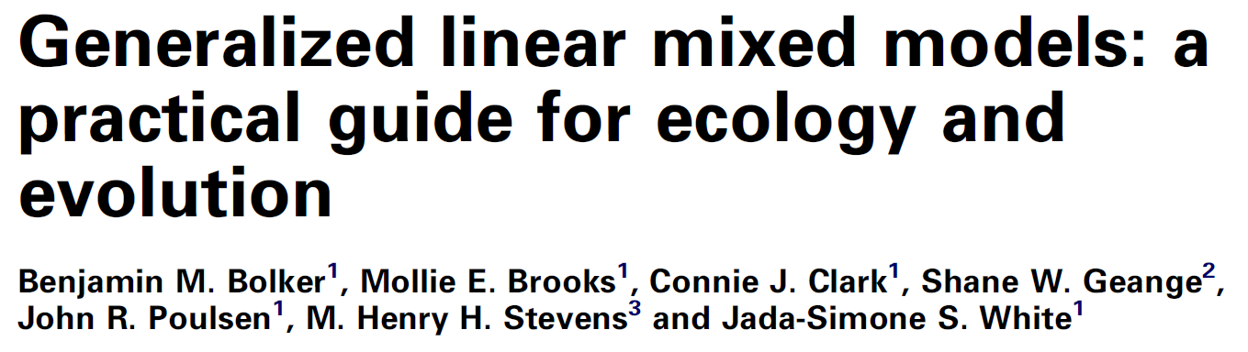
Suggested reading:
Arnqvist, G., 2020. Mixed Models Offer No Freedom from Degrees of Freedom. Trends Ecol. Evol. (Amst.) 35, 329–335. https://doi.org/10.1016/j.tree.2019.12.004
Bolker, B.M., Brooks, M.E., Clark, C.J., Geange, S.W., Poulsen, J.R., Stevens, M.H.H., White, J.-S.S., 2009. Generalized linear mixed models: a practical guide for ecology and evolution. Trends in Ecology & Evolution 24, 127–135. https://doi.org/10.1016/j.tree.2008.10.008
Murtaugh, P.A., 2007. Simplicity and Complexity in Ecological Data Analysis. Ecology 88, 56–62. https://doi.org/10.1890/0012-9658(2007)88[56:SACIED]2.0.CO;2

