Slide 1
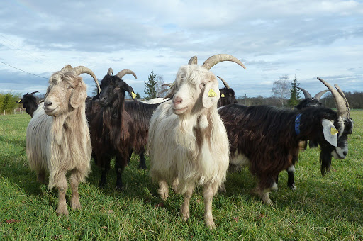
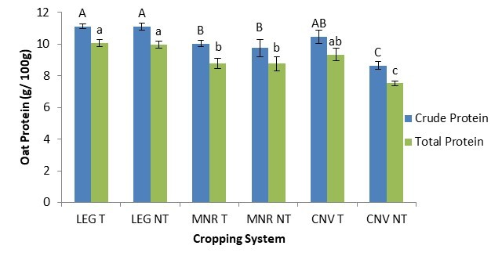

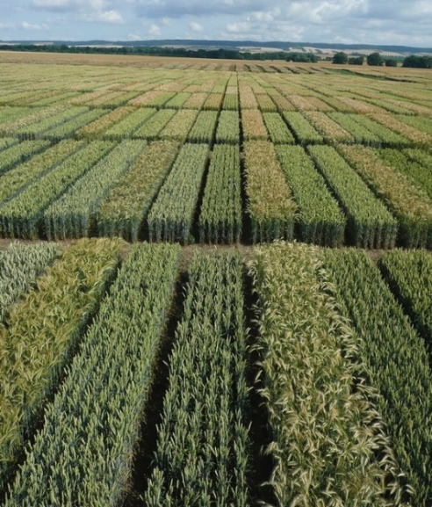

C7041 Experimental Design and Analysis
Ed Harris

Slide 2
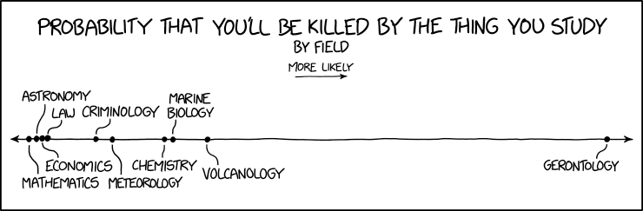
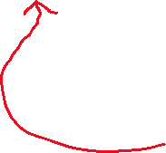



2.06: Likelihood

Slide 3
Outline
What is probability
What is likelihood
Maximum likelihood estimation
Example 1: estimate a proportion
Likelihood works backward from probability
Likelihood-based confidence intervals
Example 2: estimate survival curve
Log-likelihood ratio test
Example: test a proportion

Slide 4
What is probability
Frequentist definition:
The probability of an event is the proportion of times that the event would occur if a random trial is repeated over and over again under the same conditions.
A probability distribution is a list of all mutually exclusive outcomes of a random trial and their probabilities of occurrence.

Slide 5
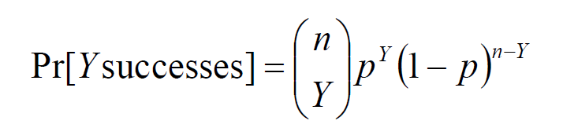
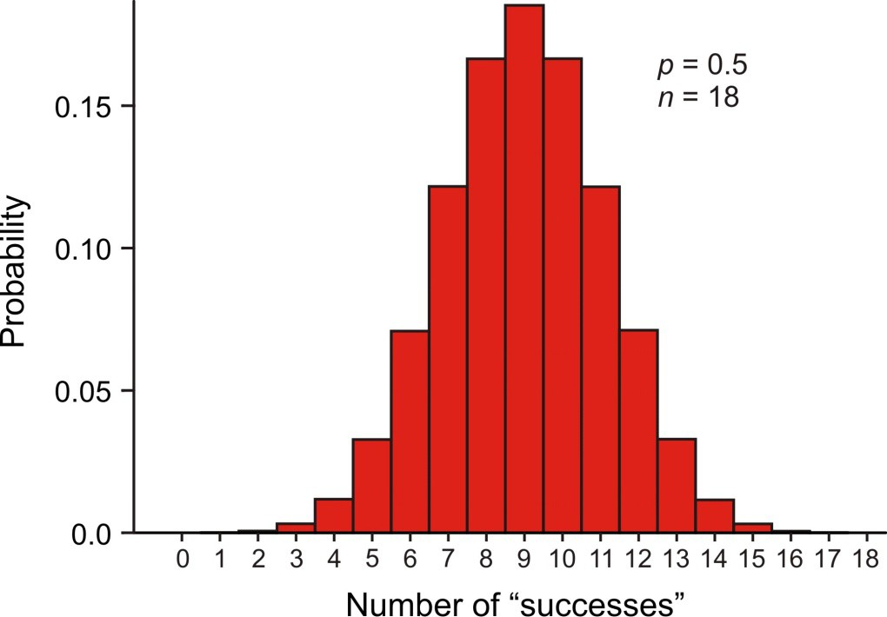
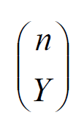
Example: binomial distribution
The binomial distribution is the probability distribution of the number of Y “successes” in n independent trials, with p the probability of success being the same in each trial.
counts up the different ways
of getting Y successes and n – Y
failures (e.g., S-S-F; S-F-S; F-S-S)
Graph shows Pr[0], Pr[1] , Pr[2], … when p = 0.50 and n = 18

Slide 6
What is conditional probability?
The conditional probability of an event is the probability of that event occurring given that a condition is met. “|” symbol used to indicate “given”
The probability that the second child born to a couple is a girl, given that their first child was a girl,
Pr[second child is girl | first child is girl]
Other conditional probabilities:
Pr[we see an elephant today | we are in the Serengeti]
Pr[we see an elephant today | we are in Telford]
Pr[ 12 successes in n trials | p = 0.50]
Pr[ 12 successes in n trials | p = 0.10]

Slide 7
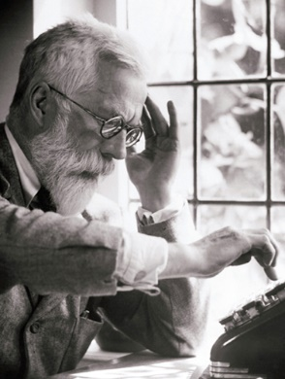
What is likelihood?
Likelihood is a conditional probability.
The likelihood of a population parameter equaling a specific value, given the data, is the probability of obtaining the observed data given that the population parameter equals the specific value.
L[ parameter = ρ | data ] = Pr[ data | parameter = ρ ]
Law of Likelihood:
The extent to which data supports one parameter value or hypothesis against another is equal to the ratio of their likelihoods (difference in their log-likelihoods)
Method invented by R. A. Fisher when a 3rd-year undergraduate.

Slide 8
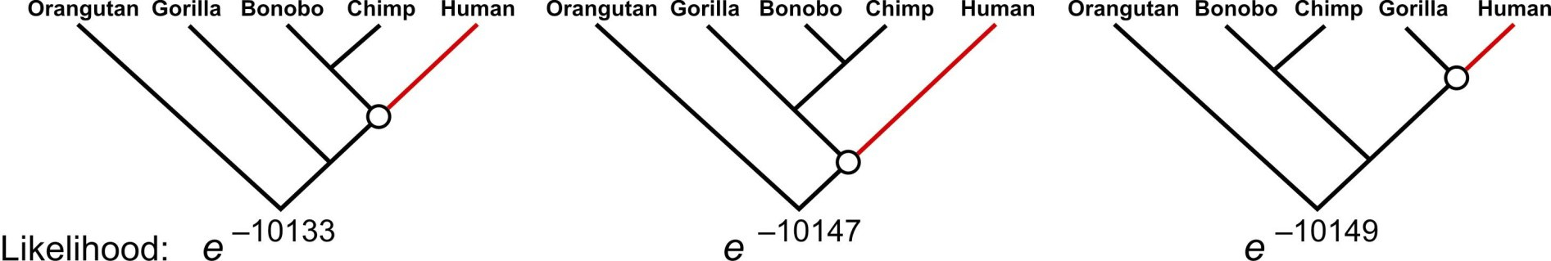
Likelihood is used a lot in phylogeny estimation
Three proposed trees of ancestor–descendant relationships between humans and the other great apes. The human branch is highlighted. Numbers at the bottom are the likelihoods of each proposed tree based on gene sequence data (Rannala and Yang 1996). The likelihood of the left-most tree is the highest.
L[ tree = i | gene sequences ] = Pr[ gene sequences | tree = i ]
What matters is not the likelihood of each tree as such, but the likelihood of each tree relative to the others.

Slide 9
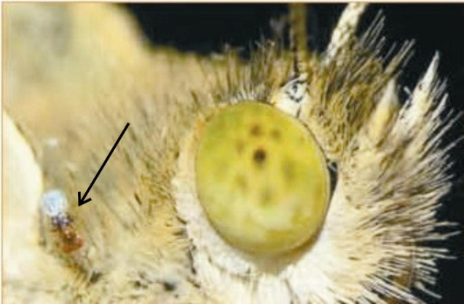
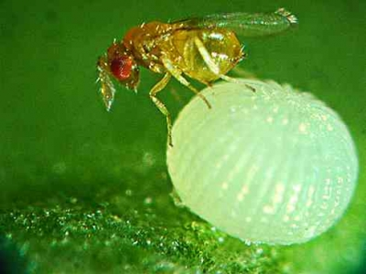
Example 1: Estimate a binomial proportion p
Data: The tiny wasp, Trichogramma brassicae, rides on female cabbage white butterflies, Pieris brassicae.
When a butterfly lays her eggs on a cabbage, the wasp climbs down and parasitizes the freshly laid eggs.
What is the proportion p of wasps in the population choosing the mated female?
Y = 23 “successes”, n = 32 trials. Use these data to estimate p.
Fatouros et al. (2005): Can distinguish mated female butterflies from unmated females?
In each trial a single wasp was presented with two female cabbage white butterflies, one a virgin female, the other recently mated. Y = 23 of 32 wasps tested chose the mated female.

Slide 10
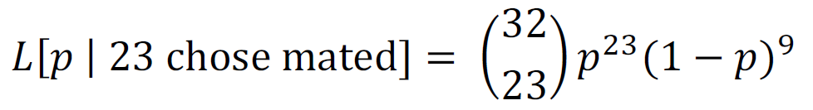
Example 1: Estimate a binomial proportion p
Likelihood function for the binomial proportion p
Data: Y = 23, n = 32
𝐿[𝑝 | 𝑌 chose mated female] = Pr[𝑌 chose mated female | 𝑝]
For example, the likelihood of p = 0.5, given the data, is
in R:
dbinom(23, 32,
[1] 0.00653062
prob=0.5)

Slide 11
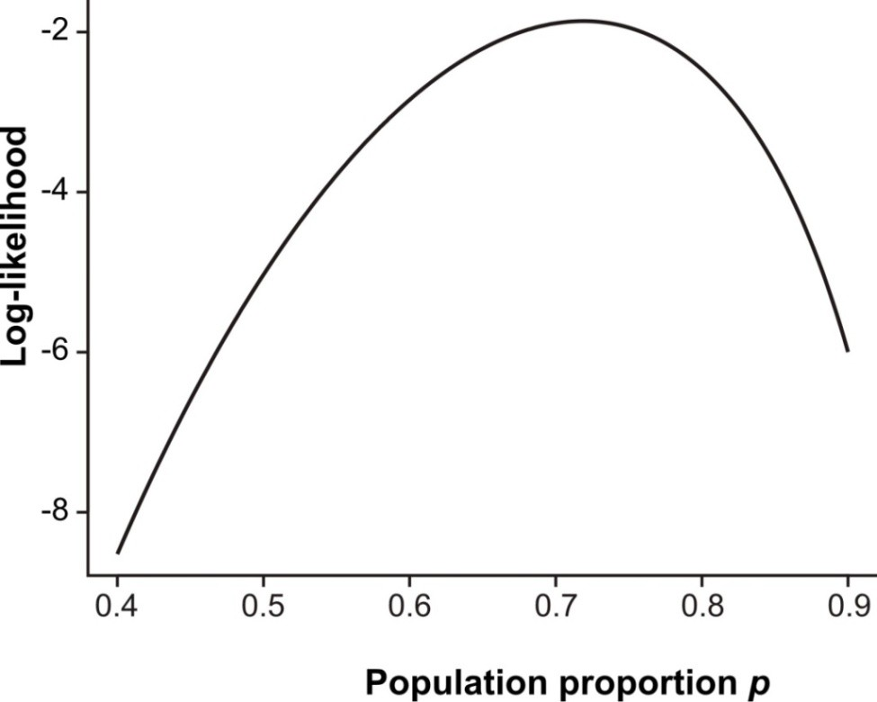
Example 1: Estimate a binomial proportion p
Easier to work with log-likelihoods
in R:
dbinom(23, 32, prob = [1] -5.031253
0.5, log=TRUE)
Repeat for many values of p
to get the log-likelihood curve:

Slide 12

Likelihood works backward from probability.
We use likelihood to estimate unknown parameters based on known data. The parameters are treated as variables, the data are a constant, unvarying.

Slide 13
Likelihood works backward from probability.
But the likelihood function is not a probability distribution.
The population proportion p is the variable of the function, but it is not a random variable (i.e., its value is not determined by random trial).

Slide 14
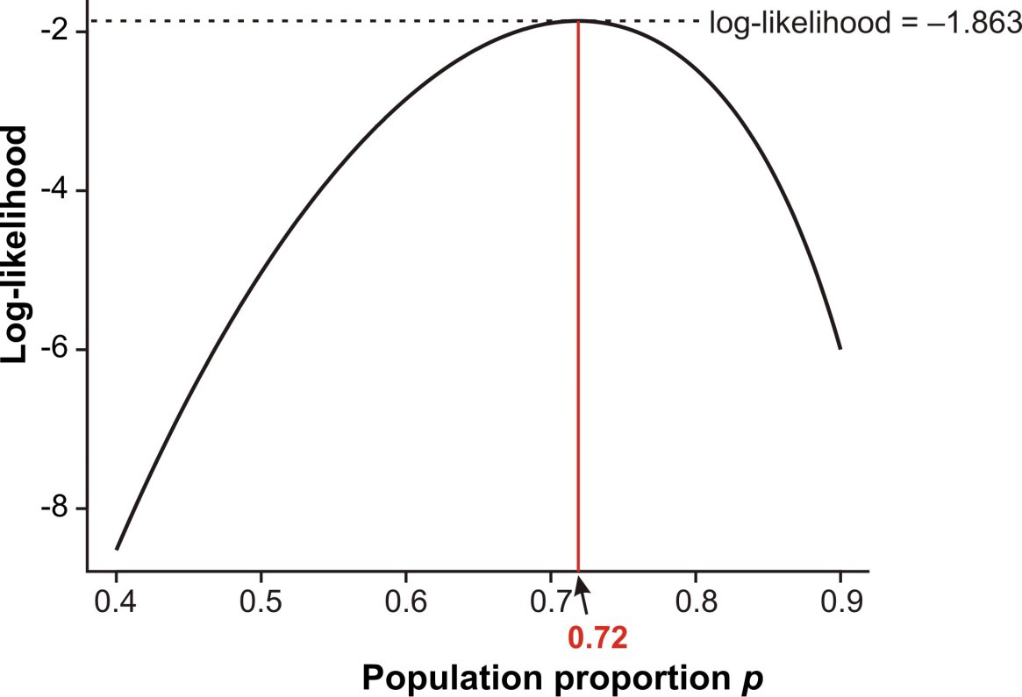
Maximum likelihood estimate
The likelihood ratio (difference of log-likelihoods) measures relative support for alternative parameter values. The maximum likelihood estimate (MLE) of a parameter is the parameter value having the highest likelihood (and log-likelihood), given the data. This is the parameter value most strongly supported by the data.

Slide 15
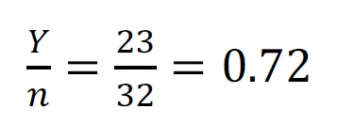

Maximum likelihood estimate
The ML estimate could instead have been obtained as
The conventional formula for estimating a proportion yields the ML estimate.
Most formulas we use to estimate parameters can yield maximum likelihood estimates.

Slide 16
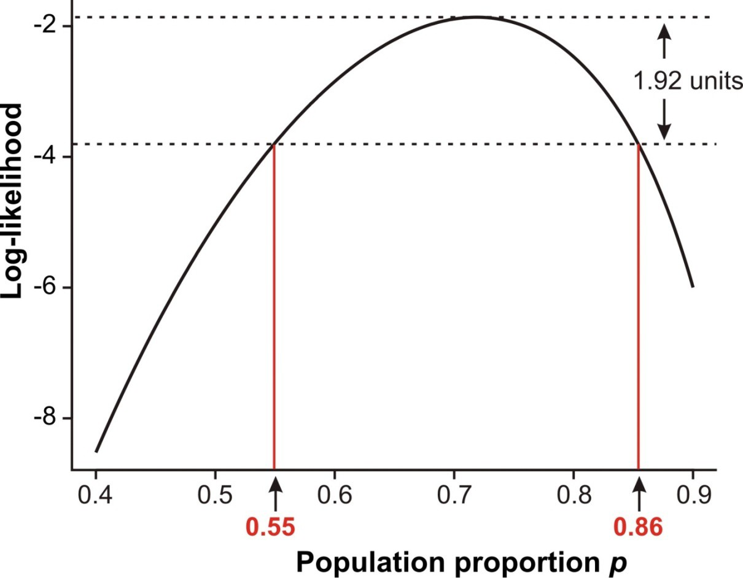

Likelihood-based confidence intervals
When estimating a single parameter, an approximate 95% confidence interval is obtained with the values corresponding to 1.92 log-likelihood units below the maximum.
So the 95% CI for p in the wasp example is
0.55 ≤ p ≤ 0.86
The connection to χ² will become apparent later

Slide 17
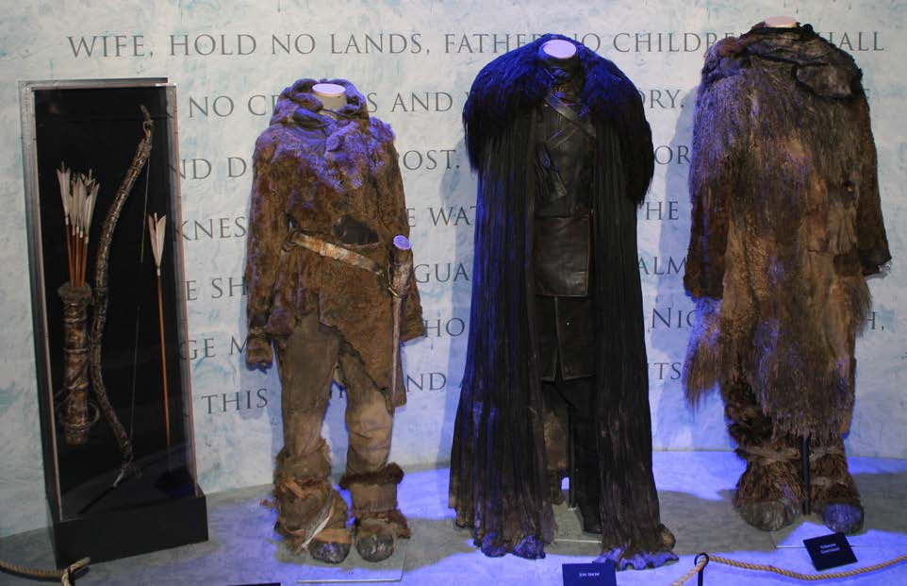
Example 2: Survival rates of characters in Game of Thrones.
You don’t need to be a mathematician to use likelihood in your data analysis.
You just need to find a formula for the probability distribution of outcomes for your particular situation.
Costumes worn by Ygritte, Jon Snow and Tormund Giantsbane, Oslo 2014.
B. Skinstad. CC3.
https://commons.wikimedia.org/wiki/File:Game_ of_Thrones_Oslo_exhibition_2014_-
_Ygritte,_Jon_and_Tormund_costumes.jpg

Slide 18
Example 2: Survival rates of characters in Game of Thrones.
Death of male characters – causes
name time.hrs
death_description Killed by a white walker in a forest Decapitation by a white walker in a forest
Decapitation by Ned Stark (legal execution) in a field
<NA>
<NA>
Shot by arrows and stabbed in the abdomen in the wedding hall at The Twins Decapitated by Theon Greyjoy in Winterfell castle grounds
Waymar Royce Gared Tuttle Will
Jon Snow Bran Stark Robb Stark
0.10
0.11
0.19
63.99
63.99
24.34
Rodrik Cassel 12.70
Rickon Stark Eddard Stark Jory Cassel
...
49.15 Shot with an arrow through the thorax by Ramsay Bolton in field near Winterfell
7.67
4.16
Decapitated by Ilyn Payne on the steps of the Great Sept of Baelor Stabbed in the eye by Jamie Lannister in the streets of King's Landing
Lystad, R. P. and B. T. Brown. 2018. Injury Epidemiology 5:

Slide 19
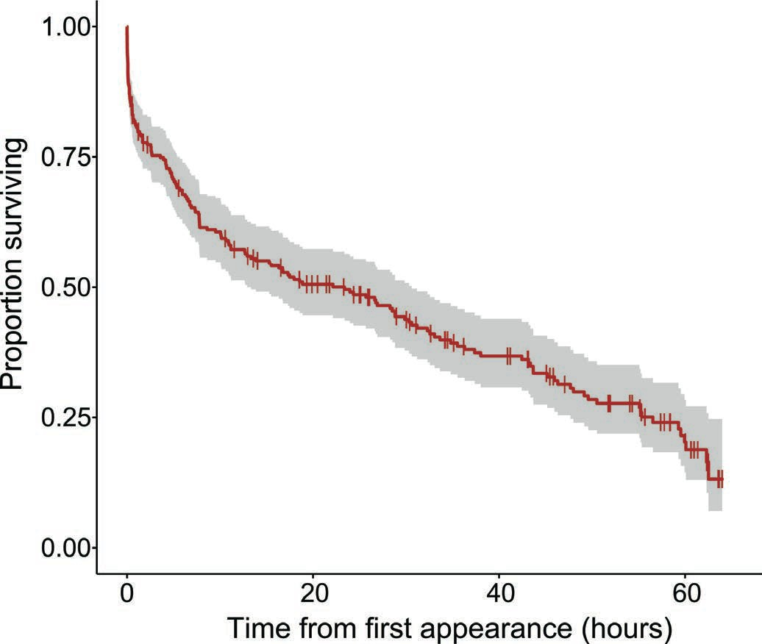
Example 2: Survival rates of characters in Game of Thrones.
Survival curve, male characters all 8 seasons

Slide 20
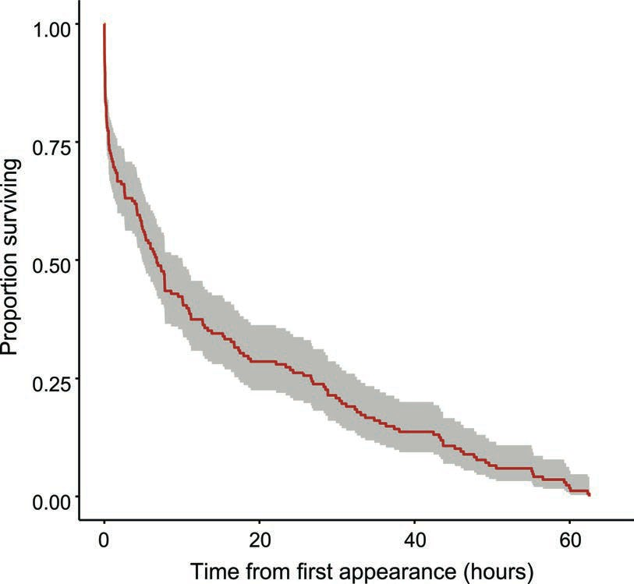
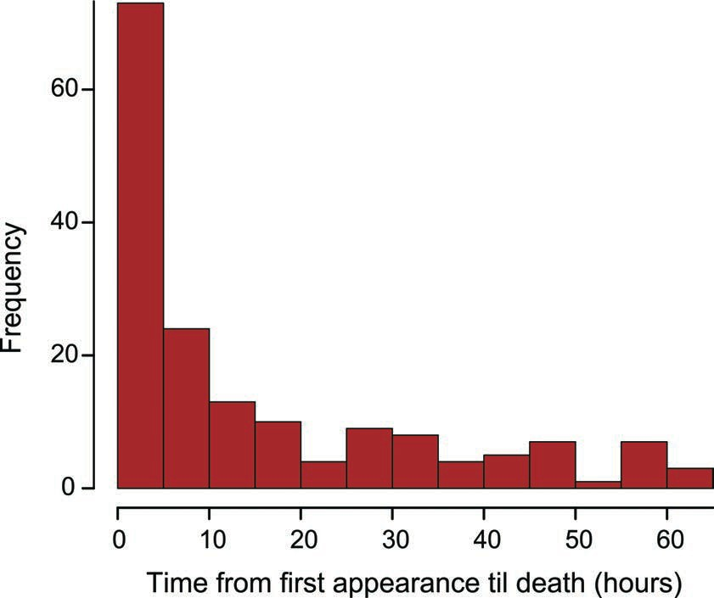
Example 2: Survival rates of characters in Game of Thrones.
Times til death of male characters known to have died by the end of 8 seasons

Slide 21
Example 2: Survival rates of characters in Game of Thrones.
The goal was to fit a model to the data that would allow us to estimate death rates.
We use the Weibull distribution, which is like the exponential distribution but allows a wider diversity of shapes. If the shape parameter λ = 1, then the death rate is constant over time. The Weibull distribution has two parameters λ and k.
No simple calculation will give the ML estimates of λ. What to do?
You can calculate log-likelihoods for a range of possible values for λ and k to find the maximum likelihood values.

Slide 22
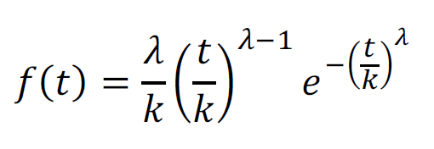
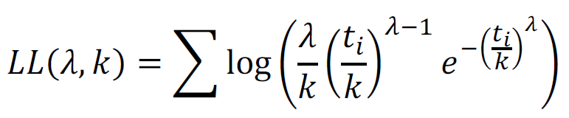
Example 2: Survival rates of characters in Game of Thrones.
Probability distribution
Log likelihood calculation
Using function in R
Loglike <- sum(dweibull(time.hrs, shape = λ, scale = k, log = TRUE))

Slide 23
Example 2: Survival rates of characters in Game of Thrones.
Since there are two parameters we’ll search over combinations of the two.
λ
k | 0.1 | 0.2 | 0.3 | 0.4 | 0.5 | 0.6 | 0.7 | 0.8 | 0.9 | 1
6 | -746.9967 | -644.5018 | -596.8230 | -574.5869 | -568.7294 | -575.6231 | -593.8734 | -623.2852 | -664.4679 | -718.6863
6.1 | -747.0068 | -644.5142 | -596.7977 | -574.4575 | -568.4026 | -574.9750 | -592.7432 | -621.4655 | -661.6929 | -714.6161
6.2 | -747.0172 | -644.5281 | -596.7769 | -574.3381 | -568.0948 | -574.3598 | -591.6659 | -619.7272 | -659.0390 | -710.7217
6.3 | -747.0279 | -644.5435 | -596.7604 | -574.2283 | -567.8052 | -573.7758 | -590.6388 | -618.0662 | -656.5002 | -706.9939
6.4 | -747.0388 | -644.5603 | -596.7481 | -574.1276 | -567.5329 | -573.2215 | -589.6595 | -616.4787 | -654.0705 | -703.4243
6.5 | -747.0499 | -644.5784 | -596.7397 | -574.0355 | -567.2770 | -572.6955 | -588.7258 | -614.9611 | -651.7446 | -700.0049
6.6 | -747.0612 | -644.5978 | -596.7349 | -573.9518 | -567.0368 | -572.1964 | -587.8354 | -613.5101 | -649.5175 | -696.7283
6.7 | -747.0727 | -644.6183 | -596.7338 | -573.8759 | -566.8116 | -571.7230 | -586.9863 | -612.1224 | -647.3844 | -693.5875
6.8 | -747.0844 | -644.6399 | -596.7359 | -573.8075 | -566.6005 | -571.2740 | -586.1766 | -610.7952 | -645.3408 | -690.5759
6.9 | -747.0963 | -644.6626 | -596.7413 | -573.7462 | -566.4031 | -570.8484 | -585.4044 | -609.5256 | -643.3826 | -687.6875
7 | -747.1083 | -644.6863 | -596.7497 | -573.6918 | -566.2186 | -570.4452 | -584.6682 | -608.3110 | -641.5057 | -684.9163
7.1 | -747.1205 | -644.7110 | -596.7610 | -573.6438 | -566.0465 | -570.0632 | -583.9662 | -607.1489 | -639.7065 | -682.2571
7.2 | -747.1329 | -644.7366 | -596.7751 | -573.6021 | -565.8863 | -569.7017 | -583.2969 | -606.0370 | -637.9815 | -679.7045
7.3 | -747.1453 | -644.7630 | -596.7918 | -573.5663 | -565.7374 | -569.3596 | -582.6590 | -604.9730 | -636.3273 | -677.2538
7.4 | -747.1579 | -644.7903 | -596.8110 | -573.5362 | -565.5993 | -569.0361 | -582.0510 | -603.9548 | -634.7408 | -674.9005
7.5 | -747.1706 | -644.8183 | -596.8327 | -573.5116 | -565.4715 | -568.7306 | -581.4717 | -602.9805 | -633.2191 | -672.6402
7.6 | -747.1835 | -644.8471 | -596.8566 | -573.4921 | -565.3537 | -568.4421 | -580.9198 | -602.0482 | -631.7593 | -670.4689
7.7 | -747.1964 | -644.8766 | -596.8827 | -573.4776 | -565.2454 | -568.1699 | -580.3943 | -601.1562 | -630.3589 | -668.3827
7.8 | -747.2094 | -644.9068 | -596.9109 | -573.4678 | -565.1463 | -567.9135 | -579.8939 | -600.3026 | -629.0152 | -666.3779
7.9 | -747.2225 | -644.9375 | -596.9411 | -573.4626 | -565.0558 | -567.6721 | -579.4178 | -599.4860 | -627.7260 | -664.4512

Slide 24

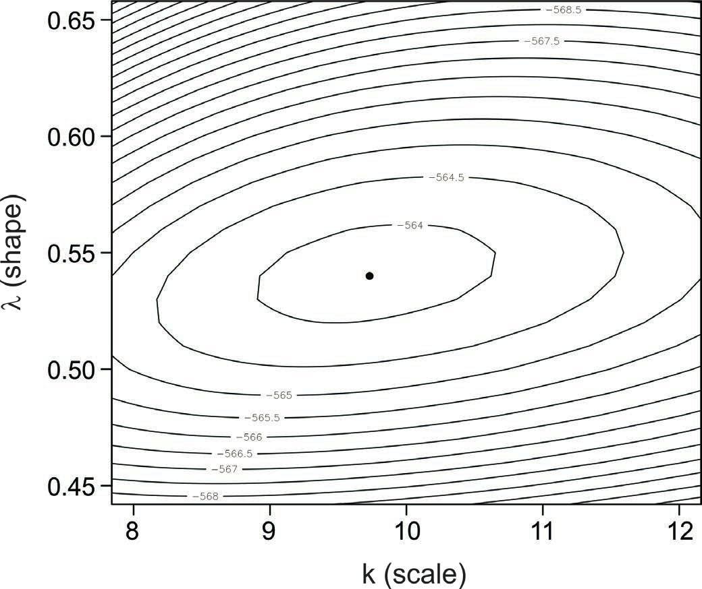
Example 2: Survival rates of characters in Game of Thrones.
The log-likelihood curve can be visualized as a surface
Found maximum likelihood estimates:

Slide 25
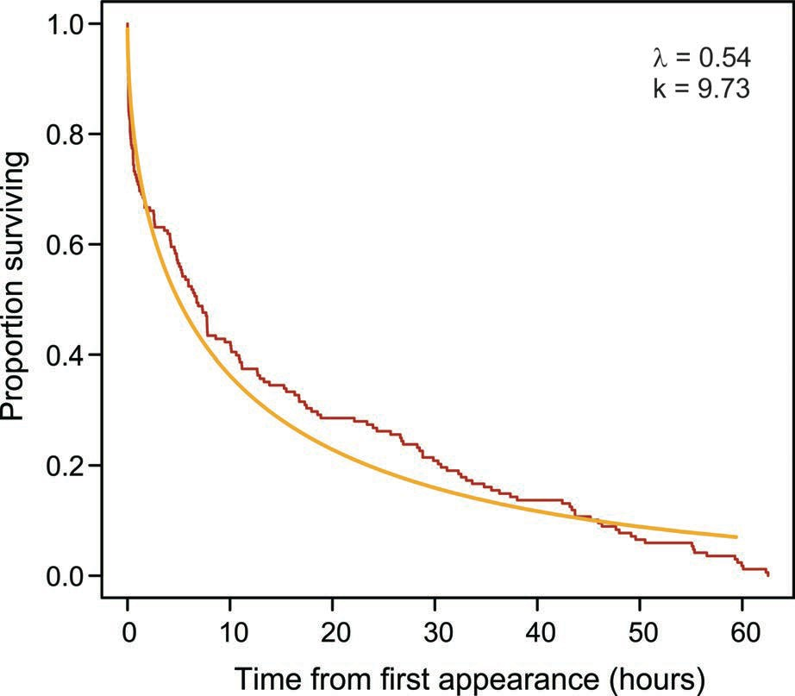
Example 2: Survival rates of characters in Game of Thrones.
Fit to survival curve of male characters who died.
λ < 1 means that mortality not constant, it declines with time
Biological interpretation: defectives are eliminated quickly, and the remaining men live a bit longer.

Slide 26
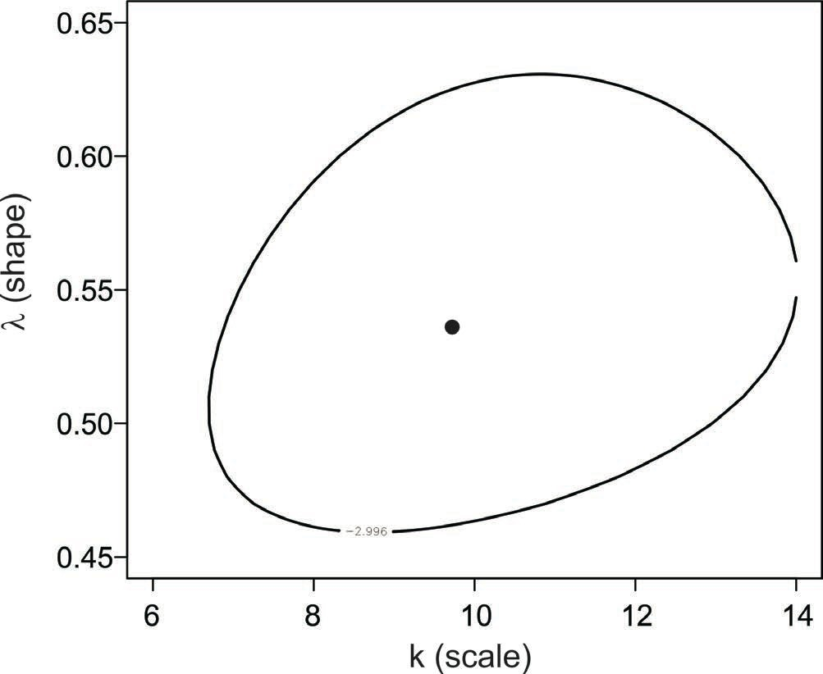
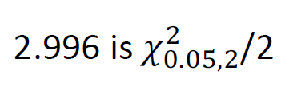
Example 2: Survival rates of characters in Game of Thrones.
Likelihood-based 95% confidence region
When estimating two parameters jointly, an approximate 95% confidence region along any one axis is obtained by the values corresponding to 2.996 log-likelihood units below the maximum
You can see that λ is between 0.46 and 0.62.

Slide 27
Example 2: Estimating speciation and extinction rates
We can calculate profile likelihood function: at every possible value for λ, find the maximum likelihood estimates of k, and plot the log-likelihood. This can be used to obtain a 95% confidence interval for λ by itself:
0.47 < λ < 0.61.
The 95% confidence interval is an approximation based on χ². It assumes that sample size is "large".
R has many tools for calculating maximum likelihood estimates and confidence intervals.
The {survival} package in R can be used to fit models to survival curves that include "censored data" (data on individuals whose time of death is not known). These lead to similar estimates to the values estimated here.

Slide 28
Log-likelihood ratio test
Likelihood method to compare the fit of two models to data.
Models must be nested, i.e., one of the models (reduced model) must have a subset of the terms present in the other model (full model).
Tests whether the “full model” fits the data statistically significantly better than a “reduced model”.
Very general method – applies to any type of data, not necessarily normally distributed.
P-value is approximate, but approximation improves with sample size.

Slide 29
Log-likelihood ratio test
𝐿[full model | data]
𝐿[reduced model | data]
𝐺 = 2 ln
G is the log-likelihood ratio test statistic.
Under H0, G is approximately χ² distributed.
Degrees of freedom are equal to the difference between the full model and the reduced model in the number of parameters estimated from the data.
Very general method – applies to any data.
The approximation to the χ² distribution improves with increasing sample size.

Slide 30

Example 1: Fatouros et al. (2005) carried out trials to determine whether the wasps can distinguish mated female butterflies from unmated females. In each trial, a single wasp was presented with two female cabbage white butterflies, one a virgin female, the other recently mated. Results: 23 successes out of n = 32 trials.
Log-likelihood ratio test
“Reduced” model:
H0: Wasps choose mated and unmated females with equal probability (p = 0.5)
“Full” model:
HA: Wasps prefer one type of female over the
other (p ≠ 0.5)
To fit the full model, p is estimated from the data. In this sense, the full model has 1 more term than the reduced model.

Slide 31
Log-likelihood ratio test
𝐿[full model | data]
𝐿[reduced model | data]
𝐺 = 2 ln
Applied to the wasp example:
_{𝐺 = 2 ln} 𝐿[𝑝 = 𝑝̂ = 0.72 | 23 of 32 chose mated female]
𝐿[𝑝 = 𝑝_{M} = 0.50| 23 of 32 chose mated female]
A parameter estimated from the data uses the maximum likelihood estimate (e.g., 𝑝̂ = 0.72 in the full model here).

Slide 32
Log-likelihood ratio test
From calculations using formulae shown earlier,
𝐿[0.72 | 23 of 32 chose mated female] = 0.1553
𝐿[0.50 | 23 of 32 chose mated female] = 0.00653
𝐺 = 2 ln ^{0.1553} = 6.336
0.00653
df = 1, so the critical value χ² = 3.841
Since 6.336 > 3.841, we reject H0.

Slide 33
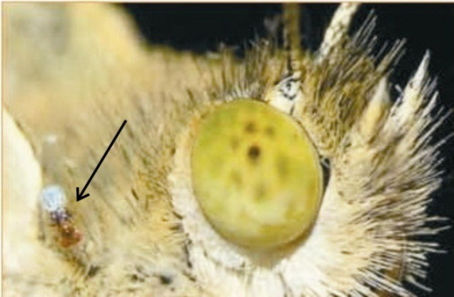
Wasp example: finale
The chemical that the wasps use to distinguish mated from unmated females is benzyl cyanide, which the male butterfly passes to the female during mating. The compound is an “anti-aphrodisiac”, rendering the mated female less attractive to other male butterflies (Fatouros et al. 2005).

Slide 34
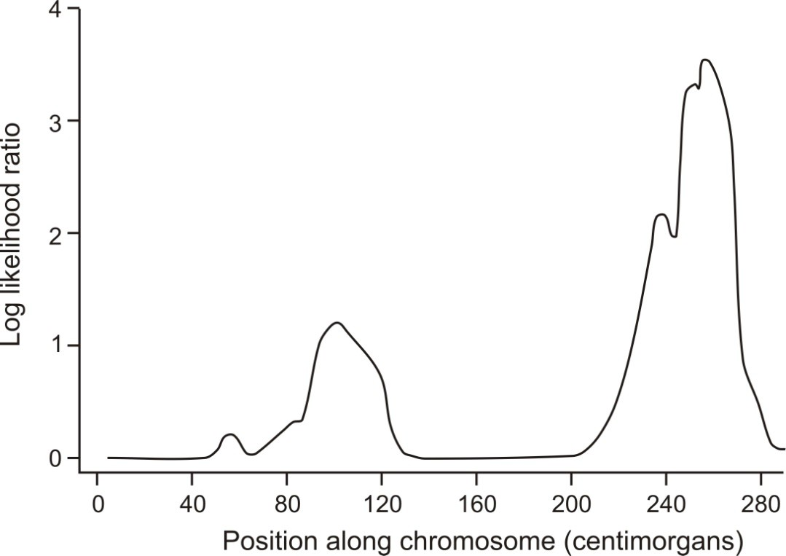
At each marker along the chromosome two models are fitted to data on healthy and diseased individuals. The “reduced model” assumes that the frequency of healthy and diseased individuals is the same for every genotype. The “full model” assumes that some genotypes are associated with a higher frequency of diseased individuals than other genotypes. The log of the ratio of the likelihoods of the two models (“full” divided by “reduced”) is called the LOD score, and is a measure of the strength of evidence for a causative mutation near the marker.
Log-likelihood ratios are used in gene mapping
Evidence for a gene affecting schizo-affective disorder on human chromosome 1.

Slide 35
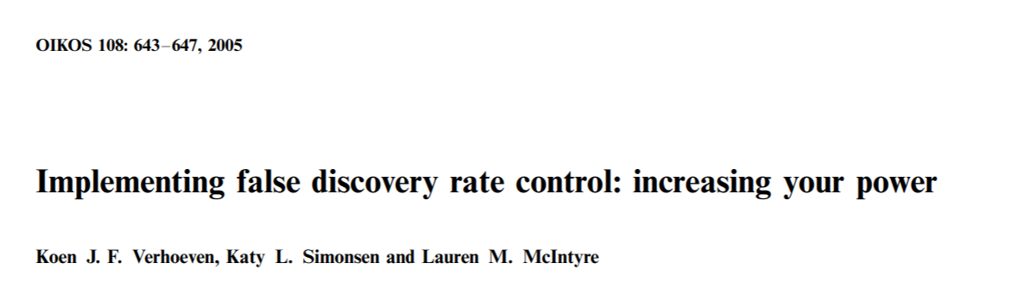
Suggested reading:
Verhoeven, K.J.F., Simonsen, K.L., McIntyre, L.M., 2005. Implementing false discovery rate control: increasing your power. Oikos 108, 643–647. https://doi.org/10.1111/j.0030-1299.2005.13727.x

