Slide 1
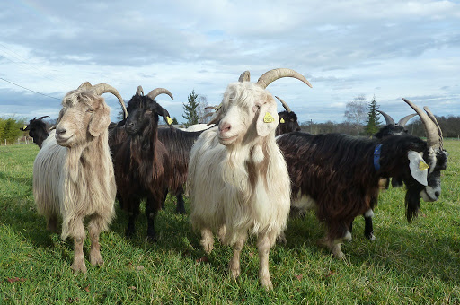
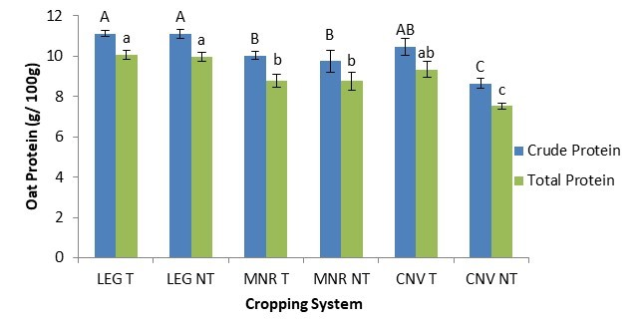

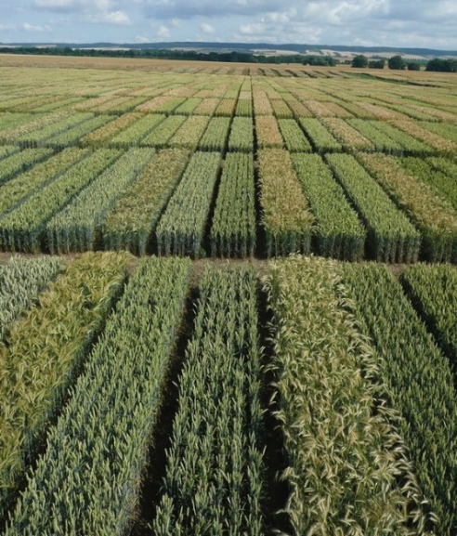

C7041 Experimental Design and Analysis
Ed Harris

Slide 2

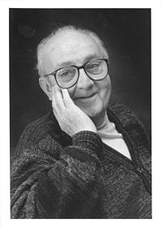
2.08: Model selection
“All models are wrong, but some are useful”
-George Box

Slide 3
Outline
Example 1: polynomial regression – which degree is best?
The problem of model selection
Choose among models using an explicit criterion
Goals of model selection
AIC criterion
Search strategies: dredge(); stepAIC()
Example 2: Predicting ant species richness
Several models may fit about equally well
The science part: formulate a set of candidate models
Example 3: Adaptive evolution in the fossil record

Slide 4
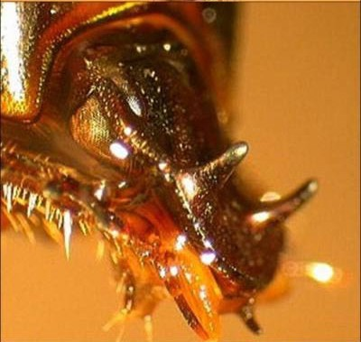
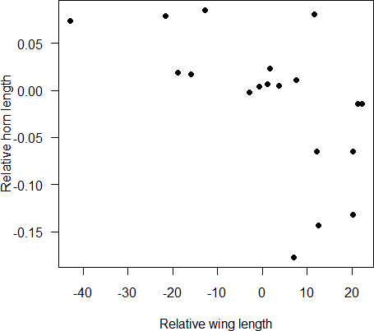
Example 1: Fit a polynomial regression model – which degree is best?
Data: Trade-off between the sizes of wings and horns in 19 females of the beetle
Onthophagus sagittarius. Both variables are size corrected.
Emlen, D. J. 2001. Costs and the diversification of exaggerated animal structures. Science 291: 1534-1536.

Slide 5
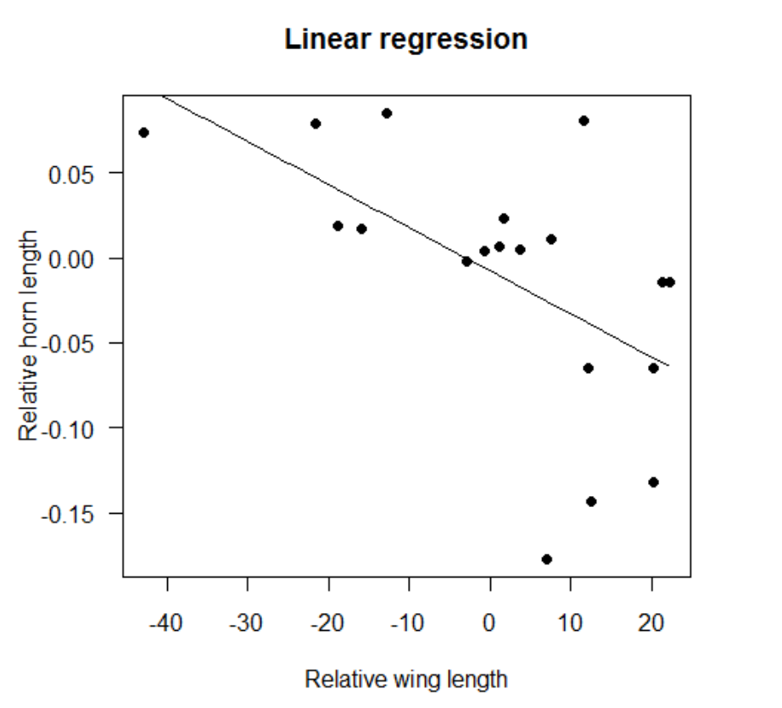
Example 1: Fit a polynomial regression model – which degree is best?
Start with a linear regression

Slide 6
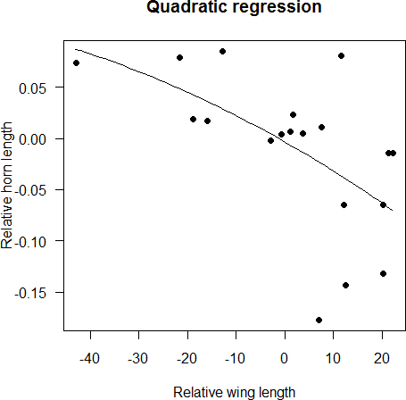
Example 1: Fit a polynomial regression model – which degree is best?
Why not a quadratic regression instead (polynomial degree 2)

Slide 7
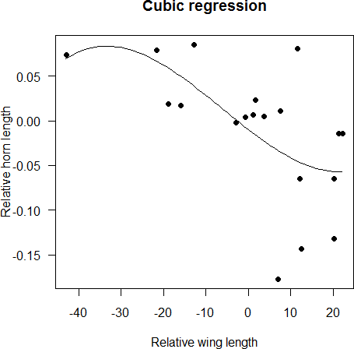
Example 1: Fit a polynomial regression model – which degree is best?
How about a cubic polynomial regression (degree 3)

Slide 8
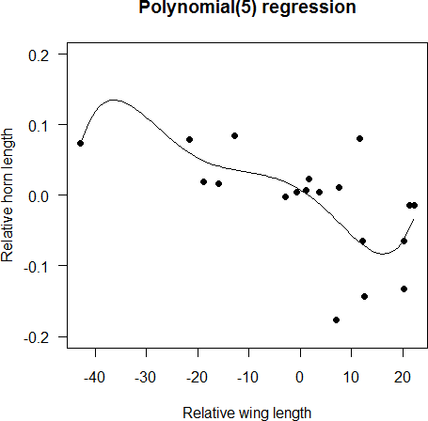
Example 1: Fit a polynomial regression model – which degree is best?
Better still, a polynomial degree 5

Slide 9
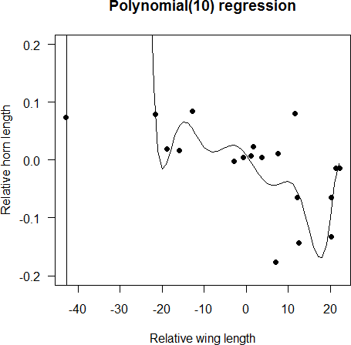
Example 1: Fit a polynomial regression model – which degree is best?
A polynomial, degree 10

Slide 10
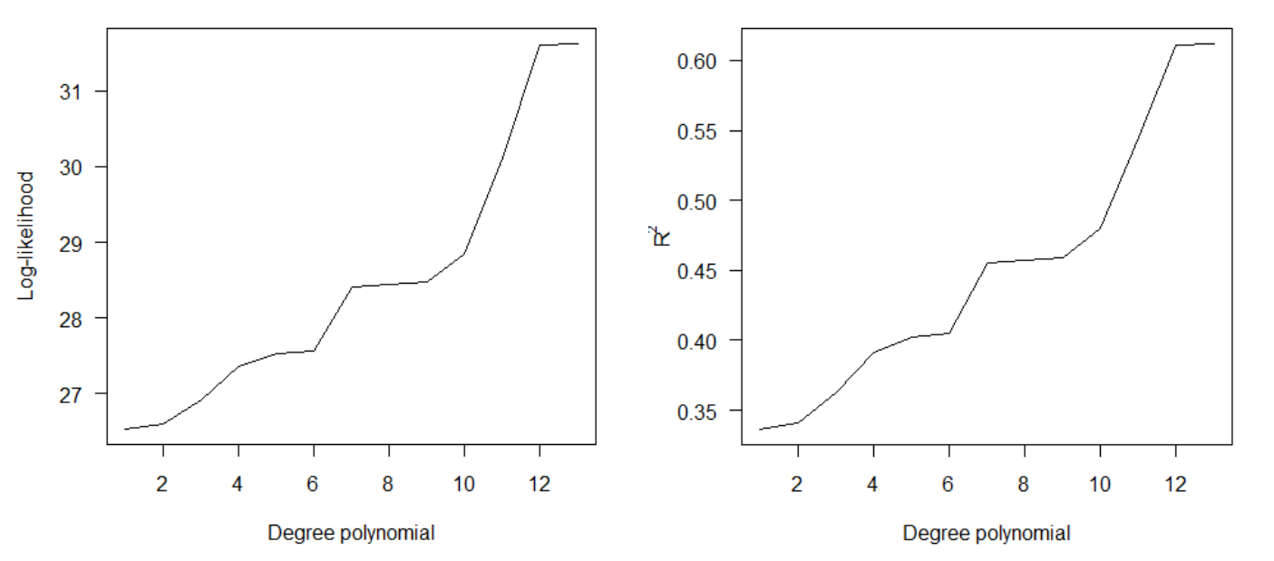
The problem of model selection
R² and log-likelihood increase with number of parameters in model.
Isn’t this good? Isn’t this what we want – the best fit possible to data?

Slide 11
The problem of model selection
What is wrong with this picture?

Slide 12
The problem of model selection
Does it violate some principle?
Parsimony principle: Fit no more parameters than is necessary. If two or more models fit the data almost equally well, prefer the simpler model.
“models should be pared down until they are minimal adequate”
-- Crawley 2007, p325
But how is “minimal adequate” decided? What criterion is used?

Slide 13
The problem of model selection
Stepwise multiple regression, using stepwise elimination of terms, is a common practice
This approach involves fitting a multiple regression with many variables, followed by a cycle of deleting model terms that are not statistically significant and then refitting. Continue until only statistically significant terms remain.
The procedure ends us up with a single, final model, the “minimum adequate model.”

Slide 14
Does stepwise elimination of terms actually yield the “best” model?
What criterion are we actually using to decide which model is “best”?
Each step in which a variable is dropped from the model involves “accepting” a null hypothesis. What happens if we drop a false null hypothesis? How can a sequence of Type 2 errors lead us to the “best” model?
How repeatable is the outcome of stepwise regression? With a different sample, would stepwise elimination bring us to the same model again?
Might models with different subsets of variables fit the data nearly as well?

Slide 15
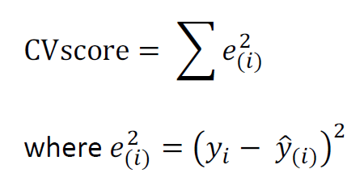
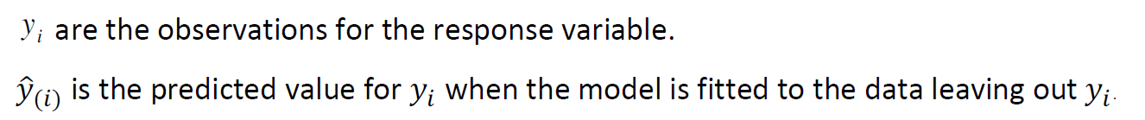
Alternative: choose among models using an explicit criterion
A reasonable criterion: choose the model that predicts best.
“Cross-validation score” is one way to measure prediction error:
A larger CV score corresponds to a worse prediction (more prediction error).

Slide 16
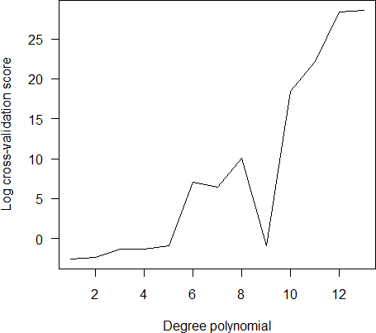
Choose among models using an explicit criterion
In our beetle example, the CVscore increases (prediction error worsens) with increasing numbers of parameters in the model. Here, the simple linear regression was “best”. But some other polynomials do nearly equally well.

Slide 17
What determines prediction errors?
You might think that prediction errors worsen as models become more complicated because the more complicated models are wrong. This is not correct.
Prediction errors result from a combination of bias and sampling error (sampling variance). These two quantities trade off (the bias-variance tradeoff).
The coefficients of the simplest model are likely to be biased, because the model includes too few terms (compared to the true model in nature). But these coefficients are relatively well estimated (low sampling variance).
The coefficients of the most complex models have low bias (their long-run averages are close to their true values), but these coefficients are poorly estimated (high sampling variance).
Prediction error is minimized somewhere in between.

Slide 18
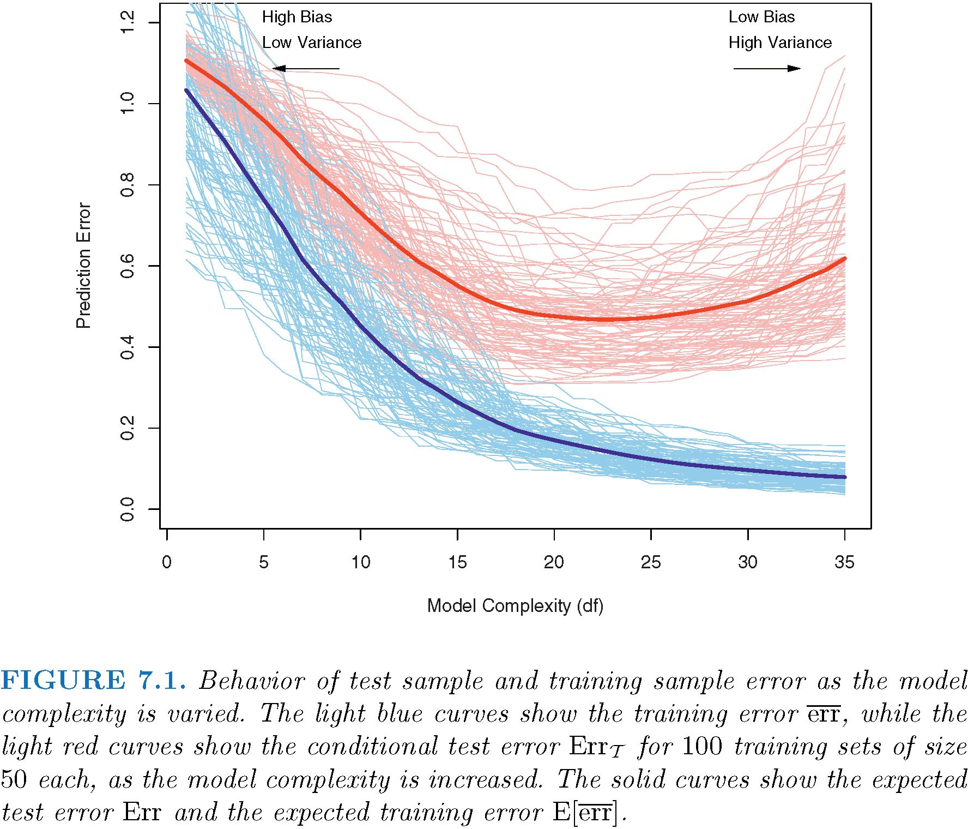
What determines prediction errors?
The simplest models have low variance but high bias resulting from missing terms.
The most complex models have low bias but high variance resulting
from estimating too many parameters (“overfitting”) with limited data.
Training error: how well a model fits the data used to fit the model.
Test error: how well a model fits a new sample of data.
Hastie et al. (2009)

Slide 19
The problem of model selection
What else is worrying about my polynomial regression analysis:
I’m “data dredging”. I didn’t have any hypotheses to help guide my search. This too can lead to non- reproducible results.
E.g., my 9th degree polynomial is surprisingly good at prediction.
But is there any good, a priori reason to include it among the set of candidate models to evaluate?

Slide 20
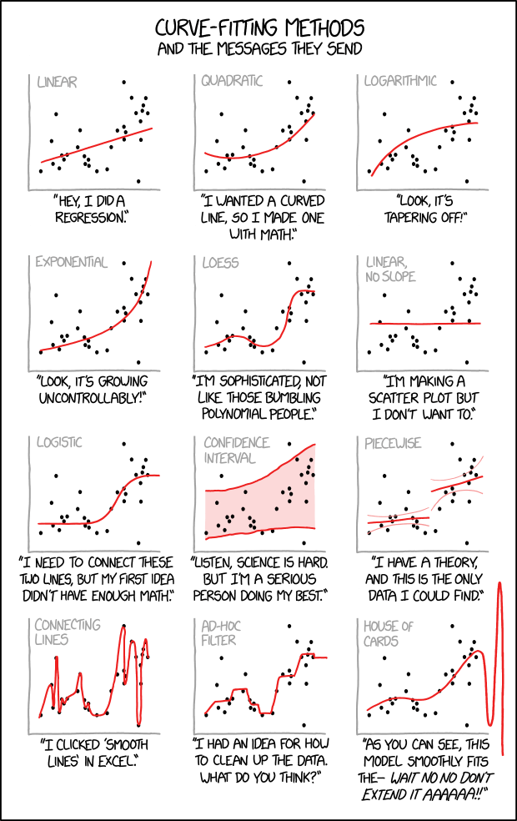
xkcd.com/2048

Slide 21
Goals of model selection
Some reasonable objectives:
A model that predicts well.
A model that approximates the true relationship between the variables.
A set of models that fit the data nearly as well as the “best” model.
To compare non-nested* models, not just compare each “full” model to “reduced” models having a subset of its terms.
*Reduced vs. full models are referred to as “nested models”, because the one contains a subset of the terms occurring in the other. Models in which the terms contained in one are not a subset of the terms in the other are called “non-nested” models. (Don’t confuse with nested experimental designs or nested sampling designs.)

Slide 22
Goals of model selection
To accomplish these goals, we need a model selection approach that includes:
A criterion to compare models:
CVscore
AIC (Akaike’s Information Criterion)
BIC (Bayesian Information Criterion)
A strategy for searching the candidate models
Typically we are modeling observational data. We are not dealing with data from an experiment, where we can make intelligent choices based on the experimental design.

Slide 23
AIC (Akaike’s Information Criterion)
Criterion: minimize AIC.
AIC = −2 ln 𝐿(model | data) + 2𝑘
k is the number of parameters estimated in the model (including intercept and σ ²) First part of AIC is the log-likelihood of the model given the data.
Second part is 2k, which acts like a penalty – the price paid for including k variables in the model (this is an interpretation, not why the 2k is part of the formula).
Just as with the log-likelihood, what matters is not AIC itself but the difference between models in their AIC.

Slide 24
AIC (Akaike’s Information Criterion)
AIC = −2 ln 𝐿(model | data) + 2𝑘
AIC is an estimate of the expected distance (“information lost”) between the fitted model and the “true” model.
There are two reasons why a model fitted to data might depart from the truth.
Bias: The fitted model may contain too few parameters, underestimating the complexity of reality.
Variance: There is not enough data to yield good estimates of many parameters, leading to high sampling error (low precision).
AIC yields a balance between these two sources of information loss.

Slide 25
Example 2: Ant species richness
Data: Effects of latitude, elevation, and habitat on ant species richness.
Gotelli, N.J. & Ellison, A.M. (2002b). Biogeography at a regional scale: determinants of ant species density in bogs and forests of New England. Ecology, 83, 1604–1609.
 | site | nspecies | habitat | latitude | elevation
1 | TPB | 6 | forest | 41.97 | 389
2 | HBC | 16 | forest | 42.00 | 8
3 | CKB | 18 | forest | 42.03 | 152
4 | SKP | 17 | forest | 42.05 | 1
...
23 | TPB | 5 | bog | 41.97 | 389
24 | HBC | 6 | bog | 42.00 | 8
25 | CKB | 14 | bog | 42.03 | 152
26 | SKP | 7 | bog | 42.05 | 1
...
n = 44 sites
(Bog and forest sites were technically paired by latitude and elevation, but residuals were uncorrelated, so we’ll follow authors in treating data as independent for the purposes of this exercise)

Slide 26
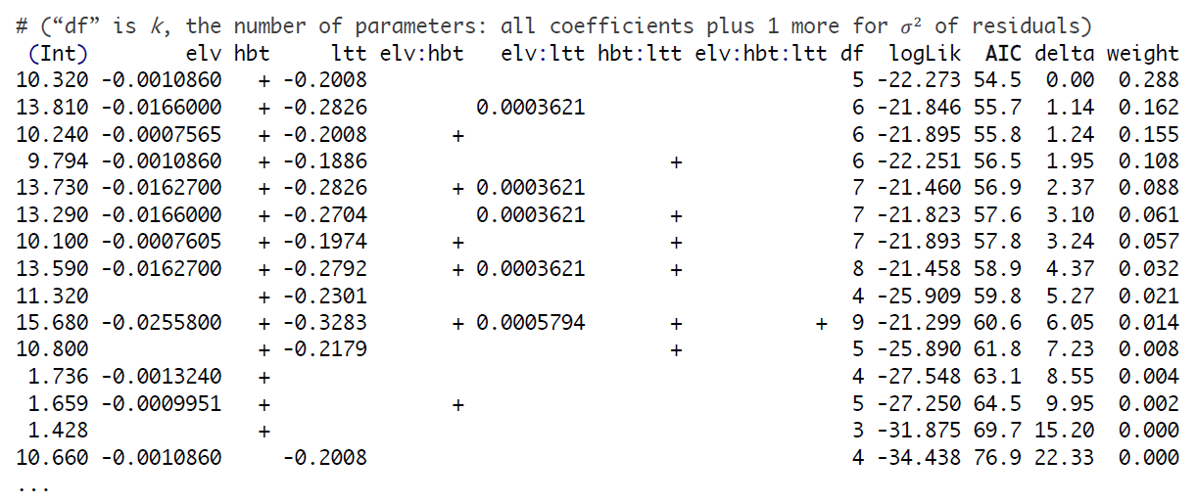
Example 2: Ant species richness
dredge() in MuMIn package in R. Provide model with all desired terms: zfull <- lm(log(nspecies) ~ habitat * latitude * elevation) zdredge <- dredge(zfull, evaluate = TRUE, rank = "AIC")
# Model selection table (variable names abbreviated; "+" refers to categorical term)

Slide 27
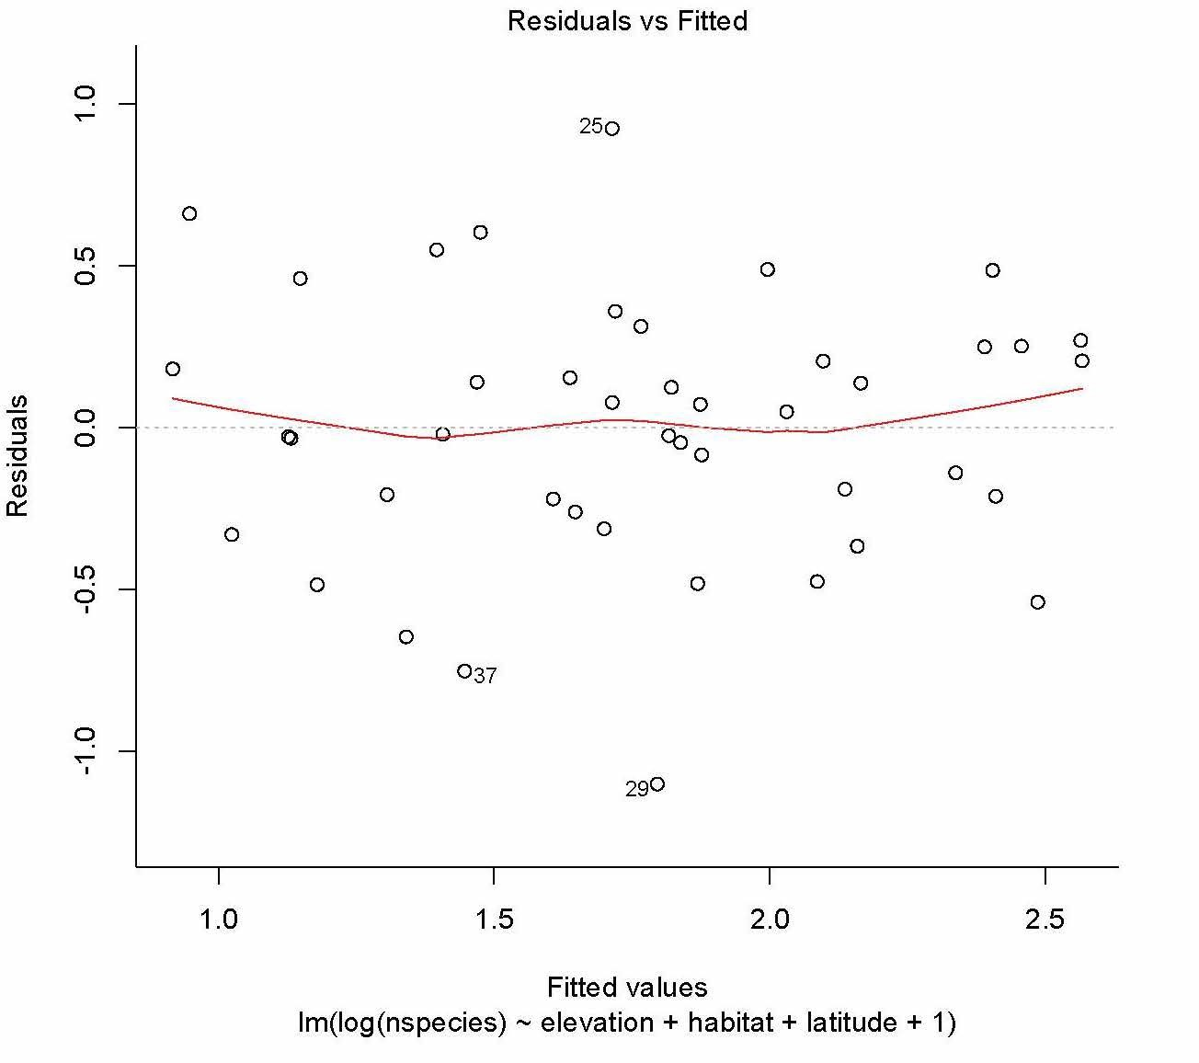
Example 2: Ant species richness
“Best” model (smallest AIC) is the model with the three additive terms Habitat, Latitude, and Elevation.
z <- lm(log(nspecies) ~ habitat + latitude + elevation)
 | Estimate | Std. Error | t | value | Pr(>|t|)
(Intercept) | 10.3180285 | 2.6101963 |  | 3.953 | 0.000306 | ***
habitat | 0.6898845 | 0.1269432 |  | 5.435 | 2.94e-06 | ***
latitude | -0.2007838 | 0.0609920 |  | -3.292 | 0.002085 | **
elevation | -0.0010856 | 0.0004049 |  | -2.681 | 0.010610 | *

Slide 28
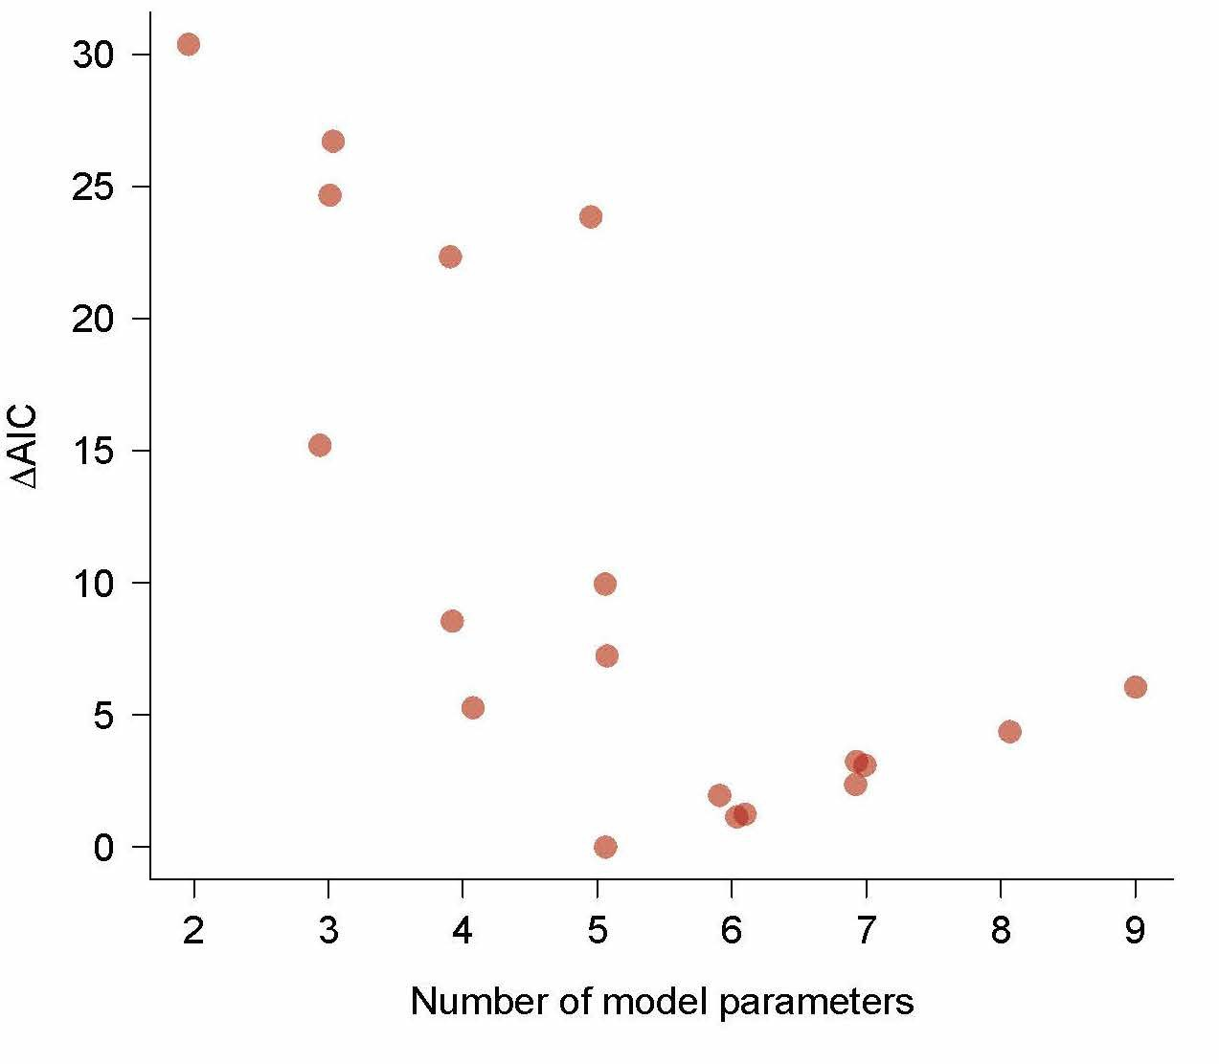
Example 2: Ant species richness
Each dot refers to a model.
AIC difference (Δ) is the difference between a model’s AIC score and that of the “best” model.
The best model has 5 parameters
But a few other models fit the data nearly as well.
AIC difference (Δ) support 0 – 2 Substantial support
4 – 7 Considerably less support
10 Essentially no support

Slide 29
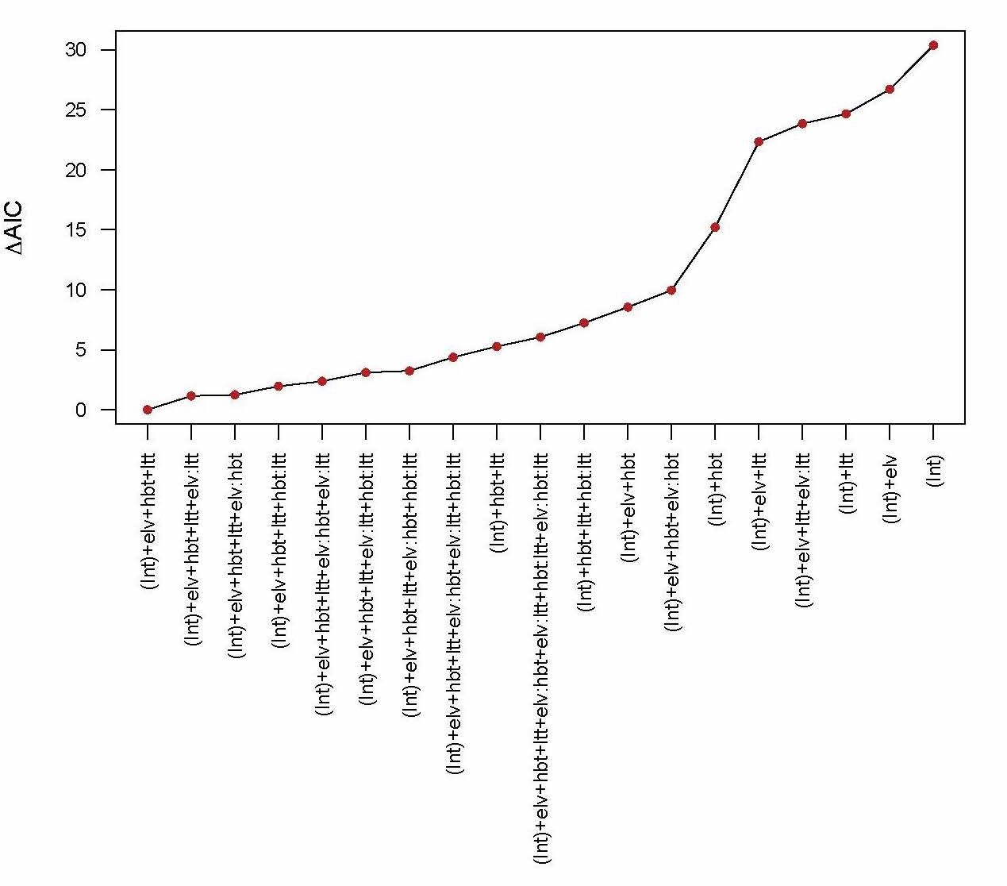
Example 2: Ant species richness
AIC difference (Δ) support 0 – 2 Substantial support
4 – 7 Considerably less support
10 Essentially no support
A cutoff based on AIC score can be used to generate a “95% confidence set of models”, analogous to a 95% confidence interval for a parameter.

Slide 30
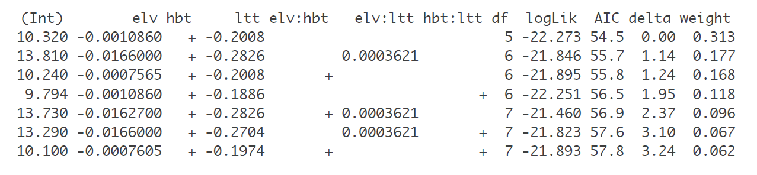
Example 2: Ant species richness
Another way to form a “95% confidence set of models”, analogous to a 95% confidence interval for a parameter, is to use cumulative model weights.
AIC weights measure support that a given model is the “best” model, assuming that the “best” model is one of the set of models being compared.
subset(zdredge, cumsum(zdredge$weight) <= .95)

Slide 31
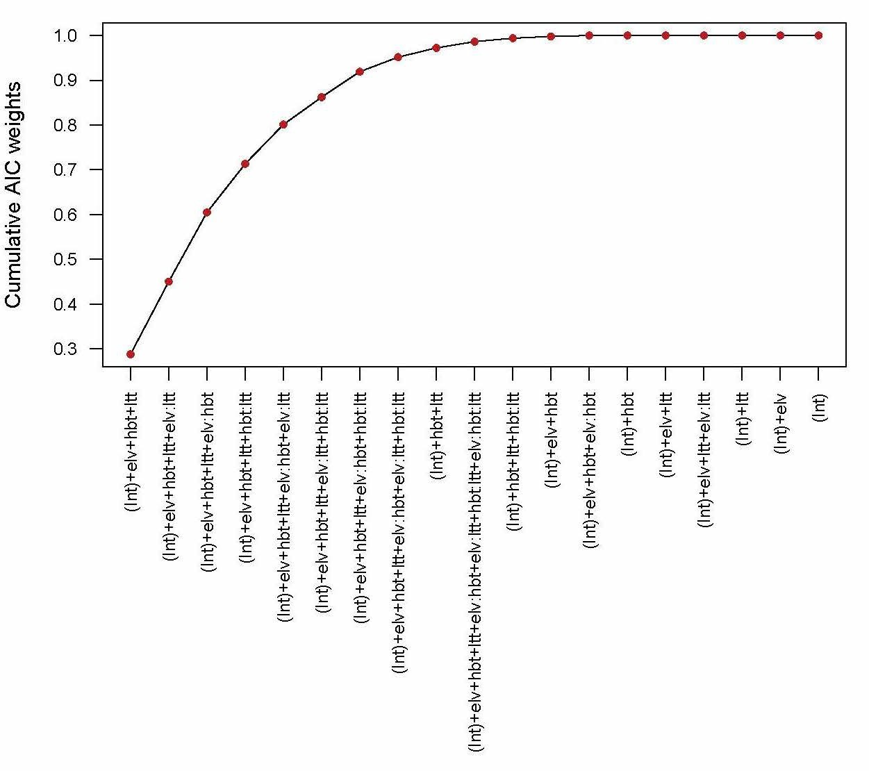
Example 2: Ant species richness
Another way to form a “95% confidence set of models”, analogous to a 95% confidence interval for a parameter, is to use cumulative model weights.

Slide 32
Example 2: Conclusions
If regression is purely for prediction, all of the models with relatively small ΔAIC predict about equally well. This means there’s no reason to get carried away with excitement over a single “best” model. Present the confidence set of models, the same way you would a confidence interval for a parameter.
The interpretation is more complex if regression is used for explanation. If numerous models are nearly equally good at fitting the data, it is difficult to claim to have found the predictors that “best explain” the response.
Keep in mind that, like correlation, “regression is not causation”. It is not possible to find the true causes of variation in the explanatory variable without experimentation.

Slide 33
AIC (Akaike’s Information Criterion)
Search strategies:
One method is a stepwise procedure for selection of variables implemented by stepAIC in the MASS library in R. Another is dredge() in the MuMIn package, which searches all subsets while obeying restrictions.
Both methods obey restrictions. Not all terms are on equal footing. E.g.,
Squared term x² is not fitted unless x is also present in the model
the interaction a:b is not fitted unless both a and b are also present
a:b:c not fitted unless all two-way interactions of a, b, c, are present
However, keep in mind that we are data dredging. The only intelligent decision we’ve made is the choice of variables to include in our dredge. No other scientific insight was used to decide an a priori set of models.

Slide 34
How AIC differs from classical statistical approaches
No hypothesis testing.
No null model. No P-value.
No model is formally “rejected”.

Slide 35
How AIC differs from classical statistical approaches
Several models may be about equally good.
Your “best” model isn’t necessarily the true model. This is because AIC balances the bias-variance trade-off. It does a good job to minimize information loss, on average.

Slide 36
How AIC differs from classical statistical approaches
Model uncertainty
AIC difference (Δ) support 0 – 2 Substantial support
4 – 7 Considerably less support
10 Essentially no support
The reason for model uncertainty is sampling error. Keep in mind that the data being used to select the “best” model is sampled from a population, and would be different if we returned to that same population for another sample.
Think of all the models that have some support as constituting a “confidence set” of models, analogous to a confidence interval when estimating a parameter.

Slide 37
How AIC differs from classical statistical approaches
Going further: Multimodel Inference
Multimodel Inference allows inferences to be made about a parameter based on a set of models that are ranked and weighted according to level of support from the data. It avoids the need to base inference solely conditional upon the single “best” model.
“Model averaging” is an example: a model-average estimate takes a weighted estimate of the parameter estimates from each model deemed to have sufficient support.
Implemented in MuMIn package in R. The best source for further information is
Burnham, K. P., and D. R. Anderson. 2002. Model selection and multimodel inference: a practical information-theoretic approach. 2nd. New York, Springer

Slide 38
Avoid data-dredging by formulating a set of candidate models
The information-theoretic approach shows it true advantage when comparing alternative conceptual or mathematical models to data
This is where data dredging ends and science begins.
No model is considered the “null” model. Rather, all models are evaluated on the same footing.

Slide 39
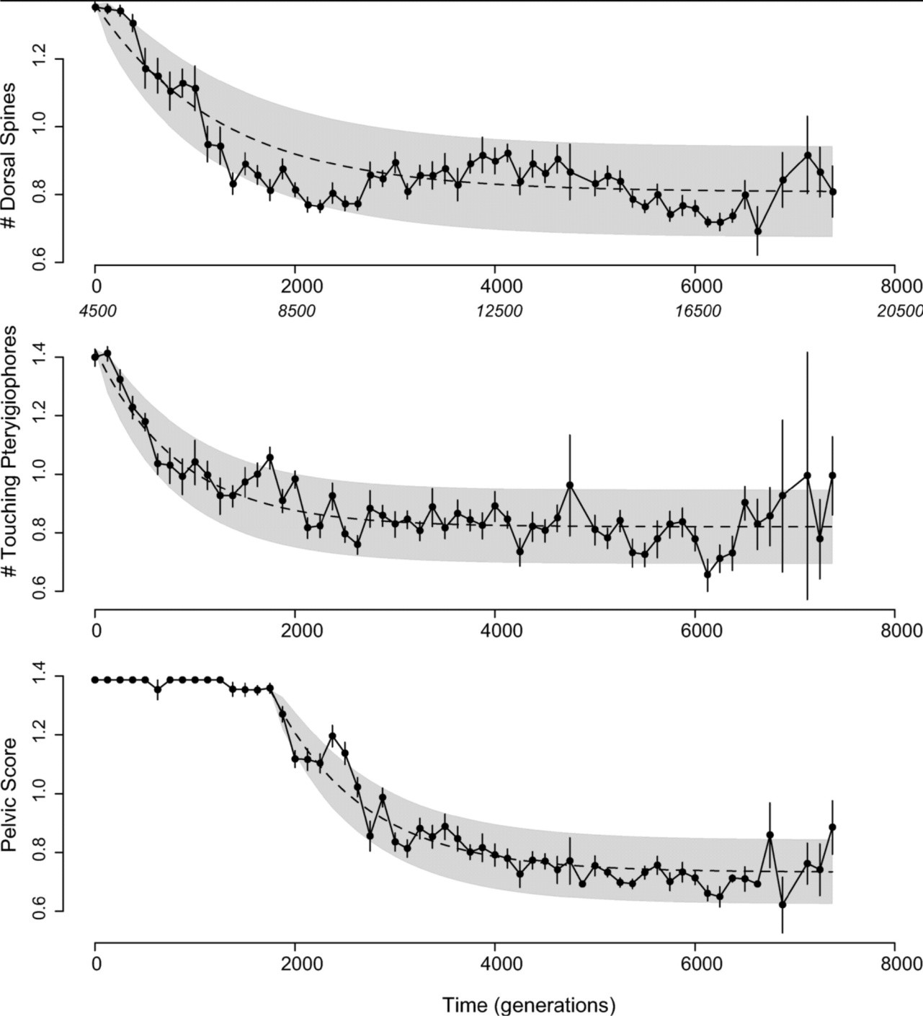
Example 3: Adaptive evolution in the fossil record
Data: Armor measurements of 5000 fossil Gasterosteus doryssus (threespine stickleback) from an open pit diatomite mine in Nevada.
Time=0 corresponds to the first appearance of a highly-armored form in the fossil record.
G. Hunt, M. A. Bell & M. P Travis 2008,
Evolution 62: 700–710.

Slide 40

Example 3: Adaptive evolution in the fossil record
A previous analysis was not able to reject a null hypothesis of random drift in the trait means.
1 generation = 2 years

Slide 41
Example 3: Adaptive evolution in the fossil record
Hunt et al used the AIC criterion to compare the fits of two evolutionary models fitted to the data.
Neutral random walk (like Brownian motion)
Two parameters need to be estimated from the data: 1) initial trait mean; 2) variance of the random step size each generation.
Adaptive peak shift (Orstein–Uhlenbeck process)
Four parameters to be estimated: 1) initial trait mean; 2) variance of the random step size each generation; 3) phenotypic position of a single “optimum”; 4) strength of the “pull” toward the optimum.

Slide 42
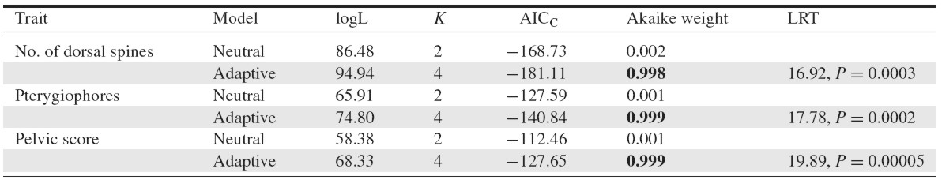
Example 3: Adaptive evolution in the fossil record
Results: AIC difference (Δ) of neutral model is large (no support)
The adaptive model beats neutral drift for all three traits.
Akaike weight is the weight of evidence in favor of a model being the best model among the set being considered, and assuming that one of the models in the set really is the best. A 95% confidence set of models is obtained by ranking the models and summing the weights until the cumulative sum reaches 0.95.

Slide 43

Example 3: Adaptive evolution in the fossil record
Stepping back from the model selection approach, the authors showed that the adaptive model rejects neutrality in a likelihood ratio test (here the models are not on equal footing – one of them, the simpler, is set as the null hypothesis).
This suggests that even under the conventional hypothesis testing framework, specifying 2 specific candidate models is already superior to an approach in which the alternative hypothesis is merely “everything but the null hypothesis.”

Slide 44
Conclusions
Stepwise elimination of terms and null hypothesis significance testing is not the ideal approach for model selection. Information-theoretic approaches have explicit criteria and better properties.
Using this approach involves giving up on P-values.
These IT approaches work best when thoughtful science is used to specify the candidate models under consideration before testing (minimizing data dredging).
Working with a set of models that fit the data about equally well, rather than with the one single best model, recognizes that there is model uncertainty.
If you want more certainty about which variables cause variation in the response variable, then you will need to do an experiment.

Slide 45
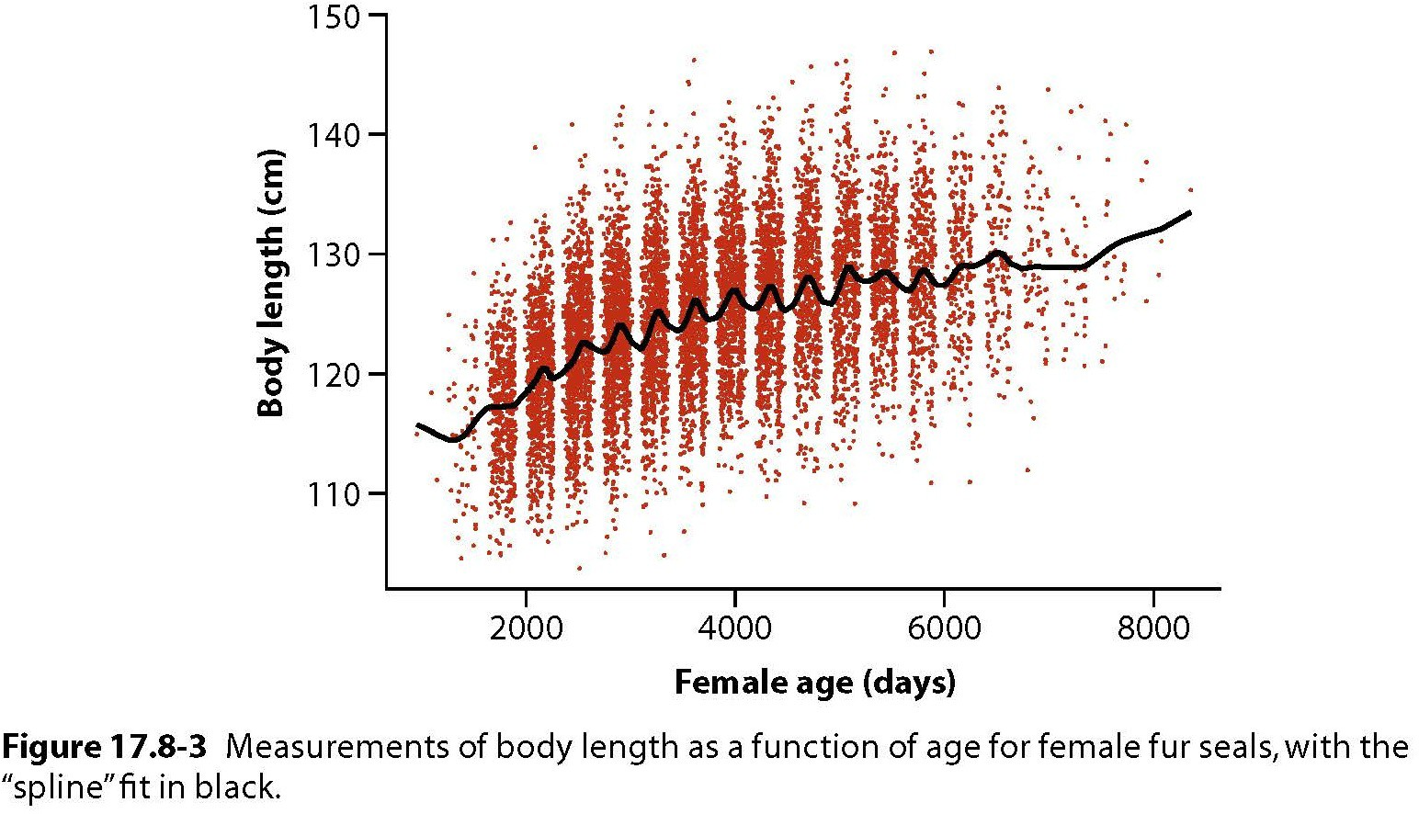
Digression: Exploring your data can be good

Slide 46
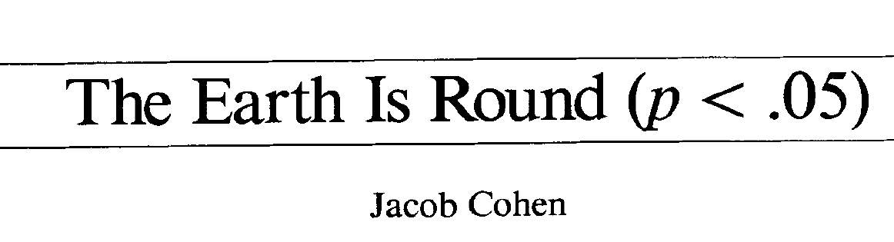
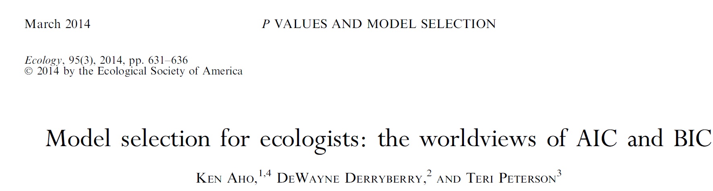
Suggested reading
Aho, K., Derryberry, D., Peterson, T., 2014. Model selection for ecologists: the worldviews of AIC and BIC. Ecology 95, 631–636. https://doi.org/10.1890/13-1452.1
Cohen, J., 1994. The earth is round (p < .05). 49, 997–1003. https://doi.org/doi=10.1037%2F0003-066X.49.12.997

