Slide 1
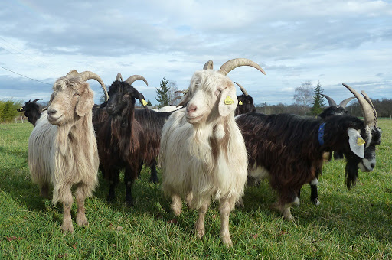
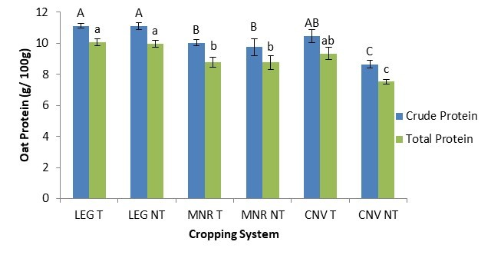

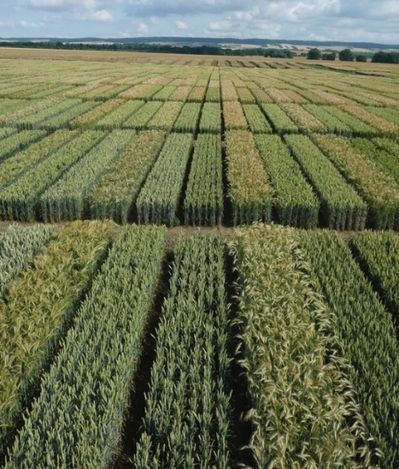

C7041 Experimental Design and Analysis
Ed Harris

Slide 2
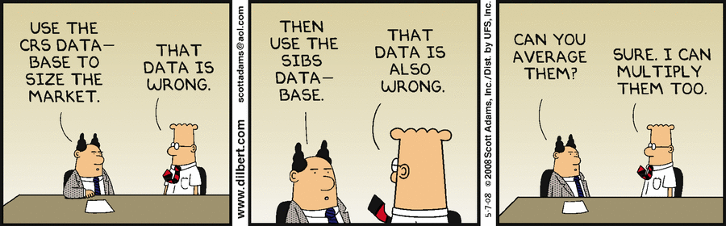
1.03 Describing data

Slide 3
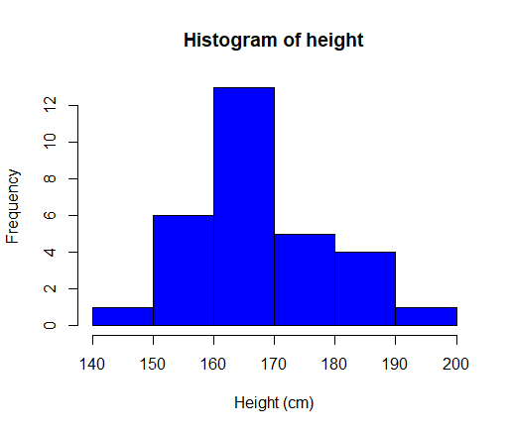
Two common descriptions of data
Central tendency (or Frequency)
Width (or spread)
hist(height,
col="blue",
xlab = "Height (cm)")

Slide 4
Measures of central tendency
Mean
Median
Mode

Slide 5
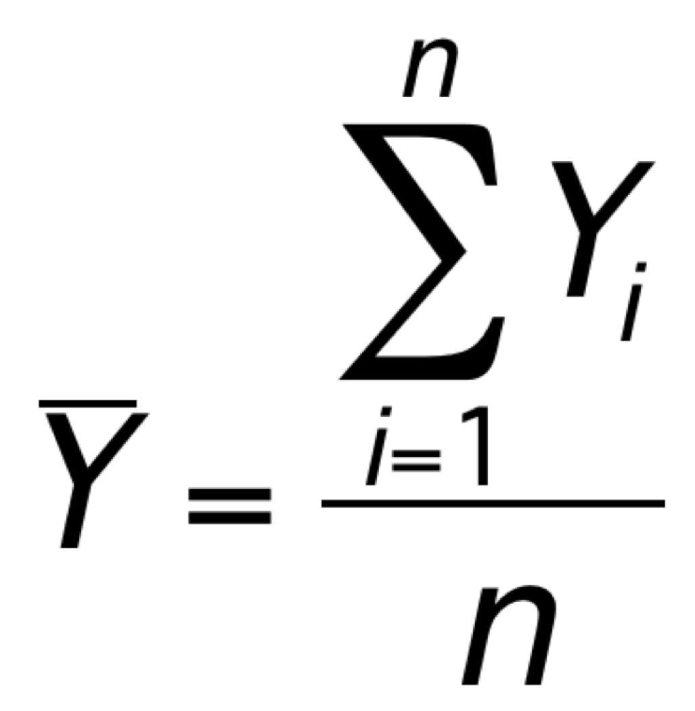
Mean
n is the size of the sample
Y_{i} are the individual measures of observation i

Slide 6
Mean
Y₁ = 56, Y₂ = 72, Y₃ = 18, Y₄ = 42
Mean = (56+72+18+42) / 4 = 47

Slide 7
Median
The median is the middle measurement in a set of ordered data.

Slide 8
Median
The data:
18 28 24 25 36 14 34
Can be put in order:
14 18 24 25 28 34 36
The median is 25.

Slide 9
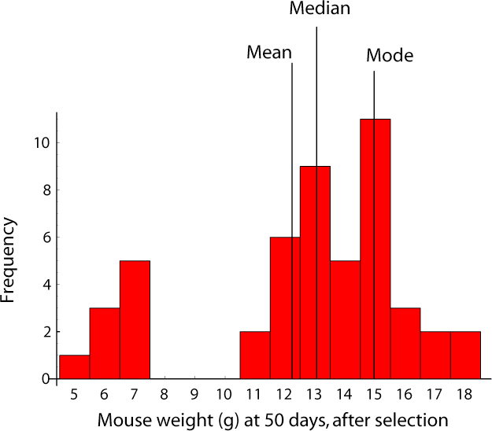
Mode
The mode is the most frequent measurement.

Slide 10
Mean and median for US household income, 2005
Median | $46,326
Mean | $63,344
Mode | $5000-$9999
Why?

Slide 11
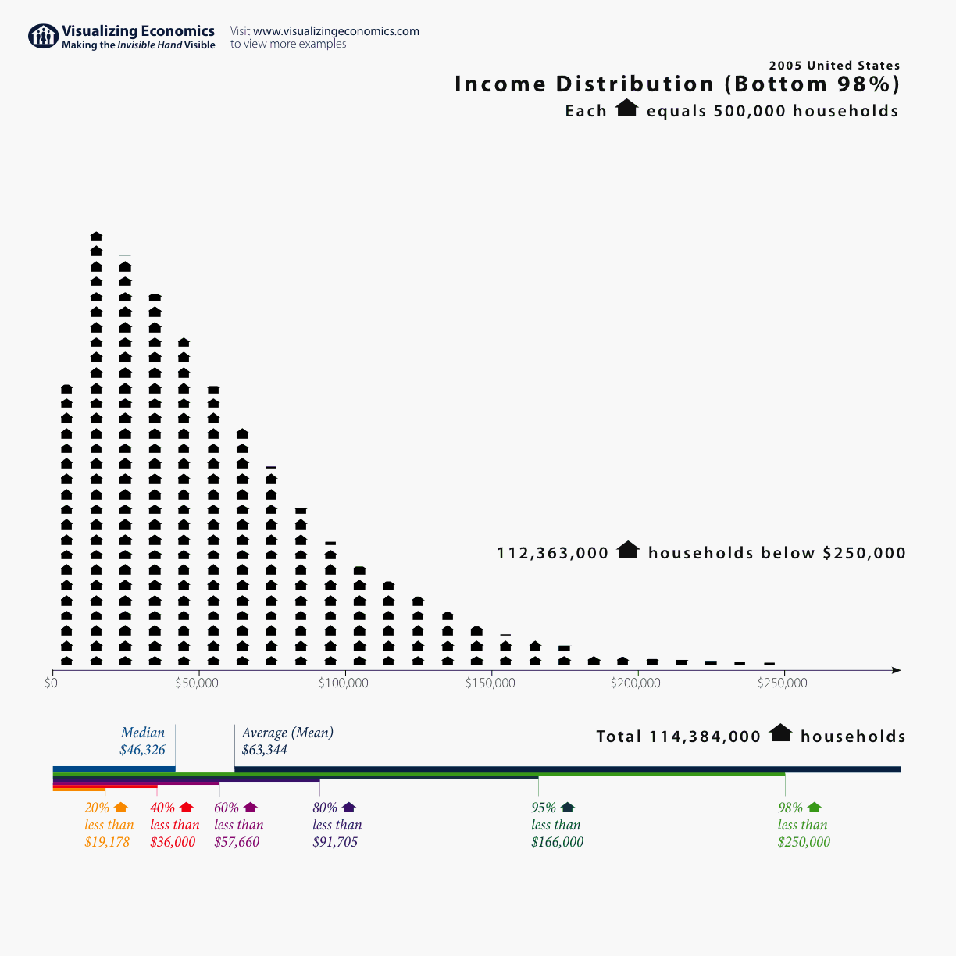
http://www.visualizingeconomics.com/blog/2006/11/05/2005-us-income-distribution?rq=household%20income

Slide 12
EDA student heights
Mean 168.3 cm
Median 166.3 cm
Mode 160 cm

Slide 13
Measures of width
Range
Standard deviation
Variance
Coefficient of variation

Slide 14
Range
14 17 18 20 22 22 24 25
26 28 28 28 30 34 36
The range is the maximum minus the minimum:
36 -14 = 22

Slide 15
The range is a poor measure of distribution width
Small samples tend to give lower estimates of the range than large samples
So sample range is a biased estimator of the true range of the population.

Slide 16
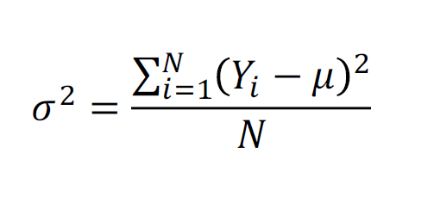
Variance in a population
N is the number of individuals in the population.
μ is the true mean of the population.

Slide 17
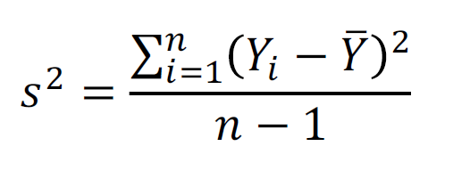
Variance in a sample
n is the sample size

Slide 18
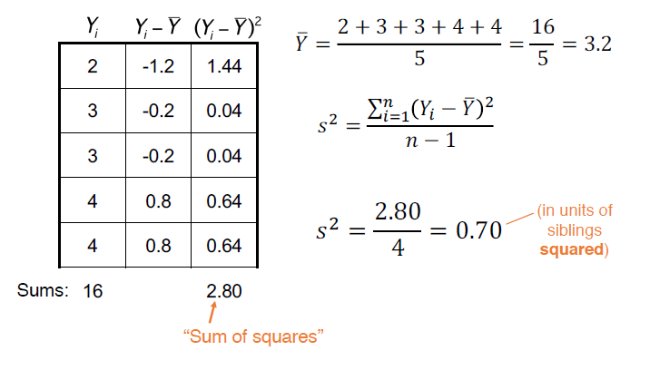
Example: Sample variance
Family sizes of 5 EDA students (# siblings):
2 3 3 4 4

Slide 19
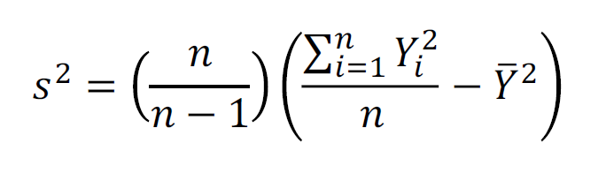
Shortcut for calculating sample variance

Slide 20
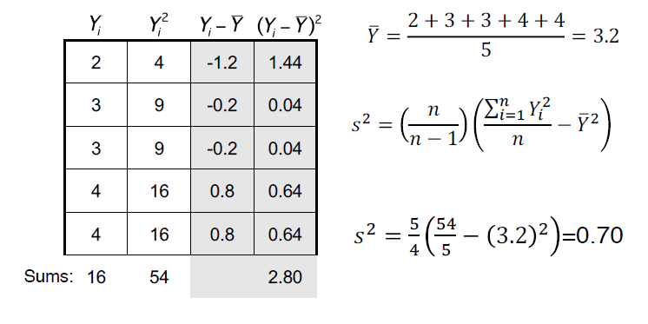
Example: Sample variance (shortcut)
Family sizes of 5 EDA students (# siblings):
2 3 3 4 4

Slide 21
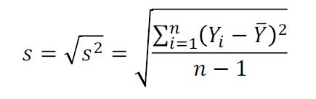
Standard deviation (SD)
Positive square root of the variance
(sigma) is the true standard deviation
s is the sample standard deviation:
s² = 0.70 people²
s = 0.70 = 0.84 people

Slide 22
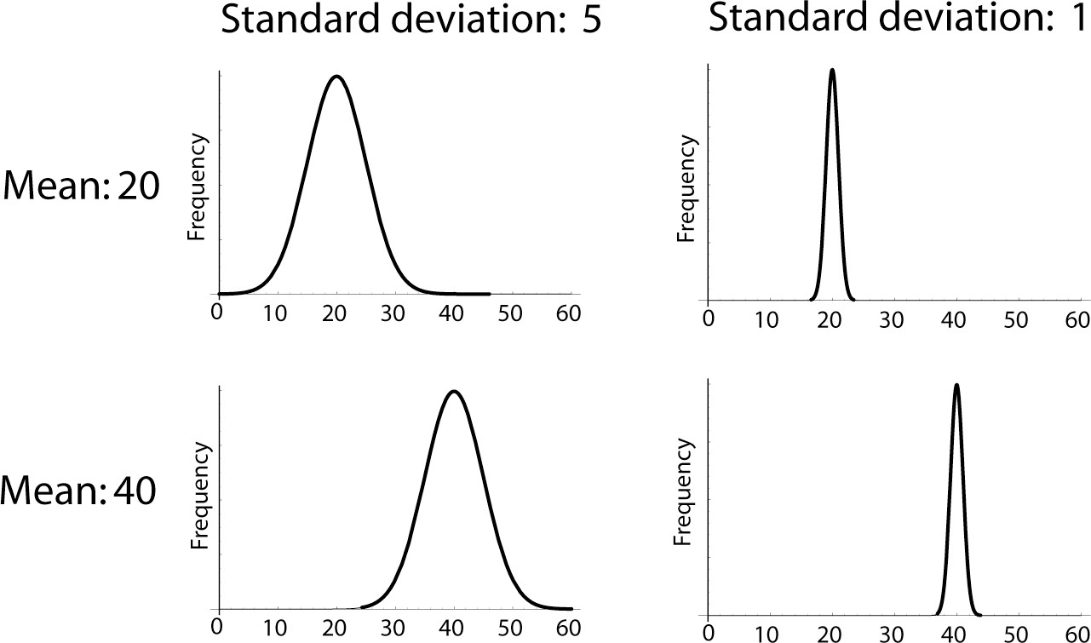
Standard deviation (SD)

Slide 23
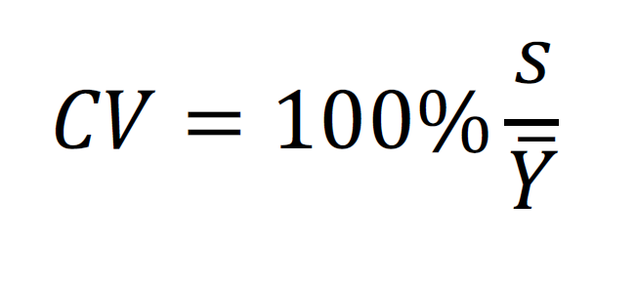
Coefficient of variation (CV)

Slide 24
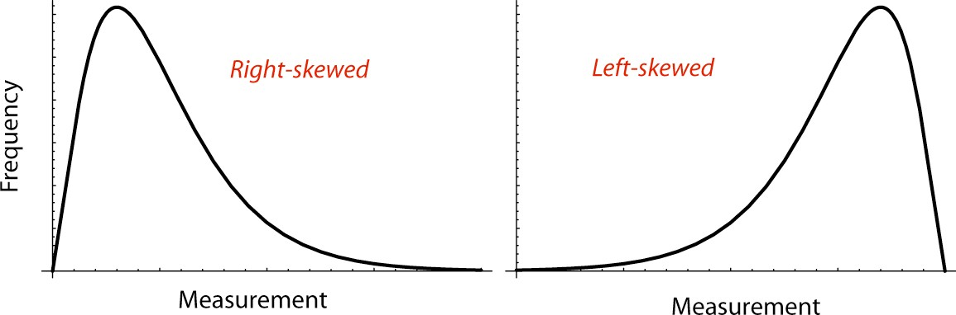
Skew
Skew is a measurement of asymmetry.
Skew (as in "skewer") refers to the pointy tail of a distribution

Slide 25
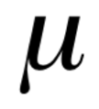
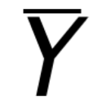
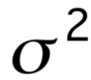

Nomenclature
 | Population Parameters | Sample Statistics
Mean
Variance |  | s²
Standard Deviation |  | s

Slide 26
Basic stats in R
mean(classHeightDataFull$height) [1] 169.7955
median(classHeightDataFull$height) [1] 170
sd(classHeightDataFull$height) [1] 11.48828
var(classHeightDataFull$height) [1] 131.9807

Slide 27
Manipulating means
The mean of the sum of two variables:
E[X + Y] = E[X]+ E[Y]
The mean of the sum of a variable and a constant:
E[X + c] = E[X]+ c
The mean of a product of a variable and a constant:
E[c X] = c E[X]

Slide 28
Manipulating variance
The variance of the sum of two variables:
Var[X + Y] = Var[X]+ Var[Y]
if and only if X and Y are independent.
The variance of the sum of a variable and a constant:
Var[X + c] = Var[X]
The variance of a product of a variable and a constant:
Var[c X] = c² Var[X]

Slide 29
Example: converting units
Height:
Mean = 169.8 cm Variance = 131.98 cm²
In inches (1 cm = 0.394 in):
Mean: 169.8 cm ✕ 0.394 = 66.9 in
Variance: 131.98 cm² (0.394)² = 20.5 in²

