Slide 1
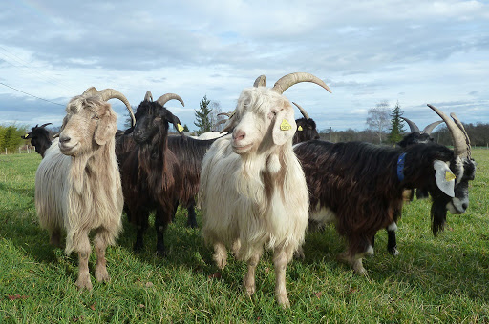
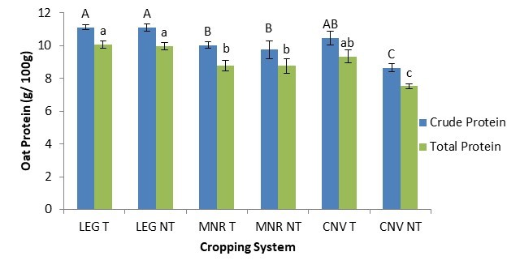
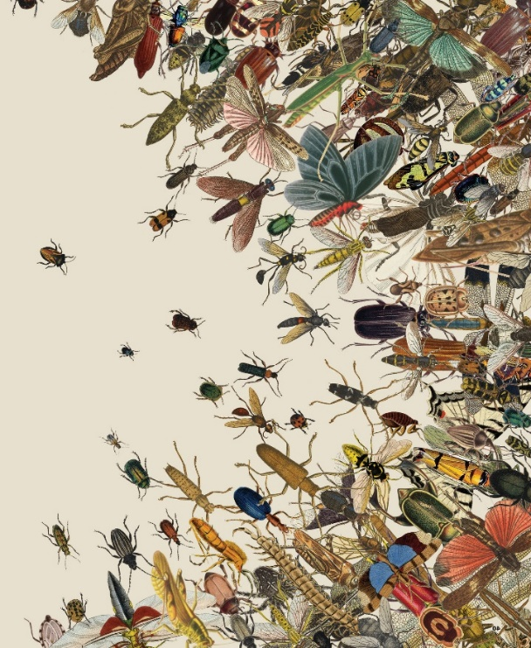
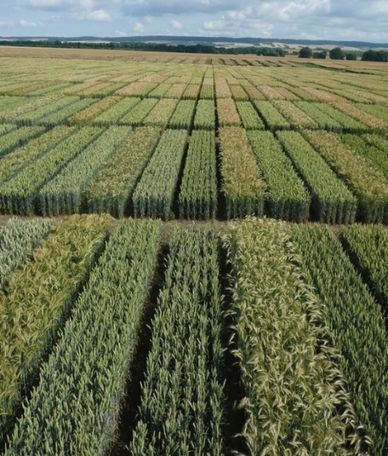
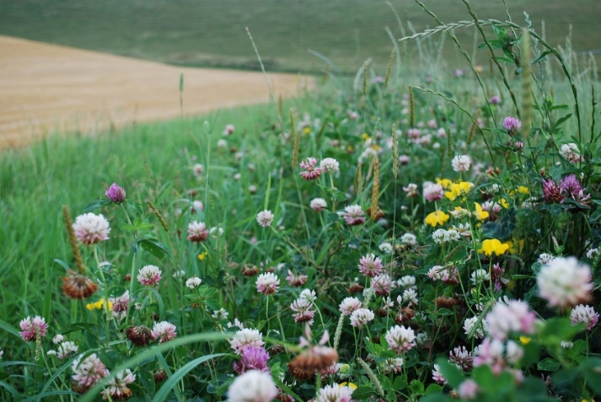
C7041 Experimental Design and Analysis
Ed Harris

Slide 2
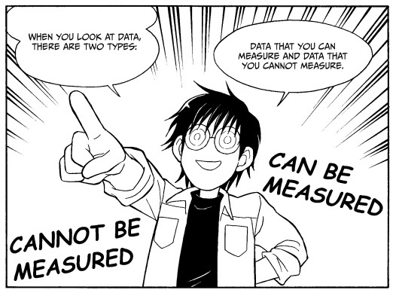
1.04 Estimation

Slide 3
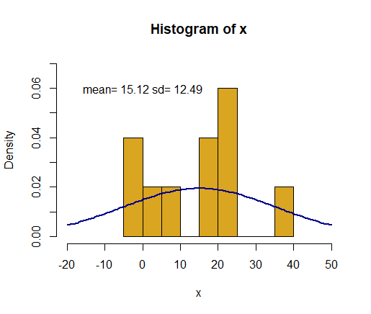
Estimation
set.seed(1); x <- rnorm(10, 13, 16)
hist(x, freq=F, breaks = 10,
col="goldenrod")
curve(dnorm(x, mean=mean(x), sd=sd(x)),
col="darkblue", lwd=2, add=TRUE, yaxt="n")
Sample size 10 from Gaussian distribution with μ=13 and σ²=16

Slide 4
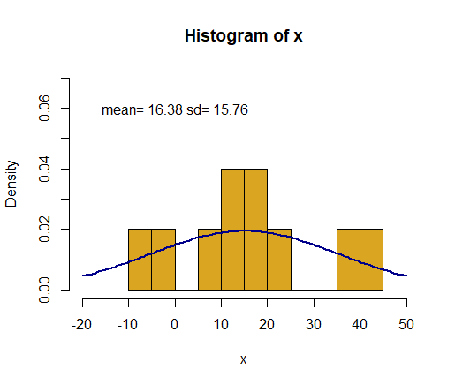
Estimation
set.seed(2); x <- rnorm(10, 13, 16)
hist(x, freq=F, breaks = 10,
col="goldenrod")
curve(dnorm(x, mean=mean(x), sd=sd(x)),
col="darkblue", lwd=2, add=TRUE, yaxt="n")
A different sample of 10 from a Gaussian distribution with μ=13 and σ²=16

Slide 5
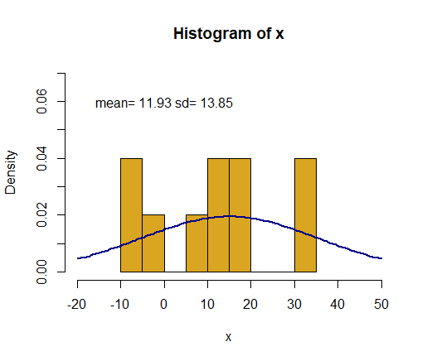
Estimation
set.seed(2); x <- rnorm(10, 13, 16)
hist(x, freq=F, breaks = 10,
col="goldenrod")
curve(dnorm(x, mean=mean(x), sd=sd(x)),
col="darkblue", lwd=2, add=TRUE, yaxt="n")
A 3rd sample

Slide 6
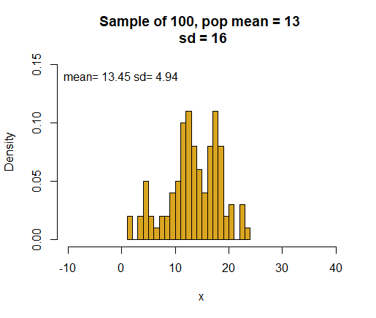
Distribution of the means of many samples, each of sample size 10

Slide 7
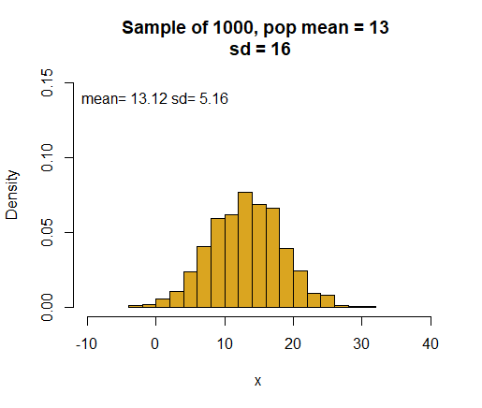
Distribution of the means of many samples, each of sample size 10

Slide 8
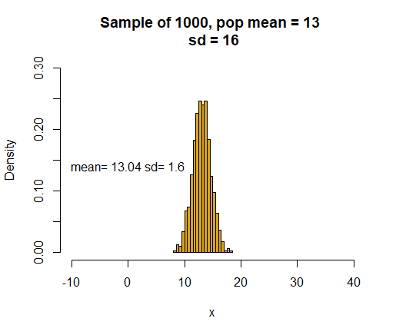
Distribution of the means of many samples, each of sample size 100

Slide 9
Variation in sample means decreases with sample size
n = 10
1000 samples each
n = 100

Slide 10
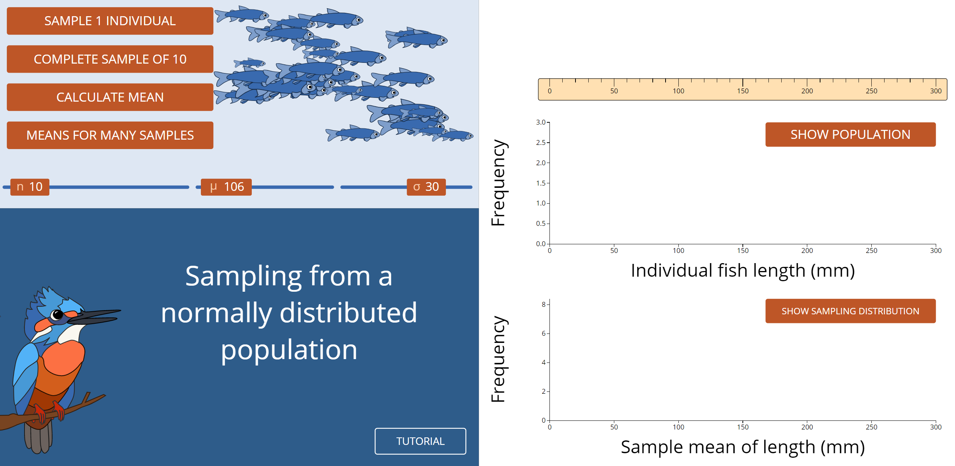
Sampling tool

Slide 11
The standard error of an estimate is the standard deviation of its sampling distribution.
The standard error predicts the sampling error of the estimate.

Slide 12
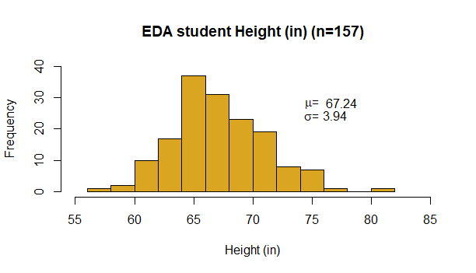
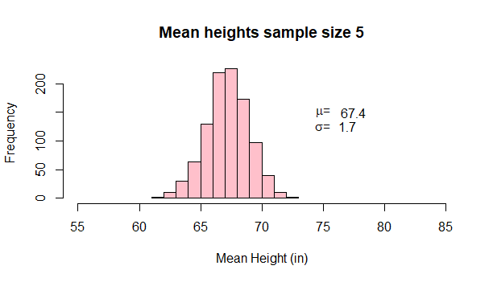

Slide 13
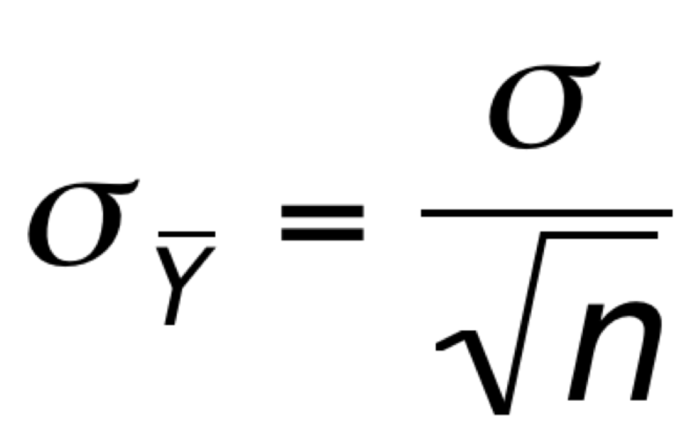
Standard error of the mean
Very simple estimate of SAMPLE variation
Represents difference between sample estimate and true population estimate
Related to population std dev and the sample size
This is totally GREAT

Slide 14
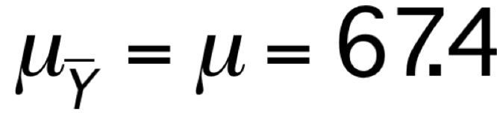
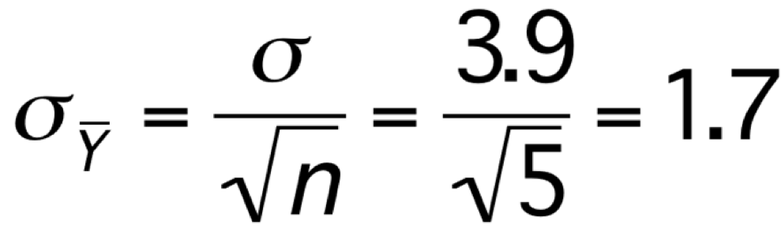

Standard error of the mean
Mean = 67.4
The math works!
The problem is, we rarely know σ!

Slide 15
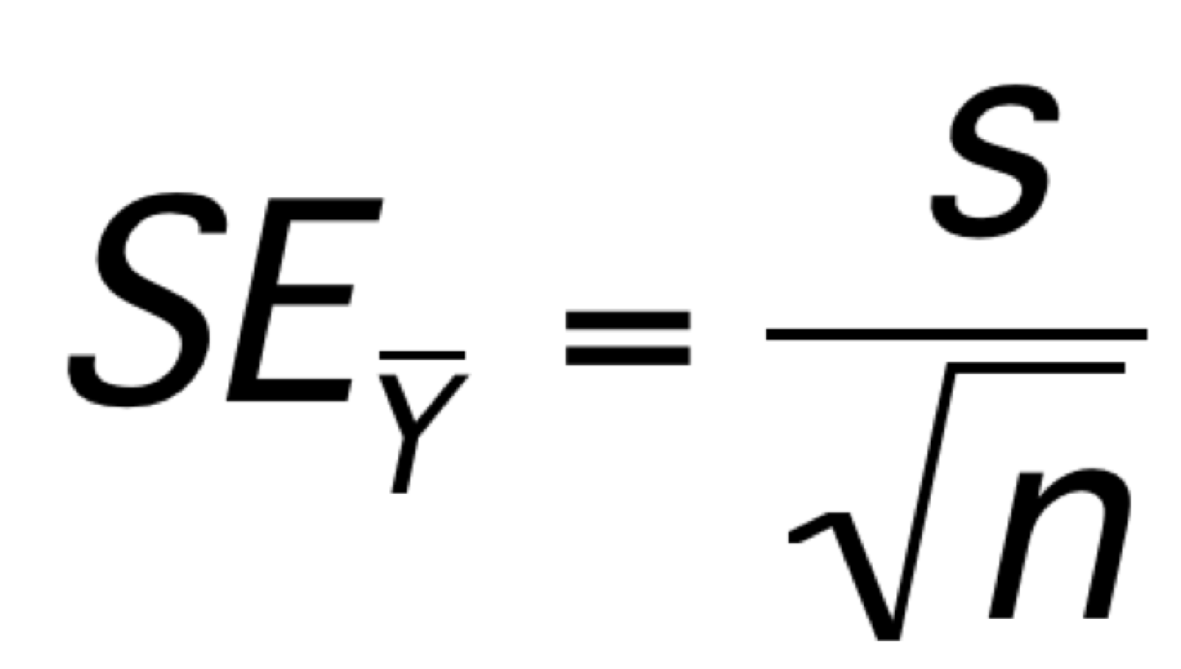
Estimate of the standard
error of the mean
This gives us some knowledge of the likely
difference between our sample mean and the true population mean

Slide 16
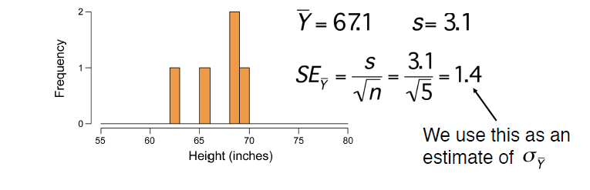
In most cases, we don’t know the real population distribution.
We only have 1 sample.

Slide 17
Confidence interval
The 95% confidence interval provides a plausible range for a parameter.
All values for the parameter lying within the interval are plausible, given the data, whereas those outside are unlikely.

Slide 18

The 2SE rule-of-thumb
The interval
provides a rough estimate of the 95% confidence interval for the mean.
(Assuming Gaussian distributed population and/or sufficiently large sample size.)

Slide 19
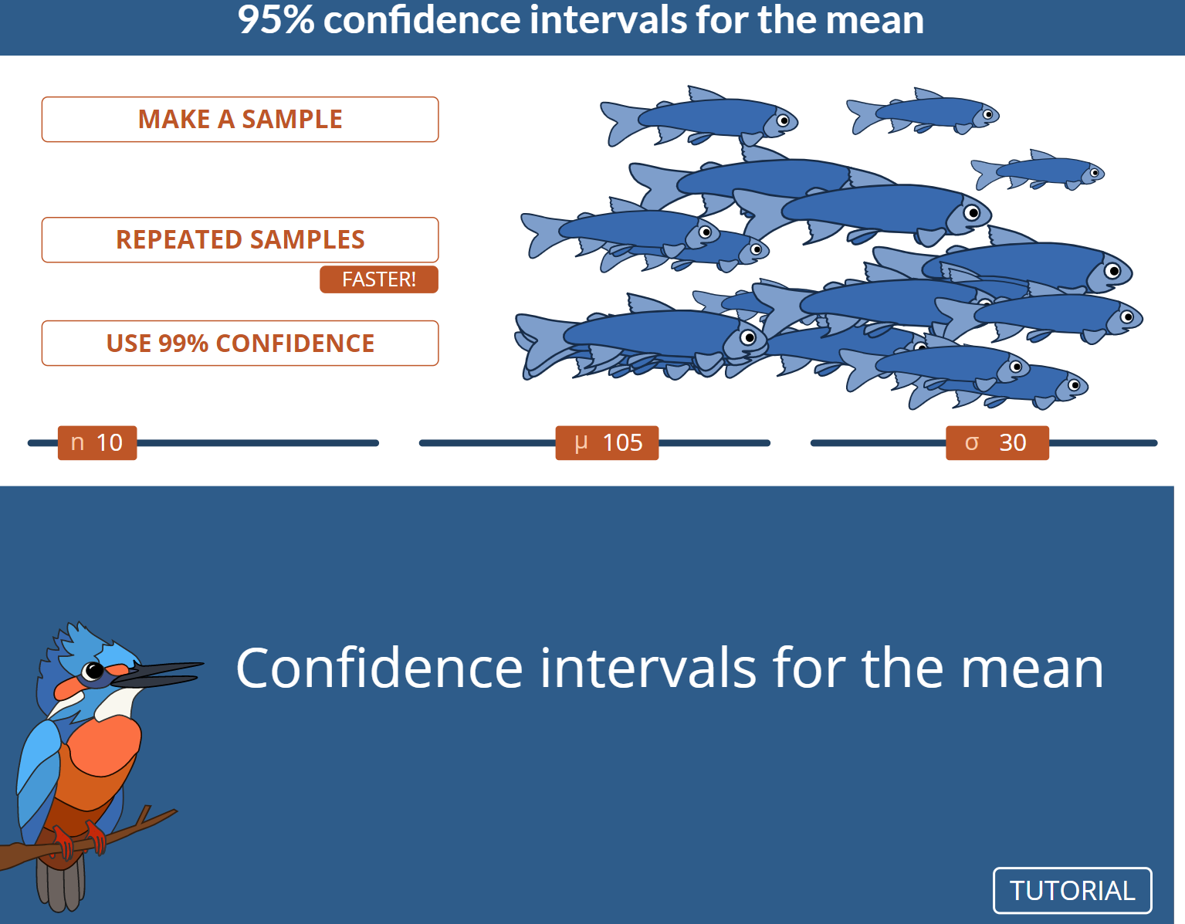
CI calculator

Slide 20
Use correct language when talking about confidence intervals
Not correct:
“There is a 95% probability that the population mean is within a particular 95% confidence interval”
(this implies likelihood)
Correct:
“We are 95% confident that the population mean lies within the 95% confidence interval.”
(this implies plausibility)

Slide 21
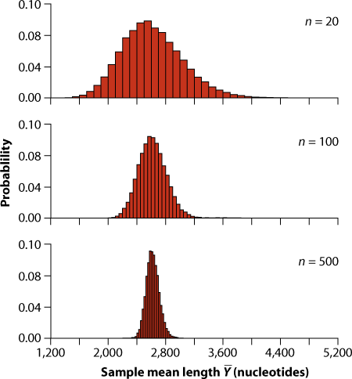
Sample means of gene sizes

Slide 22
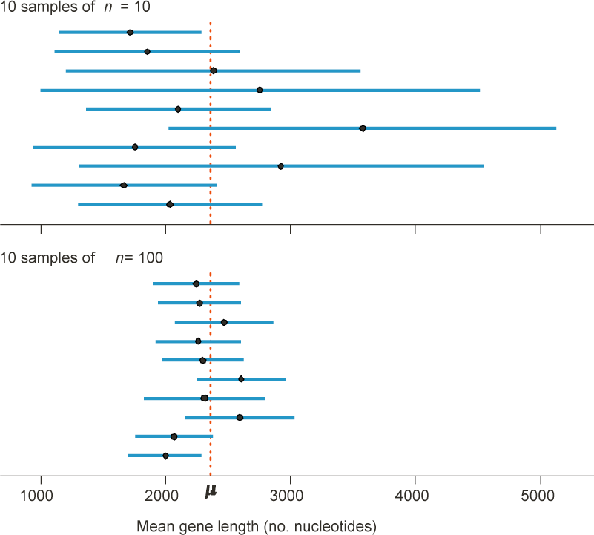
Confidence interval

Slide 23
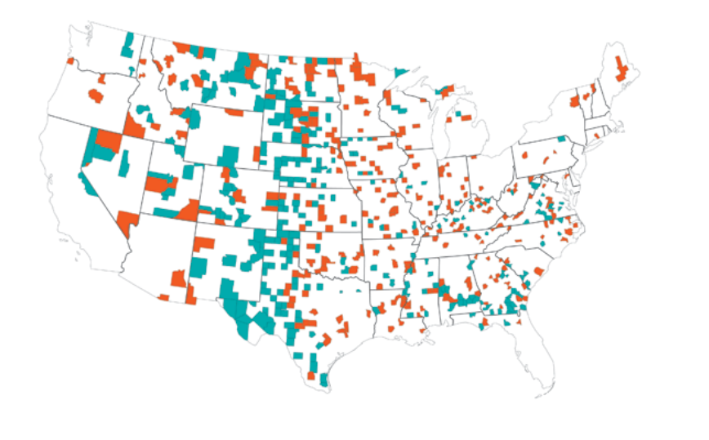
US counties with unusual kidney cancer death
Counties coloured teal are the lowest 10% of the cancer distribution, red are the highest 10%

Slide 24
US counties with unusual kidney cancer death
Teal counties are small, rural low population density
This could be an effect of fresh air, honest work, and clean living?
Counties coloured teal are the lowest 10% of the cancer distribution, red are the highest 10%

Slide 25
US counties with unusual kidney cancer death
Red counties are ALSO small, rural low population density
Could this be due to the effects of low income – diabetes, poor diet, smoking, etc.?
Counties coloured teal are the lowest 10% of the cancer distribution, red are the highest 10%

Slide 26
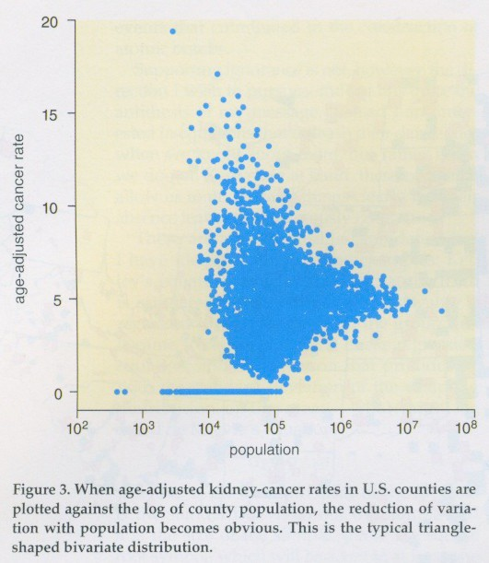
Variation in cancer rates decreases with population size of counties
Sampling is the cuplit!
The rural counties have small population size
A county with pop == 100, might have zero
BUT, with only 1 case it looks BAD!
Bigger counties converge towards the global mean…
Wainer (2007) The most dangerous equation. American Scientist 95: 249-256.

Slide 27
Pseudoreplication
The error that occurs when samples are not independent, but they are treated as though they are.

Slide 28
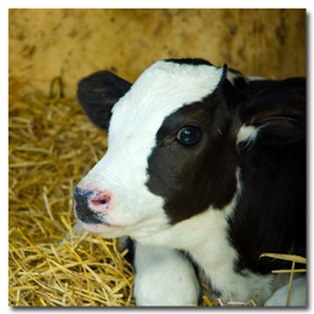
Example: Pseudoreplication
You are interested in bovine growth hormone (BGH) in cows.
Collecting this kind of data is expensive and you decide to take 10 measurements from each cow.
You study 6 cows, so you have 60 measurements.
What is your sample size (n)?

Slide 29
Avoiding pseudoreplication
You are interested in bovine growth hormone (BGH) in cows.
Collecting this kind of data is expensive and you decide to take 10 measurements from each cow.
You study 6 cows, so you have 60 measurements.
Take the mean BGH for each cow, so that you have 6 measures, one for each cow (n = 6).

Slide 30
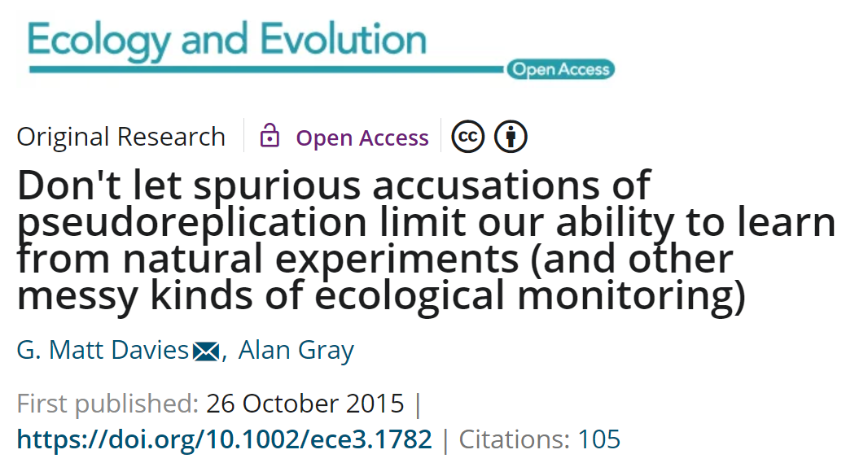
Suggested reading
Davies, G.M., Gray, A., 2015. Don’t let spurious accusations of pseudoreplication limit our ability to learn from natural experiments (and other messy kinds of ecological monitoring). Ecology and Evolution 5, 5295–5304.

