Slide 1
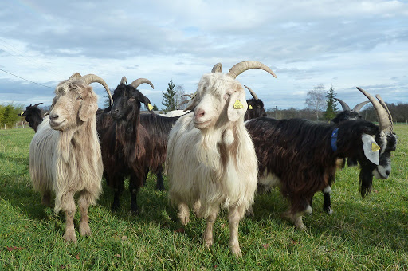
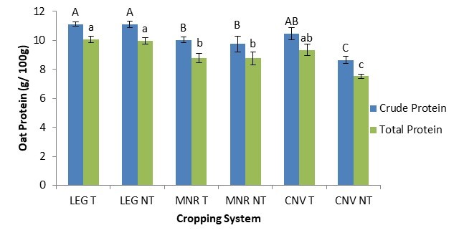



C7041 Experimental Design and Analysis
Ed Harris

Slide 2
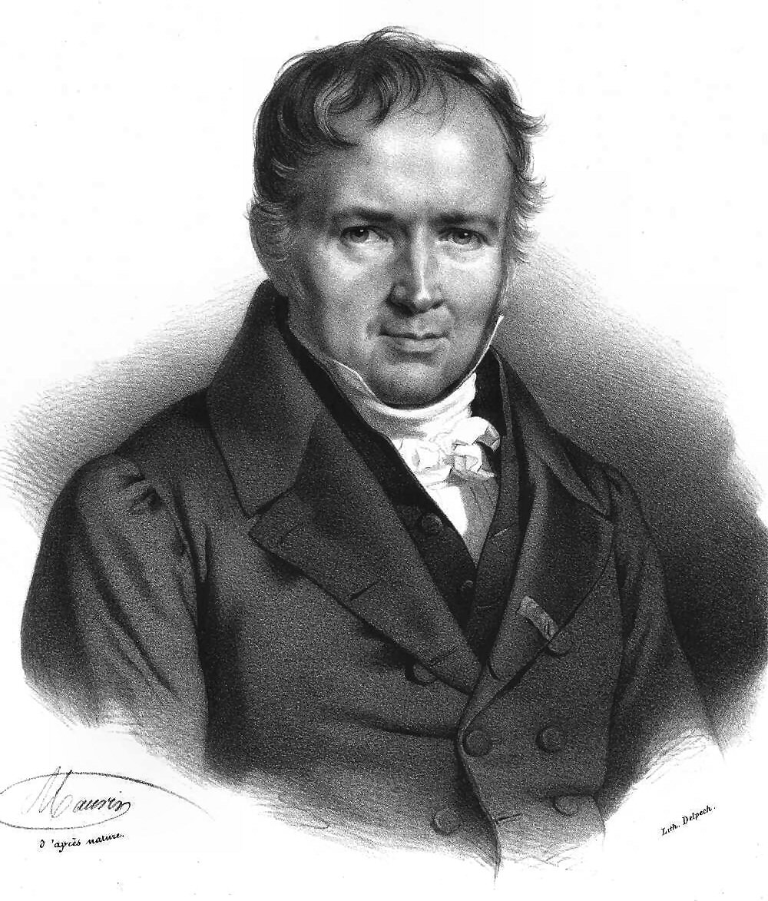
~“Life is good for only two things, researching statistics and teaching statistics”
-Siméon Denis Poisson

Slide 3
Fitting probability models to frequency data

Slide 4
Discrete distribution
A probability distribution describing a discrete numerical random variable (where you count something)
For example:
Number of heads from 10 flips of a coin
Number of flowers in a square meter
Number of disease outbreaks in a year

Slide 5
χ² Goodness-of-fit test
Compares counts to a discrete probability distribution

Slide 6
Hypotheses for χ² test
H₀: The data come from a particular discrete probability distribution.
H_{A}: The data do not come from that distribution.

Slide 7
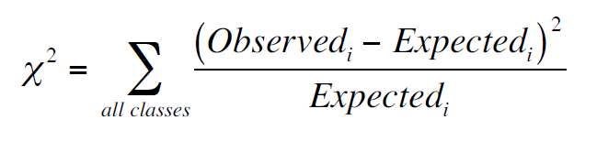
Test statistic for χ² test

Slide 8
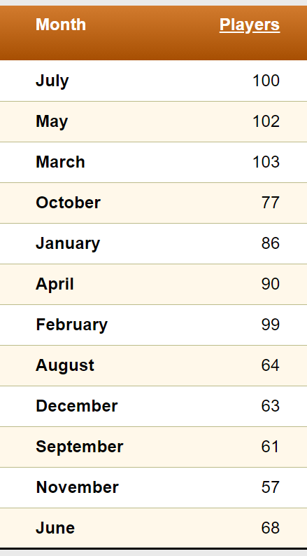

Test statistic for χ² test
Relatable example ™
NHL player birth month 2019-2020
Data from https://www.quanthockey.com/ for 2019-2020

Slide 9
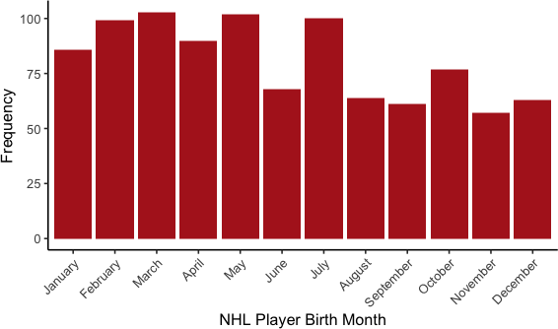
Test statistic for χ² test

Slide 10
Test statistic for χ² test
A Goodness-of-Fit test compares count data to a model of the expected frequencies of a set of categories.

Slide 11
Test statistic for χ² test
Hypotheses for birth month example
H₀: The probability of a NHL birth occurring on any given month is equal to national proportions.
H_{A}: The probability of a NHL birth occurring on any given month is not equal to national proportions.

Slide 12
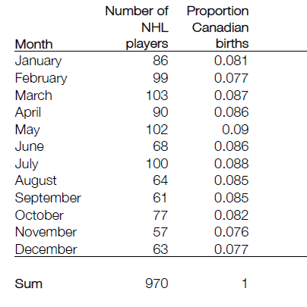
NHL compared to all Canadians
Test statistic for χ² test

Slide 13
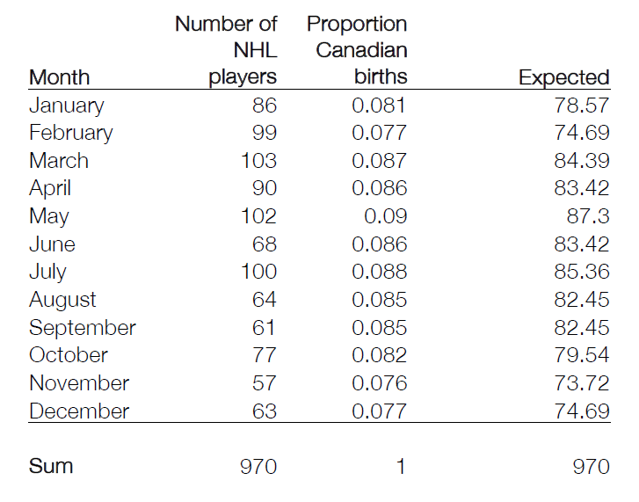
Computing Expected values

Slide 14
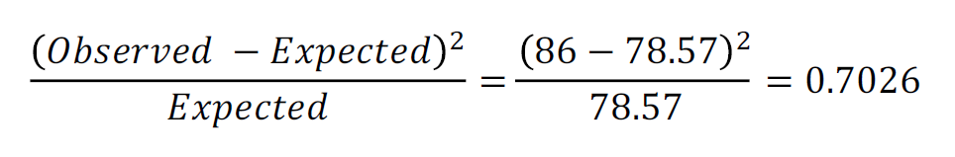
The calculation for January

Slide 15
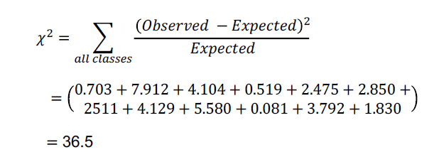
Calculating χ²

Slide 16
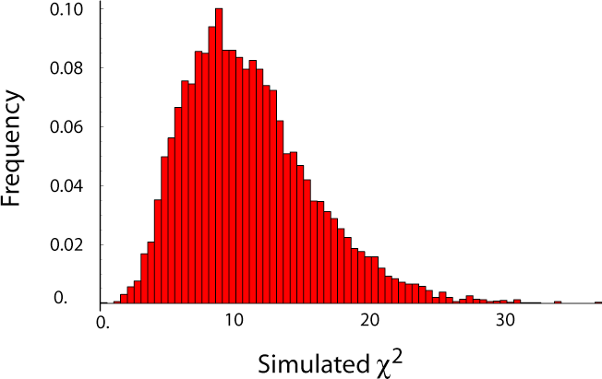
The sampling distribution of χ²
by simulation

Slide 17
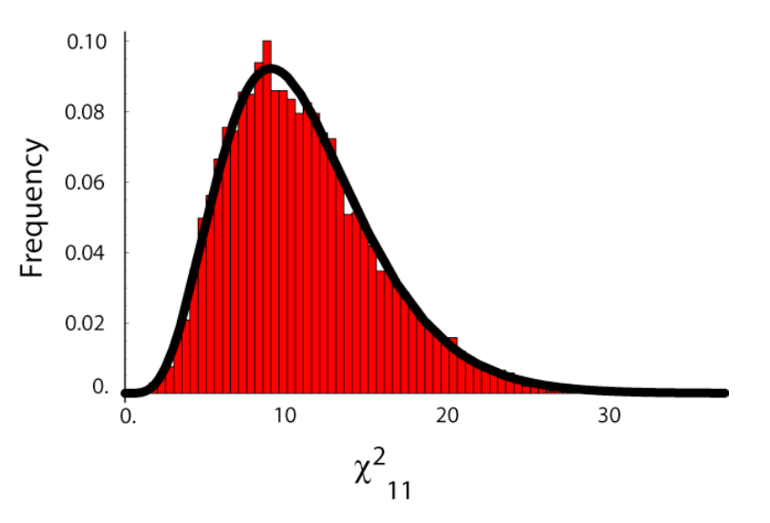
Sampling distribution of χ² by the χ² distribution
Degrees of freedom

Slide 18
Degrees of freedom
The number of degrees of freedom of a test specifies which of a family of distributions to use.

Slide 19
Degrees of freedom for χ² test
df = (Number of categories)
– (Number of parameters estimated from the data)
– 1

Slide 20
Degrees of freedom for NHL month of birth
# months
Zero parameters
Minus 1
df = 12 - 0 - 1 = 11

Slide 21
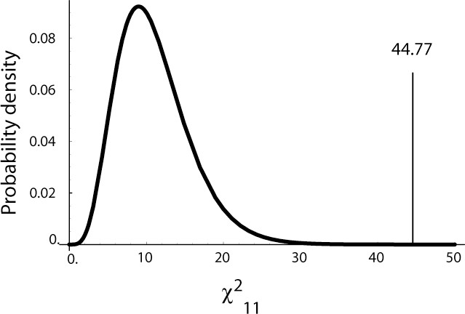
Finding the P-value
χ² = 36.5

Slide 22
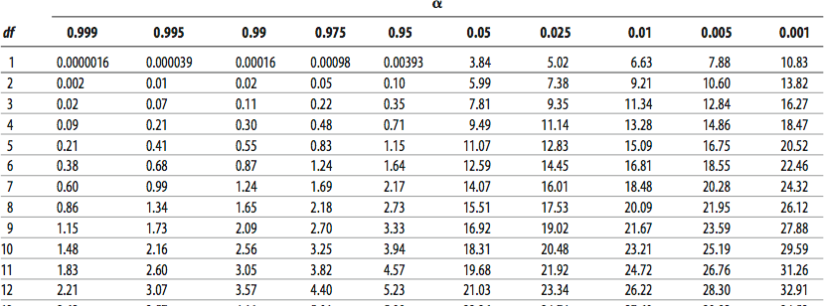
Critical value
The value of the test statistic where P = α.
χ² distribution table
(like when I were a child)

Slide 23
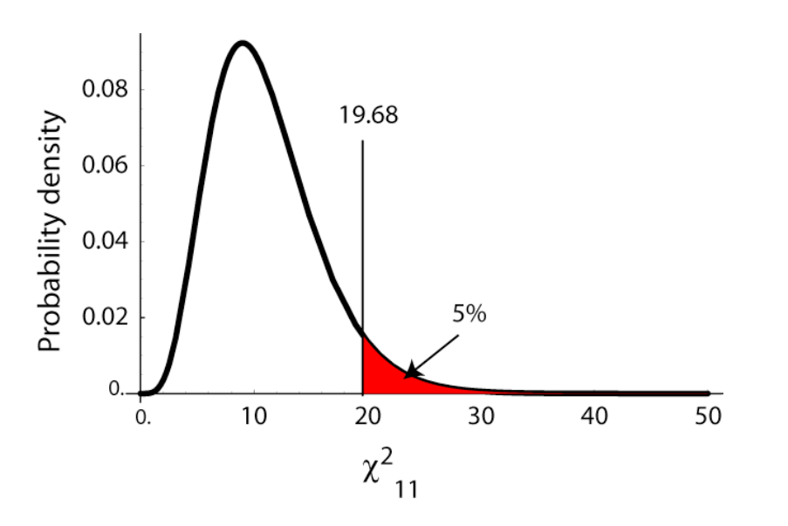
The 5% critical value

Slide 24
The 5% critical value
P<0.05,
so we can reject the null hypothesis
NHL players are not born in the same proportions per month as the population at large.

Slide 25
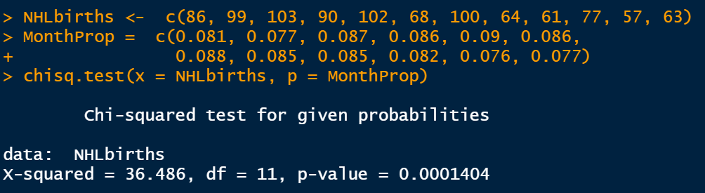
Goodness of fit in R
Math way:
R way:

Slide 26
Test statistics
A test statistic is a number calculated from the data and the null hypothesis that can be compared to a standard distribution to find the P-value of the test.

Slide 27
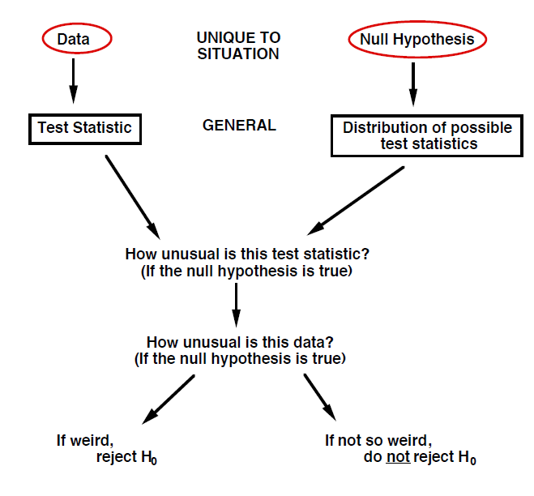
Test statistics

Slide 28
χ² test as approximation of the binomial test
χ² goodness-of-fit test works even when there are only two categories, so it can be used as a substitute for the binomial test.
Very useful if the number of data points is large.

Slide 29
Assumptions of χ² test
No more than 20% of categories have Expected < 5
No category with Expected ≤ 1

Slide 30
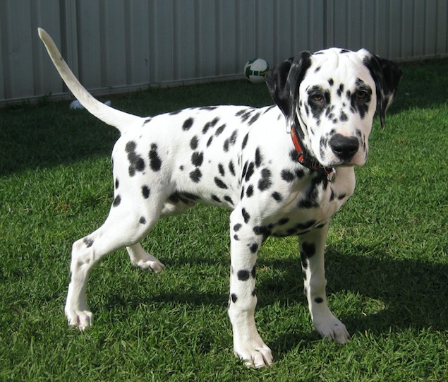
Estimating parameters from data
HUU (Hyperuricosuria and hyperuricemia) caused by mutation in the SLC2A9 gene
>> uric acid…
Zierath, S. 2017. Frequency of five disease-causing genetic mutations in a large mixed-breed dog population (2011–2012). PLoS ONE 12(11): e0188543.

Slide 31
Estimating parameters from data
34,118 mixed breed dogs tested:
57 Homozygous for mutation
1,517 Heterozygotes
32,544 Homozygous for wild type
Do these genotypes appear in frequencies predicted by random pairing of alleles?
Zierath, S. 2017. Frequency of five disease-causing genetic mutations in a large mixed-breed dog population (2011–2012). PLoS ONE 12(11): e0188543.

Slide 32
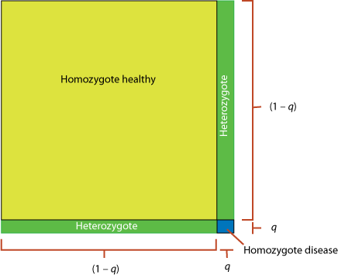
Estimating parameters from data
The expectation for these frequencies is
(From the Hardy-Weinberg equation…)
Homozygous mutant: q²
Heterozygote: 2 q (1– q)
Homozygous healthy: (1 – q)²

Slide 33
Estimating parameters from data
H₀: Genotype frequencies follow predictions of random association of alleles:
But what is the value of q?
q² : 2q (1– q) : (1 – q)²
Homozyg mutant : Hetero normal : homozyg normal

Slide 34
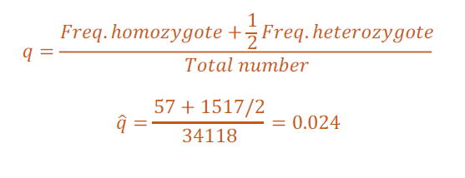
Estimating parameters from data
But what is the value of q?

Slide 35
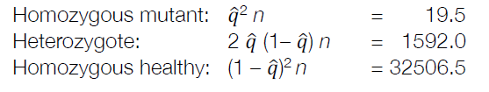

Estimating parameters from data
Expected values:
But remember – we had to estimate one parameter ($\hat{q})$from the data.

Slide 36
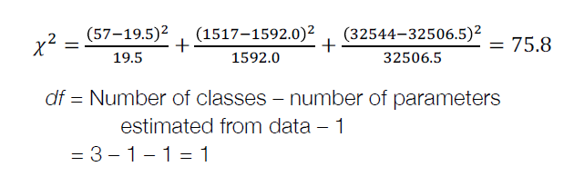
Estimating parameters from data
But remember – we had to estimate one parameter ($\hat{q})$from the data.

Slide 37

Estimating parameters from data
Therefore P = 3.14 x 10⁻¹⁸, and we reject the null hypothesis. These genotypes do not occur as we would expect by random combinations of alleles.

Slide 38
Fitting other distributions: the Poisson distribution
The Poisson distribution describes the probability that a certain number of events occur in a block of time or space, when those events happen independently of each other and occur with equal probability at every point in time or space.

Slide 39
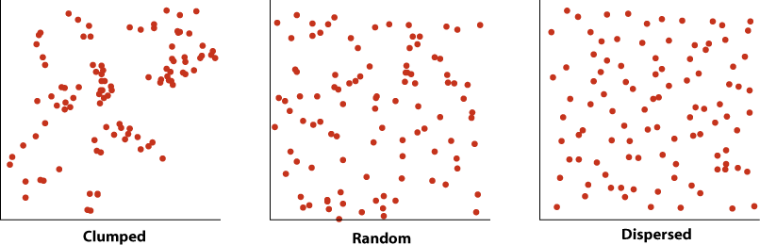
Fitting other distributions: the Poisson distribution

Slide 40
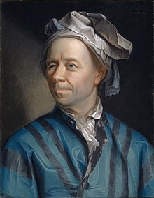
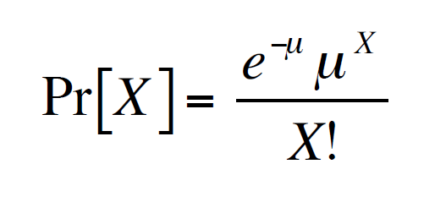
Poisson distribution
Base of natural log (~2.718)
Aka “Euler’s number”
Number successes
Mean successes

Slide 41

Example: Number of goals per side in World Cup Soccer
Q: Is the outcome of a football game (at this level) random?
In other words, is the number of goals per team distributed as expected by pure chance?

Slide 42
Hypotheses
H0: Number of goals per side follows a Poisson distribution. (i.e. random)
HA: Number of goals per side does not follow a Poisson distribution.

Slide 43
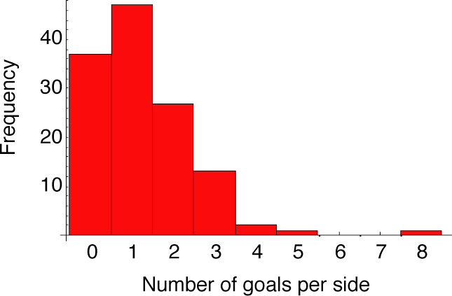
World Cup 2002 scores

Slide 44
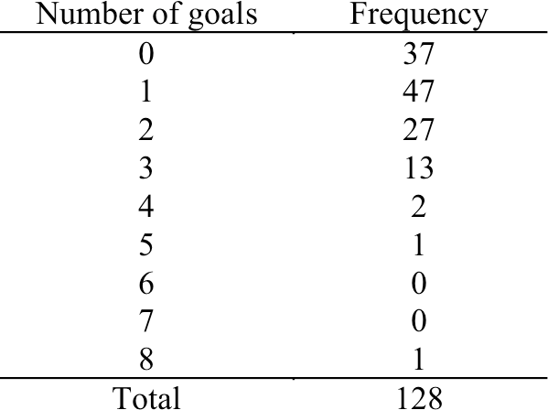
Number of goals for a team (World Cup 2002)

Slide 45
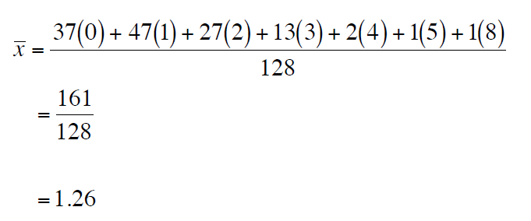
Number of goals for a team (World Cup 2002)
What’s the mean?

Slide 46
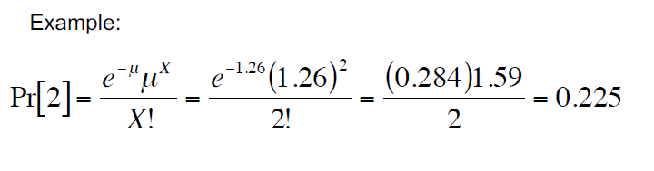
Number of goals for a team (World Cup 2002)
What’s the Poisson probability (e.g. for scoring exactly 2 goals) with mean = 1.26?

Slide 47
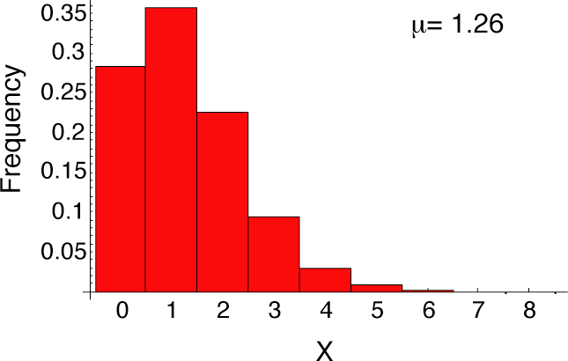
Number of goals for a team (World Cup 2002)
Poisson with μ = 1.26
Goals (X) | Pr[X]
0 | 0.284
1 | 0.357
2 | 0.225
3 | 0.095
4 | 0.030
5 | 0.008
6 | 0.002
7 | 0
≥8 | 0

Slide 48
Number of goals for a team (World Cup 2002)
Finding the Expected
Goals (X) | Pr[X] | Expected
0 | 0.284 | 36.3
1 | 0.357 | 45.7
2 | 0.225 | 28.8
3 | 0.095 | 12.1
4 | 0.030 | 3.8
5 | 0.008 | 1.0
6 | 0.002 | 0.2
7 | 0 | 0.04
≥8 | 0 | 0.007
}
Too small!

Slide 49
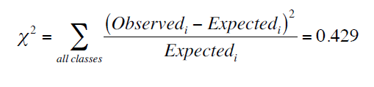
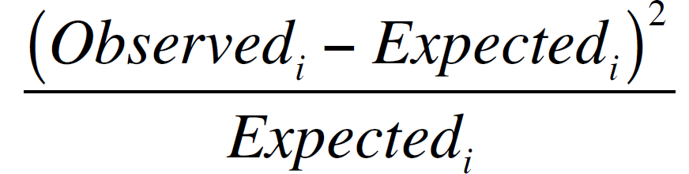
Number of goals for a team (World Cup 2002)
Calculating χ²
X | Expected | Observed
0 | 36.3 | 37 | 0.013
1 | 45.7 | 47 | 0.037
2 | 28.8 | 27 | 0.113
3 | 12.1 | 13 | 0.067
≥ 4 | 5.0 | 4 | 0.200

Slide 50
Degrees of freedom
Number of goals for a team (World Cup 2002)
df = (Number of categories)
– (Number of parameters estimated from the data)
– 1
= 5 – 1 – 1 = 3

Slide 51
Number of goals for a team (World Cup 2002)
Critical value

Slide 52
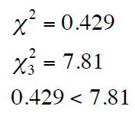

Number of goals for a team (World Cup 2002)
Comparing χ² to the critical value
2
So we cannot reject the null hypothesis.
There is no evidence that the score of a World Cup football game is not Poisson distributed.

Slide 53
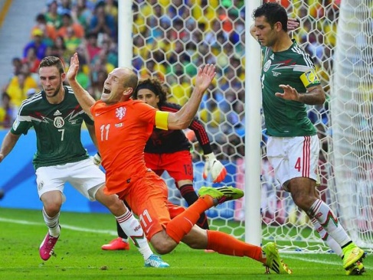
Number of goals for a team (World Cup 2002)
World Cup 2002 scores
Poisson distribution

Slide 54

Suggested reading
Zierath, S. 2017. Frequency of five disease-causing genetic mutations in a large mixed-breed dog population (2011–2012). PLoS ONE 12(11): e0188543.

