Slide 1
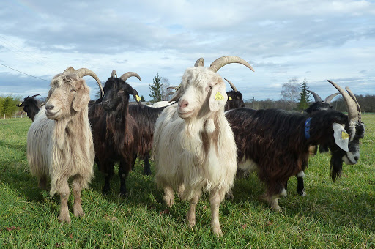
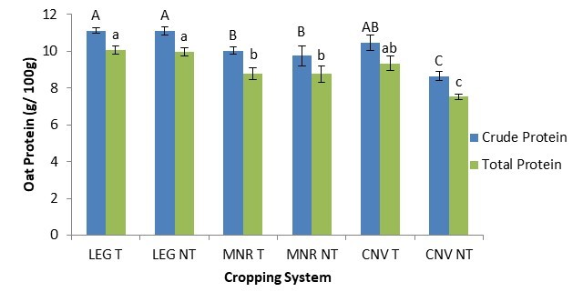



C7041 Experimental Design and Analysis
Ed Harris

Slide 2
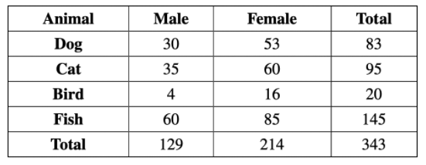




1.09 Contingency analysis : associations between categorical variables

Slide 3
Contingency analysis
Test the independence of two or more categorical variables
We’ll learn one kind: χ² contingency analysis

Slide 4
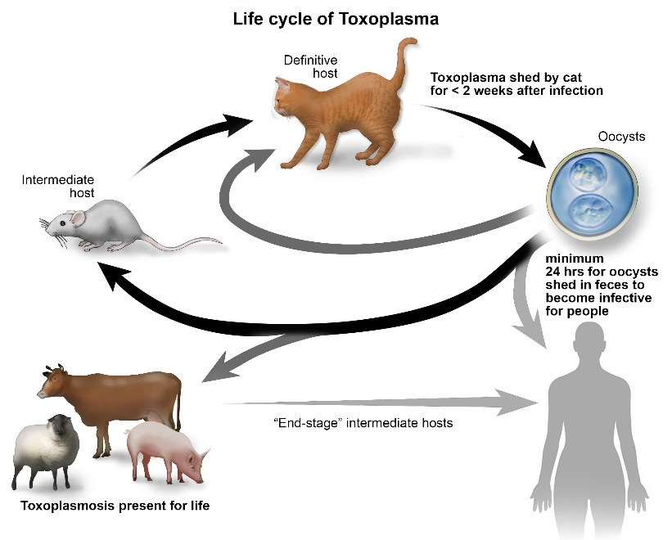
Toxoplasma and accidents
 | Infected with Toxoplasma | Uninfected | Totals
Accident | 21 | 38 | 59
No accident | 38 | 211 | 249
Totals | 59 | 249 | 308
Flegr, J. et al. 2002. Increased risk of traffic accidents in subjects with latent toxoplasmosis: a retrospective case-control study. BMC Infect. Dis. 2:11.

Slide 5
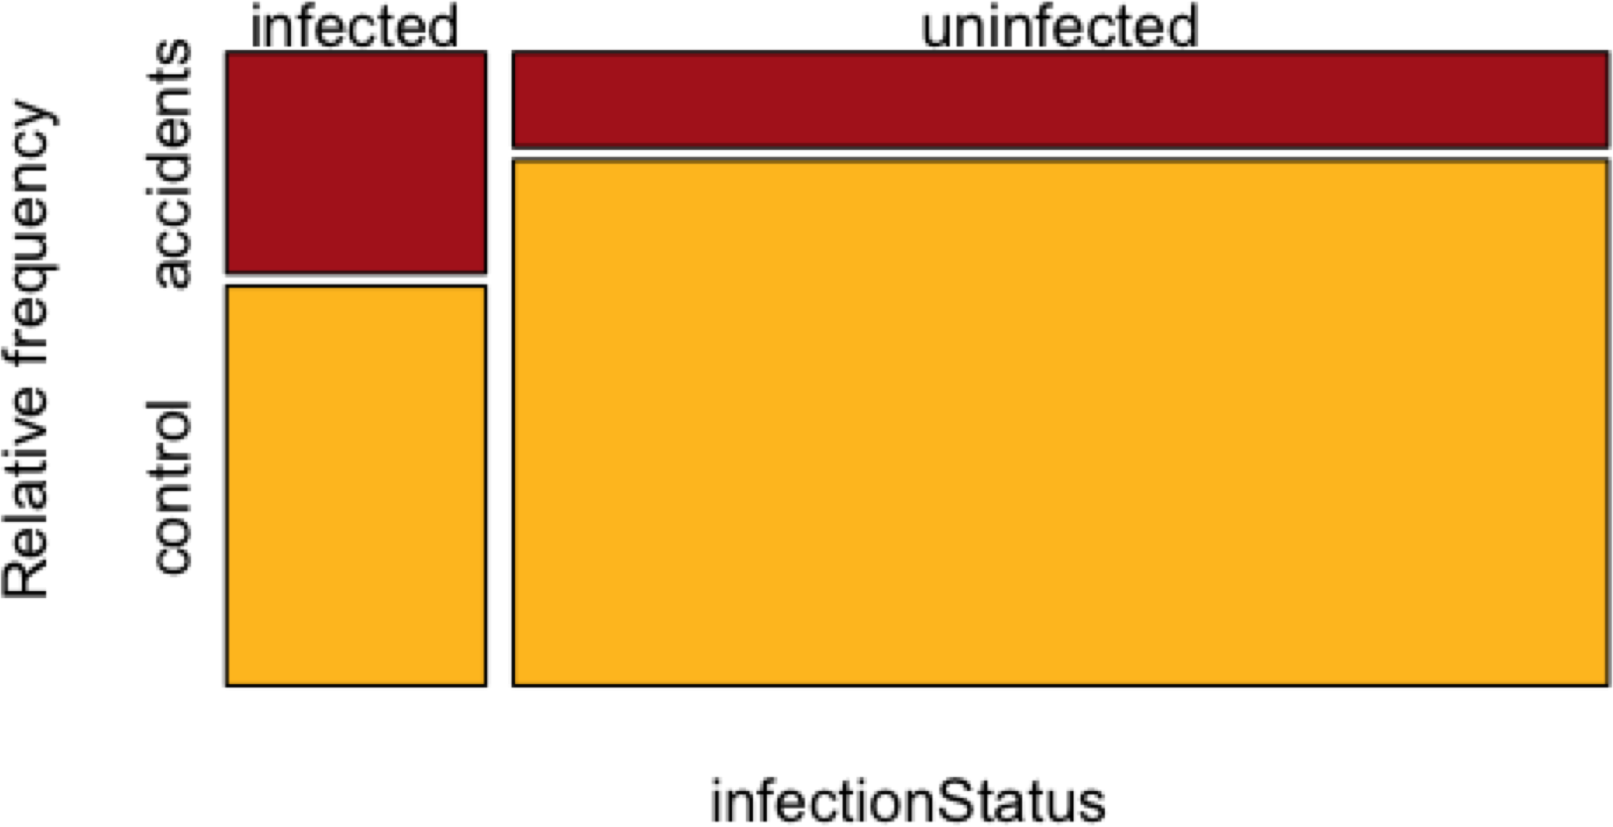
Toxoplasma and accidents
Mosaic plot

Slide 6
Hypotheses
Toxoplasma and accidents
H₀: Being infected with
Toxoplasma does not affect chance of having a car accident.
H_{A}: Being infected with
Toxoplasma does affect chance of having a car accident.

Slide 7
Toxoplasma and accidents
Calculating the expectations
With independence,
Pr[Toxoplasma AND accident] = Pr[Toxoplasma] × Pr[accident]

Slide 8
Toxoplasma and accidents
Calculating the expectations
EXPECTED | Infected with Toxoplasma | Uninfected | Totals
Accident |  |  | 59
No accident |  |  | 249
Totals | 59 | 249 | 308
Pr[Infection] = 59/308=0.1916

Slide 9
Toxoplasma and accidents
Calculating the expectations
EXPECTED | Infected with Toxoplasma | Uninfected | Totals
Accident |  |  | 59
No accident |  |  | 249
Totals | 59 | 249 | 308
Pr[Infection] = 59/308=0.1916
Pr[No accident] = 249/308= 0.8084

Slide 10
Toxoplasma and accidents
Calculating the expectations
EXPECTED | Infected with Toxoplasma | Uninfected | Totals
Accident |  |  | 59
No accident | 47.7 |  | 249
Totals | 59 | 249 | 308
Pr[Infection] = 59/308=0.1916
Pr[No accident] = 249/308= 0.8084
If H₀ is true,
Pr[Infection AND No accident] = (0.1916)(0.8084) = 0.1548
Expected = 0.1548 x 308 = 47.7

Slide 11
Toxoplasma and accidents
Calculating the expectations
EXPECTED | Infected with Toxoplasma | Uninfected | Totals
Accident | 11.3 | 47.7 | 59
No accident | 47.7 | 201.3 | 249
Totals | 59 | 249 | 308

Slide 12
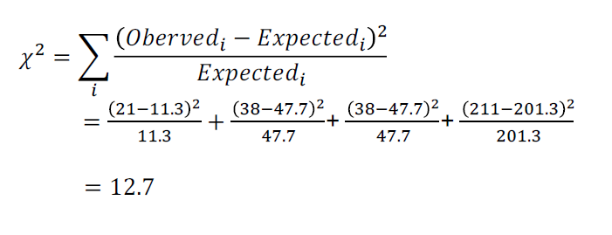
Toxoplasma and accidents
Calculating χ²

Slide 13
Toxoplasma and accidents
Calculating χ²
Degrees of freedom
df = (# columns -1 )(#rows -1)
For Toxoplasma example,
df = (2-1)(2-1) = 1

Slide 14
Toxoplasma and accidents
Calculating χ²
χ² = 12.7 >> χ²_{1,α=0.05} = 3.84,
We can reject the null hypothesis of independence. Toxoplasma infection status did covary with having car accidents.

Slide 15
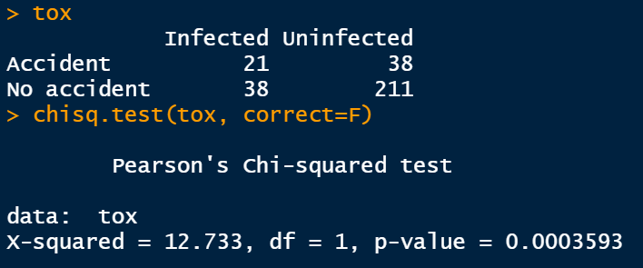
Toxoplasma and accidents
Calculating χ²
using R

Slide 16
χ² Assumptions
This χ² test is just a special case of the χ² goodness-of-fit test, so the same rules apply.
You can’t have any expectation less than 1, and no more than 20% < 5.

Slide 17
Fisher’s exact test
For 2 x 2 contingency analysis
Does not make assumptions about the size of expectations
R (or other programs) will do it, but cumbersome to do by hand

Slide 18
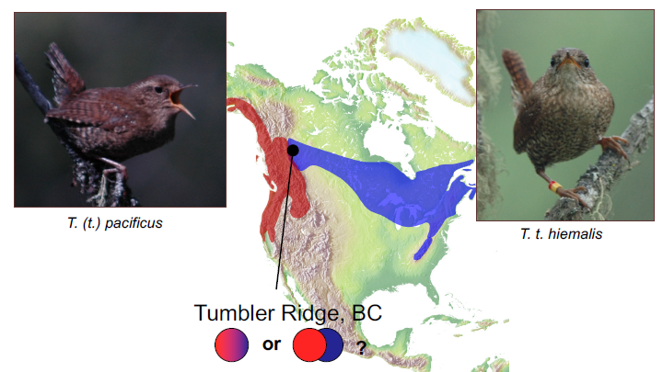
Winter Wren (Troglodytes troglodytes)
Are western and eastern forms (currently considered subspecies) actually reproductively isolated, and therefore separate species?

Slide 19
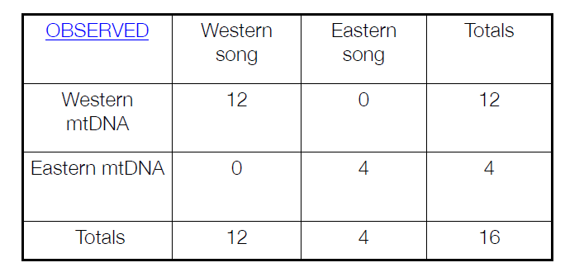
Association of DNA and song: The winter wren contact zone
Winter Wren (Troglodytes troglodytes)
Data from Toews & Irwin 2008, Molecular Ecology

Slide 20
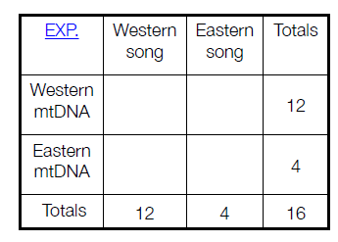
Winter Wren (Troglodytes troglodytes)
Calculating the expectations
A shortcut for calculating
expectations (assuming H₀ is true):
Exp[row i, column j] =
(row i total)(column j total) grand total
Exp[w mtDNA, w song] = 12*12/16 = 9

Slide 21
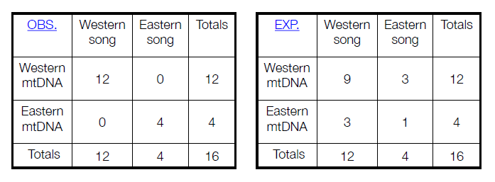
Winter Wren (Troglodytes troglodytes)
Comparing observed and expected
Too many of the expected are below 5, so we cannot use the χ² contingency test.
Instead, we use a computer to do Fisher’s exact test:
P = 0.00055, so we reject the H₀ of no association.

Slide 22
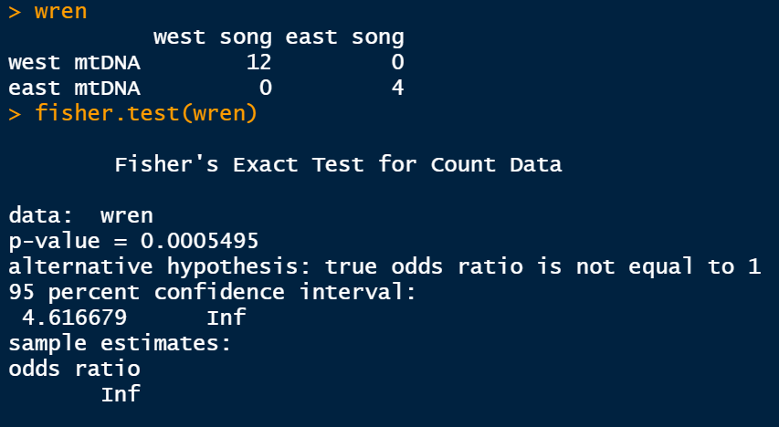
Winter Wren (Troglodytes troglodytes)
Fisher’s exact test in R

Slide 23
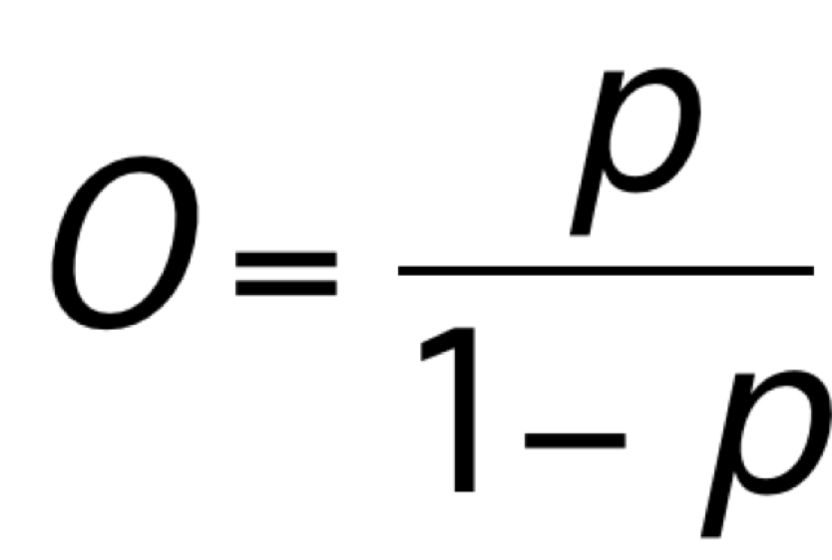

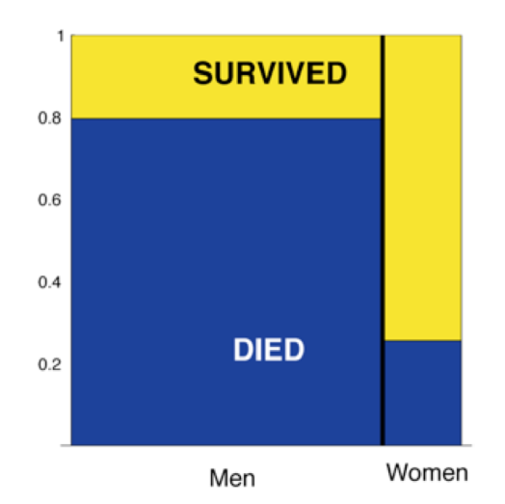
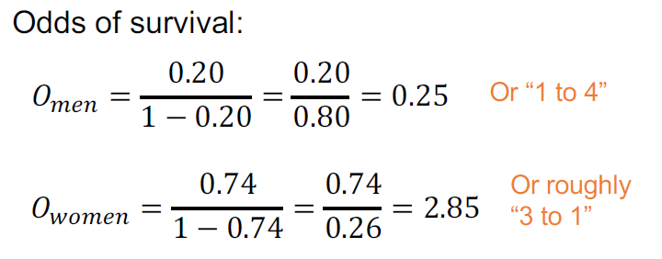
Odds
The probability of success divided by the probability of failure.

Slide 24
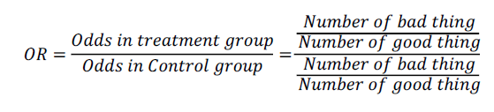
The odds ratio
The odds of success in one group divided by the odds of success in another group.
Used often in medical research
OR < 1 means treatment helps
OR > 1 means treatment makes things worse

Slide 25
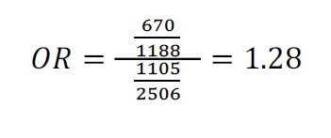
The odds ratio
Odds ratio: ABO blood type and hospitalization for COVID-19
 | A | other
Hospitalized | 670 | 1105
Control | 1188 | 2506

Slide 26
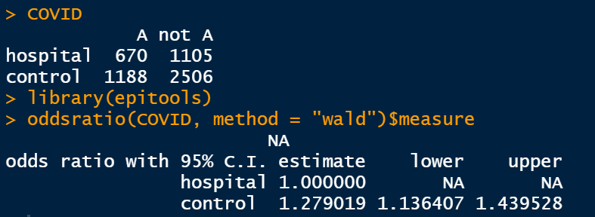
The odds ratio
Odds ratio: ABO blood type and hospitalization for COVID-19
OR < 1 means treatment helps
OR > 1 means treatment makes things worse

Slide 27
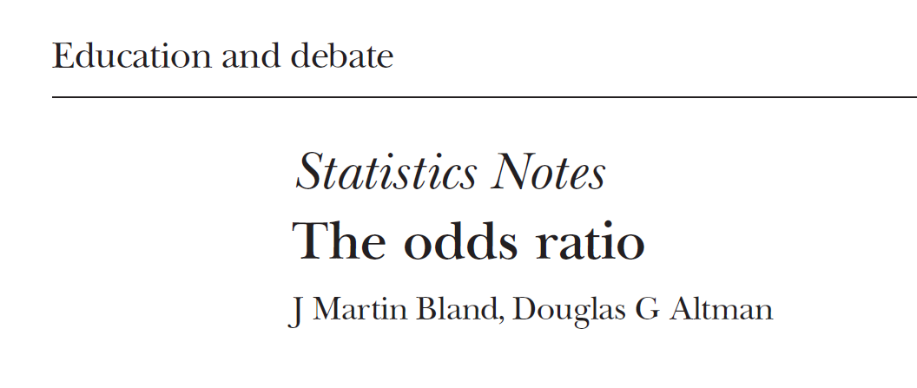
Suggested reading
Bland, J.M., Altman, D.G., 2000. The odds ratio. BMJ 320, 1468. https://doi.org/10.1136/bmj.320.7247.1468

