Slide 1
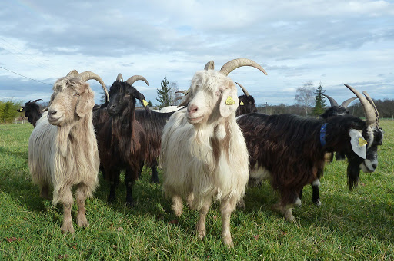
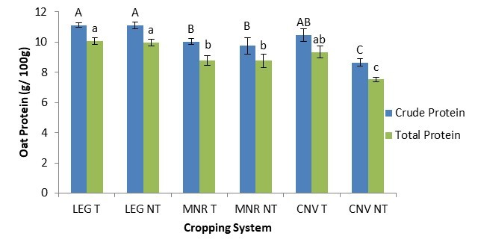



C7041 Experimental Design and Analysis
Ed Harris

Slide 2
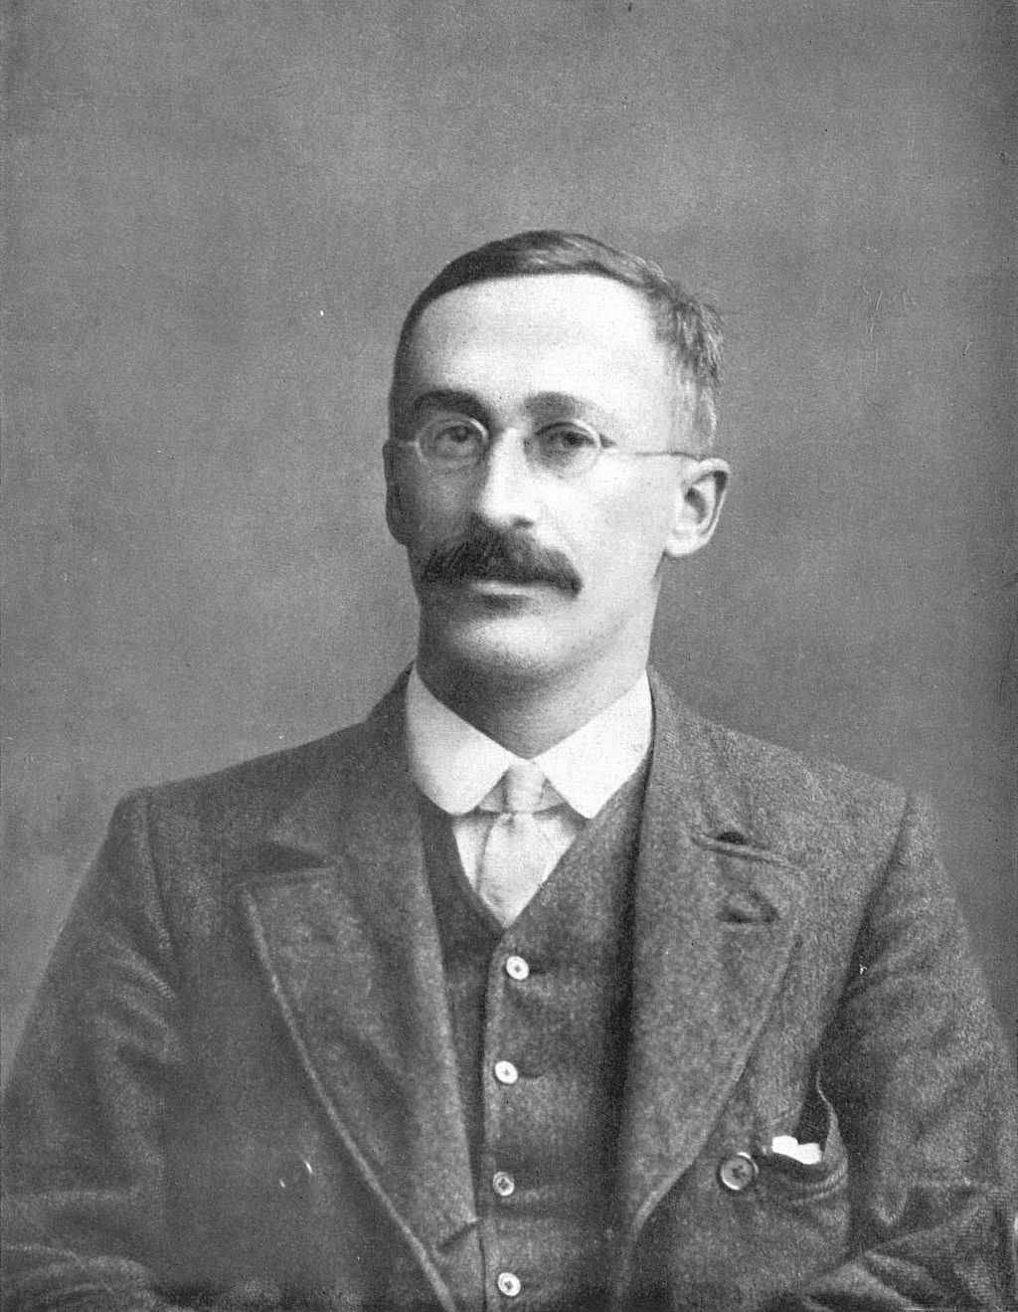
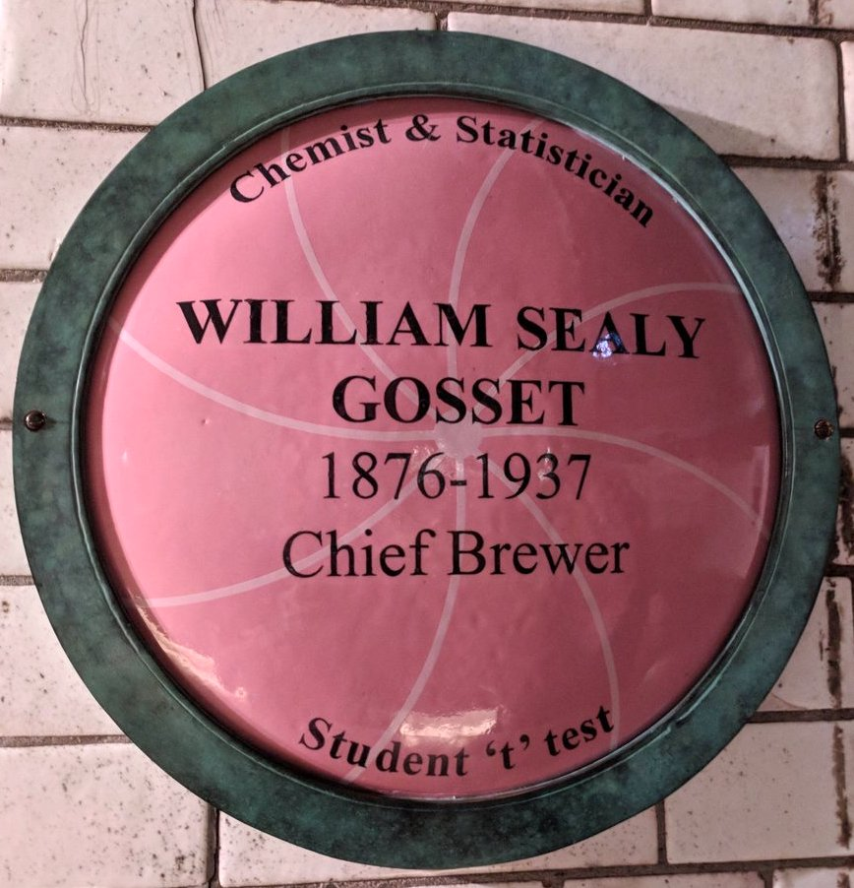

1.12 two sample tests

Slide 3
Comparing means
Tests with one categorical and one numerical variable
Goal: to compare the mean of a numerical variable for different groups

Slide 4
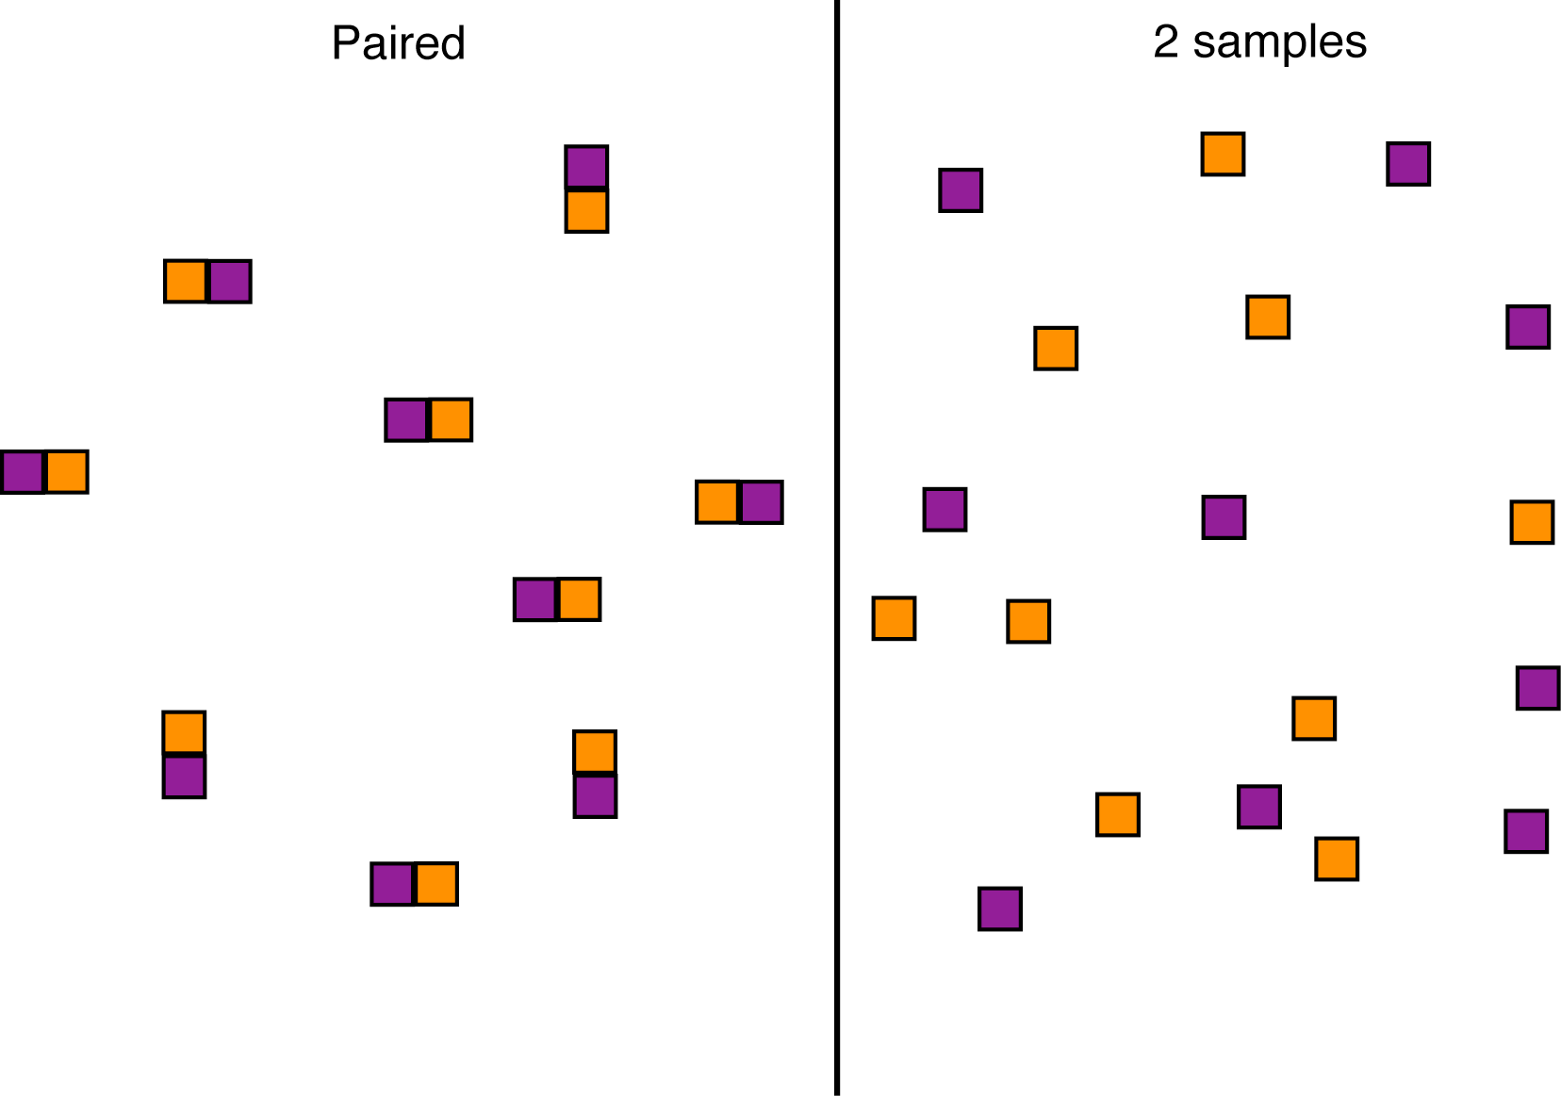
Paired vs. 2 sample comparisons

Slide 5
Paired vs non-paired
Paired comparisons allow us to account for a lot of extraneous variation
2-sample methods are sometimes easier to collect data for
Used to ask different questions

Slide 6
Paired design: Examples
Before and after treatment
Upstream and downstream of a power plant
Identical twins: one with a treatment and one without
Earwigs in each ear: how to get them out? Compare tweezers to hot oil

Slide 7
Paired designs
Data from the two groups are paired
Each member of the pair shares much in common with the other, except for the tested categorical variable
There is a one-to-one correspondence between the individuals in the two groups

Slide 8
Paired comparisons
We have many pairs
In each pair, there is one member that has one treatment and another who has another treatment
("Treatment" can mean "group")

Slide 9
Paired comparisons
To compare two groups, we use
the mean of the difference
between the two members of each pair

Slide 10
Paired t test
Compares the mean of the differences to a value given in the null hypothesis
For each pair, calculate the difference
The paired t-test is simply a one-sample t-test on the differences

Slide 11
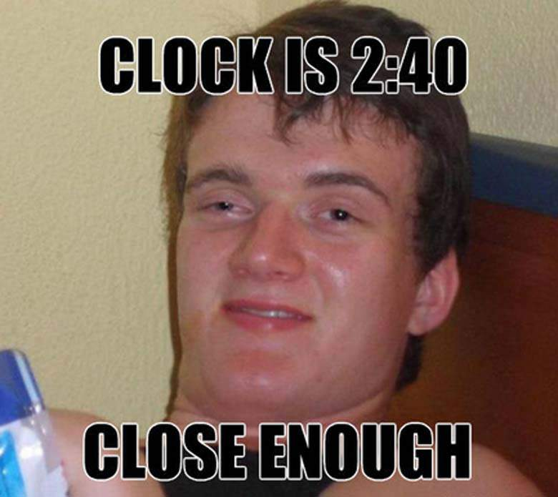
Example: A & E admissions on 4/20
Counted A & E admissions for April 20
Compared to average admissions one week before and after
Each data point is a year
Staples, J.A., et al. 2020. Emergency department visits during the 4/20 cannabis celebration
Emergency Medicine Journal 37:187-192.

Slide 12
Example: A & E admissions on 4/20
year | ER.visits | ER.controls
2009 | 269 | 306.5
2010 | 289 | 283
2011 | 292 | 301.5
2012 | 338 | 304
2013 | 326 | 308
2014 | 340 | 333.5
2015 | 429 | 367
2016 | 404 | 341.5
2017 | 402 | 383
2018 | 379 | 334

Slide 13
Example: A & E admissions on 4/20
Hypotheses
H₀: ER admissions are the same on average on 4/20 as on control days
H_{A}: ER admissions are different on average on 4/20 compared to control days
 |  |  | .

Slide 14
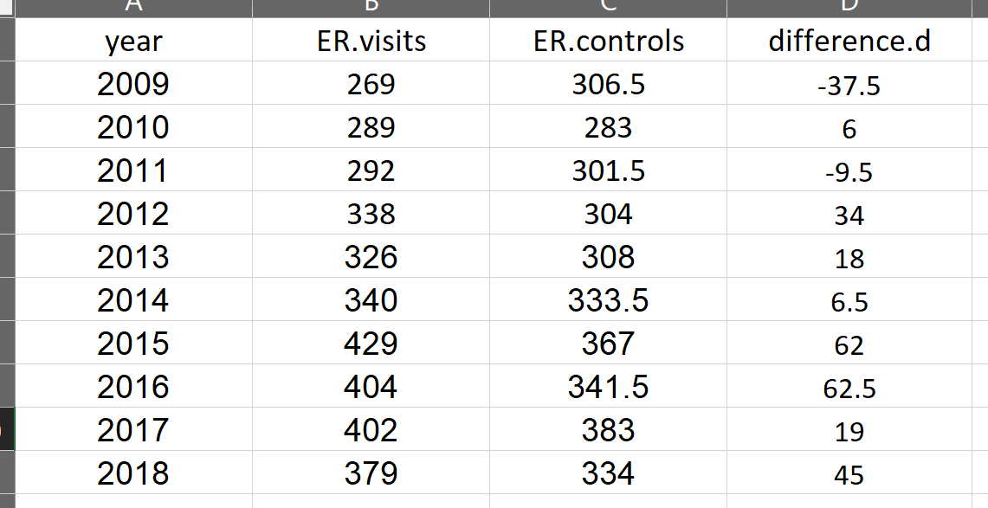
Calculate differences
Example: A & E admissions on 4/20

Slide 15
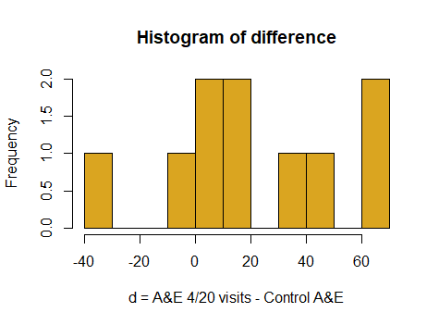
Example: A & E admissions on 4/20

Slide 16
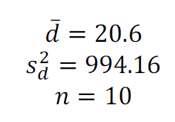
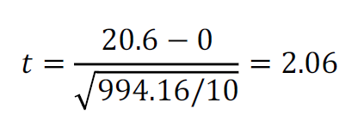
Example: A & E admissions on 4/20
Calculate t using d values

Slide 17
Example: A & E admissions on 4/20
Important!
The number of data points in a paired t test is the number of pairs -- Not the number of individuals
Degrees of freedom = Number of pairs - 1

Slide 18
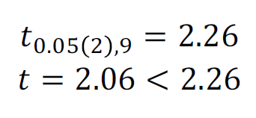
Critical value of t
Example: A & E admissions on 4/20
So we cannot reject the null hypothesis. There is insufficient evidence that ER visits increase on 4/20.

Slide 19
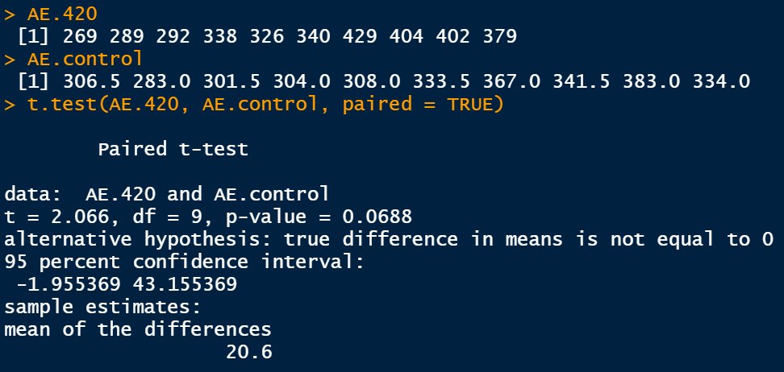
Example: A & E admissions on 4/20
R for paired t-test

Slide 20
Assumptions of paired t test
Pairs are chosen at random
The differences have a Gaussian distribution
It does not assume that the individual values are Gaussian distributed,
only the differences.

Slide 21
Comparing the means of two groups
Hypothesis test: 2-sample t test

Slide 22
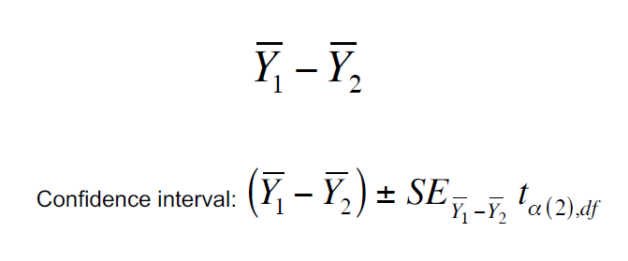
Estimation: Difference between two means

Slide 23
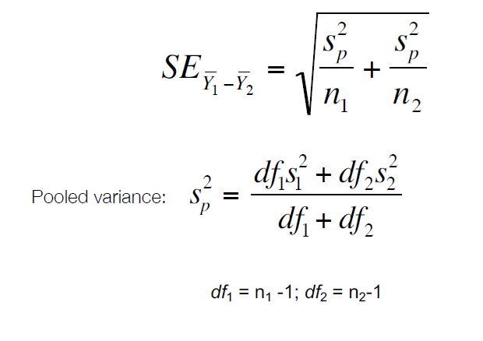
Standard error of difference in means

Slide 24
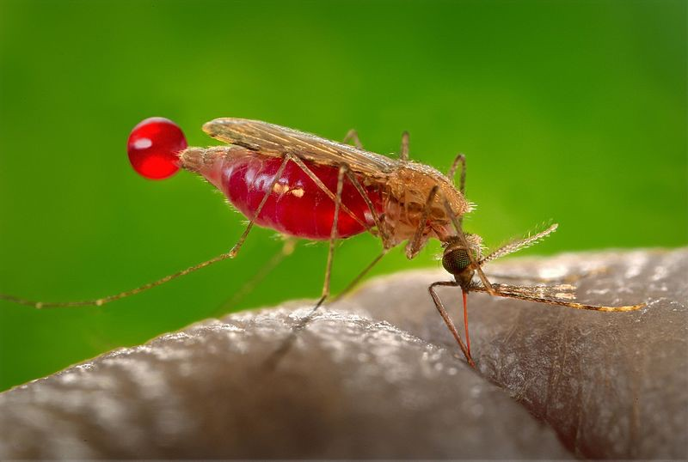
Malaria, mosquitoes and beer
Mosquitoes find prey by odor
Are mosquito biting rates affected by beer consumption?
Anopheles gambiae
Lefèvre, T. et al. 2010. Beer consumption increases human attractiveness to malaria mosquitoes. PLoS ONE 5: e9546
.

Slide 25
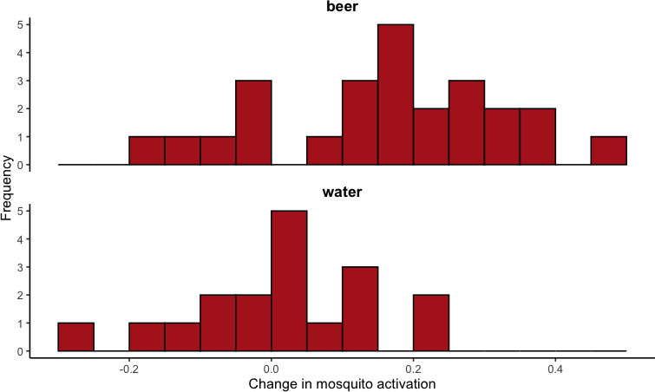
Malaria, mosquitoes and beer

Slide 26
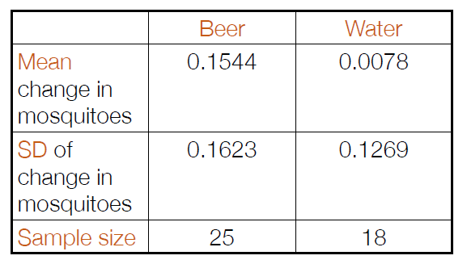
Data, summarized
Malaria, mosquitoes and beer
Both distributions are approximately Gaussian

Slide 27
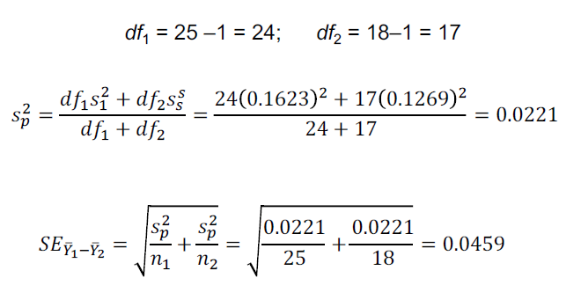
Malaria, mosquitoes and beer
Calculating the standard error

Slide 28
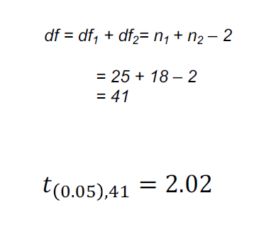
Malaria, mosquitoes and beer
Finding t

Slide 29
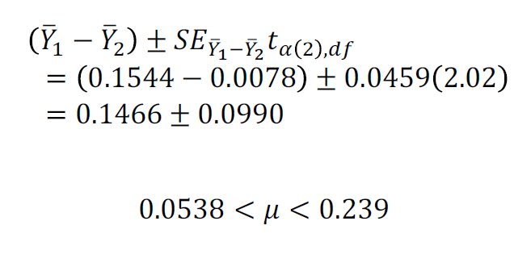
Malaria, mosquitoes and beer
The 95% confidence interval of the difference in the means

Slide 30
Testing hypotheses about the difference in two means
Malaria, mosquitoes and beer
2-sample t-test
The two sample t-test compares the means of a numerical variable between two populations.

Slide 31
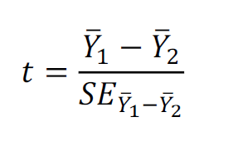
Malaria, mosquitoes and beer
2-sample t-test

Slide 32
Malaria, mosquitoes and beer
Hypotheses
H₀: There is no difference between the mosquito activation between beer and water drinkers. (μ₁ = μ₂)
H_{A}: The beer and water drinkers differ in their mean mosquito activation. (μ₁ ≠ μ₂)

Slide 33
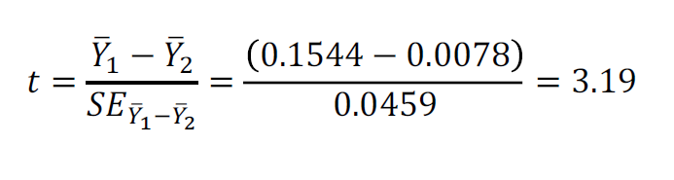
Malaria, mosquitoes and beer
Calculating t

Slide 34

Malaria, mosquitoes and beer
Drawing conclusions...
t > 2.02, so we reject the null hypothesis.
These data suggest that beer drinkers attract more mosquitoes than water drinkers.

Slide 35
Assumptions of two-sample t-tests
Both samples are random samples.
Both populations have Gaussian distributions
The variance of both populations is equal.

Slide 36
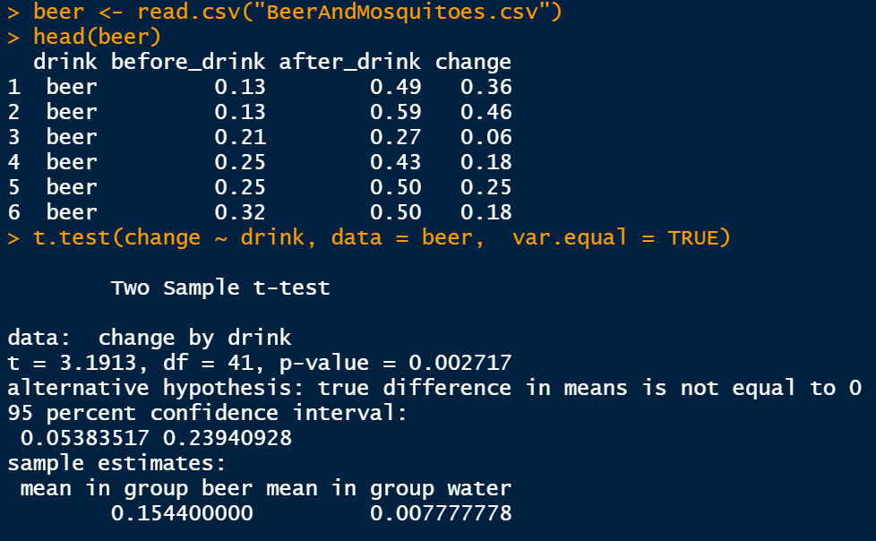
2-sample t-test in R

Slide 37
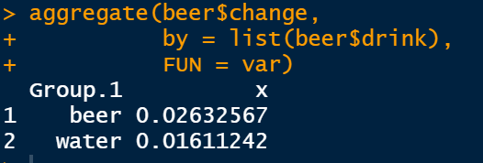
Relaxing equal variance assumption: Welch’s t-test
Welch’s t-test compares the means of two groups without requiring the assumption of equal variance.

Slide 38
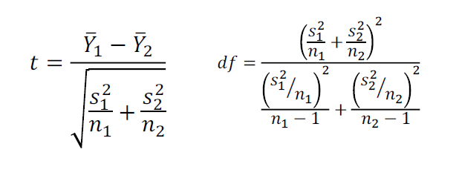
Relaxing equal variance assumption: Welch’s t-test
Welch’s t

Slide 39
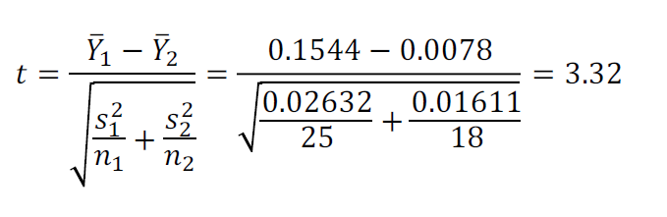
Relaxing equal variance assumption: Welch’s t-test
Welch’s t for mosquito and beer

Slide 40
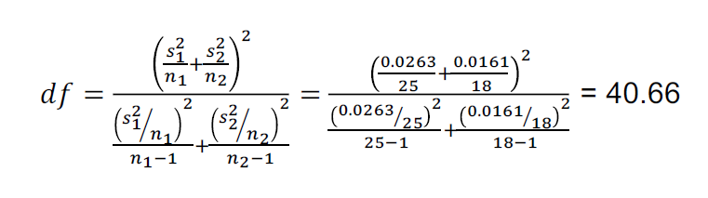
Relaxing equal variance assumption: Welch’s t-test
Degrees of freedom
Note that the df are not necessarily an integer here.

Slide 41
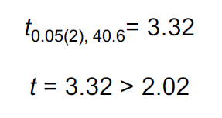
Relaxing equal variance assumption: Welch’s t-test
Reaching a conclusion
So we can reject the null hypothesis with P<0.05
Beer attract mosquitoes more than water

Slide 42
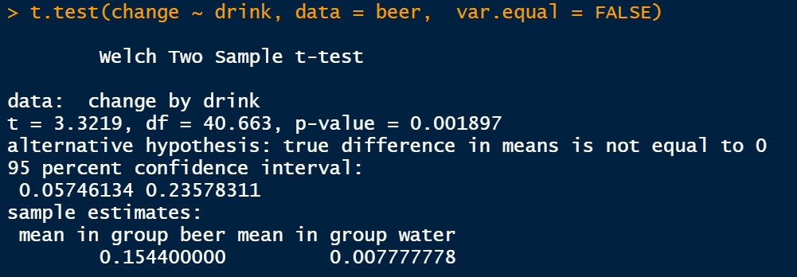
Relaxing equal variance assumption: Welch’s t-test
Welch’s t-test in R

Slide 43
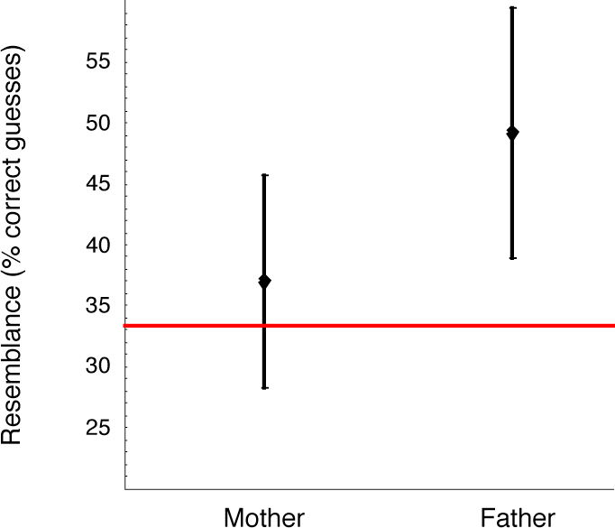
The wrong way to compare two groups
"Group 1 is significantly different from a constant, but Group 2 is not. Therefore Group 1 and Group 2 are different from each other."

Slide 44
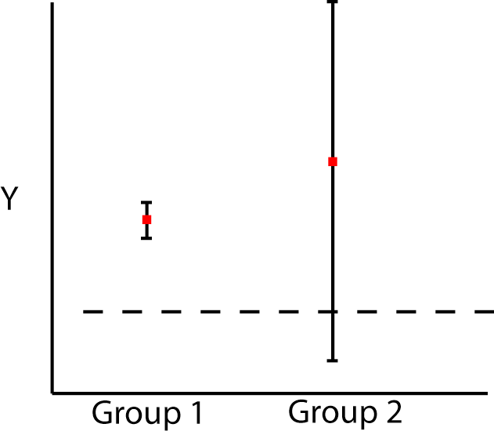
The wrong way to compare two groups
A more extreme case...

Slide 45
Comparing means when variances are not equal
Welch's t-test
Welch's t-test approximates the mean difference of two Gaussian distributed populations that have unequal variances.

Slide 46
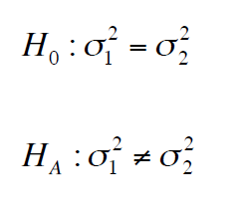
Comparing the variance of two groups

Slide 47
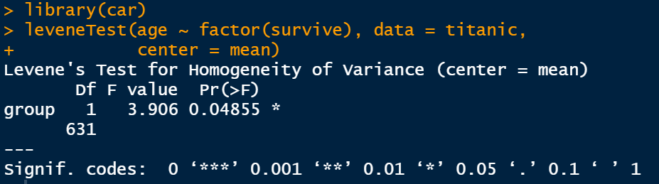
Comparing the variance of two groups
Levene’s test
Compares the variances of two (or more) groups

Slide 48
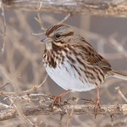
Example: Comparing apparent and realized reproductive success
Variance is crucial to evolution
Apparent reproductive success assigns offspring to “social males”
Realized reproductive success assigns paternity by genotyping
Song sparrow
Melospiza melodia
Is there a lot more variance among males in reproductive success than we think?

Slide 49
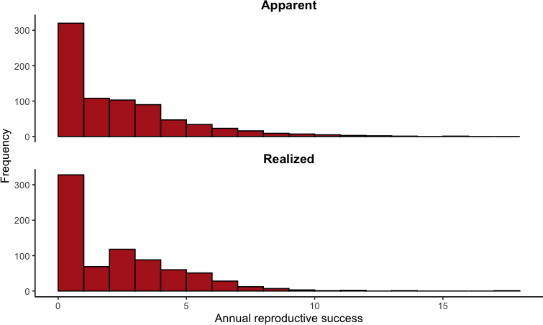
Example: Comparing apparent and realized reproductive success
Data from song sparrows on Mandarte Island

Slide 50
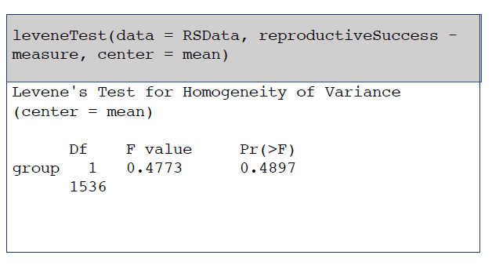
Levene’s test in R
Example: Comparing apparent and realized reproductive success
These data show no strong evidence for increased variance in reproductive success in the realized data.

Slide 51
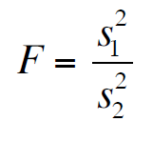
Note about the F test
The most commonly used test to compare variances
The F test is very sensitive to its assumption that both distributions are Gaussian
Therefore use Levene’s test instead!

Slide 52
Comparing the means of two groups
Summary
We can compare the means of two groups, using the mean of paired differences or the mean difference between two groups
Paired data can be analyzed using the differences between two members of the pairs.
(confidence intervals just like single sample on the differences; paired t-tests)

Slide 53
Comparing the means of two groups
Summary
Two-sample comparisons can be done with 2-sample t-test or Welch’s t-test.
Both assume Gaussian distributed variables. 2- sample assumes equal variance; Welch’s does not.
The variances of two groups can be compared with a Levene’s test.

