Slide 1
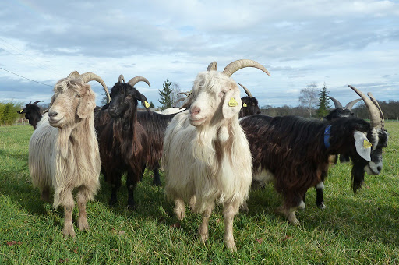
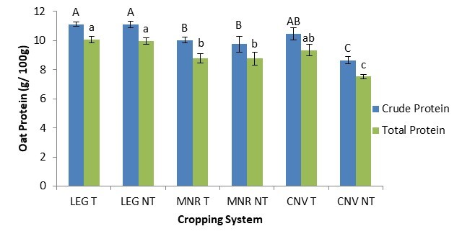



C7041 Experimental Design and Analysis
Ed Harris

Slide 2
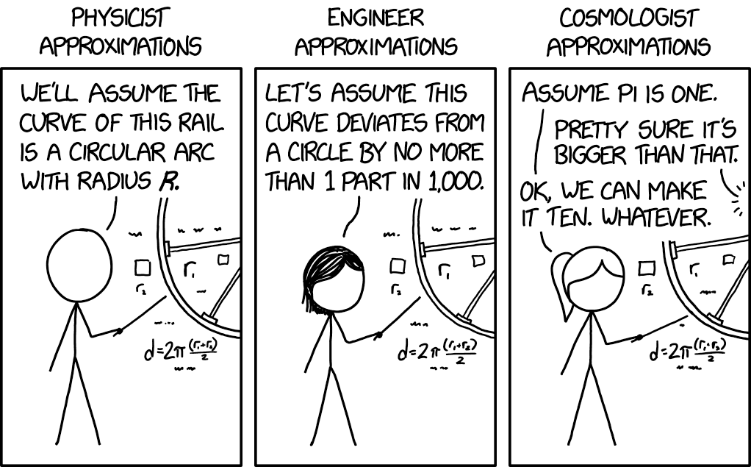
1.13 Violating assumptions

Slide 3
Assumptions of t-tests
Violating assumptions
Random sample(s)
Populations are Gaussian distributed
(for 2-sample t) Populations have equal variances

Slide 4
Violating assumptions
Detecting deviations from Gaussian
Previous data / theory
Histograms
Quantile plots
Shapiro-Wilk test

Slide 5
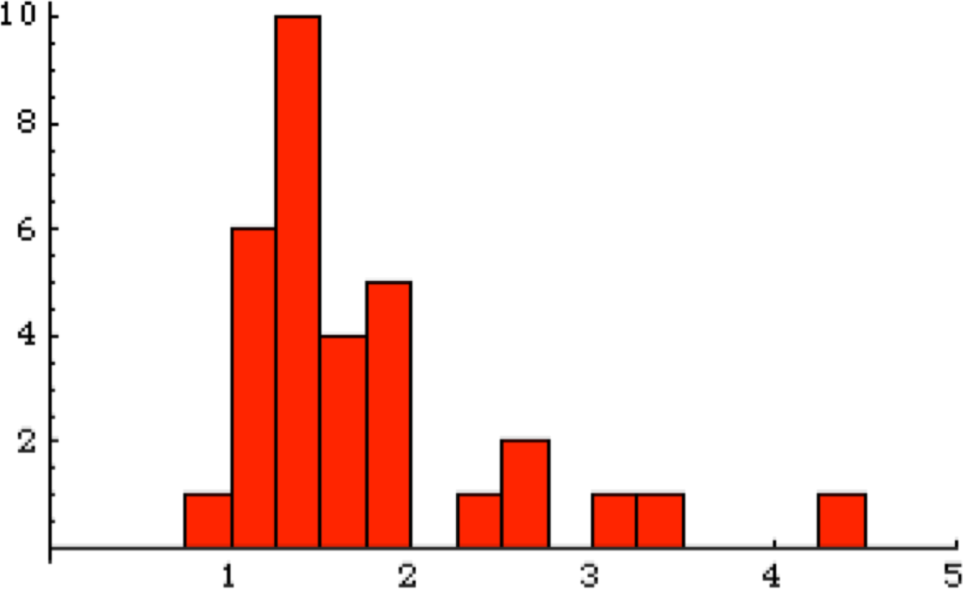
Violating assumptions
Detecting deviations from normality: by histogram
Frequency
Biomass ratio

Slide 6
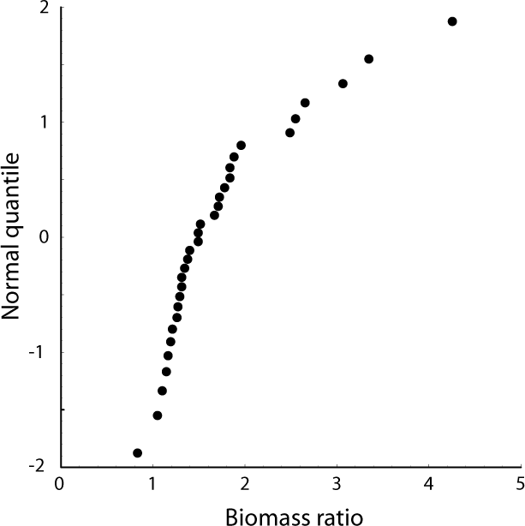
Detecting deviations from normality: by quantile plot
Violating assumptions
Gaussian line of prediction

Slide 7
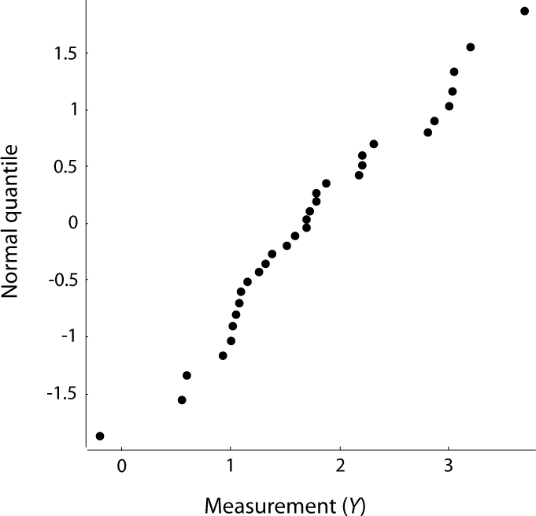
Violating assumptions
Detecting deviations from normality: by quantile plot
Gaussian data

Slide 8
Violating assumptions
Detecting differences from Gaussian: Shapiro-Wilk test
A Shapiro-Wilk test is used to test statistically whether a set of data comes from a Gaussian distribution.

Slide 9
Violating assumptions
What to do when the assumptions are not true: options
If the sample sizes are large, sometimes the parametric tests work OK anyway
Transformations
Non-parametric tests
Permutation tests
Bootstrapping

Slide 10
The Gaussian approximation
Violating assumptions
Means of large samples are Gaussian distributed
Therefore, the parametric tests on large samples work relatively well, even for non-Gaussian data
Rule of thumb: if n > ~50, the Gaussian approximations may work.

Slide 11
Violating assumptions
Parametric tests - Unequal variance
Welch s t-test is ideal.
If sample sizes are equal and large, then even a ten-fold difference in variance is approximately OK. (But Welch’s is still better.)

Slide 12
Violating assumptions
Data transformations
A data transformation changes each data point by some simple mathematical formula.

Slide 13
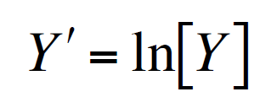
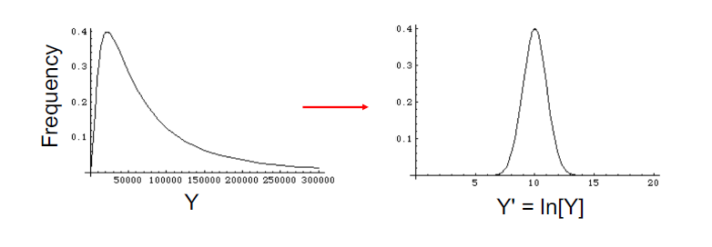
Violating assumptions
Log-transformation

Slide 14
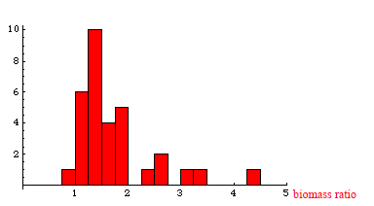
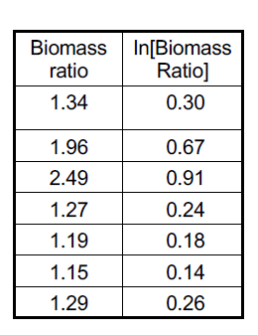
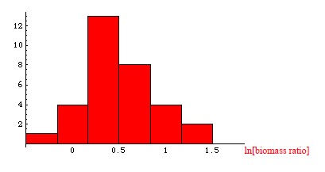
Violating assumptions
Carry out the test on the transformed data!

Slide 15
Violating assumptions
The log transformation is often useful when
the variable is likely to be the result of multiplication or division of various components.
the frequency distribution of the data is skewed to the right
the variance seems to increase as the mean gets larger ( in comparisons across groups).

Slide 16
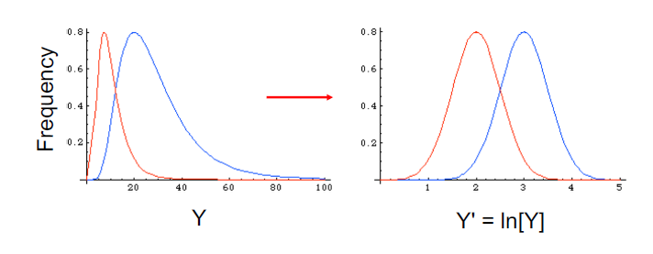
Violating assumptions
Variance and mean increase together
--> try the log-transform

Slide 17
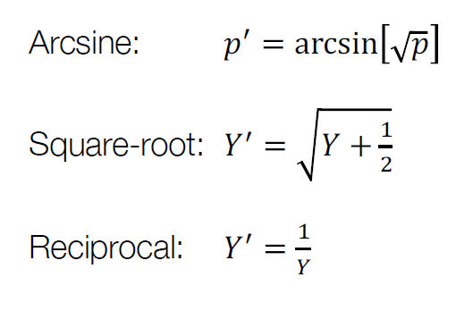
Violating assumptions
Other transformations

Slide 18
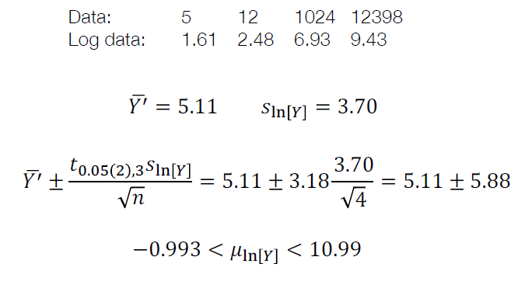
Example: Confidence interval with log-transformed data
Violating assumptions

Slide 19
Violating assumptions
Valid transformations...
Require the same transformation be applied to each individual
Have one-to-one correspondence to original values
Have a monotonic relationship with the original values (e.g., larger values stay larger)

Slide 20
Violating assumptions
Choosing transformations
Must transform each individual in the same way
The transformed values must still carry biological meaning.
You CANNOT keep trying transformations until P <0.05!!!

Slide 21
Violating assumptions
Non-parametric methods
Assume less about the underlying distributions
Also called "distribution-free"
"Parametric" methods assume a distribution or a parameter

Slide 22
Violating assumptions
Sign test
Non-parametric test
Compares data from one sample to a constant
Simple: for each data point, record whether individual is above (+) or below (–) the hypothesized constant.
Use a binomial test to compare result to 1/2.

Slide 23
Example: Polygamy and the origin of species
Violating assumptions
Is polygamy associated with higher or lower speciation rates?

Slide 24
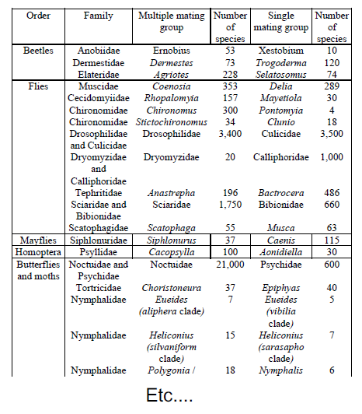
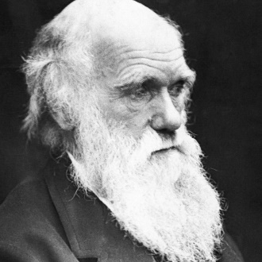
Violating assumptions
Data:

Slide 25
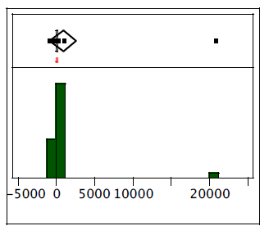
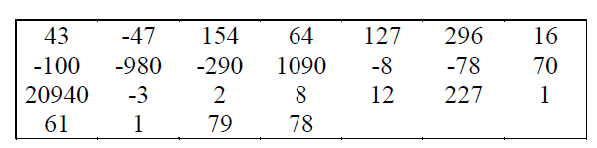
Violating assumptions
The differences are not normal

Slide 26
Hypotheses
Violating assumptions
H₀: The median difference in number of species between singly-mating and multiply-mating insect groups is 0.
H_{A}: The median difference in number of species between these groups is not 0.

Slide 27
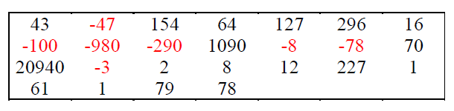
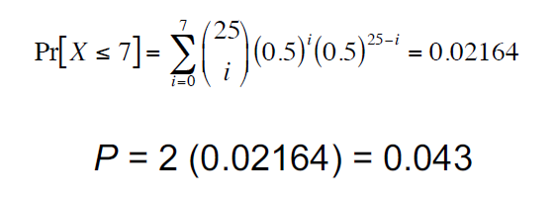
Violating assumptions
7 out of 25 comparisons are negative
Binomial test on pluses and minuses (compared to p = 0.5):

Slide 28
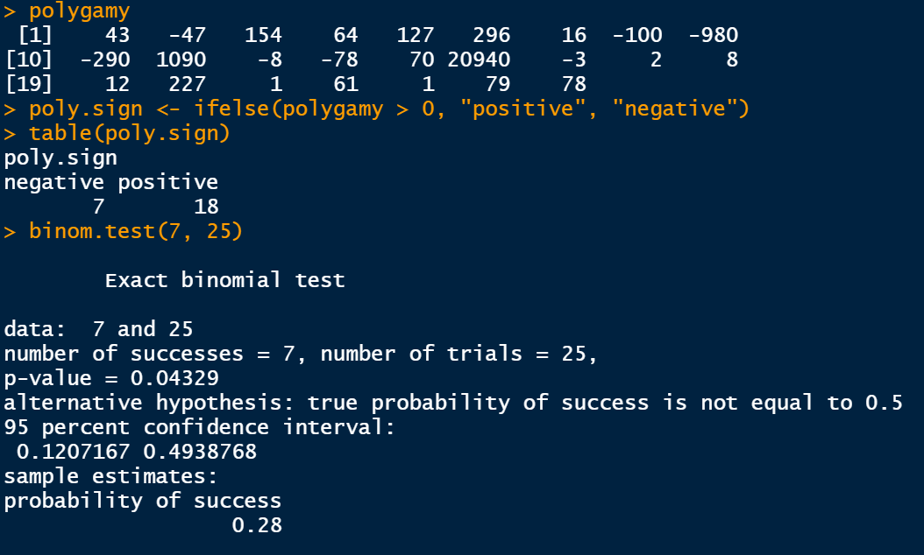
Violating assumptions
Sign test in R

Slide 29
Violating assumptions
The sign test has very low power
So it is quite likely to not reject a false null hypothesis.

Slide 30
Most non-parametric methods use RANKS
Violating assumptions
Rank each data point in all samples from lowest to highest.
Lowest data point gets rank 1, next lowest gets rank 2, ...

Slide 31
Violating assumptions
Non-parametric test to compare 2 groups
The Mann-Whitney U test compares the central tendencies of two groups using ranks.

Slide 32
Violating assumptions
Performing a Mann-Whitney U test
First, rank all individuals from both groups together in order (for example, smallest to largest).
Sum the ranks for all individuals in each group --> R₁ and R₂

Slide 33
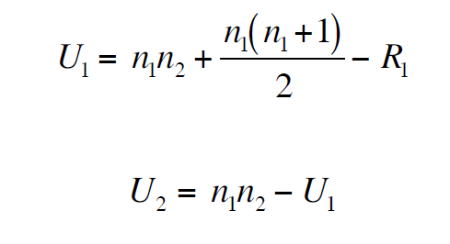
Violating assumptions
Calculating the test statistic, U
U₁ is the number of times an individual from pop. 1 has a lower rank than an individual from pop. 2, out of all pairwise comparisons.

Slide 34
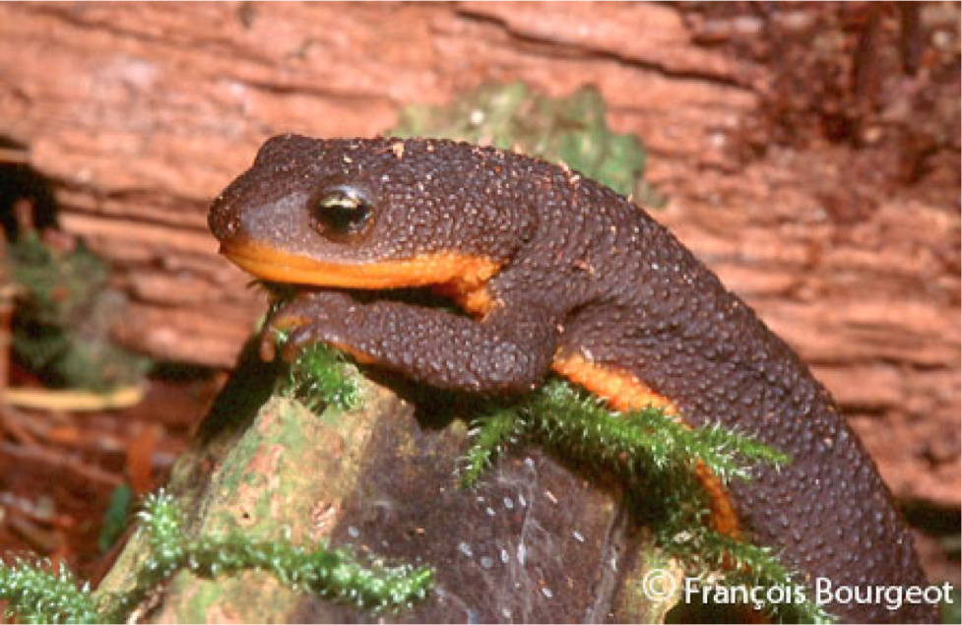
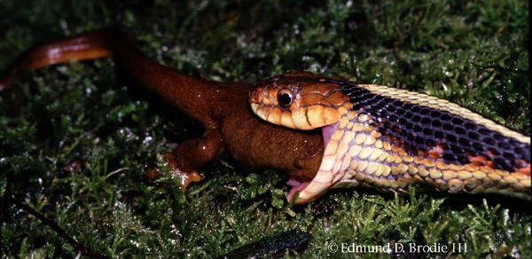
Example: Garter snake resistance to newt toxin
Violating assumptions
Rough-skinned newt
Taricha granulosa
Garter snake
Thamnophis sirtalis

Slide 35
Violating assumptions
Comparing snake resistance to TTX (tetrodotoxin)
Locality | Resistance
Benton | 0.29
Benton | 0.77
Benton | 0.96
Benton | 0.64
Benton | 0.70
Benton | 0.99
Benton | 0.34
Warrenton | 0.17
Warrenton | 0.28
Warrenton | 0.20
Warrenton | 0.20
Warrenton | 0.37
This variable is known to be non-Gaussian within populations.

Slide 36
Violating assumptions
Hypotheses
H₀: The TTX resistance for snakes from Benton is the same as for snakes from Warrenton.
H_{A}: The TTX resistance for snakes from Benton is different from snakes from Warrenton.

Slide 37
Violating assumptions
Calculating the ranks
Locality | Resistance | Rank
Benton | 0.29 | 5
Benton | 0.77 | 10
Benton | 0.96 | 11
Benton | 0.64 | 8
Benton | 0.70 | 9
Benton | 0.99 | 12
Benton | 0.34 | 6
Warrenton | 0.17 | 1
Warrenton | 0.28 | 4
Warrenton | 0.20 | 2.5
Warrenton | 0.20 | 2.5
Warrenton | 0.37 | 7
Rank sum for Warrenton:
R=1+4+2.5+2.5+7=17

Slide 38
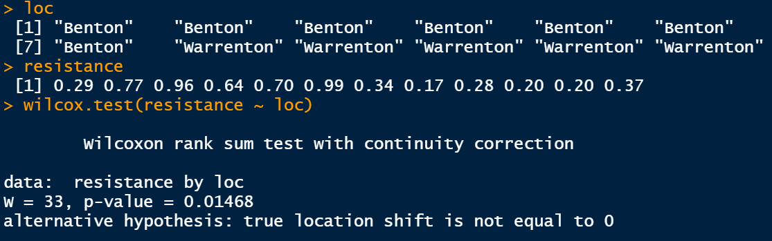
Mann-Whitney test in R
(equivalent to Wilcoxon rank sum test)
Violating assumptions

Slide 39
Violating assumptions
Assumptions of Mann-Whitney U test
Both samples are random samples.
Both populations have the same shape of distribution.*
* Only necessary when using Mann-Whitney to compare means.

Slide 40
Violating assumptions
Permutation tests
Used for hypothesis testing on measures of association
Mixes the real data randomly

Slide 41
Violating assumptions
Permutation tests
Variable 1 from an individual is paired with variable 2 data from a randomly chosen individual. This is done for all individuals.
The estimate is made on the randomized data.
The whole process is repeated numerous times. The distribution of the randomized estimates is the null distribution.

Slide 42
Without replacement
Violating assumptions
Permutation tests are done without replacement.
In other words, all data points are used exactly once in each permuted data set.

Slide 43
Violating assumptions
Permutation can be done for any test of association between two variables

Slide 44
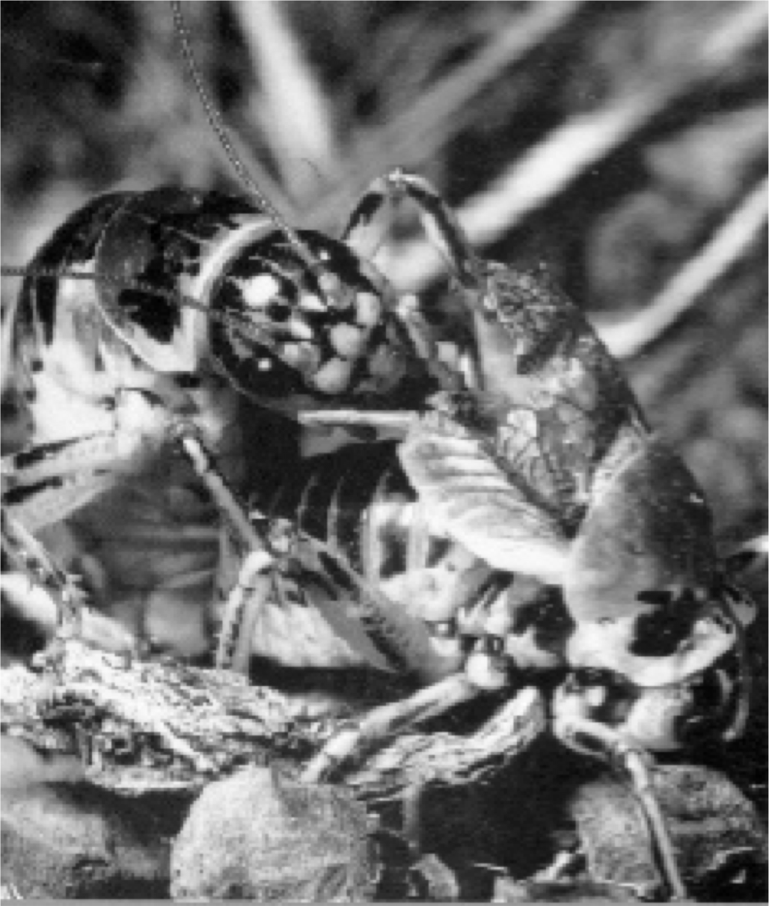
Violating assumptions
Example: Sagebrush crickets
Cyphoderris strepitans
Sage cricket males sometimes offer their hind-wings to females to eat during mating.
Do females who eat hind-wings wait longer to re-mate?

Slide 45
Violating assumptions
Waiting time to remating in sage cricket females after initial mating with either a wingless or winged male (presented in ln(days))
Male wingless | Male winged
0 | 1.4
0.7 | 1.6
0.7 | 1.9
1.4 | 2.3
1.6 | 2.6
1.8 | 2.8
1.9 | 2.8
1.9 | 2.8
1.9 | 3.1
2.2 | 3.8
2.1 | 3.9
2.1 | 4.5
 | 4.7

Slide 46
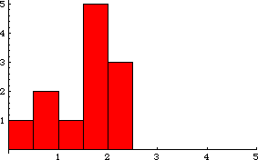
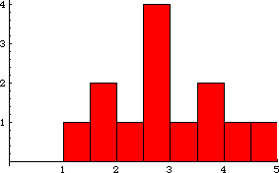
Violating assumptions
ln(Time to remating):
no wings
Problems: Unequal variance,
non-Gaussian distributions
ln(Time to remating):
intact wings

Slide 47


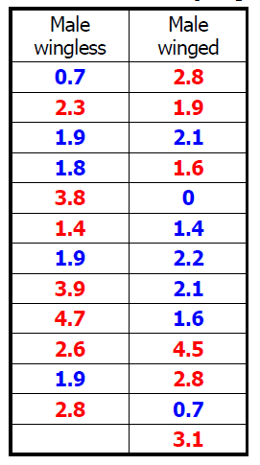
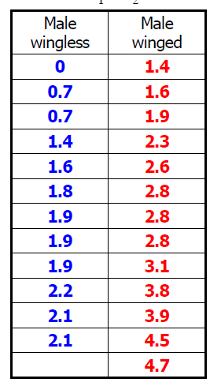
Violating assumptions
Permutation
Note that each data point was only used once

Slide 48
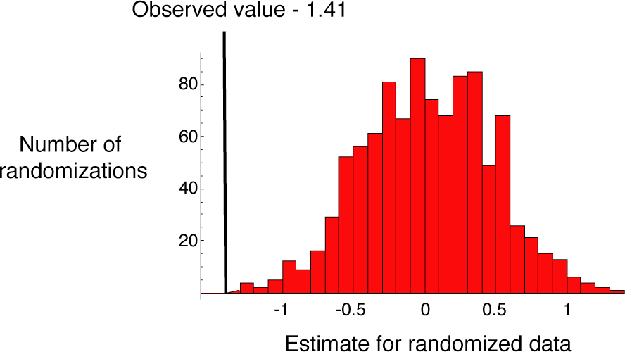
Violating assumptions
1000 permutations
P < 0.001

Slide 49
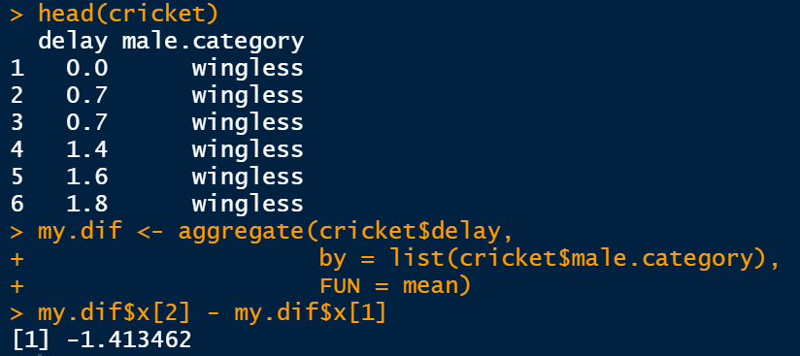
A permutation approach in R
Violating assumptions
Calculate the real, observed difference

Slide 50
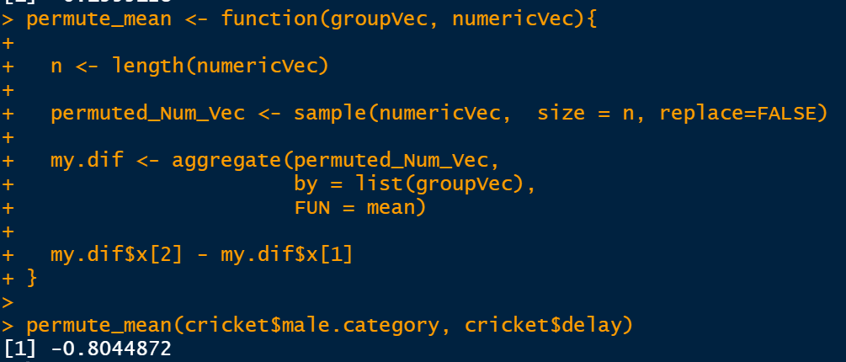
A permutation approach in R
Violating assumptions
Calculate the random permuted difference
Note: this is just one possible answer from the permutation.

Slide 51
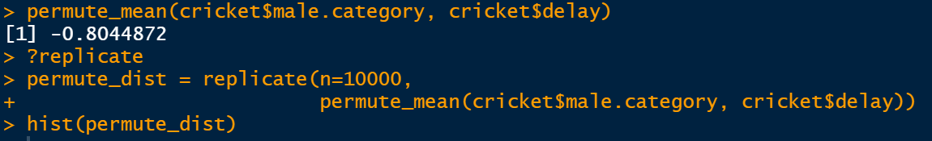
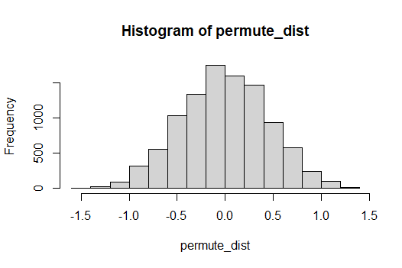

A permutation approach in R
Violating assumptions
Now permute difference 10,000 times!

Slide 52
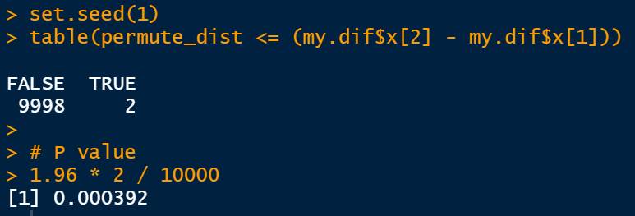
A permutation approach in R
Violating assumptions
Is our OBSERVED difference LIKELY at random?
So the P-value for this test is P = 0.000392

Slide 53
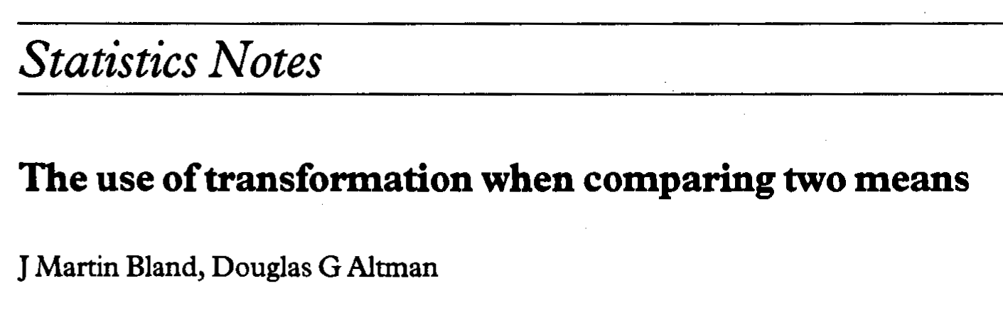
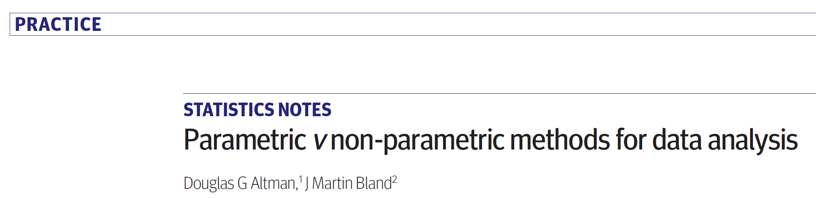
Suggested reading
Altman, D.G., Bland, J.M., 2009. Parametric v non-parametric methods for data analysis. BMJ 338. https://doi.org/10.1136/bmj.a3167
Bland and Altman - 1996 - Statistics Notes The use of transformation when comparing 2 means BMJ 1996; 312 doi: https://doi.org/10.1136/bmj.312.7039.1153

