Slide 1
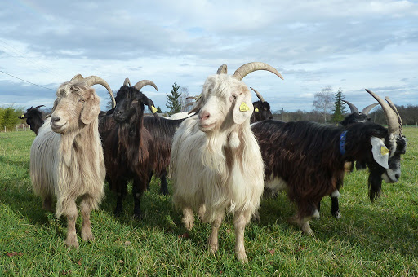
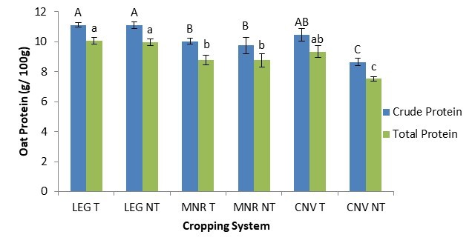

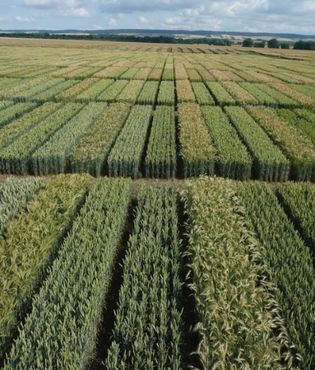

C7041 Experimental Design and Analysis
Ed Harris

Slide 2
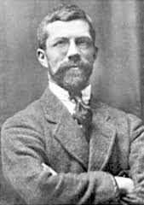
1.15 ANOVA
“The analysis of variance is not a mathematical theorem, but rather a convenient method of arranging the arithmetic.”
-R. A. Fisher

Slide 3
Analysis of variance (ANOVA)
Like a t-test, but can compare more than two groups
Asks whether any of two or more means is different from any other.
In other words, is the variance among groups greater than 0?

Slide 4
Null hypothesis for simple ANOVA
H₀ : Variance among groups = 0
OR
H₀ : μ₁ = μ₂ = μ₃ = μ₄ = ... μ_{k}

Slide 5
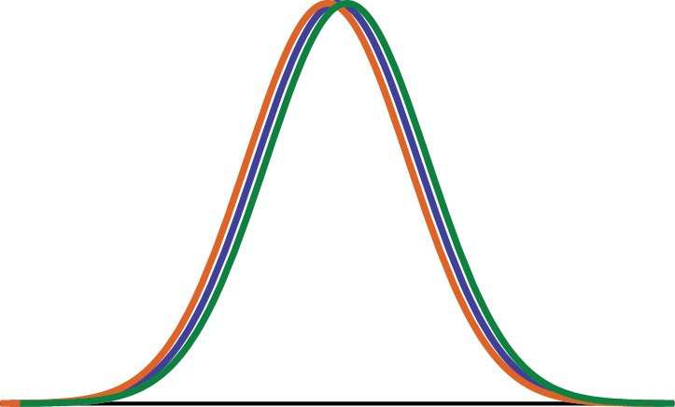
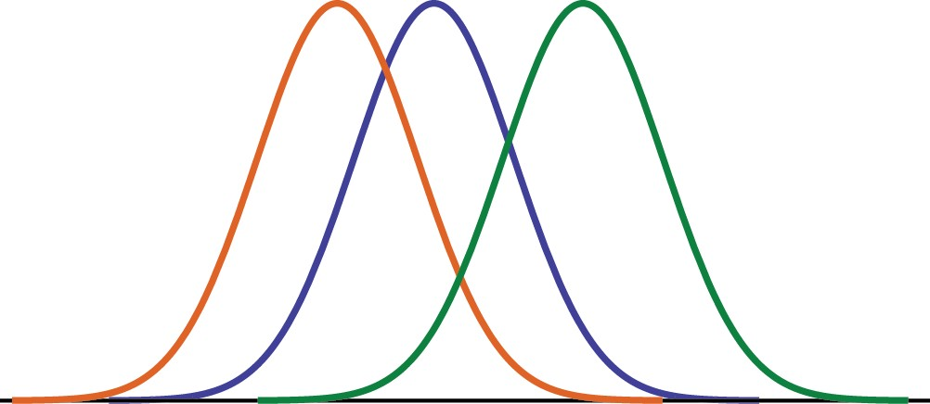
Null hypothesis for simple ANOVA
H₀: all populations have equal means
H_{A}: at least one population mean is different.

Slide 6
ANOVA's v. t-tests
An ANOVA with 2 groups is mathematically equivalent to a two-tailed 2-sample t-test.

Slide 7
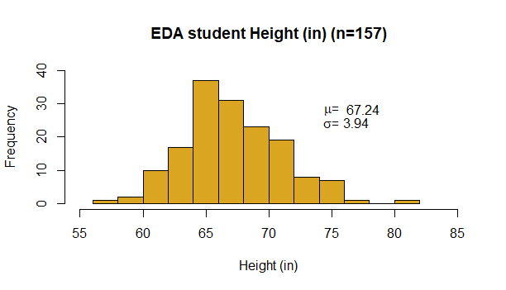
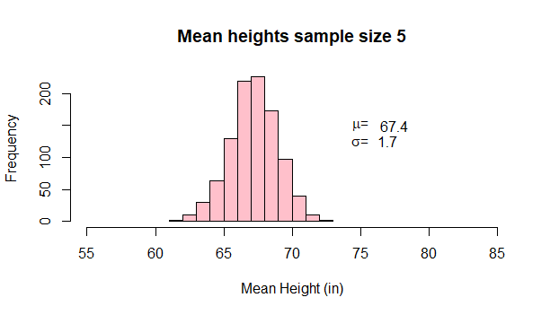



Sampling distribution of Y
If we draw multiple samples from the same population, we are also drawing sample means from an expected distribution.
Sampling
distribution of $\overline{\text{Y}}$

Slide 8
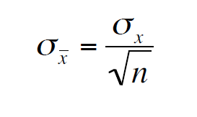
Under the null hypothesis, the sample mean of each group should vary because of sampling error.
The standard deviation of sample means, when the true mean is constant, is the standard error:

Slide 9
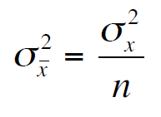
Squaring the standard error, the variance among groups due to sampling error should be:
In ANOVA, we work with variances rather than standard deviations.

Slide 10
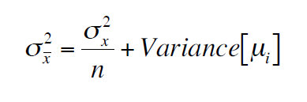
If the null hypothesis is not true, the variance among groups should be equal to the variance due to sampling error plus the real variance among population means.

Slide 11
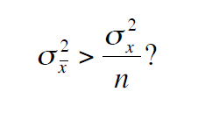
With ANOVA, we test whether the variance among true group means is greater than zero.
We do this by asking whether the observed variance among groups is greater than expected by chance (assuming the null is true):

Slide 12
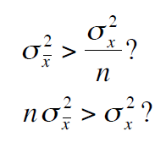
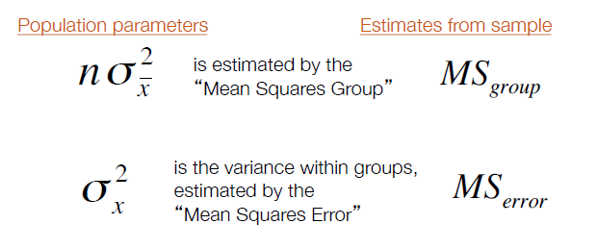

Slide 13
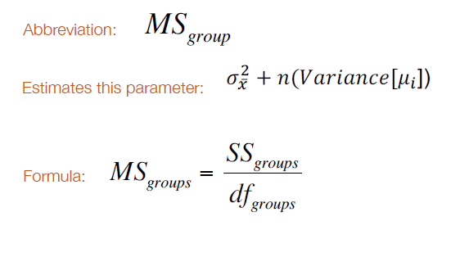
Mean squares group

Slide 14
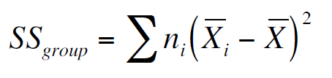
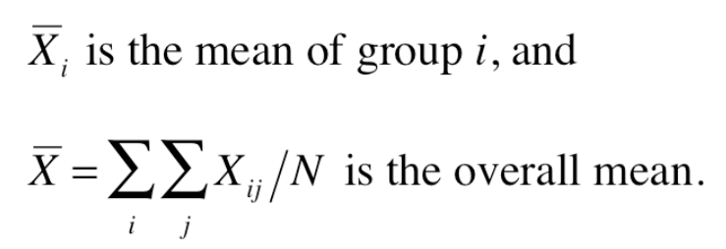
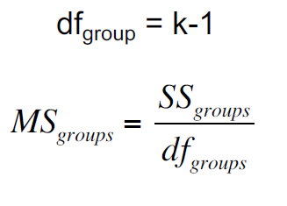
Mean squares group

Slide 15
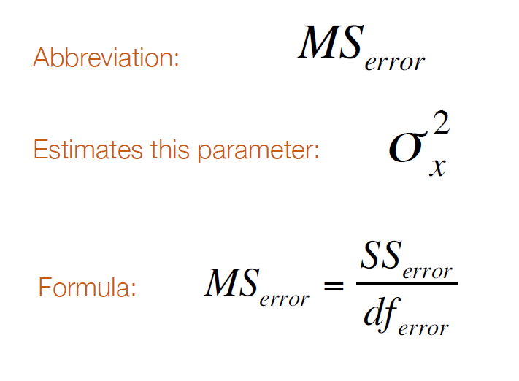
Mean squares error

Slide 16
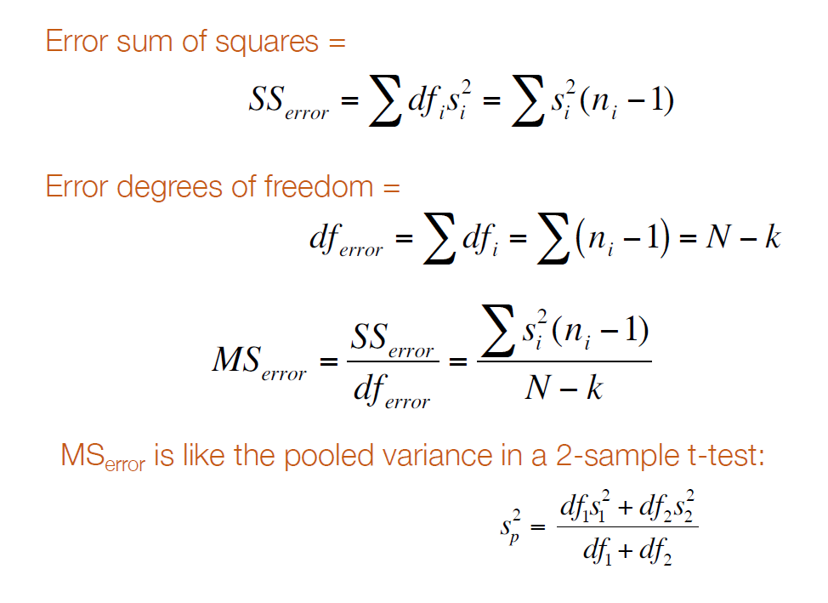
Mean squares error

Slide 17
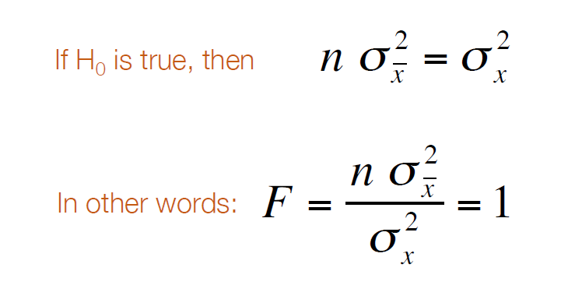
Test statistic: F
But the above refers to population parameters.
We must estimate F from samples with:
MS_{group} / MS_{error}

Slide 18
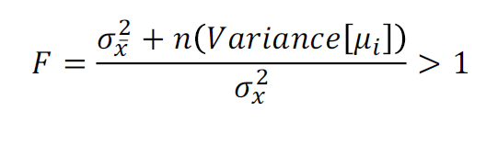
F if null hypothesis is false:
We test whether the F ratio is greater than one, as it would be if H_{0 is} false:
But we must take into account sampling error. Often, F calculated from data will be greater than one even when the null is true. Hence we must compare F to a null distribution.

Slide 19
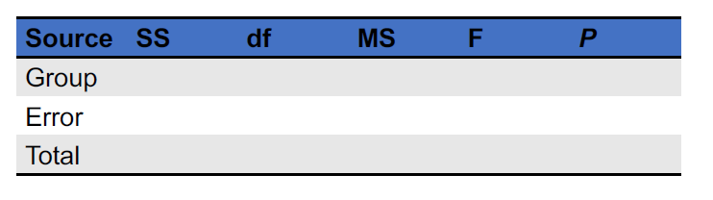
ANOVA table
An ANOVA table is a convenient way to keep track of the important calculations.
Scientific papers often report ANOVA results with ANOVA tables.

Slide 20
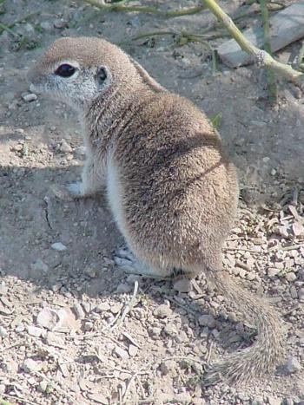
Example: Body temperature of squirrels in low, medium and hot environments
Round-tailed ground squirrel
Spermophilus tereticaudus
Wooden & Walsberg (2004) Body temperature and locomotor capacity in a heterothermic rodent. Journal of Experimental Biology 207:41-46. doi: 10.1242/jeb.00717

Slide 21
Example: Body temperature of squirrels in low, medium and hot environments
Squirrel body temperature data (°C)
Cold: 30.4, 31.0, 31.2, 31.0, 31.5, 30.4, 30.6, 31.1,
31.3, 31.9, 31.4, 31.6, 31.5, 31.4, 30.3, 30.5,
30.3, 30.0, 30.8, 31.0
Warm: 36.3, 37.5, 36.9, 37.2, 37.5, 37.7, 37.5, 37.7,
38.0, 38.0, 37.6, 37.4, 37.9, 37.2, 36.3, 36.2,
36.4, 36.7, 36.8, 37.0, 37.7
Hot: 40.7, 40.6, 40.9, 41.1, 41.5, 40.8, 40.5, 41.0,
41.3, 41.5, 41.3, 41.2, 40.7, 40.3, 40.2, 41.3,
40.7, 41.6, 41.5, 40.5

Slide 22
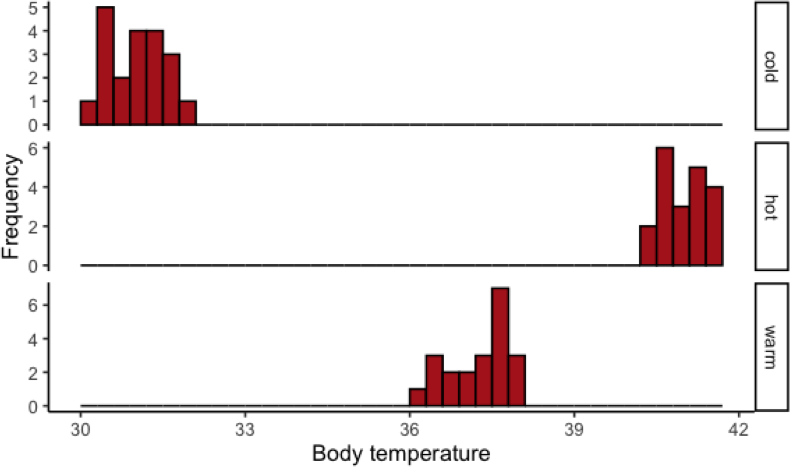
Example: Body temperature of squirrels in low, medium and hot environments

Slide 23
Hypotheses
Example: Body temperature of squirrels in low, medium and hot environments
H₀: Mean body temperature is the same for all three groups of squirrels.
H_{A}: At least one of the three is different from the others.

Slide 24
Example: Body temperature of squirrels in low, medium and hot environments
Summary data
Group | x | s | n
Cold | 31.0 | 0.526 | 20
Warm | 37.2 | 0.582 | 21
Hot | 41.0 | 0.430 | 20
Total sample size:
N = ∑ n = 20 + 21 = 20 = 61

Slide 25
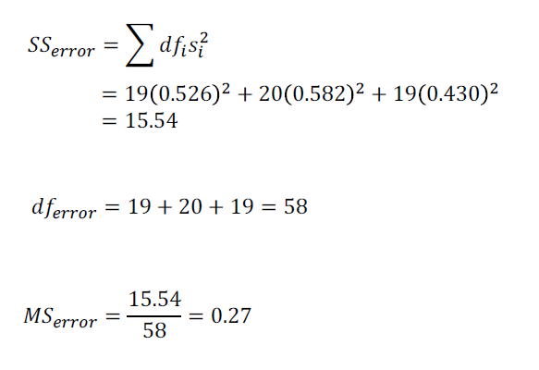
Example: Body temperature of squirrels in low, medium and hot environments
Error Mean square for squirrels

Slide 26
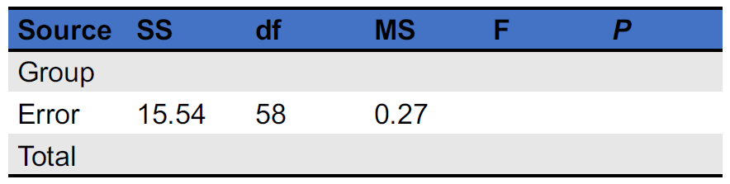
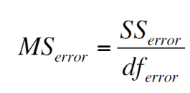
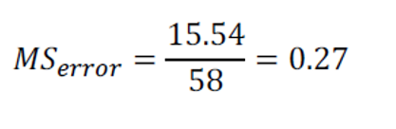
ANOVA table – squirrel data

Slide 27
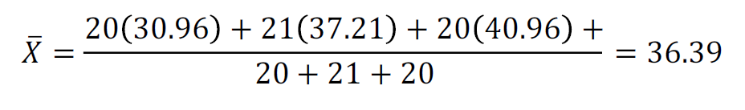
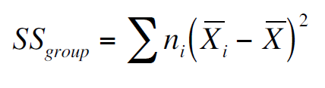
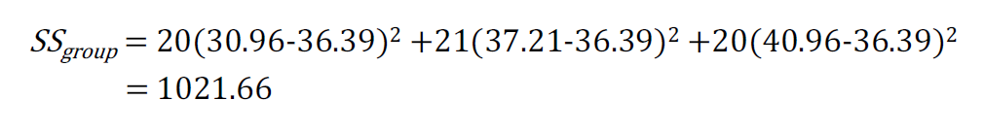
Squirrel Mean Squares Group:

Slide 28
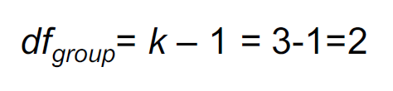
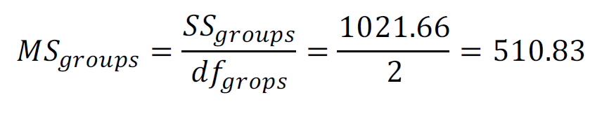
Squirrel Mean Squares Group:

Slide 29
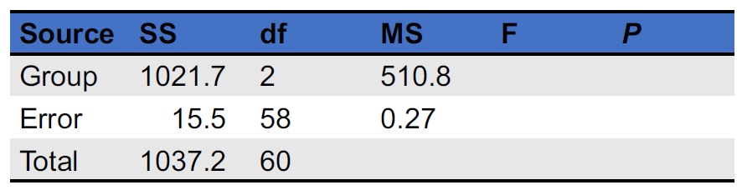
ANOVA table – squirrel data

Slide 30
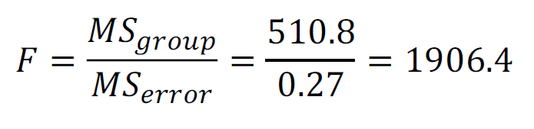
The test statistic for ANOVA is F
MS_{group} is always in the numerator;
MS_{error} is always in the denominator

Slide 31
Compare to F_{α , df_group, df_error}
F_{0.05, 2, 58} = 3.15
Since 1906 > 3.15, we know P < 0.05 and we can reject the null hypothesis.
The variance in sample group means is bigger than expected given the variance within sample groups.
Therefore, at least one of the groups has a population mean different from another group.

Slide 32
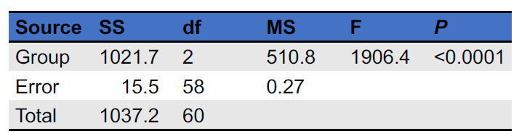
ANOVA table – squirrel data

Slide 33
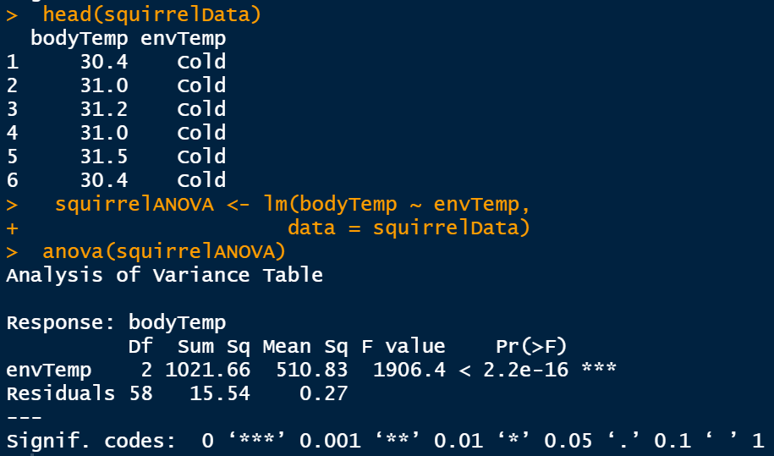
ANOVA in R

Slide 34
Assumptions of ANOVA
(1) Random samples
(2) Gaussian distributions for each population
(3) Equal variances for all populations. (Homoscedasticity)

Slide 35
Kruskal-Wallis test
A non-parametric test similar to a single factor ANOVA
Uses the ranks of the data points

Slide 36
Multiple-factor ANOVA
A factor is a categorical variable
ANOVAs can be generalized to look at more than one categorical variable at a time.
Not only can we ask whether each categorical variable affects a numerical variable, but also do they interact in affecting the numerical variable.

Slide 37
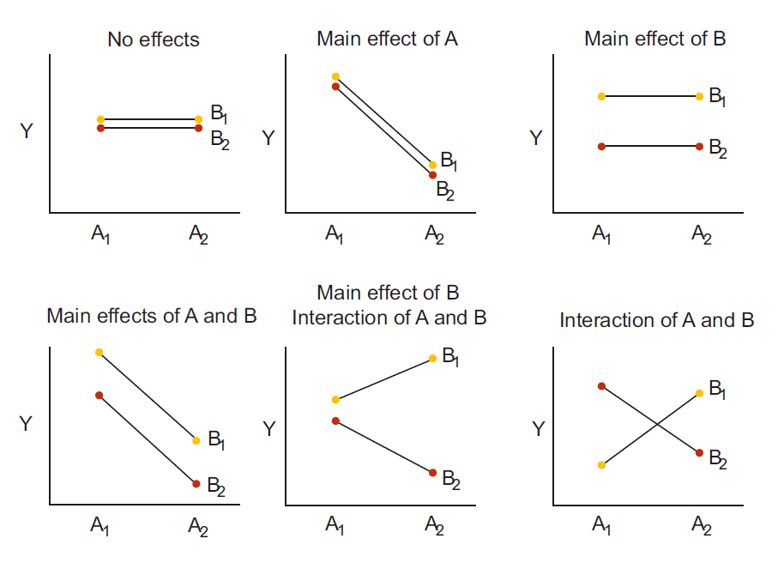
Multiple-factor ANOVA
We are looking for interaction in these interaction plots
Interactions

Slide 38
Fixed vs. random effects
Fixed effects: With fixed effects, the treatments are chosen by the experimenter. They are not a random subset of all possible treatments.
(e.g., specific drug treatments, specific diets, season...)
Random effects: With random effects, the treatments are a random sample from all possible treatments.
(e.g., family, location, ...)
For single-factor ANOVAs, there is no difference in the statistics for fixed or random effects.

Slide 39

2-factor ANOVA: Example
Regions
north
south
Plants sampled from each region
Interested in root investment and hydrological regimen
wet
watering treatments
dry

Slide 40
Testing multiple hypotheses
H₀: Mean root length is the same for all regions
H₀: Mean root length is the same for all watering treatments
H₀: There is no interaction between region and treatment for determining mean root length

Slide 41
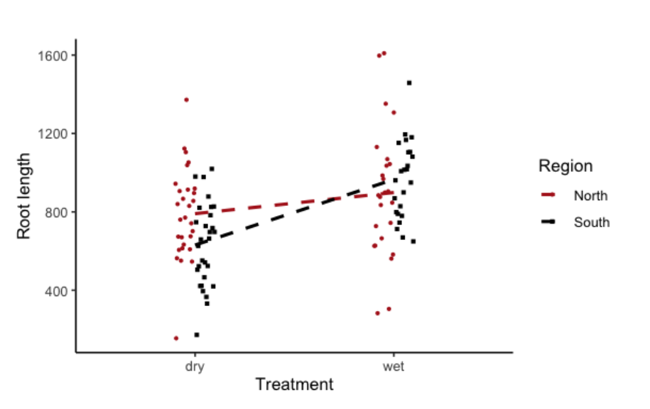
Testing multiple hypotheses

Slide 42
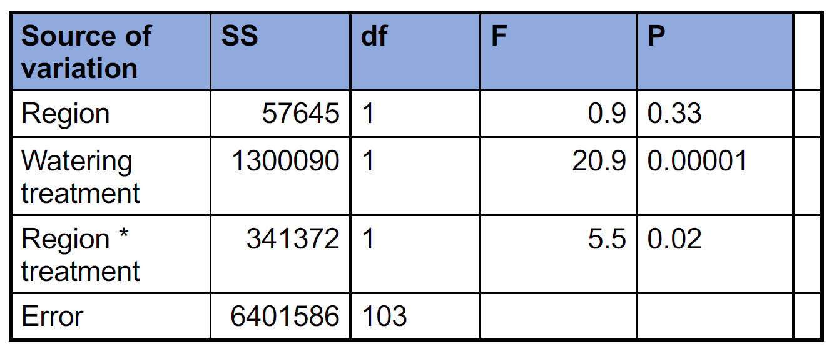
Heliconius ANOVA table

Slide 43
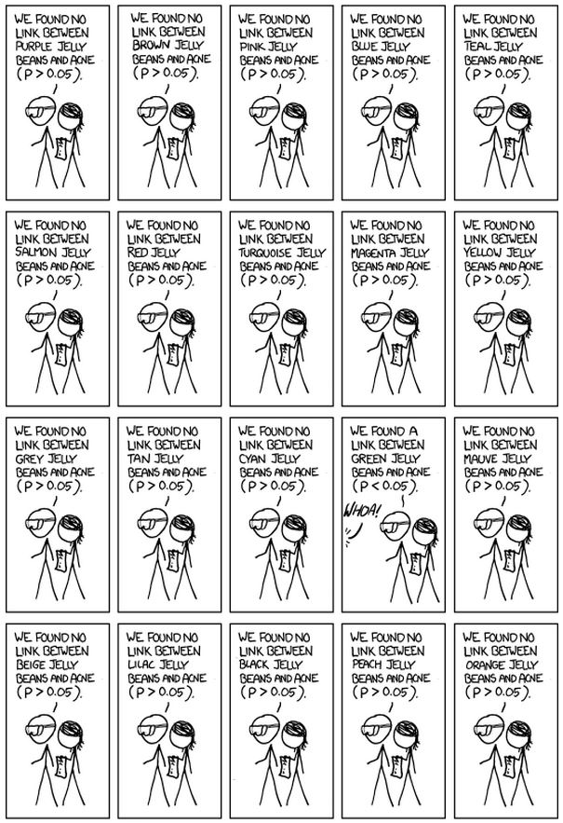
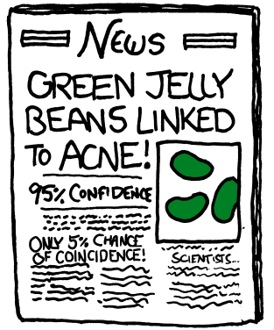
Multiple
comparisons
XKCD significant

Slide 44
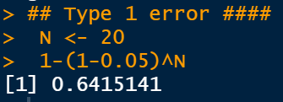
Multiple comparisons
Probability of a Type I error in N tests =
1– (1 – α)^{N}
For 20 tests, the probability of at least one Type I error is ~65%!

Slide 45
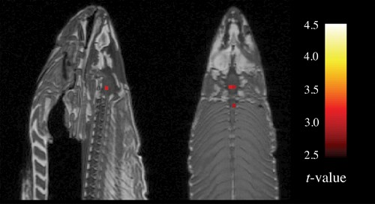
MRI on dead salmon:
Dead fish shows emotional reactions to photos of human activities
“The salmon was shown a series of photographs depicting human individuals in social situations with a specified emotional valence."
“The salmon was asked to determine what emotion the individual in the photo must have been experiencing."

Slide 46
MRI on dead salmon:
Dead fish shows emotional reactions to photos of human activities
“The salmon was shown a series of photographs depicting human individuals in social situations with a specified emotional valence."
“The salmon was asked to determine what emotion the individual in the photo must have been experiencing."
(Each MRI had 130,000 pixels to compare…)

Slide 47
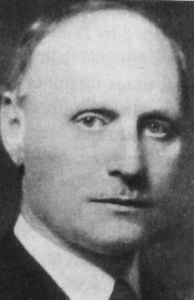
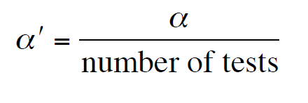

Bonferroni correction for multiple comparisons
Adjusts the α value to prevent false positives (Type I error)
Adjust
your α
Carlo Bonferroni

Slide 48
Which groups are different?
After finding evidence for differences among means with ANOVA, sometimes we want to know:
Which groups are different from which others?
One method for this: the Tukey test
Tukey HSD [Honestly Significant Differences, balanced sample sizes]
Tukey-Kramer [unbalanced sample sizes]

Slide 49
When to do a Tukey test?
Done after finding variation among groups with single-factor ANOVA.
Compares all group means to all other group means

Slide 50
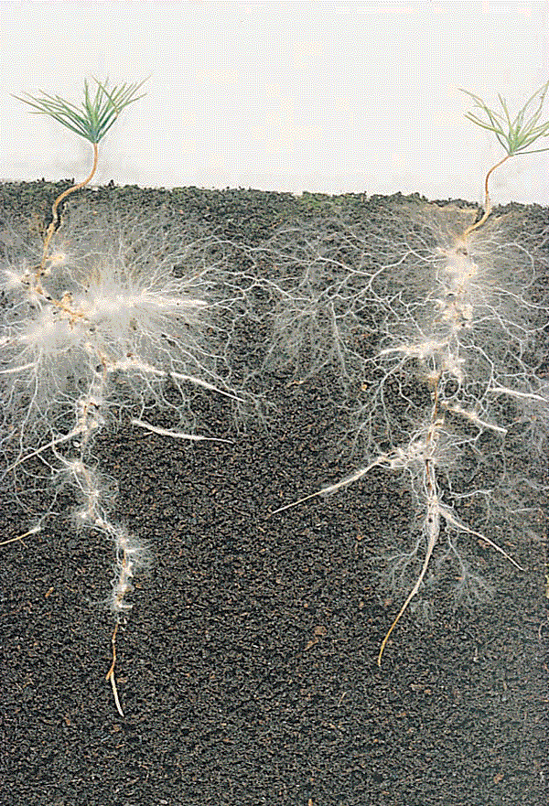
The wood-wide web
Trees (and other plants) are often connected by roots via mycorrhizae, which allow the exchange of resources.

Slide 51
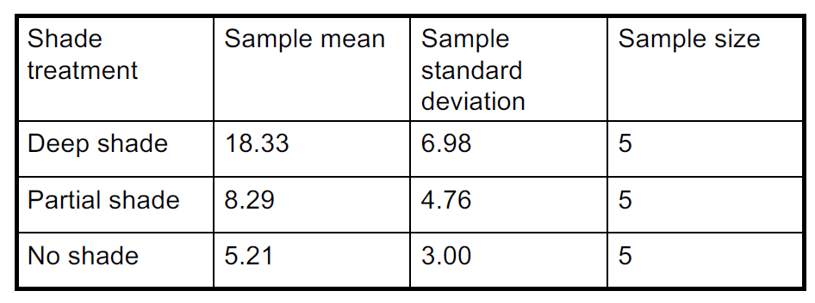
Carbon transfer between birch and Douglas fir: Comparing effects of shading on fir
Net amount of carbon transferred from birch to fir
Simard et al. (1997) Net transfer of carbon between ectomycorrhizal tree species in the field. Nature 388:579-582.

Slide 52
ANOVA results
Source of variation | SS | df | MS | F | P
Groups (treatments) | 470.704 | 2 | 235.352 | 8.784 | 0.004
Error | 321.512 | 12 | 26.792
Total | 792.216 | 14

Slide 53
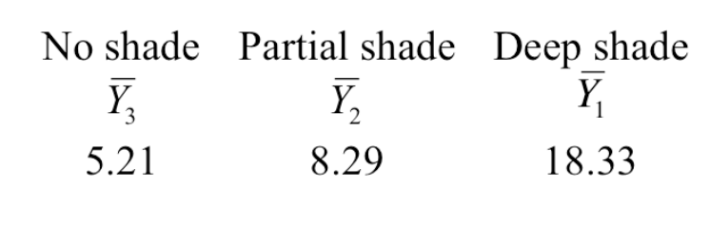
Order the group means

Slide 54

Null hypotheses for Tukey-Kramer

Slide 55
Why not use a series of two-sample t-tests?
Multiple comparisons would cause the t-tests to reject too many true null hypotheses.
Tukey-Kramer adjusts for the number of tests.
Tukey-Kramer also uses information about the variance within groups from all the data, so it has more power than a t-test with a Bonferroni correction.

Slide 56

Tukey-Kramer results

Slide 57



Tukey-Kramer plot
Groups which cannot be distinguished share the same letter

Slide 58

Tukey-Kramer plot
An imaginary example:
H₀ : μ₁ = μ₂
H₀ : μ₁ = μ₃
H₀ : μ₂ = μ₃
Cannot reject
Reject
Cannot reject

Slide 59
Tukey-Kramer take home message
With the Tukey-Kramer method, the probability of making at least one Type 1 error throughout the course of testing all pairs of means is no greater than the significance level α.

Slide 60


Example Tukey test in R

Slide 61

Suggested reading
Simard, S.W., Perry, D.A., Jones, M.D., Myrold, D.D., Durall, D.M., Molina, R., 1997. Net transfer of carbon between ectomycorrhizal tree species in the field. Nature 388, 579–582. https://doi.org/10.1038/41557

