Slide 1
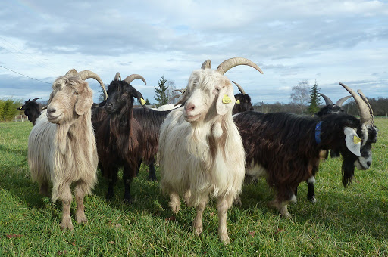
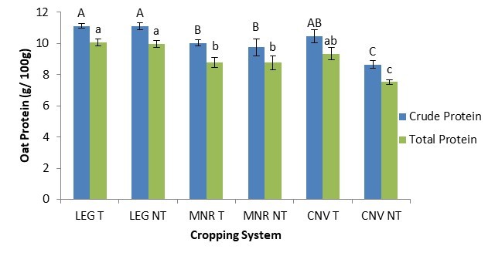



C7041 Experimental Design and Analysis
Ed Harris

Slide 2

1.17: Regression
“Regression analysis is the biggest sumo wrestler in the stable”
-unattributed

Slide 3
Regression
Predicts Y from X
Linear regression assumes that the relationship between X and Y can be described by a line

Slide 4
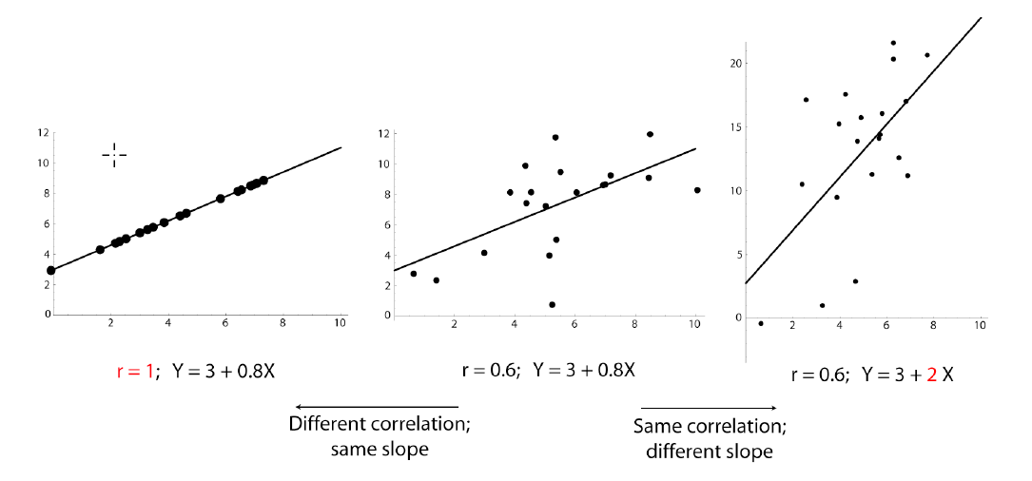
Correlation vs. regression

Slide 5
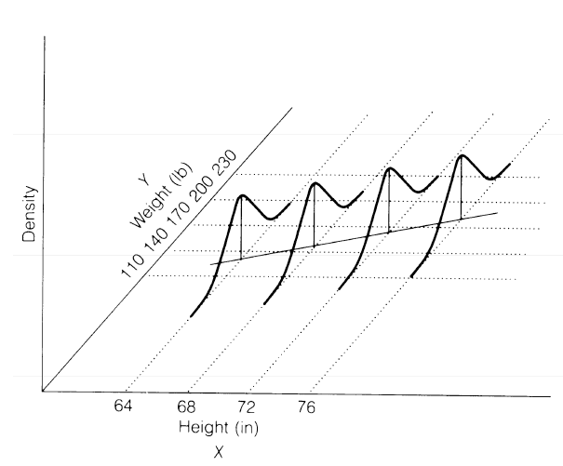
Regression assumes...
Random sample
Y is normally distributed with equal variance for all values of X

Slide 6
The parameters of linear regression
Y = α + β X

Slide 7
The parameters of linear regression
Your data
Dependent var. vector
Predictor var. vector
Y = α + β X
intercept
slope
Parameters you use regression to estimate

Slide 8
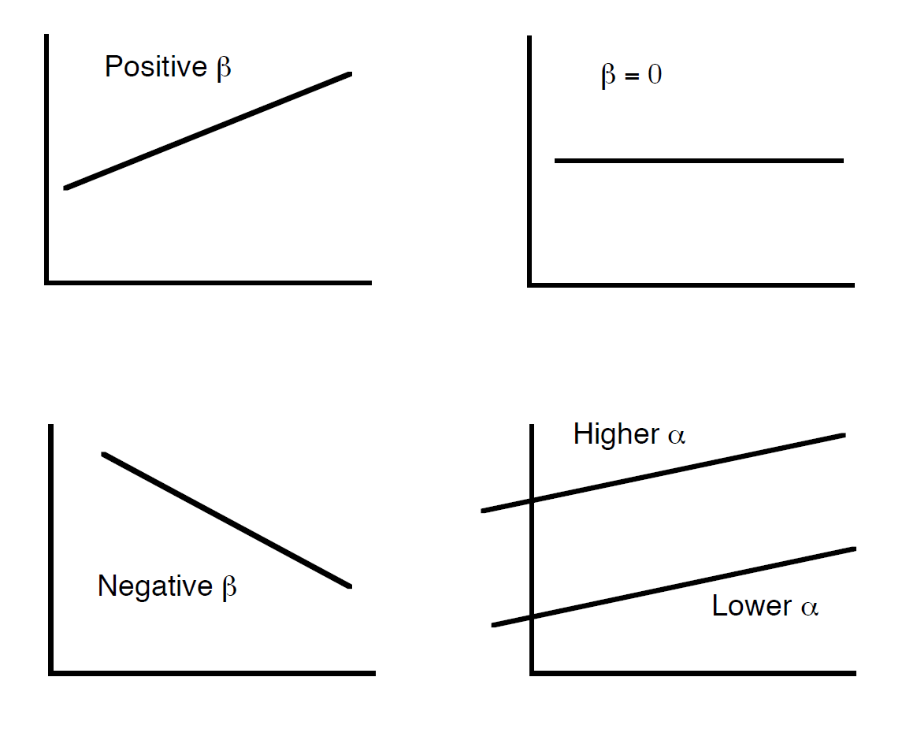
The parameters of linear regression

Slide 9
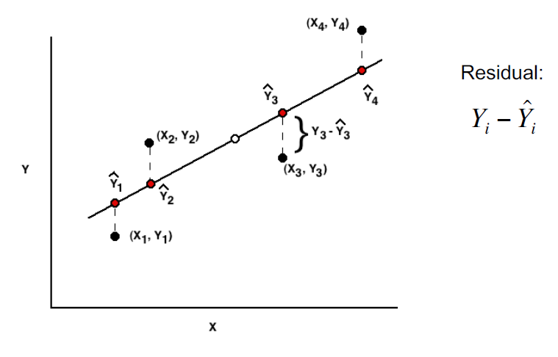
Estimating a regression line
Y = a + b X
Nomenclature

Slide 10
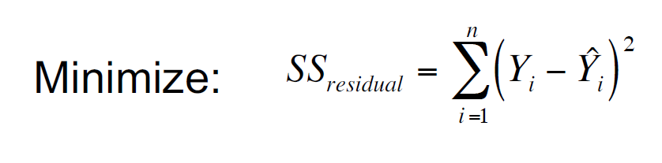
Finding the "least squares" regression line

Slide 11
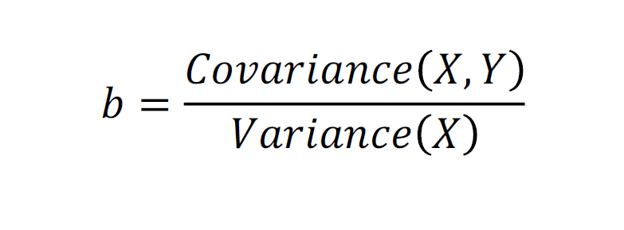
Best estimate of the slope

Slide 12
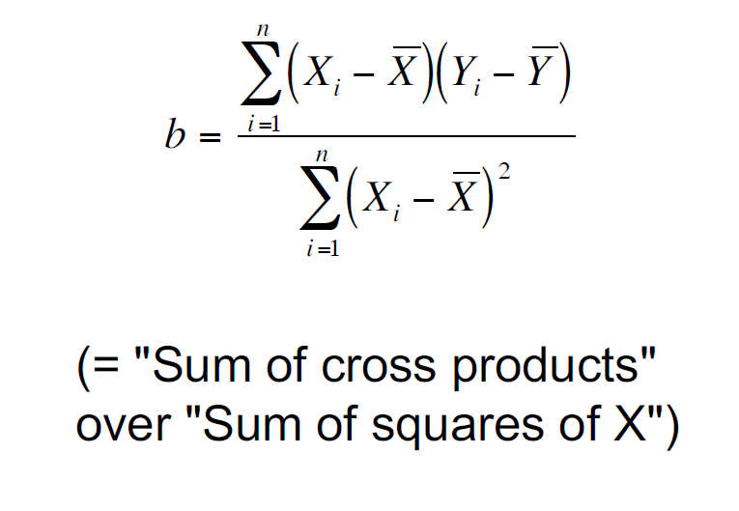
Best estimate of the slope

Slide 13
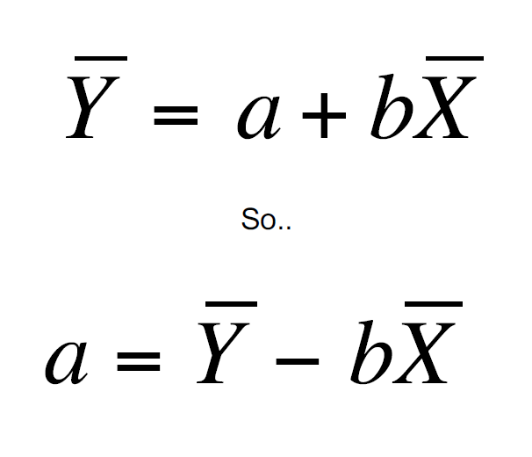
Finding a

Slide 14
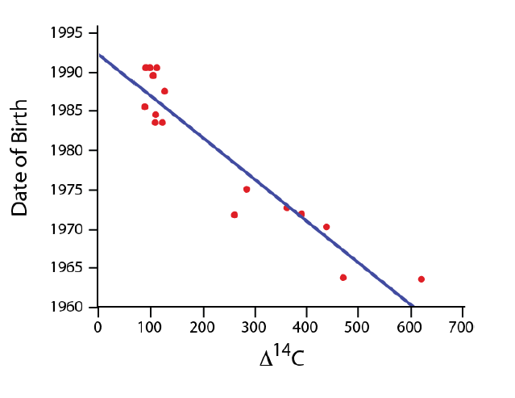
Example: Predicting age based on radioactivity in teeth
Many above ground nuclear bomb tests in the '50s and ‘60s may have left a radioactive signal in developing teeth.
Is it possible to predict a person’s age based on dental ¹⁴C?
Data from 1965 to present from Spalding et al. 2005. Forensics: age written in teeth by nuclear tests. Nature 437: 333–334.

Slide 15
Teeth data:
Δ14_{C} | Date of Birth |  | Δ14_{C} | Date of Birth
89 | 1985.5 |  | 622 | 1963.5
109 | 1983.5 |  | 262 | 1971.7
91 | 1990.5 |  | 471 | 1963.7
127 | 1987.5 |  | 112 | 1990.5
99 | 1990.5 |  | 285 | 1975
110 | 1984.5 |  | 439 | 1970.2
123 | 1983.5 |  | 363 | 1972.6
105 | 1989.5 |  | 391 | 1971.8

Slide 16
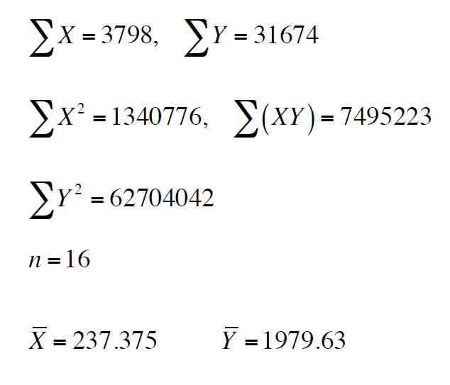
Teeth data:
Let X be the Δ¹⁴C, and Y be the year of birth.

Slide 17
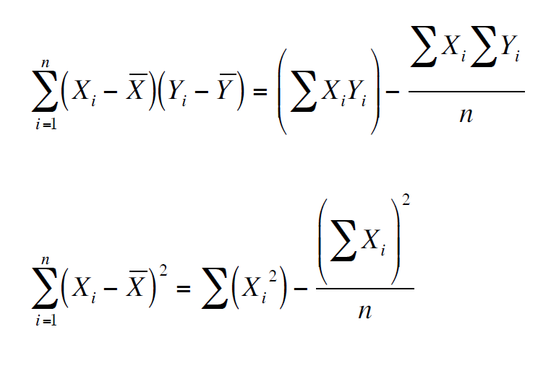
Remember the shortcuts:

Slide 18
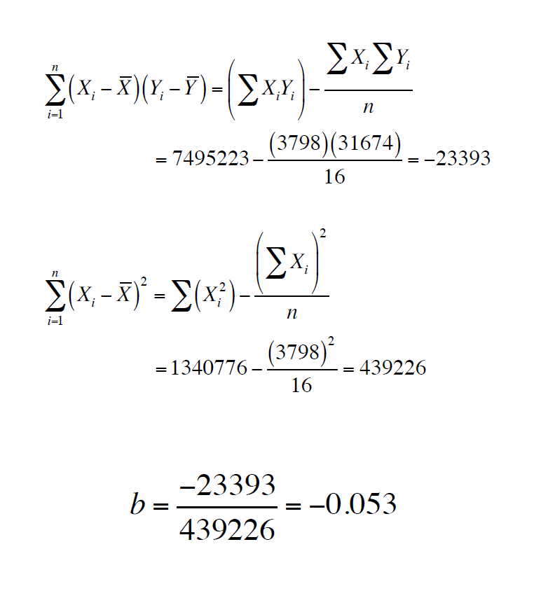
Remember the shortcuts:

Slide 19
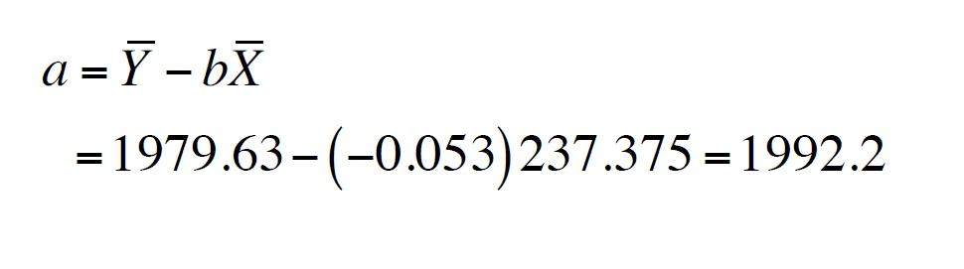
Calculating a

Slide 20
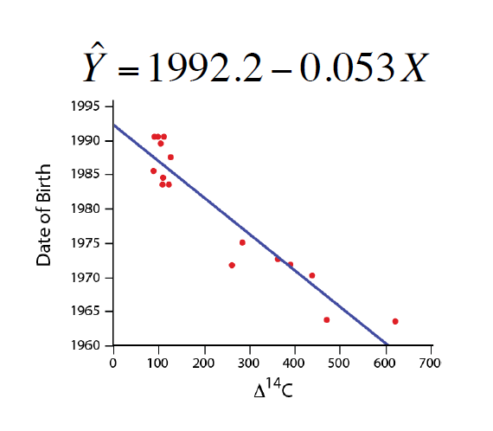
Predicting Y from X

Slide 21
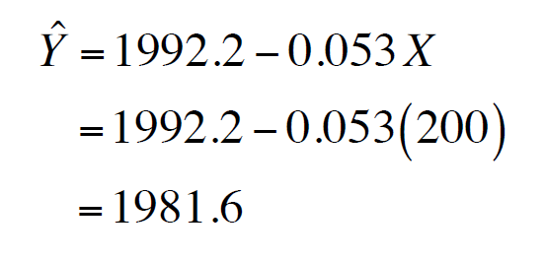
Predicting Y from X
If a cadaver has a tooth with Δ¹⁴C content equal to 200, what does the regression line predict its year of birth to be?

Slide 22
r² predicts the amount of variance in Y explained by the regression line
r² is the "coefficient of determination"
It is the square of the correlation coefficient r

Slide 23
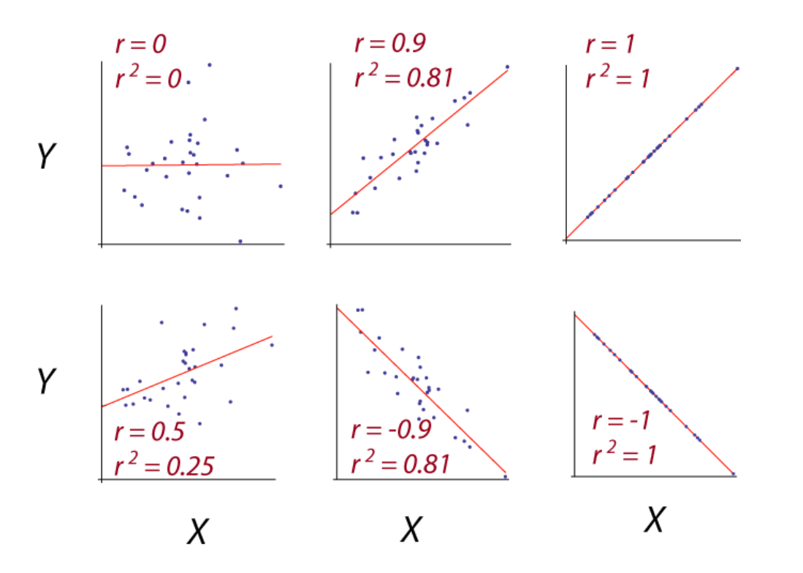
r² predicts the amount of variance in Y explained by the regression line

Slide 24
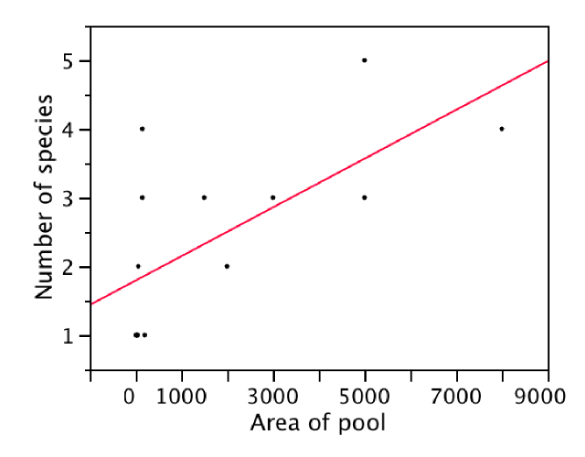
Caution: It is unwise to extrapolate beyond the range of the data.
Number of species of fish as predicted by the area of a desert pool
If we were to extrapolate to ask how many species might be in a pool of 50,000 m², we would guess about 20.

Slide 25
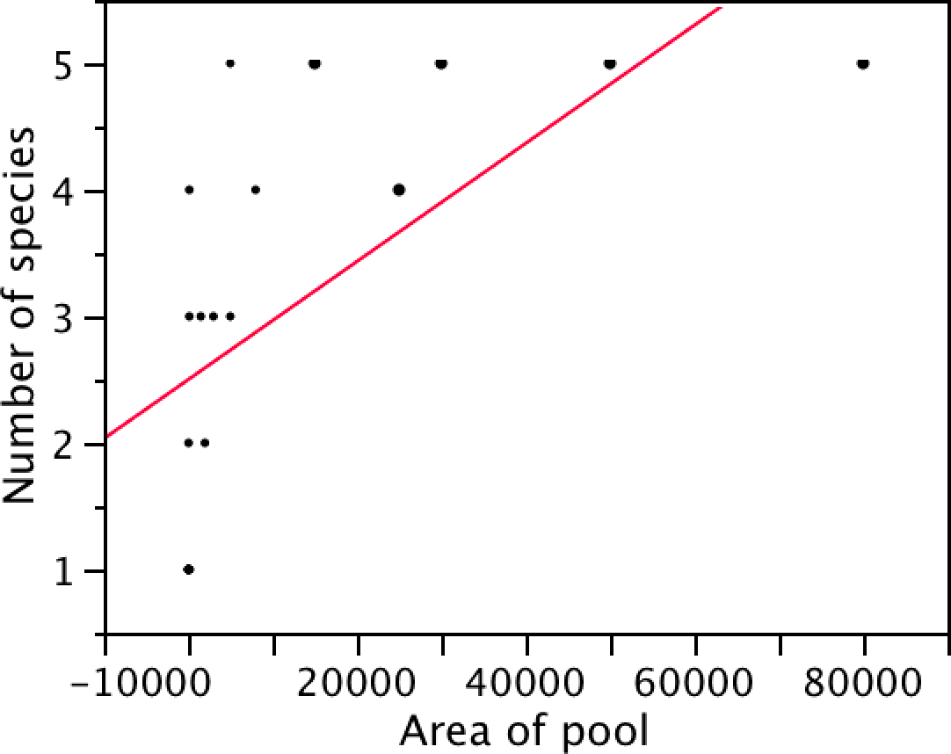
Caution: It is unwise to extrapolate beyond the range of the data.
More data on fish in desert pools

Slide 26
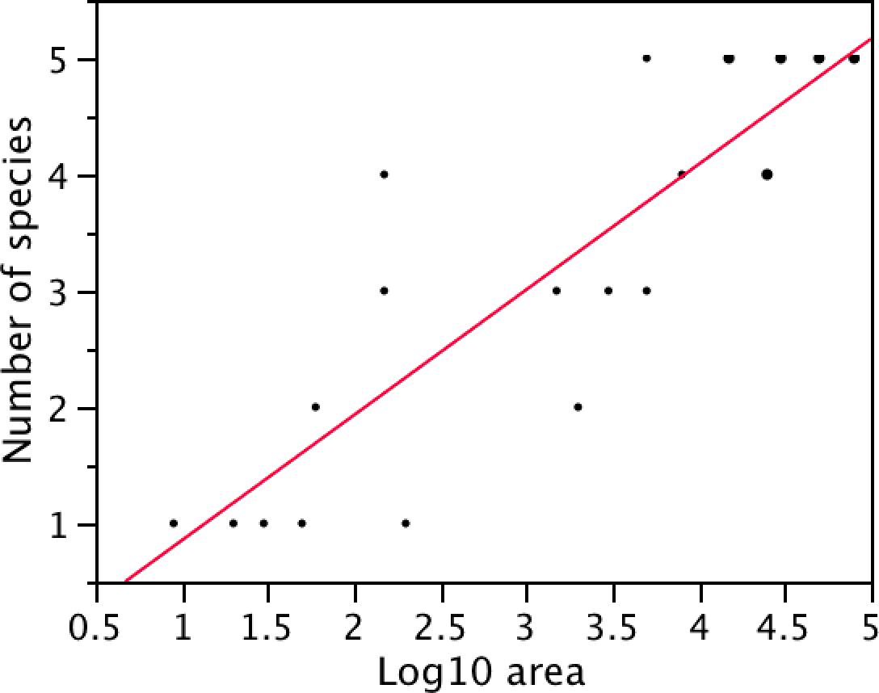
Log transformed data:
Y = a + b log10( X )

Slide 27
Testing hypotheses about regression
H₀: β = 0
H_{A}: β ≠ 0

Slide 28
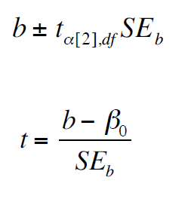
b has a t distribution
Confidence interval for a slope:
Hypothesis tests can use t:

Slide 29
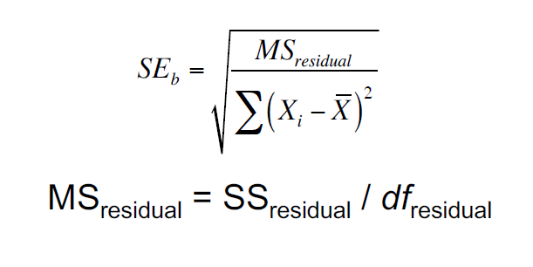
Standard error of a slope

Slide 30
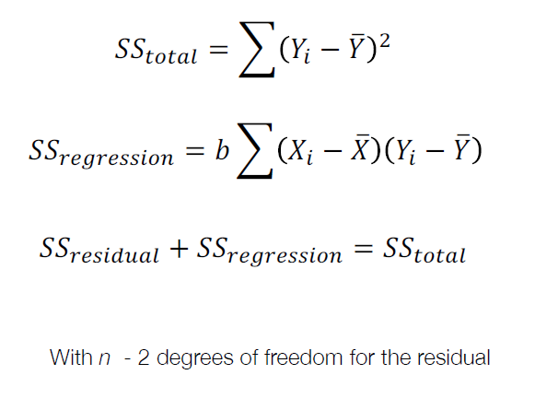
Sums of squares for regression

Slide 31
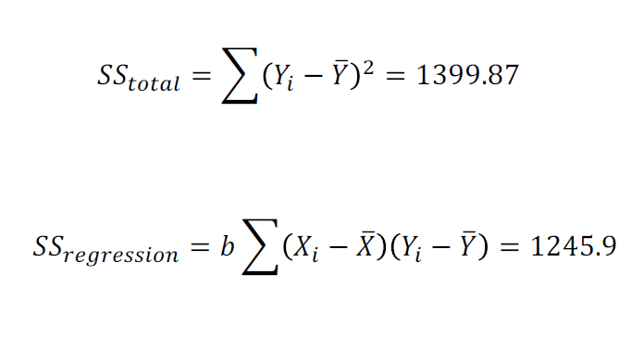
Radioactive teeth: Sums of squares

Slide 32
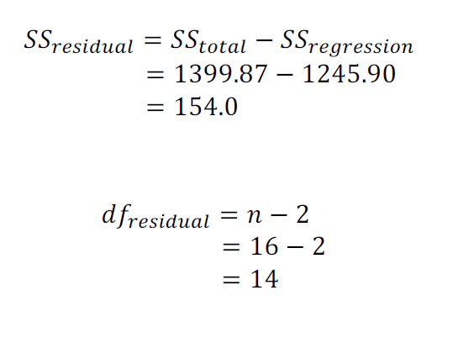
Teeth: Sums of squares

Slide 33
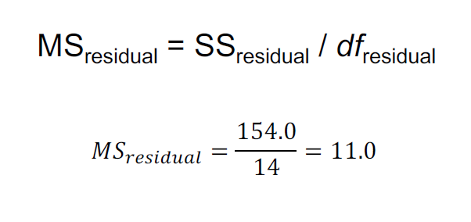
Calculating residual mean squares

Slide 34
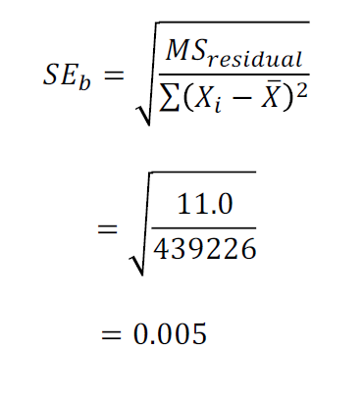
Standard error of the slope

Slide 35
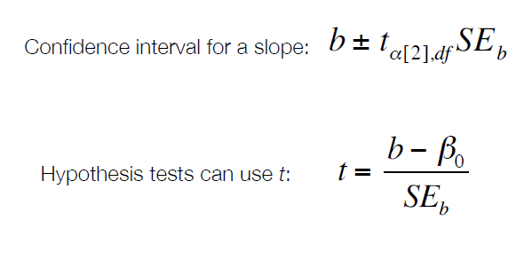
b has a t distribution

Slide 36
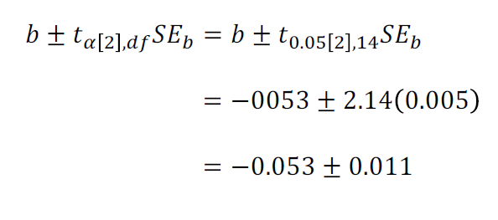
95% confidence interval for slope with teeth example

Slide 37
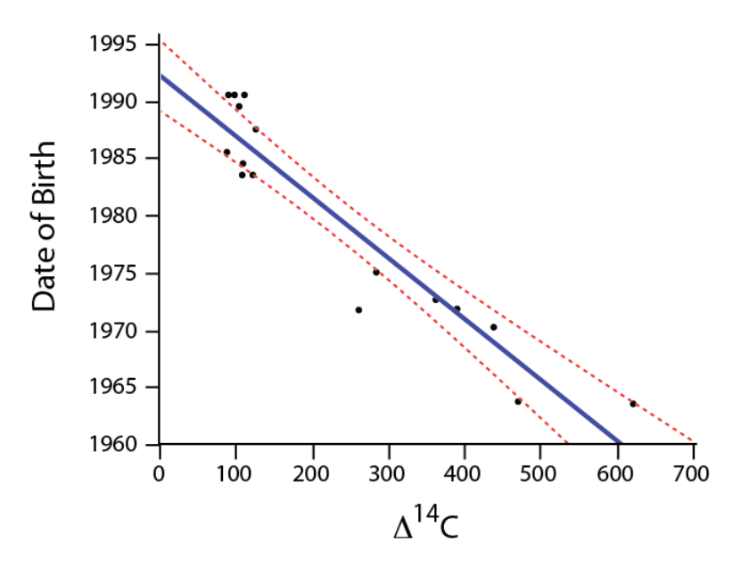
Confidence bands: confidence intervals for predictions of mean Y

Slide 38
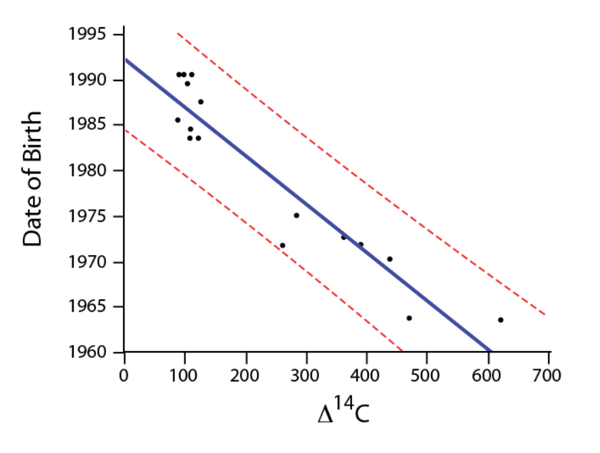
Prediction intervals: confidence intervals for predictions of individual Y

Slide 39
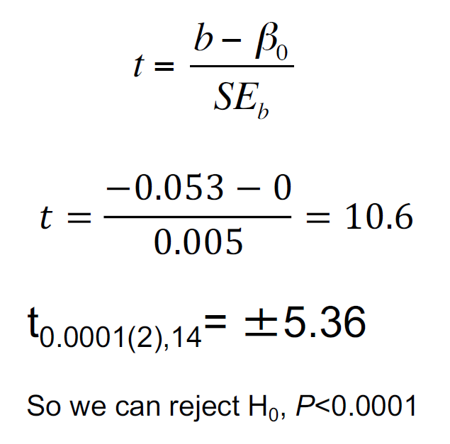
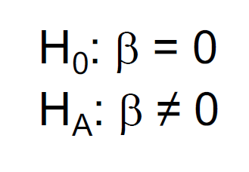
Hypothesis tests on slopes

Slide 40
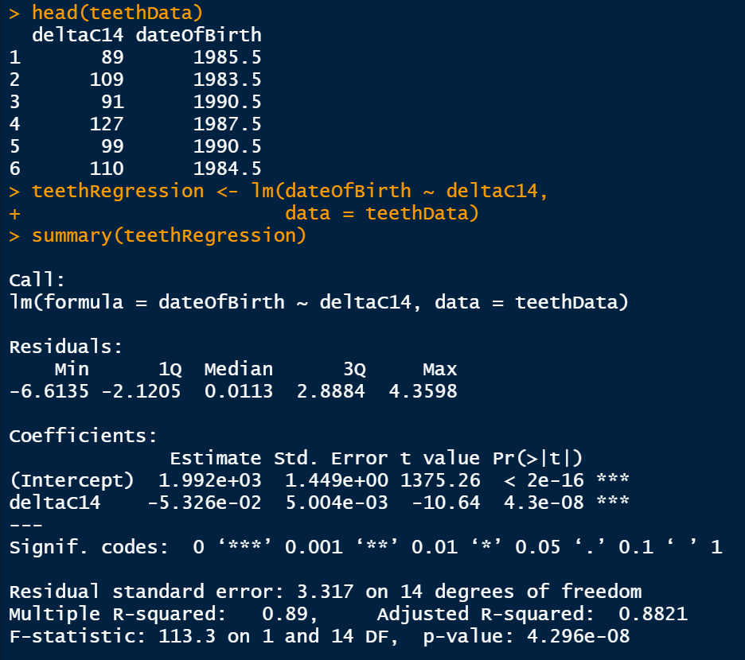
Regression in R

Slide 41
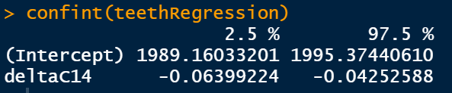
Regression in R
This generates the confidence interval for the estimate of the slope.

Slide 42
Non-linear relationships
Transformations
Quadratic regression
Splines

Slide 43
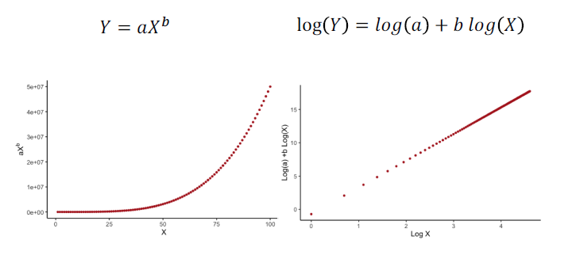
Sometimes transformations make non-linear relationships linear

Slide 44
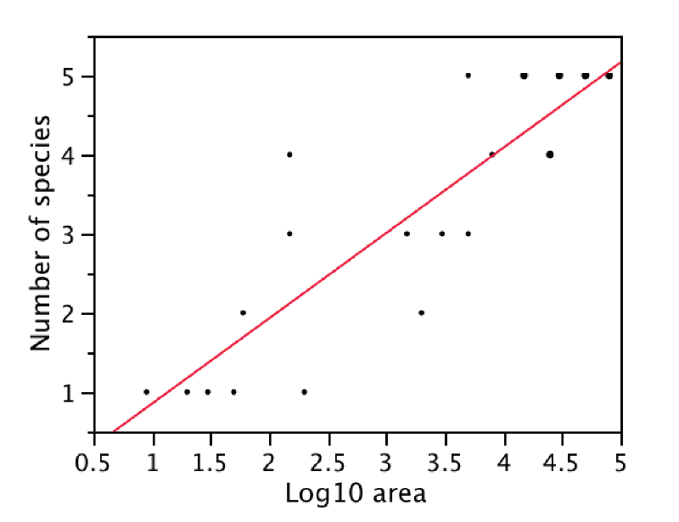
Non-linear relationship: Number of fish species vs. Size of desert pool

Slide 45
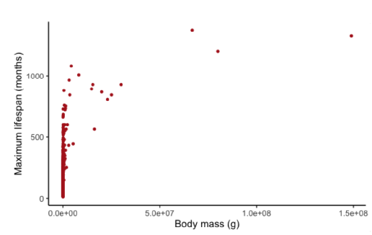
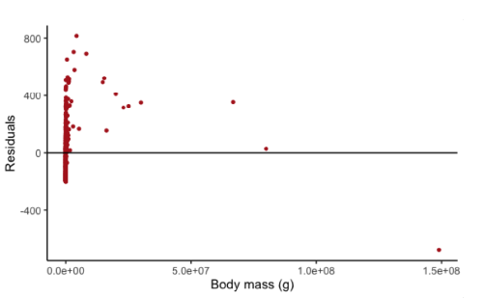
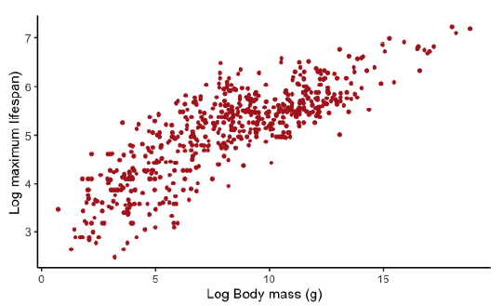
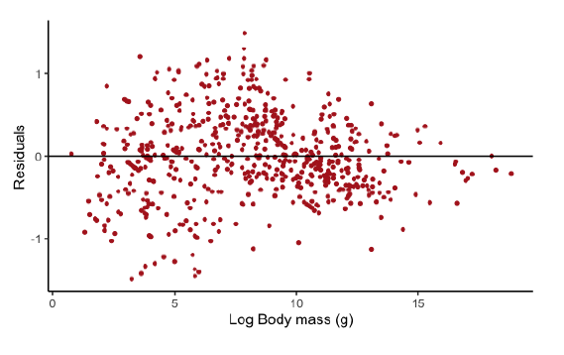
Residual plots help assess assumptions
Data plot
Residual plot
Original
Log transformed

Slide 46

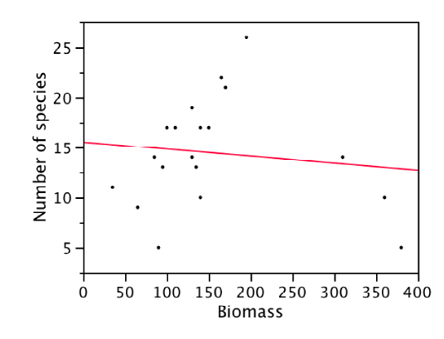
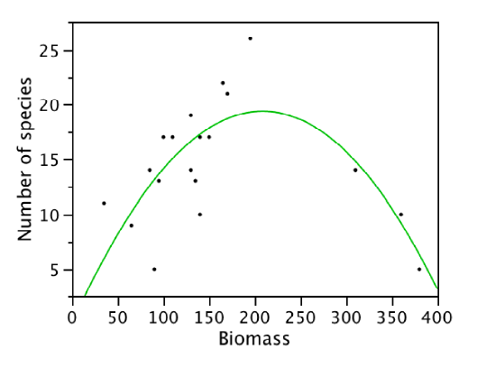
Polynomial regression
Y = a + b₁X + b₂X² + … + b_{n}X^{n}
Number of species = 0.046 + 0.185 Biomass - 0.00044 Biomass²

Slide 47
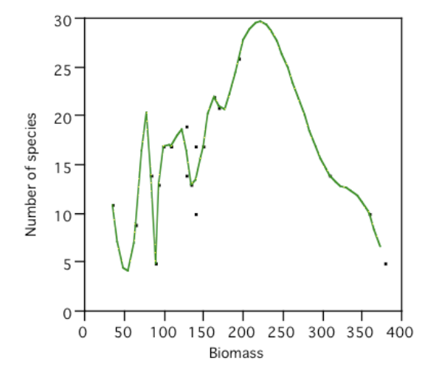
Do not fit a polynomial with too many terms.
(The sample size should be large ~ at least 7 times the number of terms)

Slide 48
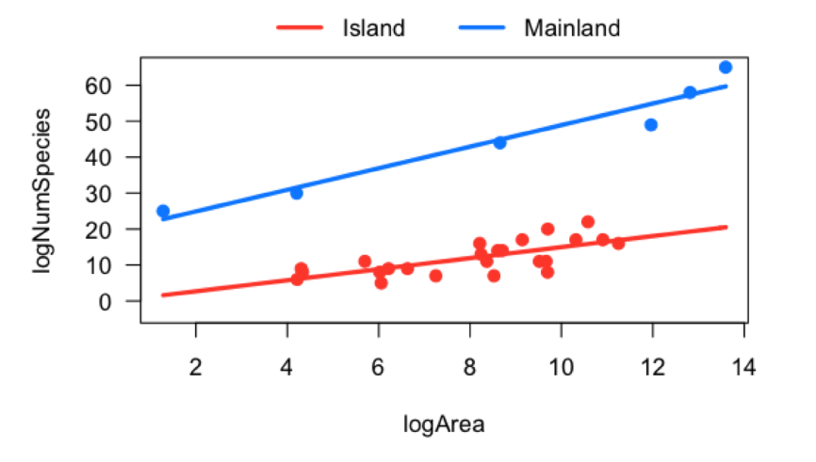
Comparing two slopes with ANCOVA (Analysis of COVariance)
Example: Comparing species-area curves for islands to those of mainland populations

Slide 49
ANCOVA: 3 hypotheses
Main effect
H₀: Area has no effect on the number of species
H₀: Island and mainland factor levels are the same for mean number of species
H₀: Area and land type do not interact in determining the number of species
Main effect
Interaction

Slide 50
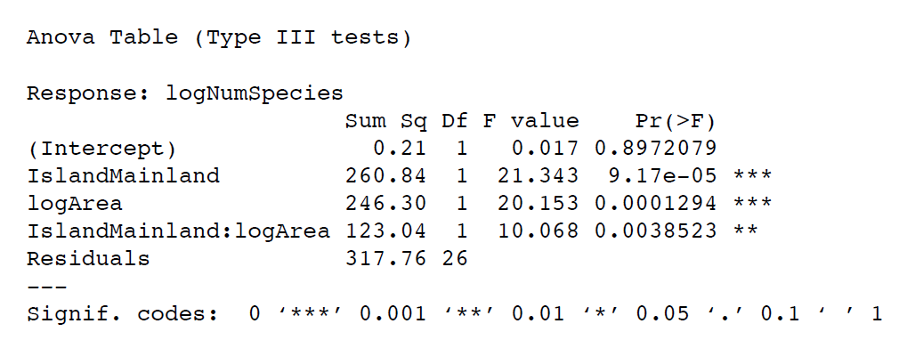
ANOVA table from R for ANCOVA
Y = a + b₁X1 + b₂X2 + b₃X3
In R: lm(logNumSpecies Y = IslandMainland +
logArea + IslandMainland:logArea)

Slide 51
Analysis of covariance (ANCOVA)
Compares many slopes
H₀: β₁ = β₂ = β₃= β₄= β₅…
H_{A}: At least one of the slopes is different from another.

Slide 52
Logistic regression
Tests for relationship between a numerical variable (as the explanatory variable) and a binary variable (as the response).
Ex 1: Does the dose of a toxin affect probability of survival?
Ex 2: Does the length of a peacock's tail affect its probability of getting a mate?

Slide 53
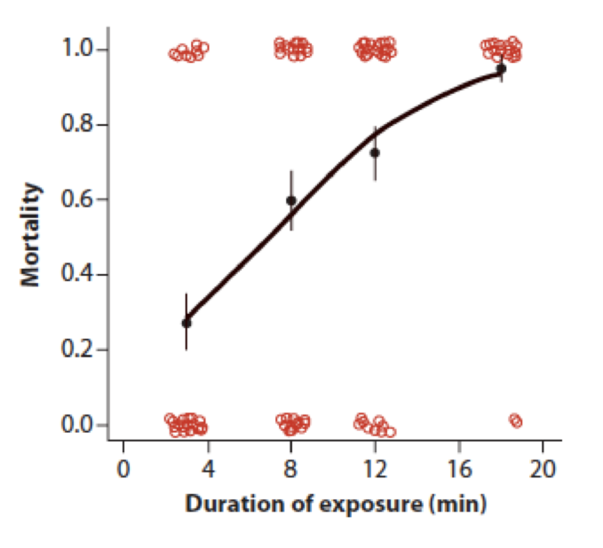
Logistic regression
Dependent variable is 0,1
(like [live, die], [mate, don’t mate], [survive statistics, don’t survive], etc.)
The line of prediction is the probability of 1 for each value of the predictor variable

