Slide 1
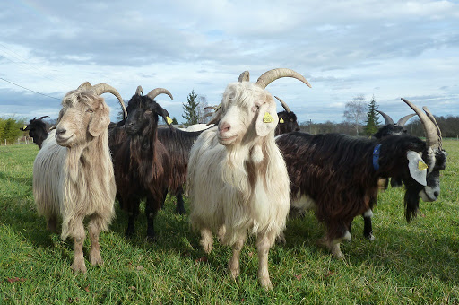
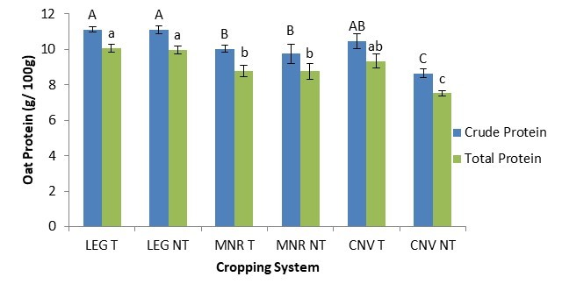



C7041 Experimental Design and Analysis
Ed Harris

Slide 2
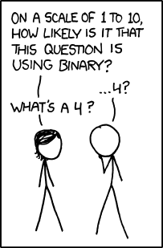
2.07: Generalized Linear Model (GLM)

Slide 3
Outline for today
What is a generalized linear model
Linear predictors and link functions
Example: fit a constant (the proportion)
Analysis of deviance table
Example: fit dose-response data using logistic regression
Example: fit count data using a log-linear model
Advantages and assumptions of glm
Modeling overdispersion (excessive variance)
Example: Modeling contingency tables

Slide 4
Review: what is a linear model
A model of the following form:
Y = β0 + β1X1 + β2X2 + …
Y is the response variable
The X ‘s are the explanatory variables
The β ‘s are the parameters of the linear equation
The errors are normally distributed with equal variance at all values of the X
variables.
Uses least squares to fit model to data and to estimate parameters
Use lm() in R

Slide 5
Review: fitting a linear model in R
Use lm() in R
Simplest linear model: fit a constant (the mean)
z <- lm(y ~ 1)
Linear regression
z <- lm(y ~ x)
Single factor ANOVA
z <- lm(y ~ A)

Slide 6
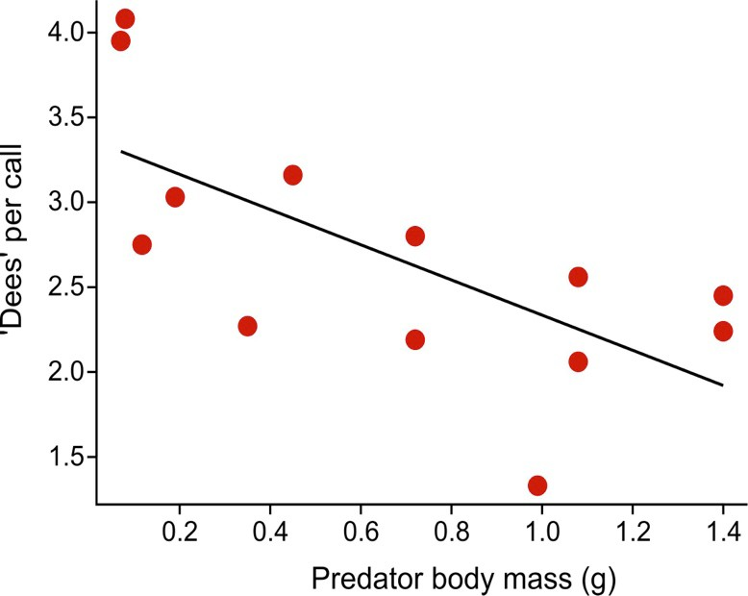
Review: what is a linear model
Eg: linear regression: Y = β0 + β1X + error
The predicted Y-values, symbolized here by μ, is modeled as
µ = β0 + β1X
The part to the right of “=” is the linear predictor

Slide 7
What is a generalized linear model
A model whose predicted values are of the form
g(µ) = β0 + β1X1 + β2X2 + …
The model still include a linear predictor (to right of “=”)
But the predicted Y-values are transformed
g(µ) is called the “link function,” of which there are several types
Non-Gaussianl distributions of errors OK (specified by link function)
Unequal error variances OK (specified by link function)
Uses maximum likelihood to estimate parameters
Uses log-likelihood ratio tests to test parameters
Fit models using glm() in R

Slide 8
The two most common link functions
1) Natural log (i.e., base e)
log(µ) = η = β0 + β1X1 + β2X2 + …
Usually used to model count data (e.g., number of mates, etc)
log(µ) is the link function. The inverse function is µ = e^{η}

Slide 9
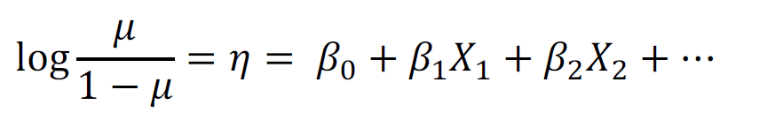
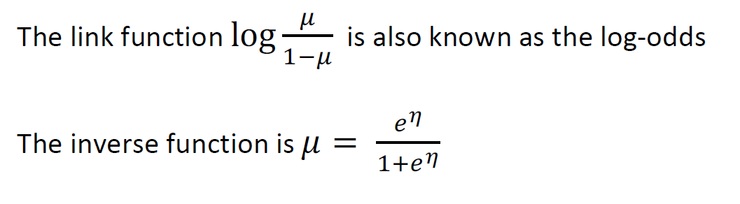
The two most common link functions
2) Logistic or logit
Used to model binary data (e.g., survived vs died)

Slide 10
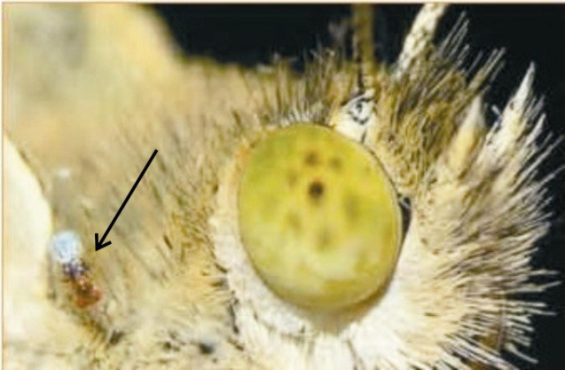
Example 1: Fit a constant to 0-1 data (estimate a proportion)
This example was used previously in Likelihood lecture. My goal with this example is to connect what glm() does with what we did by brute force last week.
The wasp, Trichogramma brassicae, rides on female cabbage white butterflies, Pieris brassicae. When a butterfly lays her eggs on a cabbage, the wasp climbs down and parasitizes the freshly laid eggs.
Fatouros et al. (2005) carried out trials to determine whether the wasps can distinguish mated female butterflies from unmated females. In each trial a single wasp was presented with two female cabbage white butterflies, one a virgin female, the other recently mated.
Y = 23 of 32 wasps tested chose the mated female. What is the proportion p of wasps in the population choosing the mated female?

Slide 11

Number of wasps choosing the mated female fits a binomial distribution
Under random sampling, the number of “successes” in n trials has a binomial distribution, with p being the probability of “success” in any one trial.
To model these data, let “success” be “wasp chose mated butterfly”
Y = 23 successes
n = 32 trials
Goal: estimate p
Data are :
1 1 1 0 1 1 1 0 1 0 1 0 1 1 1 1 0 1 0 1 1 1 1 1 0 1 1 1 0 0 1 1

Slide 12
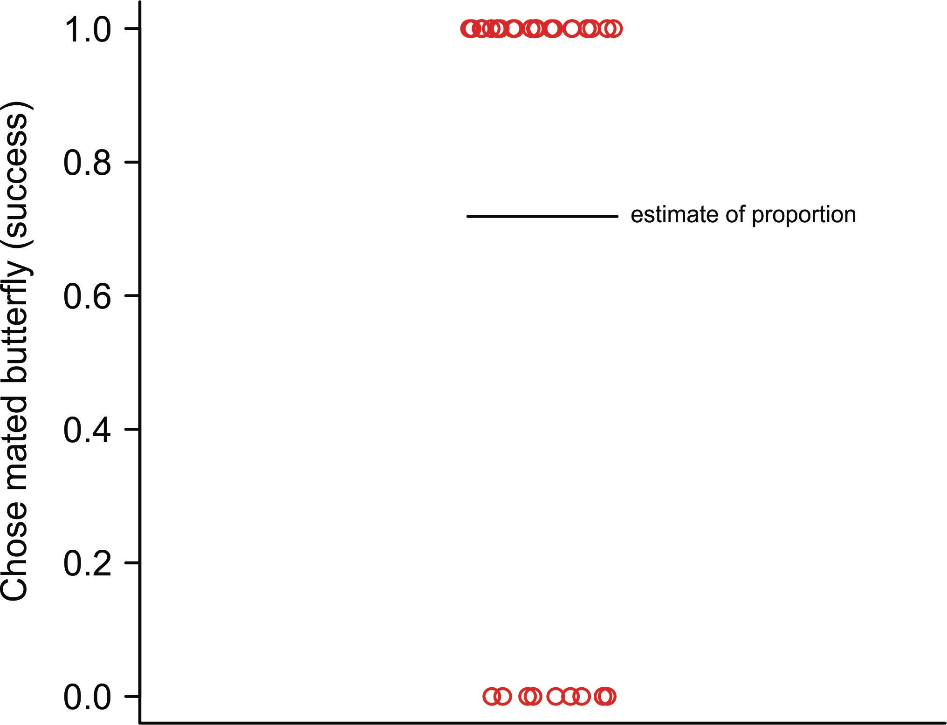
Use glm() to fit a constant, and so obtain the ML estimate of p
The data are binary. Each wasp has a measurement of 1 or 0
(“success” or “failure”):
1 1 1 0 1 1 1 0 1 0 1 0 1 1 1 1 0 1 0 1 1 1 1 1 0 1 1 1 0 0 1 1
z <- glm(choice ~ 1, family = binomial(link=”logit”))
family specifies the error distribution (binomial) and the link function (logit).

Slide 13

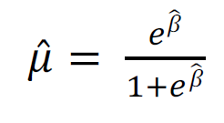
Use glm() to fit a constant, and so obtain the ML estimate of p
Fits a model having only a constant. Use the link function appropriate for binary data:
𝜇
log
= 𝛽
1 − 𝜇
µ here refers to the population proportion (p) but let’s stick with µ symbol here to use consistent notation for generalized linear models.
Fitting will yield the estimate
The estimate of proportion 𝜇̂ is then obtained using the inverse function:

Slide 14
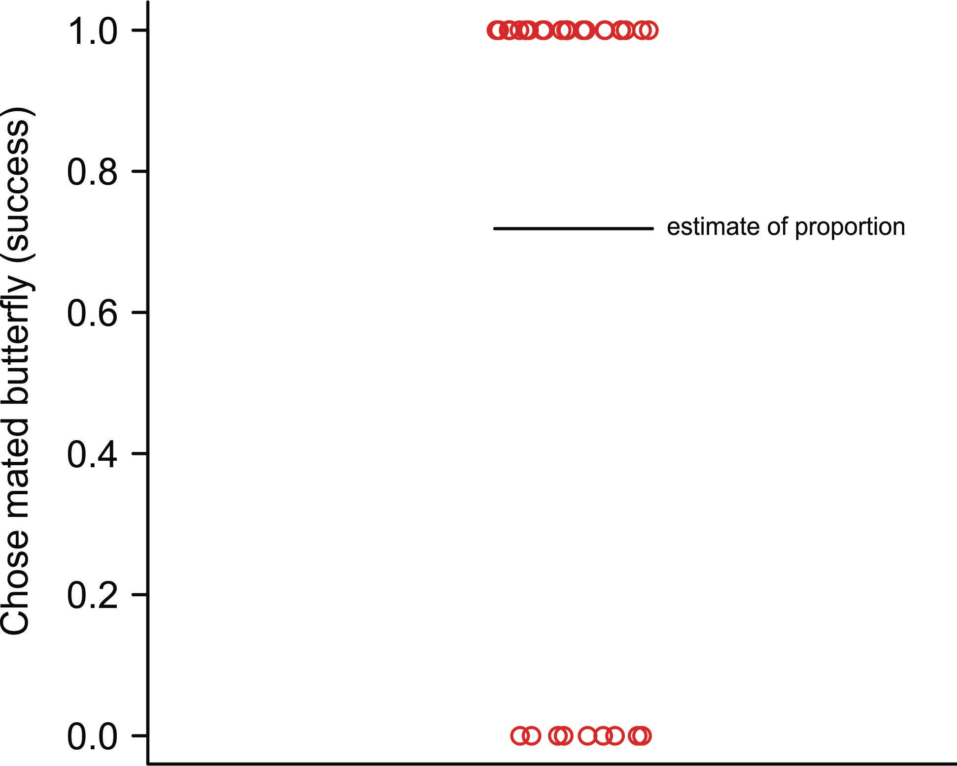
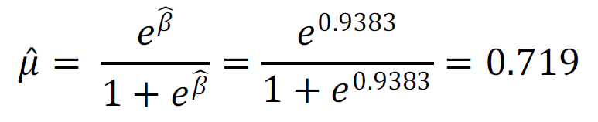

Use summary()for estimation
summary(z) Coefficients:
Estimate Std. Error 0.9383 0.3932
z value Pr(>|z|) 2.386 0.017 *
(Intercept)
0.9383 is the estimate of 𝛽 (the constant on the logit scale). Convert back to ordinary scale (plug into inverse equation) to get estimate of population proportion:
This is the ML estimate of the population proportion. This is identical to the estimate obtained last week using likelihood function.

Slide 15
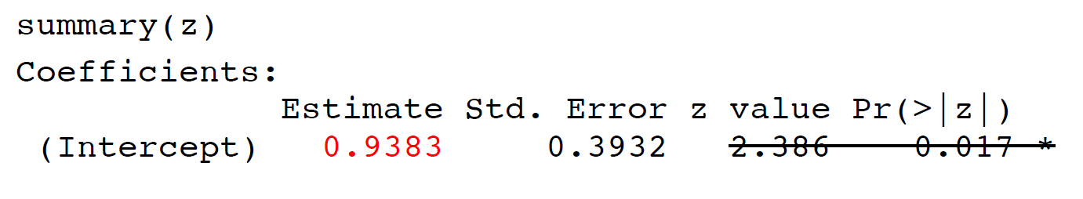
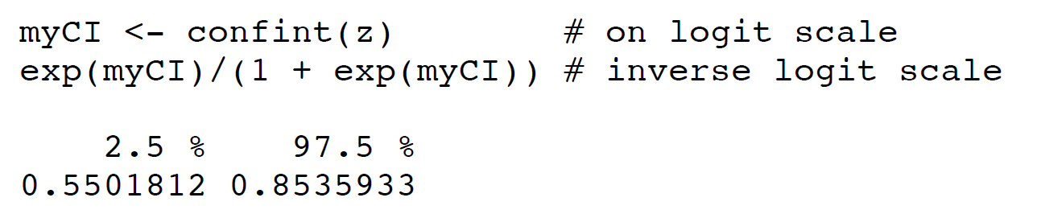
Confidence intervals
95% confidence limits:
0.550 ≤ p ≤ 0.853 is the same result we obtained before for likelihood-based confidence intervals using likelihood function (more decimal places this week).

Slide 16
Avoid using summary() for hypothesis testing
summary(z) Coefficients:
Estimate (Intercept) 0.9383
Std.
Error z value Pr(>|z|) 0.3932 2.386 0.017 *
The z-value (Wald statistic) and P-value test the null hypothesis that β = 0. This is the same as a test of the null hypothesis that the true (population) proportion
µ = 0.5, because
_{1 + 𝑒0} = 0.5
_{𝑒}0
Agresti (2002, Categorical data analysis, 2nd ed., Wiley) says that for small to moderate sample size, the Wald test is less reliable than the log-likelihood ratio test.

Slide 17
Use anova() to test hypotheses
Last week we calculated the log-likelihood ratio test for these data “by hand”. Here we’ll use glm() to accomplish the same task.
“Full” model (β estimated from data):
z1 <- glm(y ~ 1, family = binomial(link=”logit”))
“Reduced” model (β set to 0 by removing intercept from model):
z0 <- glm(y ~ 0, family = binomial(link=”logit”))

Slide 18
Use anova() to test hypotheses
anova(z0, z1, test = "Chi") # Analysis of deviance
Model | 1: | y | ~ | 0 | # Reduced model
Model | 2: | y | ~ | 1 | # Full model
Analysis of deviance table:
Resid. Df Resid. Dev Df Deviance P(>|Chi|)
1 | 32 | 44.361
2 | 31 | 38.024 | 1 | 6.337 | 0.01182 | *
The deviance is the log-likelihood ratio statistic (G-statistic). It has an approximate
χ² distribution under the null hypothesis.
Residual deviance measures goodness of fit of the model to the data.
G = 6.227 is the identical result we obtained “by hand” using log likelihood ratio test last week.

Slide 19
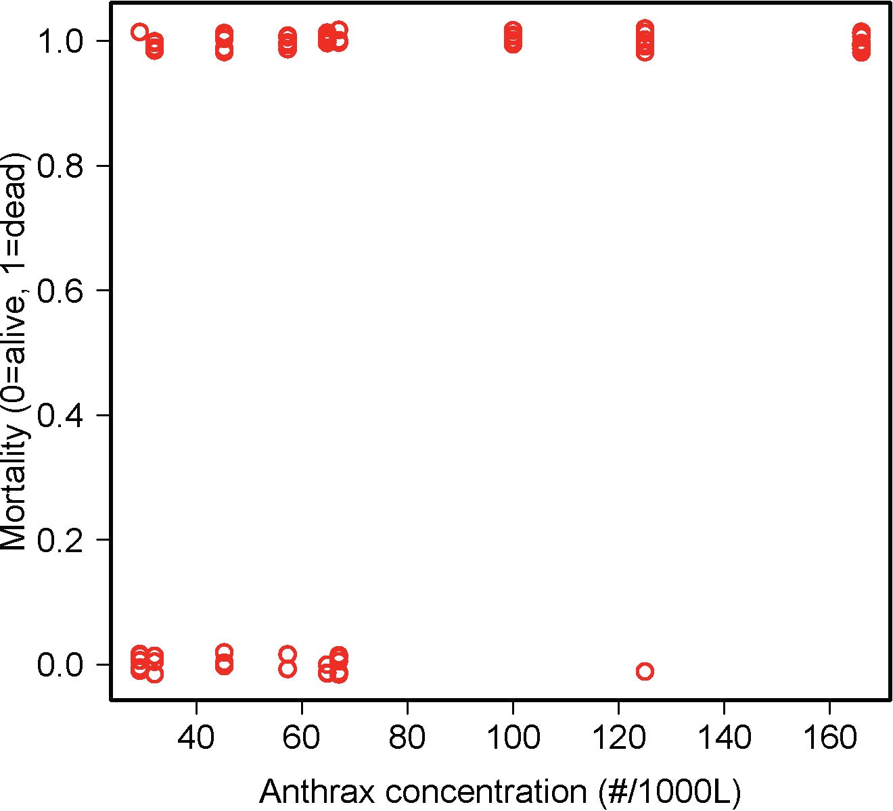
Example 2: Logistic regression
One of the most common uses of generalized linear models.
Goal is to model the relationship between a proportion and an explanatory variable
Data: 72 rhesus monkeys (Macacus rhesus) exposed for 1 minute to aerosolized preparations of anthrax (Bacillus anthracis).
Goal is to estimate the relationship between dose and probability of death.

Slide 20
Logistic regression
Measurements of individuals are 1 (dead) or 0 (alive)
Ordinary linear regression model not appropriate because
For each X the Y observations are binary, not normal
For every X the variance of Y is not constant
A linear relationship is not bounded between 0 and 1
0, 1 data can’t simply be transformed

Slide 21
The generalized linear model
g(µ) = β0 + β1X
µ is the probability of death, which depends on concentration X.
g(µ) is the link function.
Linear predictor (right side of equation) is like an ordinary linear regression, with intercept β0 and slope β1
Logistic regression uses the logit link function
z <- glm(mortality ~ concentration,
family = binomial(link
= "logit"))

Slide 22
The generalized linear model
g(µ) = β0 + β1X
glm() uses maximum likelihood: the method finds those values of β0 and β1 for which the data have maximum probability of occurring. These are the maximum likelihood estimates.
No formula for the solution. glm() uses an iterative procedure to find the maximum likelihood estimates on
the likelihood surface.

Slide 23
Use summary() for estimation
z <- glm(mortality ~ concentration,
family = binomial(link = "logit"))
summary(z)
Estimate Std. Error z value Pr(>|z|)
(Intercept) | -1.74452 | 0.69206 | -2.521 0.01171 | *
concentration | 0.03643 | 0.01119 | 3.255 0.00113 | **
Number of Fisher Scoring iterations: 5
Numbers in red are the estimates of β0 and β1 (intercept and slope) which predict
log(µ / 1 – µ).
Number of Fisher Scoring iterations refers to the number of iterations used before the algorithm used by glm() converged on the maximum likelihood solution.

Slide 24
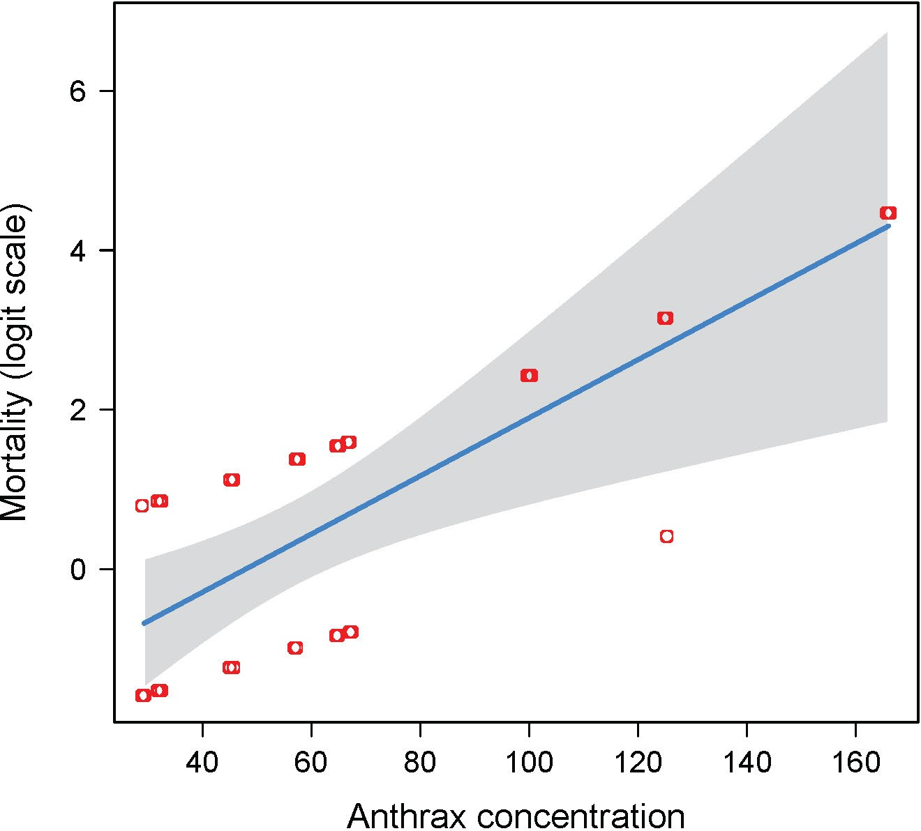

The generalized linear model
Use predict(z)to obtain predicted values on the logit scale
visreg(z) uses predict to plot predicted values with confidence limits on logit scale.
See that the function is a line.
The points on this scale are not the logit-transformed data. Instead, glm() creates “working” values to fit model to data on transformed scale.

Slide 25
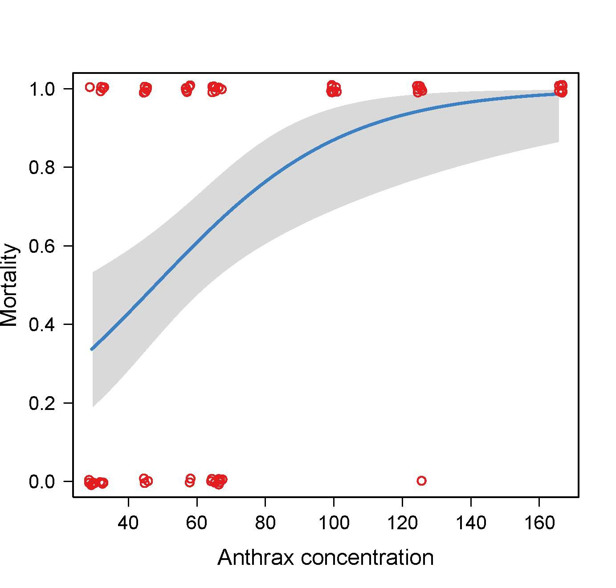
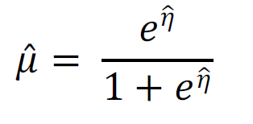
The generalized linear model
Use fitted(z)to obtain predicted values on the original scale
Use
visreg(z,
scale = ‘response’)
to get fitted curve with confidence bands on the original scale.

Slide 26
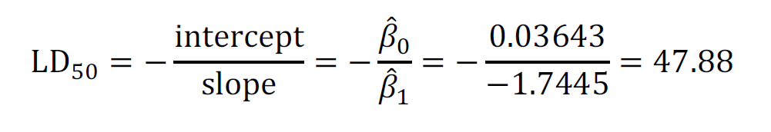
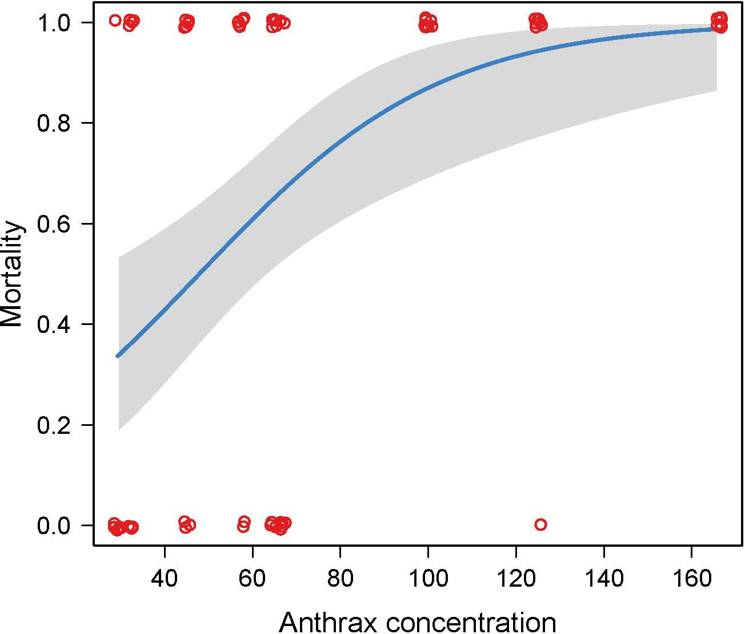
The generalized linear model
The parameter estimates from the model fit can be used to estimate LD50, the estimated concentration at which 50% of individuals are expected to die.
library(MASS) dose.p(z)
 |  | Dose | SE
p = | 0.5: | 47.8805 | 8.168823

Slide 27
Use anova() to test hypotheses
Analysis of deviance table gives log-likelihood ratio test of the null hypothesis that there is no differences among years in mean number of offspring.
anova(z, test="Chisq")
 | Df | Deviance | Resid | Df | Resid Dev | P(>|Chi|)
NULL |  |  | 71 |  | 92.982
concentration | 1 | 19.020 | 70 |  | 73.962 | 1.293e-05
As with lm(), terms are tested using model comparison (always a “full” vs “reduced” model). Default program of action is to fit terms sequentially (“Type 1 sums of squares”), just like lm().

Slide 28
Advantages of generalized linear models
More flexible than simply transforming variables. (A given transformation of the raw data may not accomplish both linearity and homogeneity of variance.)
Yields more familiar measures of the response variable than data transformations.
Avoids the problems associated with transforming 0’s and 1’s. For example, the logit transformation of 0 or 1 can’t be computed.
Retains the same analysis framework as linear models.

Slide 29
Assumptions of generalized linear models
Statistical independence of data points.
Correct specification of the link function for the data.
The variances of the residuals correspond to that assumed by the link function. (A method to deal with violation of this assumption is shown below).

Slide 30
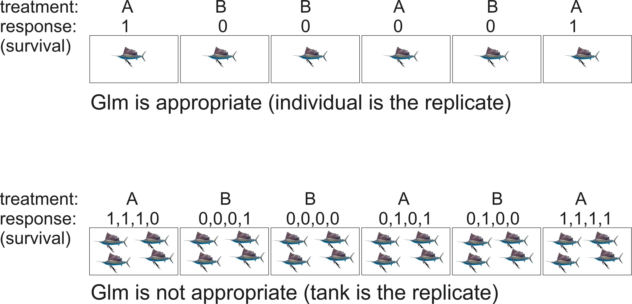
When glm() is appropriate and when it is not
In second case, analyze summary statistic (fraction surviving) with lm(). Fitting generalized linear mixed models is possible in lme4 package using glmm() method.

Slide 31
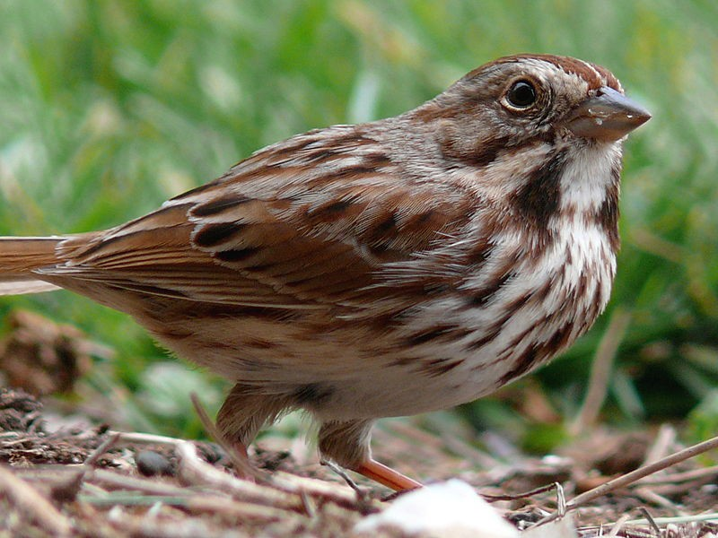
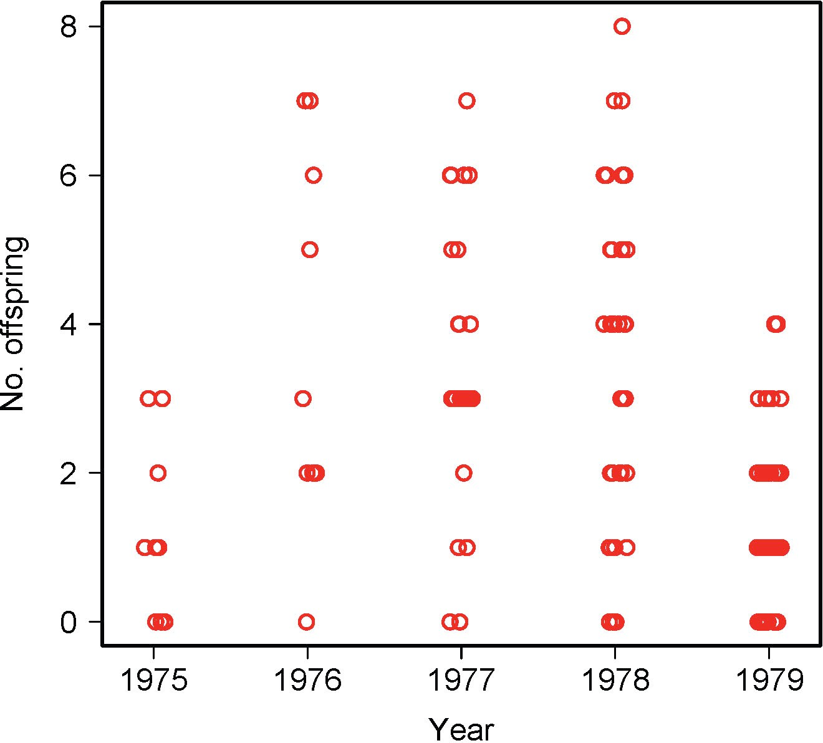
Example 3: Analyzing count data with log-linear regression
Estimate mean number of offspring fledged by female song sparrows
http://commons.wikimedia.org/wiki/ File:Song_Sparrow-27527-2.jpg
Linear model assumptions not met:
Data are discrete counts (non-Gaussian).
Variance increases with mean.

Slide 32
Estimate mean number of offspring fledged by female song sparrows
Example 3: Analyzing count data with log-linear regression
Linear model assumptions not met:
Data are discrete counts (non-normal). Variance increases with mean.
Two possible solutions:
Transform data: X’ = log(X + 1)
2. Generalized linear model. Poisson distribution might be appropriate for error distribution.
So try log link function

Slide 33
Example 3: Analyzing count data with log-linear regression
Log-linear regression (a.k.a. Poisson regression) uses the log link function
log(𝜇) = 𝜂 = 𝛽₊ + 𝛽₋𝑋₋ + 𝛽/𝑋/ + ⋯
𝜂 is the response variable on the log scale (here, mean of each group on log scale). Year is a categorical variable. So is analogous to single factor ANOVA.
Categorical variables are modeled in R using “dummy” indicator variables, as with lm().

Slide 34
Use summary() for estimation
z <- glm(noffspring ~ year, family=poisson(link="log")) summary(z)
Estimate Std. Error z value Pr(>|z|)
(Intercept) | 0.24116 | 0.26726 | 0.902 0.366872
year1976 | 1.03977 | 0.31497 | 3.301 0.000963 | ***
year1977 | 0.96665 | 0.28796 | 3.357 0.000788 | ***
year1978 | 0.97700 | 0.28013 | 3.488 0.000487 | ***
year1979 | -0.03572 | 0.29277 | -0.122 0.902898
(Dispersion parameter for poisson family taken to be 1)
Numbers in red are the parameter estimates on the log scale.
Intercept refers to mean of the first group (1975) and the rest of the coefficients are differences between each given group (year) and the first group.
Dispersion parameter of 1 states assumption that in every year, variance = mean.

Slide 35
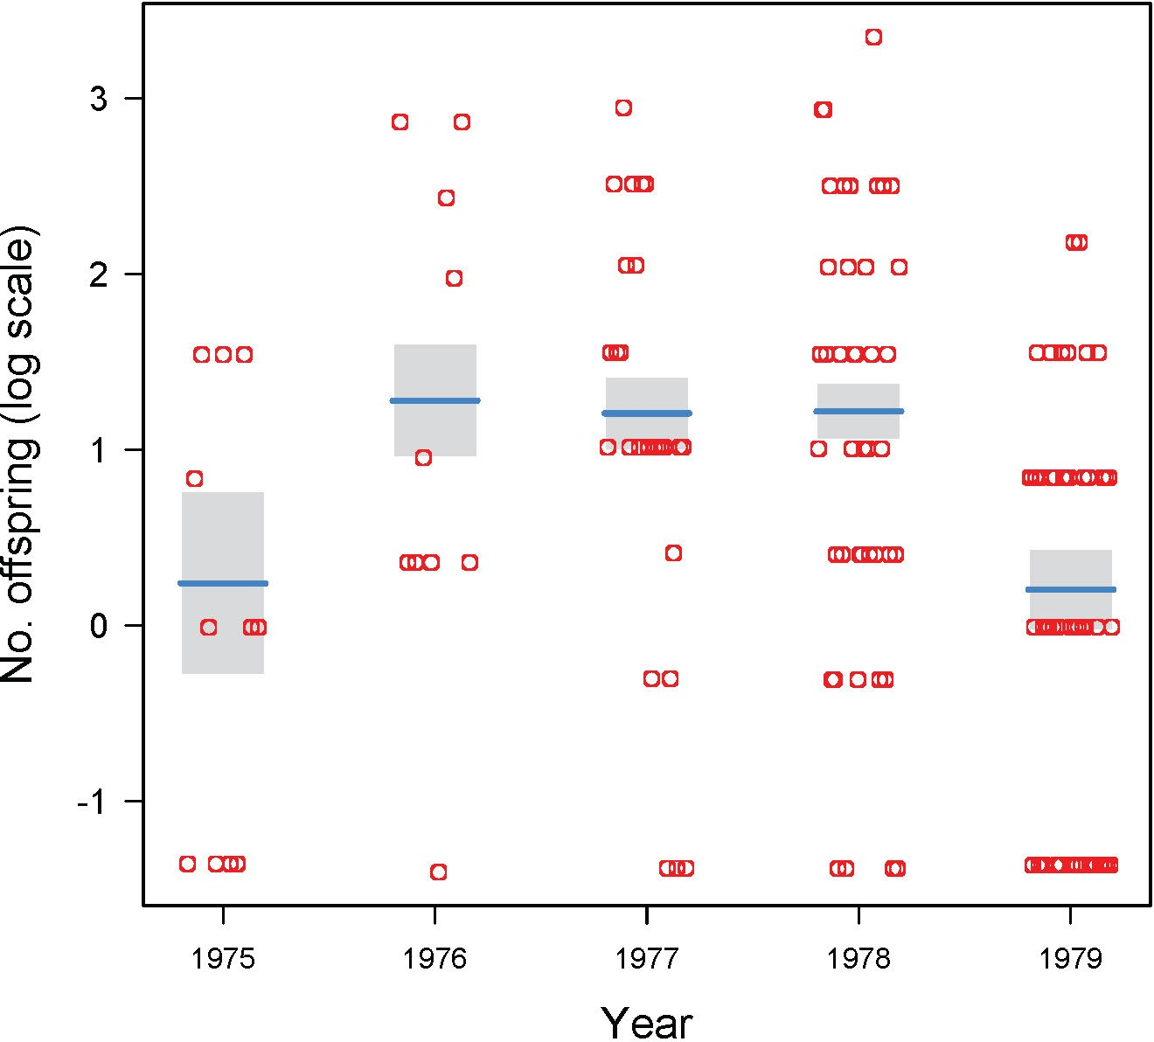
Predicted values on the transformed scale
Predicted values on the transformed (log) scale: predict(z)
visreg(z) uses predict to plot the predicted values, with confidence limits, on this transformed scale.
See that the “data points” on this scale are not just the transformed data (we can’t take log of 0). Instead, glm() creates “working” values to fit the model to the data on the transformed scale.

Slide 36
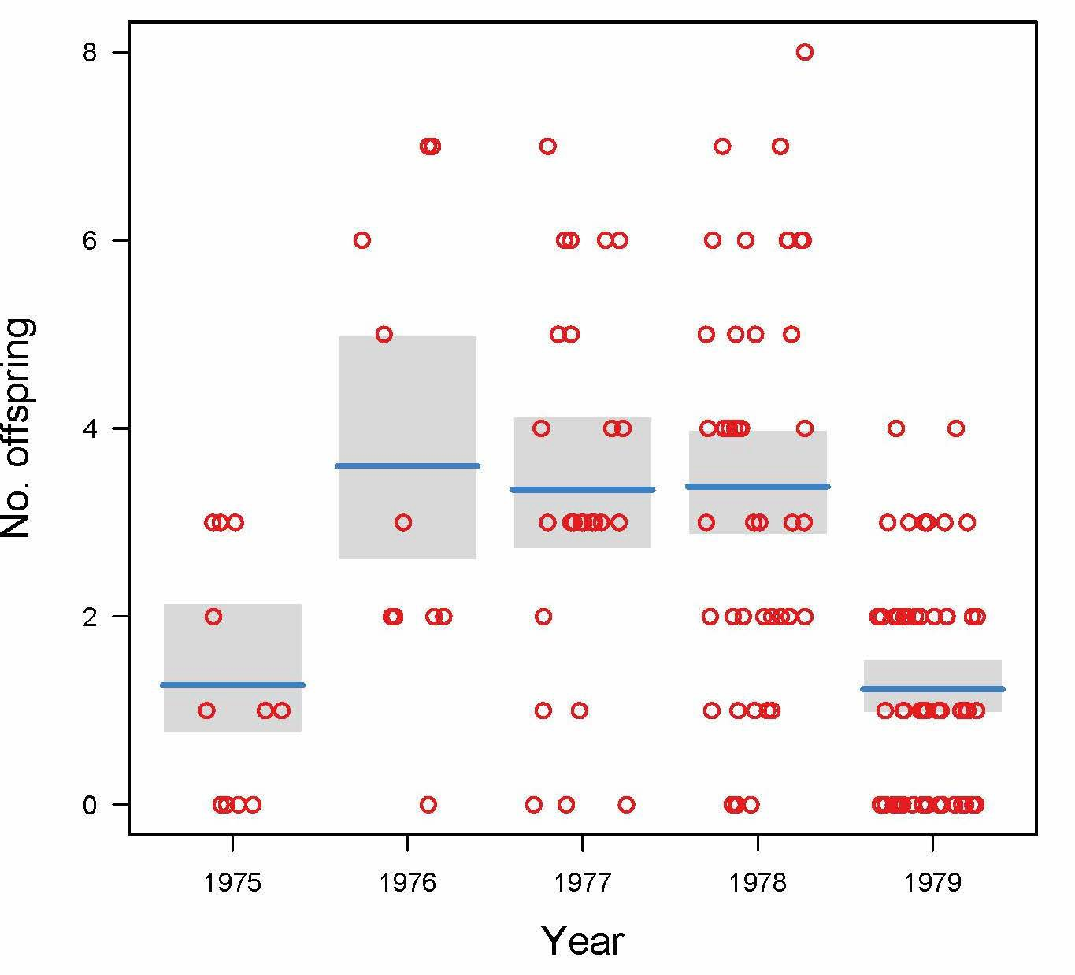

Predicted values on the original scale
Predicted values on original scale:
fitted.values(z)
plotted here using visreg() with superimposed original data points.
Note that the fitted values aren’t the means of the original data.
Fitted values are the transformed means estimated on the log scale (geometric means).

Slide 37
Use emmeans() to obtain model predicted values on original scale
emmeans(z, "year", type = "response")
Yields model-fitted predicted values and approximate 95% confidence intervals.
year rate SE df asymp.LCL asymp.UCL
1975 | 1.272727 0.3401496 Inf | 0.7537770 | 2.148957
1976 | 3.600000 0.6000000 Inf | 2.5967825 | 4.990791
1977 | 3.346154 0.3587453 Inf | 2.7119865 | 4.128614
1978 | 3.380952 0.2837232 Inf | 2.8681893 | 3.985385
1979 | 1.228070 0.1467822 Inf | 0.9715952 | 1.552248
Uses a large-sample approximation (degrees of freedom (df) are shown as infinite), and confidence limits might not be accurate for small sample sizes.

Slide 38
Use anova() to test hypotheses
Analysis of deviance table gives log-likelihood ratio test of the null hypothesis that there is no differences among years in mean number of offspring.
anova(z, test="Chisq")
Terms added sequentially (first to last)
 | Df | Deviance | Resid. Df | Resid. Dev | P(>|Chi|)
NULL |  |  | 145 | 288.656
year | 4 | 75.575 | 141 | 213.081 | 1.506e-15 | ***
As with lm(), terms are tested using model comparison (always a “full” vs “reduced” model). Default program of action is to fit terms sequentially (“Type 1 sums of squares”), as with lm().

Slide 39
Evaluating assumptions of the glm() fit
Do the variances of the residuals correspond to those assumed by the chosen link function?
The log link function assumes that the Y values are Poisson distributed at each X.
A key property of the Poisson distribution is that within each treatment group the variance and mean are equal (i.e., the glm() dispersion parameter = 1).
Similarly, when analyzing binary data, the logit link function also assumes a strict mean-variance relationship, specified by binomial distribution, when dispersion parameter = 1. This is rarely violated with 0/1 data, so I focus on log-linear model here.

Slide 40
Evaluating assumptions of the glm() fit
A central property of the Poisson distribution is that the variance and mean are equal (i.e., the glm() dispersion parameter = 1).
Let’s check the sparrow data:
tapply(noffspring, tapply(noffspring, |  | year, year, | mean) var)
1975 | 1976 | 1977 |  | 1978 | 1979
1.272727 | 3.600000 | 3.346154 |  | 3.380952 | 1.228070 | # | mean
1.618182 | 6.044444 | 3.835385 |  | 4.680604 | 1.322055 | # | variance
Variances slightly, but not alarmingly, larger than means.

Slide 41
Modeling excessive variance
Finding excessive variance (“overdispersion”) is common when analyzing count data. Excessive variance occurs because variables not included in the model also affect the response variable.
In lab we will analyze an example where the problem is more severe than in the case of the song sparrow data here.

Slide 42
Modeling excessive variance
Excessive variance can be accommodated with glm() by using a different link function, one that incorporates a dispersion parameter (which must be estimated from the data). If the estimated dispersion parameter is >> 1 then there is likely excessive variance.
The glm() procedure to accomplish over (or under) dispersion uses the observed relationship between mean and variance rather than an explicit probability distribution for the data. In the case of count data,
variance = dispersion parameter × mean
Method generates “quasi-likelihood” estimates that behave like maximum likelihood estimates.

Slide 43
Modeling excessive variance
z <- glm(noffspring ~
year, family = quasipoisson)
summary(z)
Estimate Std. Error t value Pr(>|t|)
Intercept) | 0.24116 | 0.29649 | 0.813 0.41736
year1976 | 1.03977 | 0.34942 | 2.976 0.00344 **
year1977 | 0.96665 | 0.31946 | 3.026 0.00295 **
year1978 | 0.97700 | 0.31076 | 3.144 0.00203 **
year1979 | -0.03572 | 0.32479 | -0.110 0.91259
Dispersion parameter for quasipoisson family taken to be 1.230689
The dispersion parameter is reasonably close to 1 for these data. But typically it is much larger than 1 for count data, so use family = quasipoisson.

Slide 44
Modeling excessive variance
Lets try it with the song sparrow data
z <- glm(noffspring ~ year,
family = quasipoisson)
summary(z)
Estimate Std. Error t value Pr(>|t|)
Intercept) | 0.24116 | 0.29649 | 0.813 0.41736
year1976 | 1.03977 | 0.34942 | 2.976 0.00344 **
year1977 | 0.96665 | 0.31946 | 3.026 0.00295 **
year1978 | 0.97700 | 0.31076 | 3.144 0.00203 **
year1979 | -0.03572 | 0.32479 | -0.110 0.91259
Dispersion parameter for quasipoisson family taken to be 1.230689
The point estimates are identical with those obtained using family=poisson
instead, but the standard errors (and resulting confidence intervals) are a little wider.

Slide 45
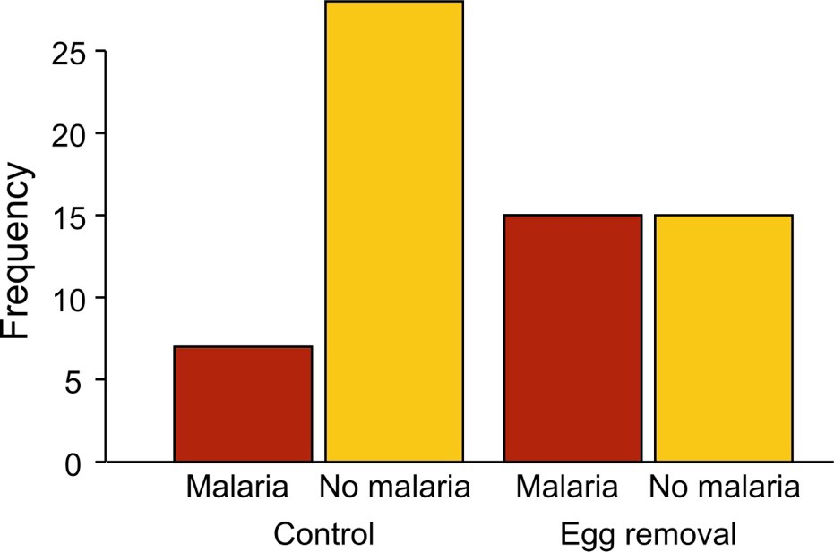
Example 4: Modeling contingency tables
Example: Incidence of malaria in female great tits in relation to experimental treatment. n = 65 birds.
Grouped bar graph
Explanatory variable = outer groups; response variable = inner groups

Slide 46
Example 4: Modeling contingency tables
Response Treatment | Frequency
Malaria Control | 7
No Malaria Control | 28
Malaria Egg removal | 15
No Malaria Egg removal 15
z <- glm(Frequency ~ Treatment +
Response, data = mydata,
family = poisson(link = "log"))
The counts are modeled in an analogous way to modeling of means in an ordinary linear model.

Slide 47
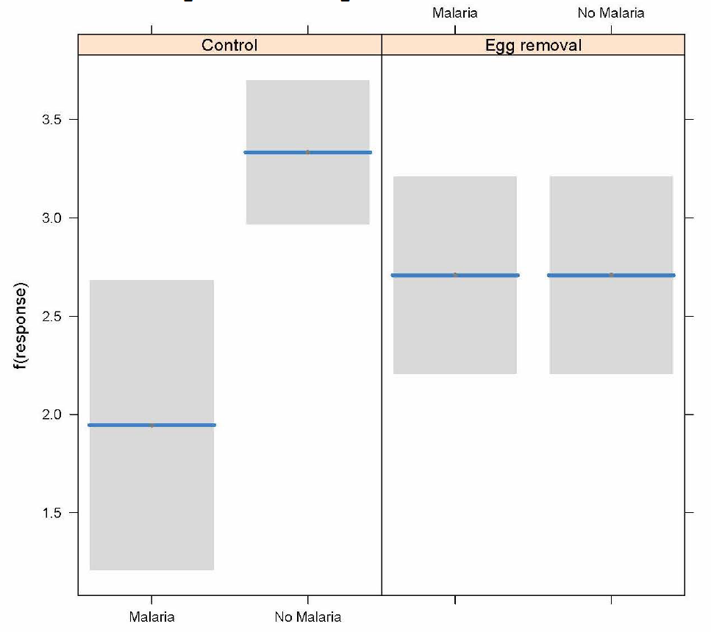
Example 4: Modeling contingency tables
visreg(z, xvar="Response", by="Treatment", scale="response")

Slide 48
Use anova() to test hypotheses
anova(z, test="Chi")
Df Deviance
Resid. Df
Resid. Dev
P
NULL | 3 | 13.8771
Treatment | 1 | 0.3850 | 2 | 13.4921 0.534942
Response | 1 | 6.9079 | 1 | 6.5843 0.008582
Treatment:Response | 1 | 6.5843 | 0 | 0.0000 0.010288
The interaction between Treatment and Response is the test of association
Ignore the main effects

Slide 49
Other uses of generalized linear models
The method is especially useful when analyzing higher-order contingency tables, where there may be two- and three-way interactions. Each of the interactions can be assessed separately.
glm() can handle data having other probability distributions than the ones used in my examples, including exponential and gamma distributions.

Slide 50


Suggested reading:
Whittingham, M.J., Stephens, P.A., Bradbury, R.B., Freckleton, R.P., 2006. Why do we still use stepwise modelling in ecology and behaviour? J Anim Ecol 75, 1182–1189. https://doi.org/10.1111/j.1365-2656.2006.01141.x
Zuur, A.F., Ieno, E.N., Elphick, C.S., 2010. A protocol for data exploration to avoid common statistical problems. Methods in Ecology and Evolution 1, 3–14. https://doi.org/10.1111/j.2041-210X.2009.00001.x

