Slide 1
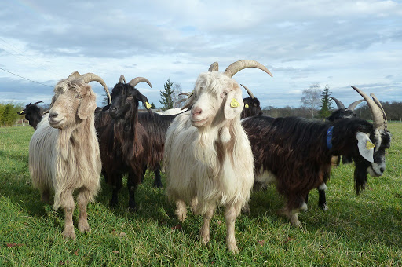
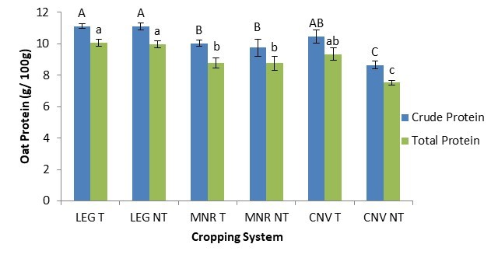
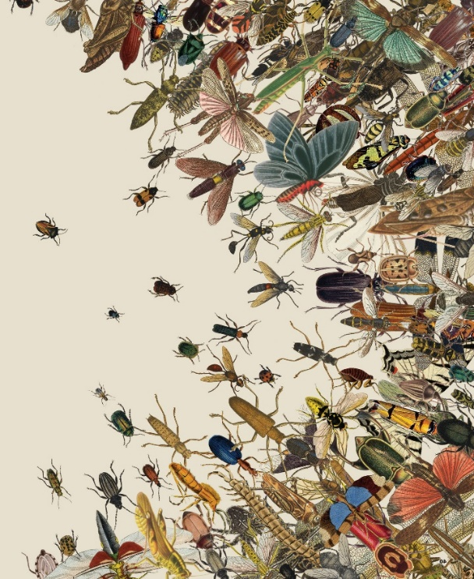
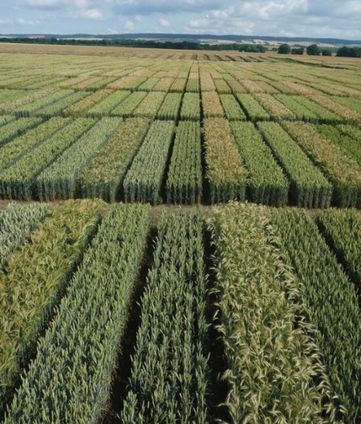

C7041 Experimental Design and Analysis
Ed Harris

Slide 2
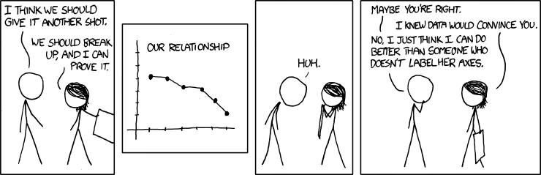
1.02 Graphics 1

Slide 3
Types of Data
Categorical Variables (aka Class variables, or Nominal variables)
Numerical Variables (aka Quantitative Variables)
Numerical variables are either continuous or discrete

Slide 4
Categorical variables
Genotype (e.g., AA, AG, GG)
Pesticide treatment (organic vs. chemical)
Province
Survival (i.e., live or die)

Slide 5
Numerical variables
Height, Weight
Tail length
Dose (e.g., in micrograms/gram)
Longevity (i.e., number of years)

Slide 6
Discrete
Can be counted
Continuous
Can be measured
Arm length
Height
Weight
Age
Number of limbs
Number of offspring
Number of petals

Slide 7
Graphing categorical variables

Slide 8
Frequency table showing cases of COVID in a Canadian Health Authorities on June 2, 2020
Health Authority | Frequency
Fraser | 1307
Vancouver Coastal | 904
Interior | 195
Vancouver Island | 127
Northern | 64

Slide 9
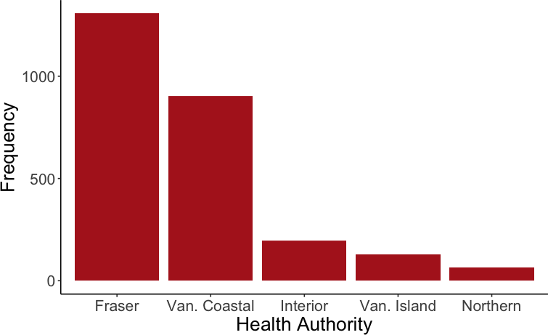
Bar graph

Slide 10
Graphing numerical variables

Slide 11
Heights of EDA students (cm)
165 | 168 | 163 | 173 | 170
163 | 170 | 155 | 152 | 190
170 | 168 | 142 | 160 | 154
165 | 156 | 177 | 173 | 165
165 | 175 | 155 | 166 | 168
165 | 180 | 165

Slide 12
Frequency table
Height Group | Frequency
141-150 | 1
151-160 | 6
161-170 | 15
171-180 | 5
181-190 | 1

Slide 13
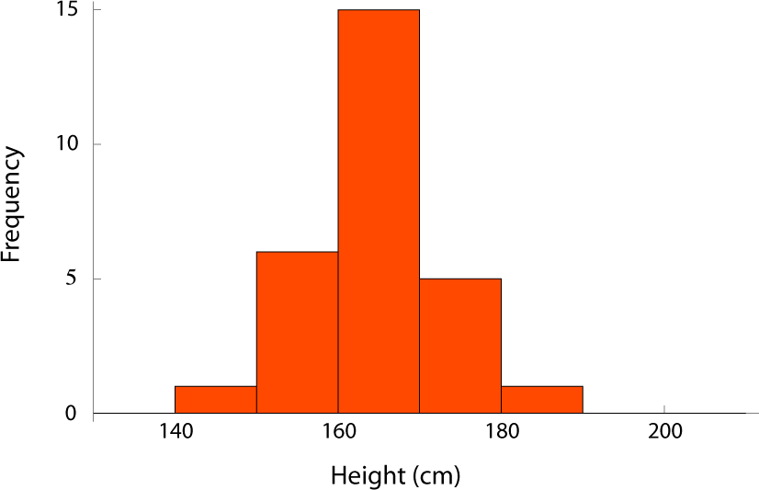
Histogram

Slide 14
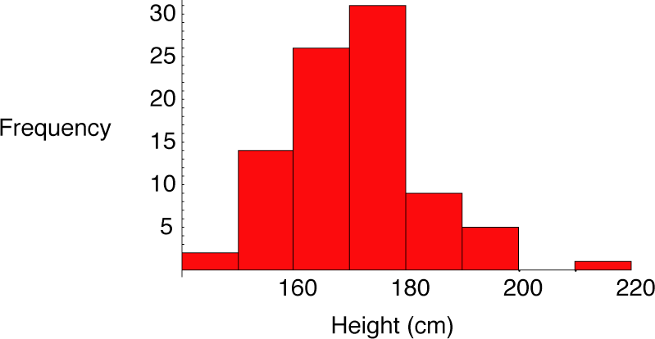
Height histogram with more data

Slide 15
Cumulative Frequency Distribution (CFD)
1
0.8
0.6
0.4
0.2
Cumulative Frequency
150 160 170 180 190 200 210
Height (in cm) of EDA Students
The cumulative frequency of a value is the proportion of individuals equal to or less than that value.

Slide 16
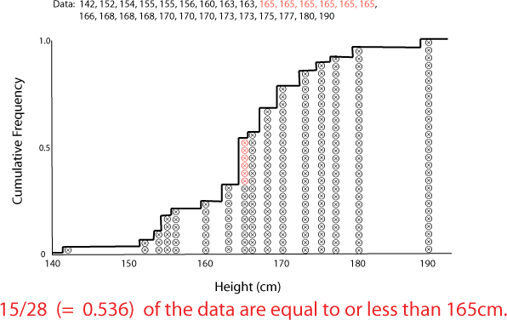
Making a CFD

Slide 17
Associations between two categorical variables

Slide 18
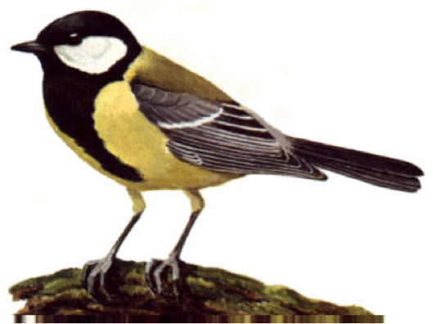
Association between reproductive effort and disease (avian malaria)
Contingency table showing incidence of malaria in female great tits subjected to experimental egg removal.
control group |  | egg removal group | row total
malaria | 7 | 15 | 22
no malaria | 28 | 15 | 43
column total | 35 | 30 | 65

Slide 19
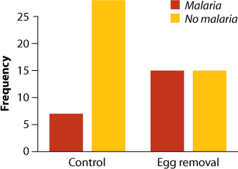
Grouped Bar Graph

Slide 20
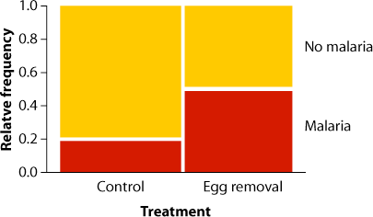
Mosaic plot

Slide 21
Associations between categorical and numerical variables

Slide 22
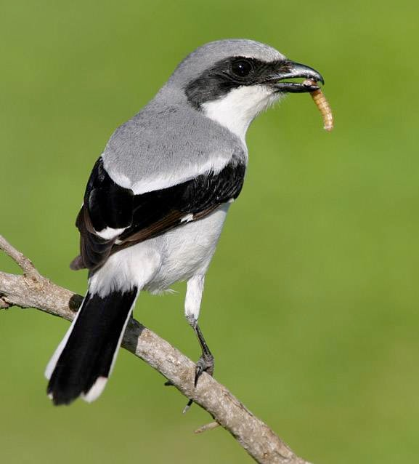
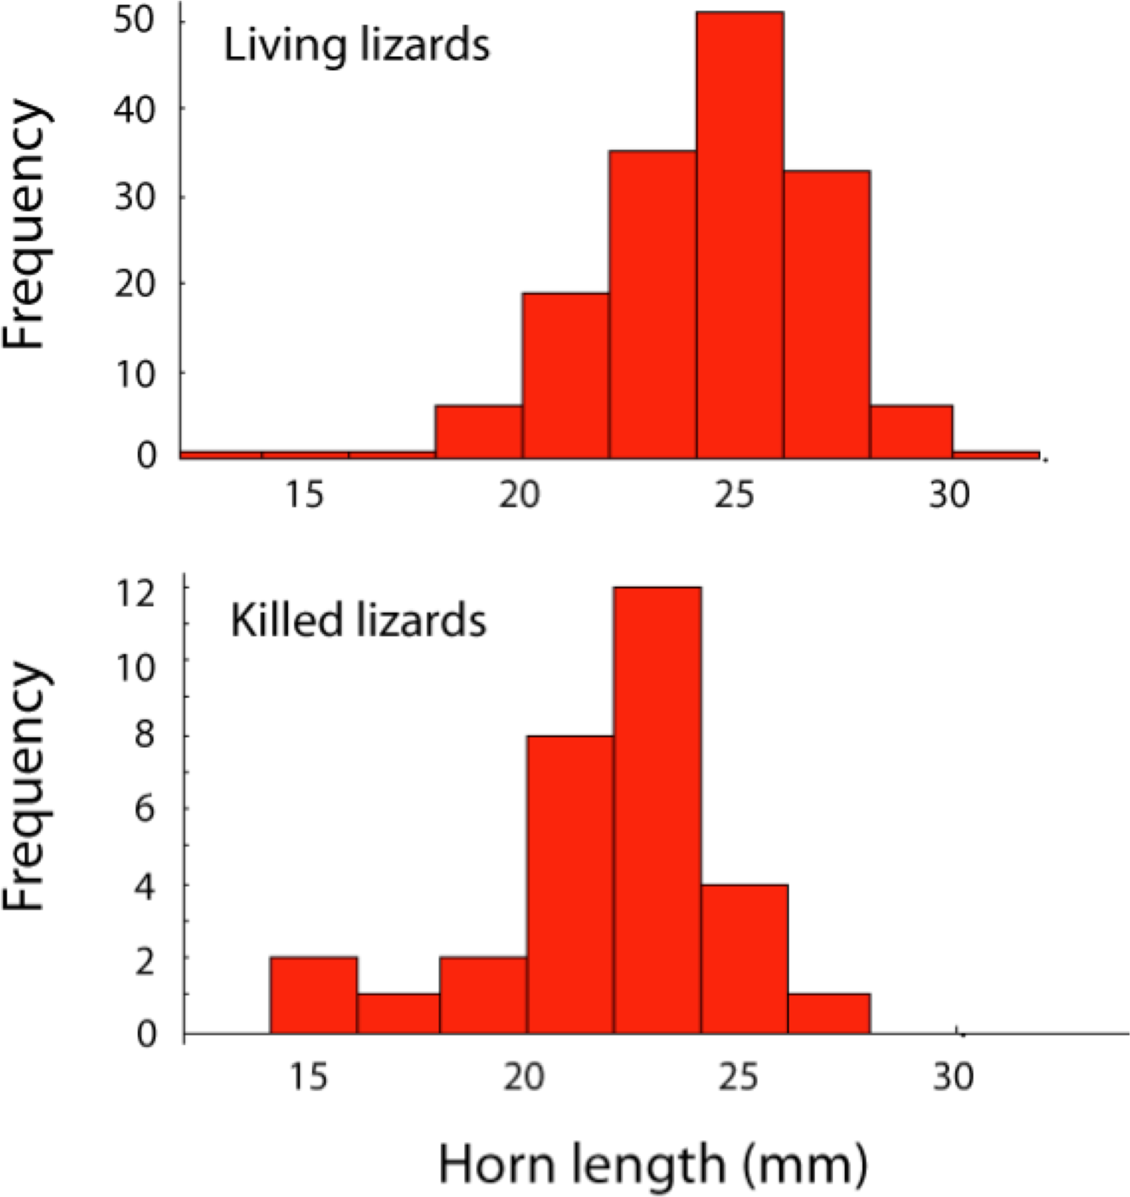
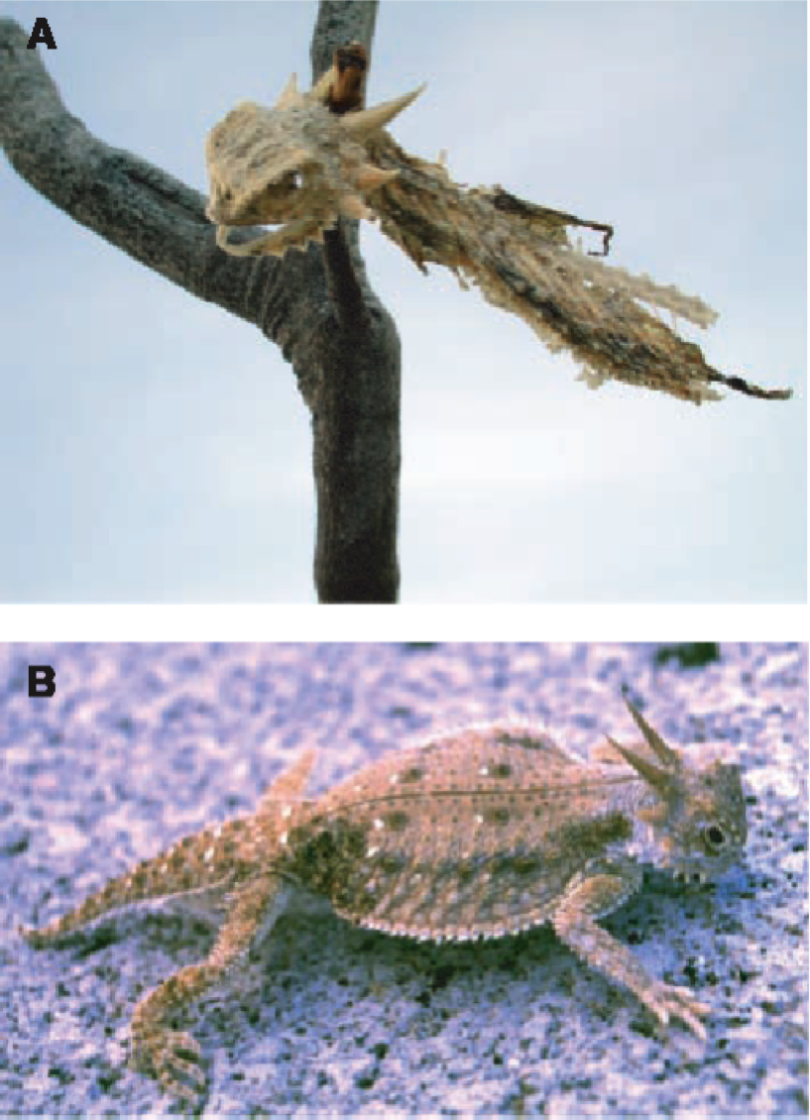
Multiple histograms
Shrike
Young, K. V., E. D. Brodie Jr., and E. D. Brodie III. 2004. How the horned lizard got its horns. Science 304:65.
www.netcore.ca/~peleetom

Slide 23
Associations between two numerical variables

Slide 24
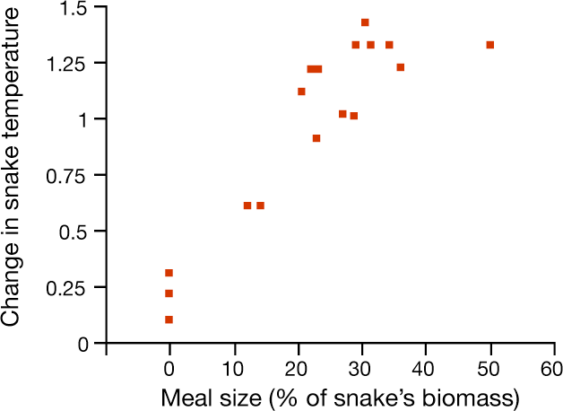
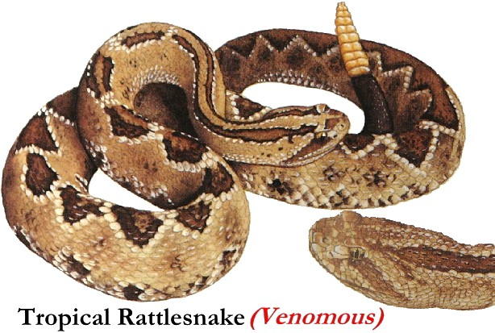
Scatter plot
Tattersall et al. (2004) Journal of Experimental Biology 207:579-585

Slide 25
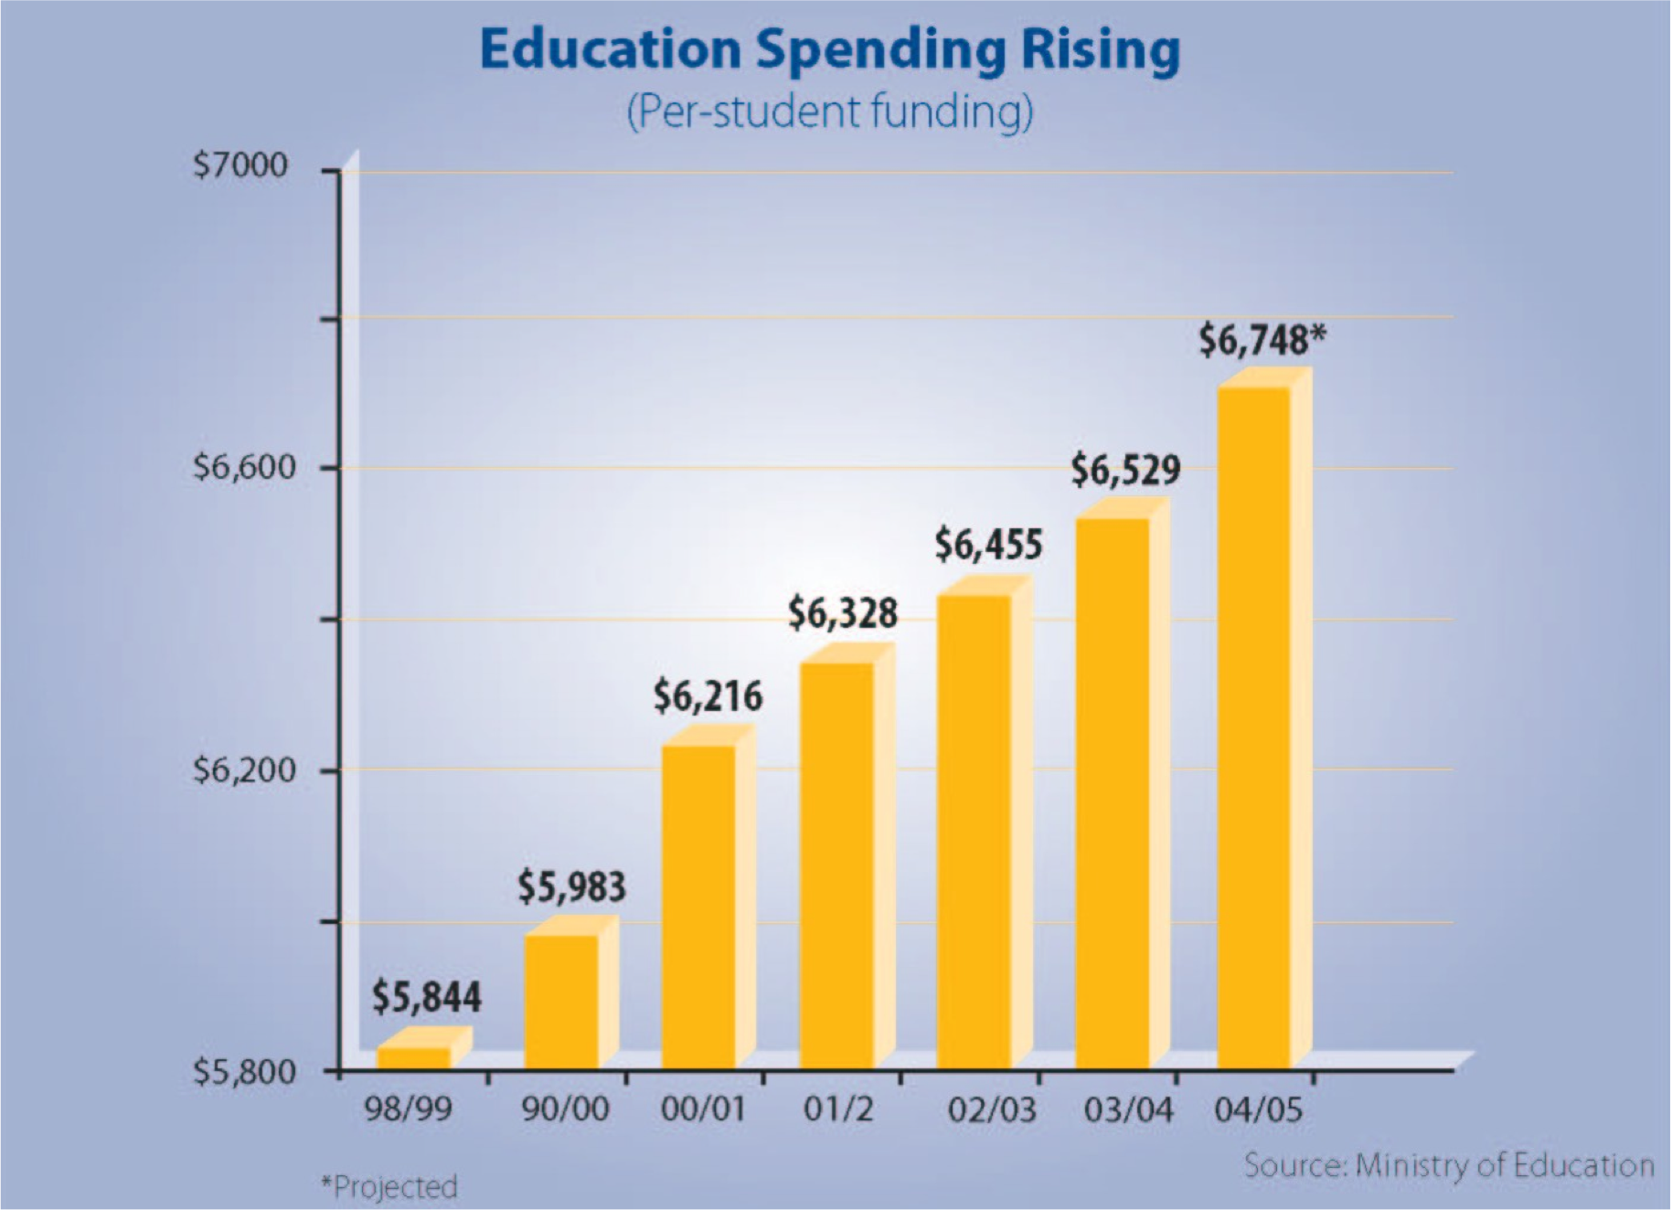
Don’t mislead with graphics

Slide 26
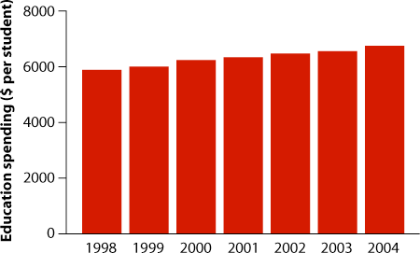
Better representation of truth

Slide 27
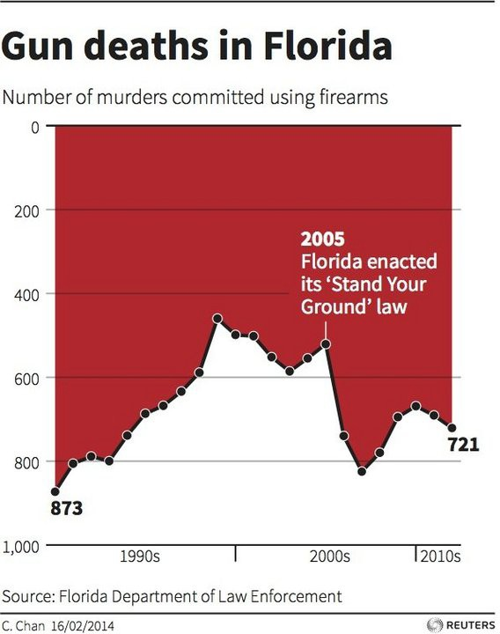
Creative representation of truth
Source: http://www.livescience.com/45083-misleading-gun-death-chart.html

Slide 28

Creative representation of truth
Source: http://www.livescience.com/45083-misleading-gun-death-chart.html

Slide 29
Summary: Graphical methods for frequency distributions
Type of Data | Method
Categorical data | Bar graph
Numerical data | Histogram Cumulative frequency distribution

Slide 30
Summary: Associations between variables
 | Explanatory variable
Response variable | Categorical | Numerical
Categorical | Contingency table Grouped bar graph Mosaic plot
Numerical | Multiple histograms Cumulative frequency distributions | Scatter plot

Slide 31
Graphics in R
Bar graphs:
ggplot(data = BCCOVIDData, aes(x = HealthAuthority)) + geom_bar(stat = "count")
Histograms:
ggplot(classHeightDataFull, aes(x=height)) + geom_histogram(binwidth=5)
Scatterplots:
ggplot(data = snakeTempData,
aes(x = mealSize, y = tempChange)) + geom_point()

