Slide 1
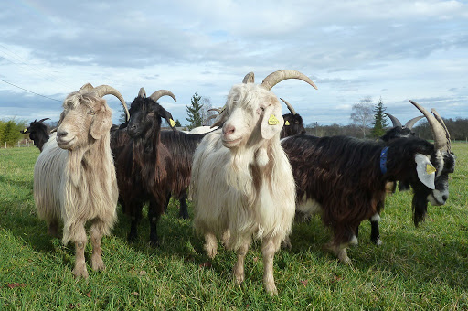
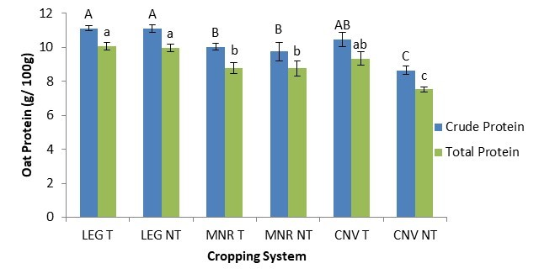
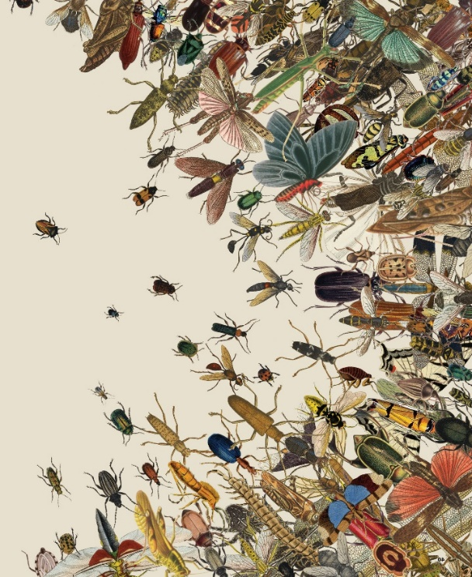
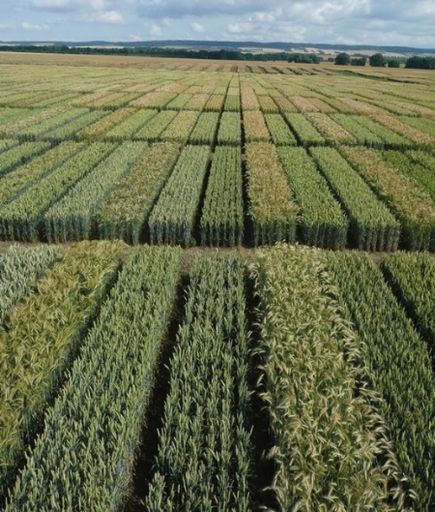

C7041 Experimental Design and Analysis
Ed Harris

Slide 2
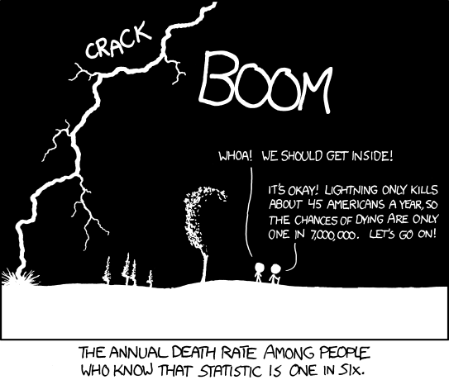
1.05 Probability

Slide 3
Probability
The probability of an event is its true relative frequency, the proportion of times the event would occur if we repeated the same process over and over again.

Slide 4
Probability
Two events are mutually exclusive if they cannot both be true.

Slide 5
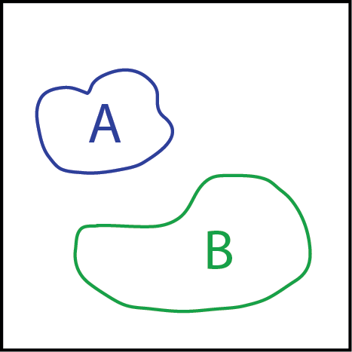
Probability
A and B are mutually exclusive

Slide 6
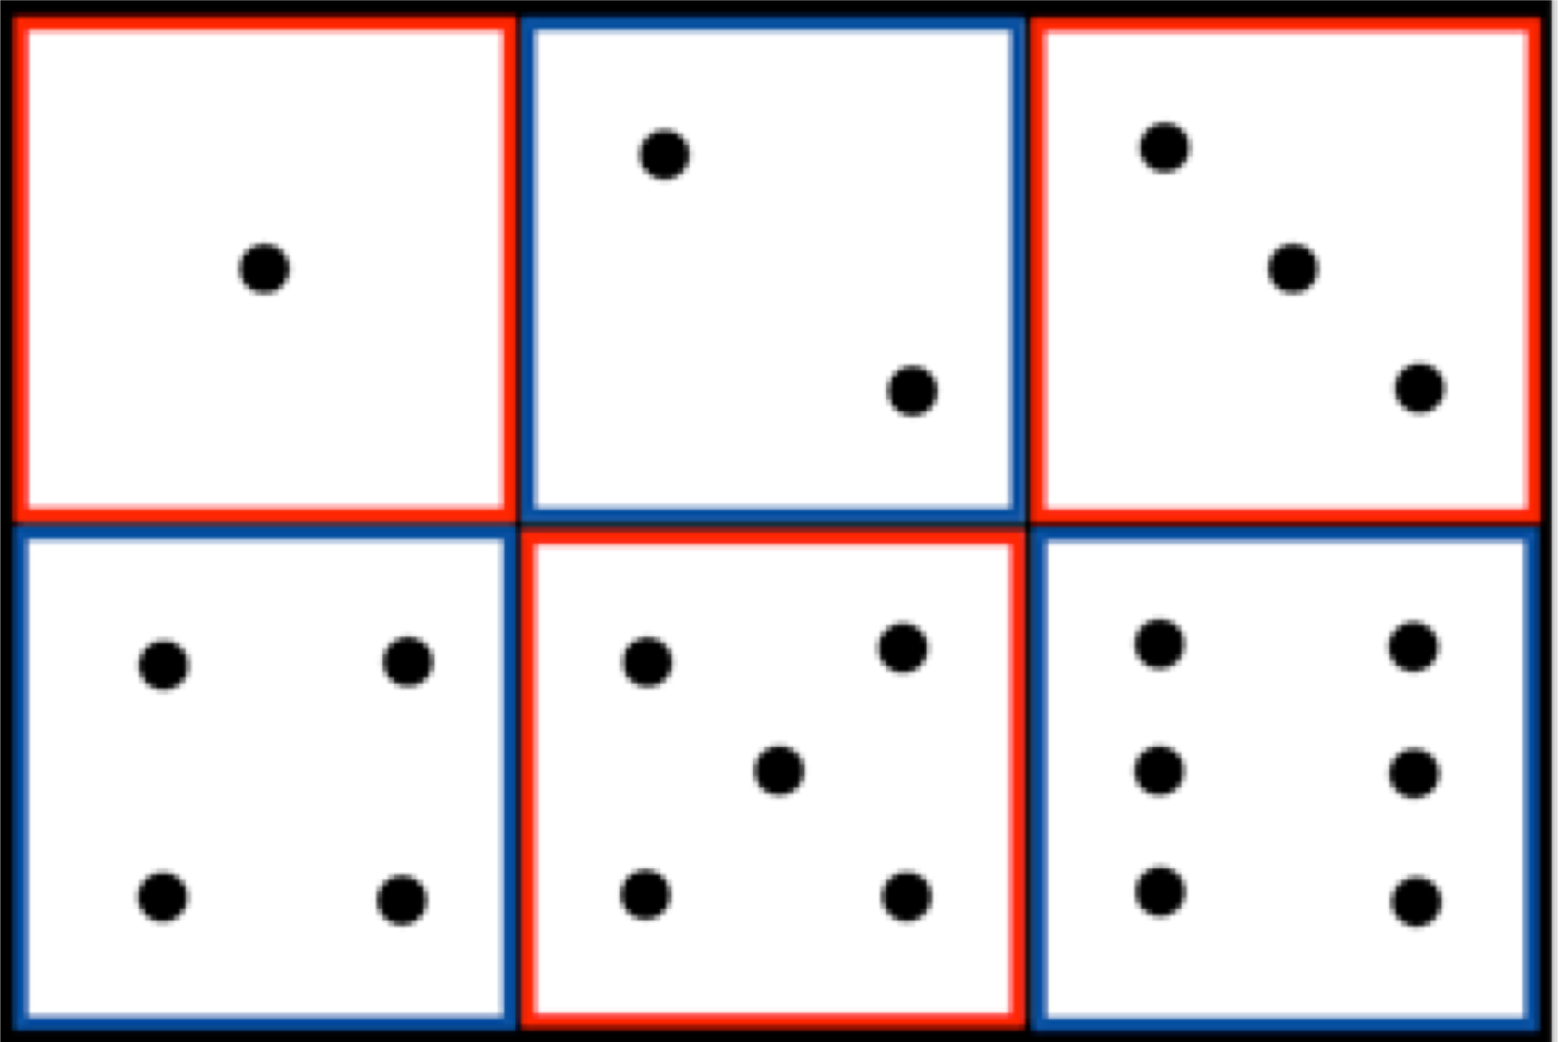
Mutually exclusive

Slide 7
Mutually exclusive
Pr(A and B) = 0

Slide 8
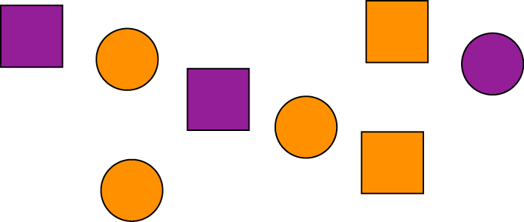
Not mutually exclusive
Pr(A and B) ≠ 0
Pr(purple AND square) ≠ 0

Slide 9
Probability distribution
A probability distribution describes the true relative frequency of all possible values of a random variable.

Slide 10
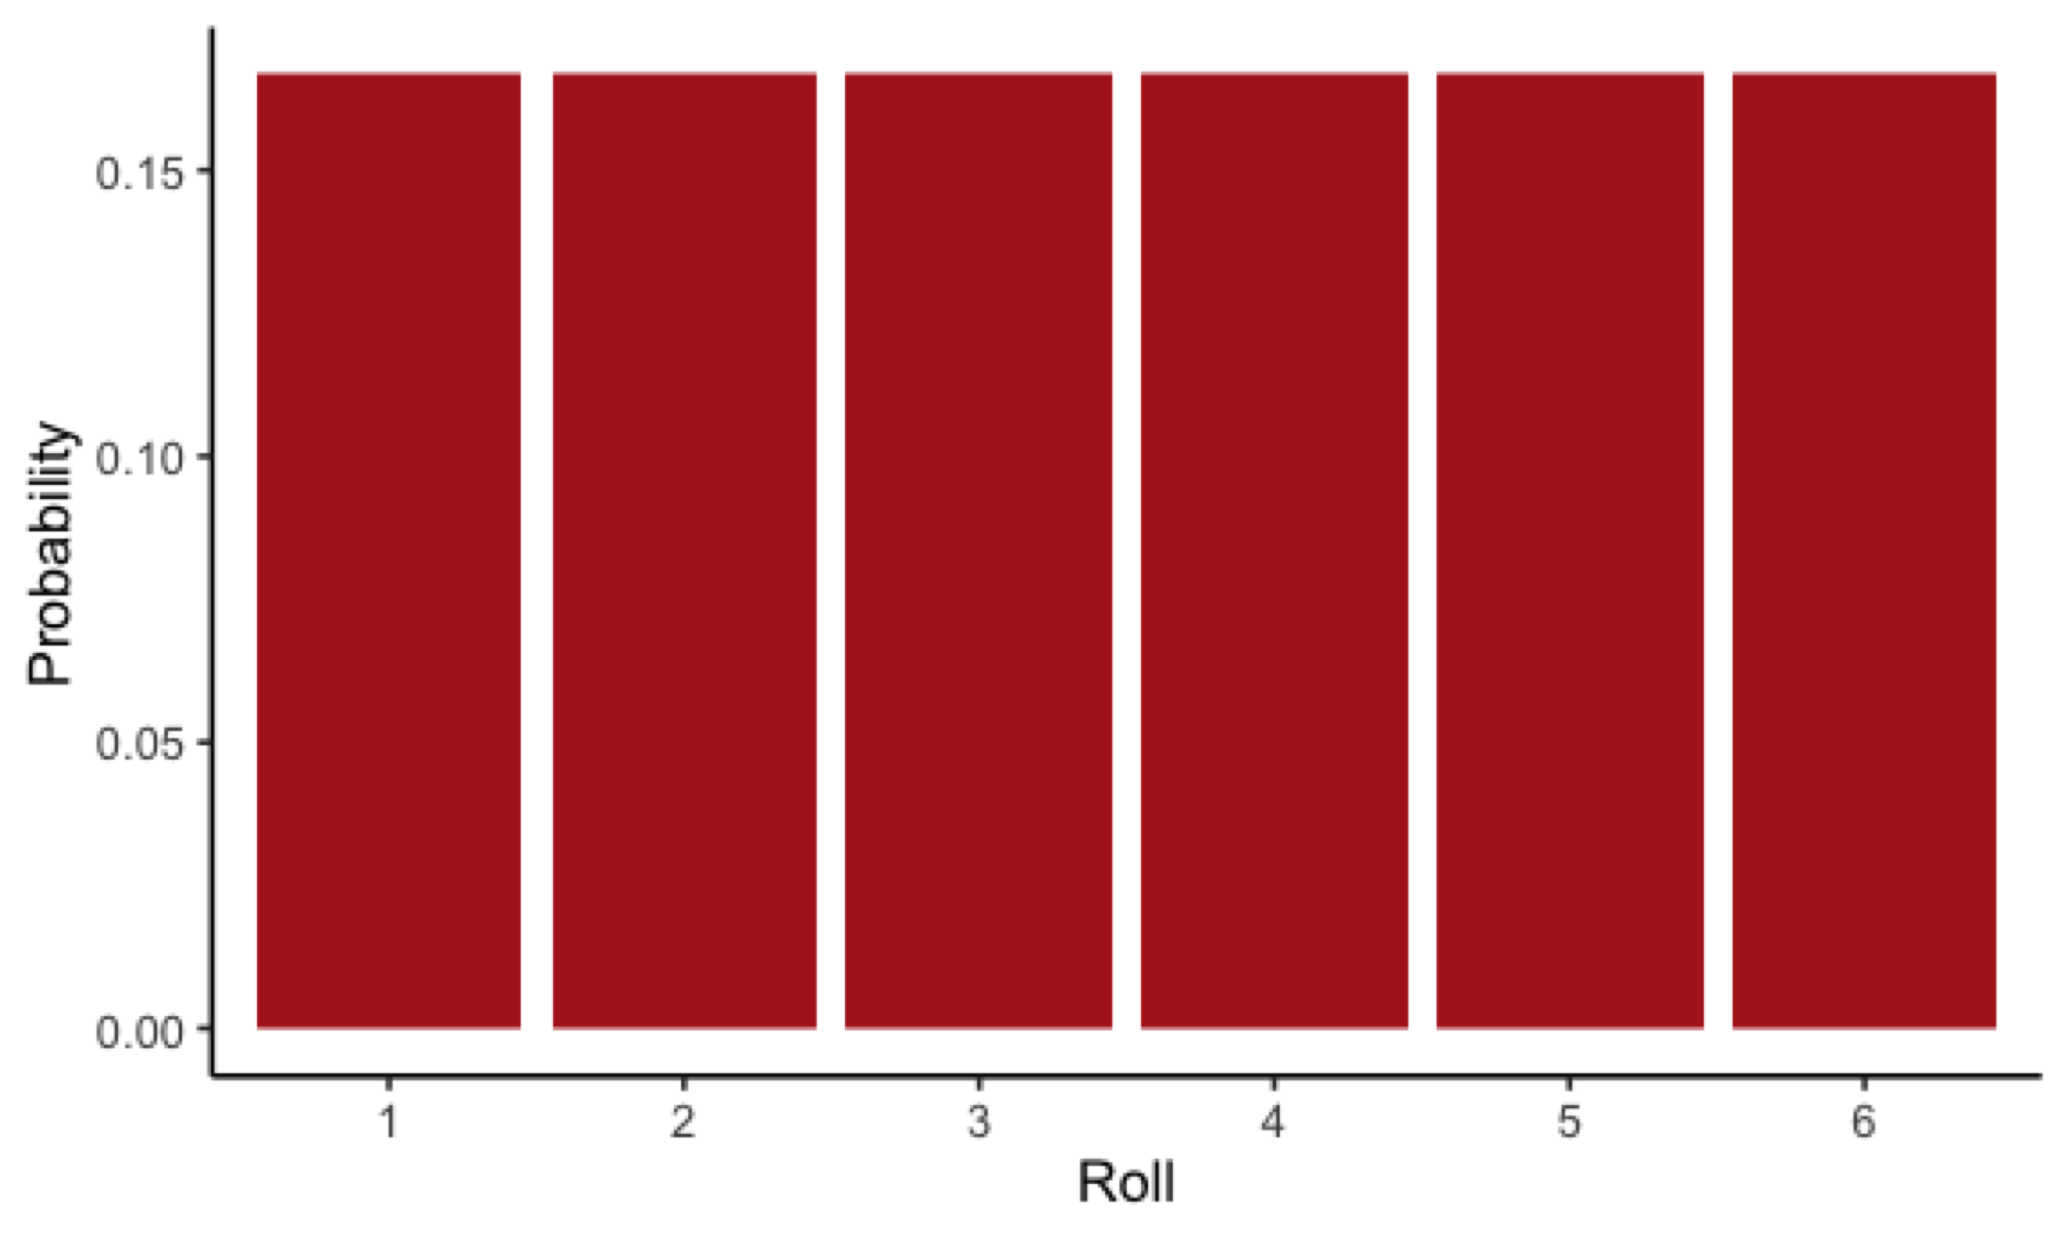
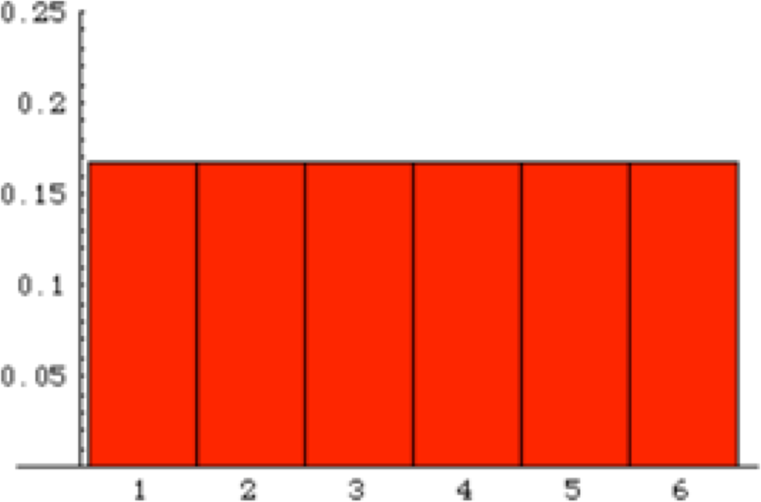
Probability distribution for the outcome of a roll of 1 die

Slide 11
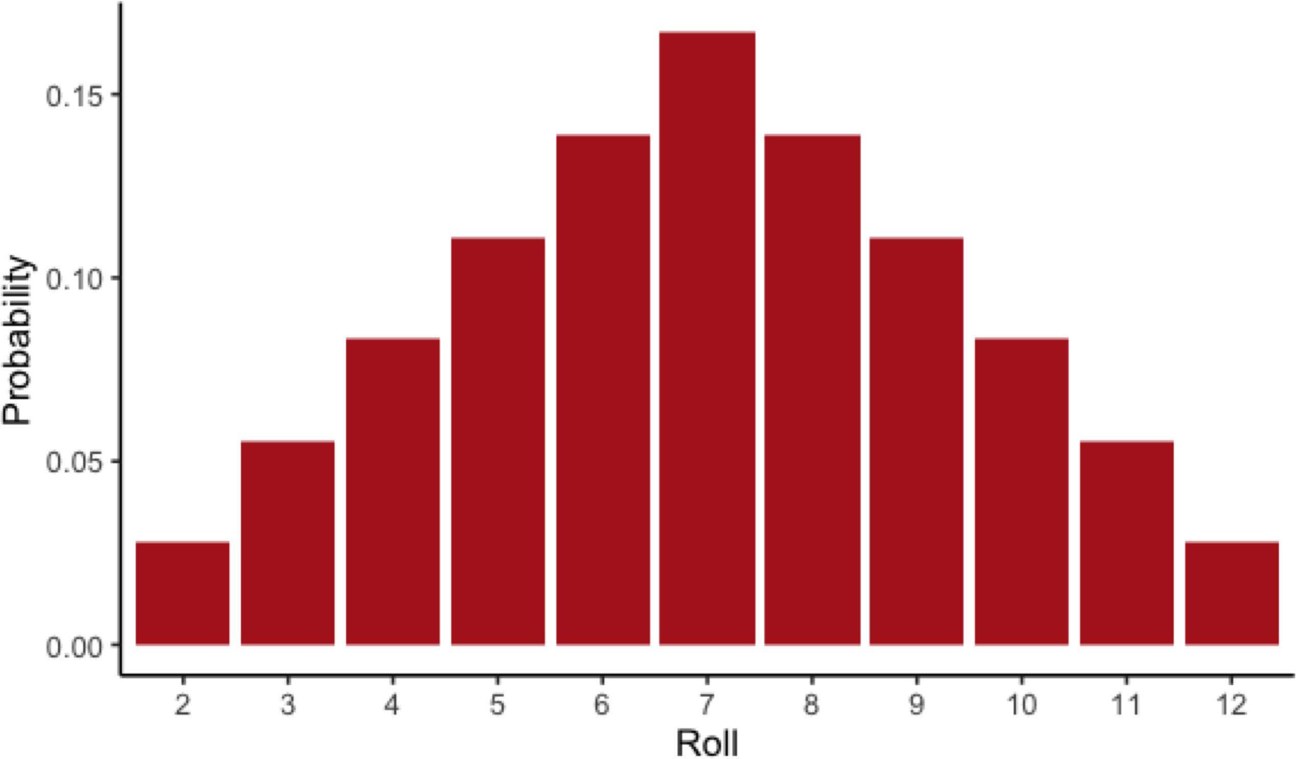
Probability distribution for the sum of a roll of 2 dice

Slide 12
The addition principle
The addition principle: If two events A and B are mutually exclusive, then
Pr[A OR B] = Pr[A] + Pr[B]

Slide 13
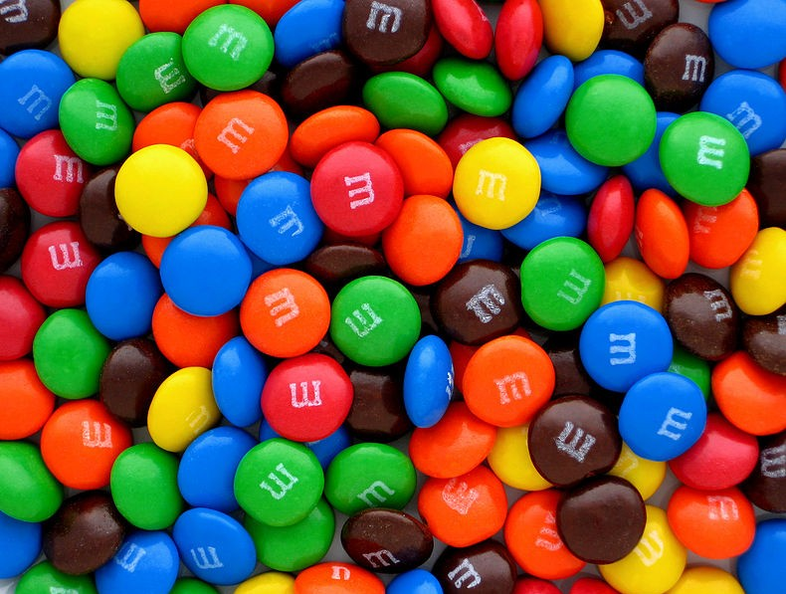
The probability of a range
Pr[Number of green M&Ms ≥ 6] =
Pr[6 green] + Pr[7 green] + Pr[8 green]....

Slide 14
The probability of a range
The probabilities of all possibilities add to exactly 1.

Slide 15

Probability of Not
Pr[NOT rolling a 2] = 1 – Pr[Rolling a 2] = 5/6

Slide 16
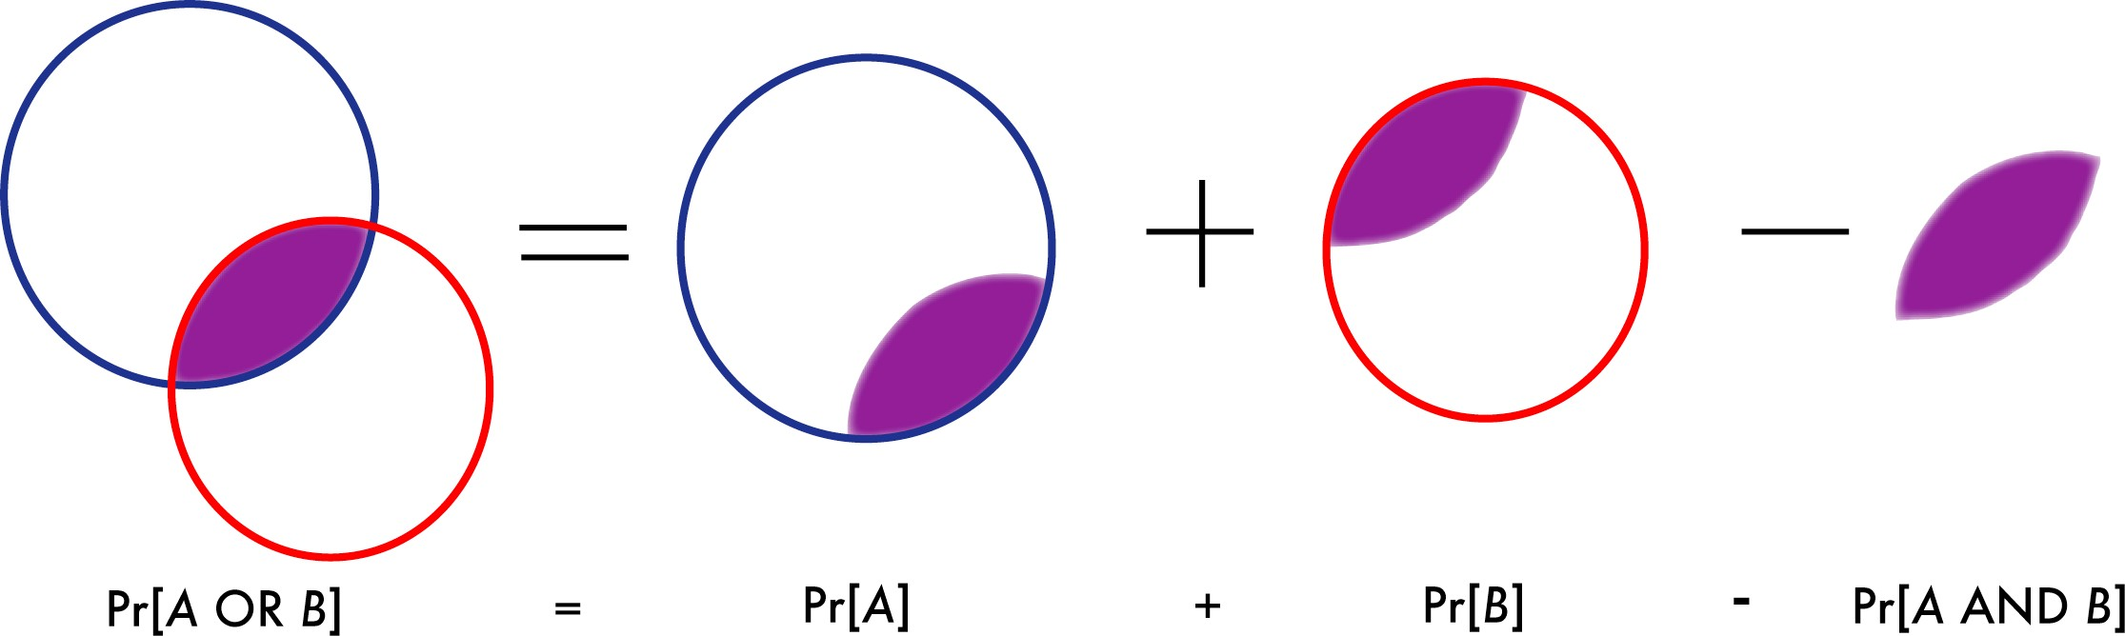
General Addition Principle

Slide 17
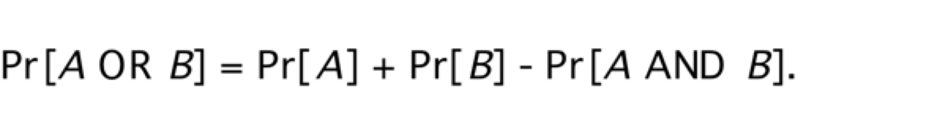
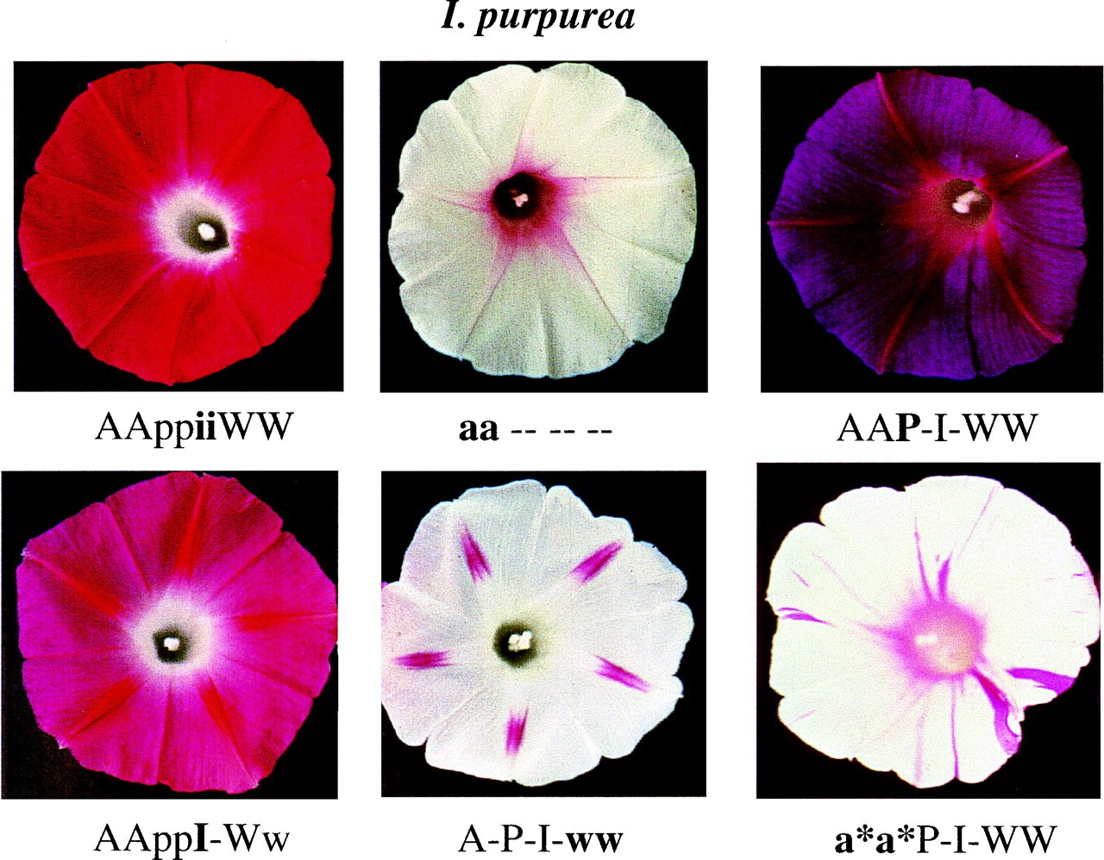
General Addition Principle
e.g., Morning glory flowers can be white because of their ww genotype at the W locus and/or because of their aa genotype at the A locus
© 2000 National Academy of Sciences, https://doi.org/10.1073/pnas.97.13.7016

Slide 18
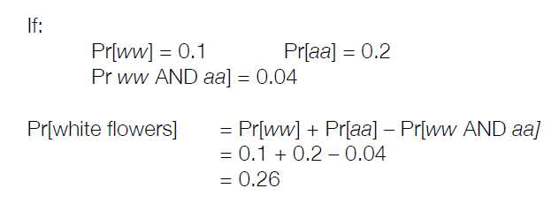
General Addition Principle
e.g., Morning glory flowers can be white because of their ww genotype at the W locus and/or because of their aa genotype at the A locus

Slide 19
Independence
Two events are independent if the occurrence of one gives no information about whether the second will occur.

Slide 20
Multiplication principle
The multiplication principle: If two events A and B are independent, then:
Pr[A AND B] = Pr[A] × Pr[B]

Slide 21
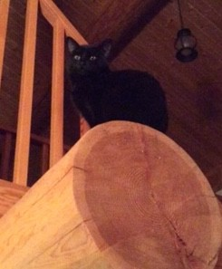
Short-haired, black cats
What is the probability that
a cat is black- and short-haired?
Pr[black hair] = 0.33
Pr[short-haired] = 0.90
Pr[ black hair AND short hair] = 0.33 × 0.90
= 0.30.

Slide 22
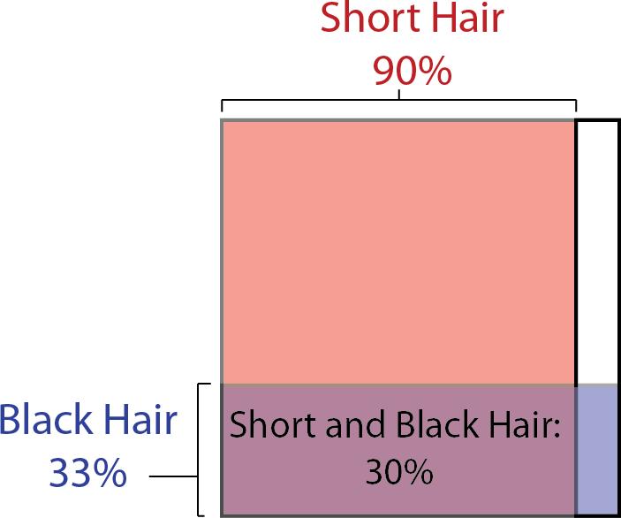
Short-haired, black cats

Slide 23
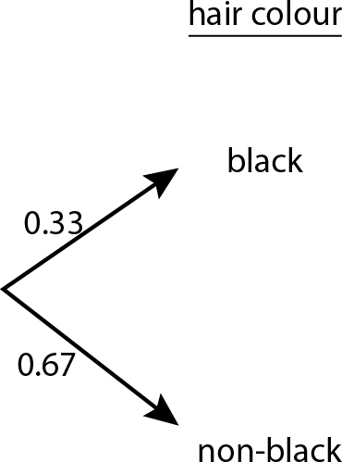
Probability trees

Slide 24
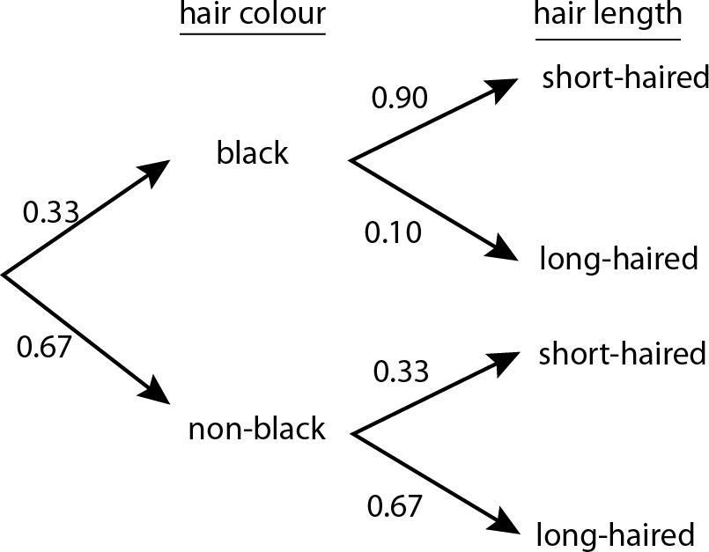
Phenotypes in two-offspring family

Slide 25
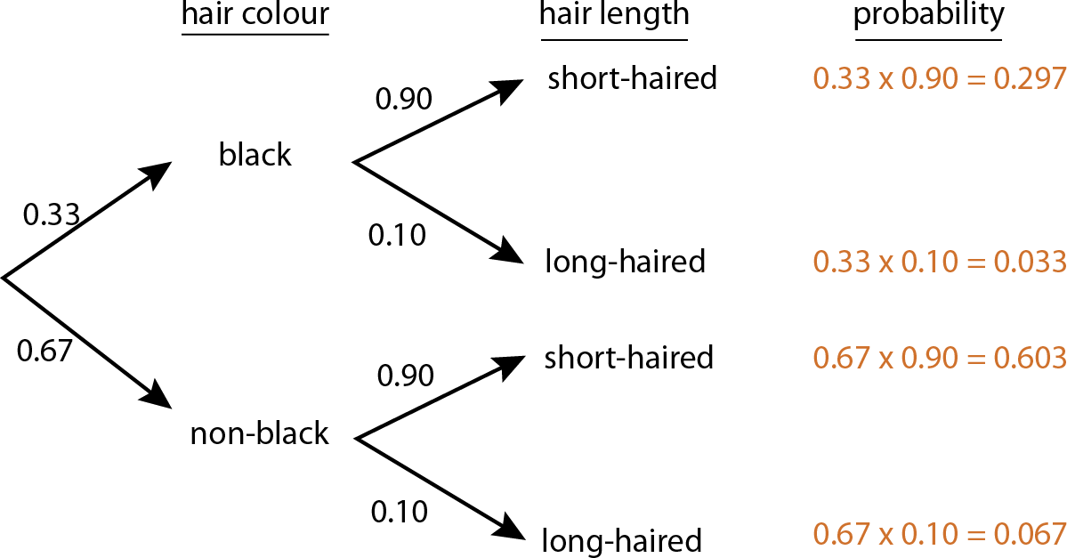
Phenotypes in two-offspring family

Slide 26
Short summary
The probability of A OR B involves addition.
Pr(A or B) = Pr(A) + Pr(B) if the two are mutually exclusive
The probability of A AND B involves multiplication
Pr(A and B) = Pr(A) Pr(B) if the two are independent

Slide 27
Dependent events
Variables are not always independent.
The probability of one event may depend on the outcome of another event.

Slide 28
Triple test and detection of trisomy 23
The triple test detects Down syndrome when it is present 60% of the time
This means it has a 40% false negative rate of 40%
The triple test gives a false positive 5% of the time (when the fetus does not have trisomy 23)
The probability that a fetus has trisomy 23 is 0.001

Slide 29
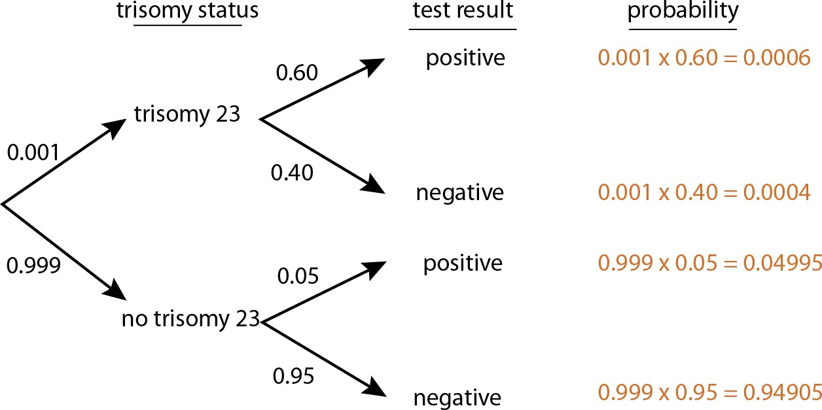
Triple test outcomes

Slide 30
Triple test outcomes
Are trisomy status and test results independent?
Pr(trisomy) = 0.001
Pr(positive test result) = 0.006 + 0.04995 = 0.05595
Pr(trisomy AND positive result) = 0.006 ≠
Pr(trisomy) × Pr(positive result) = 0.001 × 0.05595 = 0.000056
So these two events are NOT independent.

Slide 31

Conditional probability
The conditional probability of an event is the probability of that event occurring given that a condition is met.
Pr[ X | Y]

Slide 32
Conditional probability
Pr(X | Y) means the probability of X if Y is true.
It is read as "the probability of X given Y"
Pr(positive test | trisomy) = 0.60.

Slide 33
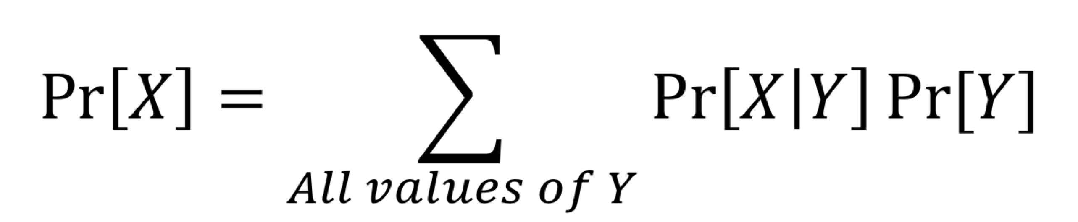
Law of total probability

Slide 34
Law of total probability
The probability of a positive test result is
Pr[positive result] =
Pr(positive result | trisomy) Pr(trisomy) +
Pr(positive result | no trisomy) Pr(no trisomy)
= 0.60 (0.001) +
0.05 (0.999) = 0.05055

Slide 35
The general multiplication rule
Pr[A AND B] = Pr[A] Pr[B | A]

Slide 36
The general multiplication rule
Pr[A AND B] = Pr[A] Pr[B | A].
Pr[A AND B] = Pr[B] Pr[A | B].
Therefore
Pr[A] Pr[B | A] = Pr[B] Pr[A | B].

Slide 37
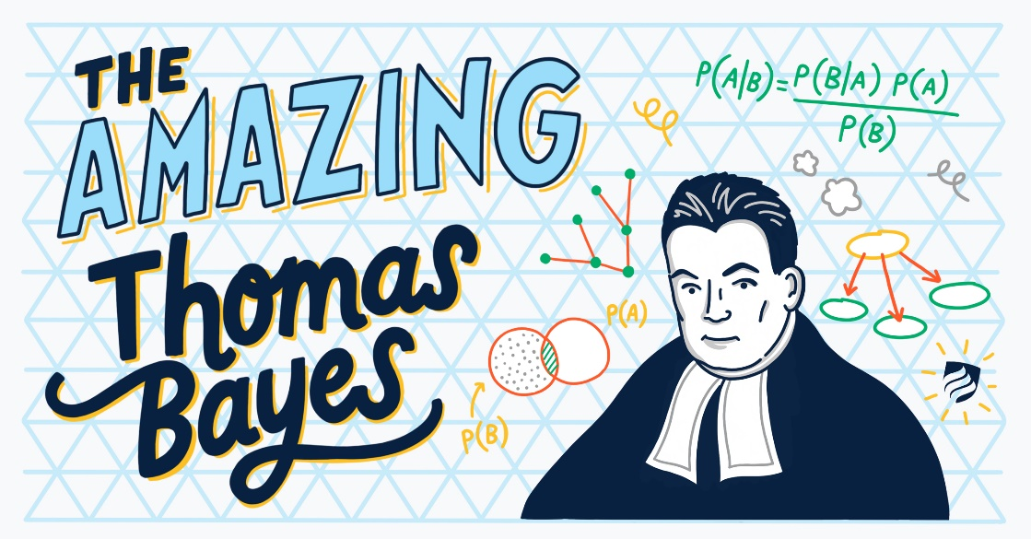
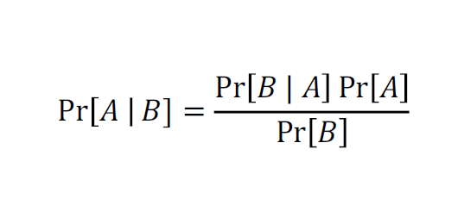
Bayes' theorem

Slide 38
Applying Bayes’ theorem
For the triple test, what is the probability that a pregnancy with a positive result is actually affected by trisomy 23?
In other words:
Pr[trisomy 23 | positive result] = ?

Slide 39
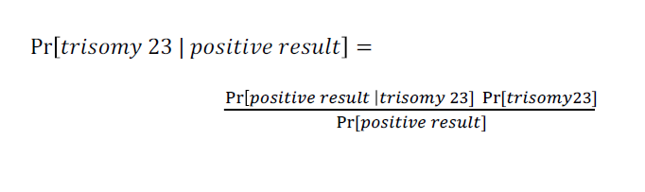
Applying Bayes’ theorem

Slide 40
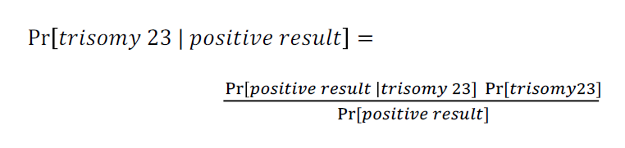
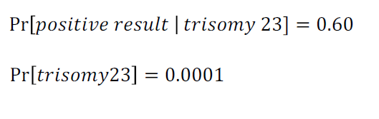
Applying Bayes’ theorem
We already know:

Slide 41
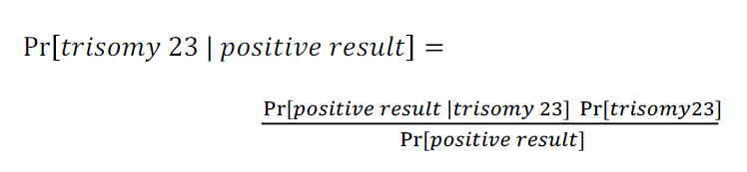

Applying Bayes’ theorem
We need to know:

Slide 42
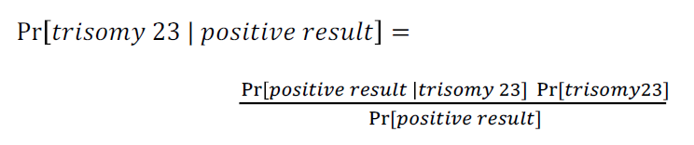
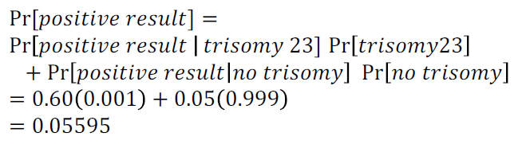
Applying Bayes’ theorem
We need to know:
(Law of total probability)

Slide 43
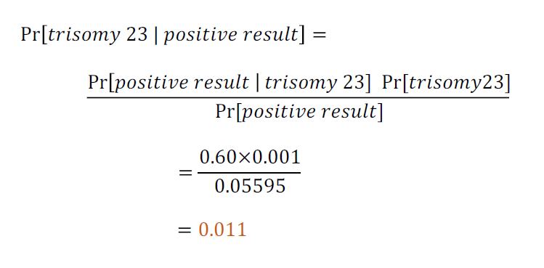
Applying Bayes’ theorem

Slide 44
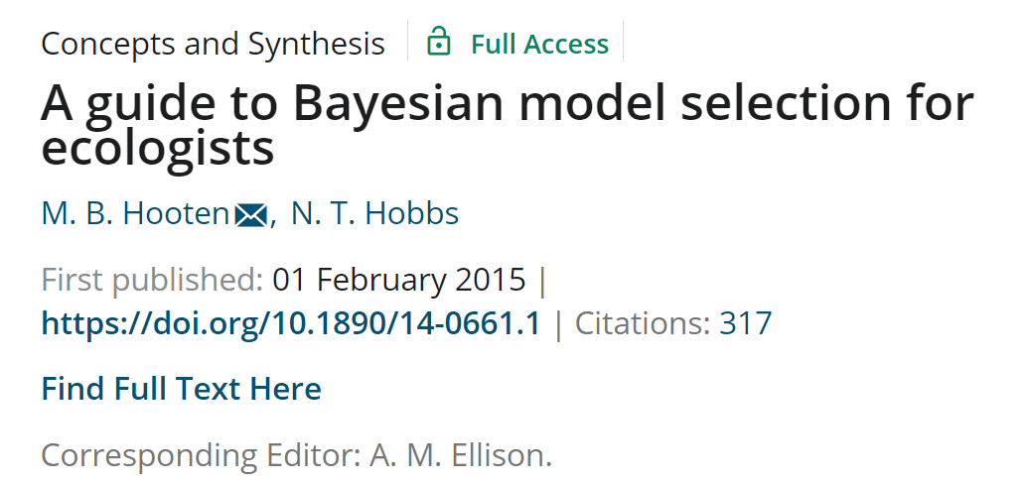
Hooten, M.B., Hobbs, N.T., 2015. A guide to Bayesian model selection for ecologists. Ecological Monographs 85, 3–28.

