Slide 1
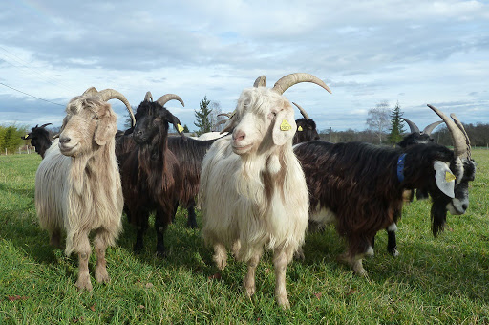
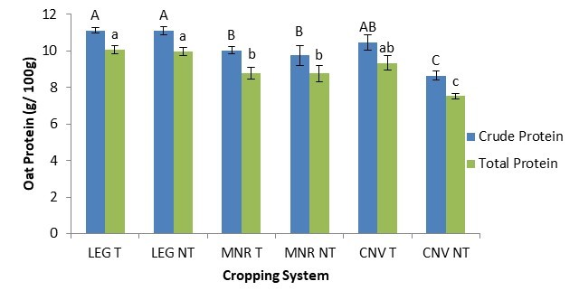



C7041 Experimental Design and Analysis
Ed Harris

Slide 2
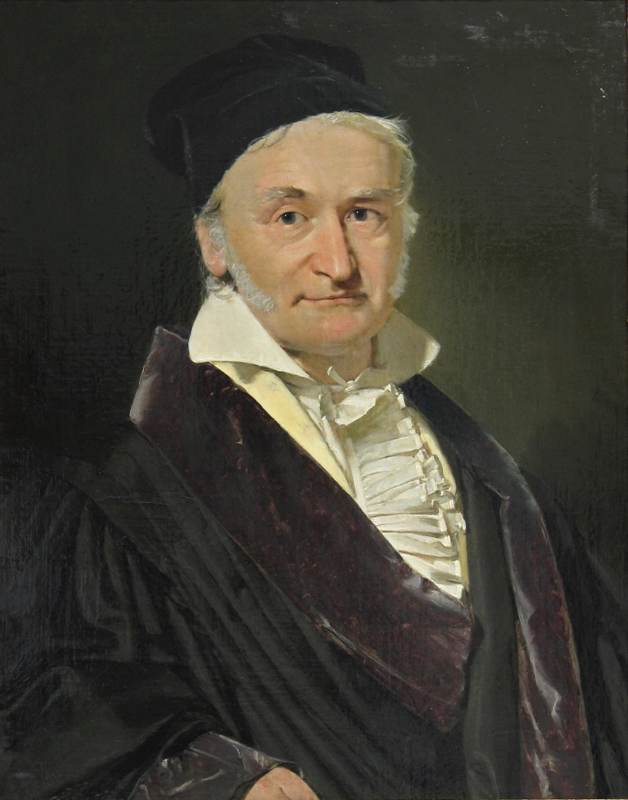
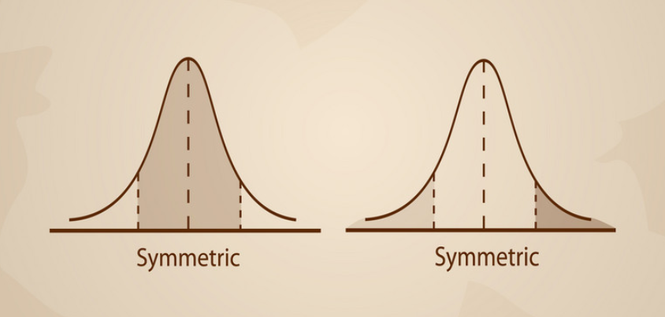
1.10 The Gaussian distribution
I have had my results for a long time: but I do not yet know how I am to arrive at them.
-Carl Friedrich Gauss

Slide 3
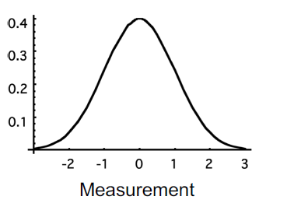
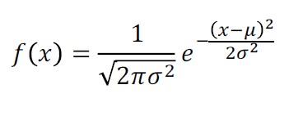
Gaussian distribution
Sometimes called the “normal distribution”, or the “bell curve”, but we will stick with Gaussian

Slide 4
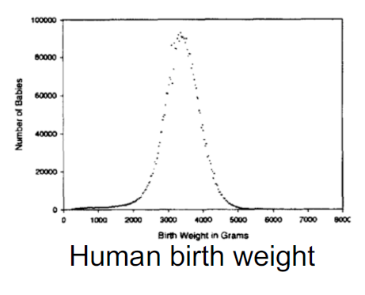
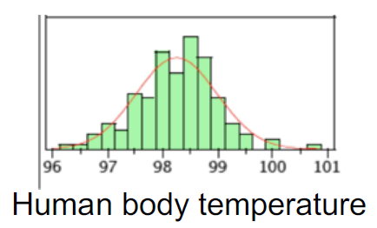
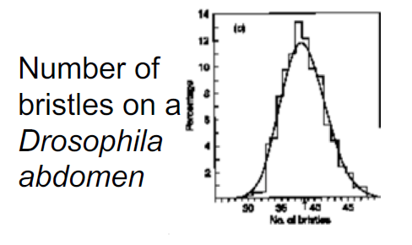
The Gaussian distribution is very common in nature

Slide 5
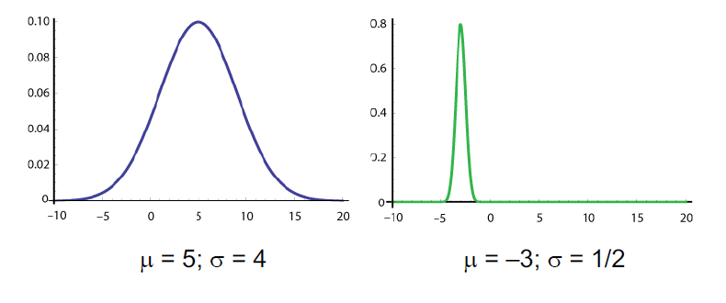
The Gaussian distribution
Fully described by its mean and standard deviation

Slide 6
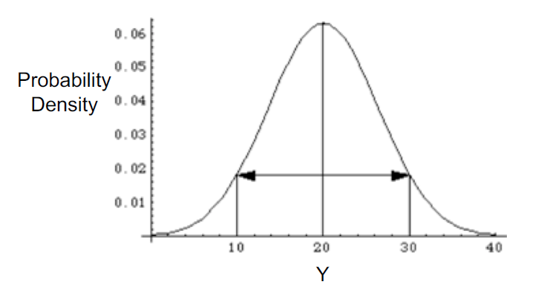
Symmetric around its mean
The Gaussian distribution
The mean, median and mode are all the same

Slide 7
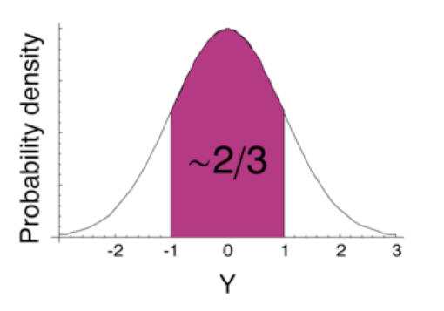
The Gaussian distribution
About 2/3 of "random draws" from a normal distribution are within one standard deviation of the mean

Slide 8
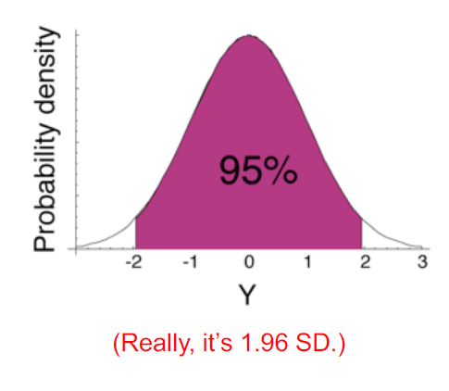
The Gaussian distribution
About 95% of random draws from a normal distribution are within two standard deviations of the mean
(the mean + or - 2* std dev)

Slide 9
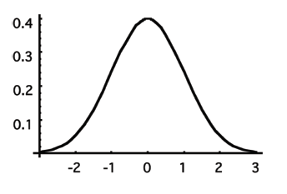
Standard Gaussian distribution
Mean is zero. (μ = 0)
Standard deviation is one. (σ = 1)

Slide 10
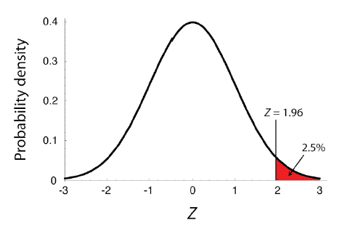
Standard Gaussian table
Gives the probability of getting a random draw from a standard normal distribution greater than a given value

Slide 11
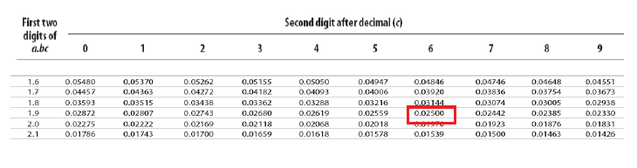
Standard Gaussian table
Z = 1.96

Slide 12
Using R to find area under curve

Slide 13
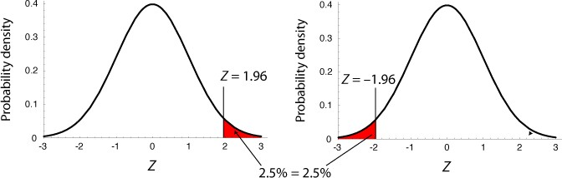
Standard Gaussian is symmetric, so...
Pr[Z > x] = Pr[Z < – x]

Slide 14
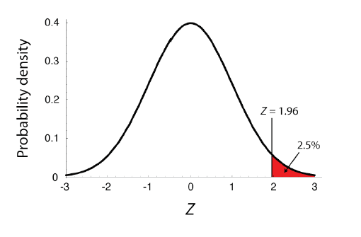
Remember the total area under the curve is equal to 1
Pr[Z < x] =1 – Pr[Z > x]

Slide 15
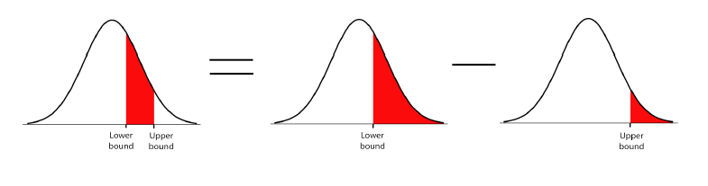
Remember the total area under the curve is equal to 1

Slide 16
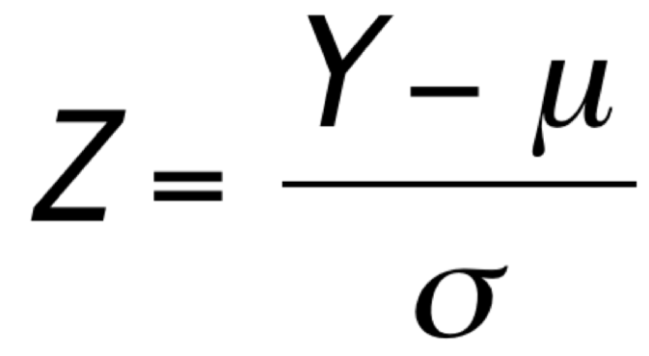
What about other Gaussian distributions (i.e. ones for real data)?
All Gaussian distributions are shaped alike, just with different means and variances
Any normal distribution can be converted to a standard normal distribution, by
Z is called a “standard Gaussian deviate.”

Slide 17
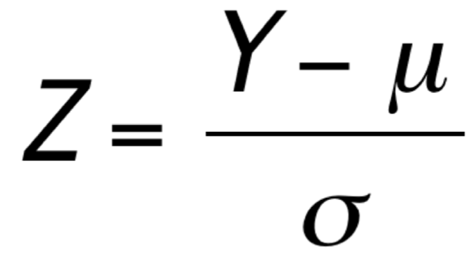
What about other Gaussian distributions (i.e. ones for real data)?
Z tells us how many standard deviations Y is from the mean
The probability of getting a value greater than Y is the same as the probability of getting a value greater than Z from a standard Gaussian distribution.

Slide 18

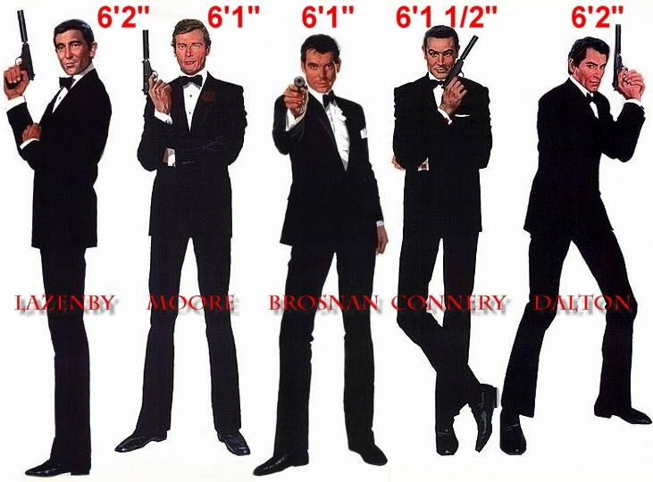
Example: British spies
MI5 says a man has to be shorter than 180.3 cm tall to be a spy.
Mean height of British men is 177.0cm,
with standard deviation 7.1cm, with a Gaussian distribution.
What proportion of British men are excluded from a career as a spy by this height criteria?

Slide 19
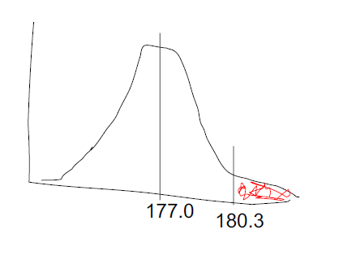
Example: British spies
What proportion of British men are excluded from a career as a spy by this height criteria?
Draw a rough sketch of the question
We want to know this shaded area

Slide 20
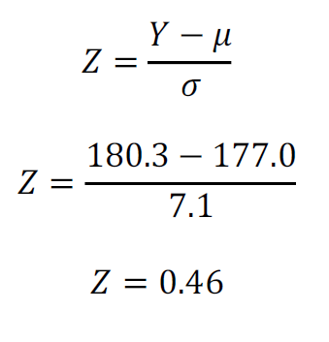
Example: British spies
What proportion of British men are excluded from a career as a spy by this height criteria?
Draw a rough sketch of the question
μ = 177.0cm
σ = 7.1cm
Y = 180.3
Pr[height > 180.3]

Slide 21
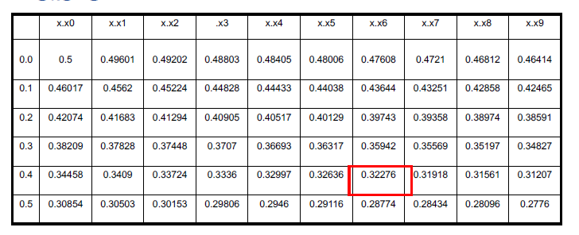
Part of the standard Gaussian table
Example: British spies
What proportion of British men are excluded from a career as a spy by this height criteria?
Pr[Z > 0.46] = 0.32276,
so Pr[height > 180.3] = 0.32276

Slide 22

Sample means are Gaussian distributed
(If the variable itself is Gaussian distributed)
The mean of the sample means is μ.
The standard deviation of the sample means is:

Slide 23

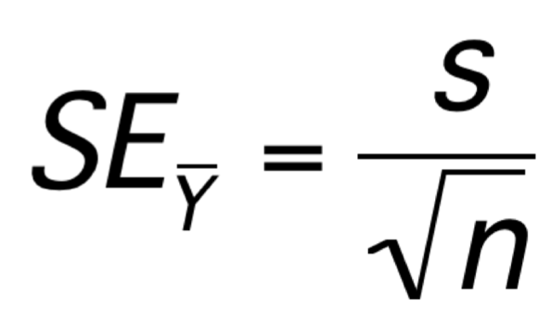
Standard error
The standard error of an estimate of a mean is the standard deviation of the distribution of sample means
standard deviation:
We can approximate this by
standard error:

Slide 24
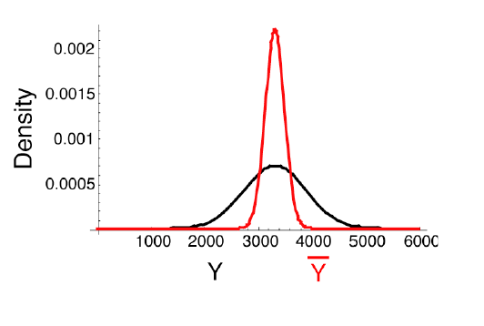
Distribution of means of samples with n =10

Slide 25
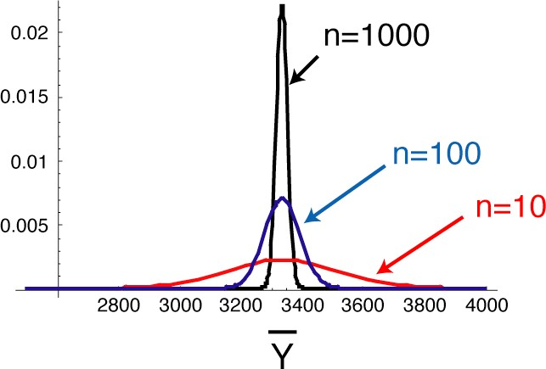
Larger samples equal smaller standard errors

Slide 26
Central limit theorem
The sum or mean of a large number of measurements randomly sampled from any population is approximately Gaussian distributed.

Slide 27
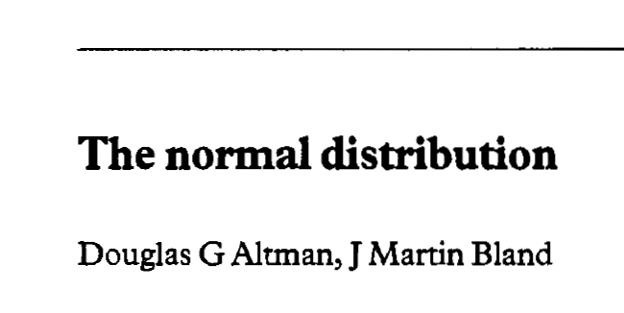
Suggested readings:
Altman, D.G., Bland, J.M., 1995. Statistics notes: The normal distribution. BMJ 310, 298. https://doi.org/10.1136/bmj.310.6975.298
Lovric, M.M., 1995. Note on the correct interpretation of the Central Limit Theorem. https://www.bmj.com/rapid-response/2011/11/01/note-correct-interpretation-central-limit-theorem

