Slide 1
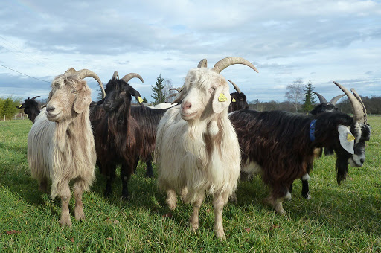
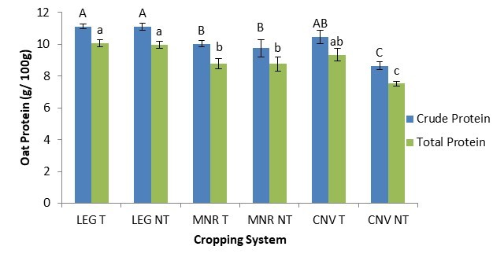



C7041 Experimental Design and Analysis
Ed Harris

Slide 2

1.11 One sample inference

Slide 3
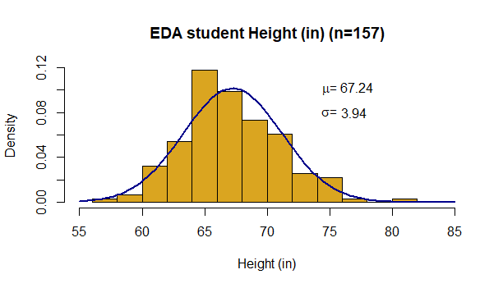
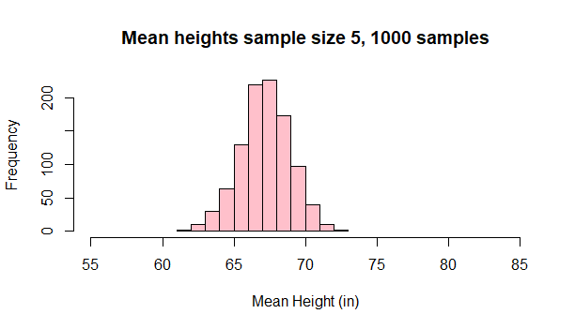
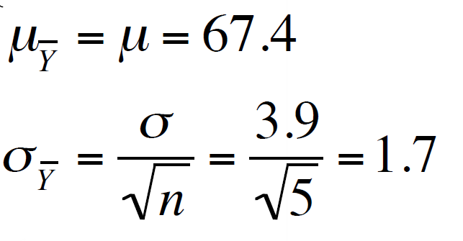

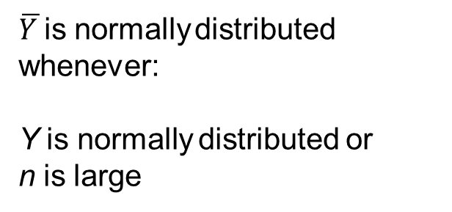
$\overline{Y }$is normally distributed
whenever:
Y is normally distributed or
n is large

Slide 4
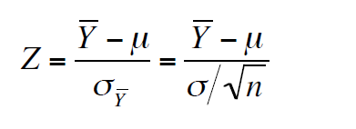


Inference about means
Because $\overline{Y }$ is normally distributed, we can convert its distribution to a standard normal distribution:
This would give a probability distribution of the difference between a sample mean and the population mean.

Slide 5

But... We don’t know σ . . .
However, we do know s, the standard deviation of our sample. We can use that as an estimate of σ!

Slide 6
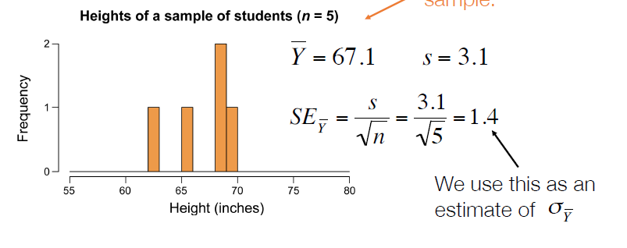
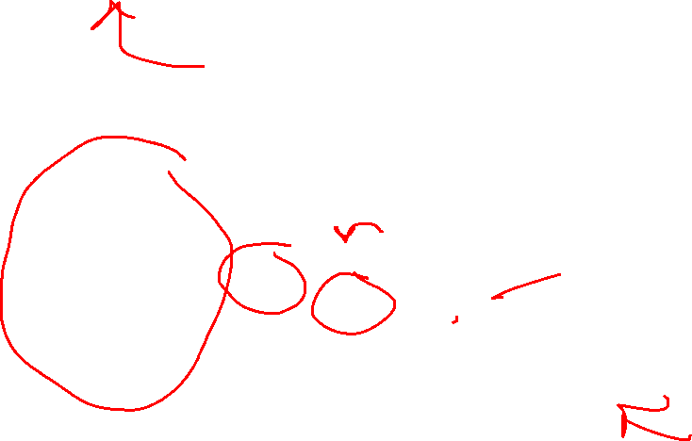
In most cases, we don’t know the real population distribution. We only have a sample.

Slide 7
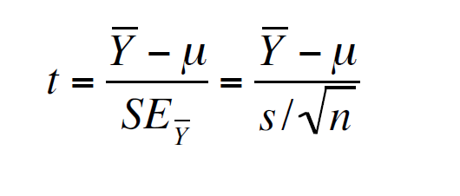

A good approximation to the standard normal is then:

Slide 8
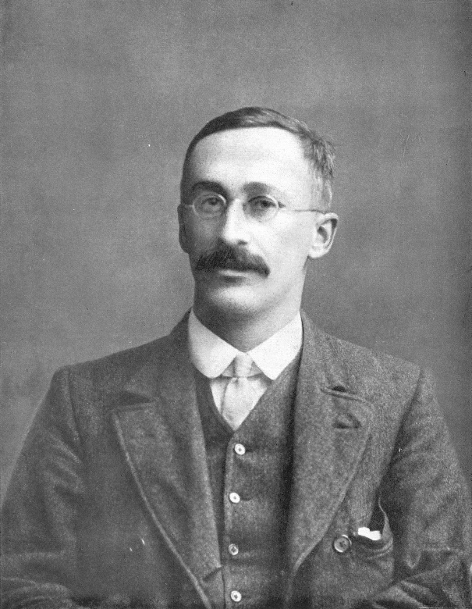
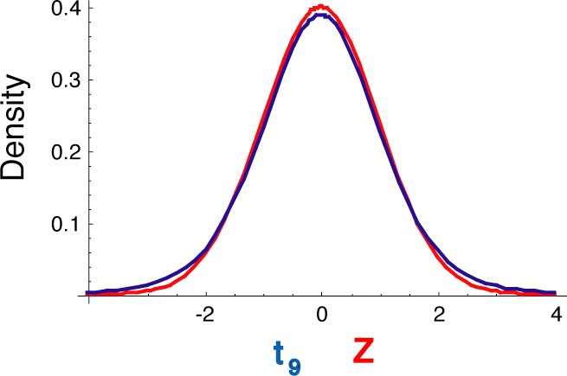
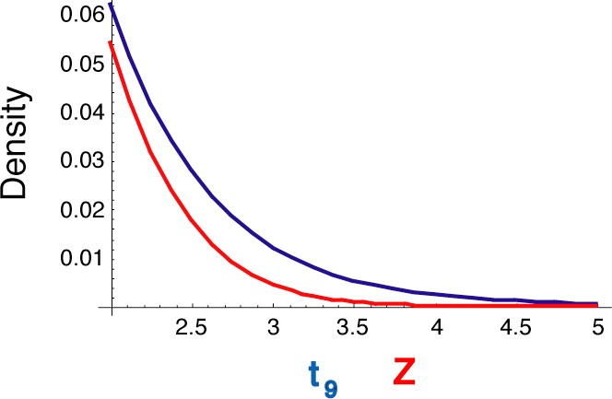
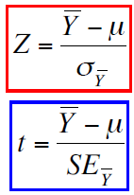

t exhibits Student’s t distribution
Discovered by William Gossett, of the Guinness Brewing Company
Degrees of freedom
df = n - 1
}

Slide 9
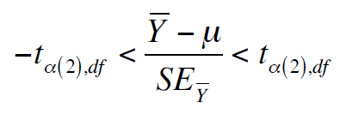
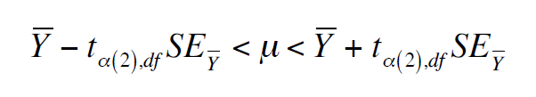

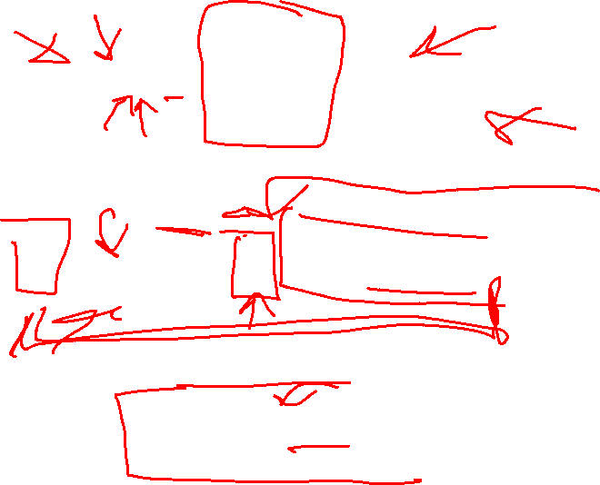
We use the t-distribution to calculate a confidence interval of the mean
We rearrange the above to generate:
Another way to express this is:

Slide 10
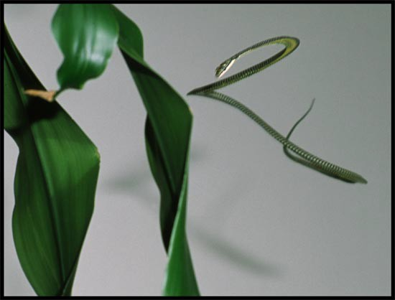

95% confidence interval for a mean
Example:
Paradise flying snakes
Undulation rates (in Hz)
0.9, 1.4, 1.2, 1.2, 1.3, 2.0, 1.4, 1.6
Colubridae Chrysopelea

Slide 11


https://www.youtube.com/watch?v=16aGSx9gFO4

Slide 12
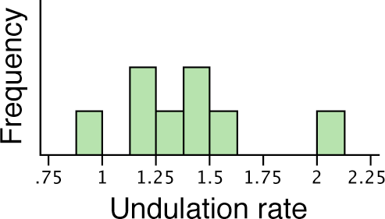
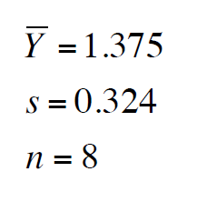

Estimate the mean and standard deviation

Slide 13
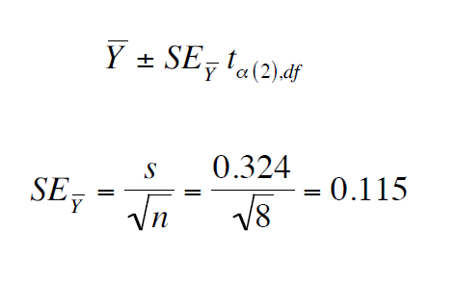

Find the standard error

Slide 14
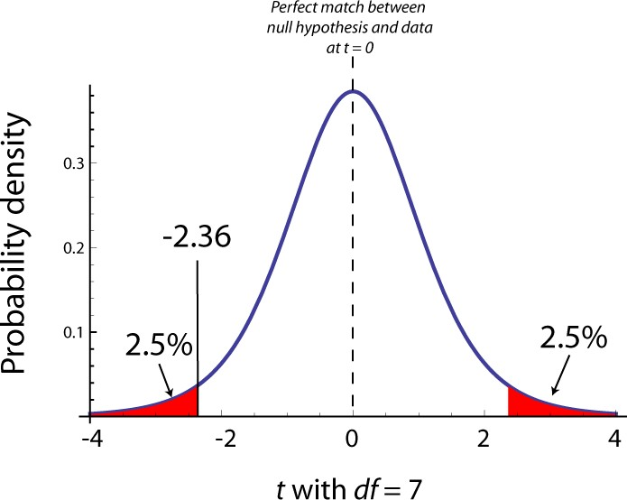
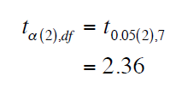
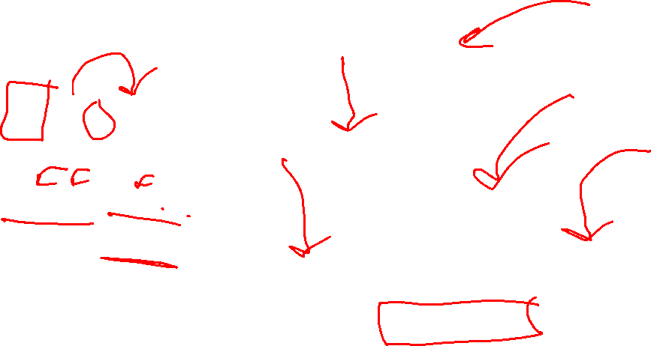
Find the critical value of t
df = n − 1 = 7

Slide 15
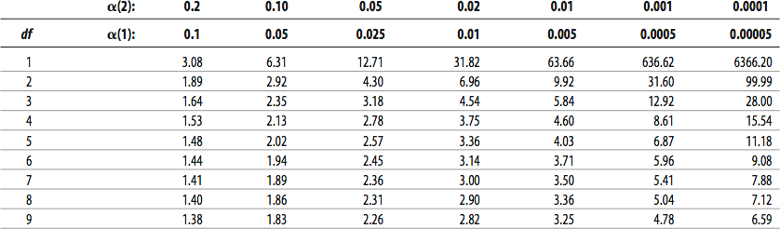

Find the critical value of t
Student's t distribution

Slide 16

Finding the critical value of t in R

Slide 17
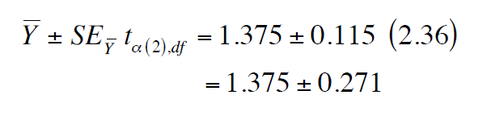

Putting it all together...
1.10 < μ < 1.65
(95% confidence interval)

Slide 18

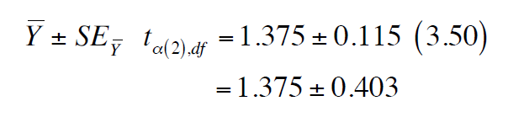

99% confidence interval
0.97 < μ < 1.78

Slide 19
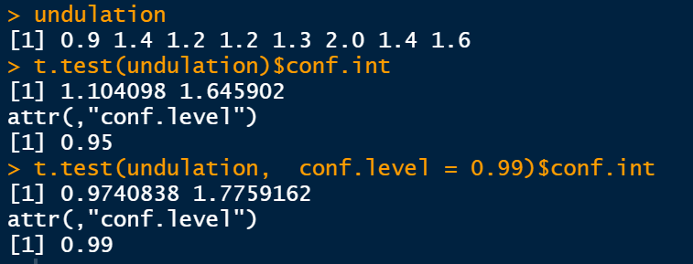

Confidence interval for mean in R
Hand calculation: 95% CI
99% CI
1.10 < μ < 1.65
0.97 < μ < 1.78

Slide 20
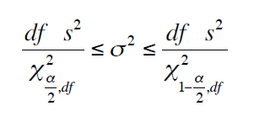

Confidence interval for the variance

Slide 21
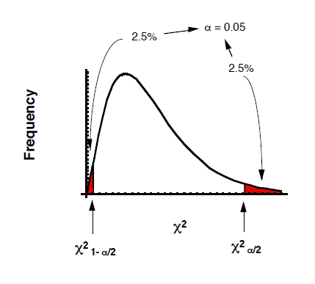

Confidence interval for the variance

Slide 22
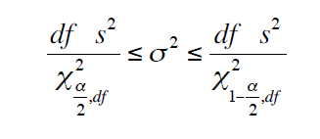

95% confidence interval for the variance of flying snake undulation rate
df = n - 1 = 7
s² = (0.324)² = 0.105

Slide 23
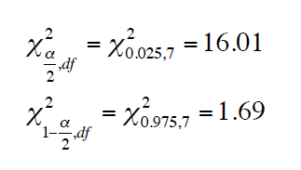
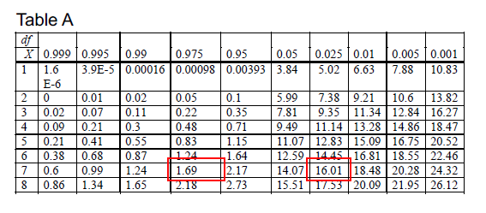

95% CI for the variance of flying snake undulation rate

Slide 24
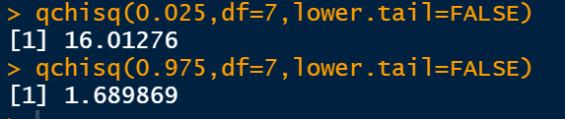

95% CI for the variance of flying snake undulation rate

Slide 25
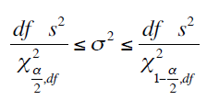
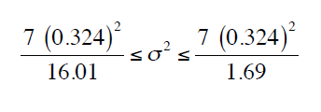
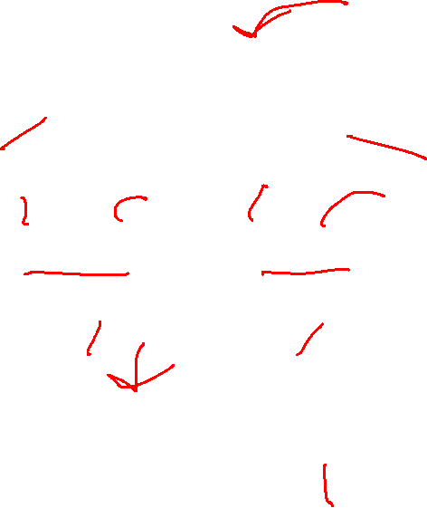
95% CI for the variance of flying snake undulation rate
0.0459 ≤ σ ² ≤ 0.435

Slide 26

One-sample t-test
The one-sample t-test compares the mean of a random sample from a normal population with the population mean proposed in a null hypothesis.

Slide 27
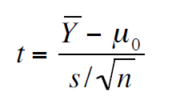
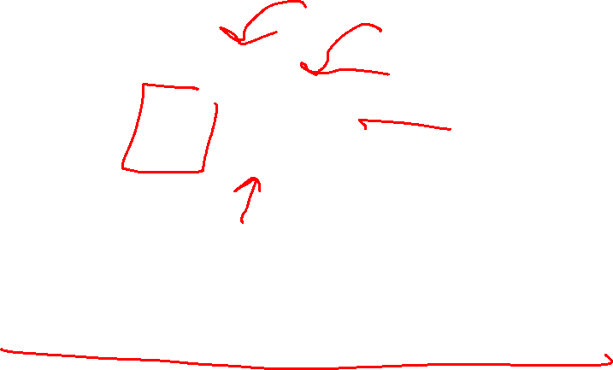
Test statistic for one-sample t-test
μ₀ is the mean value proposed by H₀

Slide 28

Hypotheses for one-sample t-tests
H₀ : The mean of the population is μ_{0.}
H_{A}: The mean of the population is not μ₀.

Slide 29
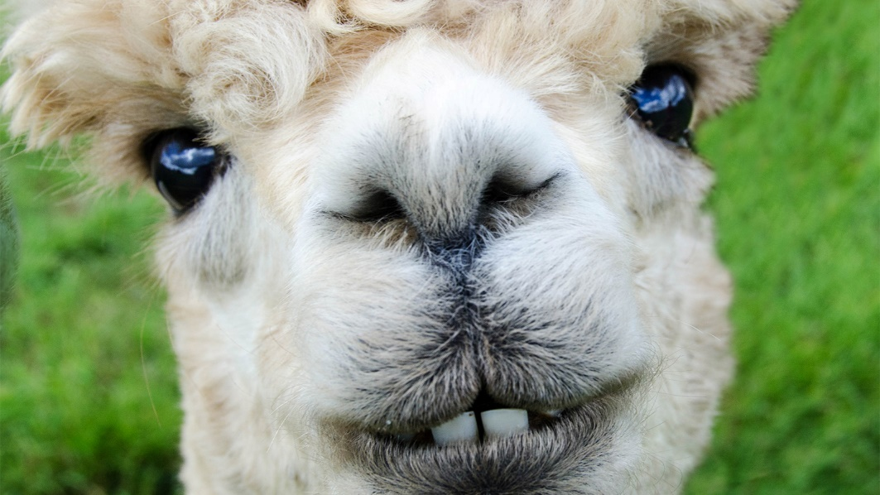

Example: Alpaca body temperature
H₀ : Mean healthy alpaca body temperature is 38.2ºC.
H_{A} : Mean healthy alpaca body temperature is not 38.2ºC.

Slide 30
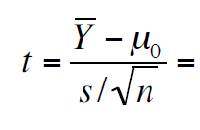


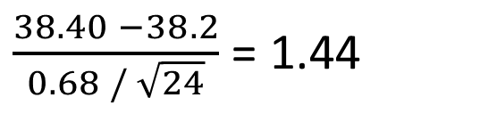
Alpaca body temperature
H₀ : Mean healthy alpaca body temperature is 38.2ºC
n = 24
$\overline{Y}\text{}$38.40
s = 0. 6 8
$\frac{38.40 −38.2}{0.68 / \sqrt{24}}$ = 1.44

Slide 31
Degrees of freedom
df = n – 1 = 23

Slide 32
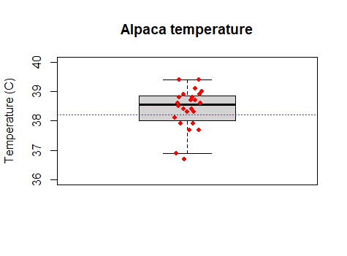
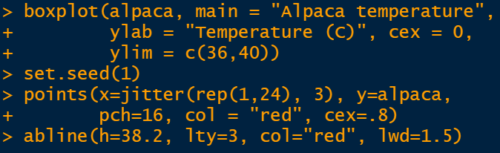
Note about graphing data

Slide 33
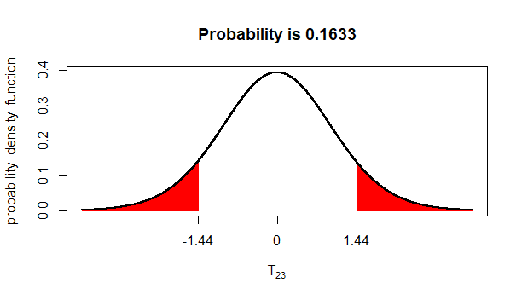
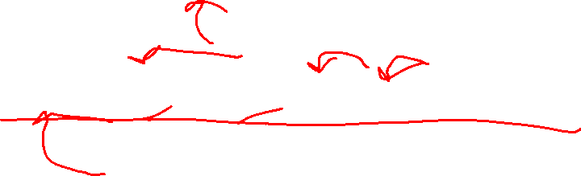
Comparing t to its distribution to find the P-value

Slide 34
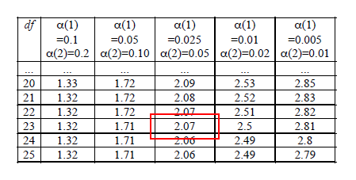

A portion of the t table

Slide 35
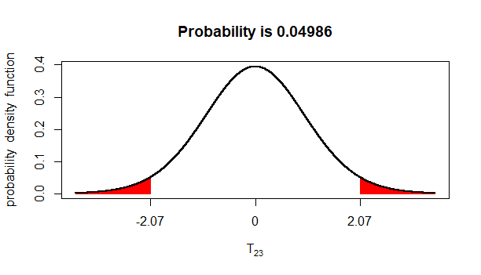

Comparing t to its distribution to find the P-value
1.44

Slide 36

Comparing t to its distribution to find the P-value
1.44 is closer to 0 than 2.07, so P > 0.05.
With these data, we cannot reject the null hypothesis that mean alpaca body temperature is 38.2.

Slide 37


Comparing t to its distribution to find the P-value

Slide 38

One-sample t-test: Assumptions
The variable is normally distributed.
The sample is a random sample.

