Slide 1
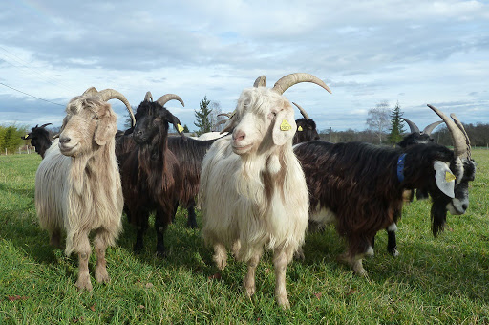
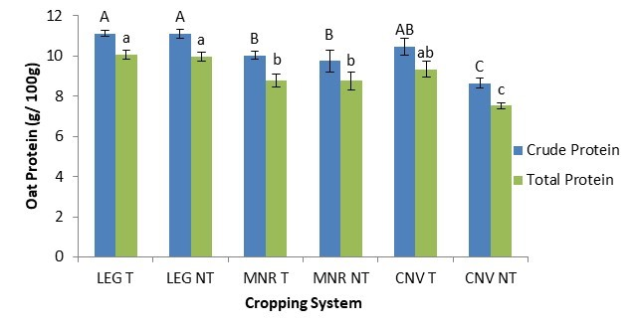
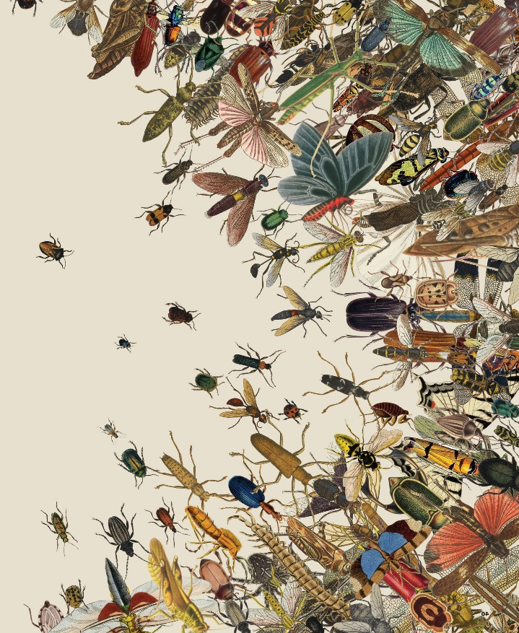
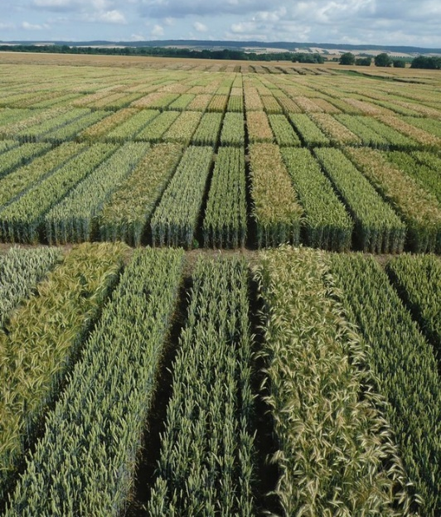
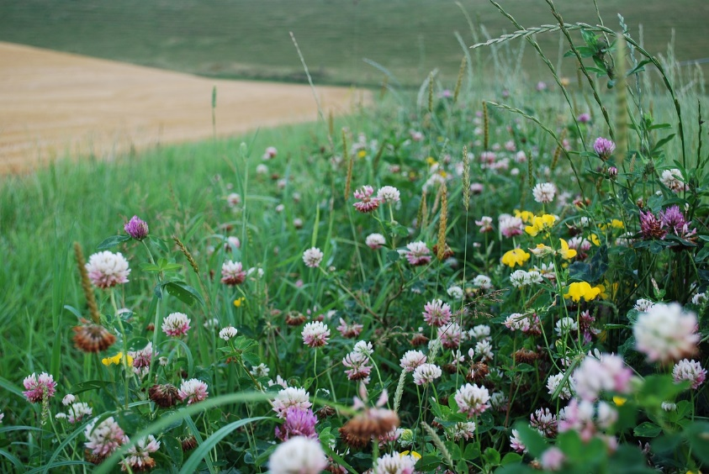
C7041 Experimental Design and Analysis
Ed Harris

Slide 2
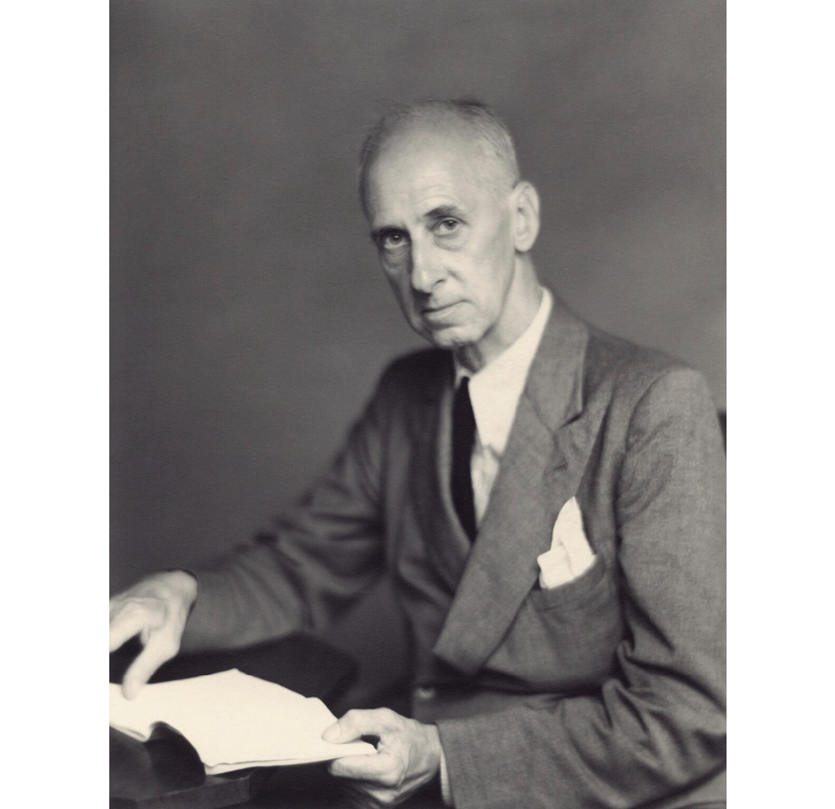
2.01: Data and reproducibility
"Statistics Are No Substitution for Judgment".
-Sir Henry Clay

Slide 3
Data recommendations
Now is a good time to think about your own strategy for data entry, storage, and organization.
Use a script-based program for analysis
For example: R (Other programs include MATLAB, SAS, or even Python).
Menu-based programs leave no record of the analyses you carried out. You will forget. Menus change.
Script files (commands) become the written record of your analyses.
Surround commands in script files with detailed comments on your choices and actions.
RMarkdown makes human-readable documents with R script, analysis descriptions, and results (e.g., figures, tables).
Consider using version control, which records changes over time so that you can undo or retrieve earlier versions later (e.g., keep script files on Github).
Borer, E. T., E. W. Seabloom, M. B. Jones, and M. Schildhauer. 2009. Some simple guidelines for effective data management. Bulletin of the Ecological Society of America 90: 205-214.

Slide 4
Some data recommendations
Store data in an accessible software format
Spreadsheet programs to develop the text files (Google Sheets, Excel, FreeOffice, LibreOffice).
For example: use comma- or tab-delimited text ﬁles.
Text files can always be read, whereas proprietary formats can become unavailable in future.
Store data in nonproprietary hardware formats
Keep data on the internet, which probably won’t die soon.
Backup copies at another location.

Slide 5
Some data recommendations
Leave your data ﬁle uncorrected, with all warts
Otherwise you might change something that you later discover was correct; reduces reproducibility erasing assumptions
Make corrections instead using the scripted language (R) so you have a record, and can undo later if necessary
Corrections directly to the data file go unrecorded – you have no record of the change you made
Keep comments in your script (command) file that explains reasons for corrections, so you can redo or reevaluate later

Slide 6
Some data recommendations
Use descriptive names for your data files
Use names that are short but indicative of file contents.
“Veg_Biodiv_2007.csv” not “Veg.csv”.
Avoid file names containing blank spaces

Slide 7
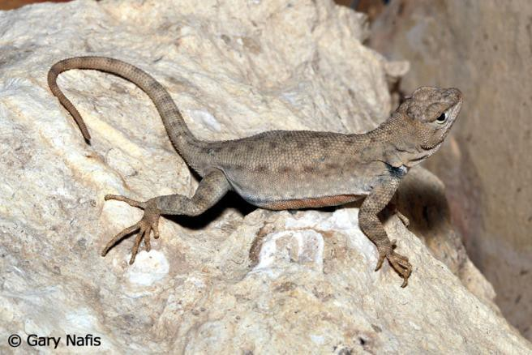
Some data recommendations
Include a “header” first line in data file with descriptive variable names
Variable names should be terse but descriptive, without blank spaces or commas.
The read.csv() command in R assumes by default that the first line of a .csv file is a header line.
lizard
sprintSpeed1984
← this is the header line
1 | 1.43
2 | 1.56
3 | 1.64
4 | 2.13
5 | 1.96
...
Huey, R. B. and A. E. Dunham. 1987. Repeatability of locomotor performance in natural populations of the lizard Sceloporus merriami. Evolution 42: 1116-1120.

Slide 8

Some data recommendations
Use plain ASCII text for names and data values
Plain ASCII includes all letters of English alphabet (uppercase and lowercase), numbers, and many common punctuation marks ( _ - * . are ok)
Avoid commas because they separate fields in .csv format
Avoid symbols (e.g., α ♥  )
When you add data to a database, add rows not columns
Set up data ﬁles to maximize consistency of column content
Use “long” format rather than “wide”

Slide 9
Data on sprint speed in wide format:
lizard | sprintSpeed1984 | sprintSpeed1985
1 | 1.43 | 1.37
2 | 1.56 | 1.30
3 | 1.64 | 1.36
4 | 2.13 | 1.54
5 | 1.96 | 1.82
...
Data on sprint speed in long format:
lizard | sprintSpeed | year
1 | 1.43 | 1984
2 | 1.56 | 1984
3 | 1.64 | 1984
4 | 2.13 | 1984
5 | 1.96 | 1984
1 | 1.37 | 1985
2 | 1.30 | 1985
3 | 1.36 | 1985
4 | 1.54 | 1985
5 | 1.82 | 1985
...

Slide 10
Some data recommendations
A column of data should contain only one data type
(i.e., either numerical or character, not both)
R will interpret a column of numbers having even a single character as character or factor data
lizard | speed | year
1 | 1.43 | 1984
2 | 1.56 | 1984
3 | 1.64? | 1984
4 ... | 2.13 | 1984
don’t:
lizard | speed | year | comment
1 | 1.43 | 1984 | ok
2 | 1.56 | 1984 | ok
3 | 1.64 | 1984 | dubious
4 | 2.13 | 1984 | ok
...
do:

Slide 11
Some data recommendations
Record full dates using standardized ISO format
For dates use YYYY-MM-DD (promoted by the International Organization for Standardization). Other formats are ambiguous
For datetime use hh:mm:ss (or use different columns for year, months, day, time)
Create a database if needed
Put separate information collected at different scales into different files
For example: One file for SITE data (temperature, elevation). Another file for measurements of SPECIES collected at those sites. Both files contain the SITE variable, allowing data to be matched if needed (using match command in R).

Slide 12
Some data recommendations
Maintain effective metadata (data about the data), i.e. a DATA DICTIONARY
Ten years from now you won’t remember what the site looked like, which sample you left out of the analysis, or how you assigned a single value for “depth” of a pond.
Record why you collected the data.
Write down details of methods.
Fegraus, E.H., Andelman, S., Jones, M.B. and Schildhauer, M., 2005. Maximizing the value of ecological data with structured metadata: an introduction to ecological metadata language (EML) and principles for metadata creation.

Slide 13
Some data recommendations
Maintain effective metadata (data about the data), i.e. a DATA DICTIONARY
Include names of all files associated with the study, definitions for data and treatment codes, missing value codes, definitions, unit of measurement for each variable.
Consider using a metadata standard such as Ecological Metadata Language (EML).
Fegraus, E.H., Andelman, S., Jones, M.B. and Schildhauer, M., 2005. Maximizing the value of ecological data with structured metadata: an introduction to ecological metadata language (EML) and principles for metadata creation.

Slide 14
Some data recommendations
Deposit your data when you publish it
(and even if you don’t publish)
Online data archives, e.g., Dryad (http://datadryad.org/repo), Ecological Archives, http://esapubs.org/archive/, Genbank

Slide 15

Some data recommendations
All of these best-practice guidelines adhere to the principles of Tidy Data!
Data should be tidy (like your room)
-Each variable in a column
-Each observation in a row
-Data dictionary
https://dsgarage.netlify.app/bootcamp/1.4-m1-data-frames/

Slide 16
Finding data (besides collecting your own)
I borrowed the lizard data from a scatter plot in the original article.
There is no copyright on published data, which is useful when you need an example or are carrying out a meta-analysis.
Graphics tool: http://www.datathief.org/
Online data archives, e.g., Ecological Archives, http://esapubs.org/archive/, Genbank, Dryad (http://datadryad.org/repo), many others
See more example in the assessment guidance
Permissions/conditions may be required to publish results from archives.

Slide 17
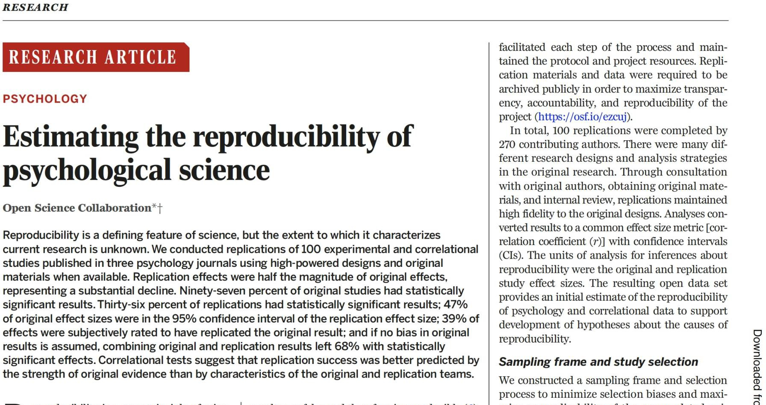
Testing reproducibility of research
A large-scale, collaborative effort (27 authors) to obtain an initial estimate of the reproducibility of psychological science.
Study repeated 100 experimental and observational studies
Replications maintained high fidelity to the original designs, including sample sizes
Collaboration, O.S., 2015. Estimating the reproducibility of psychological science. Science 349. https://doi.org/10.1126/science.aac4716

Slide 18
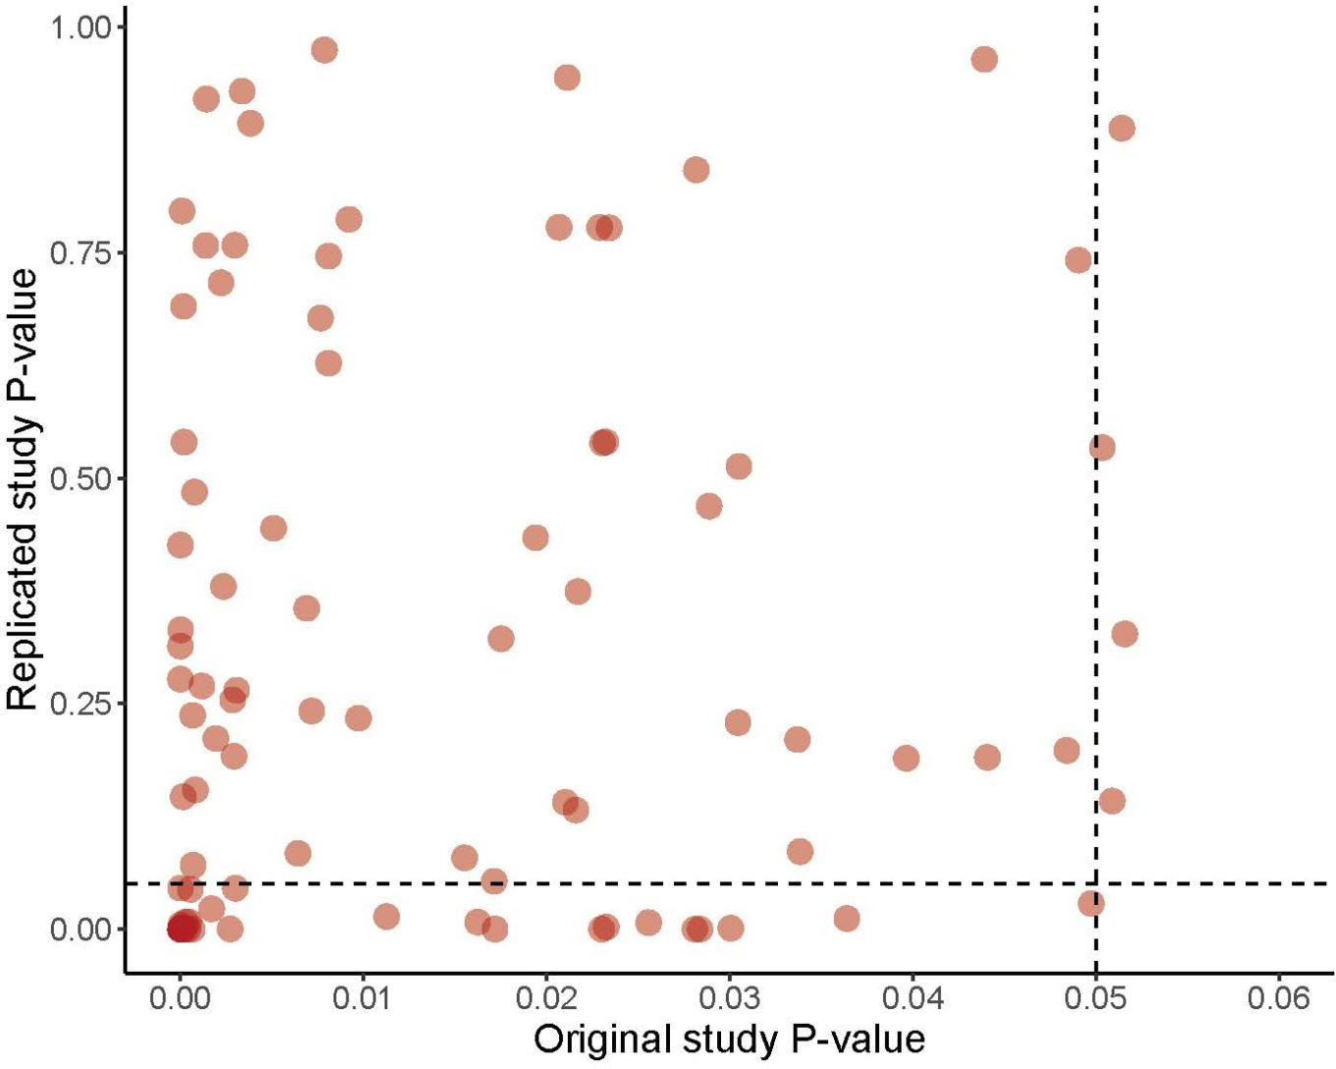
Results on reproducibility
Note the different scales of the two axes.
The median P-value of the replication effects (0.20) was about 30 times that of the original effects (0.007).
97% of original studies had statistically significant results (P < .05), whereas 36% of replications had statistically significant results.
Correlation between P-values: rS = 0.30.

Slide 19
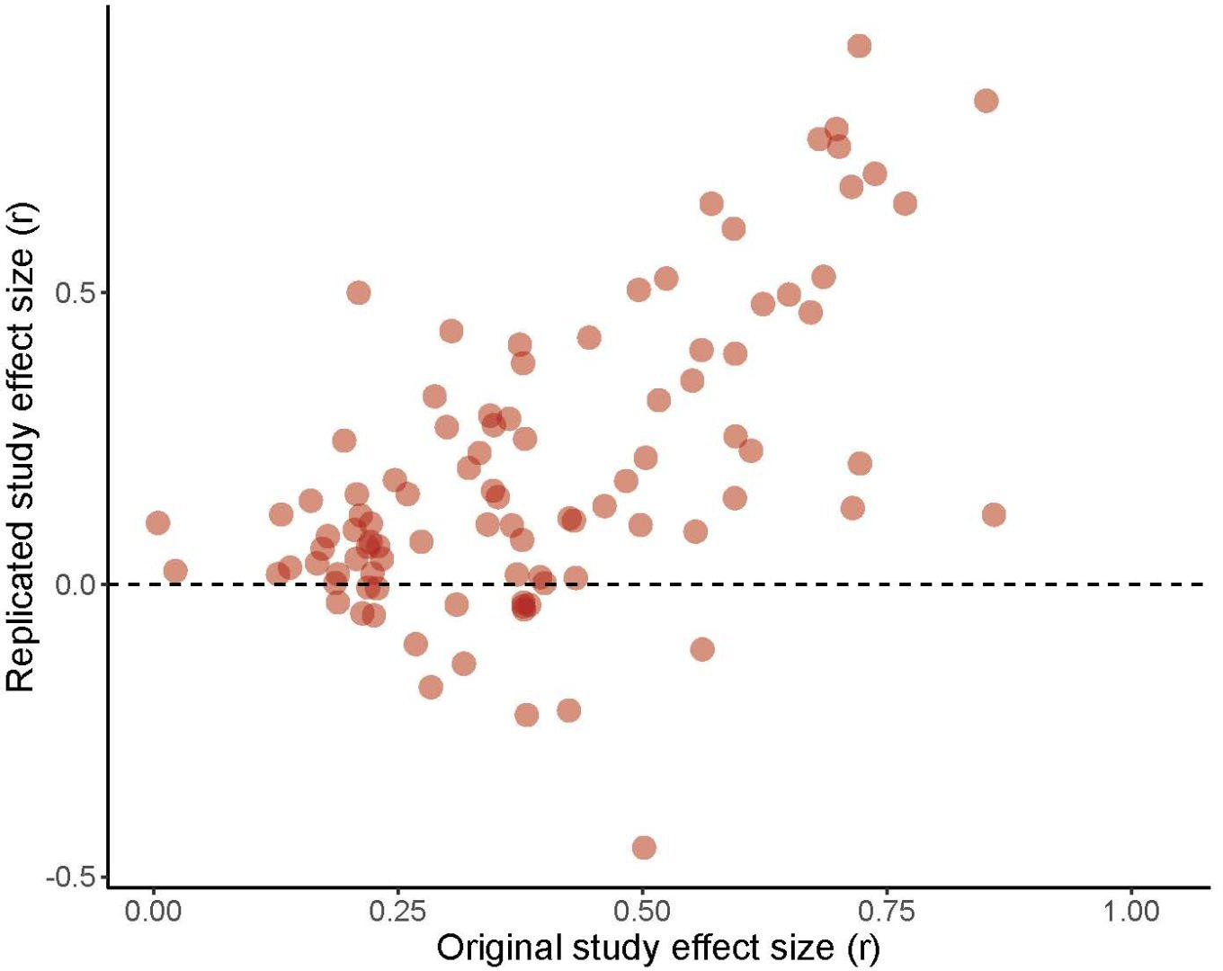
Results on reproducibility
Note the different scales of the two axes!
The median effect size of the replication effects (0.12) was about a third that of original effects (0.40).
Correlation between effect sizes:
rS = 0.51.

Slide 20
Results on reproducibility
Published results are biased, the result of low-power research designs and publication bias.
Effect sizes are more reproducible than P-values.
“Progress occurs when existing expectations are violated and a surprising result spurs a new investigation. Replication can increase certainty when findings are reproduced and promote innovation when they are not. This project provides accumulating evidence for many findings in psychological research and suggests that there is still more work to do to verify whether we know what we think we know.”
An objective of this module is to explore these concepts. There is much to do!

Slide 21
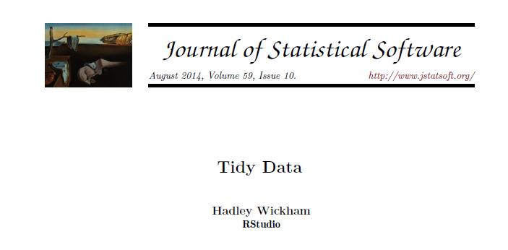
Suggested reading:

