Slide 1
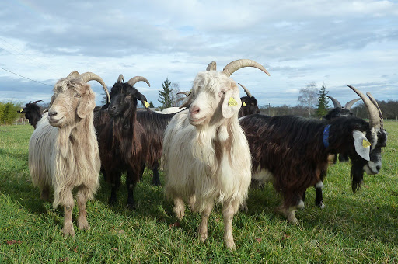
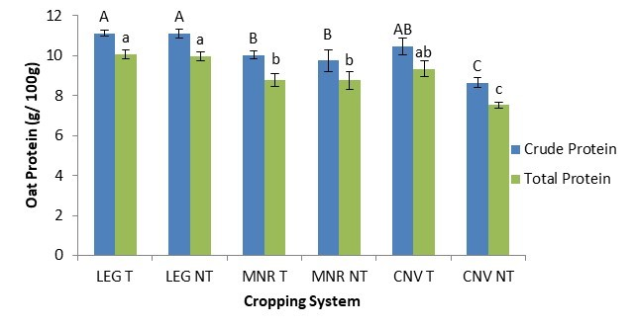



C7041 Experimental Design and Analysis
Ed Harris

Slide 2
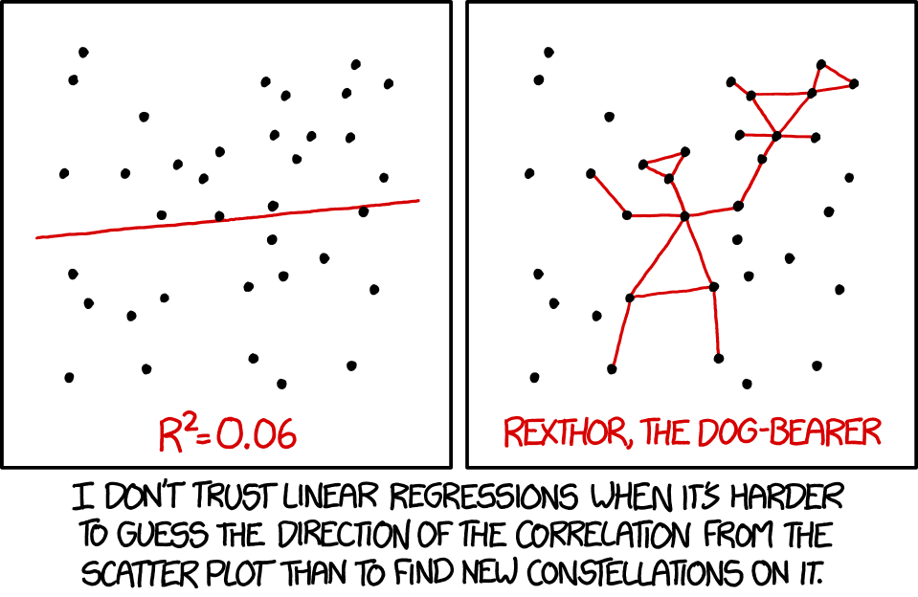
2.04: Linear Models

Slide 3
Outline
What is a linear model
Several examples
Estimating parameters vs testing hypotheses
Model comparison: full vs reduced models
Sequential vs marginal testing of terms
The lure of model simplification
Perils of correcting for covariates
Assumptions of linear models
Related methods in R

Slide 4
What is a linear model
A relationship between variables involving
a response variable Y
explanatory variables X1, X2, …
normal random errors with equal variance in the form
Y = β0 + β1X1 + β2X2 + … + error
where β0, β1, β2, … are the parameters of the linear model

Slide 5
What is a linear model
For example:
fit a mean to data:
Y = β0
simple linear regression: Y = β0 + β1X
multiple regression: quadratic regression: single-factor ANOVA:
Y = β0 + β1X1 + β2X2 + β3X3 + …
Y = β0 + β1X + β2X²
Y = β0 + β1X1 + β2X2 + … (I will explain)

Slide 6
More names for types of linear models:
Fitting different means to two groups
Linear regression
Multi-factor ANOVA
Analysis of covariance
All can be written in the same form
Y = β0 + β1X1 + β2X2 + … + error

Slide 7
More names for types of linear models:
Generalized Linear models
Gaussian Linear models
regression
ANOVA
T-test

Slide 8
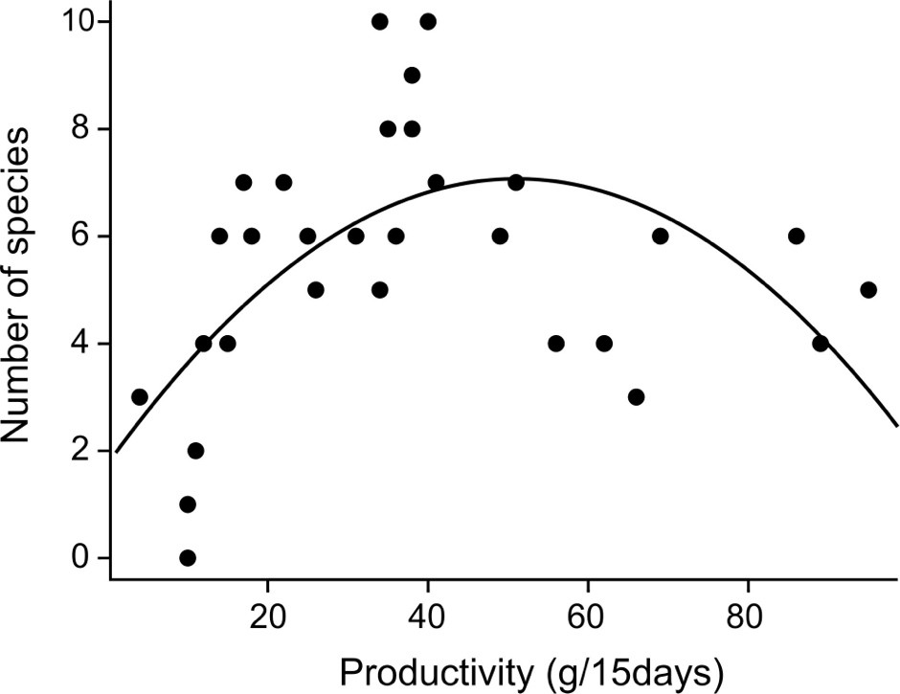
A linear model needn’t be a straight line
For example, the "quadratic equation" is a linear model
Y = β0 + β1X + β2X²

Slide 9
So what?
“Linear models” unites many methods into a common framework that:
Provides a common set of tools – e.g. lm() in R
Is flexible and handles different study designs
Has tools to estimate parameters (e.g., sizes of effects – biological significance)
Is very easy to use, even when there are multiple variables
Better handling of unbalanced designs than traditional ANOVA calculations

Slide 10
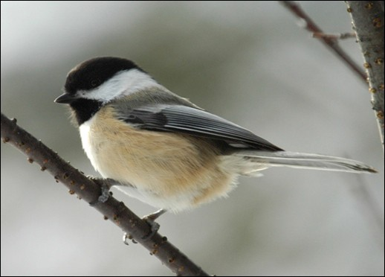
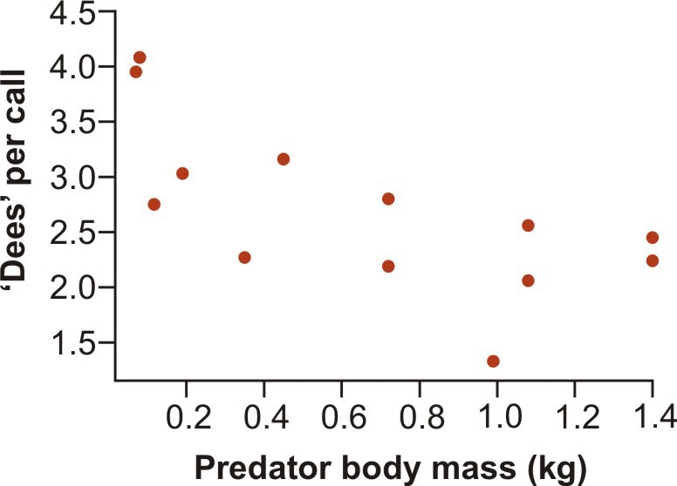
Example 1: Simple linear regression
Data: The average number of “dee” notes per alarm call by black-capped chickadees presented with a live, perched predator.
predator
mass
dees
Predator species | Predator body mass (kg) | Number of “dee” notes per call
Northern pygmy-owl | 0.07 | 3.95
Saw-whet owl | 0.08 | 4.08
American kestrel | 0.12 | 2.75
Merlin | 0.19 | 3.03
Short-eared owl | 0.35 | 2.27
Cooper’s hawk | 0.45 | 3.16
Prairie falcon | 0.72 | 2.19
Peregrine falcon | 0.72 | 2.80
Great horned owl | 1.40 | 2.45
Rough-legged hawk | 0.99 | 1.33
Gyrfalcon | 1.40 | 2.24
Red-tailed hawk | 1.08 | 2.56
Great gray owl | 1.08 | 2.06
Templeton, C. N., E. Greene, and K. Davis. 2005.
Science 308: 1934-1937.

Slide 11
Linear model for simple linear regression
Y = β0 + β1X
Parameters in this equation – these are the “effects”:
β0 : intercept, β1 : slope
b0 : estimate of intercept, b1 : estimate of slope
In R the intercept is implicit and doesn’t need to be in the word statement of the model formula:
z <- lm(dees ~ mass)

Slide 12
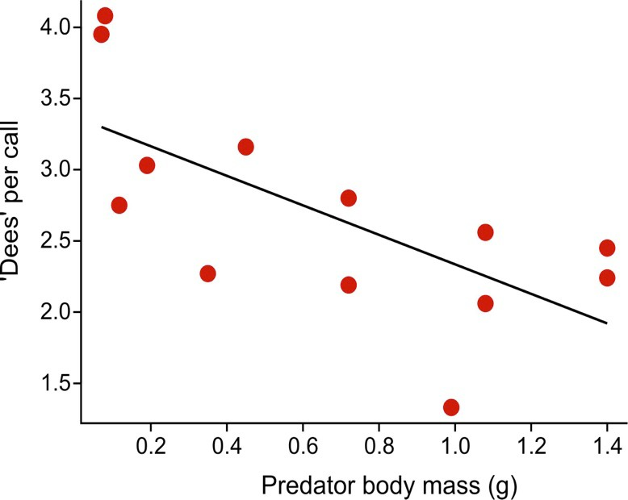
Use summary() to get parameter estimates (ignore the tests)
Formula for the least squares estimate: Y = b0 + b1X
summary(z) # produces the coefficients table (ignore the tests)
 | Estimate | Std. Error | t value | Pr(>|t|)
(Intercept) | 3.3731 | 0.2776 | 12.149 | 1.02e-07 ***
mass | -1.0382 | 0.3402 | -3.051 | 0.0110 *
Kg!

Slide 13
summary()What R does behind the scenes to estimate parameters
R fits two “variables” to the data: mass and a column of 1’s,.
dees |  |  | dummy |  |  | mass
3.95 |  |  | 1 |  |  | 0.07
4.08 |  |  | 1 |  |  | 0.08
2.75 |  |  | 1 |  |  | 0.12
3.03 |  |  | 1 |  |  | 0.19
2.27 |  |  | 1 |  |  | 0.35
3.16 | = | 0 | 1 | + | 1 | 0.45 | + | residuals
2.19 |  |  | 1 |  |  | 0.72
2.80 |  |  | 1 |  |  | 0.72
2.45 |  |  | 1 |  |  | 1.40
1.33 |  |  | 1 |  |  | 0.99
2.24 |  |  | 1 |  |  | 1.40
2.56 |  |  | 1 |  |  | 1.08
2.06 |  |  | 1 |  |  | 1.08
See that for each point i, dees[i] = b0 (1) + b1 mass[i] + residual[i] e.g.: 3.95 = b0 (1) + b1(1.07) + residual[1st]

Slide 14
summary()What R does behind the scenes to estimate parameters
R uses least squares to fit a multiple regression to the X-variables (“dummy” and mass). The best estimates of b0 and b1 minimize the sum of squared residuals.
dees |  |  | dummy |  |  | mass
3.95 |  |  | 1 |  |  | 0.07
4.08 |  |  | 1 |  |  | 0.08
2.75 |  |  | 1 |  |  | 0.12
3.03 |  |  | 1 |  |  | 0.19
2.27 |  |  | 1 |  |  | 0.35
3.16 | = | 0 | 1 | + | 1 | 0.45 | + residuals
2.19 |  |  | 1 |  |  | 0.72
2.80 |  |  | 1 |  |  | 0.72
2.45 |  |  | 1 |  |  | 1.40
1.33 |  |  | 1 |  |  | 0.99
2.24 |  |  | 1 |  |  | 1.40
2.56 |  |  | 1 |  |  | 1.08
2.06 |  |  | 1 |  |  | 1.08
You can see the behind-the-scenes coding system in R as follows.
z <- lm(dees ~ mass) model.matrix(z)

Slide 15
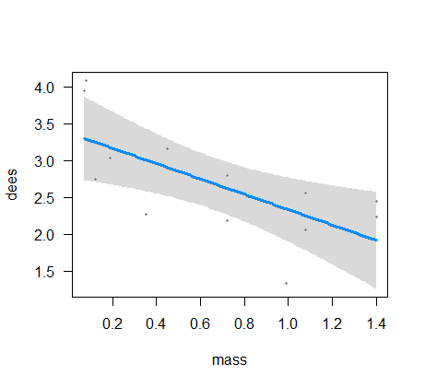
Use summary() to get parameter estimates
z <- lm(dees ~ mass) summary(z)
yields the coefficients table with estimates b0 and b1 (Ignore the tests):
 | Estimate | Std. Error | t value | Pr(>|t|)
(Intercept) | 3.3731 | 0.2776 | 12.149 | 1.02e-07 ***
mass | -1.0382 | 0.3402 | -3.051 | 0.0110 *
visreg(z, “mass”)
Produces a plot of the fitted model.
NB this is the visreg() function in the {visreg} package if you want to try…

Slide 16

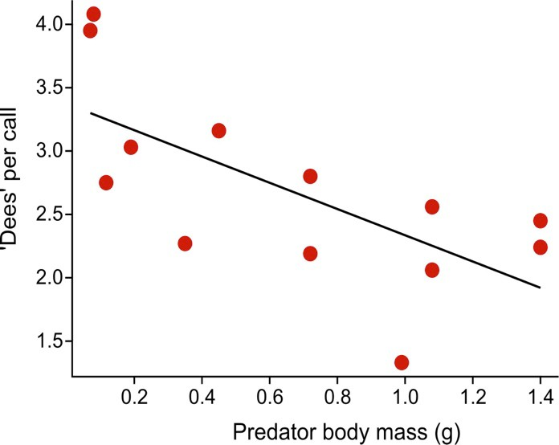
Use anova() or Anova() to test your hypothesis
z <- lm(dees ~ mass) anova(z)
yields the ANOVA table
 | Df | Sum Sq | Mean Sq | F value | Pr(>F)
mass | 1 | 3.1268 | 3.1268 | 9.3106 | 0.01102*
Residuals | 11 | 3.6942 | 0.3358
Test of null hypothesis that slope β1 = 0

Slide 17
Factors are tested using model comparison
Technically anova() tests each term or factor by comparing fits of two models to the data. Comparison is always between a reduced model and a full model. The reduced model contains a subset of terms contained in the full model. The F-test is used to determine whether the full model fits the data significantly better than the reduced model.
Behind the scenes, this is how R tests the effect of predator body mass:
z0 z1
<- lm(dees
<- lm(dees
~ 1) # fits reduced model (intercept only)
~ mass) # fits full model with intercept and mass
# compares fits with F test, yielding:
anova(z0,z1)
Res. Df | RSS | Df | Sum of Sq | F | Pr(>F)
1 [reduced] 12 | 6.8210
2 [full] 11 | 3.6942 | 1 | 3.1268 | 9.3106 | 0.01102

Slide 18
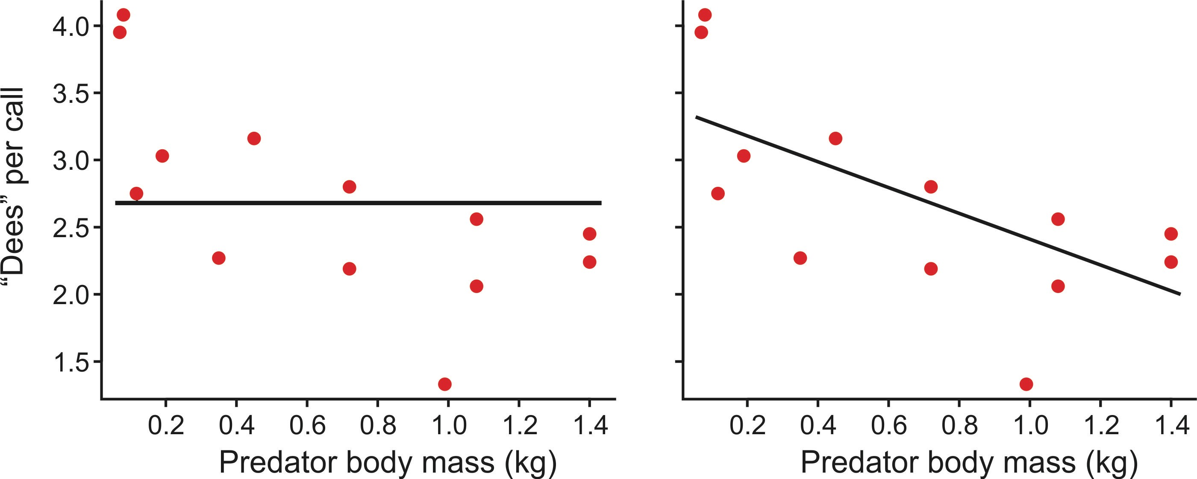
Visually, anova(z0,z1) makes the following comparison:
The test of predator body mass involves a comparison of these two models:
dees ~ 1 dees ~ mass
reduced model (fits only an intercept) full model (intercept and slope)

Slide 19
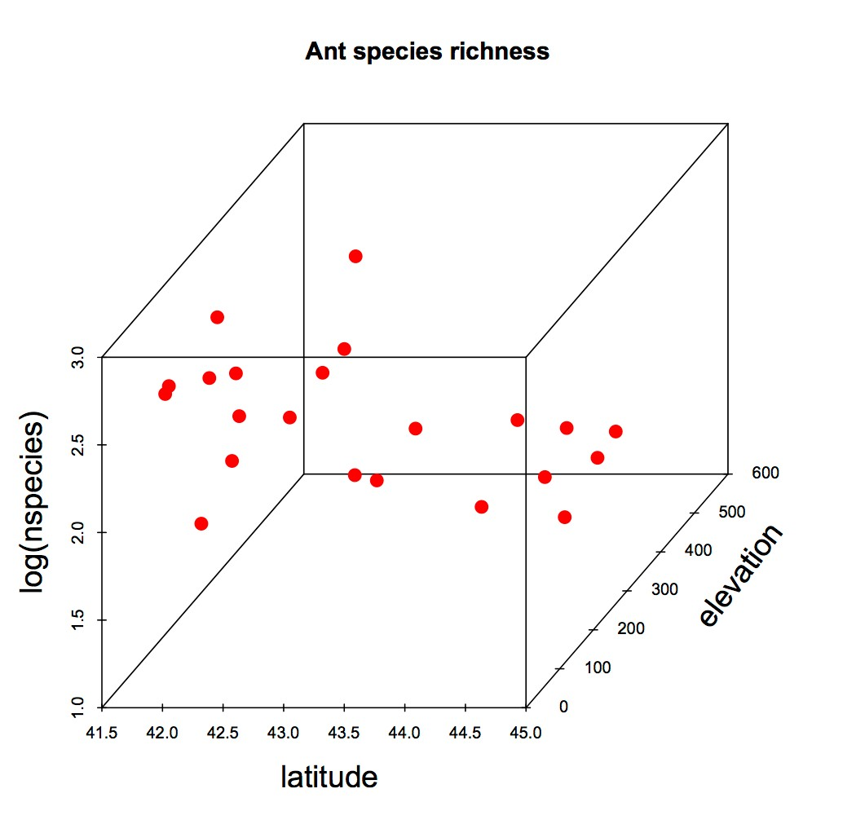
Example 2: Multiple regression
Data: Effects of latitude and elevation on ant species richness. n = 22 forest plots.
Gotelli, N.J. & Ellison, A.M. (2002b). Biogeography at a regional scale: determinants of ant species density in bogs and forests of New England. Ecology, 83, 1604–1609.
log(nspecies) = β0 + β1(latitude) + β2(elevation) + β3(latitude × elevation)
Parameters in this model
β0 : intercept
β1 : slope for latitude
β2 : slope for elevation
β3 : slope for interaction
(NB: sample size too small to fit so many parameters but for this example let’s keep going anyway)
,

Slide 20
Example 2: Multiple regression
log(nsp) |  | dummy |  | latitude |  | elevation |  | lat*elev
1.8 |  | 1 |  | 41.97 |  | 389 |  | 16326.33
2.8 |  | 1 |  | 42.00 |  | 8 |  | 336.00
2.9 |  | 1 |  | 42.03 |  | 152 |  | 6388.56
2.8 |  | 1 |  | 42.05 |  | 1 |  | 42.05
2.2 |  | 1 |  | 42.05 |  | 210 |  | 8830.50
2.7 |  | 1 |  | 42.17 |  | 78 |  | 3289.26
1.9 |  | 1 |  | 42.19 |  | 47 |  | 1982.93
2.5 |  | 1 |  | 42.23 |  | 491 |  | 20734.93
2.6 |  | 1 |  | 42.27 |  | 121 |  | 5114.67
2.2 | = 0 | 1 | + 1 | 42.31 | + 2 | 95 | + 3 | 4019.45
2.3 |  | 1 |  | 42.56 |  | 274 |  | 11661.44
2.3 |  | 1 |  | 42.57 |  | 335 |  | 14260.95
1.4 |  | 1 |  | 42.58 |  | 543 |  | 23120.94
1.6 |  | 1 |  | 42.69 |  | 323 |  | 13788.87
1.9 |  | 1 |  | 43.33 |  | 158 |  | 6846.14
1.9 |  | 1 |  | 44.06 |  | 313 |  | 13790.78
1.4 |  | 1 |  | 44.29 |  | 468 |  | 20727.72
1.8 |  | 1 |  | 44.33 |  | 362 |  | 16047.46
1.8 |  | 1 |  | 44.50 |  | 236 |  | 10502.00
2.1 |  | 1 |  | 44.55 |  | 30 |  | 1336.50
1.8 |  | 1 |  | 44.76 |  | 353 |  | 15800.28
1.8 |  | 1 |  | 44.95 |  | 133 |  | 5978.35
+ residuals

Slide 21
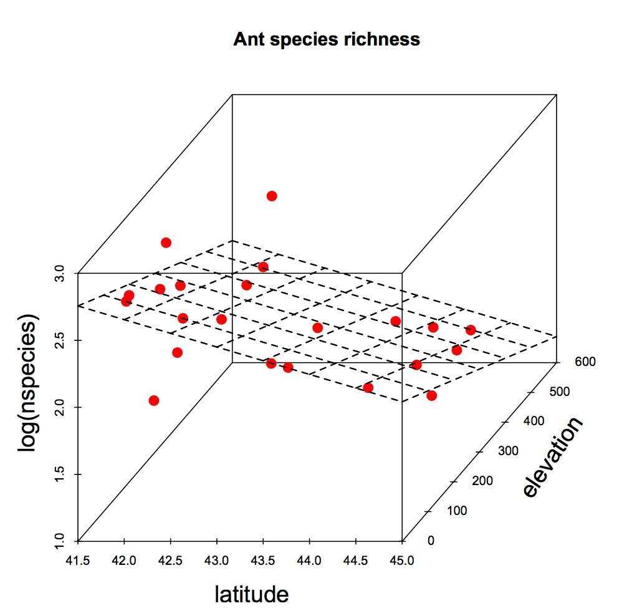
Use summary() to get parameter estimates
z <- lm(log(nspecies) ~ latitude * elevation) summary(z)
# yields the estimates b0, b1, b2, b3 (Ignore the tests):
 | Estimate | Std.Error | t value | Pr
(Intercept) | 12.6271 | 5.0457 | 2.503 | 0
latitude | -0.2369 | 0.1181 | -2.006 | 0
elevation | -0.0076 | 0.0187 | -0.406 | 0
latitude:elevation | 0.0001 | 0.0004 | 0.331 | 0
(>|t|)
.0222
.0601
.6894
.7444

Slide 22
Use anova() or Anova() to test hypothesis
z <- lm(log(nspecies) ~ latitude * anova(z)
elevation)
yields the ANOVA table
Df Sum Sq Mean Sq F Pr(>F)
latitude | 1 1.44425 1.44425 | 14.5030 0.0013 **
elevation | 1 1.07581 1.07581 | 10.8032 0.0041 **
latitude:elevation | 1 0.01091 0.01091 | 0.1096 0.7444
Residuals | 18 1.79249 0.09958

Slide 23
How does R know what full and reduced models to use?
anova() tests model terms sequentially, by default (“Type 1 SS”)
z <- lm(log(nspecies) ~ latitude * elevation) anova(z)
If you don’t give anova() explicit full and reduced models to compare (like I did earlier as anova(z0,z1)), R tests all terms following its own program of action.
anova(z) tests all model terms sequentially (“Type 1 SS”) in the order you provided them in the formula.
anova(z) respects hierarchy: intercept tested first, then main effects, then interactions. To test an interaction between 2 or more variables, anova(z) uses a reduced model that contains the main effects of those variables.

Slide 24
With sequential testing, order of terms in the model formula matters
z <- lm(log(nspecies) ~ latitude * elevation)
anova(z)
 | Df | Sum Sq | Mean Sq | F | Pr(>F)
latitude | 1 | 1.44425 | 1.44425 | 14.5030 | 0.0013 **
elevation | 1 | 1.07581 | 1.07581 | 10.8032 | 0.0041 **
latitude:elevation | 1 | 0.01091 | 0.01091 | 0.1096 | 0.7444
Residuals | 18 | 1.79249 | 0.09958
Term | Reduced model | Full model | Improvement in SS resid
latitude | intercept | Intercept + latitude | 1.44425
elevation | Intercept + latitude | Intercept + latitude + elevation | 1.07581
latitude:elevation | Intercept + latitude + elevation | Intercept + latitude * elevation | 0.01091

Slide 25
With sequential testing, order of terms in the model formula matters
z <- lm(log(nspecies) ~ elevation * latitude)
anova(z)
 | Df | Sum Sq | Mean Sq | F value | Pr(>F)
elevation | 1 | 1.52670 | 1.52670 | 15.3309 | 0.0010 **
latitude | 1 | 0.99336 | 0.99336 | 9.9752 | 0.0054 **
latitude:elevation | 1 | 0.01091 | 0.01091 | 0.1096 | 0.7444
Residuals | 18 | 1.79249 | 0.09958
Term | Reduced model | Full model | Improvement in SS resid
elevation | intercept | Intercept + elevation | 1.52670
latitude | Intercept + elevation | Intercept + elevation + latitude | 0.99336
latitude:elevation | Intercept + elevation + latitude | Intercept + elevation * latitude | 0.01091

Slide 26
Anova() in the car package can fit model terms marginally (“Type 3 SS”)
library(car)
z <- lm(log(nspecies) ~ latitude * elevation,
contrasts = c("contr.sum","contr.poly"))
Anova(z)
Df Sum Sq F value Pr(>F)
latitude | 1 0.40078 | 4.0246 0.0601 .
elevation | 1 0.01643 | 0.1650 0.6894
latitude:elevation | 1 0.01091 | 0.1096 0.7444
Residuals | 18 1.79249
Order of terms in model formula doesn’t matter. Hierarchy is not respected. The improvement in SS residual for a given term in the full model is measured against a reduced model that contains all other terms, including any interactions. Marginal testing also called “drop 1” testing.
Type 3 SS is the default in SAS, JMP and some other computer packages.

Slide 27
Warning: The lure of model simplification
The interaction term in the model was not significant. Can we drop it and refit?
“models should be pared down until they are minimal adequate”
-- Crawley 2007, The R book, p325
Q: Is this always okay? A: In word: No!
The temptation is strong to drop non-significant terms from models, to find a “minimum adequate model” or to provide more power to test remaining effects.
Dropping a term when P > 0.05 involves “accepting” a null hypothesis as true. Is this a good idea? Remaining P-values become heuristic.
Later, we will cover the topic of model selection – how to choose the best model using explicit criteria for what constitutes “best.”
In the case of experiments, a good general rule is that analysis should follow design. Shouldn’t a factor in your experiment also be in your linear model?

Slide 28
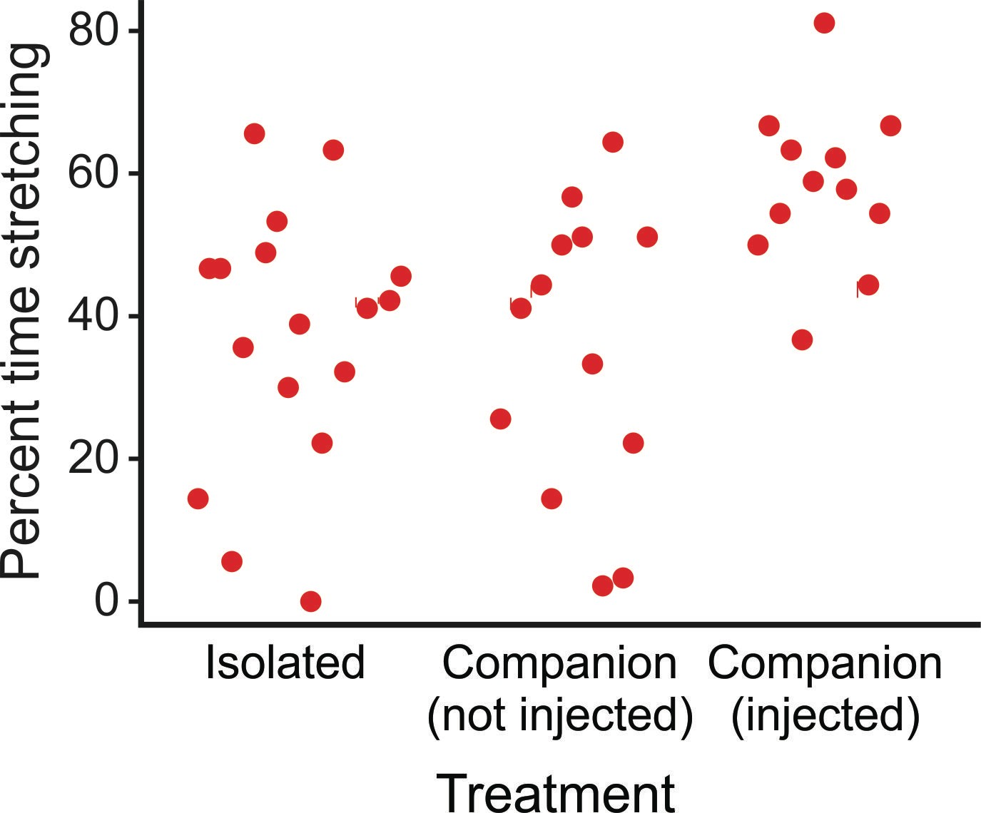
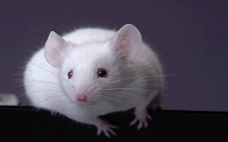
Example 3: Single-factor ANOVA
Data: the percentage of time that male mice given an injection to cause mild pain spent “stretching” in different "familiar-companion" treatments.
Langford et al. 2006. Social modulation of pain as evidence for empathy in mice. Science, 312(5782), pp.1967-1970.

Slide 29
ANOVA is fundamentally the same as linear regression
There’s a response variable, a constant, an explanatory variable. z <- lm(stretching ~ treatment)
The only difference is that the explanatory variable is categorical.

Slide 30
Use summary() to get parameter estimates (ignore the tests)
z <- lm(stretching ~ treatment)
summary(z) # yields the estimates b0, b1, b2 (Ignore the tests)
 | Estimate | Std. Error | t value | Pr(>|t|)
(Intercept) | 37.194 | 4.220 | 8.814 | 8.06e-11***
treatcompanion | -1.825 | 6.411 | -0.285 | 0.77741
treatcompan.inj | 20.856 | 6.560 | 3.179 | 0.00289**
|
These P-values are incorrect except in the case of explicitly planned comparisons
What are b0, b1, b2 ? I will explain. Let’s look at the anova() table first.

Slide 31
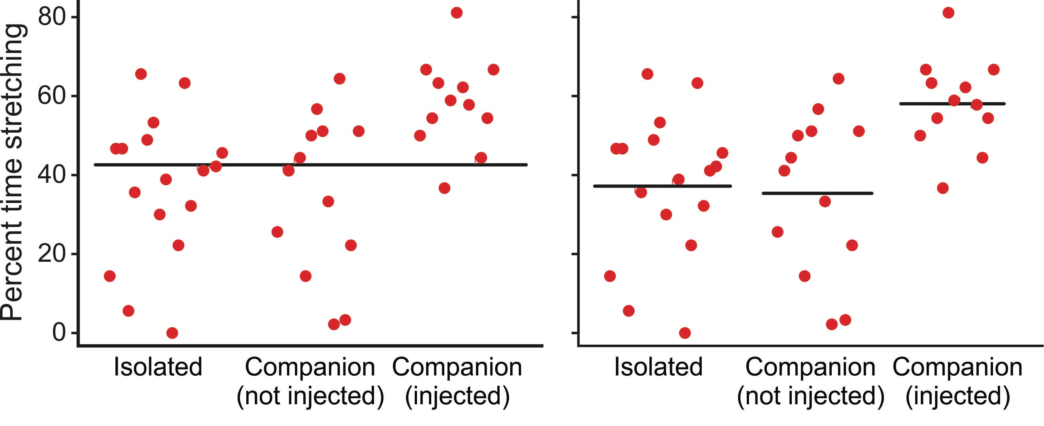
Use anova() to test hypotheses
anova(z) # Produces the ANOVA table
Df Sum Sq Mean Sq
F Pr(>F)
Treatment 2 4040.9 | 2020.5 | 6.6736 0.003216 **
Residuals 39 11807.4 | 302.8
As before, each test in anova() compares the fit of TWO models:
stretching ~ 1 stretching ~ treatment

Slide 32
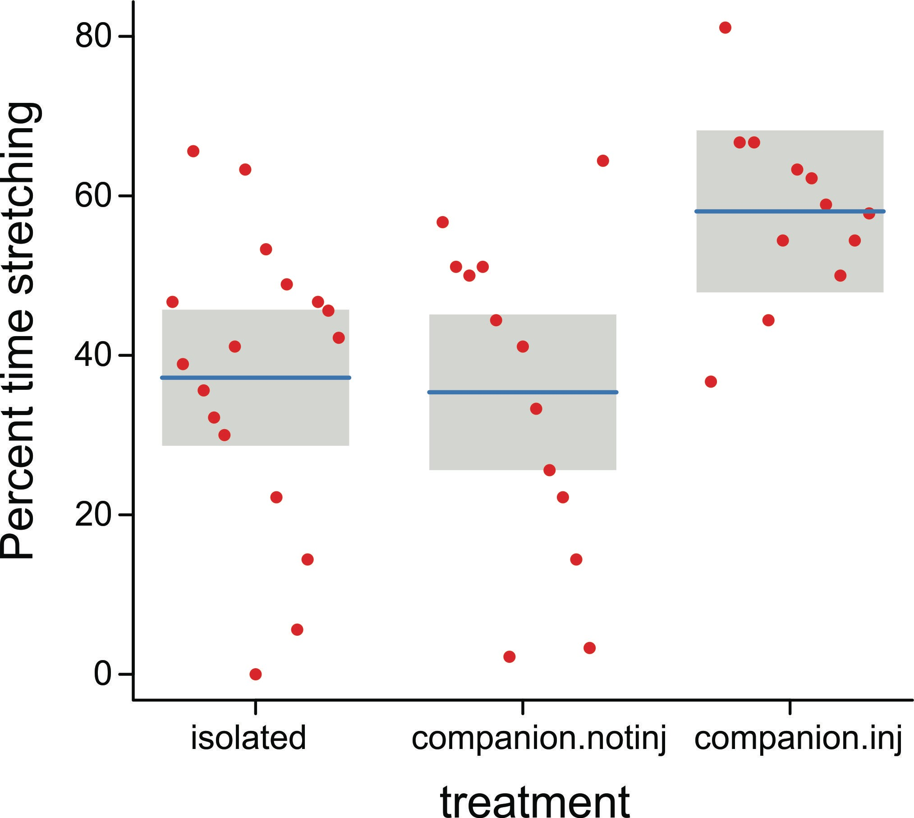
Use visreg() to visualize model fits
visreg(z, “treatment”)

Slide 33
Use emmeans() to get fitted means under the specific model
library(emmeans)
z <- lm(stretching ~ treatment) emmeans(z, “treatment”)
treatment | emmean | SE | df | lower.CL | upper.CL
isolated | 37.19412 | 4.220082 | 39 | 28.65820 | 45.73004
companion.notinj | 35.36923 | 4.825848 | 39 | 25.60803 | 45.13043
companion.inj | 58.05000 | 5.022902 | 39 | 47.89022 | 68.20978
The SE’s and confidence intervals are not the same as those you would calculate based on the data for each group separately, because they are based on the error (residual) mean square for the model (here, this is why df = 39 for each estimate).
Note: emmeans() yields the predicted or marginal means according to the model. These predicted means are not necessarily the same as the individual group means when there are multiple factors.

Slide 34
What the summary() coefficients mean
z <- lm(stretching ~ treat)
summary(z) # yields the following parameter estimates:
 | Estimate | Std. Error | t value | Pr(>|t|)
(Intercept) | 37.194 | 4.220 | 8.814 | 8.06e-11***
treatcompanion | -1.825 | 6.411 | -0.285 | 0.77741
treatcompan.inj | 20.856 | 6.560 | 3.179 | 0.00289**
|
P-values are incorrect except for explicitly planned comparisons

Slide 35
What the summary() coefficients mean
Behind the scenes, R codes the 3 groups of the categorical variable with indicator variables that indicate group membership.
stretching | dummy | treatisolation | treatcompanion | treatcompan.inj
64.4 | 1 | 1 | 0 | 0
46.7 | 1 | 1 | 0 | 0
38.9 | 1 | 1 | 0 | 0
65.6 | 1 | 1 | 0 | 0
…
56.7 | 1 | 0 | 1 | 0
51.1 | 1 | 0 | 1 | 0
50.0 | 1 | 0 | 1 | 0
51.1 | 1 | 0 | 1 | 0
…
36.7 | 1 | 0 | 0 | 1
81.1 | 1 | 0 | 0 | 1
66.7 | 1 | 0 | 0 | 1
66.7 | 1 | 0 | 0 | 1
To analyze, R leaves out the indicator representing the first factor level to avoid a particular form of redundancy (a sum of three of the columns exactly equals the fourth). Use model.matrix(z) to see how indicators are coded.

Slide 36
Linear model for the indicator variables
stretching |  | dummy |  | treatcompanion |  | treatcompan.inj
64.4 |  | 1 |  | 0 |  | 0
46.7 |  | 1 |  | 0 |  | 0
38.9 |  | 1 |  | 0 |  | 0
65.6 … 56.7 |  | 1 1 |  | 0 1 |  | 0 0
51.1 = β₀ |  | 1 + β1 |  | 1 + β₂ 0
50.0 51.1 … 36.7 81.1 66.7 66.7 |  | 1 1 1 1 1 1 |  | 1 0 1 0 0 1 0 1 0 1 0 1
 |  |  |  |  |  |  | + residuals
stretching = β0(1) + β1(0) + β2(0) + residual stretching = β0(1) + β1(1) + β2(0) + residual stretching = β0(1) + β1(0) + β2(1) + residual
(subjects in isolation treatment) (subjects in companion treatment) (subjects in compan.inj treatment)

Slide 37
What the summary() coefficients mean
In other words, the linear model being fitted is:
stretching = β0
+ residual (subjects in isolation group)
stretching = β0 + β1 + residual (subjects in companion group)
stretching = β0 + β2 + residual
(subjects in compan.inj group)
Stare at this long enough and you’ll realize that:
β0 is the mean of the isolated (control) group
β1 is the difference between companion and control groups
β2 is the difference between compan.inj and control groups
(Other codings are possible, in which case the interpretations of the parameters will change. Read the fine print. R’s 0/1 scheme is relatively straightforward.)

Slide 38
What the summary() coefficients mean
b0 estimates the mean of the isolated (control) group
b1 estimates the difference between companion and control groups
b2 estimates the difference between compan.inj and control groups
 | Estimate | Std. Error | t value | Pr(>|t|)
(Intercept) | 37.194 | 4.220 | 8.814 | 8.06e-11***
treatcompanion | -1.825 | 6.411 | -0.285 | 0.77741
treatcompan.inj | 20.856 | 6.560 | 3.179 | 0.00289**

Slide 39
How does anova() test a term having more than one indicator variable?
To test a factor/term, the reduced model drops all columns coding for that factor
In this example, the three levels of treatment are coded by two dummy indicator variables, both of which are dropped in the reduced model.
z0 <- lm(percent.stretching ~ 1) z1 <- lm(percent.stretching ~ treatment) | # # | reduced model (1 column) full model (3 columns)
anova(z0,z1)
Res.Df RSS
1 [reduced] 41 15848
Df Sum.of.Sq
F Pr(>F)
6.6736 0.003216 **
2 [full] 39 11807 2 4040.9

Slide 40
Summary of Example 3 so far
Linear models can fit categorical variables too.
Use visreg() to visualize model fits.
Use emmeans() to estimate predicted group means.
Use summary() for parameter estimation. To interpret the estimates, it is useful to know about how R handles categorical variables behind the scenes (0/1 indicator variables).
Ordering your categories well (e.g., control group first) will maximize the usefulness of the parameter estimates from the fitted model (e.g., estimates of differences between each treatment group and the control group).
Use anova() or Anova() for hypothesis testing (P values, sums of squares).
Use plot() to check assumptions (lab)

Slide 41


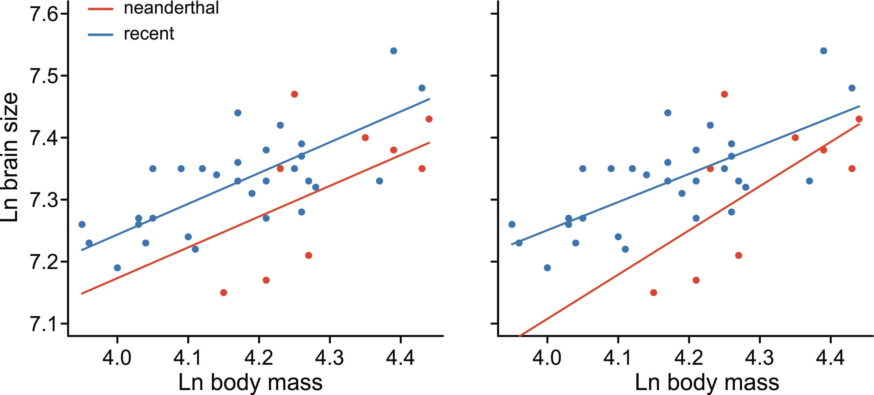
Example 4: Models with both numeric and categorical variables (ANCOVA)
Brain and body sizes of Neanderthal specimens ( ) and early modern humans ( ). Ruff et al 1977).
Do they (we) have different brain sizes, after accounting for differences in body size? Answering this is easiest if we can assume the model on the left is correct.
brain ~ mass + species brain ~ mass + species
+ mass:species

Slide 42
anova() tests terms sequentially
z <- lm(brain ~ mass * species) anova(z)
Df |  | Sum Sq | Mean Sq | F | value | Pr(>F)
mass | 1 | 0.102528 | 0.102528 | 23.1465 |  | 2.835e-05 ***
species | 1 | 0.027553 | 0.027553 | 6.2203 |  | 0.0175 *
mass:species | 1 | 0.004845 | 0.004845 | 1.0938 |  | 0.3028
Residuals | 35 | 0.155033 | 0.004430
Interaction is not significant, but equal slopes remains an assumption not a conclusion (one not contradicted by the data).

Slide 43
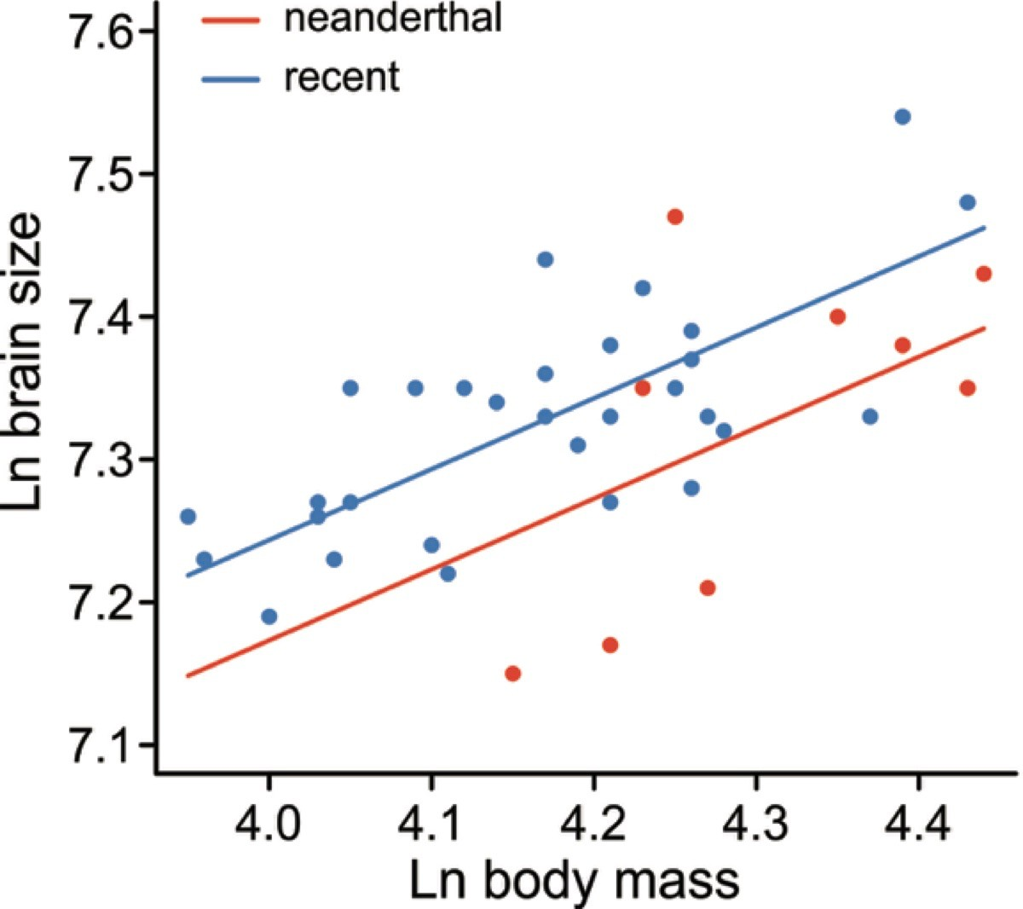
summary() obtains the parameter estimates
Model with no interaction (equal slopes)
z <- lm(brain ~ mass + species) summary(z)
Estimate Std. Error Interpretation of parameters estimated
(Intercept) 5.22321 0.38862 Intercept for species 1 (recent humans)
lnmass species1
0.49632
-0.03514
0.09173 Slope for species 1 (same slope fit to both) 0.01411 Difference between intercepts (i.e., size-corrected
difference)

Slide 44
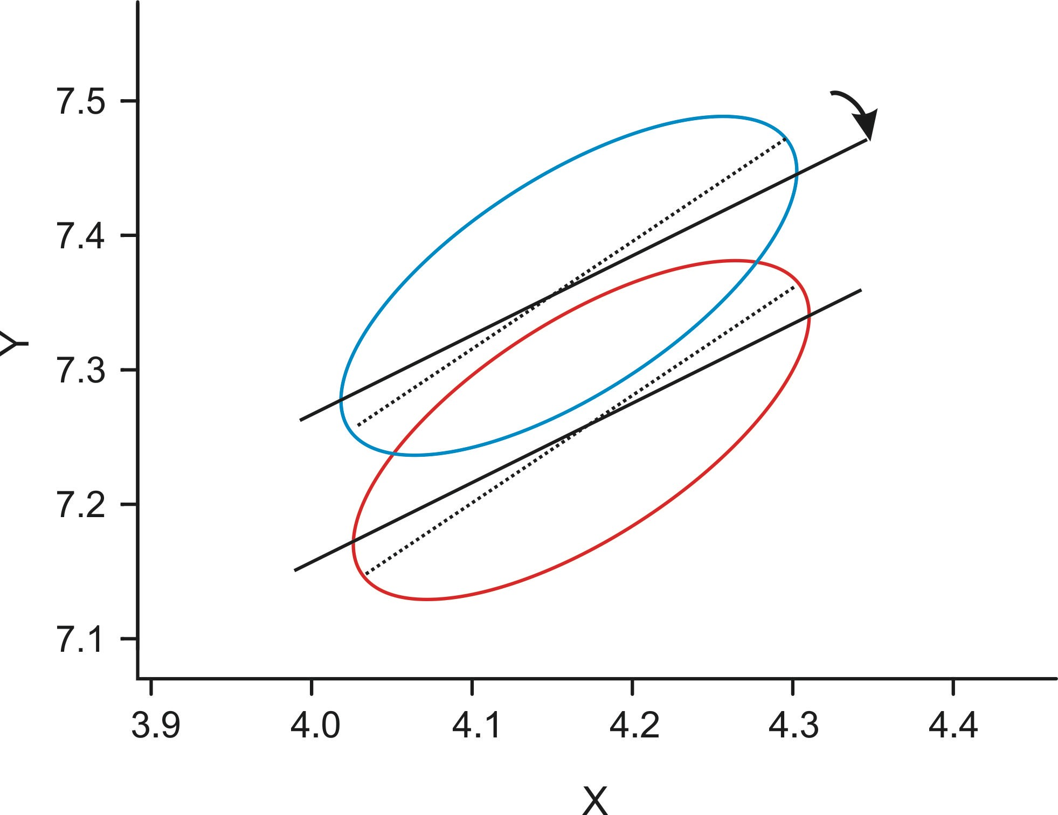
Size-correction is valid only when range of X-values is similar in all groups
Although our goal is to “correct” for variation in X in order to comparing Y among groups, X is not the cause of Y. Hence, there is “regression toward the mean”.

Slide 45
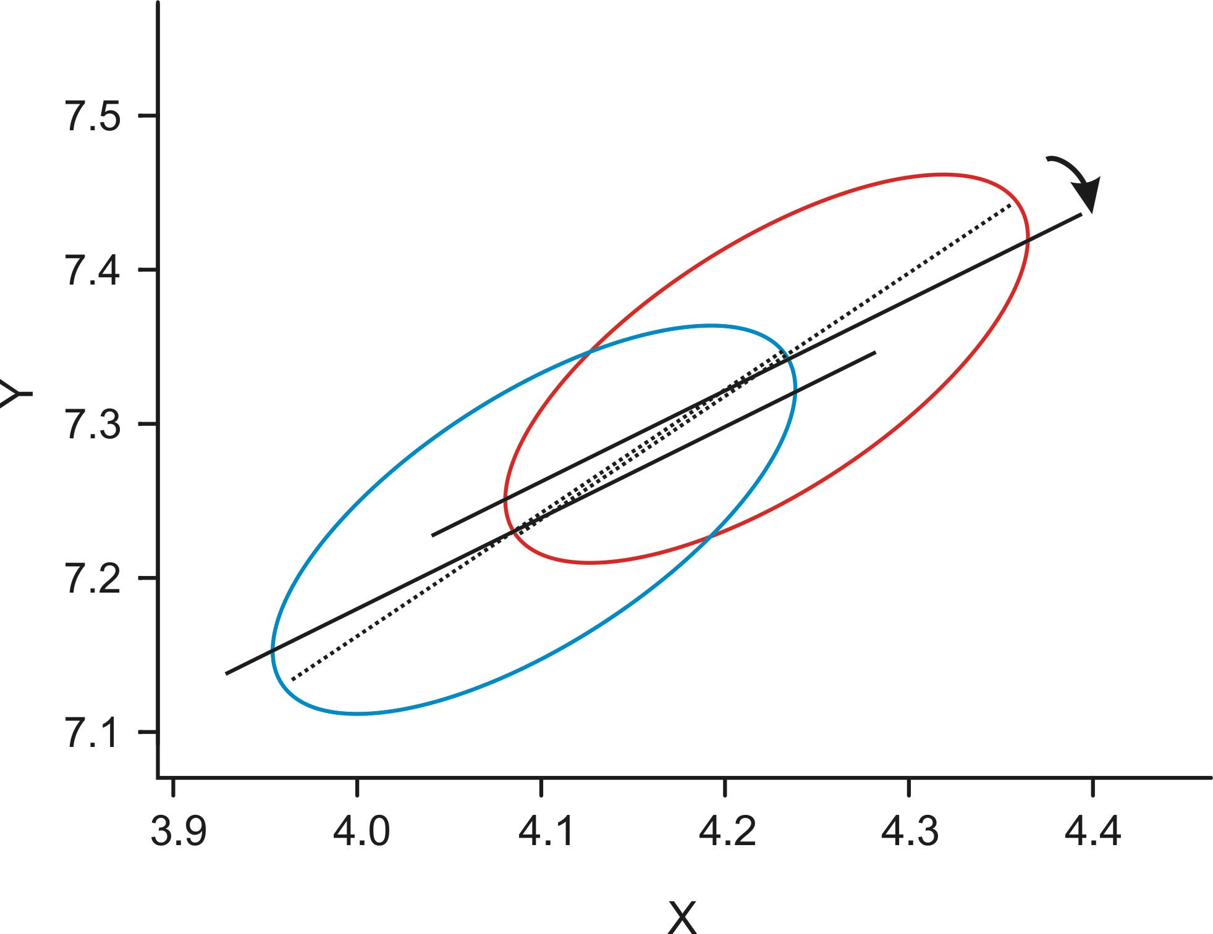
Problems arise when the range of X-values is not the same among groups
Differences in Y might persist even after “correcting” for differences in X. Major axis regression methods are more suitable instead (available in R!).

Slide 46
Core assumptions of linear models
Gaussian distributed errors (residuals)
Equal variance of residuals in all groups
Independent errors
Use plot(z) to assess departures from the assumptions of normality and equal variance (lab)
Linear models are reasonably robust to departures from these assumptions, especially if sample size is large and balanced. However, outliers can cause problems
The assumption of independent errors is met if your sample constitutes a random sample and you have not pseudoreplicated

Slide 47
Related topics
What if your residuals aren’t normal because of outliers? Nonparametric methods exist, but these don’t provide parameter estimates.
Robust regression methods (rlm)
What if response data are binary or discrete?
Generalized linear models (glm)
What if there are random effects?
Linear mixed effects models (lme)
What if residuals are not independent because of autocorrelation or phylogeny?
General least squares methods (gls)

Slide 48
A word about planned vs unplanned comparisons
Unplanned (“post hoc”) comparisons:
Multiple comparisons among means after ANOVA done.
Used to find which pairs of means are statistically significantly different.
A kind of data dredging (i.e., no plan).
Incorporates special protection against high false positive rate.
P-values in summary() table are not protected, so can’t use them.
Planned (“a priori”) comparisons:
Comparisons between group means that were decided when the experiment was designed (not after the data were in).
For example, compare a key treatment against the control.
Must be few in number to avoid inflating false positive rate.
P-values in summary() can be used for planned comparisons.
Other types of planned contrasts are also possible (glht() command in
multcomp package)

Slide 49


Suggested reading:
Kelly, C., Price, T.D., 2005. Correcting for regression to the mean in behavior and ecology. Am Nat 166, 700–707. https://doi.org/10.1086/497402
Zuur, A.F., Ieno, E.N., Elphick, C.S., 2010. A protocol for data exploration to avoid common statistical problems. Methods in Ecology and Evolution 1, 3–14. https://doi.org/10.1111/j.2041-210X.2009.00001.x

