Slide 1
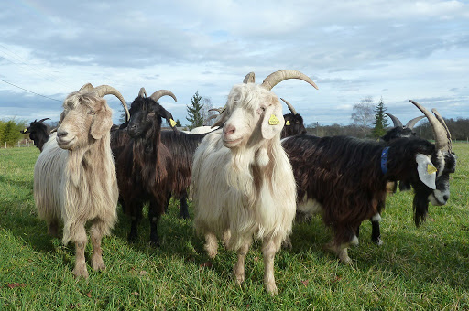
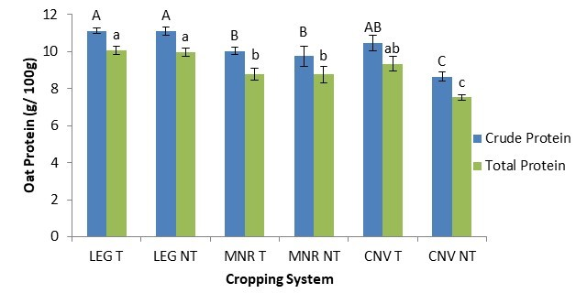

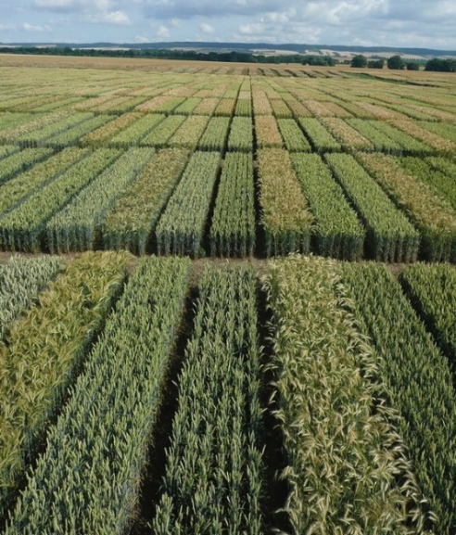

C7041 Experimental Design and Analysis
Ed Harris

Slide 2

2.09: Bayes intro
“In science, progress is possible. In fact, if one believes in Bayes' theorem, scientific progress is inevitable as predictions are made and as beliefs are tested and refined.”
-Nate Silver
(Rockstar of data science, founder of Five Thirty-Eight)

Slide 3
Outline
What is probability
Another definition of probability
Bayes’ Theorem
Prior probability; posterior probability
How Bayesian inference is different from what we usually do
Example: one species or two
Example: estimating a proportion
Credible intervals
Hypothesis testing using the Bayes factor
Bayesian model selection

Slide 4
What is probability
A way of quantifying uncertainty.
Mathematical theory originally developed to model outcomes in games of chance.
Definition of probability (frequentist)
The probability of an event is the proportion of times that the event would occur if we repeated a random trial over and over again under the same conditions.
A probability distribution is a list of all mutually exclusive outcomes of a random trial and their probabilities of occurrence.

Slide 5
Probability statements that make sense under this definition
If we toss a fair coin, what is the probability of 10 heads in a row?
If we assign treatments randomly to subjects, what is the probability that a sample mean difference between treatments will be greater than 1 standard deviation?
Under a process of genetic drift in a small population, what is the probability of fixation of a rare allele?
What is the probability of a result at least as extreme as that observed if the null hypothesis is true?
In these examples, sampling error is the source of uncertainty.

Slide 6
Probability statements that don’t make sense under this definition
What is the probability that Iran is building nuclear weapons?
What is the probability that hippos are the sister group to the whales?
What is the probability that the fish sampled from that newly discovered lake represent two species rather than one?
What is the probability that polar bears will be extinct in the wild in 40 years?

Slide 7
Why they don’t make sense
What is the probability that Iran is building nuclear weapons?
[either Iran is or isn’t – no random trial here]
What is the probability that hippos are the sister group to the whales?
[either they are or they’re not – no random trial here]
What is the probability that the fish sampled from that newly discovered lake represent two species rather than one?
[either there is one species or there are two – no random trial]
What is the probability that polar bears will be extinct in the wild in 40 years?
[maybe it is possible to state in terms of the accumulation of outcomes of random trials]
In these examples there is no random trial, so no sampling error. Lack of information is the source of uncertainty—not sampling error.

Slide 8
Alternative definition of probability (Bayesian)
Probability is a measure of a degree of belief associated with the occurrence of an event
A probability distribution is a list of all mutually exclusive events and the degree of belief associated with their occurrence
Bayesian statistics applies the mathematics of probability to uncertainty measured as subjective degree of belief

Slide 9

Bayesian methods are increasingly used in ecology and evolution
“Ecologists should be aware that Bayesian methods constitute a radically different way of doing science. Bayesian statistics is not just another tool to be added into the ecologists’ repertoire of statistical methods.
Instead, Bayesians categorically reject various tenets of statistics and the scientific method that are currently widely accepted in ecology and other sciences.” B. Dennis, 1996, Ecology
“Ecologists are facultative Bayesians” (M. Mangel, attributed)
Should we be using it?

Slide 10
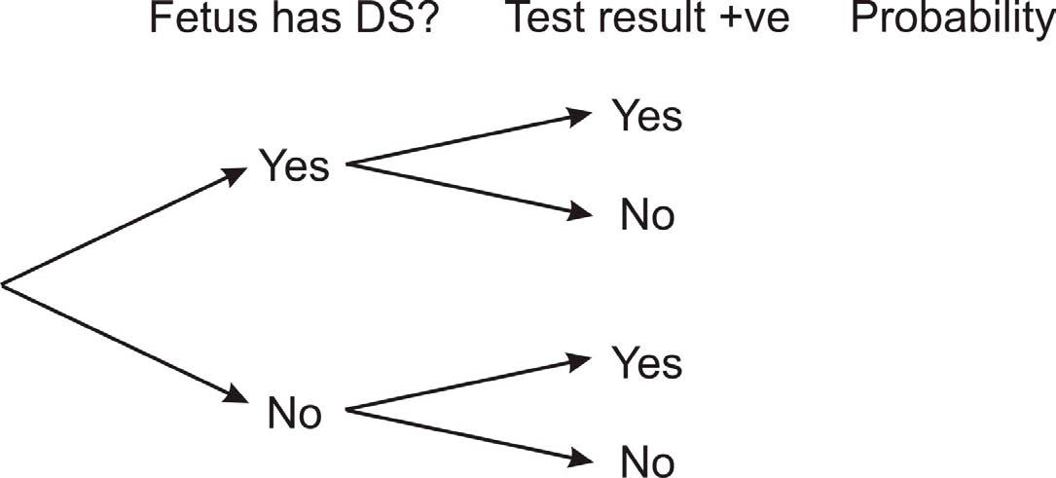
Bayes’ Theorem itself is harmless
Example: detection of Down syndrome (DS).
DS occurs in about 1 in 1000 pregnancies. A “triple test” of levels of 3 blood sera (α-fetoprotein, estriol, and β-subunit of human chorionic gonadotropin) is widely used. It is cheap and risk-free. A newer DNA test is more accurate. The most accurate test requires amniocentesis, which carries a small risk of miscarriage.

Slide 11
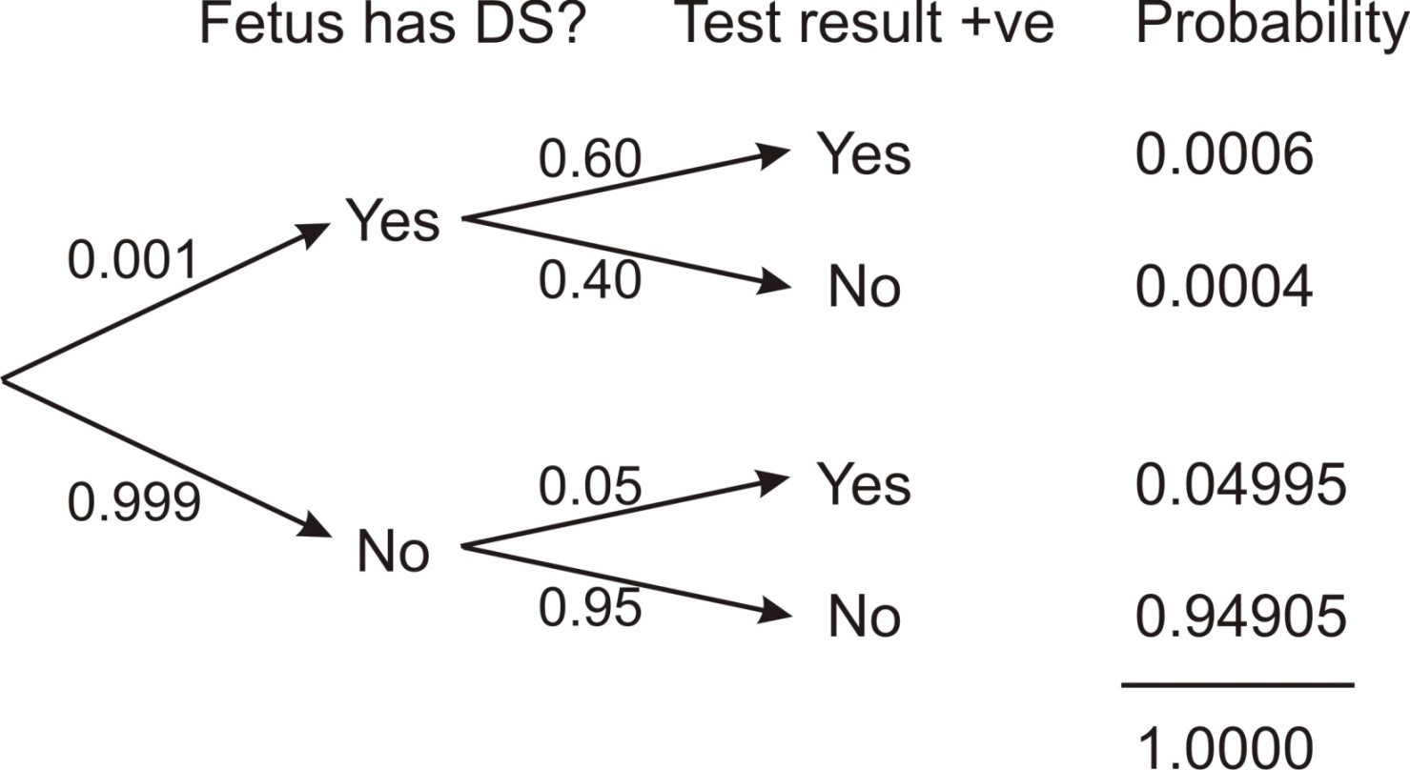
Conditional probability
Remember that the conditional probability of an event is the probability of that event occurring given that a condition is met.
The probability of a positive test result from the triple test is 0.6, given that a fetus has DS. The probability of a positive result is 0.05, given that a fetus is not DS.

Slide 12
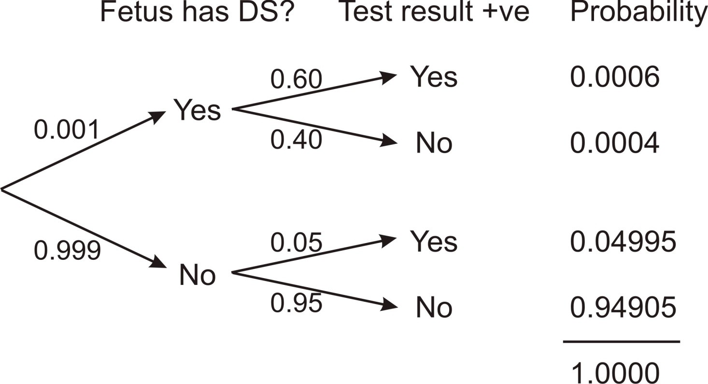
Conditional probability calculation
What is the probability that a fetus has DS given that the test is positive?
0.0006
Pr[DS | positive] = _{0.0006 + 0.04995} = 0.012, just 1.2%

Slide 13
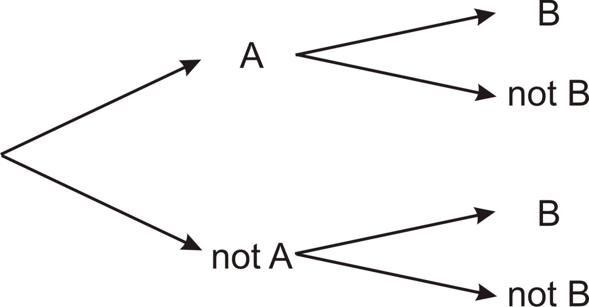
This calculation is formalized in Bayes’ Theorem
Pr[B | A] Pr[A]
Pr[A | B] =
Pr[B | A] Pr[A]+ Pr[B | notA] Pr[notA]

Slide 14
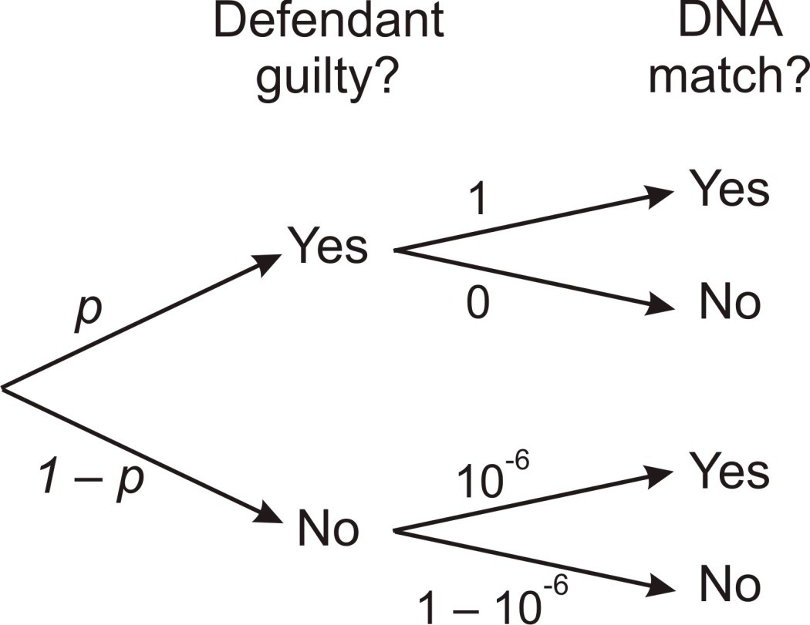
What is more controversial is how Bayes’ Theorem is used
For example: forensic evidence. Bayesian inference can be used in a court of law to quantify the evidence for and against the guilt of the defendant based on a match to DNA evidence left at the crime scene.
What is the probability of guilt given a positive DNA match (assuming no contamination of samples)?

Slide 15
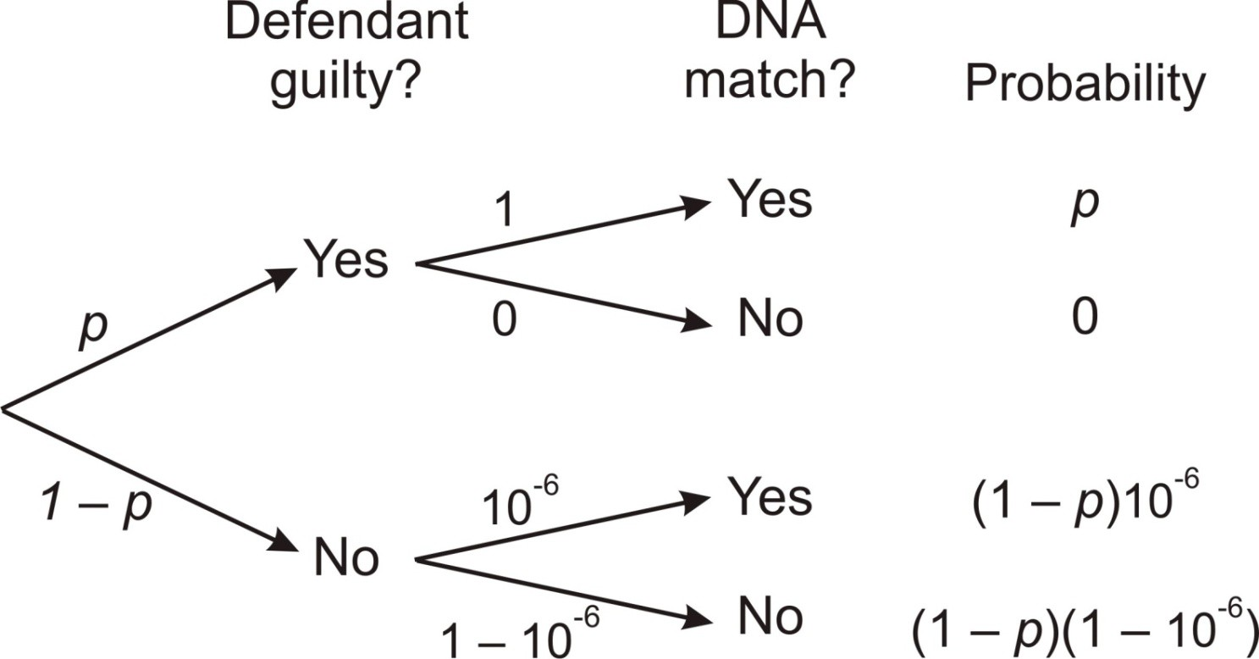
Bayesian inference in action
What is the probability of guilt given a positive DNA match?
1( p)
Pr[guilt | match] =
1( p) + 10⁻⁶ (1− p)

Slide 16
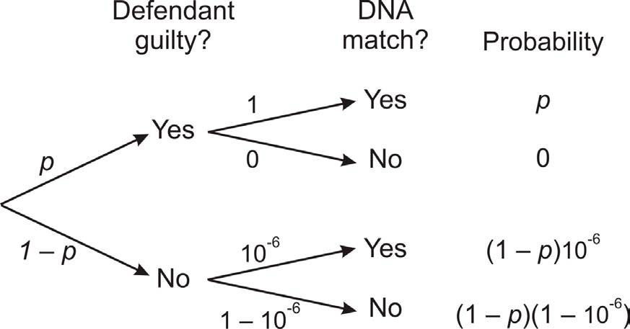
Prior and posterior probability
Prior probability of guilt
Posterior probability of guilt
1( p)
Pr[guilt | match] =
1( p) + 10⁻⁶ (1− p)

Slide 17
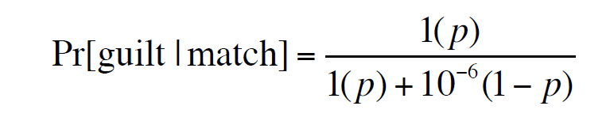
Bayesian inference in action
If p = 10⁻⁶ then Pr[guilt | match] = 0.5
If p = 0.5 then Pr[guilt | match] = 0.999999
So, is the defendant guilty or innocent?

Slide 18
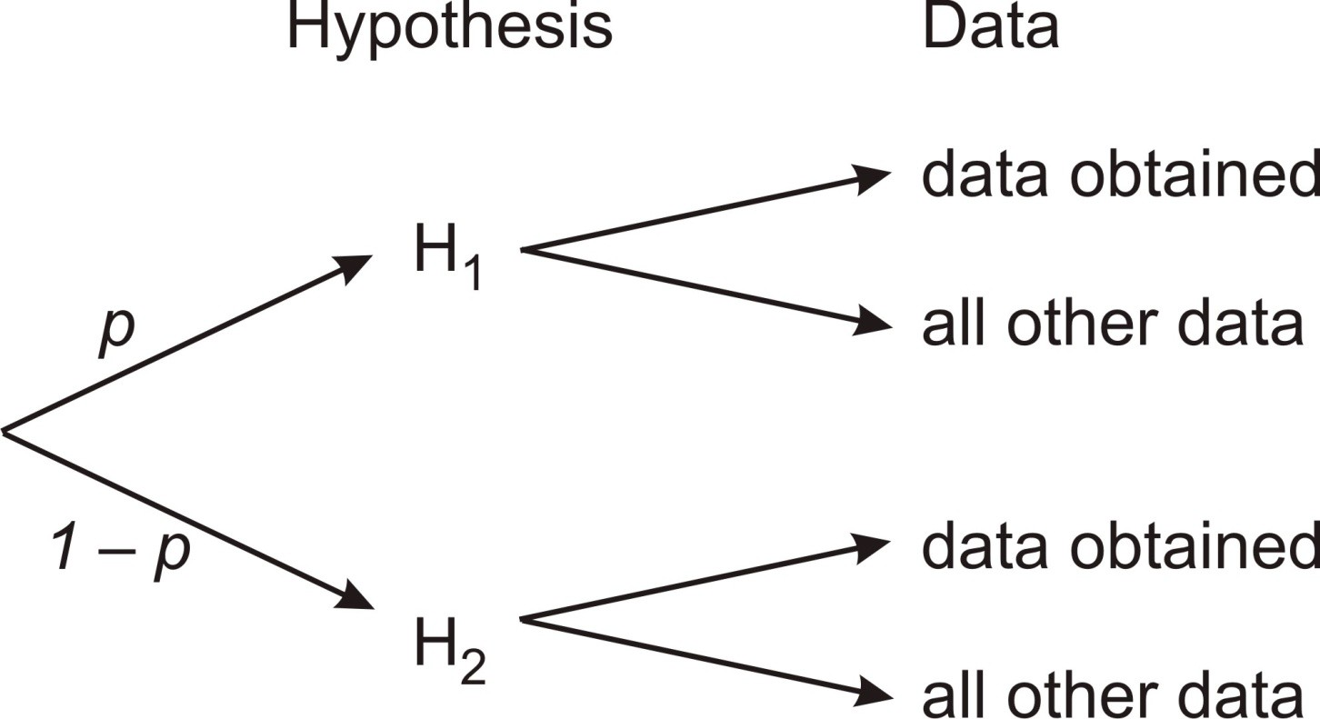
Bayesian inference with data
Prior probability
Posterior probability
Pr[data | H₁] Pr[H₁]
Pr[H | data] =
1
Pr[data | H₁] Pr[H₁] + Pr[data | H₂ ] Pr[H₂ ]

Slide 19
Bayesian inference goes beyond likelihood
Pr[data|H1] is the likelihood of H1 given the data
Prior probability
Posterior probability
Pr[data | H₁] Pr[H₁]
Pr[H | data] =
1
Pr[data | H₁] Pr[H₁] + Pr[data | H₂ ] Pr[H₂ ]

Slide 20
How Bayesian inference is different from what we usually do
The prior probability represents the investigator’s strength of belief about the hypothesis, or strength of belief about the parameter value, before the data are gathered.
The posterior probability expresses how the investigator’s beliefs have been altered by the data.
Mathematically, the value of the hypothesis or parameter is treated as though it is a random variable that has a probability distribution.
Here are several examples of how it works in practice.

Slide 21
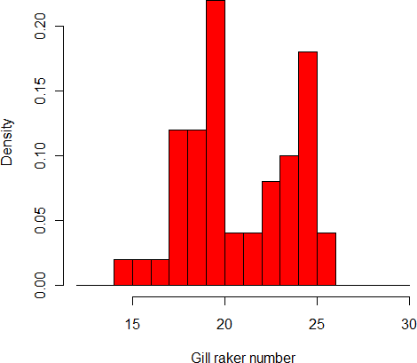
Example 1: One species or two
Data: Gill raker counts for 50 fish collected from a new lake
What is the probability that the counts represent 2 species rather than 1?

Slide 22
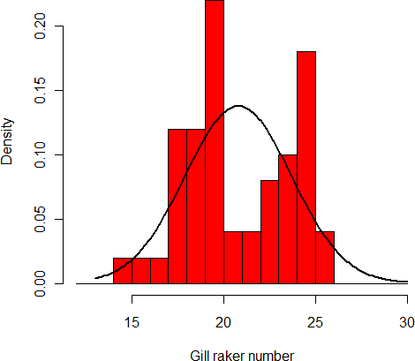
H1: one species
Assume a normal distribution of measurements
Pr[data | H1] = L[H1 | data] = e^{–124.06}

Slide 23
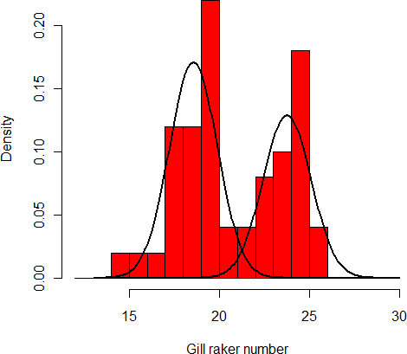
H2: two species
Assume normal distributions with equal variance in both groups
Pr[data | H2] = L[H2 | data] = e^{–116.51}

Slide 24
Posterior model probabilities
Plug the likelihoods into Bayes Theorem to calculate the posterior probabilities of each hypothesis given the data
Posterior probability depends on the prior probability
Here is the probability that H2 is correct (two species are present):
Prior probability Pr[H2] | Posterior probability Pr[H2 | data]
0.500 | 0.99
0.005 | 0.91
0.001 | 0.66
If prior is small, need more data to increase posterior probability

Slide 25
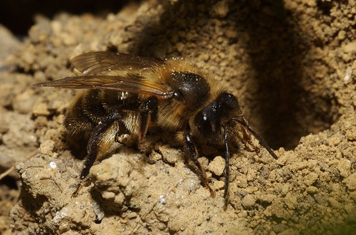
Example 2: Bayesian estimation of a proportion
Study of the sex ratio of the communal-living bee, (Paxton and Tengo, 1996, J. Insect. Behav.)
What is the proportion of males among the reproductive adults emerging from colonies?

Slide 26
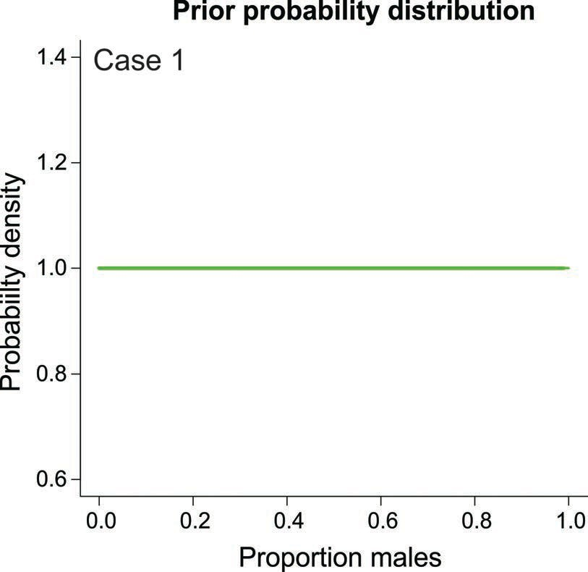
Bayesian estimation of a proportion
To begin, we need to come up with a prior probability distribution for the proportion.
Case 1: the “noninformative” prior: expression of total ignorance.

Slide 27
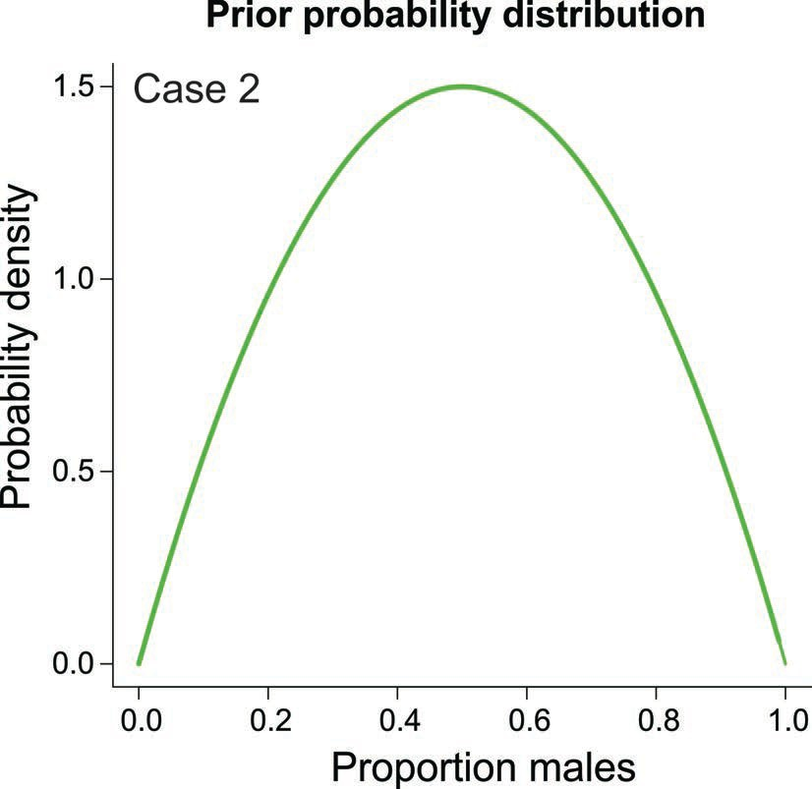
Bayesian estimation of a proportion
Case 2: Most species have a sex ratio close to 50:50, and this is predicted by simple sex-ratio theory. This prior probability distribution attempts to incorporate this previous information (this is really what priors are for).

Slide 28
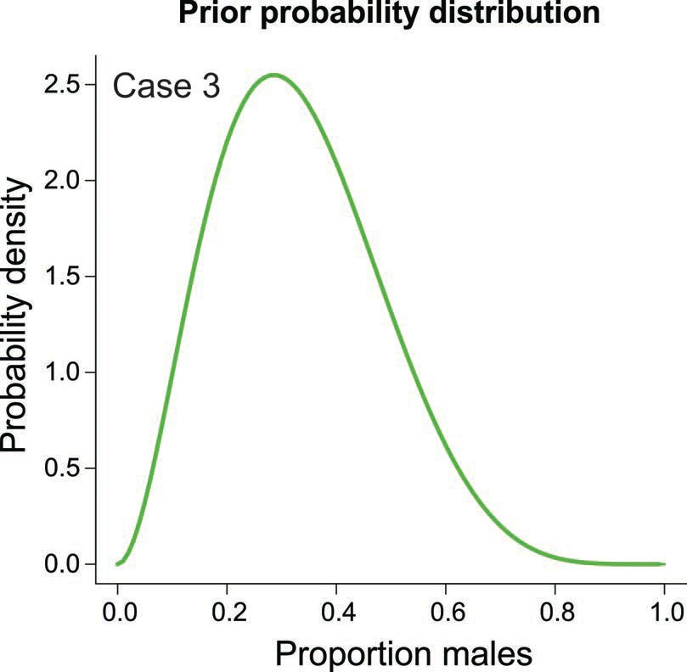
Bayesian estimation of a proportion
Case 3: Then again, female-biased sex ratios do exist in nature, more than male- biased sex ratios, especially in bees and other hymenoptera. The following prior attempts to incorporate this previous information.

Slide 29
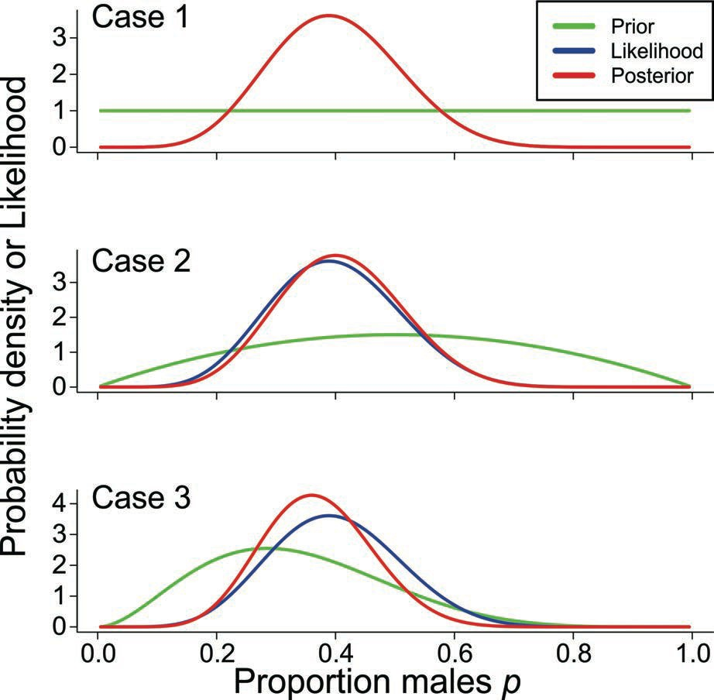
Bayesian estimation of a proportion
Data: From day 148 at nest S31: 7 males, 11 females p^{ˆ} MLE = 0.39
pˆ = 0.39
pˆ = 0.40
pˆ = 0.36

Slide 30
Bayesian estimation of a proportion
The estimate having maximum posterior probability depends on the prior probability distribution for the estimate.
Potential source of controversy: The prior is subjective. Different researchers may use different priors, hence obtain different estimates with the same data.
To resolve this we might all agree to use “noninformative” (“diffuse priors”) priors. But this stance prevents us from incorporating prior information, which is regarded as one of the strengths of the Bayesian approach.
Maybe the issue about the subjectivity of priors can be resolved if we base the prior on a survey of preexisting evidence (lot of work).
Choice of prior not so important if there is a lot of data.

Slide 31
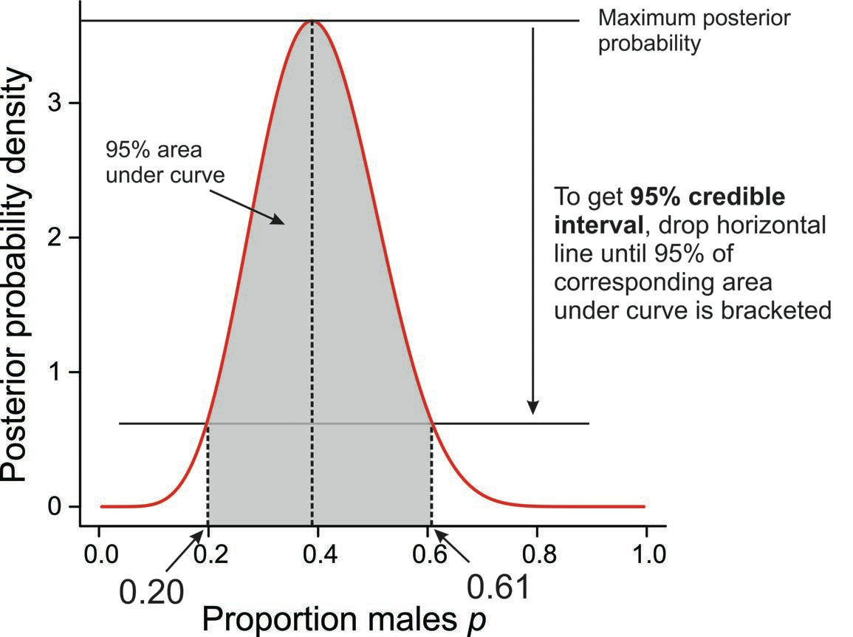
Bayesian estimation of a proportion
95% credible interval

Slide 32
Bayesian estimation of a proportion
Interpretation of the interval estimates
95% likelihood-based confidence interval: 0.19 < 𝑝 < 0.62
Likelihood interpretation:
Most plausibly, p is between 0.19 and 0.62. In repeated random samples taken from the same population, the likelihood-based confidence interval so calculated will bracket the true population proportion p approximately 95% of the time.
95% credible interval: 0.20 < 𝑝 < 0.61
(assuming Case 1, with non-informative prior)
Bayesian interpretation:
The probability is 0.95 that the population proportion lies between 0.20 and 0.61

Slide 33
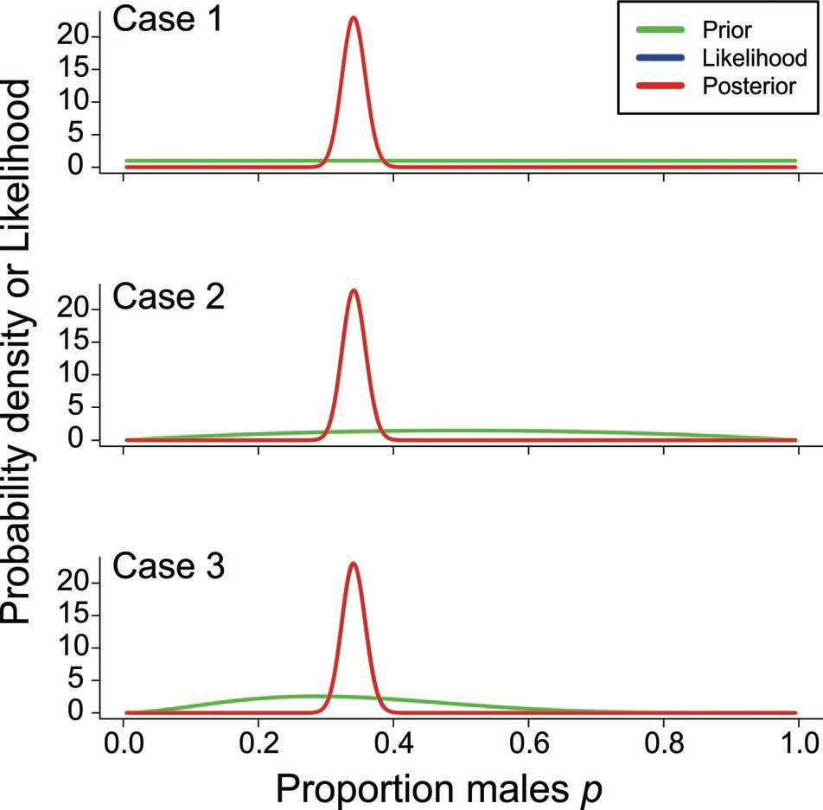
Bayesian estimation of a proportion
All the data: 253 males, 489 females p^{ˆ} MLE = 0.34
With lots of data, the choice of prior has little effect
on the posterior distribution.

Slide 34
Bayesian hypothesis testing using the Bayes factor
Bayesian methods can be used to quantify the strength of evidence for one hypothesis relative to another using a quantity called the Bayes factor. This represents a Bayesian alternative to null hypothesis significance testing.
For example, when comparing means of two groups, we can still consider a null and alternative hypothesis, where the null has priority:
H₀: 𝜇₋ − 𝜇/ = 0 H_{A}: 𝜇₋ − 𝜇/ ≠ 0
Under null hypothesis significance testing, the amount of support for the null and alternative hypotheses is never tested. The data are compared only with the null hypothesis.
In contrast, the Bayes factor quantifies the amount of support for one hypothesis (e.g., the alternative H_{A}) relative to the other (e.g., null H₀) hypothesis.

Slide 35
Bayesian hypothesis testing using the Bayes factor
Before seeing the data, the two hypotheses H₀ and H_{A} have prior probabilities Pr[H₀] and Pr[H_{A}]. Note that Pr[H₀] = 1 − Pr[H_{A}], since there are only two hypotheses. Hence, the ratio Pr[H_{A}]/Pr[H₀] is called the prior odds of H_{A}.
Calculating the posterior probabilities involves multiplying the prior odds by a quantity called the Bayes factor. The transformation itself represents the evidence provided by the data.
Pr[H_{A}|data] ₌ Pr[data|H_{A}] × Pr[H_{A}] . Pr[H₀|data] Pr[data|H₀] Pr[H₀]
Pr[data|H₀] is just the likelihood of H₀]. Calculating Pr[data|H_{A}] is a little more complicated because we have to integrate over the parameter space for 𝜇₋ − 𝜇/ (computer packages do this).

Slide 36
Bayesian hypothesis testing using the Bayes factor
Bayes factor = ^{Pr[data|HA]}
Pr[data|H₀]
What constitutes strong evidence in favor of the alternative hypothesis?
A Bayes factor of 1 – 3 is considered “anecdotal evidence” for HA
A Bayes factor of 3 – 10 is considered “substantial evidence” for HA A Bayes factor of 10 – 30 is considered “strong evidence” for HA

Slide 37
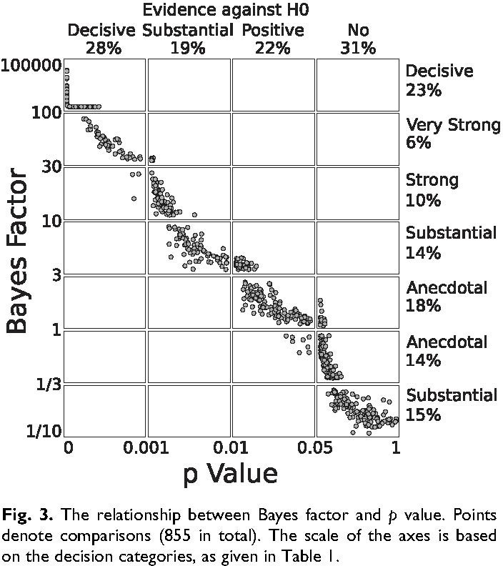
Bayesian hypothesis testing
Weight of evidence, comparing P-values from 855 t-tests in the psychology literature with corresponding Bayes factors (Wetzels et al. 2011).
Quantities obtained from the two approaches (P-value from t-test vs Bayes factor) are strongly correlated.

Slide 38
Bayesian hypothesis testing
But notice how weak is the criterion P = 0.05 by the standard of the Bayes factor.

Slide 39
Bayesian model selection
Model selection: the problem of deciding the best candidate model fitted to data Requires a criterion to compare models, and a strategy for finding the best
One Bayesian approach uses BIC as the criterion (Bayesian Information Criterion).
Derived from a wholly different theory, but yields a formula similar to that of AIC. It assumes that the “true model” is one of the models included among the candidates. The approach has a tendency to pick a simpler model than that from AIC.
AIC = −2 ln 𝐿(model | data) + 2𝑘
BIC = −2 ln 𝐿(model | data) + 𝑘 log(𝑛)
k is the number of parameters estimated in the model (including intercept and σ²), n is the sample size.

Slide 40

Bayesian data analysis
Other options:
JAGS (good with R)
BUGS
WinBUGS
Stan
About Stan
Stan is a state-of-the-art platform for statistical modeling and high-performance statistical computation. Thousands of users rely on Stan for statistical modeling, data analysis, and prediction in the social, biological, and physical sciences, engineering, and business.
Users specify log density functions in Stan’s probabilistic programming language and get:
full Bayesian statistical inference with MCMC sampling (NUTS, HMC)
approximate Bayesian inference with variational inference (ADVI)
penalized maximum likelihood estimation with optimization (L-BFGS)
Stan’s math library provides differentiable probability functions & linear algebra (C++ autodiff). Additional R packages provide expression-
based linear modeling, posterior visualization, and leave-one-out cross-validation.
Get Started
Stan interfaces with the most popular data analysis languages (R, Python, shell, MATLAB, Julia, Stata) and runs on all major platforms (Linux, Mac, Windows). To get started using Stan begin with the User’s Guide

Slide 41
Summary
Bayesian probability is a different concept than frequentist probability
Bayes’ Theorem can be used to estimate and test hypotheses using posterior probability
The approach incorporates (requires) prior probability
The influence of prior probability declines with more data
The interpretation of interval estimates (credible interval) differs from the frequentist definition (confidence interval)
Bayesian hypothesis testing using the Bayes factor suggests that we need to raise our standards of evidence
Bayesian ideas are becoming used more in ecology and evolution

Slide 42
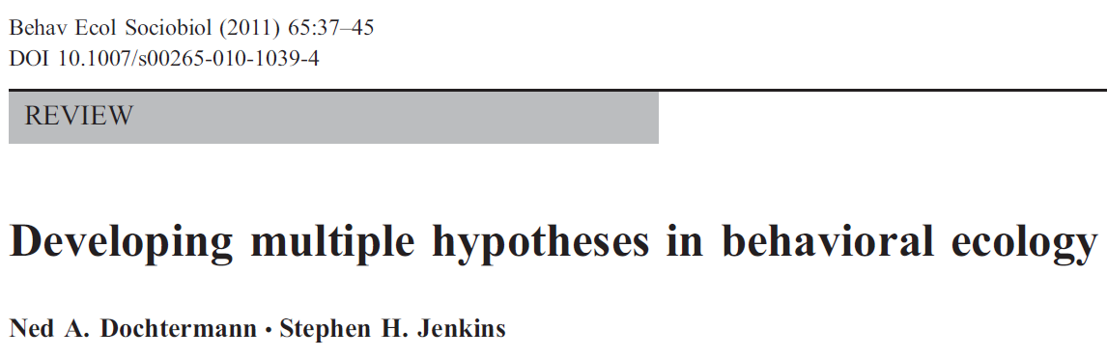
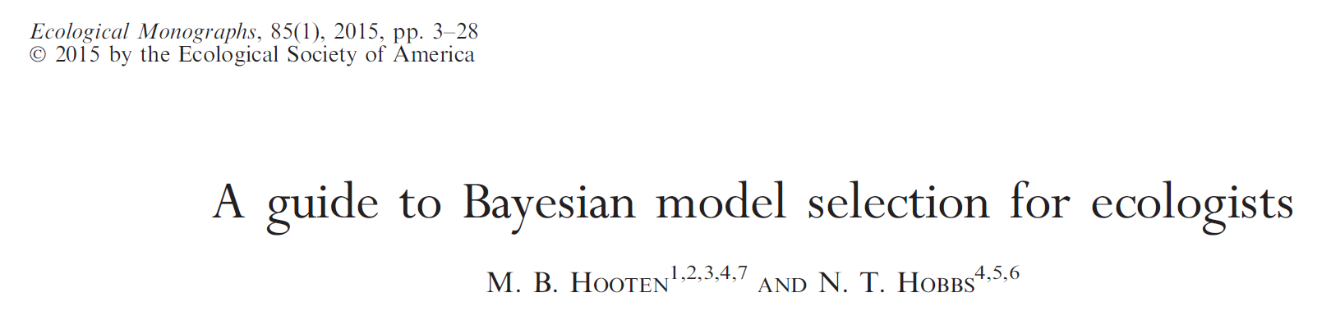
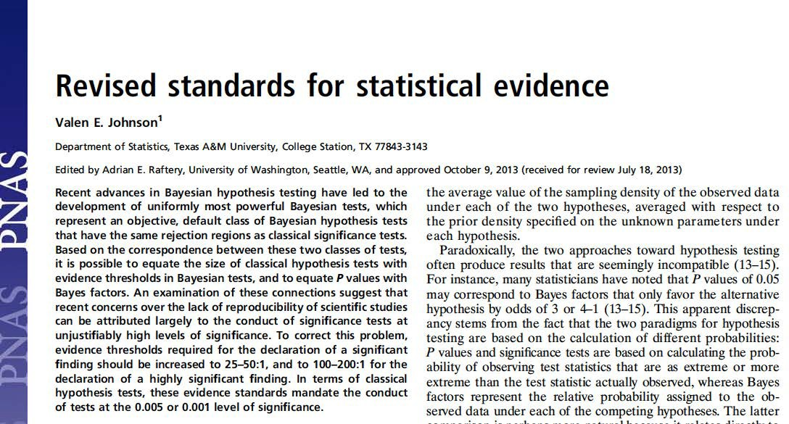
Suggested reading
Dochtermann, N.A., Jenkins, S.H., 2011. Developing multiple hypotheses in behavioral ecology. Behavioral Ecology and Sociobiology 65, 37–45.
Hooten, M.B., Hobbs, N.T., 2015. A guide to Bayesian model selection for ecologists. Ecological Monographs 85, 3–28. https://doi.org/10.1890/14-0661.1
Johnson, V.E., 2013. Revised standards for statistical evidence. Proc Natl Acad Sci U S A 110, 19313–19317. https://doi.org/10.1073/pnas.1313476110

Slide 43
Should we re-think conventional standards?

