Slide 1

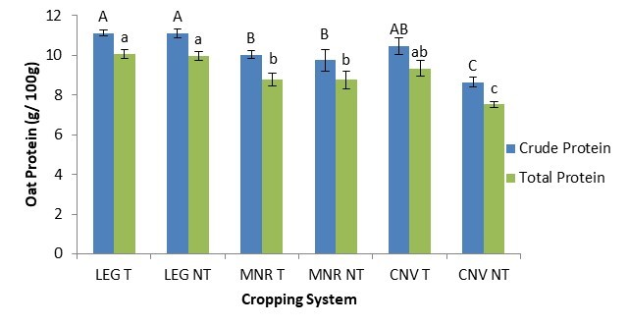



C7041 Experimental Design and Analysis
Ed Harris

Slide 2
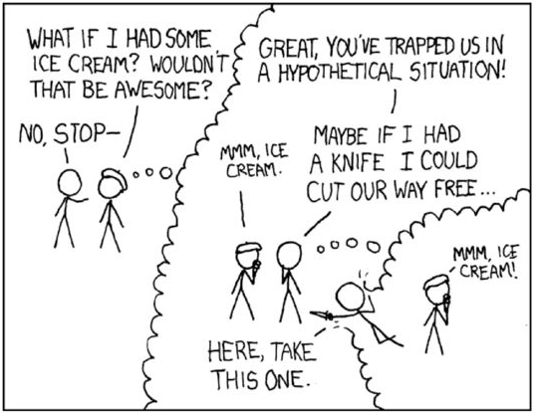
2.10: Bootstrap

Slide 3
Outline
Estimation and hypothesis testing
Permutation test
Estimation
The sampling distribution
The bootstrap standard error
The bootstrap confidence interval
Comparing two groups
Summary

Slide 4
Estimation and hypothesis testing
In conventional data analysis we carry out two types of statistical inference. Each is founded on a different sampling distribution.
Estimation
Sampling distribution of an estimate. The values for a parameter estimate we might obtain, when sampling from a population, and their probabilities. It is used to obtain standard errors, confidence intervals. (Most statistical methods we use assume that the sampling distribution has an approximately normal distribution.)
Hypothesis testing
Null sampling distribution (or null distribution). The probability distribution of a test statistic if the null hypothesis is true. We frequently use the t, F, χ², and normal distributions to approximate null distributions, from which P-values are calculated.

Slide 5
Estimation and hypothesis testing
Q: What to do if the assumptions of the best method available are violated, and we cannot turn to linear or generalized linear models (because their assumptions are also violated)?
A: Computer-intensive methods.
An approach in which the power of the computer is used to generate a sampling distribution.
Estimation: The bootstrap.
Hypothesis testing: The permutation test.

Slide 6
Permutation test
A permutation test generates a null distribution for a statistic measuring the association between two variables (or difference between groups) by repeatedly and randomly rearranging the values of one of the variables.
Rank tests, such as the Mann-Whitney U-test for two samples, are permutation tests. The data are first replaced by their ranks, and then the ranks are permuted to generate a null distribution. The exact probability distribution of U is known.
But there’s no need to replace the data with the ranks. Permute the data themselves. No known probability distribution is available, so we used the computer to generate a large number of permutations instead.

Slide 7
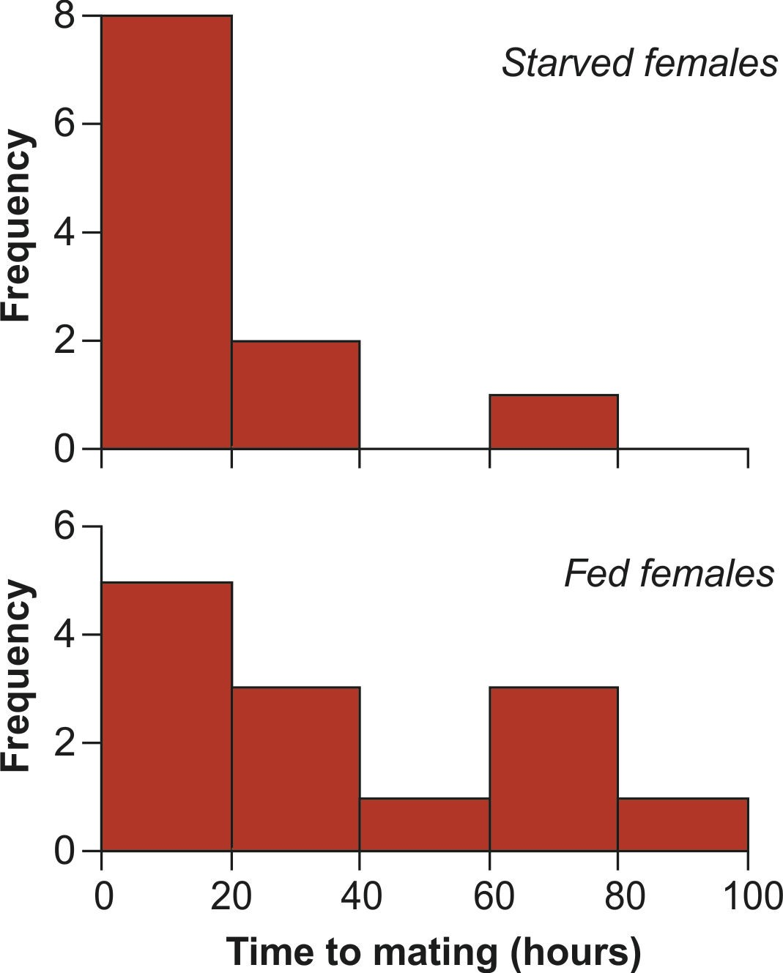
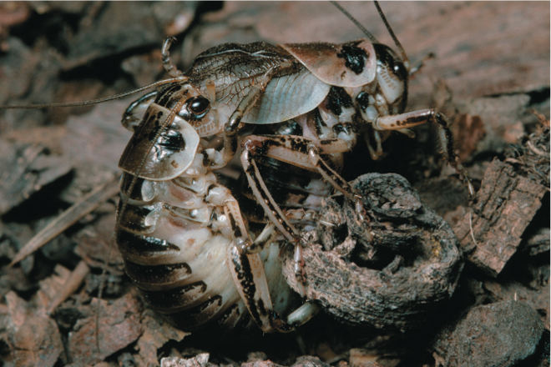
Permutation test example
During mating in the sage cricket, Cyphoderris strepitans, the male offers his fleshy hind wings to the female to eat. Females get some nutrition from feeding on the wings, which raises the question, “Are females more likely to mate if they are hungry?” Johnson et al. (1999) addressed this question by randomly dividing 24 females into two groups:
One group of 11 females was starved for at least two days.
Another group of 13 females was fed during the same period.
Each female was put separately into a cage with a single (new) male, and the waiting time to mating was recorded. The data are clearly not normally distribution.

Slide 8
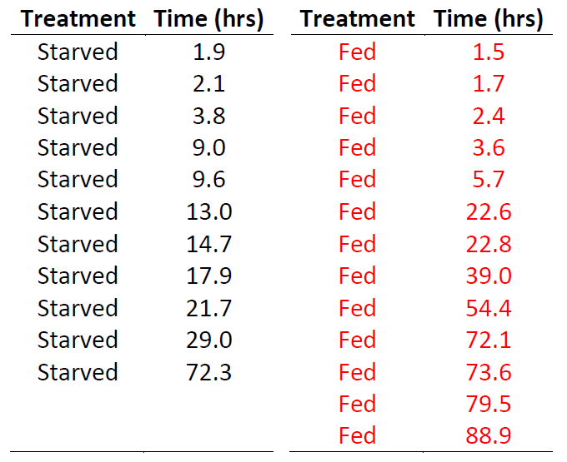
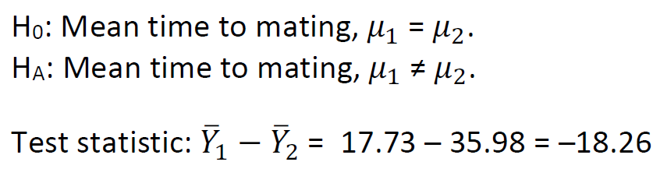
Permutation test example
The data:

Slide 9
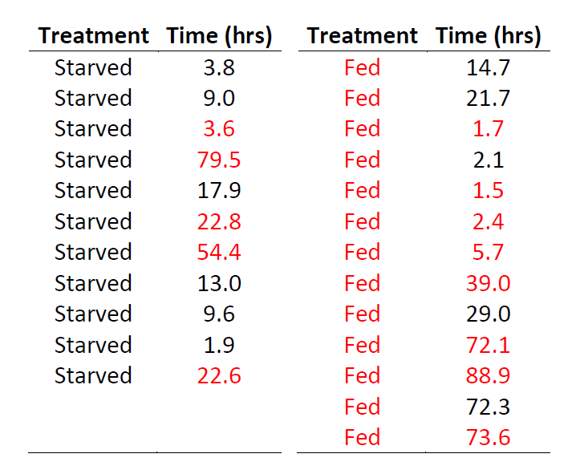
Permutation test example
Outcome of a single permutation:

Slide 10
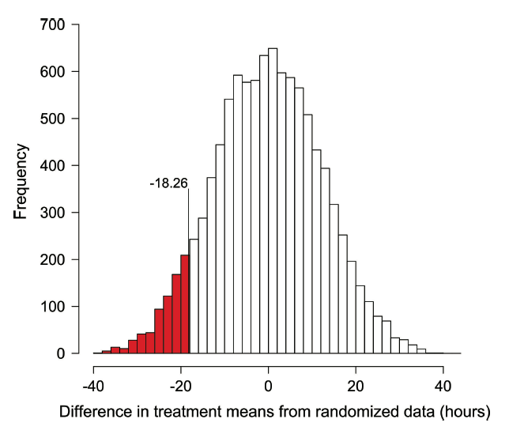
Permutation test example
Results of 10,000 permutations: The null distribution of 𝑌%" − 𝑌%#
P = 2 × 0.0712 = 0.1424

Slide 11
Permutation test assumptions
Random samples
To compare means or medians between groups, permutation tests assume that the distribution of the variable has the same shape in every population.
Permutation tests are robust to departures from the equal-shape assumption when sample sizes are large (more so than the Mann-Whitney U-test).
Permutation tests have lower power than parametric tests when the sample size is small, but they are more powerful than the Mann-Whitney U-test. They have similar power to parametric tests when sample size is large.

Slide 12
Why permutation tests (or rank tests) are not enough on their own:
Parametric methods provide estimates (with standard error or confidence interval) of a useful parameter.
Nonparametric tests, including permutations tests and rank tests, provide only a P-value. They do not provide estimates of magnitudes (effect sizes) with standard errors or confidence intervals.
Nonparametric tests, including permutations tests and rank tests, perpetuate the myth that the P-value is all you need from the data, and that the smallness of the P-value is an indication of the importance of an effect.
As our readings and discussions have stressed, the P-value in fact tells us nothing about magnitudes of effects or biological importance. No decision should ever be made on the basis of a P-value alone.

Slide 13
Why to love the bootstrap:
Primarily used for estimation.
Provides standard errors and confidence intervals of useful parameters.
The method is nonparametric, so doesn’t require normally-distributed data, or data having any other particular distribution.
It can be applied to virtually any population parameter, including means, proportions, and linear model coefficients.
It is most handy when there is no ready formula for a standard error or confidence interval (e.g., median, trimmed mean, eigenvalue).
It even works also for estimates based on complicated sampling procedures or calculations (for example, it is used in phylogeny estimation).

Slide 14
To understand the bootstrap, let’s review how estimation works
Estimation is the process of inferring a population parameter from sample data.
The value of a sample estimate is almost never the same as the parameter in the population because of random sampling error (chance).
The sampling distribution of an estimate gives all the values we might have obtained from our sample, and their probabilities of occurrence.
The standard error of an estimate is the standard deviation of its sampling distribution. No estimate is useful unaccompanied by its standard error, or by its corresponding confidence interval.

Slide 15
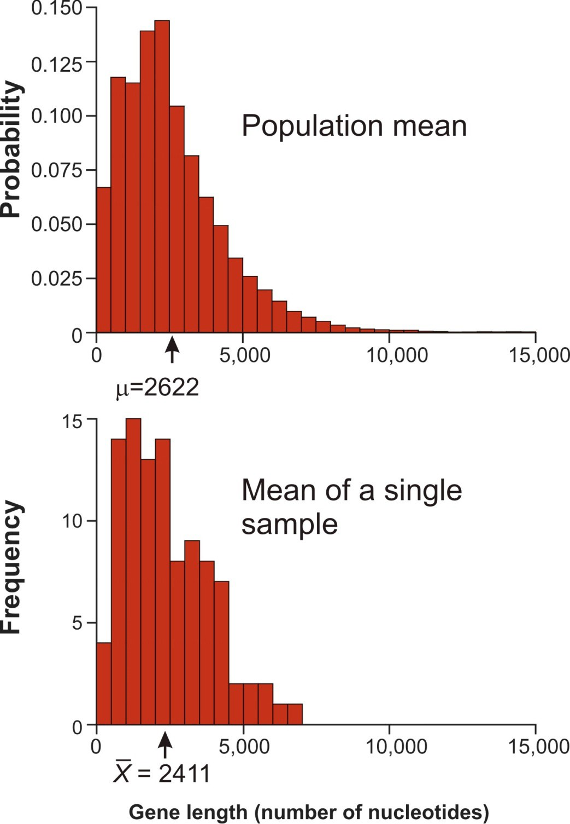
Example: Estimate a mean
What we want:
The mean of a variable in the population (e.g., the lengths of all the genes in the human genome).
What we have instead:
The sample mean (e.g., based on a random sample of n = 100 genes)

Slide 16
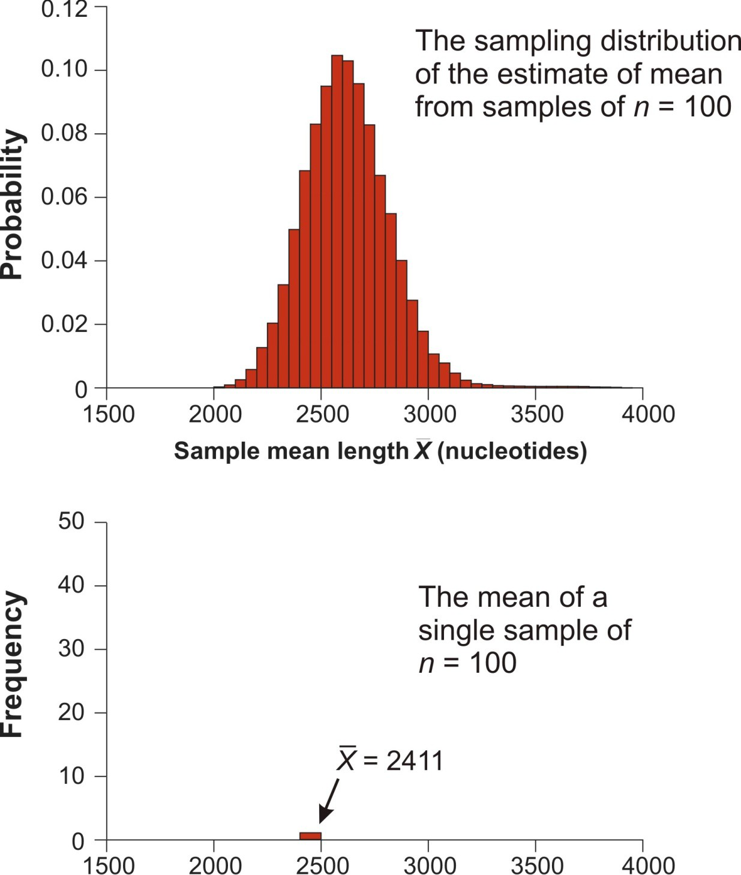
The sampling distribution
Since we don’t have the true mean, we need an approximation of the sampling distribution, giving all possible values of the estimate and their probabilities.
What we have instead: Just one sample mean

Slide 17
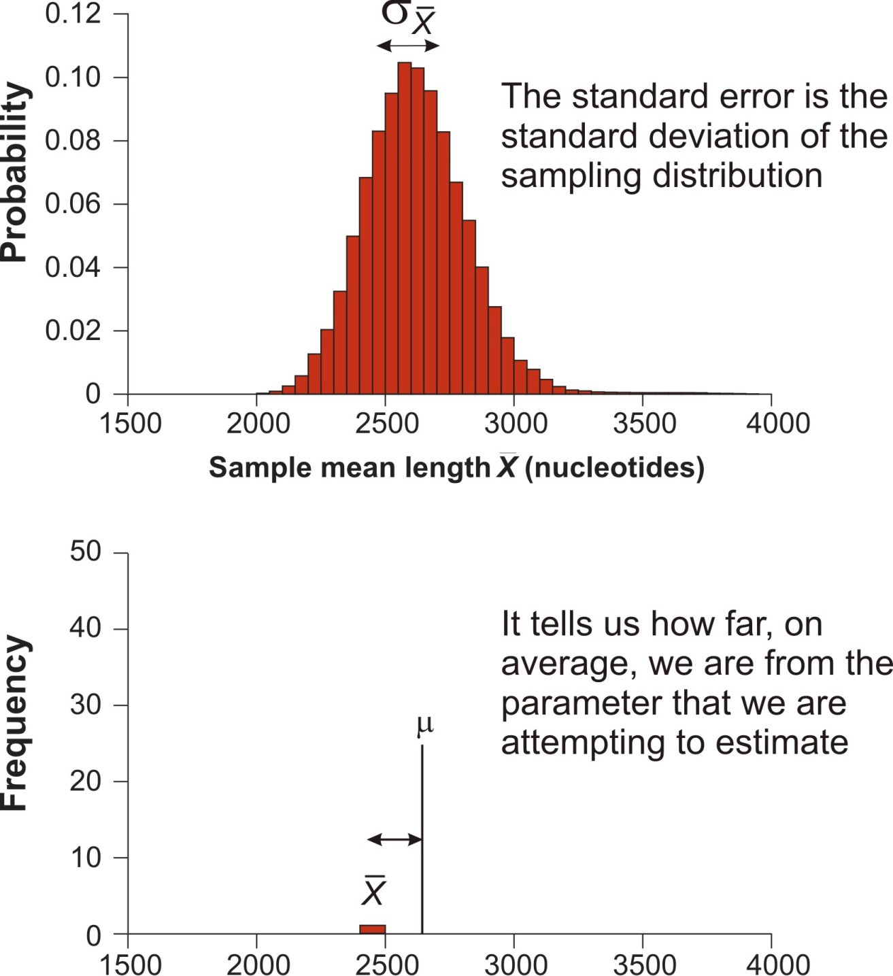
Standard error
The standard deviation of the sampling distribution (the standard error) measures the variation of sample estimates around the population parameter.
Roughly, the standard error tells us how far we are from the truth, on average.

Slide 18
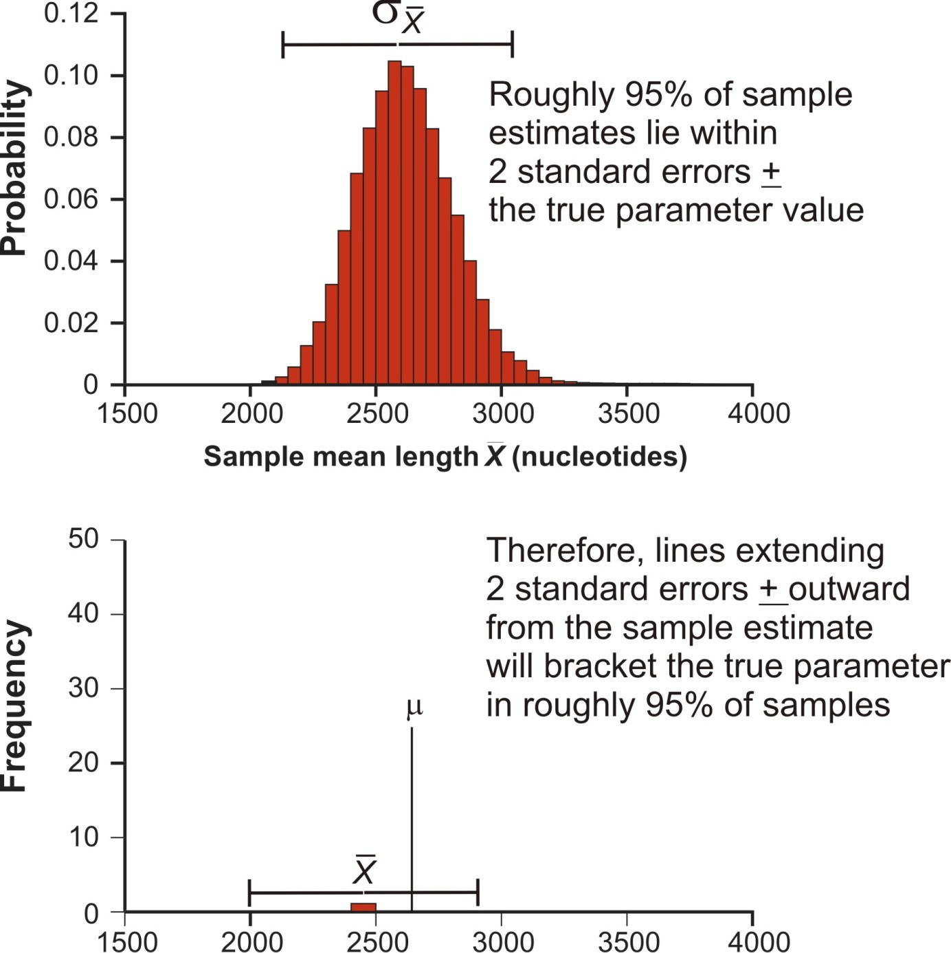
Standard error
If the sampling distribution is roughly bell-shaped, then about 95% of estimates fall within 2 SE’s of the population parameter.
Twice the SE therefore provides an approximate 95% confidence interval for the parameter.

Slide 19
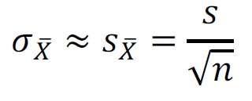


Standard error of the sample mean has a remarkable property
It can be estimated from a single sample!
is the estimated standard error. It is usually called simply the “standard error of the mean” (SE).
This is an unusual feature of
No assumptions about normality are required
The assumption of normality is nevertheless required for the 95% confidence interval.

Slide 20

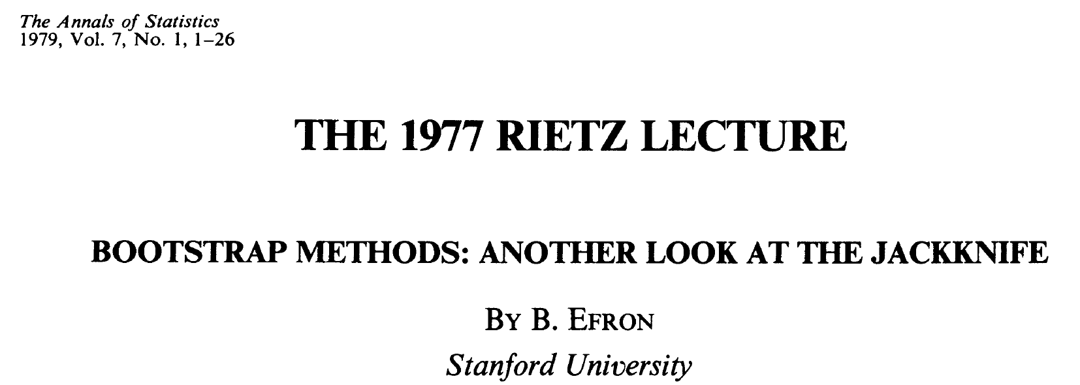
Standard error of the sample mean has a remarkable property
Sadly, most other kinds of estimates do not have this amazing property.
What to do?
One answer: Make your own sampling distribution for the estimate using the “bootstrap”
Method invented by Efron (1979)

Slide 21
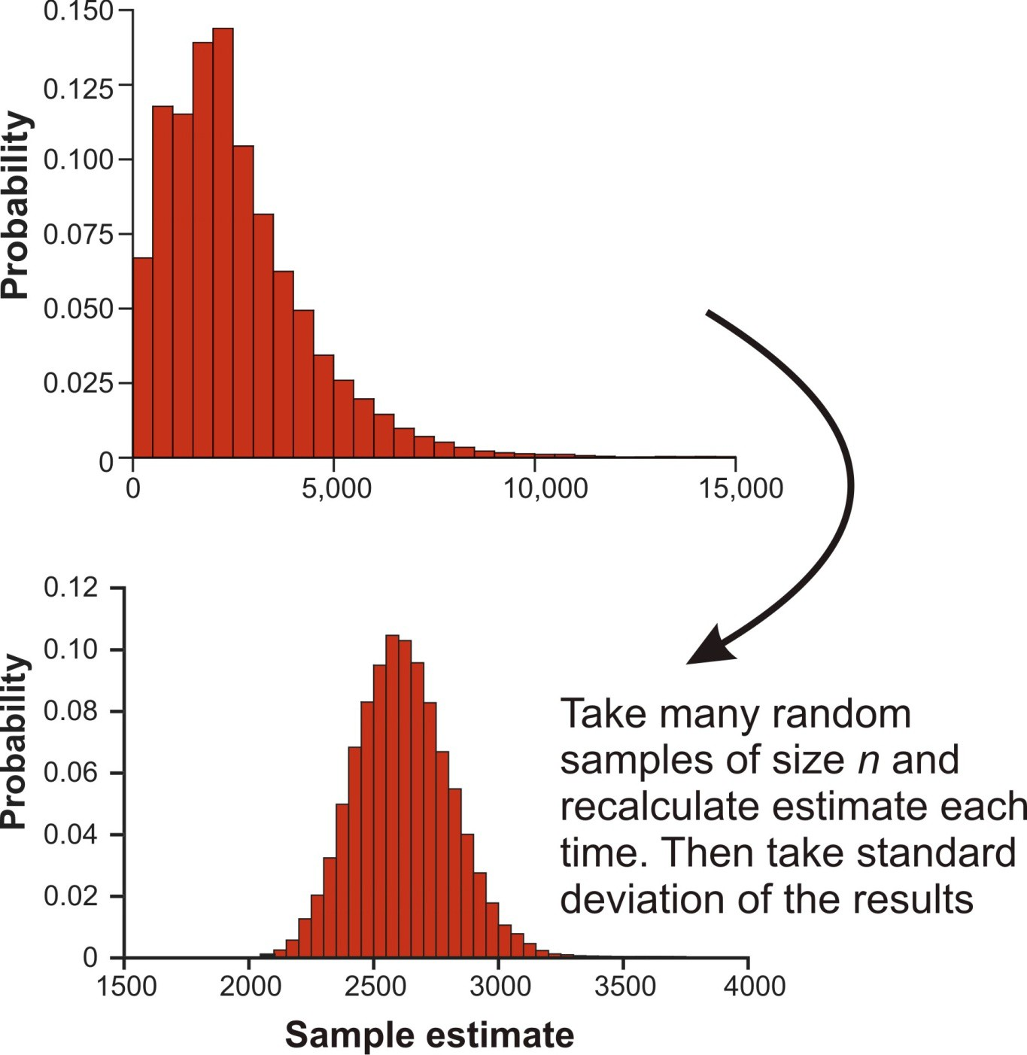
The real sampling distribution
To get real sampling distribution, sample many times from the same population.
Calculate SE as the standard deviation of the resulting sampling distribution
But we only have one sample, and so only one estimate.
Oh dear!

Slide 22
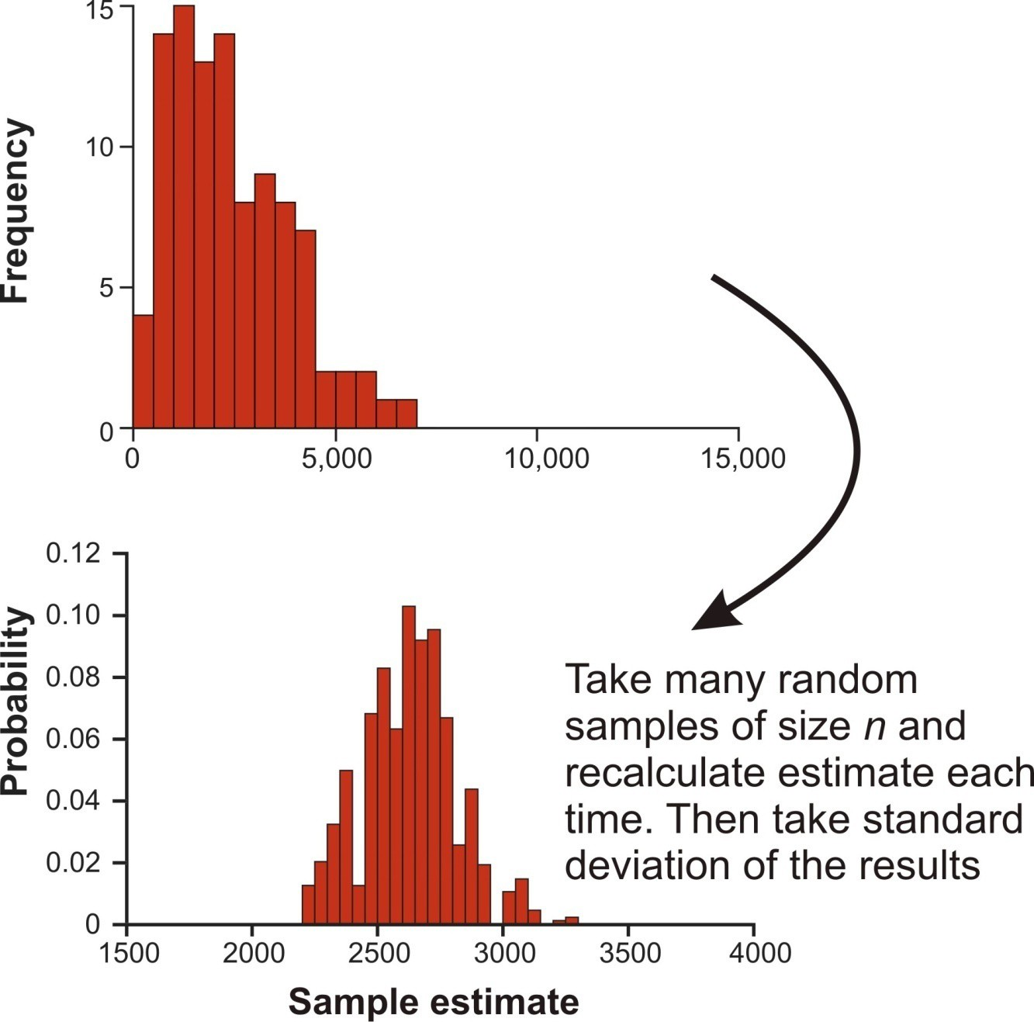
The bootstrap sampling distribution is the next best thing
Pretend the data represent the population! Sample many times from the single sample instead!
Sampling is “with replacement” so each new bootstrap sample is missing some values from the data and has duplicates of others.
The standard deviation of results yields the bootstrap standard error

Slide 23
The bootstrap algorithm
Use the computer to take a random sample of n individuals from the original data. The bootstrap sample should contain the same number of individuals as the original data: n. Each time an observation is chosen, it is left available in the data set to be sampled again (“sampling with replacement”).
Calculate the statistic (estimate) of interest using the measurements in the bootstrap sample from step 1. This is the first bootstrap replicate estimate.
Repeat steps 1 and 2 many times (10,000). The frequency distribution of all bootstrap replicate estimates approximates the sampling distribution of the estimate.
Calculate the sample standard deviation of all the bootstrap replicate estimates obtained in step 3.
The resulting quantity is called the bootstrap standard error.

Slide 24
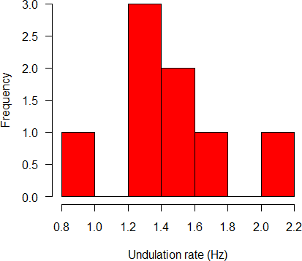

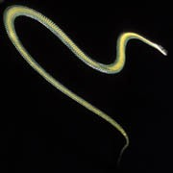
Bootstrap example: sample mean
Data: Measurements of undulation rate (Hz) of paradise tree snakes (Socha, J. J. 2002. Gliding flight in the paradise tree snake. Nature 418: 603−604)
n = 8 snakes*
0.9, 1.2, 1.2, 1.3, 1.4, 1.4, 1.6, 2.0
*The bootstrap is not advised for sample sizes this small, but I use it here to illustrate

Slide 25
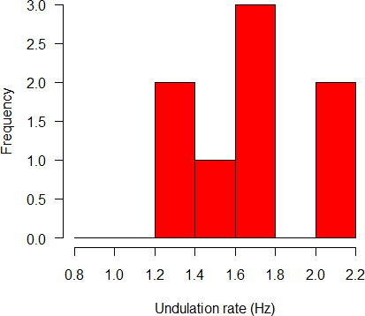
Bootstrap example: sample mean
hertz <- c(0.9,1.2,1.2,1.3,1.4,1.4,1.6,2.0)
1. Use the computer to take a random sample of individuals from the original data
xboot <- sample(hertz, replace = TRUE) xboot
[1] 2.0, 1.3, 1.6, 1.2, 1.6, 1.4, 1.6, 2.0
Histogram of the first bootstrap sample:

Slide 26
Bootstrap example: sample mean
2. Calculate the statistic (estimate) using the measurements in the bootstrap sample from step 1. This is the first bootstrap replicate estimate.
mean(xboot) 1.5875
Save the result from the first bootstrap sample:
z <- vector()
z[1] <- mean(xboot)

Slide 27
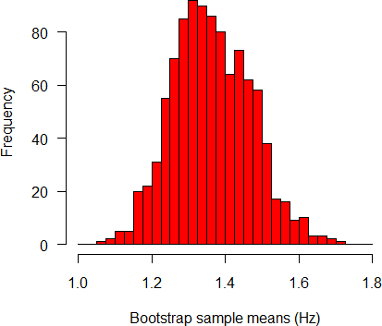
Bootstrap example: sample mean
3. Repeat steps 1 and 2 a large number of times (I used B = 1000).
xboot <- sample(hertz, replace=TRUE) z[2]
xboot z[3] <-
…
<- mean(xboot)
<- sample(hertz, replace=TRUE)
mean(xboot)
z[1000] <- mean(xboot)
Better idea: create a loop in R to accomplish the repeats.
Plot of the bootstrap sampling distribution:

Slide 28
Bootstrap example: sample mean
4. The bootstrap standard error is the standard deviation of all the bootstrap replicate estimates obtained in step 3.
sd(z) 0.1070
How does it compare with the ordinary formula for the standard error of the mean?
sd(hertz)/sqrt(length(hertz)) 0.1146
The bootstrap SE is a little smaller (a consequence of very
small sample size) but surprisingly close, considering how we got it.

Slide 29
The bootstrap can also be used to calculate a confidence interval
Incredibly, the 2.5th and 97.5th percentiles of the bootstrap sampling distribution are an approximate 95% confidence interval. No transformations or normality assumptions needed.
Level Percentile 95% ( 1.175, 1.600 )
Compare with results from using the conventional formula with the
t-distribution:
95 percent confidence interval: 1.104 1.646

Slide 30
Bootstrap confidence intervals
This “percentile” method of obtaining bootstrap confidence intervals works well if the sampling distribution is symmetric and unbiased.
Improved, bias-corrected and accelerated (BCa) confidence intervals improve accuracy when sampling distributions are skewed and/or biased (we will see an example in the workshop).

Slide 31
Difference between two (or more) groups
Procedure is similar, but now we resample both groups
Use the computer to take a random sample of the data (with replacement, same sample sizes) from each group.
Calculate the difference between the two bootstrap samples from step 1.
Repeat steps 1 and 2 a very large number of times (≥1000)
Calculate the sample standard deviation of all the bootstrap replicate estimates obtained in step 3.
The result is the bootstrap standard error of the difference

Slide 32

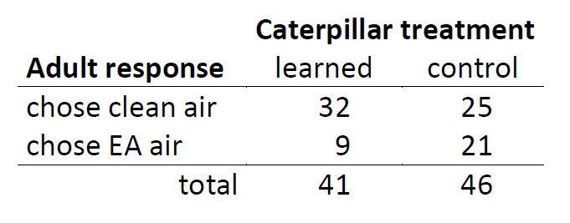
Bootstrap example: odds ratio to compare proportions
5th instar Manduca sexta caterpillars trained to associate a mild electrical shock with a specific odor (ethyl acetate; EA). Then assayed for learning in a Y-choice apparatus as larvae and again as adult moths, after metamorphosis (Blackiston et al. 2008. Retention of memory through metamorphosis: can a moth remember what it learned as a caterpillar? PLoS ONE 3: e1736)

Slide 33
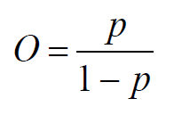
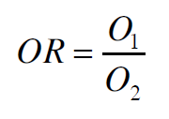
Bootstrap example: odds ratio to compare proportions
We’ll use the odds ratio to measure association between caterpillar treatment and adult response (difference between the proportions)
Odds: if we have a series of independent trials in which the probability of success in any one trial is p, then the odds of success is
If O = 1, the we say that the “the odds are one to one”
(recall: log odds is how we modeled a proportion using glm())
Odds ratio: Compares the odds of success under two treatments:

Slide 34

Bootstrap example: odds ratio to compare proportions
For the caterpillar data,
learned:
p1 = 32/41 = 0.78
O1 = 0.78/0.22 = 3.56
control:
p2 = 25/46 = 0.54
O2 = 0.54/0.46 = 1.19
OR = O1/ O2 = 3.56/1.19 = 2.99
The odds of choosing the clean air in a trial are about three times greater in the treatment group (learned) than in the control group.

Slide 35
Bootstrap example: odds ratio to compare proportions
We want a standard error for this estimate and a 95% confidence interval for the true (population) OR.
Let 1 indicate “chose clean air”, and 0 indicate “chose EA air”.
Learn group: ( thirty two 1’s and nine 0’s )
1 1 1 1 1 1 1 1 1 1 1 1 1 1 1 1 1 1 1 1 1 1 1 1 1 1 1 1 1 1 1 1 0 0 0 0 0 0 0 0 0
Control group: ( twenty five 1’s and twenty one 0’s )
1 1 1 1 1 1 1 1 1 1 1 1 1 1 1 1 1 1 1 1 1 1 1 1 1 0 0 0 0 0 0 0 0 0 0 0 0 0 0 0 0 0 0 0 0 0
Step 1: take a random sample (with replacement) from each group Step 2: calculate OR
Step 3: repeat 1000 times

Slide 36
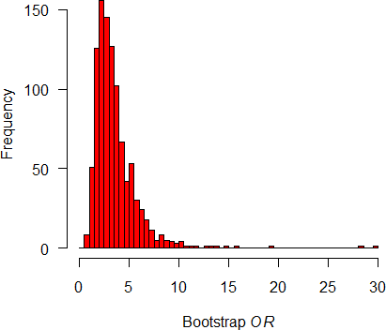
Bootstrap example: odds ratio to compare proportions
Bootstrap sampling distribution for OR:
Bootstrap SE = 2.26

Slide 37
Bootstrap example: odds ratio to compare proportions
Bootstrap 95% CI using the percentiles: 2.5% 97.5%
1.21 8.67
Bootstrap BCa (bias corrected and accelerated) 2.5% 97.5%
1.14 7.93
Compare with conventional approximate CI for odds ratio using formula
2.5% 97.5%
1.17 7.65
BCa corrects the percentiles for skewness in the sampling distribution, which otherwise results in the shape of the bootstrap sampling distribution changing with the estimate; and for bias in the estimate.

Slide 38
Summary
The bootstrap is amazing and useful for estimation.
It works in almost any situation (if n not too small).
It is approximate, though performs almost as well as parametric methods when assumptions of the parametric methods are met.
It can also be used for hypothesis testing, though I have not discussed this.
Permutation tests are useful for obtaining P-value but use the bootstrap to estimate magnitudes.

Slide 39
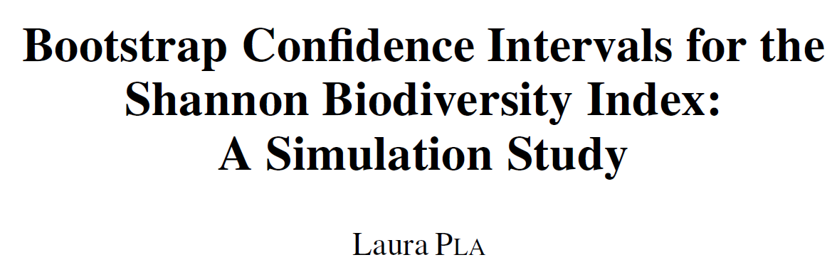
Suggested reading
Pla, L., 2004. Bootstrap Confidence intervals for the Shannon biodiversity index: A simulation study. JABES 9, 42. https://doi.org/10.1198/1085711043136

