Slide 1

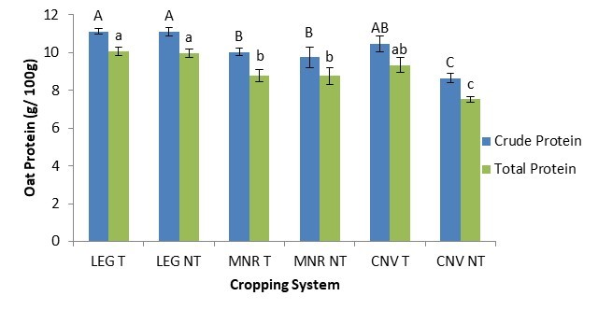



C7041 Experimental Design and Analysis
Ed Harris

Slide 2
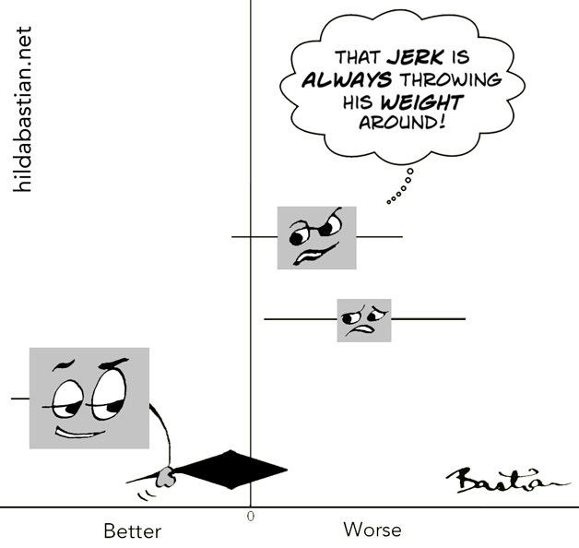
2.11: Meta-analysis

Slide 3
Outline
Meta analysis compared with traditional review article
Quantitative summaries vs. vote-counting
How to carry out a meta-analysis
Effect size
Fixed and mixed-effects
Associating effect sizes with relevant variables
Publication bias
Make your results accessible to meta-analysis

Slide 4
Scientific studies on a topic are often repeated
New studies improve/expand on previous studies, or examine the same issue in a different study system, or using different methods
Schoener et al. (1983) found 164 published field experiments on interspecific competition.
Gardner et al. (2003) obtained results from 51 separate studies reporting coral cover from 294 sites from across the Caribbean.
Bell et al. (2009) found 759 published estimates of the repeatability of behavior, from 114 studies of 98 species.
Vilà et al (2011) reviewed 199 articles reporting 1041 field studies describing the ecological impacts of 135 alien plant taxa.

Slide 5
A method is needed to summarize results from multiple studies
Dr. Benjamin Spock sold 50 million copies of Baby and Child Care 1950s -- 1990s. In it he wrote “I think it is preferable to accustom a baby to sleeping on his stomach from the beginning if he is willing”. Other pediatricians made similar recommendations.
From the 1950s into the 1990s, more than 100,000 babies died of sudden infant death syndrome (SIDS).
In the early 1990s, researchers realized that the risk of SIDS decreased by at least 50% when babies were put to sleep on their backs rather than face down.
Subsequent education campaigns led to a dramatic drop in the number of SIDS deaths.
However, research was available from 1970 that sleeping on the stomach was hazardous to babies. An earlier synthesis of the data could have got the answer much sooner.

Slide 6
Traditional approach is the review article
An expert in the field assembles the studies published on a topic, thinks about them carefully and (hopefully) fairly, and then writes a review article summarizing the overall conclusions reached.
A first-rate review article advances a field far beyond a mere summary.
It reviews and comments on the current state of thought and knowledge about a particular topic.
Such a review will propose new hypotheses, uncover previously unnoticed relationships, and point to new paths of research.

Slide 7
The traditional review lacks a quantitative method
This might lead to two problems
Bias.
In his 1986 book How to Live Longer and Feel Better, Linus Pauling (the only person to be awarded two unshared Nobel Prizes) cited 30 studies supporting his idea that large daily doses of vitamin C reduces the risk of contracting the common cold, but cited no studies opposing the idea, even though a number had been published. Not all reviews are so biased, but there are few rules regarding selection of studies for review.
Lack of a quantitative summary of research findings. Reviews don’t tell us about how large the effect is.

Slide 8

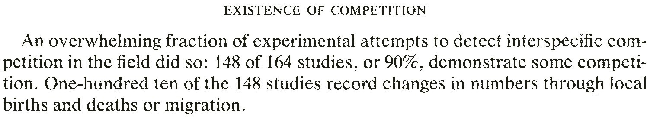
Vote-counting was a step in the right direction
Divide studies into two categories: those that yielded a statistically significant result supporting the research hypothesis, and those that did not. The proportions of studies ‘voting’ for or against the hypothesis are then counted.

Slide 9
Limitations of vote-counting
By counting only the statistically significant studies vote-counting ignores all the quantitative information about the magnitudes of effects.
Too conservative. “Votes” are affected by the power of individual studies, which may be weak.
Significance level by itself doesn’t indicate whether two or more studies obtained the same outcome.
The magnitude of the effect is downplayed.
It is difficult to quantify the effects of publication bias.
Method is unable to weigh the effect of studies differing in sample size, and therefore power.

Slide 10
Limitations of vote-counting
The Antiplatelet Trialists’ Collaboration (1994) conducted a meta-analysis of 142 randomized experiments testing whether taking aspirin or other antiplatelet medication following a stroke or myocardial infarction (“heart attack”) reduced the risk of future stroke. Total N > 70,000.
The vote: 19 of 142 studies showed a statistically significantly better result for patients on antiplatelet therapy than for the control patients. Two of the 142 studies showed a significantly worse rate of vascular events with aspirin treatment.
Yet 14.7% (5400/36,711) of patients in the control groups had subsequent vascular events, compared with 11.4% (4183/36,536) in the treated group. Small effect but real, according to meta-analysis methods. This conclusion saved many lives.

Slide 11
Meta-analysis, the “analysis of analyses”
Meta-analysis refers to the statistical synthesis of results from a series of studies (Borenstein et al 2009).
The method involves compiling all known scientific studies estimating an effect and quantitatively combining them to give an overall estimate of the effect.
Meta-analysis allows us to generalize. It lets us determine how frequent, how important, and how consistent effects are across a variety of systems.
Meta-analysis gets past the occasional sensational result (the one you read about in the newspaper) to an objective assessment of all the evidence.

Slide 12
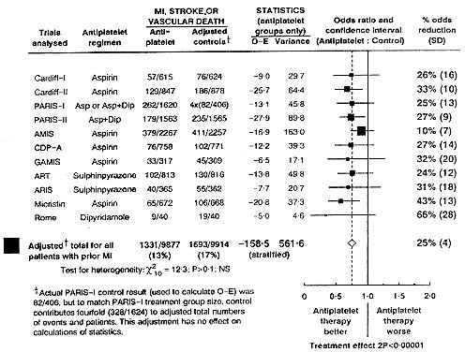
Meta-analysis, the “analysis of analyses”
Came from medical research, in which all studies are all of the same species (humans). Here is a “forest plot” from the Antiplatelet Trialists’ Collaboration.

Slide 13
Meta-analysis, the “analysis of analyses”
Ecologists and evolutionary biologists attempt to generalize across a much wider range of species and systems.
This is more challenging than studies carried out on a single species (e.g., humans).

Slide 14
Example 1: Meta-analysis of the Transylvania effect
Many people believe that a full moon can affect human behavior. The word lunacy is derived from the Latin luna, moon.
Legends of strange happenings, such as werewolves and vampires, have been connected to full moons for centuries.
Lord Blackstone, an 18th-century English jurist, was the first to define a condition of madness exacerbated by the lunar cycle: “A lunatic, or non compos mentis, is properly one who hath lucid intervals, sometimes enjoying his senses and sometimes not and that frequently depending upon the changes of the moon.”
Rotton and Kelly (1985) showed that 50% of university students believed that people act strangely during a full moon.
Vance (1995) reported that as many as 81% ofmental health professionals believed that the full moon alters individual behaviour.

Slide 15
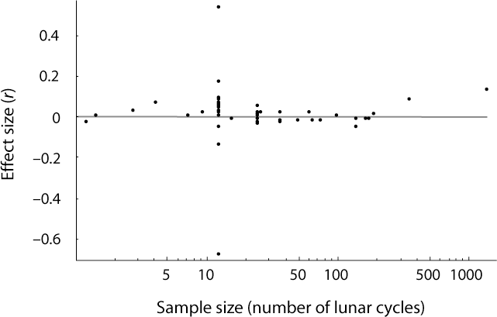
Example 1: Meta-analysis of the Transylvania effect
Rotton and Kelly (1985) carried out a meta-analysis of studies correlating homicide rates, psychiatric hospital admissions, suicide rates, crisis calls, etc. The average effect size r was smaller than 0.01.

Slide 16
Steps of a meta-analysis
Define the question and scope.
A narrow question applied to a homogeneous group? “Does aspirin reduce incidence of myocardial infarction?”
Or a heterogeneous set of studies or variables?
“How much genetic variation exists in populations for behavioral traits?”
Only experiments with controls and randomization? Only replicated experiments? Only experiments with blinding?
It may be best to adopt a reasonably wide scope and investigate later whether differences between methods lead to different effects overall.

Slide 17
Steps of a meta-analysis
Literature search, gather data.
Make it exhaustive to avoid bias.
Easily-found studies are different from those that we cannot find easily. Studies finding large, statistically significant effects are more likely to be published, more likely to be in “first-rate” journals, and more likely to be referenced in other articles.
Statistical techniques exist to account partially for publication bias (funnel plots) but they do not replace an exhaustive survey.
Decide whether to (hold your nose and) include studies of apparently poor quality. Failure to have well-defined criteria can lead to bias (we are more likely to discard a poor study if it disagrees with our pet hypothesis).

Slide 18
Steps of a meta-analysis
Ideally, the data obtained should all be independent, but non-independence of various sorts creeps in (e.g. multiple studies by the same lab).
A single study may provide measurements on multiple species, or measurements of multiple responses on the same species. Include them all or take a summary measure?
One or a small number of species (e.g., great tit) or systems (e.g., intertidal zone) may be overrepresented in the literature. Treat them all as independent?
It may be worse to leave data out, or take summary measures, than to throw every data point into the analysis.

Slide 19
Example 2: Testosterone vs aggression
Book et al. (2001) asked “Are testosterone levels and aggression correlated in human males?” It included a huge diversity of types of studies:
levels of testosterone in prisoners convicted of violent crimes compared to those of prisoners convicted of property crimes.
levels of testosterone in university students compared with their answers to questionnaires that asked them for levels of agreement to statements like “If somebody hits me, I hit back.”
levels of aggression in !Kung San males as determined by counting “their scars and sometimes still open wounds in the head region.”
drunken Finnish spouse-abusers compared to drunken Finns drinking quietly in a bar.
members of “rambunctious” fraternities compared to “responsible” fraternities.

Slide 20
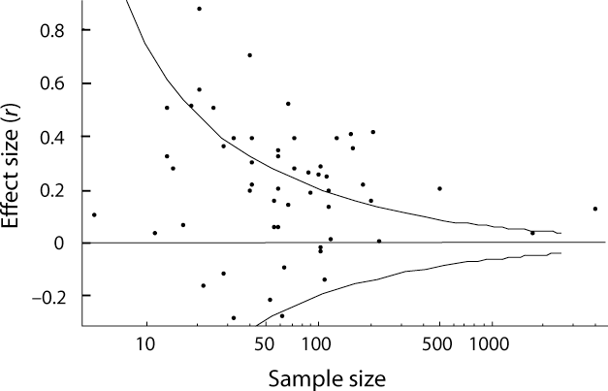
Example 2: Testosterone vs aggression
Below is the “funnel plot” of studies comparing human aggression to levels of testosterone. The curves show the approximate boundaries of the critical regions that would reject the null hypothesis in any one study with α = 0.05.

Slide 21

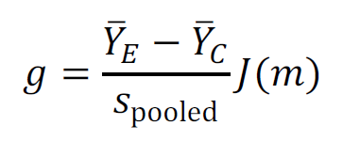
Steps of a meta-analysis
Calculate an effect size that can be combined across studies to produce a quantitative summary of the findings.
Correlation coefficient r is commonly used though not always ideal, because effect size depends on the range of the data.
Odds ratio – used in highly homogeneous studies (e.g., in tests of aspirin and myocardial infarctions).
Response ratio: or log of response ratio: ln(𝑅)
Standardized mean difference, Cohen’s d or Hedges’ g:
s is the pooled sample variance and J(m) is a small-sample bias correction.

Slide 22
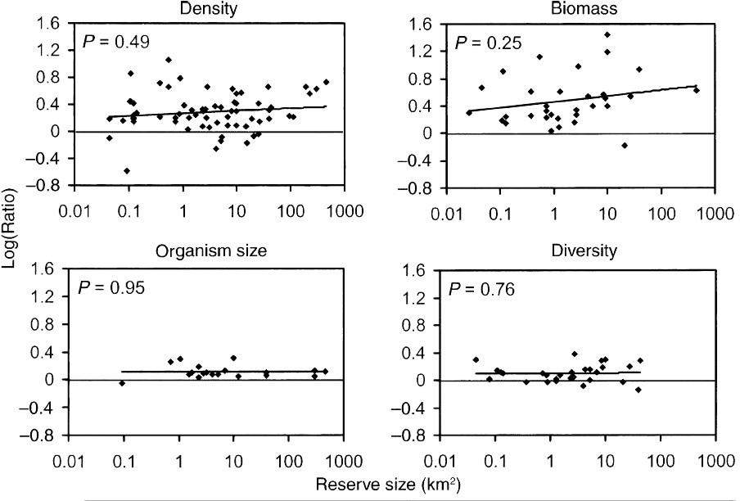
Example 3: Effectiveness of marine reserves
Halpern (2003) used the log of response ratio to compare marine reserves to comparison areas (or the same area before reserve establishment) in abundance and diversity of fish and/or invertebrates

Slide 23
Steps of a meta-analysis
Statistical inference on average effect size.
Fixed effects models
Most commonly used in medical studies.
Assumes that the multiple studies have the same mean, differing only because of sampling error. If every study were infinitely large, every study would yield an identical result. No heterogeneity among the studies.
Perhaps never justified unless all studies conducted similarly and on the same species. This is rarely the case in ecology and evolution.

Slide 24
Steps of a meta-analysis
Statistical inference on average effect size.
Random (mixed) effects models
Random variation is present among means of studies in addition to sampling error.
Individual studies are therefore estimating different treatment effects.
Most interest is focused on the central value, or mean, of the distribution of effects.
But the idea of a random effects meta-analysis is to understand the distribution of effects across different studies.

Slide 25
Steps of a meta-analysis
Fixed effect model
Effect size of each study i is Y_{i}
= Θ + ε_{i}
where Θ is the one “true” effect size.
Random effect model
Effect size of study i is Y_{i}
= μ + ζ_{i} + ε_{i}
where μ is the grand mean and ζ_{i} is the deviation of the “true” effect size of study
i from the grand mean.
The difference affects how each study is weighed when calculating the average effect size over all studies. We’ll do this in the workshop.
Unfortunately, lmer can’t be used for random effects meta-analysis in R, because it won’t calculate the necessary weights. Use packages available (e.g., metafor).

Slide 26
Steps of a meta-analysis
Look for effects of study quality. For example, are effect sizes different on average between studies that included blinding and those that did not?
Look for associations with variables that might explain heterogeneity of effect sizes among studies. For example, does the average effect size differ between studies carried out on women subjects and those on male subjects?

Slide 27
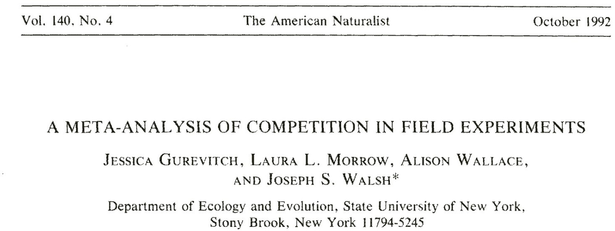
Example 4: Meta-analysis of competition in field experiments
Gurevitch et al (1992) study of inter- and intra-specific competition, looking only at studies published in 1980s

Slide 28
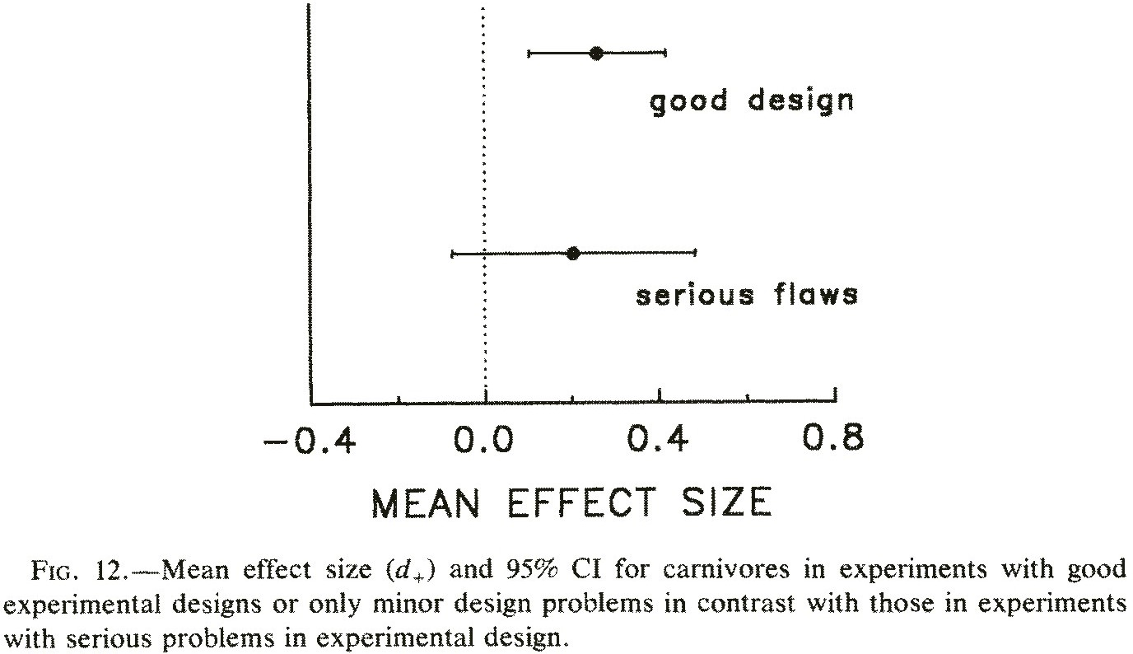
Example 4: Meta-analysis of competition in field experiments
They looked for effects of study quality

Slide 29
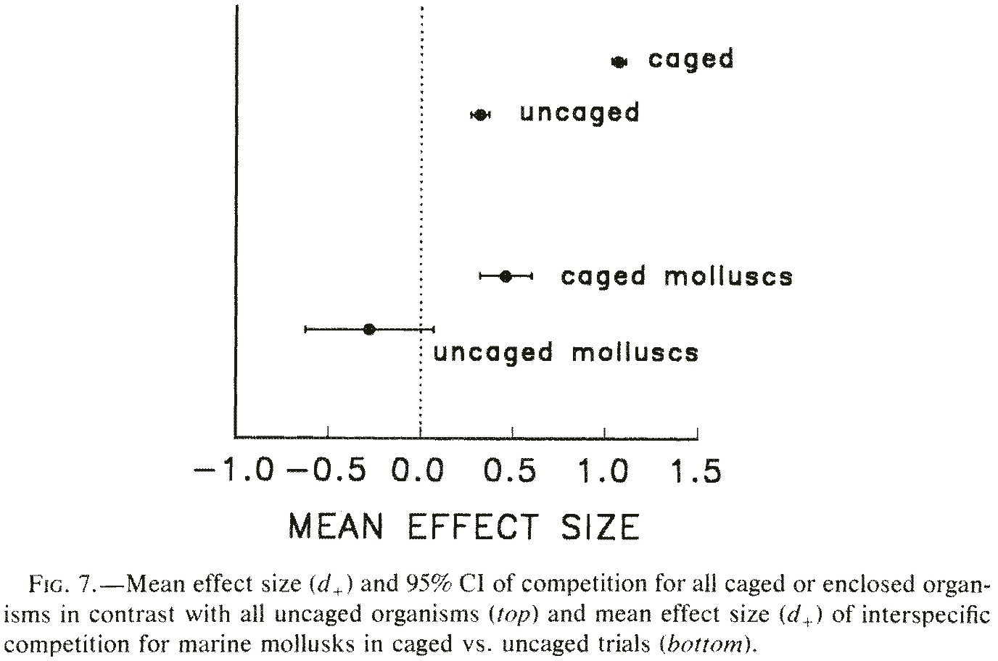
Example 4: Meta-analysis of competition in field experiments
They looked for associations with variables that might explain variation in effect size

Slide 30
File-drawer problem
In meta-analysis, the difficulties caused by publication bias are called the file- drawer problem, in reference to the unknown studies sitting unavailable in researchers’ file drawers or hidden in obscure journals.
The file-drawer problem is the possible bias in estimates and tests caused by publication bias.

Slide 31
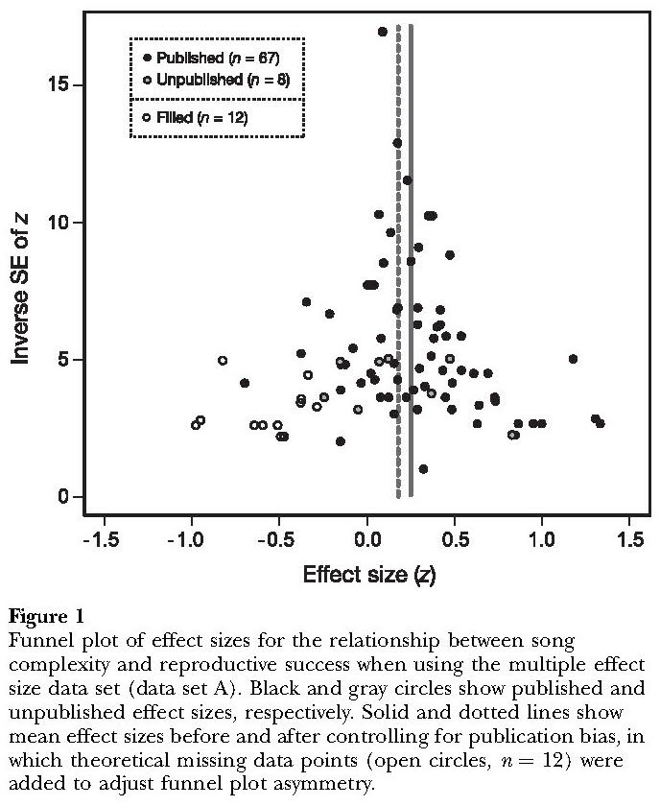
Funnel plot
Funnel plots can give an indication of the bias resulting from small studies.
Soma and Garamszegi (2011) used the Trimfill algorithm to fill in hypothetical missing studies in the funnel plot to
achieve theoretical symmetry.

Slide 32
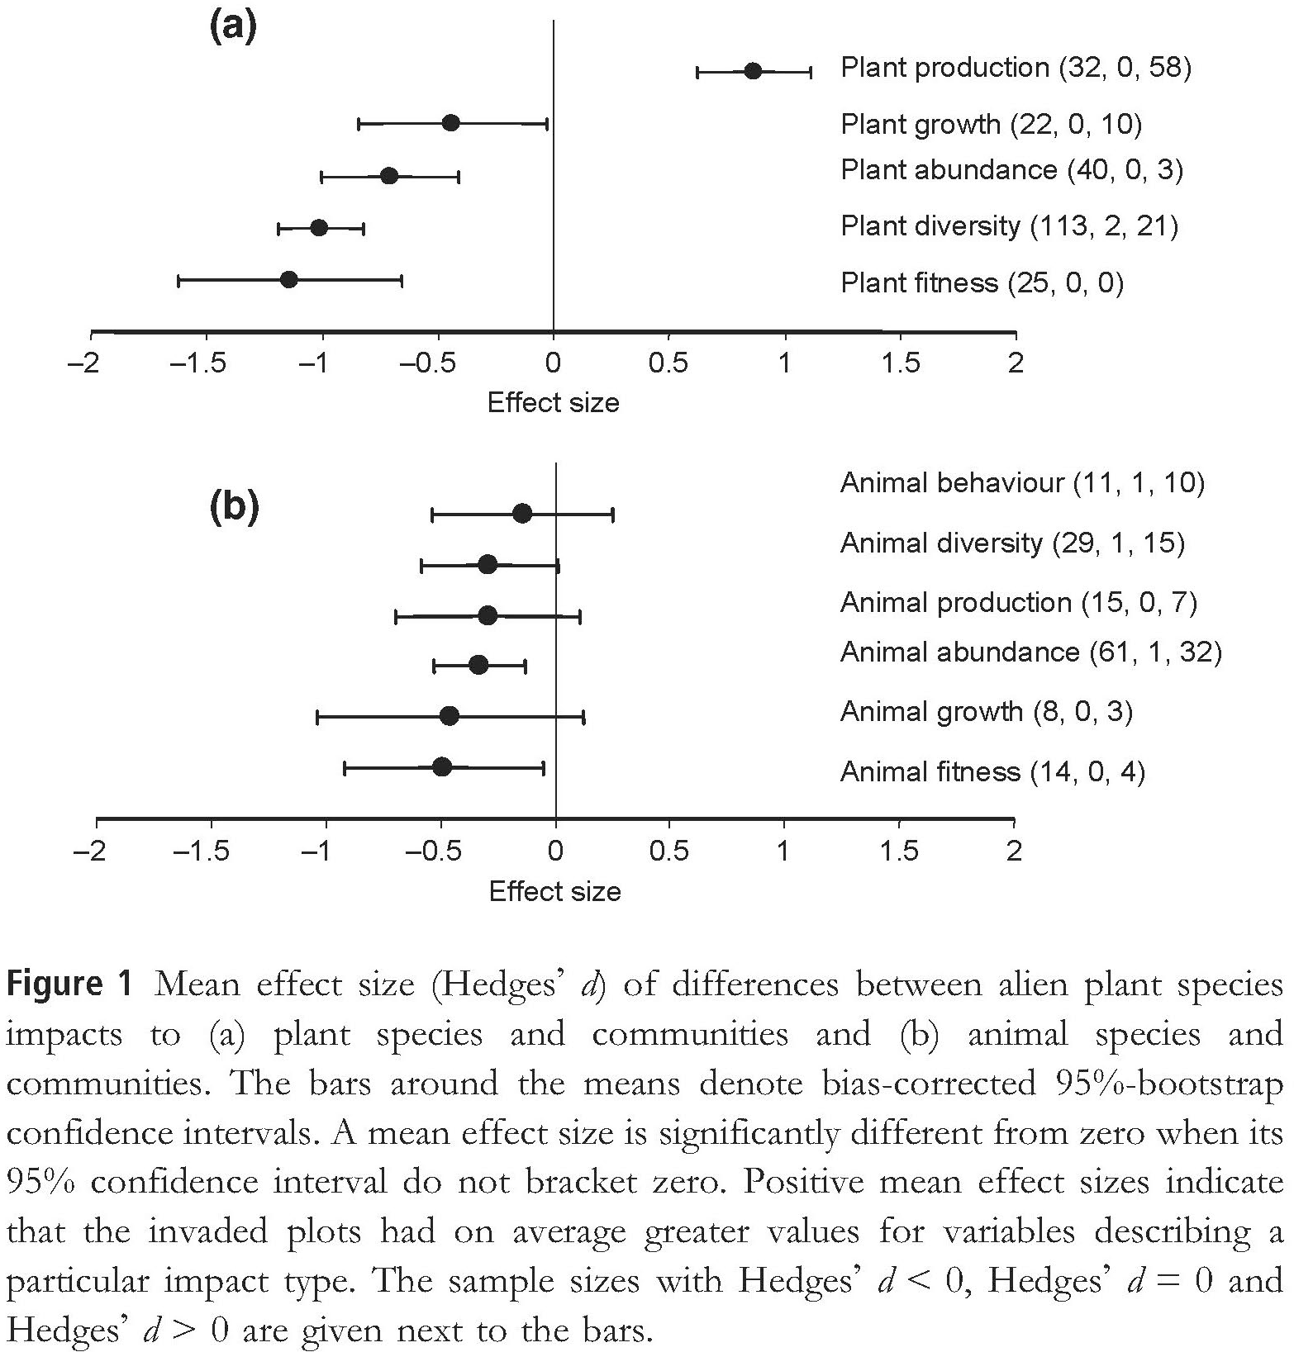
Fail-safe number
The fail-safe number calculates how many missing studies would be needed to change the overall result of the meta- analysis.
Vilà et al (2011) estimated the number of studies that would have to be added to change the results of their invasive plant meta-analysis from significant to non- significant as 37,689. This was too implausible, so they concluded that their estimates were reliable.
(Fig 1a: top line refers to total plant production; other lines are effects on native plants)

Slide 33
Make your results accessible to meta-analysis
Many published papers do not report enough information for meta-analysts to extract the numbers that they need. As a result, many otherwise relevant papers have to be discarded. Don’t let this happen to your work.
Always give sizes of effects and their standard errors. A P-value by itself is useless.
Give estimates of the means and standard deviations of the important variables.
Always indicate your sample sizes or degrees of freedom.
Make the data accessible. Publish the raw data in the paper or deposit to an online archive such as Dryad.

Slide 34
Consider a meta-analysis for your first thesis chapter
Often, the first chapter of a thesis is a review of the literature. If your review is a systematic review, and you kept track of the important quantities and feature of each study, you may have enough for a quantitative component – a meta-analysis.

Slide 35
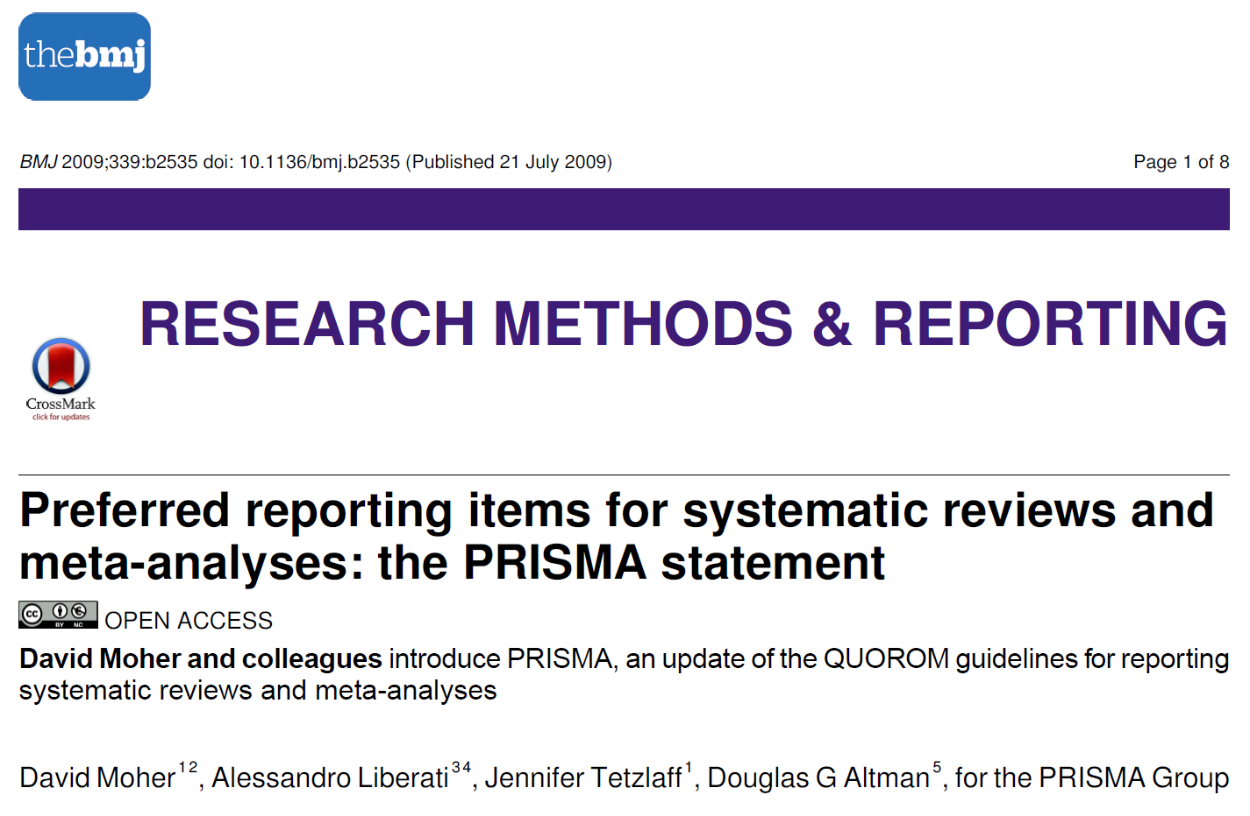
Best practices for reporting results of meta-analysis
Moher, D., Liberati, A., Tetzlaff, J., Altman, D.G., 2009. Preferred reporting items for systematic reviews and meta-analyses: the PRISMA statement. BMJ 339. https://doi.org/10.1136/bmj.b2535

Slide 36
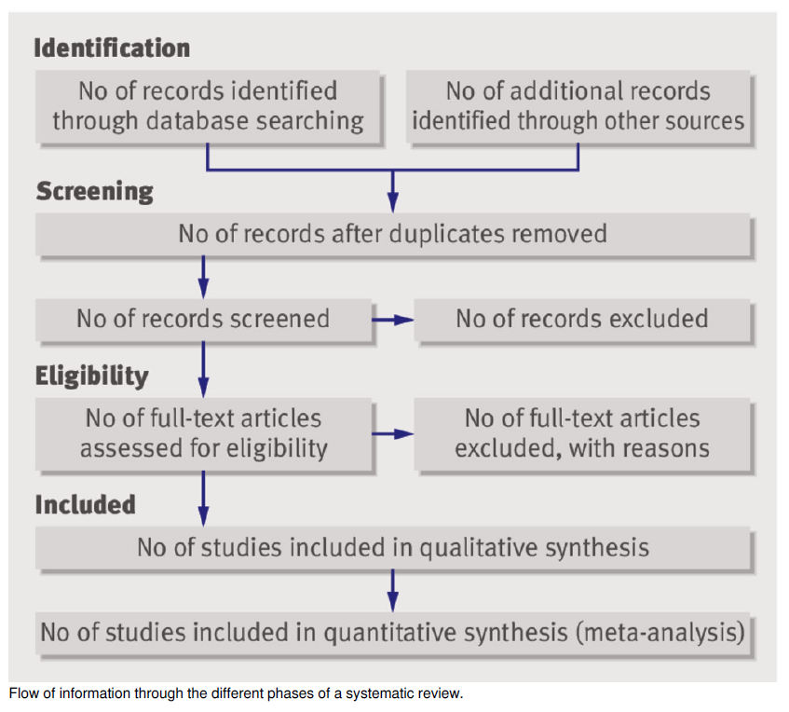
Best practices for reporting results of systematic review

Slide 37
Best practices for reporting results of meta-analysis
PRISMA detailed checklist
Section/topic | # | Checklist item | Reported on page #
TITLE
Title | 1 | Identify the report as a systematic review, meta-analysis, or both.
ABSTRACT
Structured summary | 2 | Provide a structured summary including, as applicable: background; objectives; data sources; study eligibility criteria, participants, and interventions; study appraisal and synthesis methods; results; limitations; conclusions and implications of key findings; systematic review registration number.
INTRODUCTION
Rationale | 3 | Describe the rationale for the review in the context of what is already known.
Objectives | 4 | Provide an explicit statement of questions being addressed with reference to participants, interventions, comparisons, outcomes, and study design (PICOS).
METHODS
Protocol and registration | 5 | Indicate if a review protocol exists, if and where it can be accessed (e.g., Web address), and, if available, provide registration information including registration number.
Eligibility criteria | 6 | Specify study characteristics (e.g., PICOS, length of follow-up) and report characteristics (e.g., years considered, language, publication status) used as criteria for eligibility, giving rationale.
Information sources | 7 | Describe all information sources (e.g., databases with dates of coverage, contact with study authors to identify additional studies) in the search and date last searched.
Search | 8 | Present full electronic search strategy for at least one database, including any limits used, such that it could be repeated.
Study selection | 9 | State the process for selecting studies (i.e., screening, eligibility, included in systematic review, and, if applicable, included in the meta-analysis).
Data collection process | 10 | Describe method of data extraction from reports (e.g., piloted forms, independently, in duplicate) and any processes for obtaining and confirming data from investigators.
Data items | 11 | List and define all variables for which data were sought (e.g., PICOS, funding sources) and any assumptions and simplifications made.

Slide 38
Risk of bias in individual studies | 12 | Describe methods used for assessing risk of bias of individual studies (including specification of whether this was done at the study or outcome level), and how this information is to be used in any data synthesis.
Summary measures | 13 | State the principal summary measures (e.g., risk ratio, difference in means).
Synthesis of results | 14 | Describe the methods of handling data and combining results of studies, if done, including measures of consistency (e.g., I²) for each meta-analysis.
Risk of bias across studies | 15 | Specify any assessment of risk of bias that may affect the cumulative evidence (e.g., publication bias, selective reporting within studies).
Additional analyses | 16 | Describe methods of additional analyses (e.g., sensitivity or subgroup analyses, meta-regression), if done, indicating which were pre-specified.
RESULTS
Study selection | 17 | Give numbers of studies screened, assessed for eligibility, and included in the review, with reasons for exclusions at each stage, ideally with a flow diagram.
Study characteristics | 18 | For each study, present characteristics for which data were extracted (e.g., study size, PICOS, follow-up period) and provide the citations.
Risk of bias within studies | 19 | Present data on risk of bias of each study and, if available, any outcome level assessment (see item 12).
Results of individual studies | 20 | For all outcomes considered (benefits or harms), present, for each study: (a) simple summary data for each intervention group (b) effect estimates and confidence intervals, ideally with a forest plot.
Synthesis of results | 21 | Present results of each meta-analysis done, including confidence intervals and measures of consistency.
Risk of bias across studies | 22 | Present results of any assessment of risk of bias across studies (see Item 15).
Additional analysis | 23 | Give results of additional analyses, if done (e.g., sensitivity or subgroup analyses, meta-regression [see Item 16]).
DISCUSSION
Summary of evidence | 24 | Summarize the main findings including the strength of evidence for each main outcome; consider their relevance to key groups (e.g., healthcare providers, users, and policy makers).
Limitations | 25 | Discuss limitations at study and outcome level (e.g., risk of bias), and at review-level (e.g., incomplete retrieval of identified research, reporting bias).
Conclusions | 26 | Provide a general interpretation of the results in the context of other evidence, and implications for future research.
FUNDING
Funding | 27 | Describe sources of funding for the systematic review and other support (e.g., supply of data); role of funders for the systematic review.

Slide 39


Suggested reading
Culina, A., Crowther, T.W., Ramakers, J.J.C., Gienapp, P., Visser, M.E., 2018. How to do meta-analysis of open datasets. Nat Ecol Evol 2, 1053–1056. https://doi.org/10.1038/s41559-018-0579-2
Lajeunesse, M.J., 2016. Facilitating systematic reviews, data extraction and meta-analysis with the metagear package for r. Methods in Ecology and Evolution 7, 323–330. https://doi.org/10.1111/2041-210X.12472

Slide 40
Meta-analysis of open datasets

