Slide 1
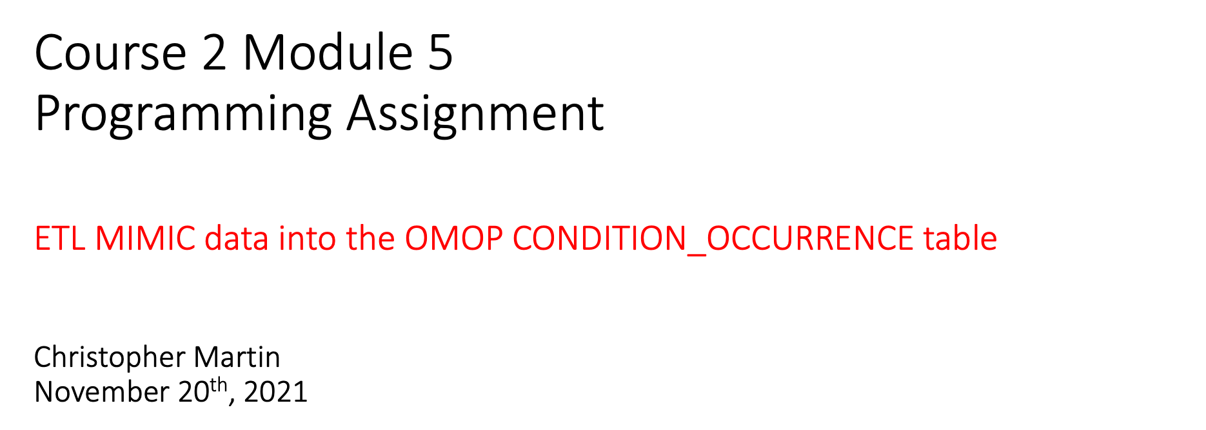

Slide 2
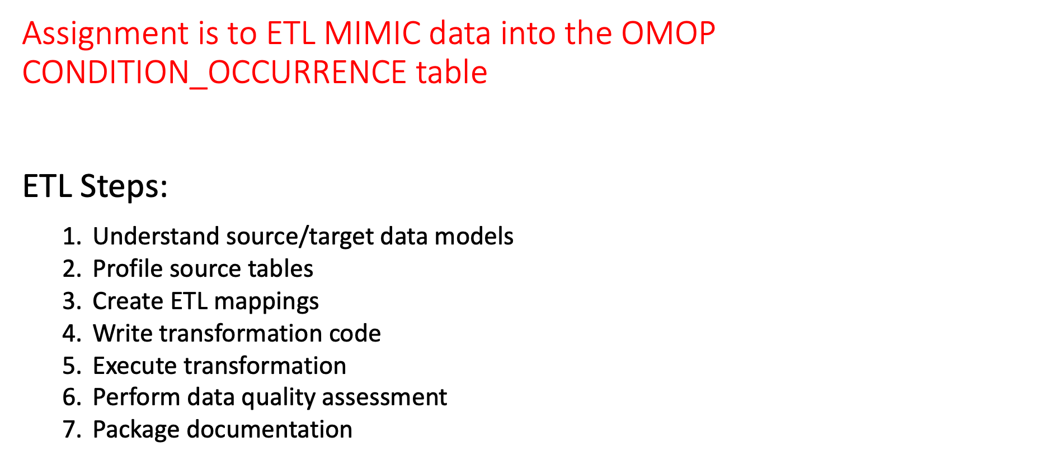
Notes:
This is an overview of the seven steps for ETL. The assignment focuses on Steps 1 thru 4 and Step 6

Slide 3
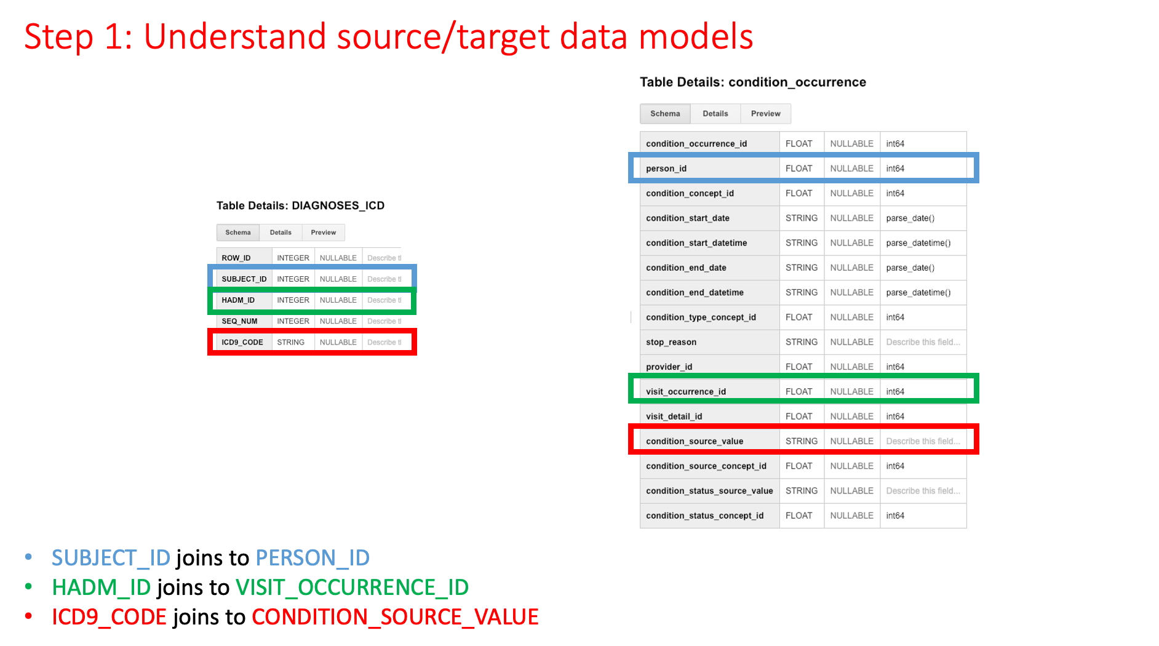

Slide 4
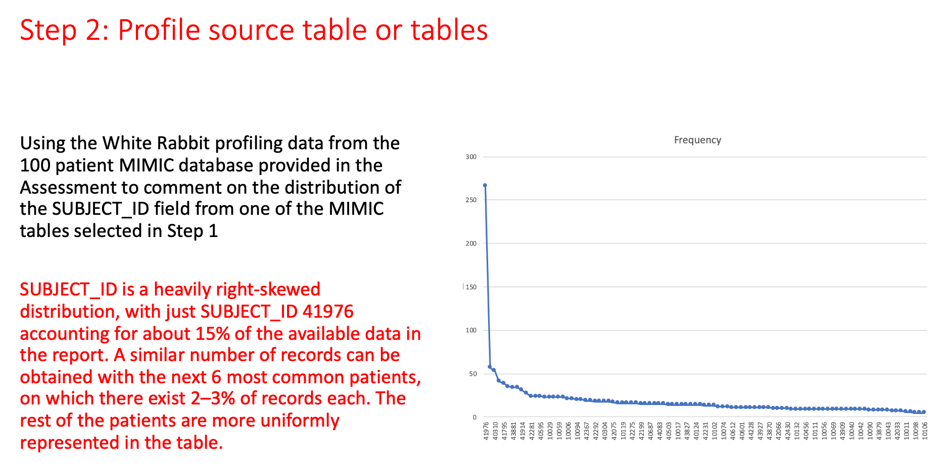

Slide 5
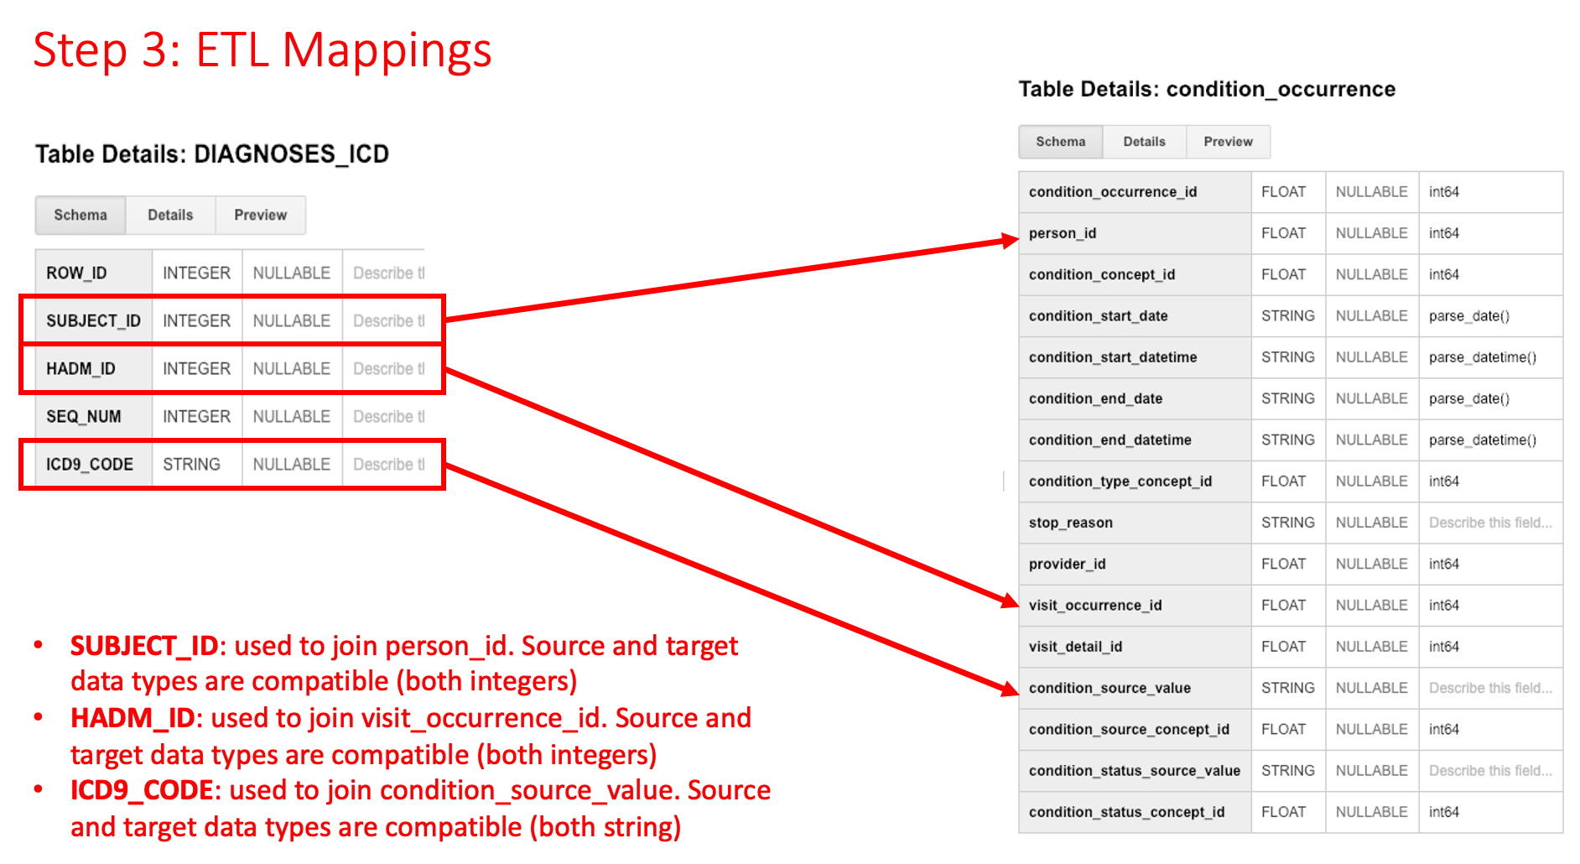

Slide 6
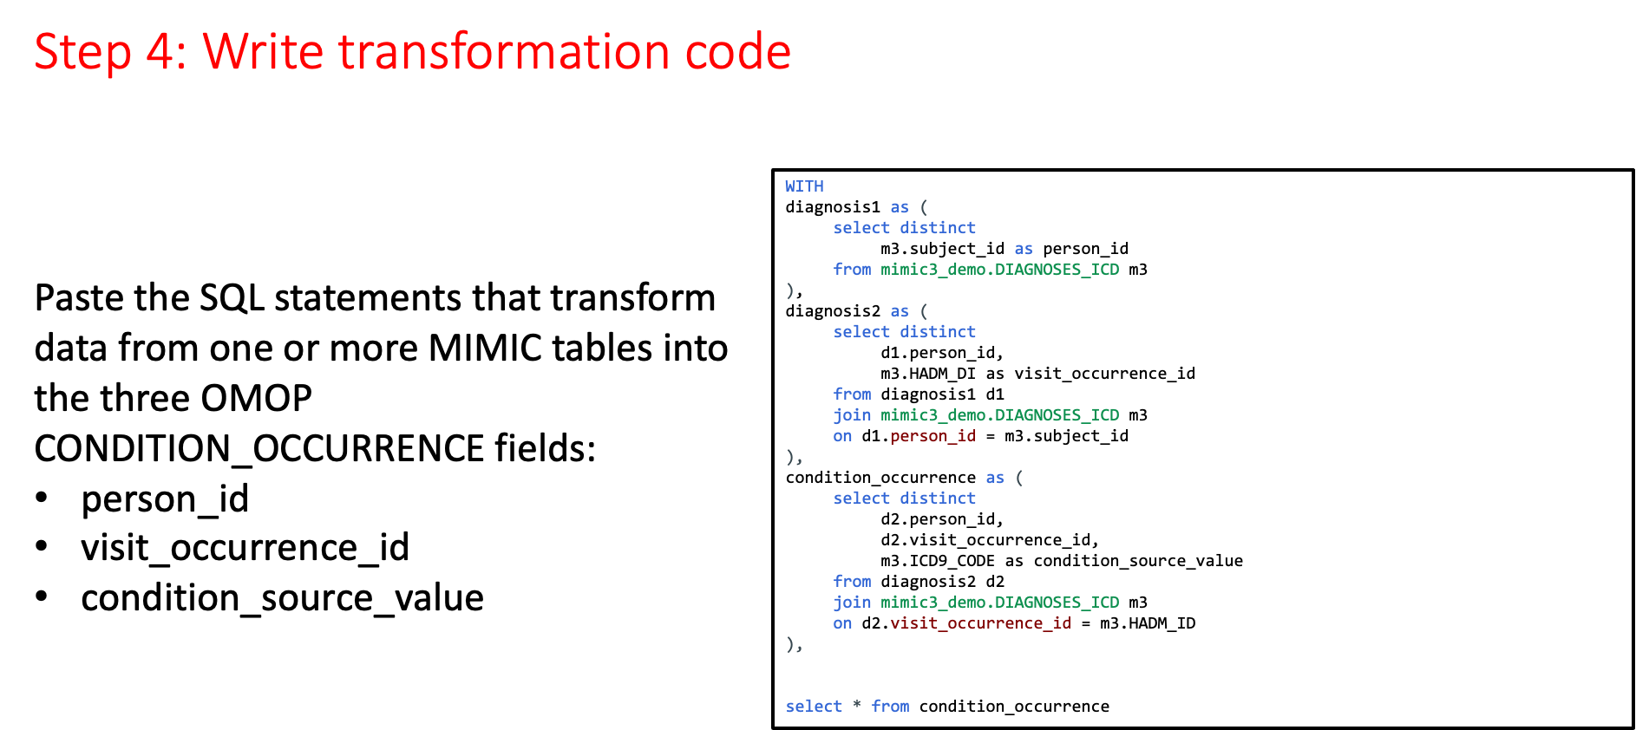

Slide 7

Notes:
There is no submission for this Step.

Slide 8
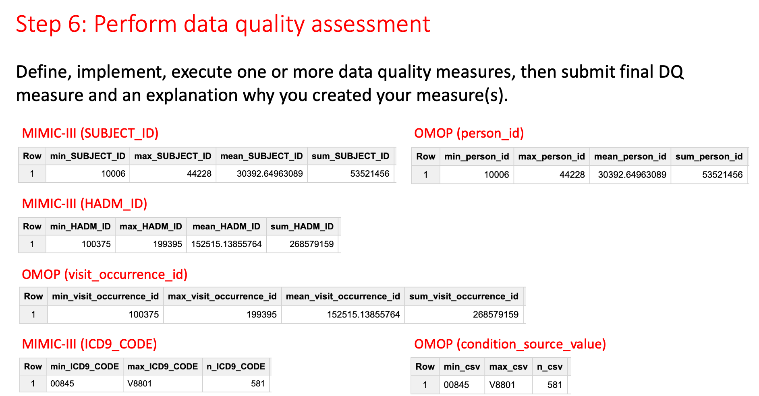

Slide 9


