Slide 1

SYSTEMS DEVELOPMENT
Enterprise Service
Request Management
System
A small Java web app that turns internal service emails into a single, accountable queue.
Kaan Apaydin · Melvin Borse · Patricia Grigoret· Kevin Queckboerner

Slide 2
00
AGENDA
Today's Overview
Seven sections · 15 minutes · live demo at the center
01
Problem
05
Project management
02
Solution & key features
06
Key benefits
03
Architecture & OO design
07
Q&A
04
Live demo
ENTERPRISE SERVICE REQUEST MANAGEMENT SYSTEM
02

Slide 3
01
PROBLEM
Why email-based requests become a problem
Emails make requests difficult to track, assign, and manage efficiently.
01
02
03
Lost in inboxes
No lifecycle
No SLA visibility
Requests get buried under daily mail. Nobody knows what is open, what is done, or what was forgotten.
Without explicit states, two agents may work the same ticket or none at all.
Managers cannot see which tickets are about to breach service-level expectations.
ENTERPRISE SERVICE REQUEST MANAGEMENT SYSTEM
03

Slide 4
02
SOLUTION & KEY FEATURES
A centralized system for handling service requests
Our system creates one shared workflow for employees, agents, and managers.
From the user
How we built it
•
Login with role-based access
→
AuthService + abstract User hierarchy
•
Submit, comment, close requests
→
Domain methods on Request enforce invariants
•
Six-state lifecycle with rules
→
Immutable ALLOWED_TRANSITIONS map
•
SLA deadline per priority level
→
Enum carries SLA hours; isOverdue() computes risk
•
Role-filtered request lists
→
Service-layer authorization, not just UI
•
Persistent state across restarts
→
SQLite via JDBC + Repository interfaces
ENTERPRISE SERVICE REQUEST MANAGEMENT SYSTEM
04

Slide 5
03
ARCHITECTURE & OO DESIGN
System architecture and package structure
The app is separated into layers with clear responsibilities.
web
Javalin routes & HTML rendering
service
↓
Authorization & orchestration
+ exceptions
cross-cutting,
used by all layers
repository
↓
Persistence - interfaces + SQLite impls
domain
↓
Real-world classes, enums, state machine
Single Responsibility at the package level. Domain knows nothing of the database. Database knows nothing of HTTP. Web knows nothing of SQL.
ENTERPRISE SERVICE REQUEST MANAGEMENT SYSTEM
05

Slide 6
03
ARCHITECTURE · REQUEST FLOW
How a request moves through the system
This flow shows how user actions are processed and stored in the database.
forward →
BROWSER
WEB
SERVICE
REPOSITORY
SQLITE
1
2
3
4
5
User clicks Submit
RequestController
RequestService.createRequest
SqliteRequestRepo.save
INSERT INTO requests
POST /requests
parses form params
authorize + validate
PreparedStatement
returns generated ID
9
8
7
6
Browser shows detail page
ctx.redirect('/requests/42')
returns Request to controller
Request object → id set
via fresh GET
302 response
by RETURN_GENERATED_KEYS
← return
ENTERPRISE SERVICE REQUEST MANAGEMENT SYSTEM
06

Slide 7
03
ARCHITECTURE · CLASS DESIGN
Core domain classes and relationships
How do the main classes interact inside the system?
« abstract »
User
id · username · password · role
Employee
ServiceAgent
Manager
submitter
assignee
Request
Comment
transitionTo(Status)
assign(ServiceAgent)
isOverdue() : boolean
◆
part-of the Request
ENTERPRISE SERVICE REQUEST MANAGEMENT SYSTEM
07

Slide 8
03
ARCHITECTURE · LIFECYCLE
Requests lifecycle and status transitions
Each request follows defined status rules from creation to closure.
reopen
NEW
assign
ASSIGNED
start
IN_PROGRESS
resolve
RESOLVED
close
CLOSED
unassign
wait
WAITING_FOR_INFO
ALLOWED_TRANSITIONS is an immutable map; transitionTo() throws InvalidStatusTransitionException on any illegal move.
The state machine cannot be bypassed.
ENTERPRISE SERVICE REQUEST MANAGEMENT SYSTEM
08

Slide 9
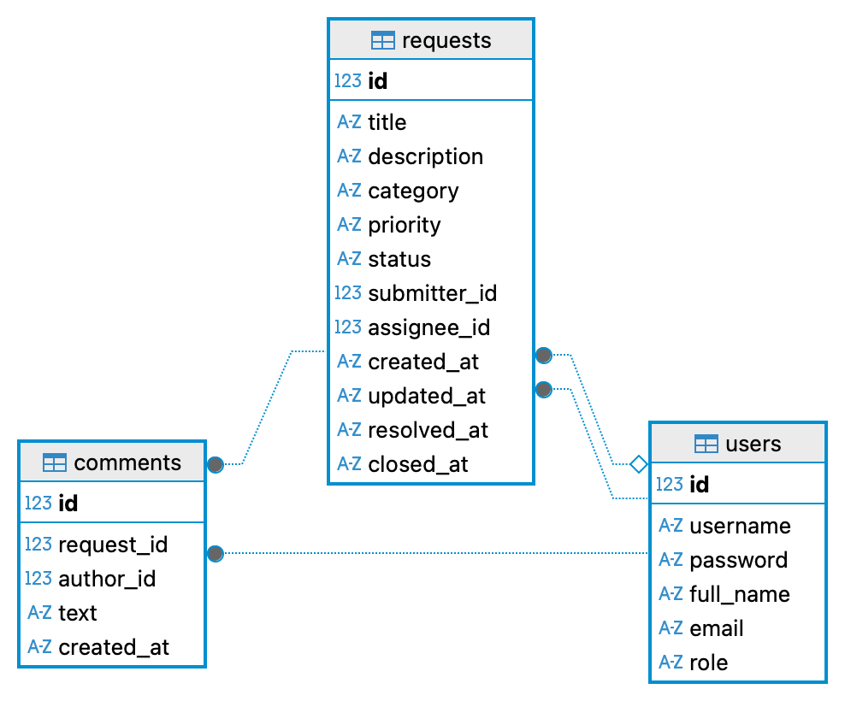
03
ARCHITECTURE · PERSISTENCE
Database structure and persistence layer
The database stores users, requests, and comments in a structured way.
Composition from the UML enforced at the database with ON DELETE CASCADE.
ENTERPRISE SERVICE REQUEST MANAGEMENT SYSTEM
09

Slide 10
03
ARCHITECTURE · SOLID
Applying SOLID principles in practice
The architecture follows object-oriented design principles to improve maintainability.
S
Single Responsibility
Strict separation of domain / service / repository / web layers.
O
Open / Closed
Add a Category or a repo implementation without touching existing code.
L
Liskov Substitution
Any User subclass works anywhere; any RequestRepository implementation too.
I
Interface Segregation
Two small repos - not one generic Repository<T>.
D
Dependency Inversion
Services depend on interfaces. Tests swap in a HashMap fake. Proven, not promised.
ENTERPRISE SERVICE REQUEST MANAGEMENT SYSTEM
10

Slide 11
04
AGENDA
Demo
Demonstration of the complete request workflow.
01
emp1 submits a request
04
agent2 resolves the request
02
manager1 reassigns to agent2
05
emp1 closes the resolved ticket
03
agent2 moves to IN_PROGRESS
06
Open SQLite - three tables on disk
http://localhost:7070 /// https://system-development-srs-final.onrender.com
ENTERPRISE SERVICE REQUEST MANAGEMENT SYSTEM
11

Slide 12
05
PROJECT MANAGEMENT
Project organization and team resposibilities
The project was developed step by step with clear responsibilities and phases.
01
02
03
04
05
06
07
08
09
Reqs.
clarification
Reqs.
engineering
OO
design
UML
diagram
Implementation
plan
Java
impl.
Persistence
Testing
Docs &
demo
THE TEAM
Kevin Q.
Melvin B.
Patricia G.
Kaan A.
Architecture & Service Layer
Domain & State Machine
Documentation & UML
Persistence & Demo
Main · AuthService · RequestService
Request · User hierarchy · 46 tests
OOAD doc · UML · ER · SOLID
schema.sql · SQLite repos · live demo
ENTERPRISE SERVICE REQUEST MANAGEMENT SYSTEM
12

Slide 13
06
KEY BENEFITS
Benefits of the system architecture
Our design improves scalability, testing, security, and maintainability.
TESTABILITY
EXTENSIBILITY
46 tests · 3 tiers · < 3 s
Open / Closed
DI lets us swap SQLite for a HashMap fake in tests.
Add a Category or a new repository - zero changes elsewhere.
SAFETY
MAINTAINABILITY
0 SQL-injection vectors
5 packages · downward only
Every query uses PreparedStatement with bound parameters.
Each package owns one concern. Change one thing in isolation.
PORTABILITY
DEFENSIBILITY
1 jar · < 10 MB · 1 command
Every line explainable
Bundled SQLite - no install. mvn package, then java -jar.
No reflection magic. No framework that hides behavior.
ENTERPRISE SERVICE REQUEST MANAGEMENT SYSTEM
13

Slide 14
06
CODE PROVENANCE
Team contributions and use of AI tools
Which parts were created by the team and where did AI support us?
TEAM LED
LLM-ASSISTED
▸ Object-oriented design Class hierarchy · abstract User · composition with Comment - shaped by team, AI as sounding board
▸ Lifecycle state machine ALLOWED_TRANSITIONS map · rule enforcement in transitionTo
▸ Authorization rules Role × action permission matrix in RequestService - business rules
▸ SQL schema design Tables · foreign keys · CASCADE · indexes
▸ JUnit test suite 46 tests across domain, service, integration tiers - testing logic owned by team
▸ Jira organization Tickets, task structure, and titles created by team; AI used to refine descriptions and acceptance criteria
▸ Frontend & UI code HTML markup & CSS styling - outside module scope; substantial AI contribution to initial drafts and iterative development, reviewed by team
▸ Java implementation support Coding assistance across backend classes - team-directed design decisions, AI-assisted execution, integrated and tested by team
▸ Repetitive code JDBC row mappers, Javalin route bindings, HTML templates - AI-assisted drafts, adapted by team
▸ Documentation drafts OOAD prose, README - refined from team-written notes, edited and approved by team
▸ Debugging & framework explanations AI used to support troubleshooting and clarify framework behavior during development
Every line was reviewed and is owned by the team. Full statement in docs/code-provenance.md
ENTERPRISE SERVICE REQUEST MANAGEMENT SYSTEM
14

Slide 15

07
Q&A
Thank you for your attention.
We are now ready to
answer your questions.
ENTERPRISE SERVICE REQUEST MANAGEMENT SYSTEM
14

