Slide 1
Serological model for English seasonal flu - User manual
11/11/2016

Slide 2
Steps
Step1. extract antibody titres
Step2. visualize serological profile
Step3. estimate disease parameters
Step4. visualize disease and serological dynamics

Slide 3
how to extract antibody titres?
Download serological.RDA
Open Rstudio, go to main/extract_antibody_titres/ to run extract_serological.R to load serological.RDA and produce serological.csv
Copy serological.csv into isltr/main/extract_antibody_titres/ folder.
Go to isltr/main/extract_antibody_titres/ and run main_producetitres_bytime_mrc.m
The extracted antibody titres will be exported into out/[yyyymmdd]/world_h3n2[world_h1n1] folder.
Copy the output file to isltr/dat/
Go back to isltr/ and update the setISL.m to include the titres data
for example,
load([proj 'h3n2_titres_2.mat']); %Syn1997
load([proj 'h3n2_titres_3.mat']); %Fuj2002

Slide 4
how to visualize serological profile?
Go to the home folder isltr/, edit setISL.m to add load([proj 'h3n2_titres_2.mat']);
run setISL from the working dir
run plot_sero_byseason(age). (The file is located in mplot/). If no input is entered, extract all age groups. If enter [1-4], the specific age group will be extracted.
enter the season you want to extract
The plots would be displayed as the next two pages

Slide 5
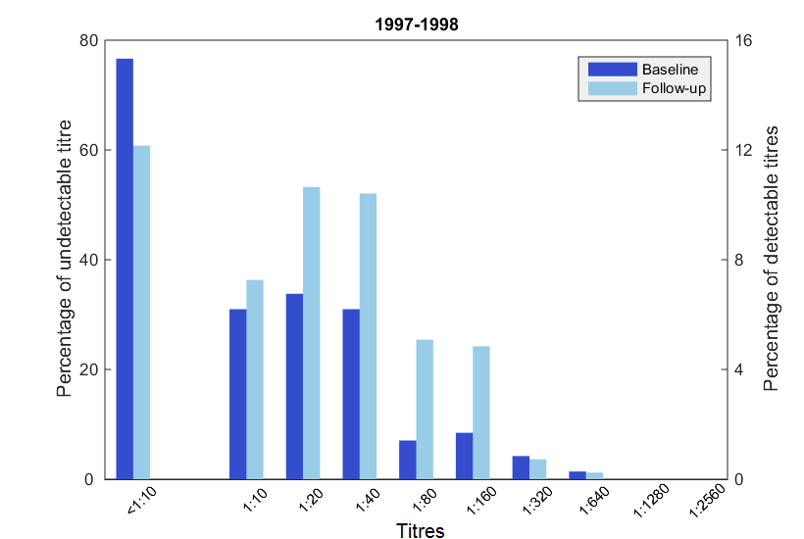
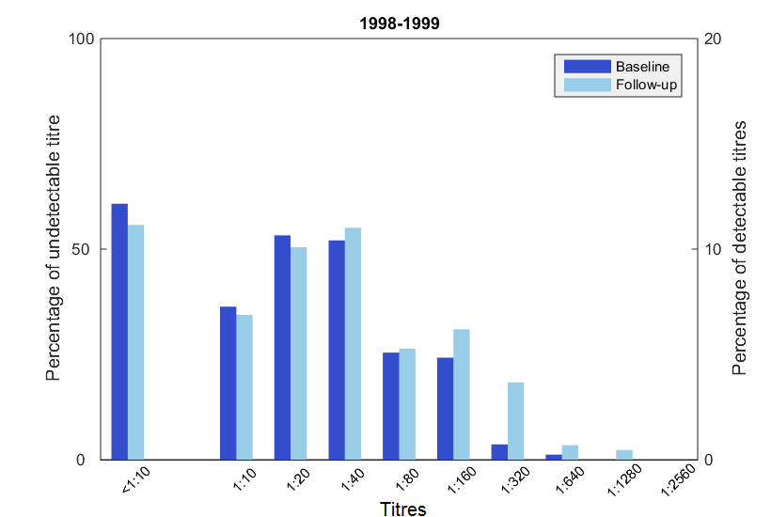
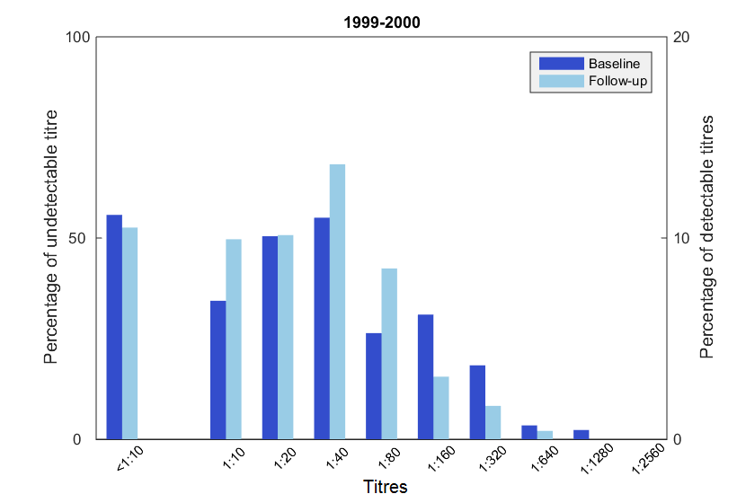
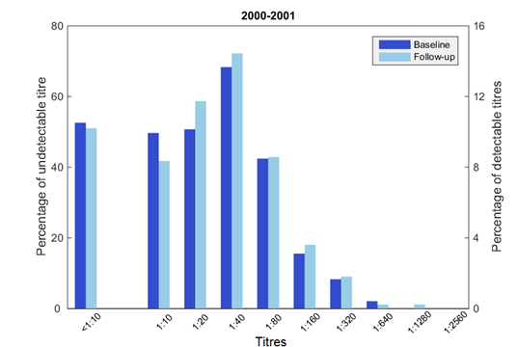
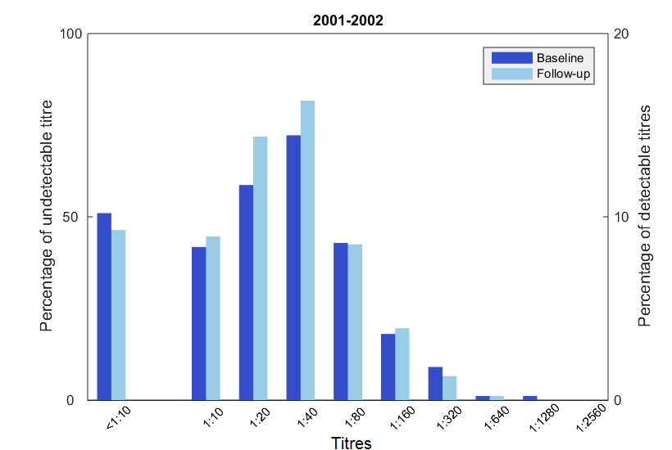
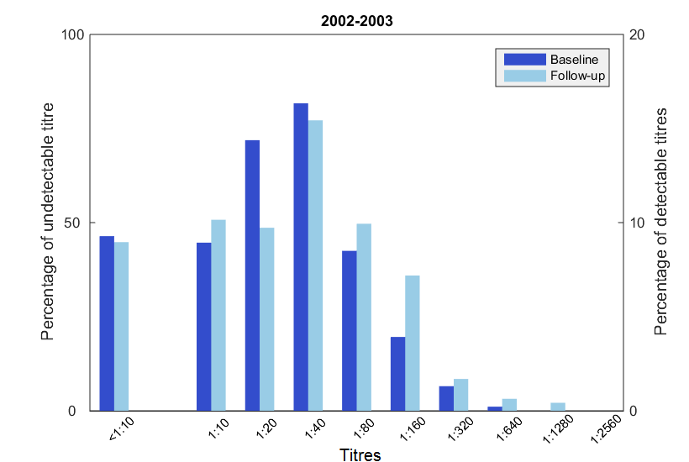
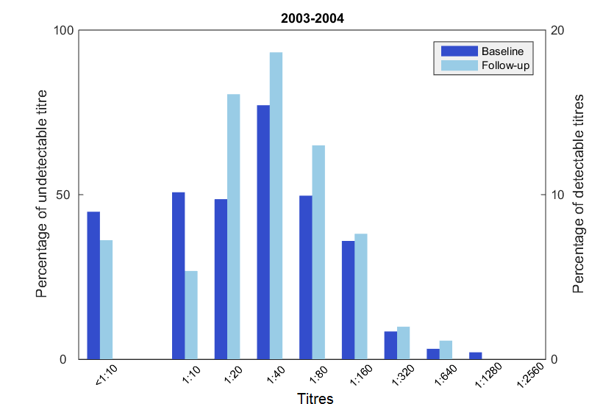
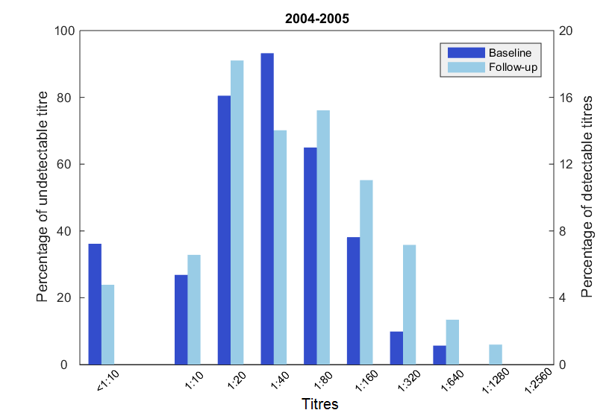
Anti H3N2/sydney/97 HAI titre

Slide 6
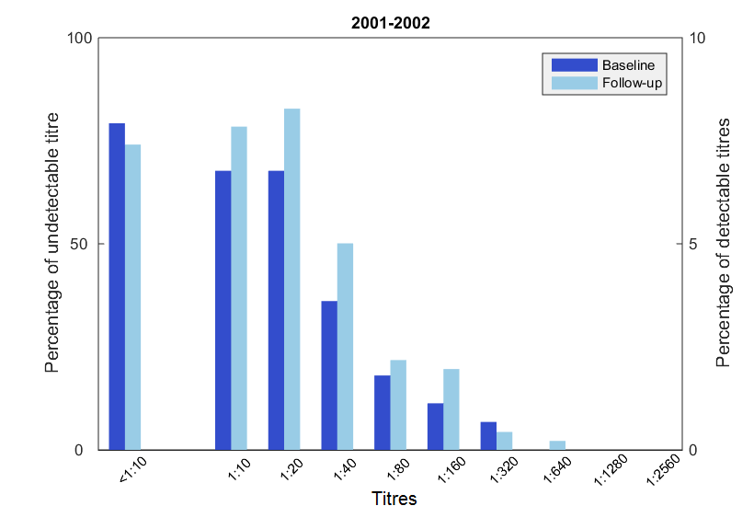
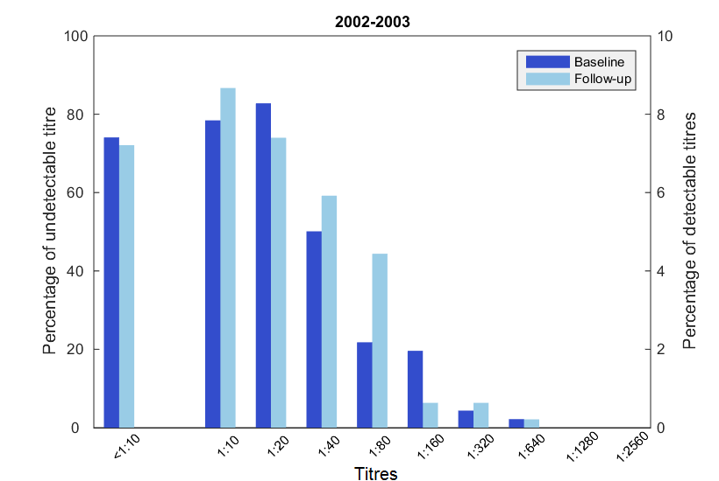
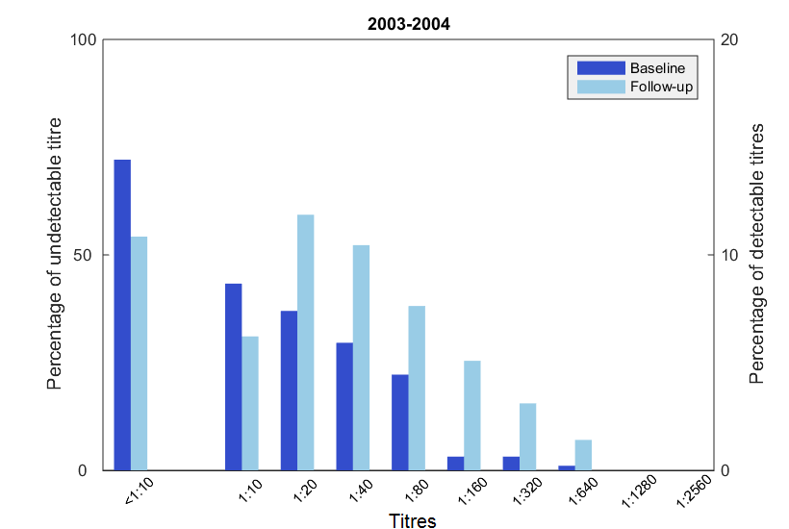
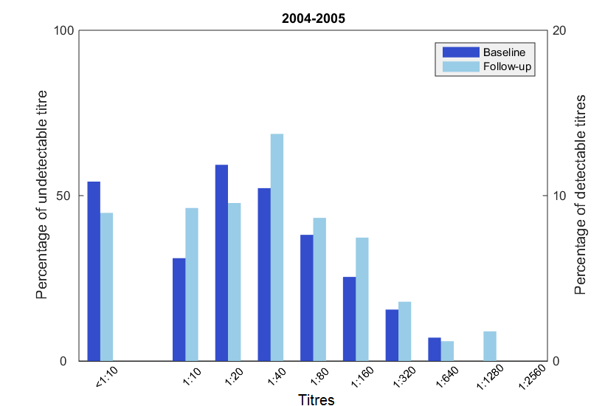
H3N2/Fujian/2002

Slide 7
how to estimate disease parameters?
Go to the working dir (isltr/)
Set the serology input file in setISL.m first.
load([proj 'h3n2_titres_2.mat']); % pick Syn1997 strain
load([proj 'h3n2_titres_3.mat']); % pick Fuj2002 strain
run setISL to setup global variables and antibody data
main_MCMC( m, outdir, nsteps, sampleno, burnIn, savefigflag, targetdate)
for example, main_MCMC( 1, 'out/phe/', 500, 20, 100, 0)
m = 1, model 1 is full titre model
savefigflag = 0, don’t produce figures
= 1, produces figures
targetdate = [empty], uses current date (today)
targetdate = ‘20161214’, uses the target folder with the specified folder

Slide 8
How to plot the results
step1: First open the MCMC output file e.g., isltr\out\phe\world_h3n2\m1\20161115\mcmc_output_m1.mat but still stay at working dir (folder isltr\). Check par.strain for strain name
step2: run setISL, check whether the correct strain is loaded
step3: run the following commands
To plot serological bars
figure1( PosteriorSamples, par, 100, 2)
Plot disease dynamics
figure2( PosteriorSamples, par, 100, 2)

Slide 9
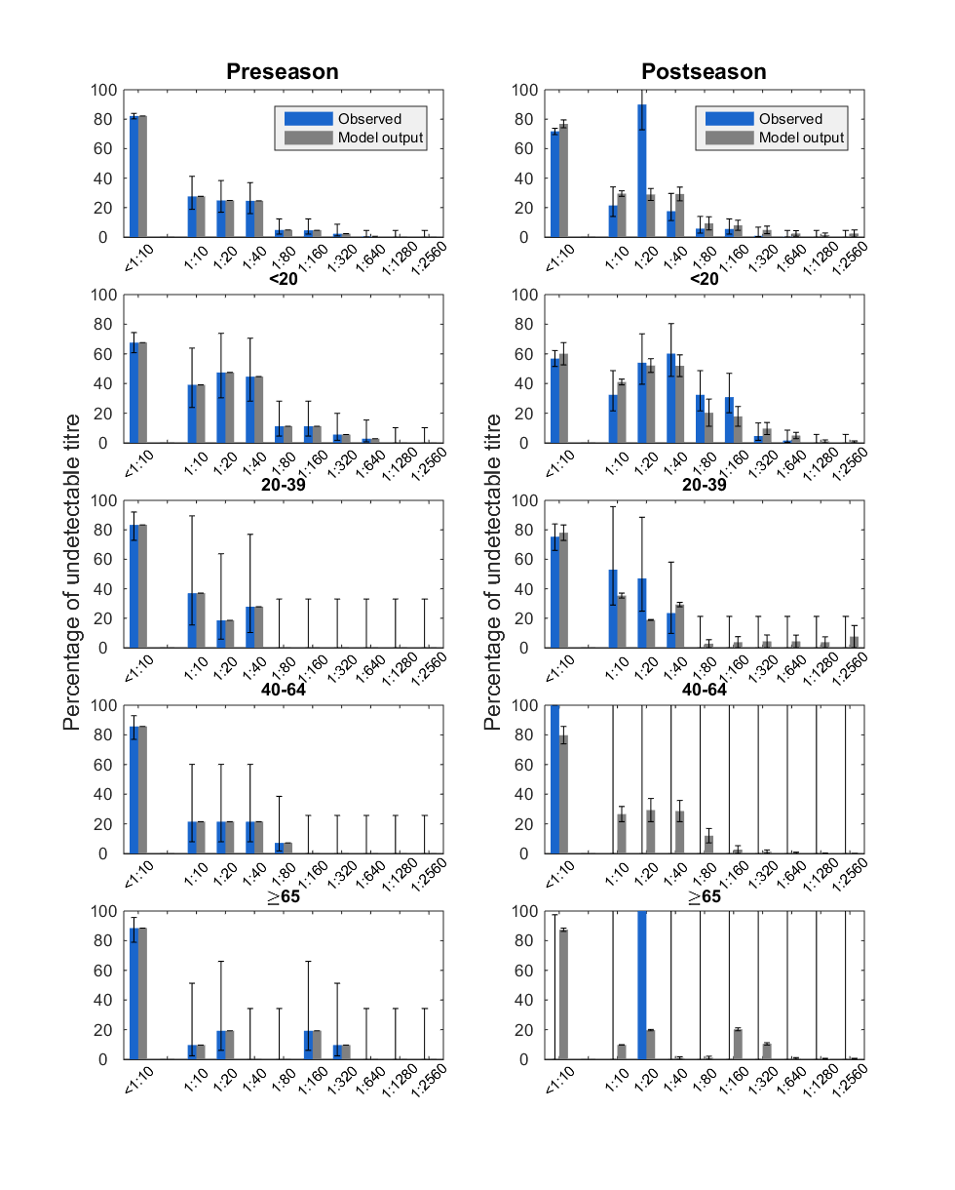
figure1

Slide 10
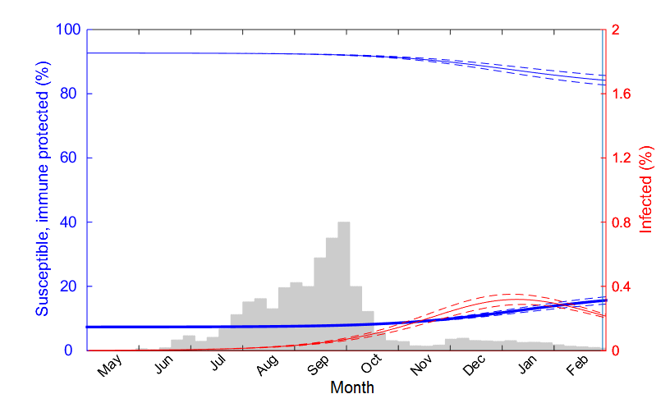
figure2

Slide 11
Notes:
Starting year: which seasonal epidemic we want to reconstruct
par.OutbreakStartingDay: which day the epidemic start to emerge 120 (May 1)
par.startdate: Antibody titre of each strain defines one earliest startdate as day 1
Antibody.numdays: sampling date use startdate as day 1
corrected_numdays = Antibody.numdays-OutbreakStartingDay;
SamplingLastDay: 365 -> 365*2 (run longer period than pandemic one to make sure simulated across pre and post sampling time)
For seasonal influenza, make_ics_naive change to make_ics_season

Slide 12
Lab notes
figure1( PosteriorSamples, pars, 100, 2) 02/12/2016
Notes:
doesn’t change too much

