Slide 1

cBio Cancer Genomics Portal
Tutorial: Introduction to the cBio Portal
Querying across cancer studies
Querying against a single cancer study
Basic Reports

Slide 2
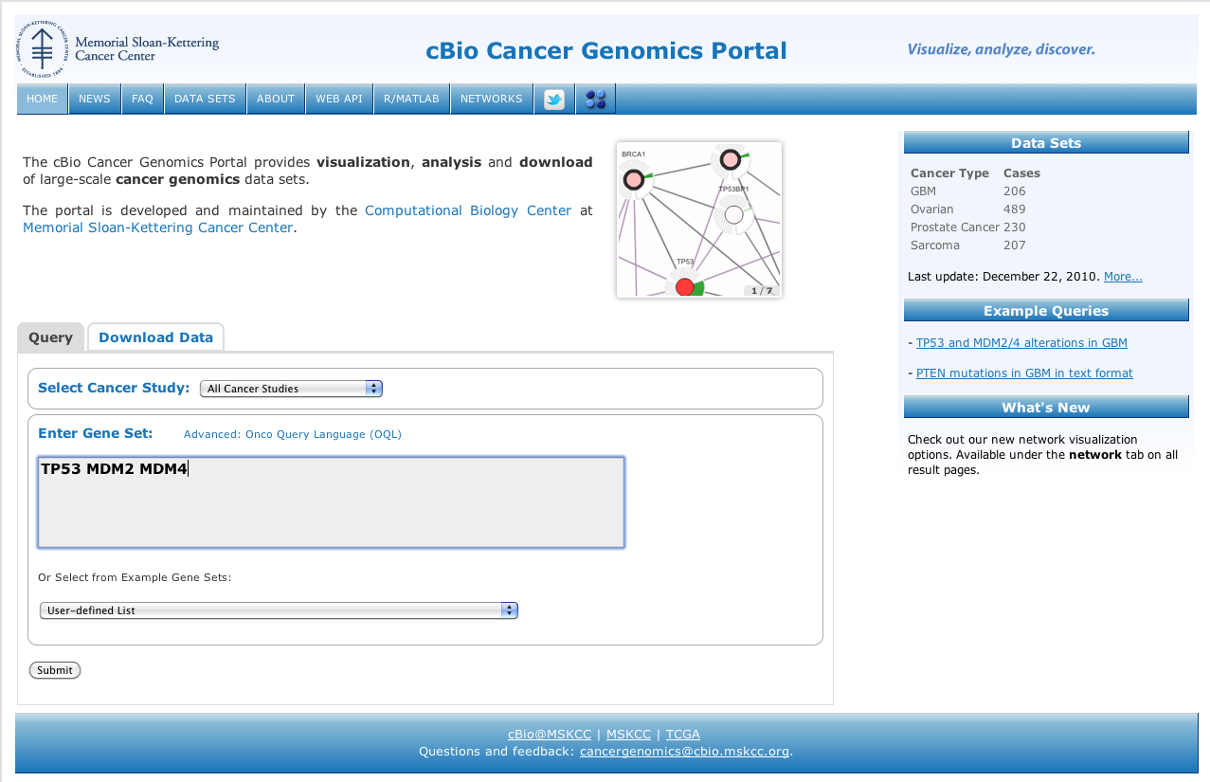
Querying Across Multiple Cancer Studies
Step 1: Select All
Cancer Studies

Slide 3
Querying Across Multiple Cancer Studies
Step 2: Enter one
or more genes

Slide 4
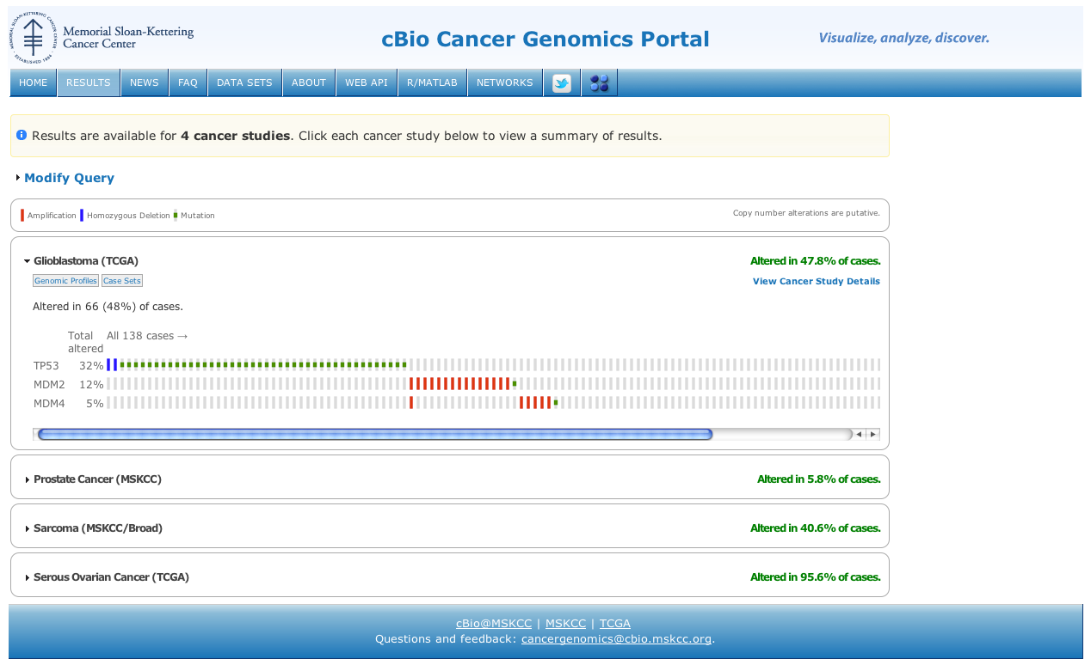
Click to modify your query
Cancer Study Summary
Click for
complete
details
Click to expand cancer study

Slide 5
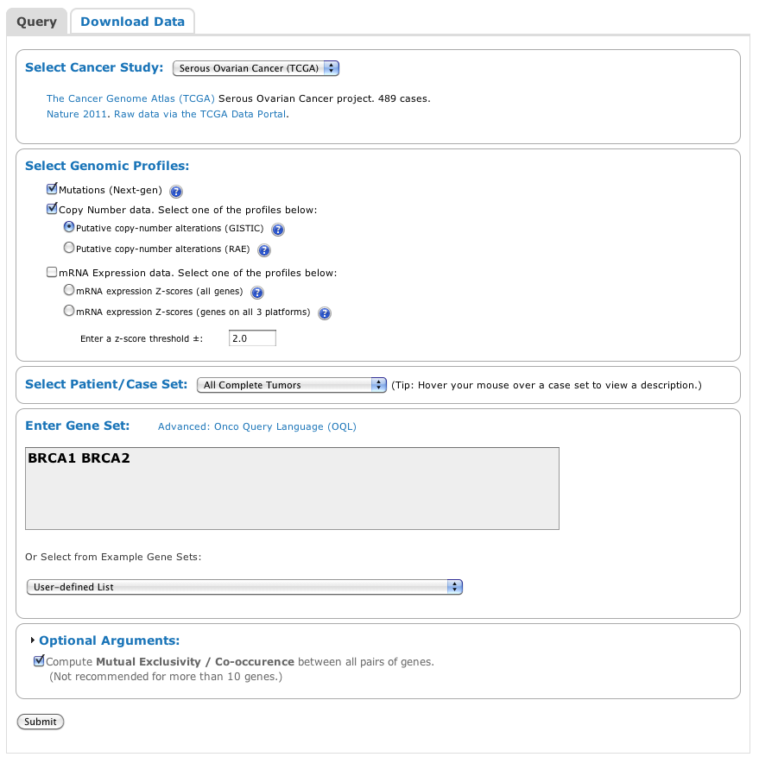
Querying A Single Cancer Study
Step 1: Select a
Cancer Study, e.g.
Ovarian Cancer (TCGA)

Slide 6
Querying A Single Cancer Study
Step 2: Select one
or more genomic profiles.
For example: mutations and
copy number.

Slide 7
Querying A Single Cancer Study
Step 3: Select a Patient Set.
Tip: Hover your move over a case set
to view a description.

Slide 8
Querying A Single Cancer Study
Step 4: Enter one or more
genes.

Slide 9
Querying A Single Cancer Study
Optional argument to
compute mutual exclusivity.

Slide 10
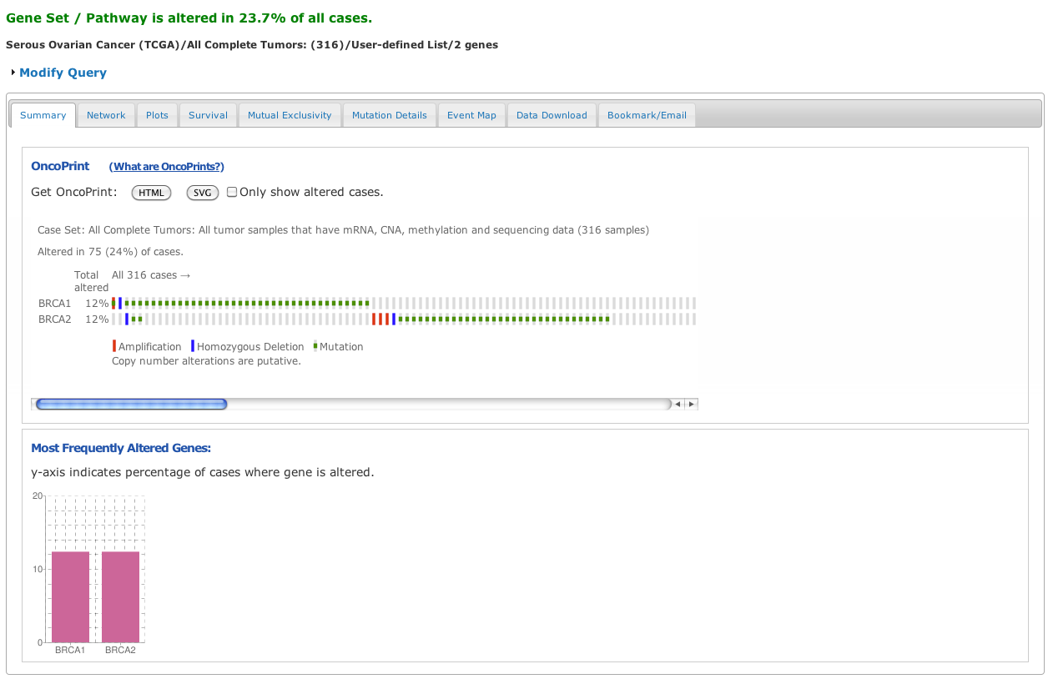
Multiple Reports, one per tab
OncoPrint Summary Visualization

Slide 11
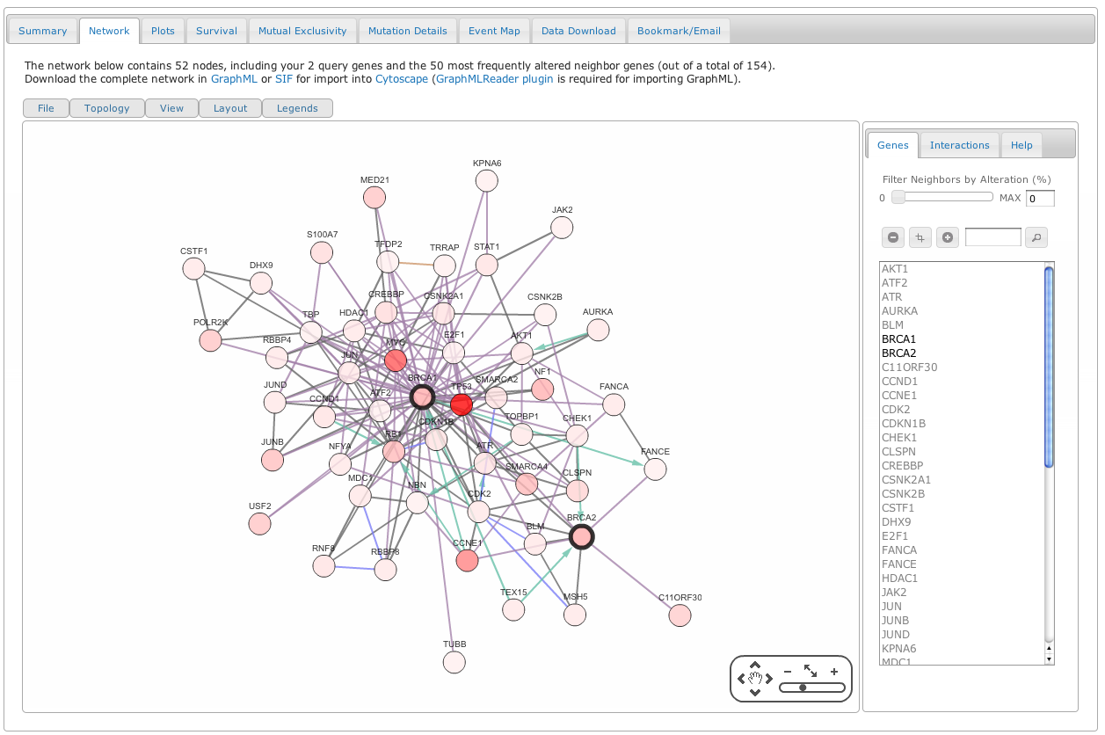
Network Analysis and Visualization

Slide 12
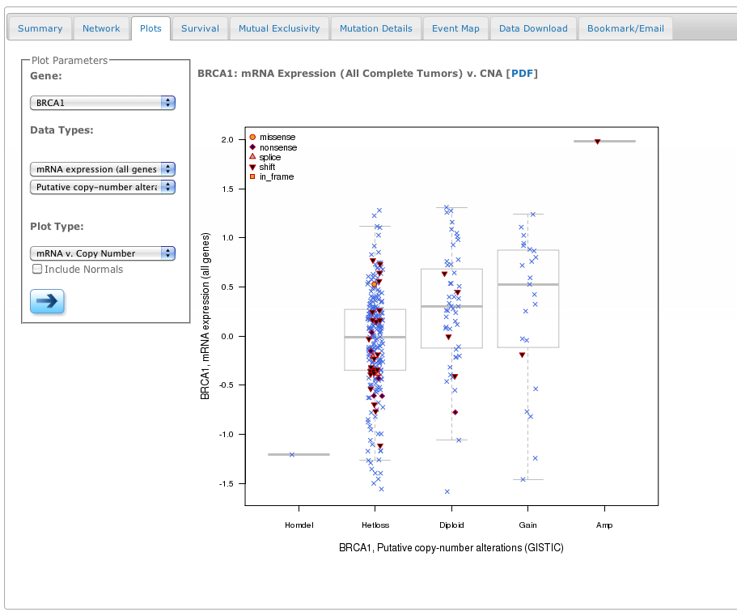
Multiple Plotting Options

Slide 13
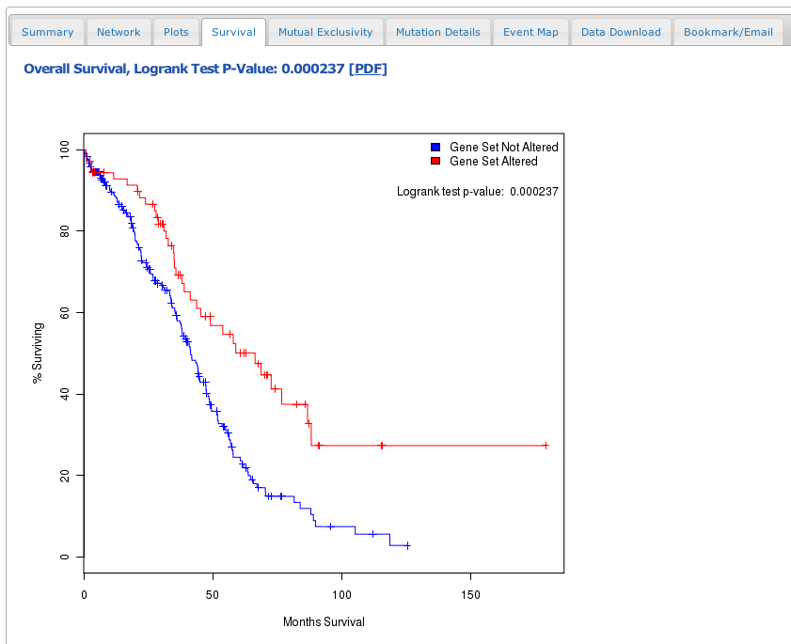
Survival Analysis

Slide 14
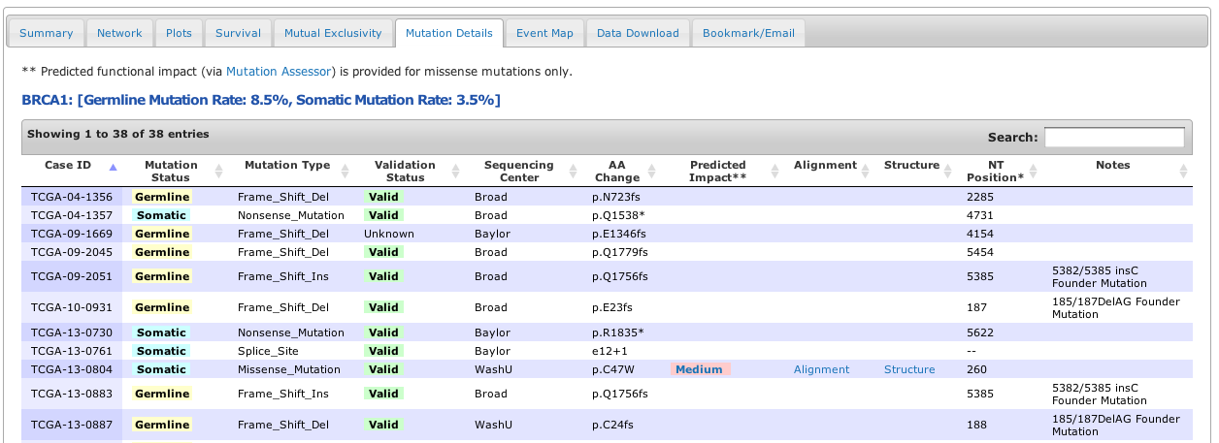
Mutation Details
Filter / Sort Options
Links to MutationAssessor.org
for predicted functional consequences of mutations.

Slide 15
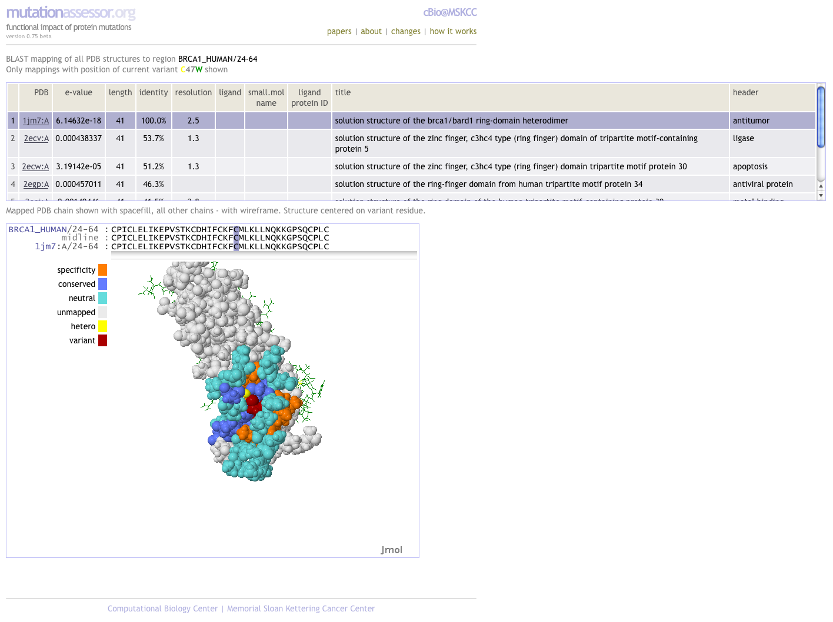
MutationAssessor.org

Slide 16
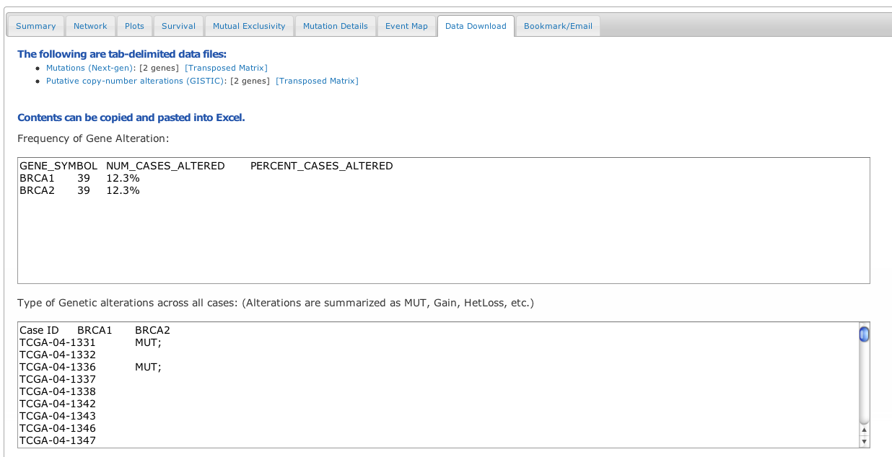
Data Download

Slide 17
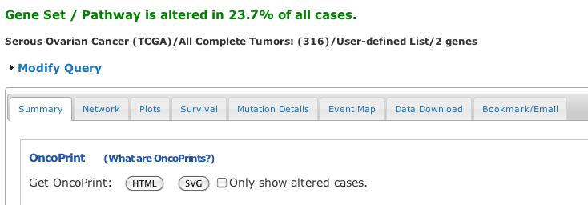
You can always modify your query here…

Slide 18
Questions?
Send us an email at:
cancergenomics@cbio.mskcc.org

