Slide 1

0x1 - Reversing Basics
NTU0FF53C
Lucas Tay Kiat Loong

Slide 2

WHAT TO KNOW IDEALLY FOR THIS TALK
C Programming
How to stack books

Slide 3
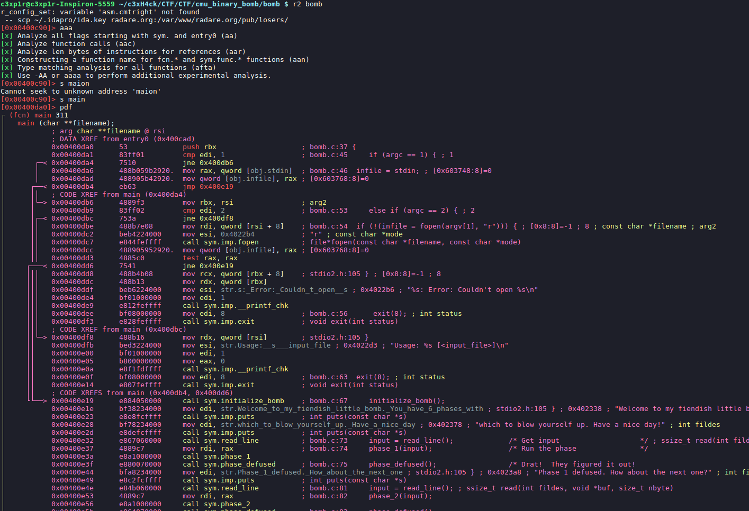
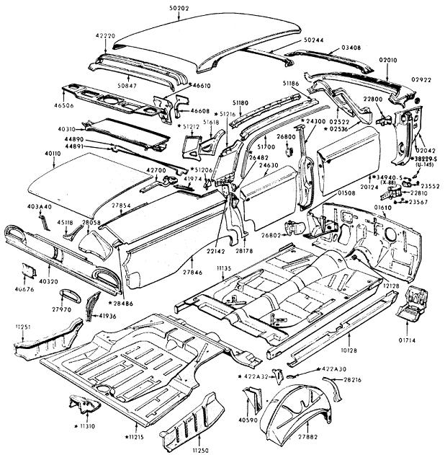
WHAT
Recovering details of implementation
Deconstruction

Slide 4
WHY
Malicious Software Analysis
- Hackers
- Anti-virus developers
Auditing program binaries
- Be faster than attacker
Cryptographic Algorithm
- Restricted vs Key-based
Low-Level Software
- AKA System software
- Close to the hardware

Slide 5
Quick Recap

Slide 6
Numbers
Binary
- radix base2
- 0 or 1
- On or Off
- 0b0 or 0b1
- 1001100010₂
Decimals
- radix base10
- 0 .. 9
- Normal number system
- 1234₁₀
Octal
- radix base8
- 0 .. 7
- 017723₈
Hexadecimal
- radix base16
- 0 .. 9,a,b,c .. f
- 0x0 , 0x1 , … 0xf
- deadbeef₁₆

Slide 7
Signed and Unsigned Numbers
  Signed numbers has either positive or negative sign.
Positive 2^{n-1}-1 is the maximum number
Negative 2^{n-1} is the minimum number
Unsigned numbers are only positive
2^{n –} 1 is the maximum number
0 is the minimum

Slide 8
Hexadecimals
Converting from Hex to Dec
0x80 = 8A₁₆ = 1000 1010₂

Slide 9

Bits and bytes
Remember
1 Byte = 8 Bits
Therefore 32 bits system has 4 bytes and 64 bits has 8 bytes
Note that in 32 bits system
The memory addressing space can range 0x00000000 to 0xffffffff
Registers has also maximum 32 bits

Slide 10
Data Types [Intel Arch]
DATA TYPE | Byte | Word | DoubleWord | Quadword | Quintword | Double QuadWord | Quad Quadword
LENGTH (Bits) | 8 | 16 | 32 | 64 | 80 | 128 | 256
Once data type is assigned, the length becomes fixed!

Slide 11
Core Concepts Of Reversing
[ Technical ]

Slide 12
4 Main Components
- Stack
- Heap
- Registers
- Instruction

Slide 13
Stack
Acts like a stack of books
First In, First Out (FIFO)
Data structure for saving important information
        E.g. Storing local variables , setting up stack frames
Two main instructions : PUSH and POP

Slide 14

Stack
Push
Pop
Push adds element to the
top of the stack
Pop removes the element from top
Of the stack and stores it into ebx register

Slide 15
Stack
Gaol : Please place book from shelf 1 to shelf 2
Book C
ABC Library Shelf 1
Book B
ABC Library Shelf 2
Book X
Book A

Slide 16
Stack
Instruction :
push BookX ; Places book X onto stack
Book C
ABC Library Shelf 1
Book B
ABC Library Shelf 2
Book X
Book A

Slide 17
Stack
Instruction :
push BookX ; Places book X onto stack
Book X
Book C
ABC Library Shelf 1
Book B
ABC Library Shelf 2
Book X
Book A

Slide 18
Stack
Instruction :
pop ABC_Library_Shelf_2 ; Take whatever that is on the stack
; and place it in the location
Book X
Book C
ABC Library Shelf 1
Book B
ABC Library Shelf 2
Book X
Book A
Book X

Slide 19
Stack
The value you want to store
Instruction :
push BookX ; Places book X onto stack
pop ABC_Library_Shelf_2 ; Take whatever that is on the stack
; and place it in the location
Location you want to store the element
at the top of the stack in

Slide 20
Stack
Memory Address
0x000...
0xfeedbeef
Grows downward
Shrinks
upwards
oxdeadbeef
0xdeadbeef
0xdeadbeef
0xfff...

Slide 21
Endian-ness
- Sequential order in which bytes are arranged
Little Endian
- Stores the Least Significant Byte first
Big Endian
-Stores the Most Significant Byte first

Slide 22

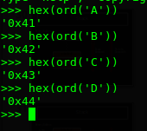
Endian-ness
IA32 typically uses Little Endian to store data on stack
ABCD
0x41424344

Slide 23
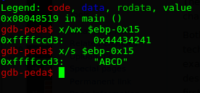
Endian-ness
IA32 typically uses Little Endian to store data on stack

Slide 24
Endian-ness
IA32 typically uses Little Endian to store data on stack

Slide 25

Endian-ness
If input is ABCDEFGH
DCBA
HGFE

Slide 26
Heap
- Data Structure that is similar to a linked-list that acts like a queue
- Data can be stored in heap when objects are created dyamically
- E.g. via malloc() in C, new in C++, etc
- Can release the data via free() in C , delete() in C++
- Different from stack
How linked list can look like

Slide 27
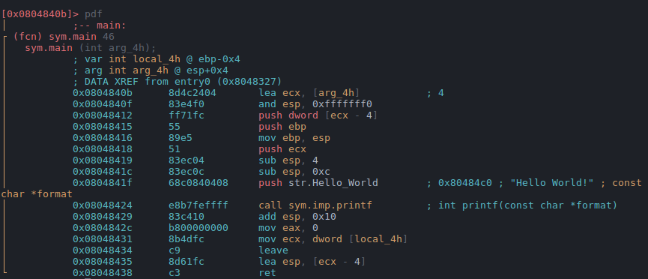
Registers
Act like temporary storage
Act like pointers to data items in memory
Can perform arithmetic calculations

Slide 28
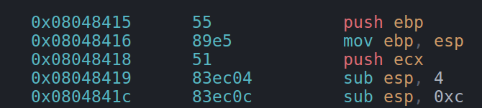
Registers
Can you guess which are the registers?

Slide 29
Registers
8 General Purpose Registers

Slide 30
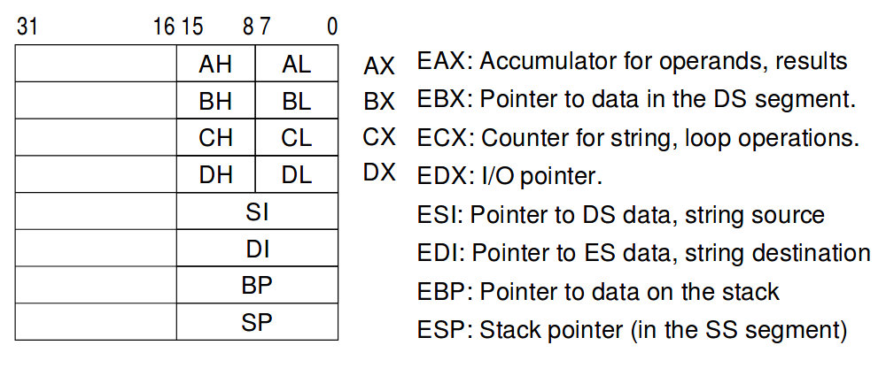
Registers
Extracted from : http://www.cs.princeton.edu/courses/archive/spr04/cos217/lectures/IA32-I.pdf

Slide 31
Registers
EIP – Extended Instruction Pointer
- All time favorite for pwnsters
- A register that contains instructions
to execute
If you can gain control of EIP, it is possible to change the
control flow of code and point it to or construct malicious payloads.
- Buffer Overflows
- Return-Oriented Programming(ROP),
- ret2libc

Slide 32
Instructions
Machine understands practically just binary [ 1 | 0 ]
Humans does not
SO HOW?

Slide 33
Instructions
MNEMONICS
- Techniques to aid memory
- Something like an Alias
- AKA Assembly language / Assembly Code / *ASM
Hex for the instruction
Mnemonics

Slide 34
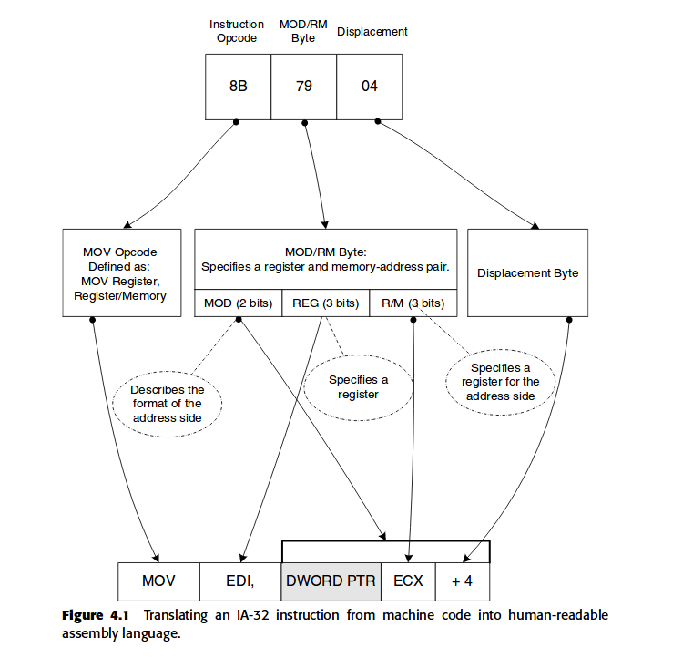
Instructions

Slide 35
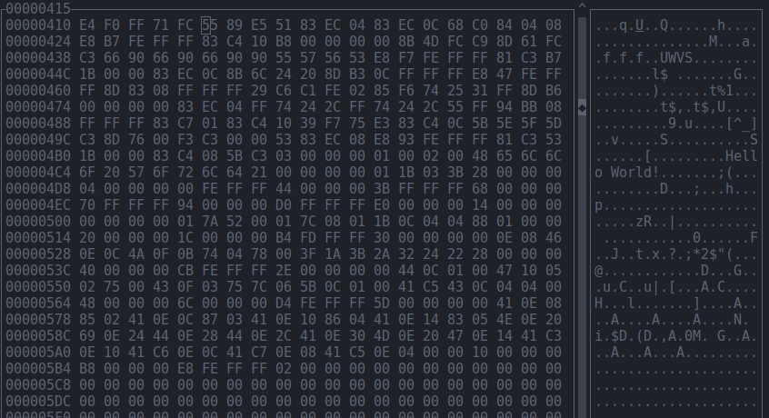
Instructions

Slide 36
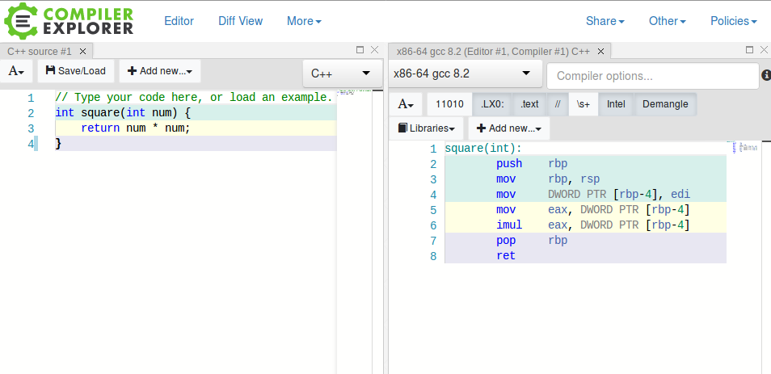
Instructions
Some Links to explore:
https://defuse.ca/online-x86-assembler.htm#disassembly
https://godbolt.org/
- See programming language convert to assembly on the fly

Slide 37
Instructions
For this workshop, we will focus on INTEL syntax
The other syntax is AT&T but not explored here
Syntax :
[label:] mnemonic argument1 [, argument2, argument3]

Slide 38
Instructions [MOV]
MOV instruction moves data between memory and the general-purpose
and segment registers . Pdf page 127, 186
basic load data and store data operations between memory and the processor’s registers and
data movement operations between registers.
5 Types of data movements:
- Mem to reg
- Reg to mem
- Reg to reg
- Immediate to reg
- immediate to memory
NO MEMORY TO MEMORY DATA MOVEMENTS!

Slide 39
Instructions [MOV]
Mnemonic destination(register) source(immediate)
Put the immediate value 0 into the eax register

Slide 40
Instructions [MOV]
-Whenever you see a [ … ], in most cases, it refers to a memory location
-There are also different sizes like BYTE, WORD, QUADWORD(64bits)
-PTR Dereferences the value in $ebp-0xc and and store the value in edx register
Mnemonic register size pointer dereferencing source(memory)
Somewhat like : uint_64 x = *(ebp-0xc) ;

Slide 41

Instructions [MOV]
mov DWORD PTR [ebp-0x15] , 0x0
Mnemonic size deferencing destination(memory) source(immediate)

Slide 42

Instructions [LEA]
- The LEA (load effective address) instruction computes the effective address in
memory (offset within a segment) of a source operand and places it in a general-
purpose register.
E.g.
- value of ebp – 0x15 → eax

Slide 43

Instructions [ADD and SUB]
add destination, source ; destination = destination + source
sub destination, source ; destination = destination - source
eax = eax + edx
esp = esp - 0x8

Slide 44
Instructions
Other commands includes MUL, DIV, SHR, XOR, test, cmp, je, etc ...
Anything unsure, refer to
https://pdos.csail.mit.edu/6.828/2009/readings/ia32/IA32-1.pdf
And find the opcode/mnemonics.
For beginners, search up all the opcode you see diligently.
Anything unsure, just post in the telegram group!

Slide 45
Lets try it out!
Open up your linux environment

Slide 46
We will discuss GDB
since I am more familiar with it than radare2
;)

Slide 47

Download some files
Make sure git is available
Command :
$ git --version
If not installed, then
$ sudo apt-get install git

Slide 48
Download some files
PLEASE INPUT LINK
FOR THE SLIDE HERE

Slide 49
GDB
- Short for GNU Debugger
- A disassembler
- Can create break points, step in, step out, run, add arguments, etc
To start, lets load the math binary file into GDB.

Slide 50
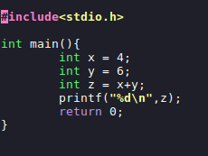
GDB
Src : math.c
We will examine this code

Slide 51
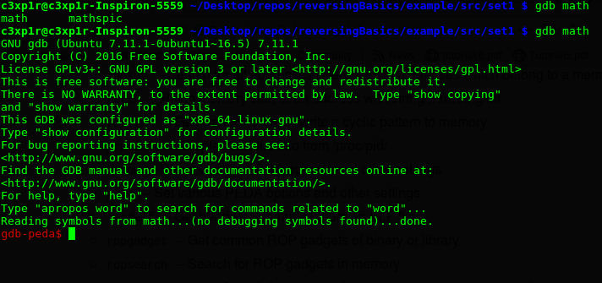
GDB
Load by using command:
gdb /path/to/binary

Slide 52
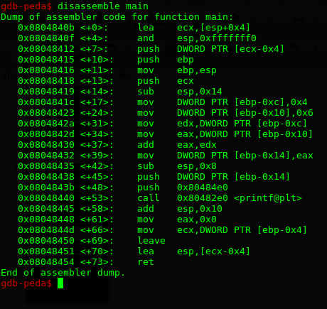
GDB
If you need some help with commands,
Command : help OR help all
Now to disassemble a function, use the
disassemble or dissas(a short hand)
Since we wanna disassemble main,
Command:
disassemble main

Slide 53
GDB

Slide 54
GDB
Epilogue
- Where stack frame
Is created.
- Where space is created for local variables
- Make sure EBP and ESP are pointing to bottom and top of the new stack frame respectively.
- We will ignore that for now

Slide 55
GDB
Prologue
- Cleaning up the stack after itself
- Houskeeing
- Tell the machine where to return to after main exits
- Will deal more of it later

Slide 56
GDB
Focus for now will be in between the prologue and epilogue of the main function

Slide 57
GDB
A little refresher
-Stack starts from higher memory address
To lower memory address
- ESP points to top of stack
- EBP points to bottom of current
stack frame
-Since stack starts from higher memory address, move up the stack, we decrease the EBP by offset.

Slide 58
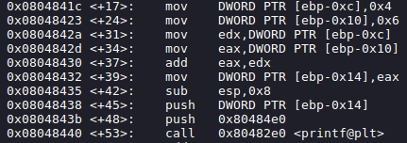
GDB
Memory Address
ESP
.
.
.
EBP-010
New stack frame
EBP-0xc
EBP-0x8
EBP-0x4
Also, remember that space for local variables
are created during the epilogue.
This means that
ebp-0xc and ebp-0x10 are local variables
EBP
Old ebp
Return address
…

Slide 59
GDB
Memory Address
ESP
.
.
.
EBP-010
6
Essentially
int *memoryX = (ebp-0xc);
int *memoryY = (ebp-0x10);
*memoryX = 4;
*memoryY = 6;
EBP-0xc
4
EBP-0x8
EBP-0x4
EBP
Old ebp
Return address
…

Slide 60
GDB
Memory Address
ESP
.
.
.
EBP-010
6
Essentially
int temp1 = *(memoryX);
int temp2 = *(memoryY);
//Values from the memory
//are put into another register
EBP-0xc
4
EBP-0x8
EBP-0x4
EBP
Old ebp
Return address
…

Slide 61
GDB
Memory Address
ESP
.
.
.
EBP-010
6
Essentially
temp2 += temp1; // temp2 = 10
EBP-0xc
4
EBP-0x8
EBP-0x4
EBP
Old ebp
Return address
…

Slide 62
GDB
Memory Address
ESP
.
.
.
EBP-010
6
Essentially
int *z = (ebp-0x14); // since new memory
// location
*z = temp2; // *z = 10
EBP-0xc
4
EBP-0x8
EBP-0x4
EBP
Old ebp
Return address
…

Slide 63

GDB
Memory Address
ESP
.
.
.
EBP-014
10
EBP-010
6
EBP-0xc
4
EBP-0x8
EBP-0x4
EBP
Essentially
printf(“%d\n”,z);
Old ebp
Return address
…

Slide 64
GDB
Memory Address
ESP
.
.
.
EBP-014
10
EBP-010
6
EBP-0xc
4
EBP-0x8
EBP-0x4
EBP
Essentially
return 0; //return value is stored in eax
Old ebp
Return address
…

Slide 65
GDB
EPILOGUE
+
Essentially
int *memoryX = (ebp-0xc);
int *memoryY = (ebp-0x10);
*memoryX = 4;
*memoryY = 6;
int temp1 = *(memoryX);
int temp2 = *(memoryY);
temp2 += temp1; // temp2 = 10
int *z = (ebp-0x14); // since new memory
// location
*z = temp2; // *z = 10
printf(“%d\n”,z);
return 0;
+
PROLOGUE

Slide 66

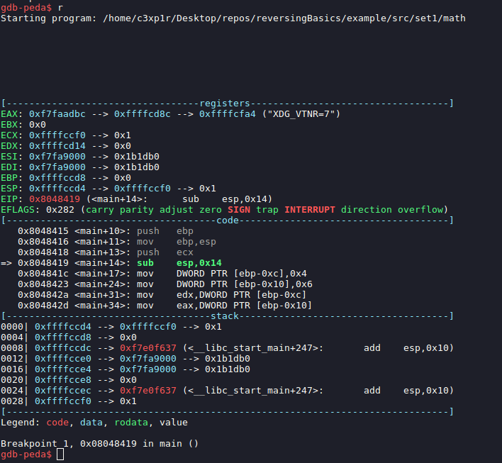
GDB
After doing some analysis, let’s try to go through the program
To set break points,
Command:
break <functionName>
To run the program,
Command:
r

Slide 67
GDB
DO NOT LET THIS
INTIMIDATE YOU
We have touched
on most of it
already :)

Slide 68
GDB
- Registers with its values.
- The right arrows are comments
that can be really helpful
- can see with command:
info registers [register name]
- EFLAGS
- Contains flag that helps
Keep track of the
Status of the program.
E.g. Is the calculated
Value 0
If is zero then z flag
is 1

Slide 69
GDB
Code
List :
- past 3 instructions
- next 5 instructions
“=>” :
- denotes the next
Instruction to execute

Slide 70
GDB
Stack
- Shows the top 8 words
of the stack
- Can see with command:
x/8wx $esp
- Also have smart comments
-x/8wx $esp
Means
eXamine /8 Words in heX of $esp
- Explore more options
Command:
help x

Slide 71
GDB
- To run the program
Command : r or run
- To set break point at main
Command : break *main or b *main
- To step into instruction/function
Command : si or step
- To go next instruction – proceeds through
Subroutine call as well
Command : next or ni
- To continue the rest without stepping
Command : continue or c
- To example string
Command : x/s <location>
-To print registers
Command : info registers [registername]
- To disassemble function
Command : diassemble <functionName>
- To show top 8 word of stack in hex
Command : x/8wx $esp
Just remember these
few for now!

Slide 72
EXPLORE
You can write your own program and compile it.
gcc target.c -o outputName -m32
Then decompile it and play around

Slide 73
Control Flow

Slide 74
Control Flow
Control Transfer Instructions includes
- JMP
- JE/JZ
- JNE/JNZ
- JA/JNBE
- JBE/JNA
- JG/JNLE
- JGE/JNL
- JL/JNGE
- JLE/JNG
- JC
- JNC
- JO
- JNO
- JS
- JNS
- etc
Conditional Jumps
Pdf pg 131 for reference

Slide 75
Control Flow
The CMP (compare) instruction computes
the difference between two integer oper-
ands and updates the OF, SF, ZF, AF, PF, and CF flags according to the result.
E.g.
mov x,3 ; x=3
mov y,3 ; y=3
cmp x, y ; x-y=0, update zf
jz somewhere ; Checks zf. Since zf = 1, jump to somewhere
…
…
Somewhere:
…
…

Slide 76
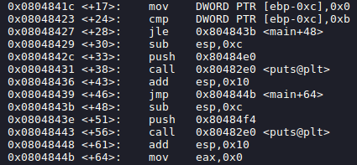
Control Flow [if..else..]

Slide 77
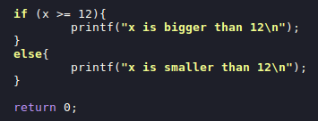
Control Flow [if..else..]
FLOW:
- Here we compare 0 with 12
- Since 0-12 is not 0,
- Zf is set to 0

Slide 78
Control Flow [if..else..]
FLOW:
Since -12 is less than or equal zero, jump to 0x804843b

Slide 79
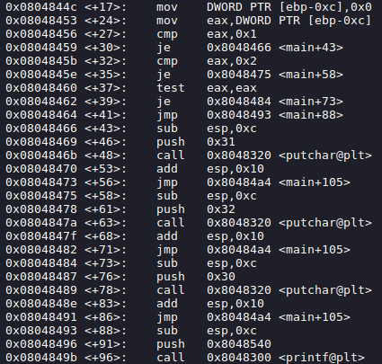
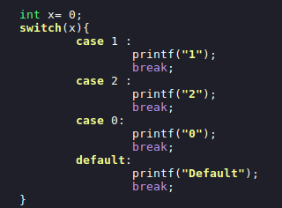
Control Flow [switch..case]
FLOW:
The TEST instruction performs a logical AND of two operands and sets the SF, ZF, and PF flags according to the results.
test eax, eax ; 0 & 0 = 0 so zf = 1

Slide 80
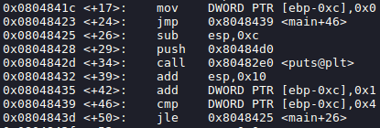

Control Flow [for loop]
Unconditional jump
Repeated 5 times
Disassembled
x=0
1. Compare if x > 4
2. while x – 4 is not 0
Then print hello world
Add x by 1
3. else dont jump and exit

Slide 81
Functions

