Slide 1
Insurance Predictions

Slide 2
Goals
Explore Data
Create some visualizations
Create Machine Learning Model
Predict Charges Based on Features

Slide 3
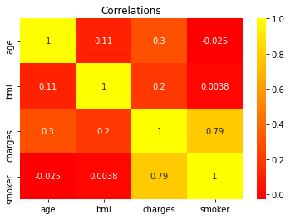
Data Visualization
Highest correlations between features in the data set
Smoker, Bmi, and Age
Affects Charges

Slide 4
Affects of high BMI
Affects of weight and obesity
Heart Disease
Diabetes
Average BMI compared to Above-Average BMI

Slide 5
Affects of Smoking
Carcinogen
Risk of long term health issues
50% more on Premiums

Slide 6
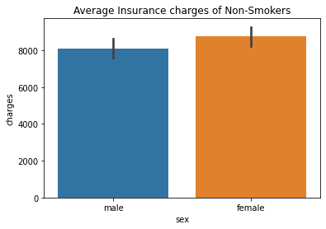
Data Visualization
Cheaper Insurance Charges
Longer Life span
Healthier Living

Slide 7
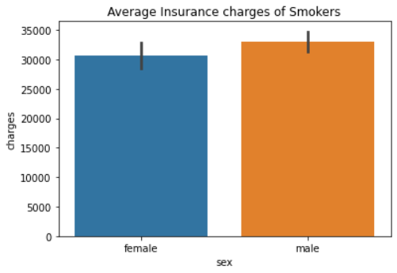
Data Visualization
More Expensive Premiums
Health risks
Shorter Life spans

Slide 8
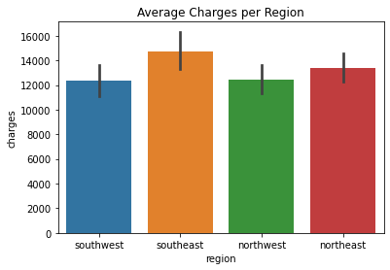
Data Visualizations
Differences in competition
State laws
Local rules
Cost of living
Affects of Location

Slide 9
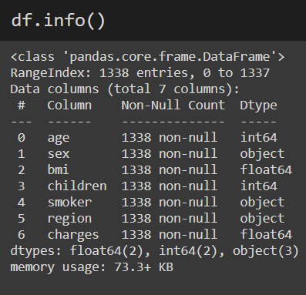
Clean Data
Data cleaning
Clean data
No missing values

Slide 10
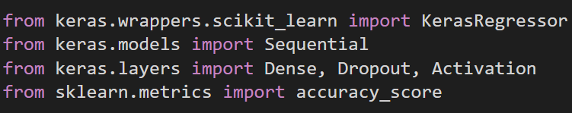
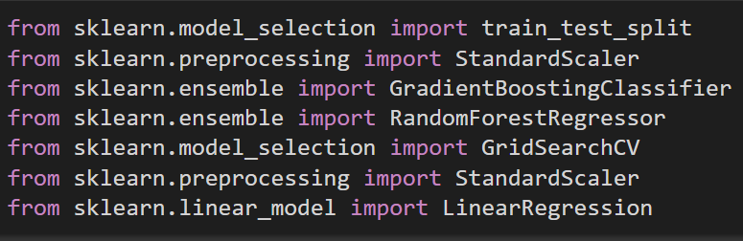
Preparing for modeling
Importing Necessary Libraries

Slide 11
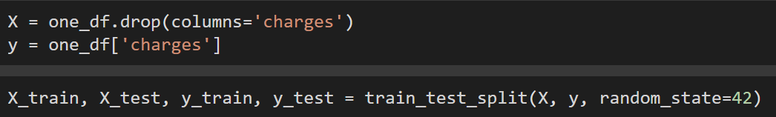
Preparing for modeling
Spitting the Data
Creating Validation

Slide 12
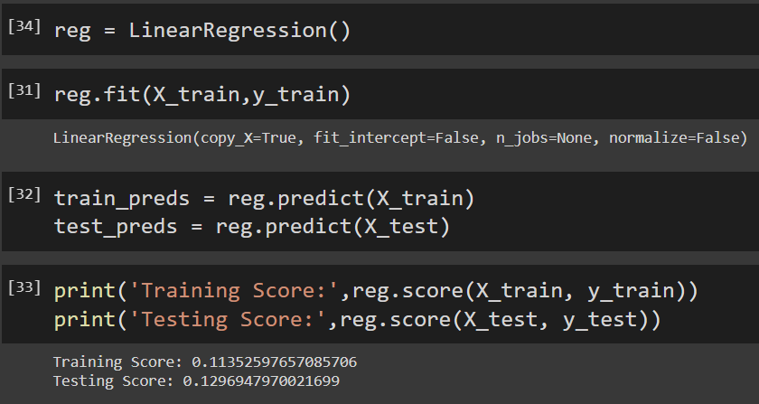
Linear Regression
Horrid Results
Tried scaling data

Slide 13
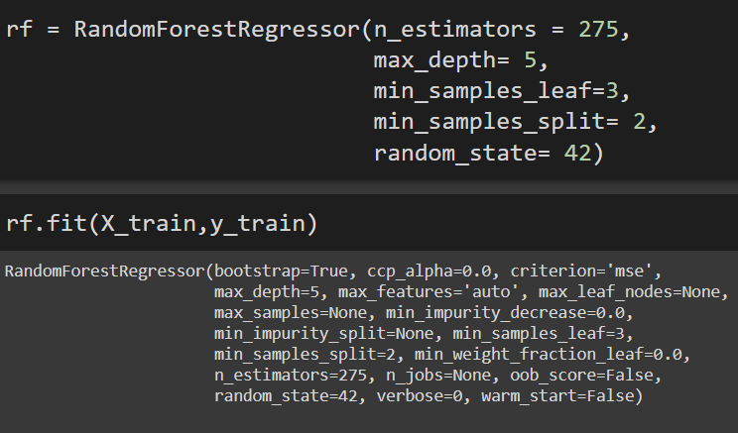
Random Forest Regressor
Used Grid Search
Find best params
Fitting

Slide 14
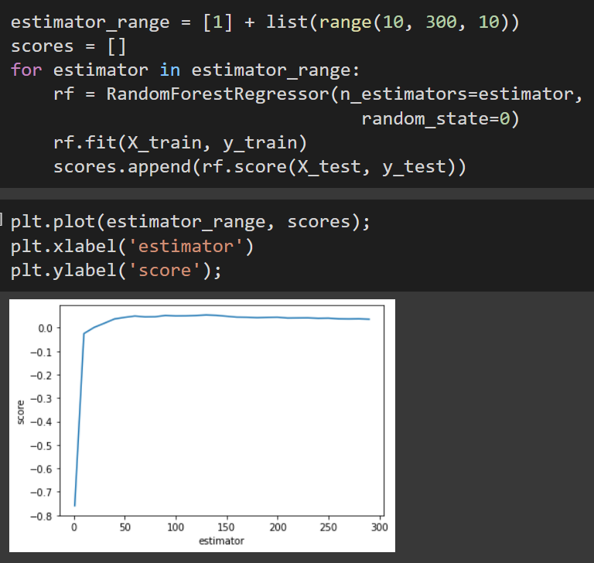
Random Forest Regressor Continued
Finding best estimators
Grid Search to find other params based on estimators

Slide 15
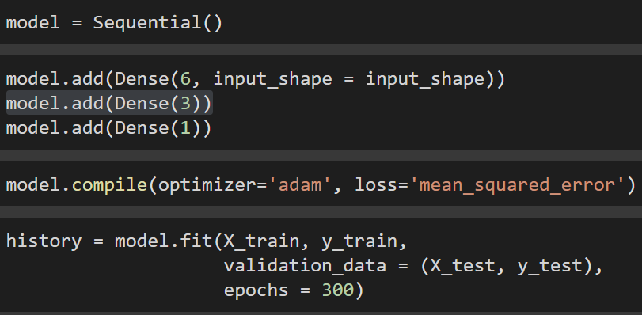
Keras Deep Learning
Building Model
Setting Layers
Compiling
Validating

Slide 16
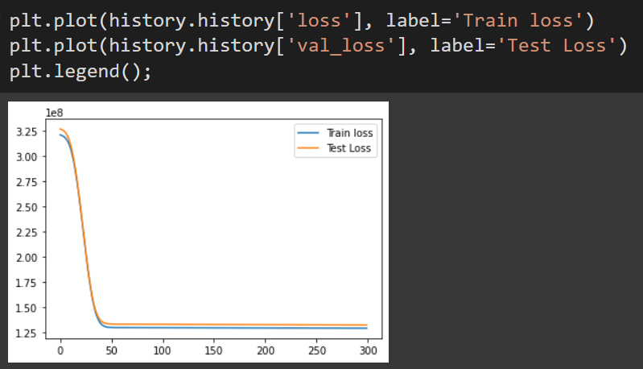
Keras Deep Learning Continued
Validation

Slide 17
Sources
https://www.quotacy.com/does-my-bmi-affect-my-term-life-insurance-rates/
https://parinsurance.com/how-smoking-affects-your-health-insurance-premiums/
https://www.healthcare.gov/how-plans-set-your-premiums/

