Slide 1

Alpha Compositing
Parallel Computing 2023-2024
Christian Mancini
Florence, 12 March 2024

Slide 2

Alpha Compositing
Florence, 12 March 2024
Alpha Compositing
What is alpha compositing
Alpha compositing is the process of combining one image with a background to create the appearance of partial or full transparency.
When alpha compositing is in use, each pixel has an additional numeric value stored in its alpha channel, with a value ranging from 0 to 1. A value of 0 means that the pixel is fully transparent and the color in the pixel beneath will show through. A value of 1 means that the pixel is fully opaque.
2

Slide 3


Alpha Compositing
Florence, 12 March 2024
Foreground (left) and background (right)
3

Slide 4

Alpha Compositing
Florence, 12 March 2024
Compositing Result
4

Slide 5
Alpha Compositing
Florence, 12 March 2024
Alpha Compositing Formula
The formula is very simple, we just have to apply it on each pixel.
5

Slide 6
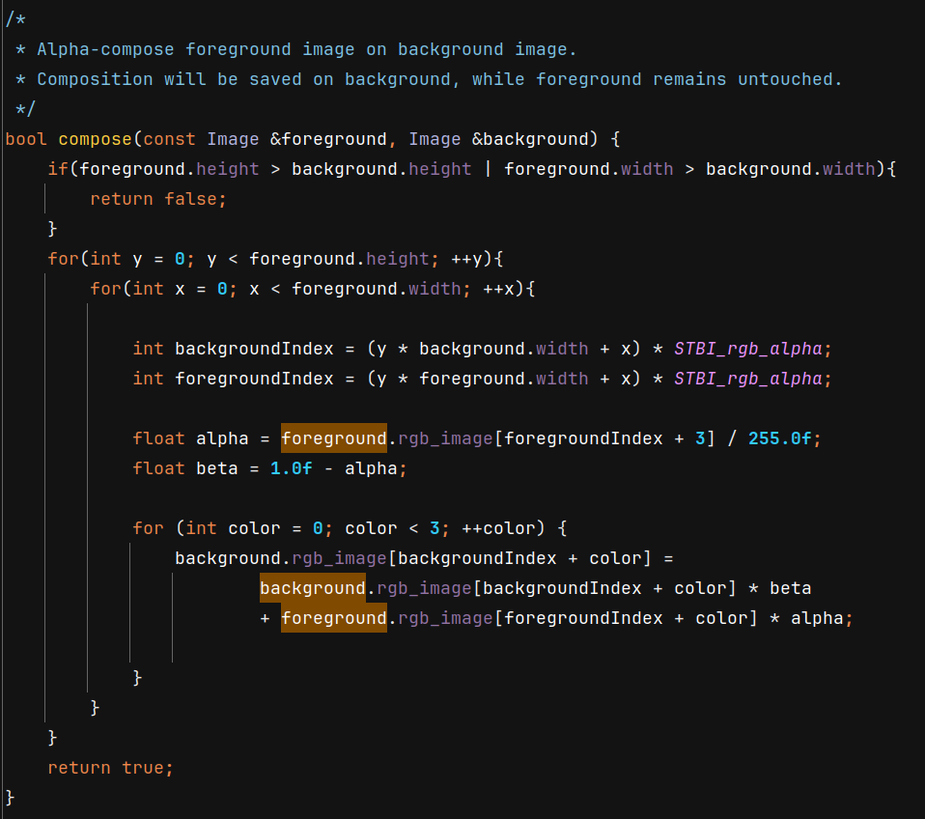
Alpha Compositing
Florence, 12 March 2024
Implementation

Slide 7
Alpha Compositing
Florence, 12 March 2024
Implementation
This implementation works with the serial and the parallel version since we decided to let a thread do a composition.
We will use OpenMP during the function call.

Slide 8
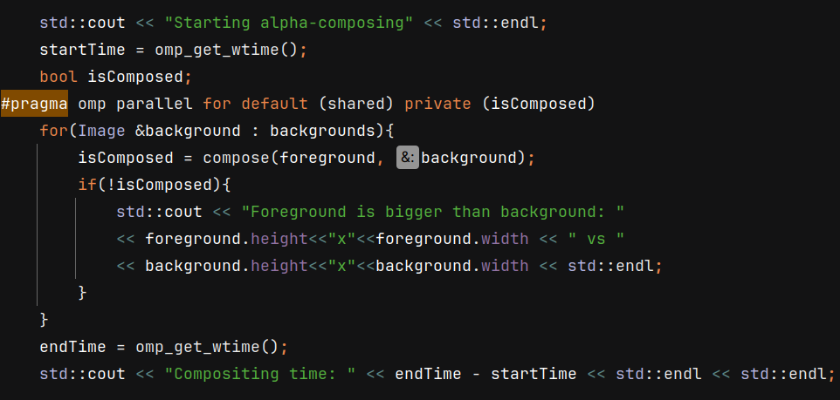
Alpha Compositing
Florence, 12 March 2024
Parallel Call
This implementation works with the serial and the parallel version since we decided to let a thread do a composition.
We will use OpenMP during the function call.
We just need a private copy the boolean variable isComposed

Slide 9
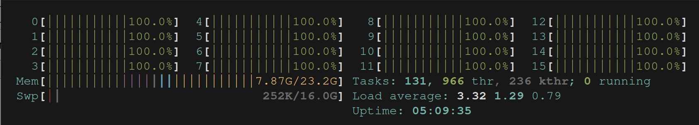
Alpha Compositing
Florence, 12 March 2024
Parallel work
Every core is working during the parallel execution

