Slide 1
Project Review Secure image transmission for military purpose
Made by.
Saksham and Ujjwal

Slide 2
Structure of our project Review
1.Firstly we have added the task which is to be performed by the user
2.We did coding in the python for every task performed in the encoding part(including cryptography and steganography)
We have attached screenshots of the output that we got in the compiler of the python
All the codes have been successfully implemented and checked.

Slide 3
Back Ground Subtraction
We have taken an image for the background subtraction which will undergo necessary changes before being transmitted – so like we have taken image of military man so the neccassary changes are as follows.
The main purpose of the image transmitted is share the image of the military personal with background subtraction we have removed the part of images which can leak some confidential info.

Slide 4
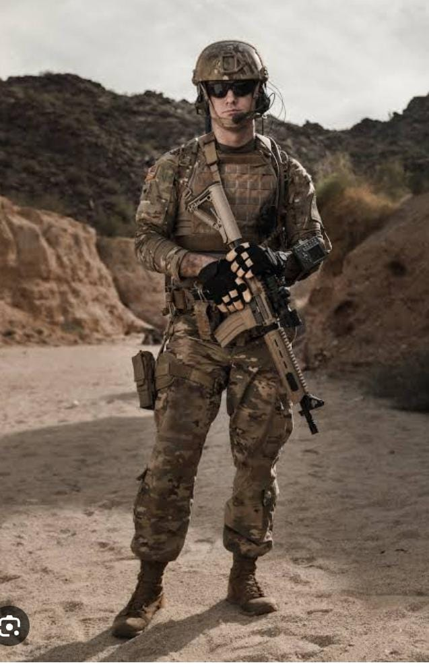
Screenshots with the picture that is being used.

Slide 5
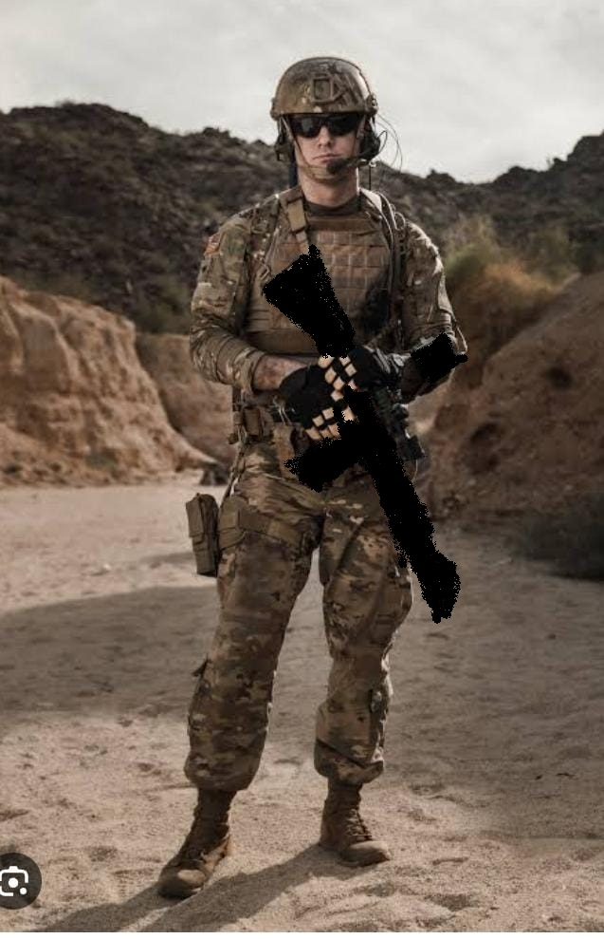
REMOVAL OF GUN FROM THE IMAGE WITH THW HELP OF PAINT

Slide 6
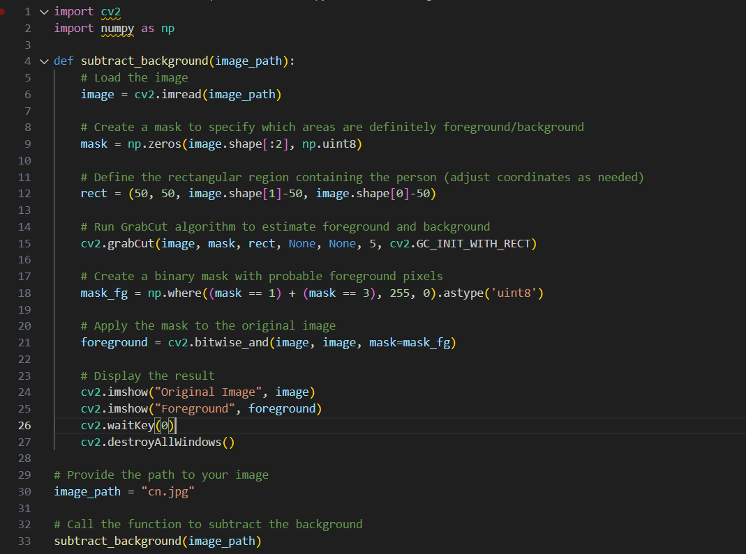
BACKGROUND SUBTRACTION CODE AND OUTPUT:

Slide 7
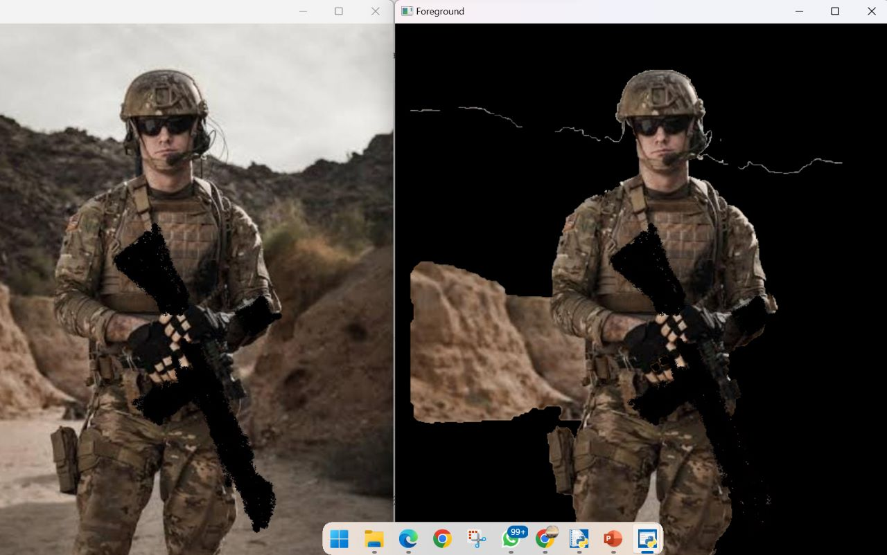
OUPTUT:

Slide 8
Cryptography.
The image the undergo cryptography with the code being generated using the python code
Cypher text is generated which is encoded version of the image.
Screenshots are attached on the next page

Slide 9
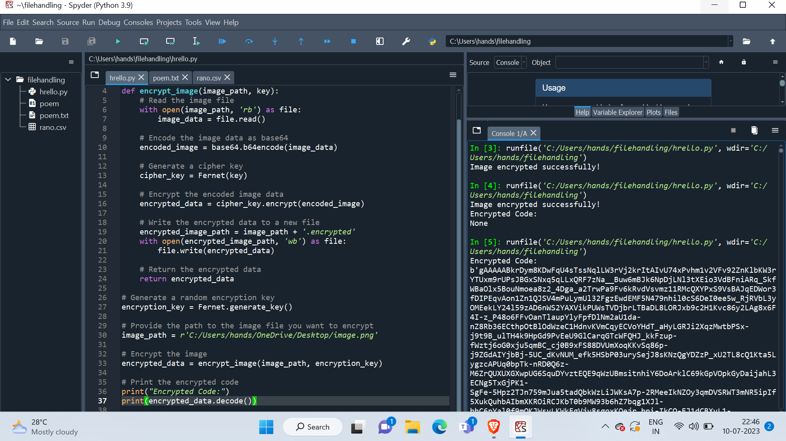
Screenshots of cryptography

Slide 10
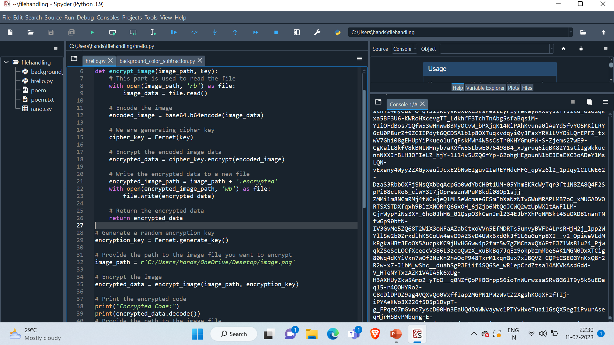

Slide 11
Now we have to move forward , we will hide our code behind some image.
We have taken image which is very common and generally no one can guess if something is being send behind this image(hidden inside it).
Image used is attached next page.
After generating the cipher text we have successfully embedded the code behind that image.

Slide 12

Image used. Path of the image :"C:\Users\hands\OneDrive\Desktop\house.png"

Slide 13
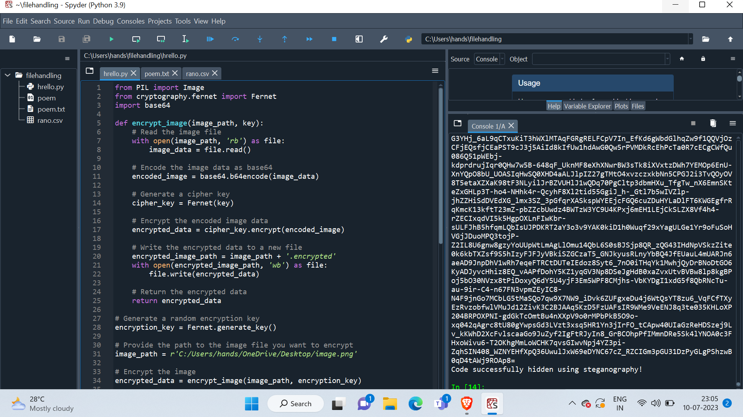

Slide 14
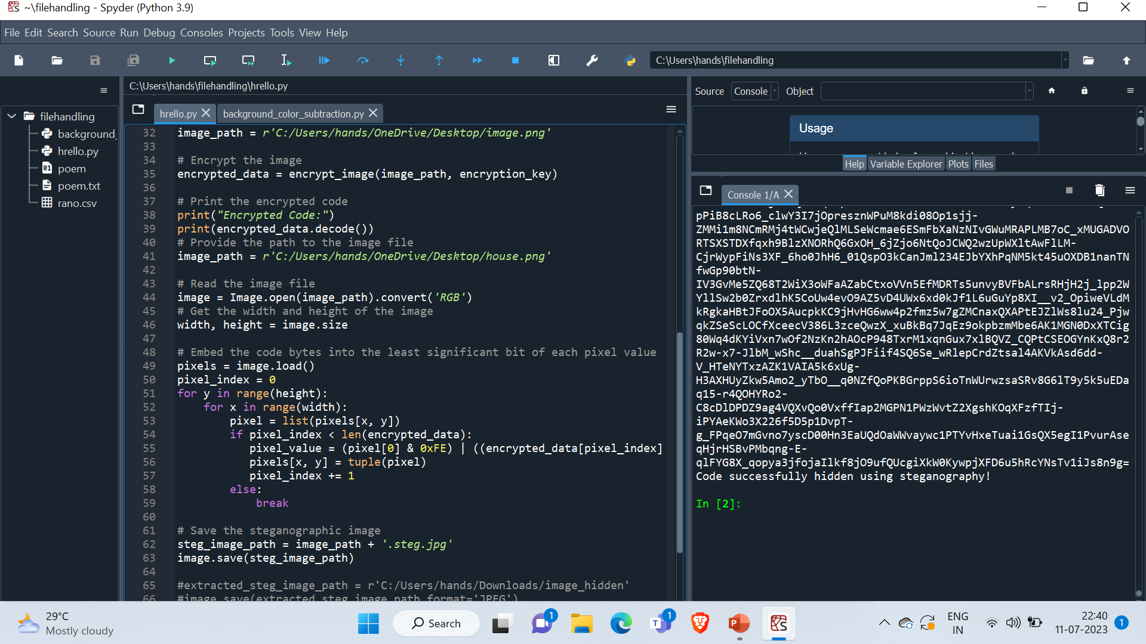

Slide 15
After the completing the Steganography
We have successfully completed all the steps involved in our project
We have removed the objects which were not required during the transmission
By using cryptography technique we have converted the image into a cipher text
We have used a house image to hide the text behind it just to make it more difficult for the unwanted people.

