Slide 1

j.health
Made by:
Antonio Butigan
Josip Mužić

Slide 2
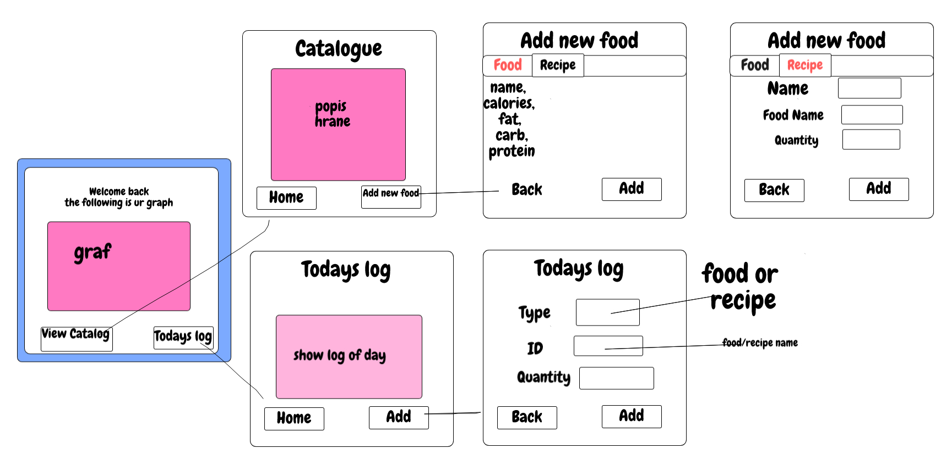

The design (Sketchpad)

Slide 3
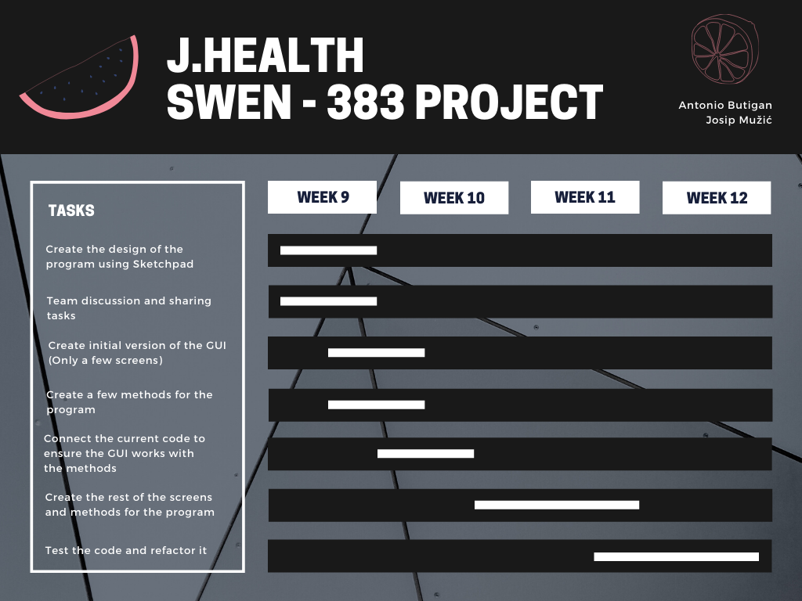
Task handling
These tasks will all be done in the following weeks!

Slide 4
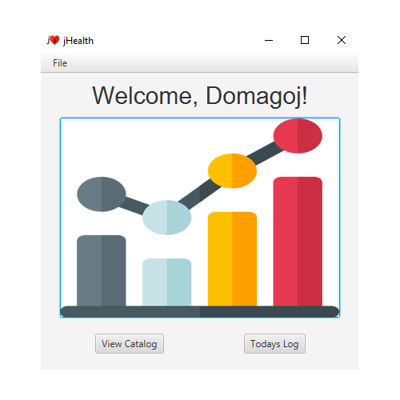
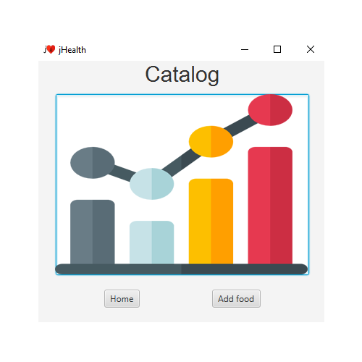
Some GUI examples
Upon pressing "View Catalog", the content of the window changes to the image on the right.

Slide 5
Thank you!
The cRITers Team

