Slide 1


Dependency Analysis Between Stock Value of PepsiCo, Inc. (PEP) and The Coca-Cola Company (KO)
Cameron Porteous
ACTSC445

Slide 2
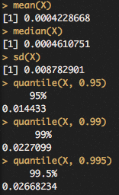
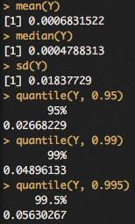
Working Data
a1,a2
X := log returns for PEP, 8 year period
Y:= log returns for KO, 8 year period
Both multinational beverage corporations

Slide 3
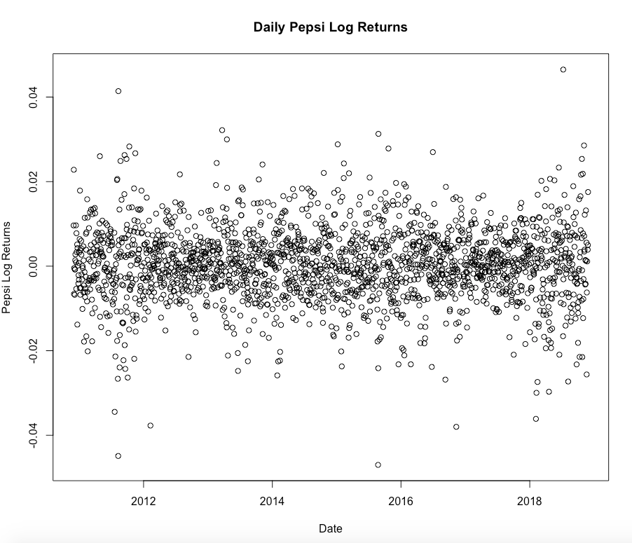
a3

Slide 4
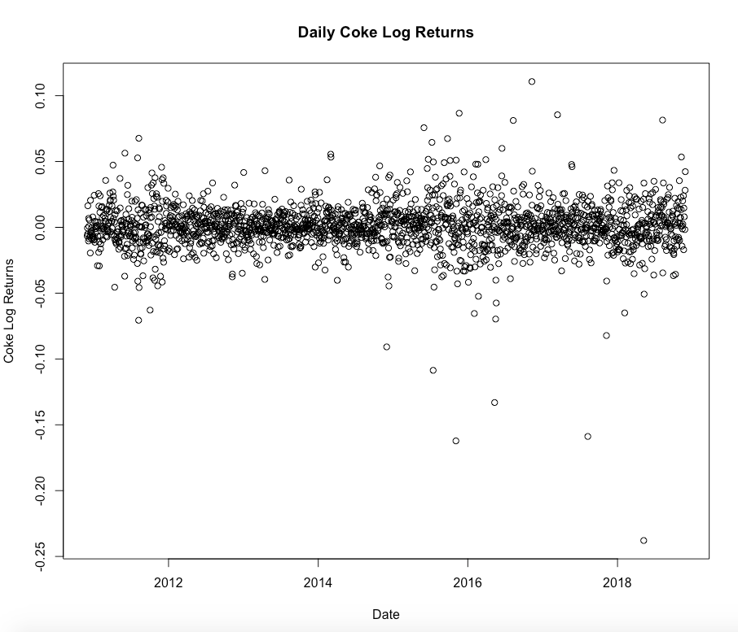

Slide 5
a4
The stocks are likely to behave similarly since their companies share the same industry, offer similar products, and operate at a similar scale

Slide 6
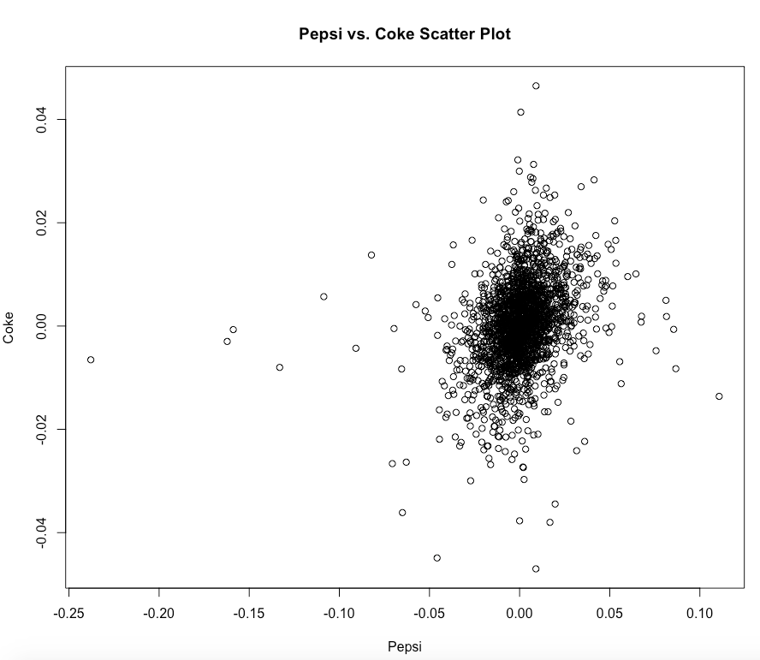
b1

Slide 7
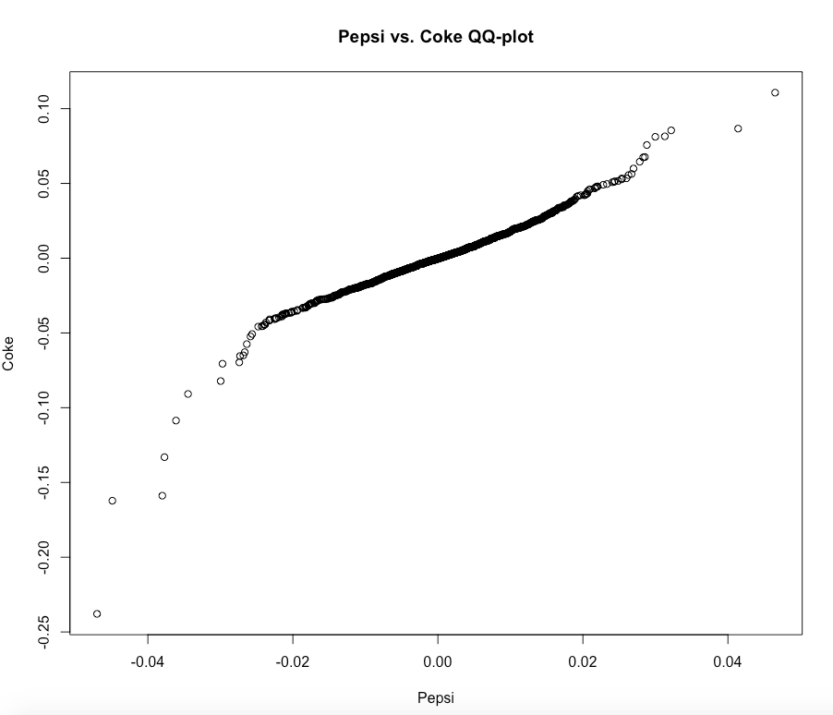

Slide 8
b2
The log returns are fairly clustered with a relatively small number of outliers
The log returns seem to be distributed symmetrically
The QQ-plot is roughly linear, so the bivariate normal distribution is a great candidate for fitting

Slide 9
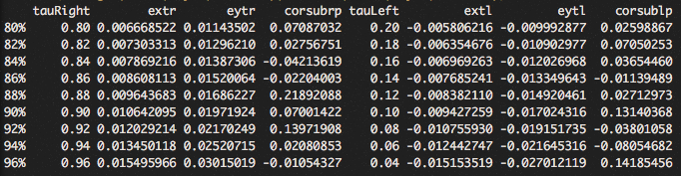
Correlation Analysis
c1,c2
cor(X,Y) Pearson = 0.2901118
e(x/y)(r/l) := quantile of (X/Y) at q = tau
corsub(r/l)p := Pearson correlation coefficient of subset of (X,Y)

Slide 10
c3
Majority of the correlation values are positive, and the vast majority of correlation values are of magnitude < 0.1
Tails are weakly and positively correlated

Slide 11
Tail Dependence Study
d1

Slide 12
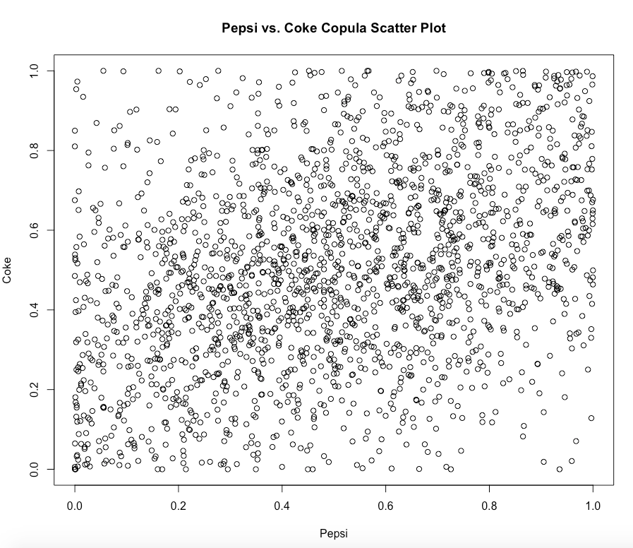

Slide 13
As previously claimed, we see a weak positive correlation between Pepsi and Coke

Slide 14
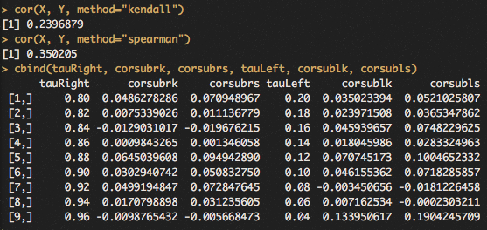
Kendall and Spearman Correlation
d2
corsub(r/l)(k/s) := (Kendall/Spearman) correlation coefficient of subset at corresponding quantile

Slide 15
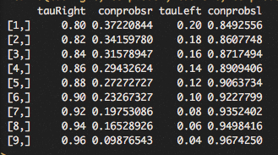
Estimating Conditional Tail Prob.
d3
conprobs(r/l) := estimated Pr(U>tau|V>tau)

Slide 16
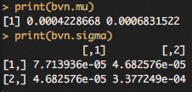
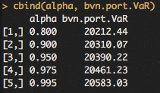
Fitting the Bivariate Normal
e1/e2
Using this model, we can obtain estimates for the VaR of the portfolio 10000(e^{X} + e^{Y})

Slide 17
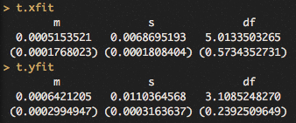
Copula-Based Model
f1/f2
We fit a t distribution to X and Y:
We construct the U and V as instructed:

Slide 18
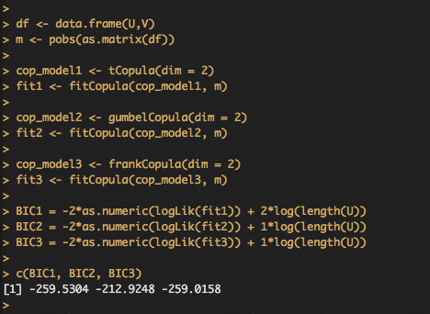
Fitting 3 Different Copulas
We choose to fit the t copula, Gumbel copula, and Frank Copula
We obtain the corresponding BIC values and fit the model with the lowest one:

Slide 19
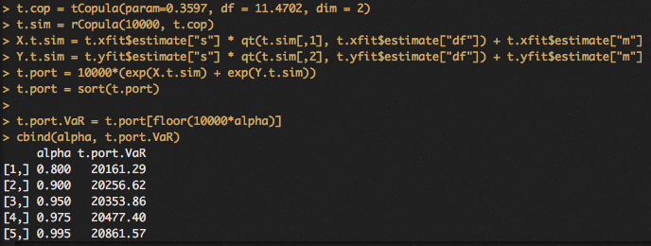
f3
We simulate (U,V) using the fitted t copula and use the t quantile function to obtain values for (X,Y)
We then obtain estimates for the VaR of the portfolio 10000(e^{X} + e^{Y})

