Slide 1
CoIoTe Problem
a Memetic approach
TEAM 35
Cometa, Davide 237684
CAPACCIO, Luca 230766
Dedominici, CHristopher 183704
Morales, CARLOS 237214
SAVA, CLAUDIO 232521

Slide 2
Problem description
Asking users to share the internet connection, offering some reward for it.
How to cover all the dumpsters minimizing the costs (reward).
Optimization Problem
Objective function : The goal of the project is to minimize the total amount of the reward.
Constraint (1) : Every dumpster must be visited.
Constraint (2) : The total amount of requests can not exceed the number of people in the cell.
Domain : The number of people must be an integer number.

Slide 3
Designing a solution
Steps:
Select a proper metaheuristic for the problem.

Slide 4
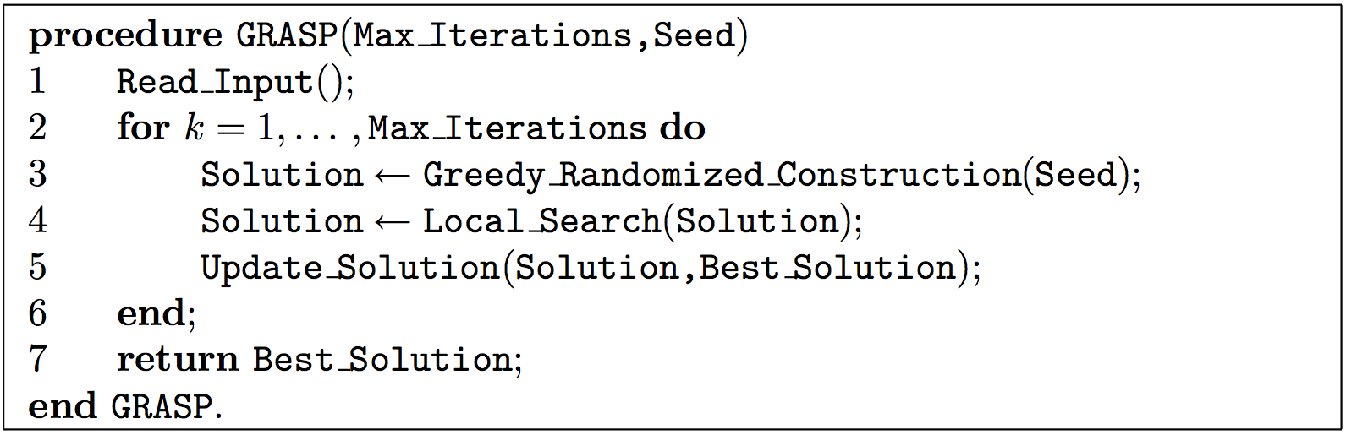
The GRASP option
A pure GRASP metaheuristic search algorithm states the following:
“Greedy randomized construction”:
By a greedy randomized adaptive procedure.
Taking moves randomly from a structure that order them by “quality”.
“Local search”:
A local search method it is applied to the trial solution.
Either a “best improving strategy” or a “first improving strategy”.
Source: “GRASP: Greedy Randomized Adaptive Search Procedures”. Resende, Mauricio et al.

Slide 5

Designing a solution
Steps:
Select a proper metaheuristic for the problem. GRASP.
Define a “Greedy randomized construction” of possible solutions.
Define a local search method to find a better solution.

Slide 6
A greedy randomized solutions generator
A structure of moves ordered by “quality”:
A multimap of all possible moves, ordered by their cost/task ratio:
Randomization:
Given by the shuffle of the order in which cell’s demands are satisfied.
Greedy:
Taking from the multimap, for each cell, sequentially and myopically, the most efficient moves until its demand is satisfied.
Adaptive:
At each iteration, the move chosen is a function of the moves previously chosen.

Slide 7
Designing a solution
Steps:
Select a proper metaheuristic for the problem. GRASP.
Define a “Greedy randomized construction” of possible solutions.
Define a local search method to find a better solution.

Slide 8
Local search method
At the beginning of our analysis, we observed that using this costs structure and a classical local heuristic for the local search phase, such as Steepest Descent or First Improvement, could lead to a local minimum.
In order to escape from this possible local minimum, we decided to replace those classical heuristics with the Simulated Annealing metaheuristic.

Slide 9
Memetic approach – SA research
A neighborhood based metaheuristic.
Inspired in the controlled annealing of metals for improving its characteristics.
The worsening solutions are stochastically accepted with a probability affected inversely by the “temperature of the system”.
The initial temperature is the maximum and during the simulation the system is constantly cooling, making worsening solution less probable to be accepted.
Source: https://en.wikipedia.org/wiki/Simulated_annealing

Slide 10

Memetic approach – SA research
Our SA implementation:
Probability of accept worsening solutions:
It is used the classic simulated annealing enunciation (Kitpatrick et al.).
Temperature of the system:

Slide 11
Designing a solution
Steps:
Select a proper metaheuristic for the problem. GRASP.
Define a “Greedy randomized construction” of possible solutions.
Define a local search method to find a better solution. Simulated Annealing.
Define the neighborhood generation.

Slide 12
Neighborhood generation
Basic idea:
Select a random subset of cells.
For each cell of the subset delete all its moves.
Solve again the cell’s demands, considering this time also worse moves from costPerTask map, getting a new neighbor.
Worsening strategy
The neighbor solution can be better or worse than the current one because when it selects the moves to solve the demand the algorithm sometimes it's forced to skip the best ones on the base of a worsening probability.

Slide 13
Designing a solution
Steps:
Select a proper metaheuristic for the problem. GRASP.
Define a “Greedy randomized construction” of possible solutions.
Define a local search method to find a better solution. Simulated Annealing.
Define the neighborhood generation.

Slide 14




Testing the solution
Instance OF Gap
Co_30_1_NT_0 1055
Co_30_1_NT_8 2324
Testing machine specifics:
CPU: Intel Core i7-4710HQ (2,5GHz)
RAM: 8GB
4 Cores
Operating system: Ubuntu 64bit
Co_100_1_T_7 5291

Slide 15
Tuning the search
Refine worsening probability.
Define the dimension of the subset of cells to be solved in a different way for the neighborhood generation.
Adjust Simulated Annealing parameters.

Slide 16
Tuning the search - Adjust Simulated Annealing parameters
Initial temperature definition:
At the beginning of the procedure, each worsening variation of the objective function had to be accepted in order to escape from possible local minimum.
To do that it had to result exp(-Δf/T0)≈1 ∀Δf >0 and so (-Δf/T0)≈0. The choice was performed as follows:
Considering the initial objective function.
Assuming a maximum objective function variation value: Δfmax=|f0/2|.
Assigning T0 = 10 * Δfmax.
Final temperature definition:
As stopping condition of the whole SA procedure we decided to define a final temperature to be reached. The definition criteria was as follows:
Considering the initial objective function.
Establishing a reference value for the minimum objective function variation: Δfmin=0.001*|f0/2|.
Assigning Δf = 0.1*Δfmin
Calculating TF = Δf/0.69

Slide 17
Tuning the search - Adjust Simulated Annealing parameters
α (cooling parameter) :
We observed that a high value(i.e. 0.99) made the cooling process too slow, allowing only small “Plateau” value to fulfill time constraints, while a small cooling parameter admit high “Plateau” values in order to restore energy balance condition. We decided for 0.5.
“Plateau” value:
According to the previous consideration about the cooling parameter, we decided to assign:
L = 15 * |Neighborhood|.

Slide 18
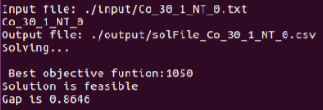
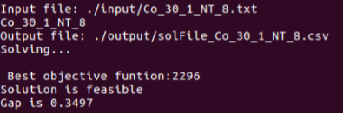
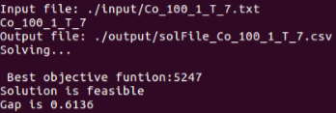

Testing the tuned solution
Before After
Testing machine specifics:
CPU: Intel Core i7-4710HQ (2,5GHz)
RAM: 8GB
4 Cores
Operating system: Ubuntu 64bit

Slide 19
Results Pie Chart
Mean Gap is: 0.15%

Slide 20
Conclusion and learned lessons
Saying we met the desired gap threshold, we consider the main objective was accomplished.
Drawbacks:
If total number of tasks required are equal or very close to the ones available to solve them, the metaheuristc is not capable to find a solution without wasting tasks.
The metaheuristic is not able to find a uniform degree of rebuilt as we noticed from some tests;
Advantages:
Our metaheuristic provides higher performances with 20 timesteps instances because of the higher number of users and a greater number of possible combinations for choosing moves to create a solution.
The combination of GRASP, Simulated Annealing and the costs multimap allow us to obtain good results in a short time. Neverthless the tuning phase has been fundamental in order to improve gap results.

Slide 21

Thank you for your attention!

