Slide 1
RPOSC – Redpitaya Oscilloscope
by Sebastian Ederer, Florian Henneke, Michael Schneider, Alexander Schmid
Overall task
Implement an extensible Logic Analyzer application for the Red Pitaya
In this HSP
Implement the acquiring and decoding of 16K Samples of UART, SPI, I²C and CAN data

Slide 2
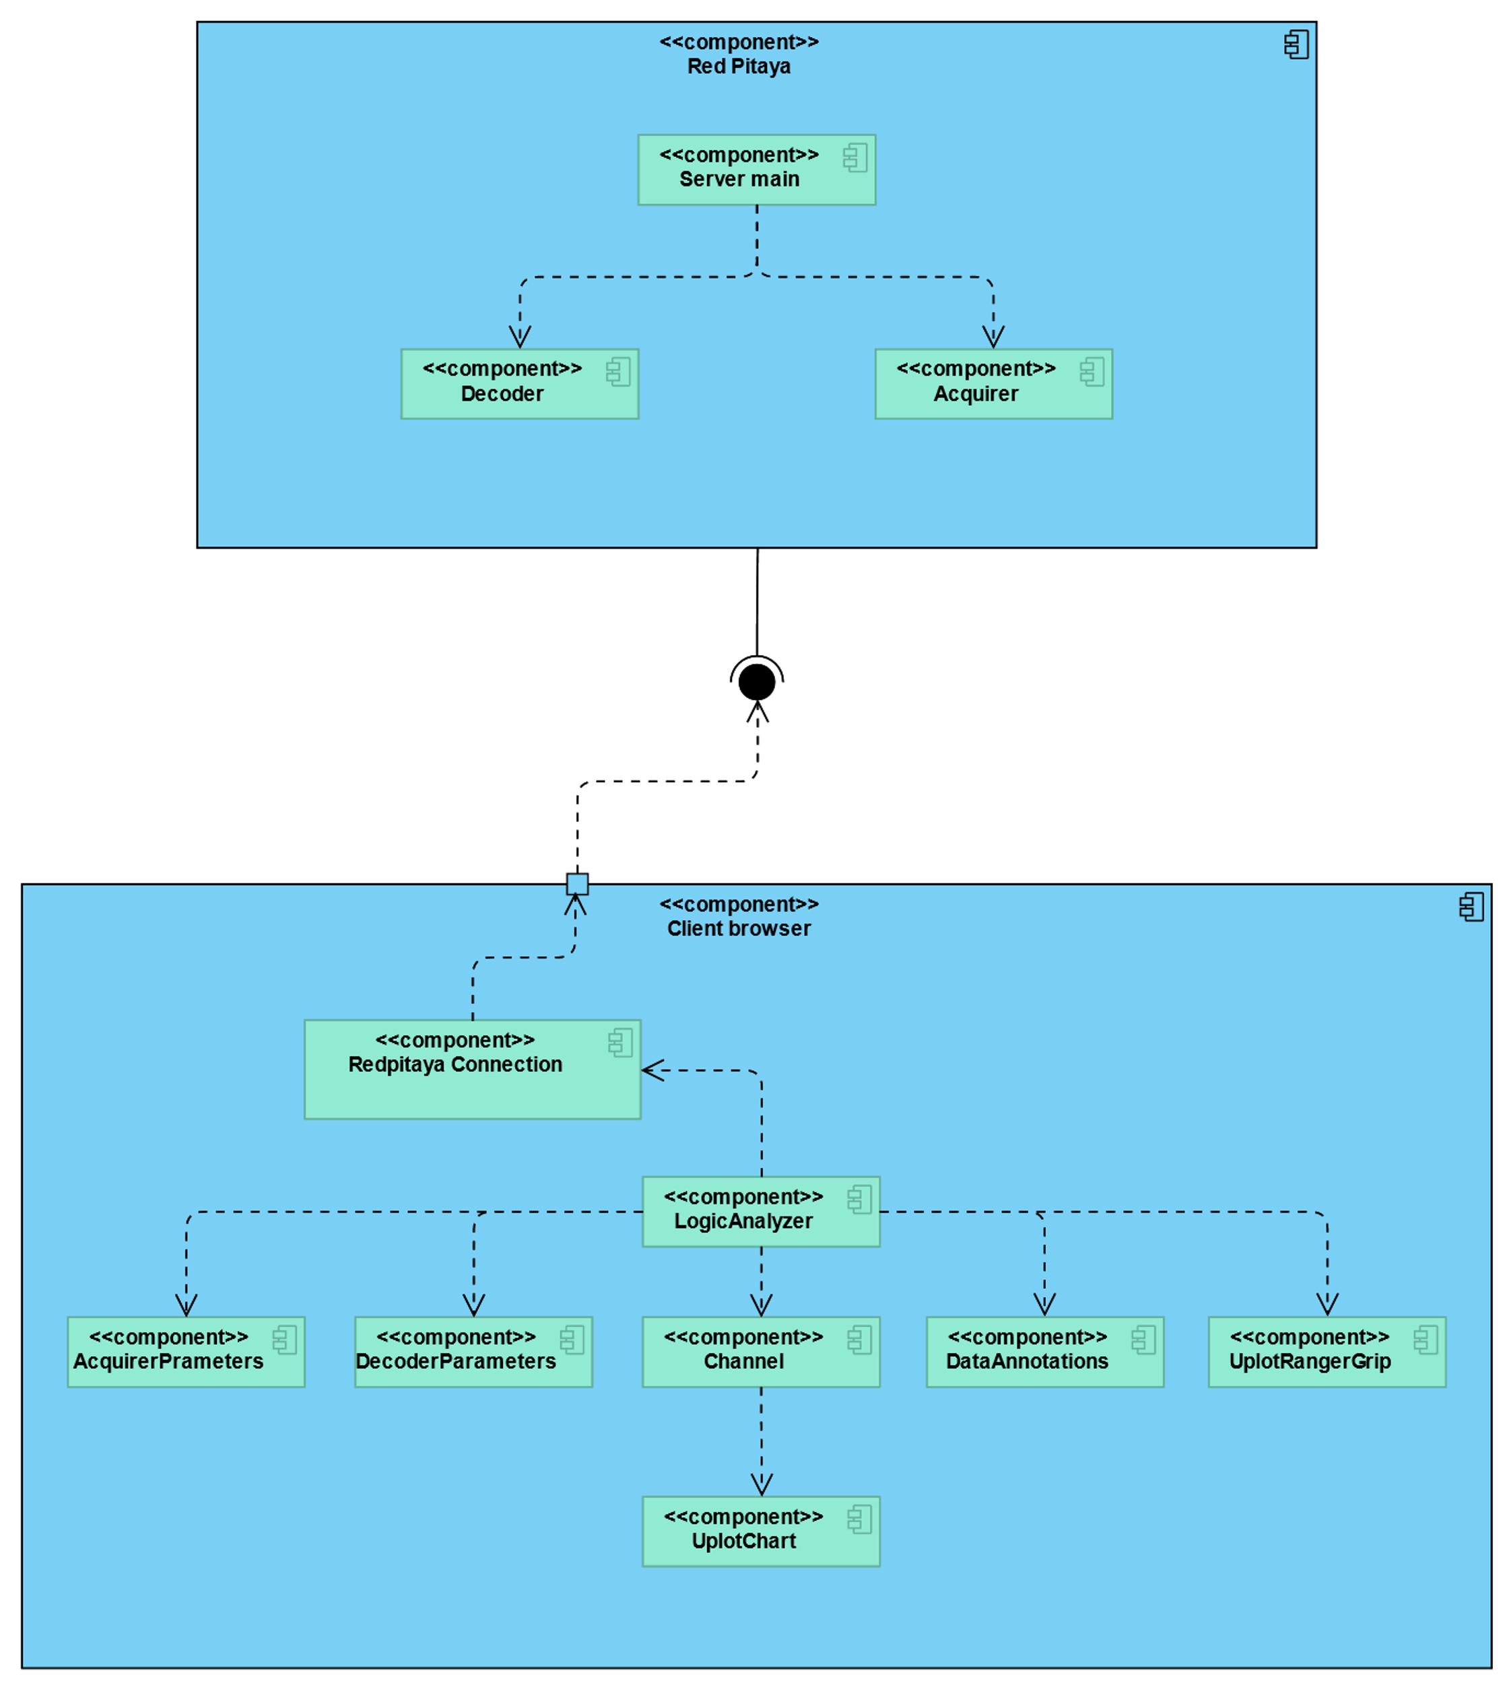
Overview
Michael Schneider, Florian Henneke
Alexander Schmid,
Sebastian Ederer

Slide 3
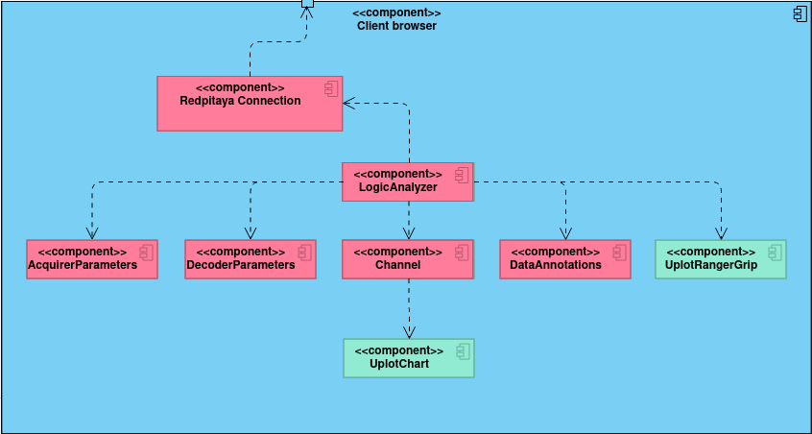
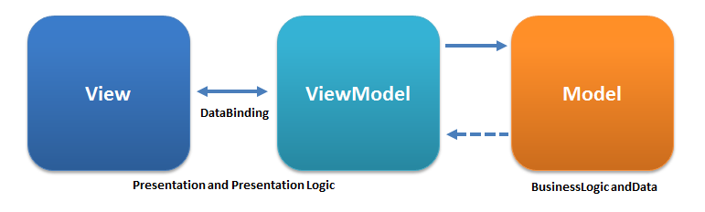
Contents (Alexander Schmid)
Port relevant parts of the project to TypeScript
Implement remaining functionality needed for a complete configure, acquire, decode and display pass
Sending the channel mapping
The AcquirerParameters (View, Model and ViewModel)
Displaying measured data
Displaying decoder annotations
The MVVM-Pattern, Ugaya40, 2012-04-12, Wikimedia, https://commons.wikimedia.org/wiki/File:MVVMPattern.png, accessed on 2021-09-20

Slide 4
Result (Alexander Schmid)
Project now uses TypeScript with type annotations where appropriate for fewer type-errors
Vue.js works with TypeScript using the third-party library vue-class-component
The AcquirerParameter view uses Math.js to parse units that the user inputs along with decimal and binary prefixes
All UI-logic needed for a configure, acquire, decode, display pass is implemented and working

Slide 5
Future Directions (Alexander Schmid)
Implement the handling and displaying of configuration errors
Implement tooltips to explain to the user which units they can input
Implement the selection of different acquirers (stock FPGA image, streaming server)

Slide 6
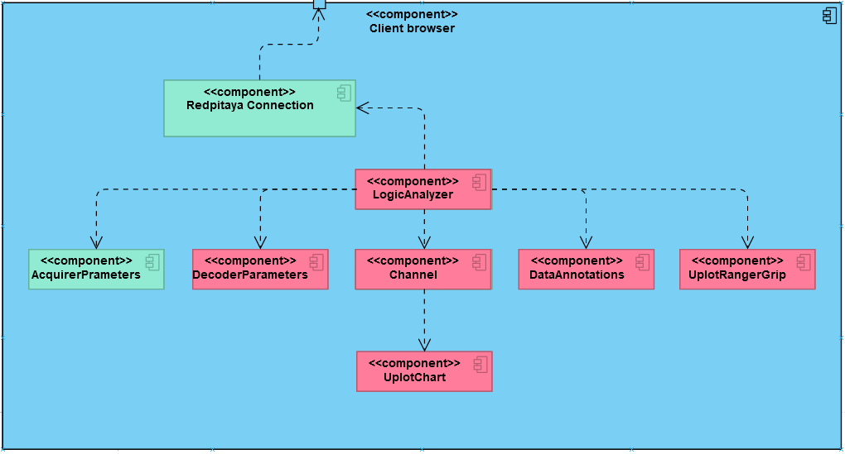
Contents (Sebastian Ederer)
Requirements:
Better performance to be able to display thousands of data points
Rendering data annotations
UX-friendly zooming and scrolling with mobile support through thousands of data
Synchronizing cursor, zooming and scrolling along all channels and the data annotations

Slide 7
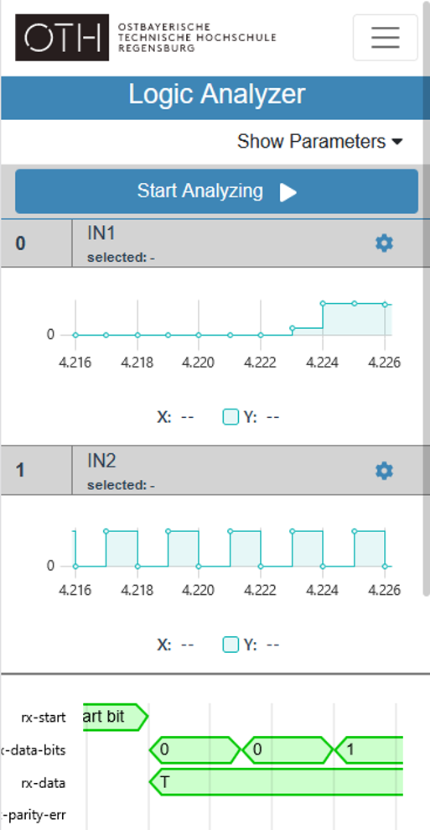
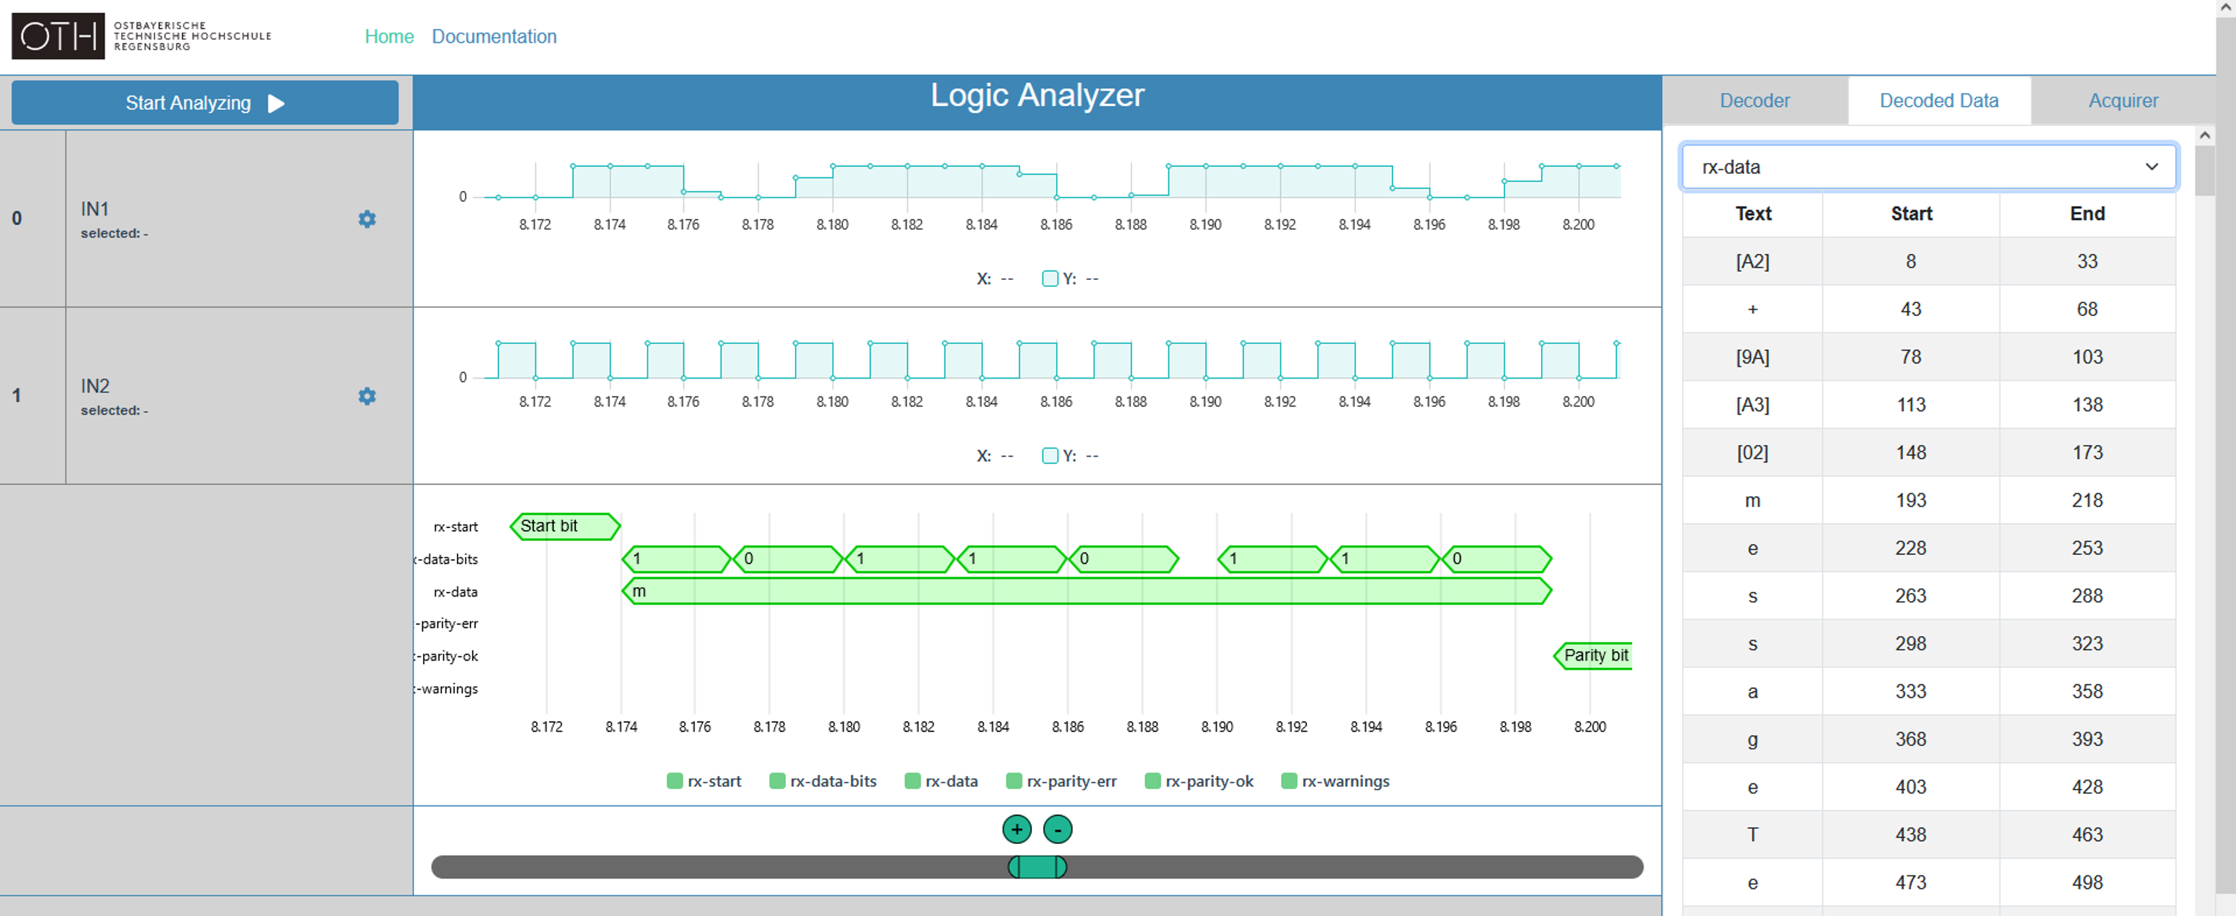
Results (Sebastian Ederer)
Data visualization was realized with uPlot
Data annotations, scrolling and zooming was designed and implemented from ground up
Responsive design was realized using Bootstrap and event listeners for canvas elements

Slide 8
Future Directions (Sebastian Ederer)
Using Web Workers (multithreading) to compute multiple tasks at once and to enhance the performance
Store current state of logic analyzer in local storage/cookies
Import/export of configurations and datasets
Detailed research on browser compatibility

Slide 9
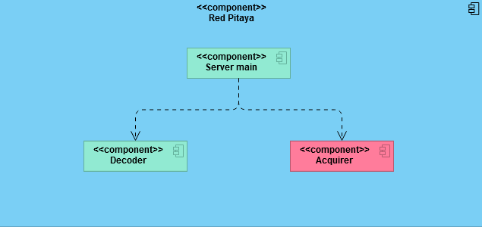
Contents (Michael Schneider)
More performance with cross-build solution
Send requested options to frontend
Receive chosen options from frontend
Validate, Parse and use the received options
Update libsigrok to newer version
Debugging/fixing occurring issues

Slide 10
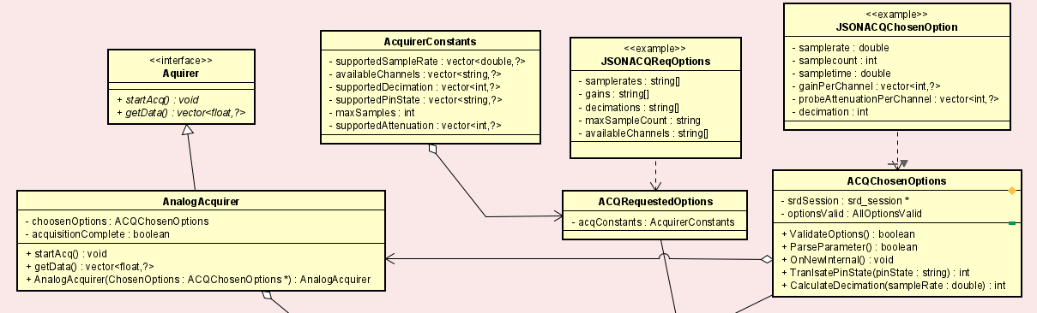
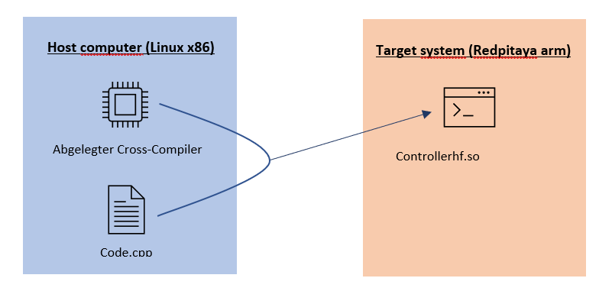
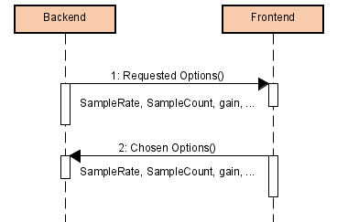
Results (Michael Schneider)
Cross-Build:
Cmake and make
Arm-hf Compiler, headers, libraries integrated in project
Acquirer options exchange (JSON):
Send set of data, receive chosen ones
Acquisition
Interface (expandability)
Use chosen options to set up
Libsigrok
Use absolute values for decoding (255 and 0) to get correct data

Slide 11

Future Directions (Michael Schneider)
Implement digital acquirer
Github project is updated but not released (supports much more sample rates etc).
If released project and Redpitaya should be updated
Singleton for acquirer, so only one can exist and be used at a time.
Unit and Integration tests

Slide 12
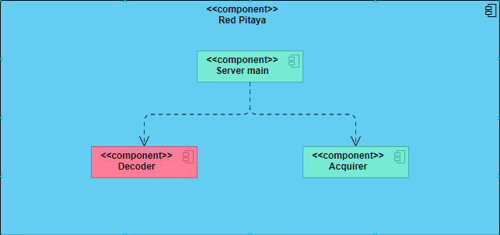
Contents (Florian Henneke)
Cross Build Environment: Easy to use and to configure environment, that builds the app fast on the developers machine.
Build Deploy: Way to build a complete folder of the app with one call on a set environment.
Provide frontend with test annnotation data
Expand the backend with libsigrokdecode functionality:
Add sending of real requested options, and channels
Provide functionality to set chosen options and the channel mapping
Combine everything with the LogicSession to acquire, decode and send the measured data.
Updating Libsigrok in order to eliminate old bugs and to support a wider range of decoders.

Slide 13
Results (Florian Henneke)
Cross Build:
Environment clonend from redpitaya image and integrated using CMake
Short build times + partial rebuilds
Build Deploy:
One script to build front- and backend and to copy the built files togehter with a config in a folder, which only has to be copied to the RedPitaya.
Github Action to build on Ubuntu Basis which sets SW versions, with which everything works (Same versions as in the VM Image)
SW Expansion:
Old libsigrokdecode (srd) did work, but did not decode very well. Had also problems with data acquired on runtime.
After update of srd: While runtime, srd loses its Python reference -> completely reload srd on some operations -> all decoders and options have to be set newly.
Currently we only can confirm a working UART decoder with baudrates up to 2 MBaud

Slide 14
Future Directions (Florian Henneke)
Add functionality for i2c and CAN decoders.
Singleton concept for unique parts of backend (currently everything, after next point the general classes, which are used by multiple decoders or acquirers)
DecoderManager class:
Concentrating all of Libsigrokdecode into one class
Handling multiple decoders and their associated communication (container) classes.

Slide 15
It was a great experience. We learned a lot!

