Slide 1
C.A.T. Weaver Rules Data Structure
By Charles Cook in cooperation with Sean Curry

Slide 2
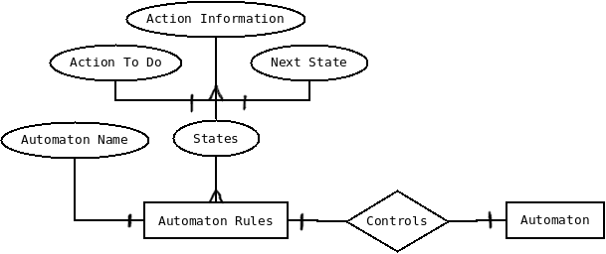

ER and Entity Class Diagram

Slide 3
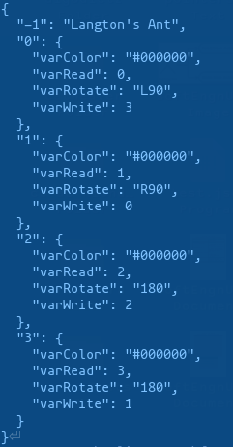
Sample Ruleset File (.json format)

