Slide 2
应用部署
APP
小程序
PC
access_token
nginx
access_token
auth svr
user svr
order svr
user
misc
order

Slide 3
依赖关系
aiwan-common
aiwan-starter-swagger2
aiwan-starter-monitor
aiwan-starter-oauth2
aiwan-core
aiwan-microsvr-api
aiwan-web-auth
aiwan-web-crm
aiwan-microsvr-misc
aiwan-microsvr-order

Slide 4
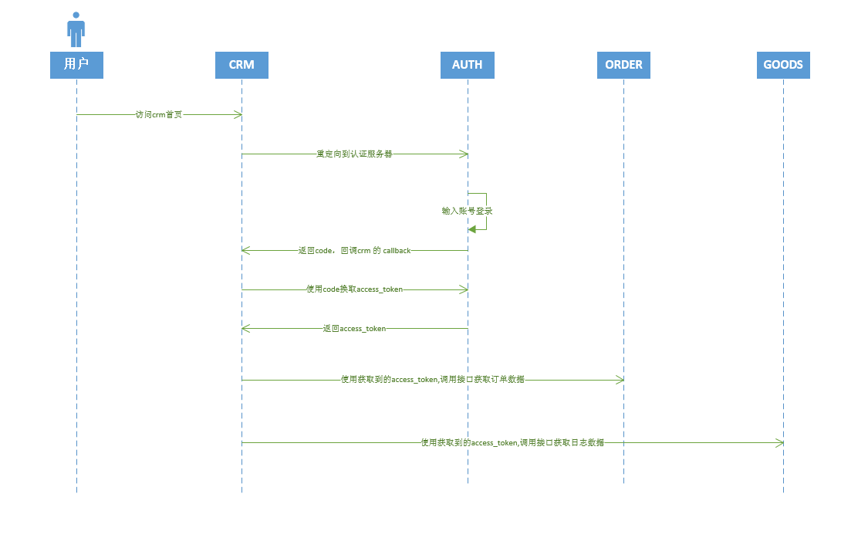

Slide 5
安全域内，不需要认证
user svr
auth front
username&password
auth web
auth
auth mall
mall web
goods svr
access_token
auth
APP
APP API
access_token
order svr

