Slide 1

AI
CA1
Tun Jing Ang :D00198874
Wenyu Shi :D00198805

Slide 2

Semantic Networks
A semantic network, or frame network is a knowledge base that represents semantic relations between concepts in a network.

Slide 3
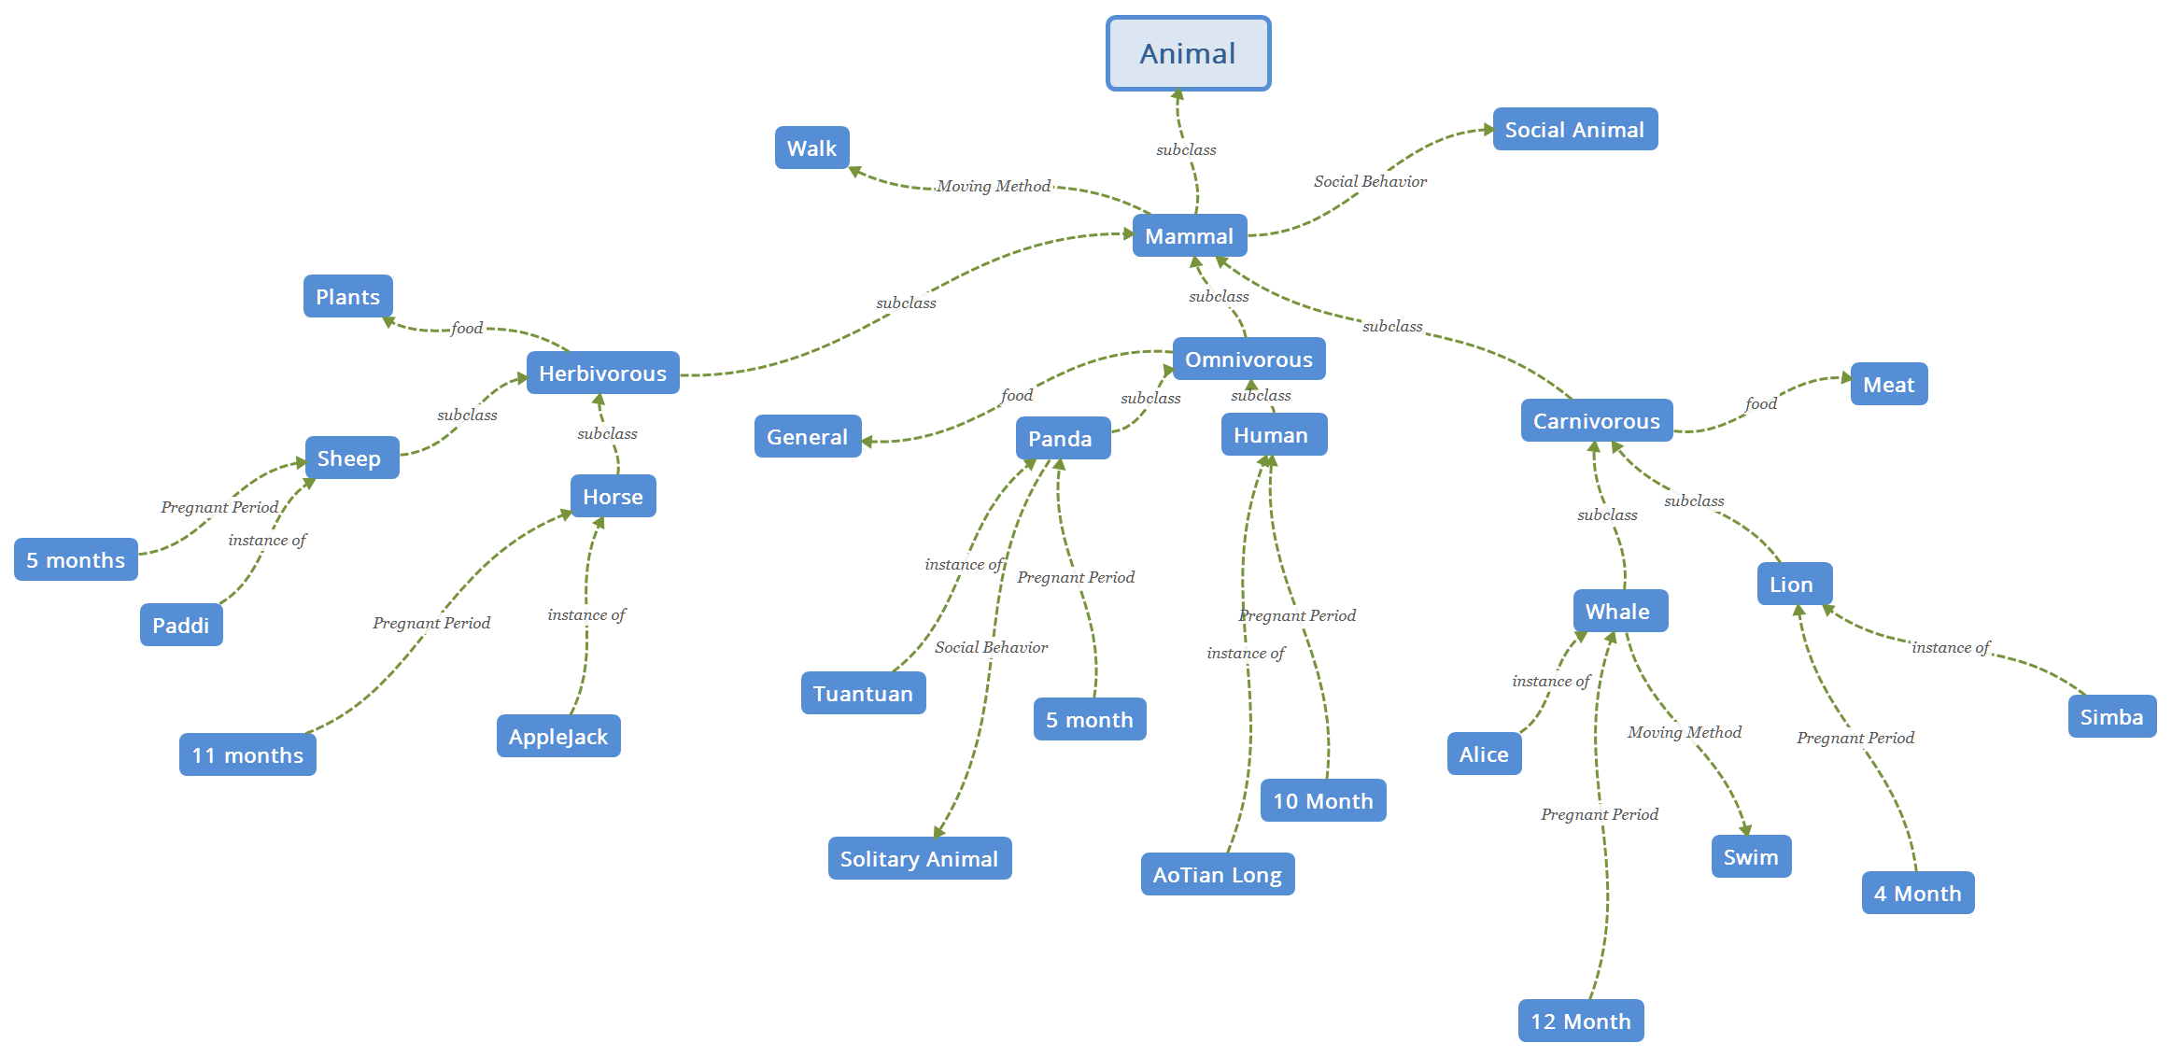
Semantic Networks Example

Slide 4
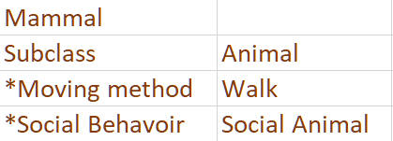
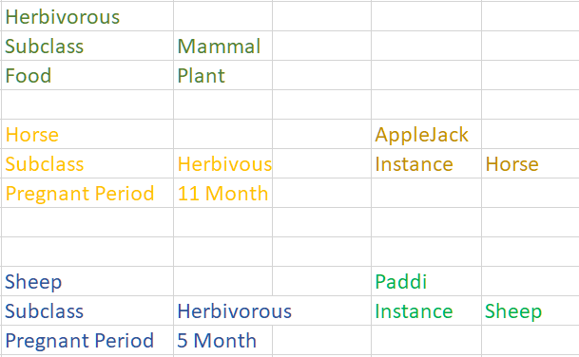
Example Frame
Mammal is a subclass of Animal.
The moving method of mammal is walk, and mammal is social animal.
Herbivorous is a subclass of mammal and eats plants.
Horse is a subclass of herbivorous, and the pregnant period of horse is 11 months.
Sheep is a subclass of herbivorous, and the pregnant period of sheep is 5 months
Paddi is a sheep.
Applejack is a horse.
Notes:
Explanation:
Mammal is a subclass of Animal. The moving method of mammal is walk, and mammal is social animal.
Herbivorous is a subclass of mammal and herbivorous eat plants. Sheep and horse are subclass of herbivorous.
The pregnant period of sheep is 5 months. The pregnant period of horse is 11 months.
Paddi is a sheep. Applejack is a horse.
Omnivorous is a subclass of mammal and omnivorous eat plants and meat. Panda and human are subclass of omnivorous.
Panda is solitary animal and pregnant period is 5 months. The pregnant period of human is 10 months.
Tuantuan is a panda. AoTian Long is a human.
Carnivorous is a subclass of Animal and eat meat. Whale and lion are subclass of carnivorous.
The moving method of whale is swim and the pregnant period of whale is 12 months. The pregnant period of lion is 4 months.
Alice is a whale, Simba is a lion.

Slide 5
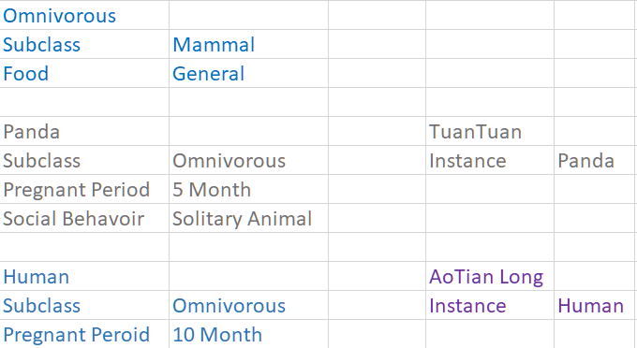
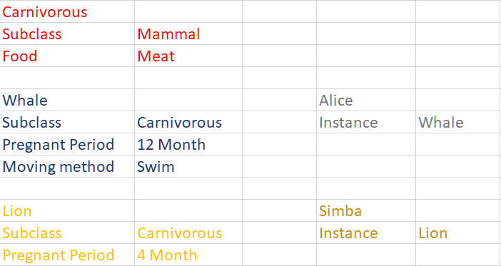
Omnivorous is a subclass of mammal and eats general food.
Panda is a subclass of omnivorous.
The pregnant period of Panda is 5 months and panda is solitary animal.
Human is a subclass of omnivorous.
The pregnant period of human is 10 months.
Tuantuan is a panda. AoTian Long is a human.
Carnivorous is a subclass of Animal and eats meat.
Whale is a subclass of carnivorous.
The moving method of whale is swim, the pregnant period of whale is 12 months.
Lion is a subclass of carnivorous.
The pregnant period of lion is 4 months.
Alice is a whale.Simba is a lion.
Notes:
Explanation:
Mammal is a subclass of Animal. The moving method of mammal is walk, and mammal is social animal.
Herbivorous is a subclass of mammal and herbivorous eat plants. Sheep and horse are subclass of herbivorous.
The pregnant period of sheep is 5 months. The pregnant period of horse is 11 months.
Paddi is a sheep. Applejack is a horse.
Omnivorous is a subclass of mammal and omnivorous eat plants and meat. Panda and human are subclass of omnivorous.
Panda is solitary animal and pregnant period is 5 months. The pregnant period of human is 10 months.
Tuantuan is a panda. AoTian Long is a human.
Carnivorous is a subclass of Animal and eat meat. Whale and lion are subclass of carnivorous.
The moving method of whale is swim and the pregnant period of whale is 12 months. The pregnant period of lion is 4 months.
Alice is a whale, Simba is a lion.

Slide 6
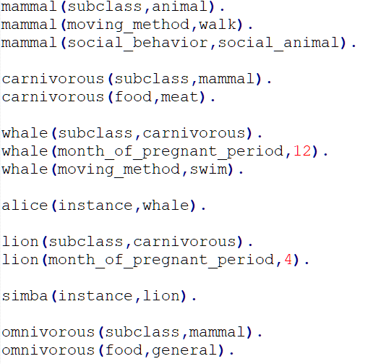
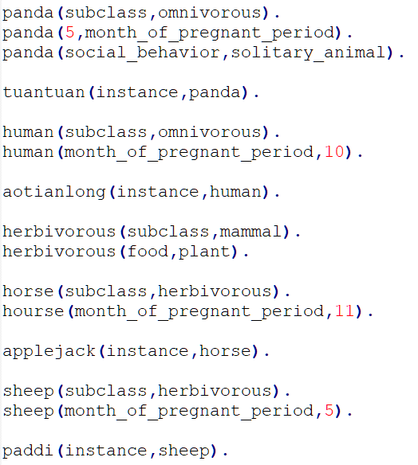

Facts
Rules

Slide 7
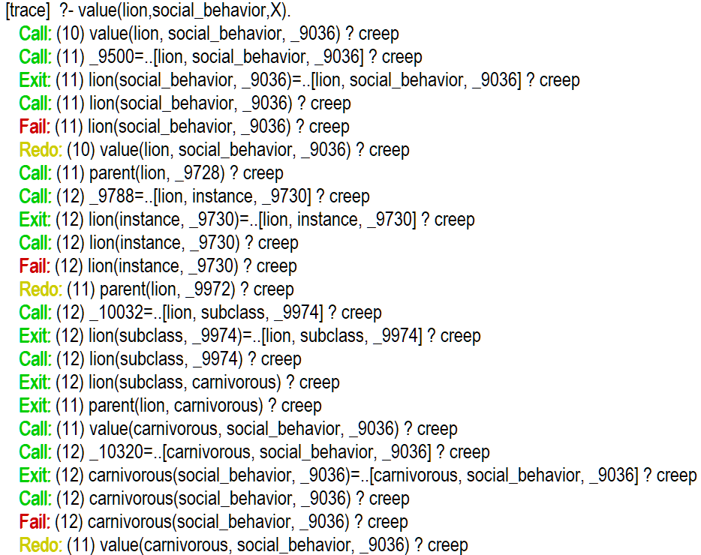
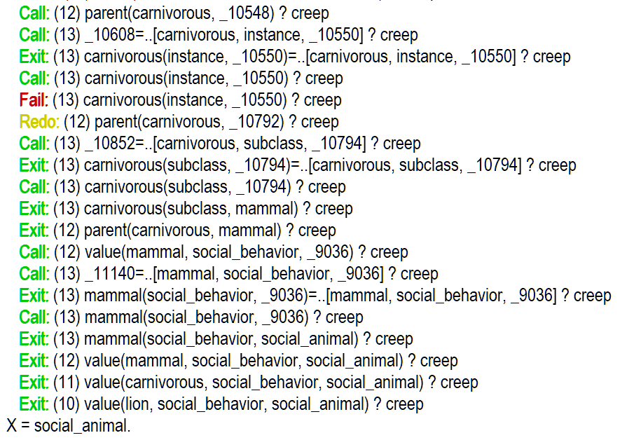
Tracing By Prolog
?- value(lion,social_behavior,X).

Slide 8
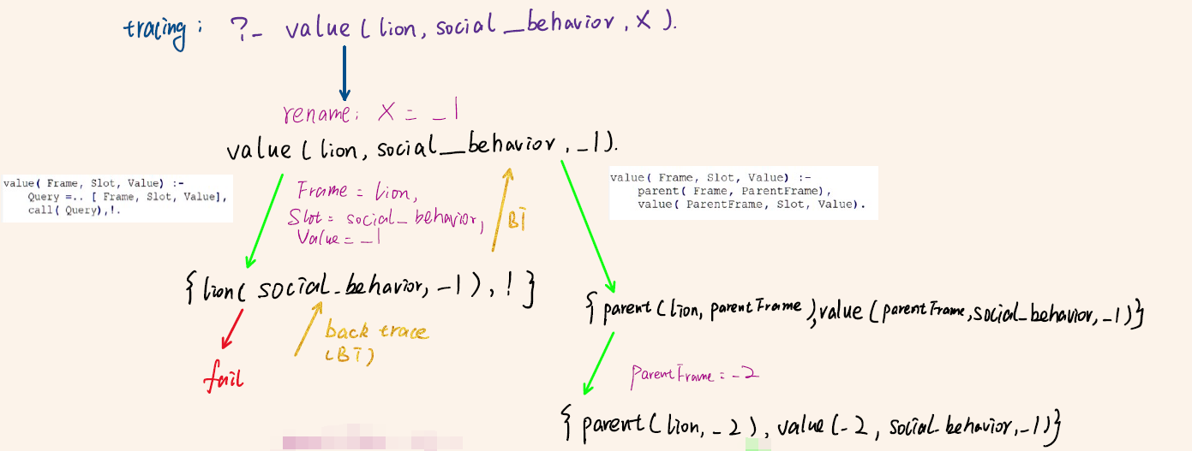
Tracing By Hand
?- value(lion,social_behavior,X).

Slide 9

Tracing By Hand
?- value(lion,social_behavior,X).

Slide 10
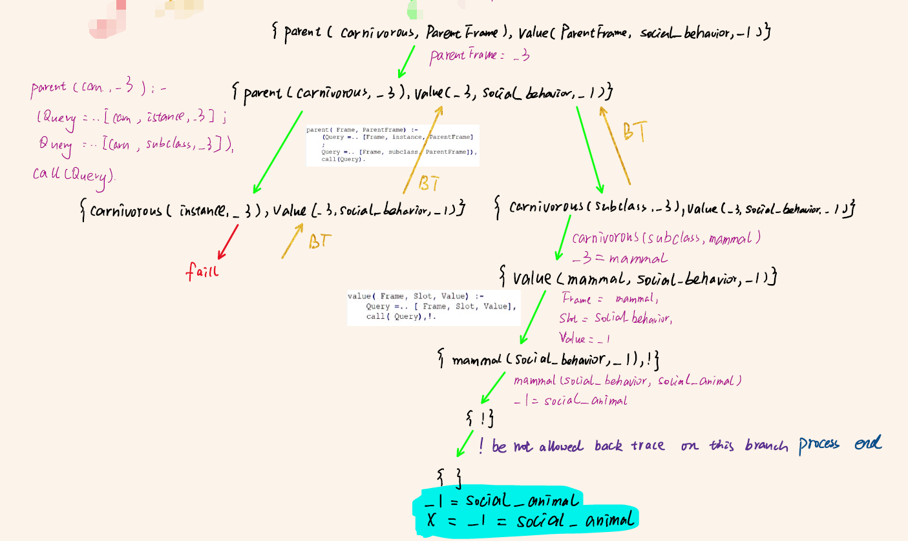
Tracing By Hand
?- value(lion,social_behavior,X).

Slide 11
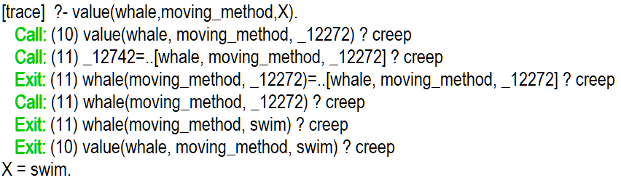
Tracing By Prolog
?- value(whale,moving_method,X).

Slide 12
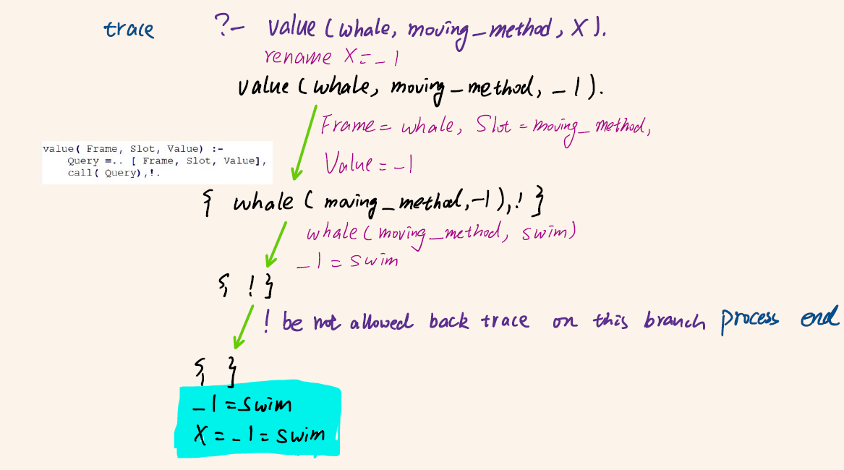
Tracing By Hand
?- value(whale,moving_method,X).

Slide 13
Thank
You
Tun Jing Ang :D00198874
Wenyu Shi :D00198805

