Slide 1
约束
Notes:
Schedule: Timing Topic
30 minutes Lecture
20 minutes Practice
50 minutes Total

Slide 2
目标
通过本章学习，您将可以:
描述约束
创建和维护约束

Slide 3
什么是约束
约束是表级的强制规定
约束放置在表中删除有关联关系的数据
有以下五种约束:
  NOT NULL
  UNIQUE
  PRIMARY KEY
  FOREIGN KEY
  CHECK
Notes:
For more information, see Oracle9i SQL Reference, “CONSTRAINT.”

Slide 4
注意事项
如果不指定约束名 Oracle server 自动按照 SYS_Cn 的格式指定约束名
在什么时候创建约束:
  建表的同时
  建表之后
可以在表级或列级定义约束
可以通过数据字典视图查看约束

Slide 5

NOT NULL 约束
保证列值不能为空:
…
NOT NULL 约束
NOT NULL
约束
无NOT NULL 约束

Slide 6
NOT NULL 约束
只能定义在列级:
CREATE TABLE employees(
employee_id NUMBER(6),
last_name VARCHAR2(25) NOT NULL,
salary NUMBER(8,2),
commission_pct NUMBER(2,2),
hire_date DATE
CONSTRAINT emp_hire_date_nn
NOT NULL,
...
系统命名
约束名称
用户自定义约束名称

Slide 7

UNIQUE 约束
UNIQUE 约束
EMPLOYEES
…
INSERT INTO
允许
不允许: 已经存在
Notes:
Instructor Note
Explain to students that since the JSMITH e-mail ID already exists after the first insertion, the second entry is not allowed.

Slide 8
UNIQUE 约束
可以定义在表级或列级:
CREATE TABLE employees(
employee_id NUMBER(6),
last_name VARCHAR2(25) NOT NULL,
email VARCHAR2(25) ,
salary NUMBER(8,2),
commission_pct NUMBER(2,2),
hire_date DATE NOT NULL,
...
CONSTRAINT emp_email_uk UNIQUE(email));

Slide 9

PRIMARY KEY 约束
DEPARTMENTS
PRIMARY KEY
…
不允许
(空值)
INSERT INTO
不允许
(50 已经存在)

Slide 10
PRIMARY KEY 约束
可以定义在表级或列级:
CREATE TABLE departments(
department_id NUMBER(4),
department_name VARCHAR2(30)
CONSTRAINT dept_name_nn NOT NULL,
manager_id NUMBER(6),
location_id NUMBER(4),
CONSTRAINT dept_id_pk PRIMARY KEY(department_id));
Notes:
Instructor Note
The example shown will not work in your schema because the DEPARTMENTS table already exists. To demonstrate this code, modify the name of the table within the script and then run the script.

Slide 11

FOREIGN KEY 约束
DEPARTMENTS
PRIMARY
KEY
…
EMPLOYEES
FOREIGN
KEY
…
INSERT INTO
不允许(9 不存在)
允许
Notes:
Instructor Note
Explain to students that you cannot create a foreign key without existing primary key values.

Slide 12
FOREIGN KEY 约束
可以定义在表级或列级:
CREATE TABLE employees(
employee_id NUMBER(6),
last_name VARCHAR2(25) NOT NULL,
email VARCHAR2(25),
salary NUMBER(8,2),
commission_pct NUMBER(2,2),
hire_date DATE NOT NULL,
...
department_id NUMBER(4),
CONSTRAINT emp_dept_fk FOREIGN KEY (department_id)
REFERENCES departments(department_id),
CONSTRAINT emp_email_uk UNIQUE(email));

Slide 13
FOREIGN KEY 约束的关键字
  FOREIGN KEY: 在表级指定子表中的列
  REFERENCES: 表示在父表中的列
  ON DELETE CASCADE: 当父表中的列被删除时，子表中相对应的列也被删除
  ON DELETE SET NULL: 子表中相应的列置空

Slide 14
CHECK 约束
定义每一行必须满足的条件
以下的表达式是不允许的:
  参照CURRVAL, NEXTVAL, LEVEL, 和ROWNUM 伪列
  使用 SYSDATE, UID, USER, 和 USERENV 函数
  在查询中涉及到其它列的值，不能使用子查询
..., salary NUMBER(2)
CONSTRAINT emp_salary_min
CHECK (salary > 0),...

Slide 15
添加约束的语法
使用 ALTER TABLE 语句:
添加或删除约束, 但是不能修改约束
有效化或无效化约束
添加 NOT NULL 约束要使用 MODIFY 语句
ALTER TABLE table
ADD [CONSTRAINT constraint] type (column);

Slide 16
添加约束
添加约束举例
ALTER TABLE employees
ADD CONSTRAINT emp_manager_fk
FOREIGN KEY(manager_id)
REFERENCES employees(employee_id);
Table altered.
Notes:
Instructor Note
To add a NOT NULL constraint, use the ALTER TABLE MODIFY syntax:
ALTER TABLE employees
MODIFY (salary CONSTRAINT emp_salary_nn NOT NULL);

Slide 17
删除约束
从表 EMPLOYEES 中删除约束
删除主键的同时级联的删除外键约束时，使用CASCADE选项删除约束
ALTER TABLE employees
DROP CONSTRAINT emp_manager_fk;
Table altered.
ALTER TABLE departments
DROP PRIMARY KEY CASCADE;
Table altered.

Slide 18
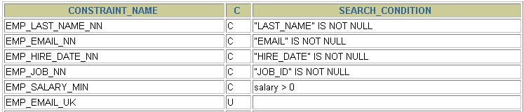
查询约束
查询数据字典视图 USER_CONSTRAINTS
SELECT constraint_name, constraint_type,
search_condition
FROM user_constraints
WHERE table_name = 'EMPLOYEES';
…

Slide 19
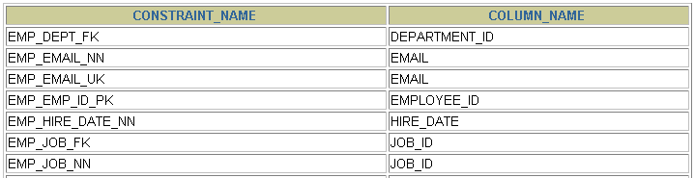
查询定义约束的列
查询数据字典视图 USER_CONS_COLUMNS
SELECT constraint_name, column_name
FROM user_cons_columns
WHERE table_name = 'EMPLOYEES';
…

Slide 20
总结
通过本章学习，您已经学会如何创建约束
描述约束的类型:
  NOT NULL
  UNIQUE
  PRIMARY KEY
  FOREIGN KEY
  CHECK
查询数据字典视图 以获得约束的信息
Notes:
Summary
In this lesson, you should have learned how the Oracle server uses constraints to prevent invalid data entry into tables. You also learned how to implement the constraints in DDL statements.
The following constraint types are valid:
NOT NULL
UNIQUE
PRIMARY KEY
FOREIGN KEY
CHECK
You can query the USER_CONSTRAINTS table to view all constraint definitions and names.

