Slide 1
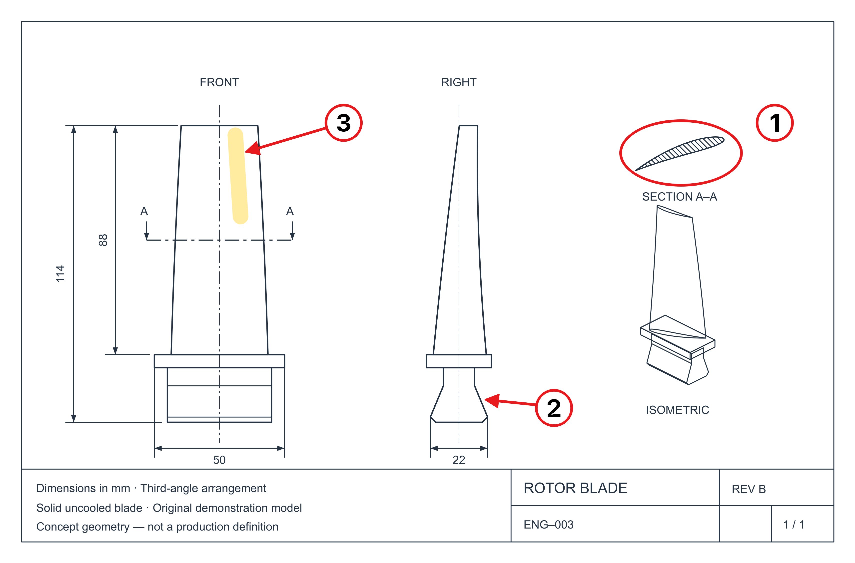
ENG-003 Rotor blade.pdf
1. Review the midspan section.
2. Review the blade root fit.
3. Check the airfoil surface.

