Slide 1
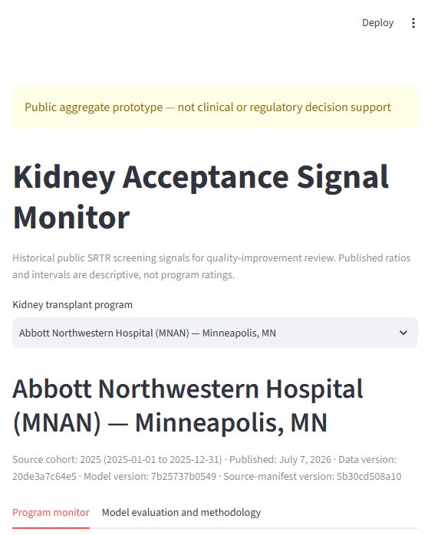
PUBLIC-DATA PORTFOLIO CASE STUDY
Kidney Acceptance
Signal Monitor
A screening signal that favors evidence over complexity
Nine annual SRTR cohorts • leakage-safe evaluation • offline delivery
Public aggregate prototype — not clinical or regulatory decision support
01
Notes:
10 seconds. Open with the product and the governing idea: this is a public-data quality-improvement monitor, and the project treats refusing unjustified complexity as a successful outcome.
[Sources]
- D:/Projects/Kidney Acceptance Signal Monitor/README.md
- D:/Projects/Kidney Acceptance Signal Monitor/SPEC.md

Slide 2
KIDNEY ACCEPTANCE SIGNAL MONITOR
A program needs context—not a scorecard
See the trajectory
PUBLISHED OFFER-ACCEPTANCE RATIO
Follow published annual OARs with their SRTR 95% credible intervals.
1.0
Locate context
Compare low-, medium-, high-KDRI and hard-to-place published strata without treating them as causal drivers.
Observed acceptances are in line with national expectation for similar offers.
Choose a review
Use the signal to decide where internal offer-level review may be worthwhile—never to prescribe acceptance.
A ratio is a screening signal—not a judgment about an individual offer or program quality.
Definition and intended use: SPEC.md • SRTR published OAR
2
Notes:
25 seconds. Explain the user question: is the published signal stable, improving, or worsening, and where is the pattern visible? The app supports quality-improvement review. It does not rate centers, evaluate offers, or make clinical or regulatory claims.
[Sources]
- D:/Projects/Kidney Acceptance Signal Monitor/SPEC.md
- https://srtr.hrsa.gov/transplant-professionals/program-specific-report/technical-methods-for-the-program-specific-reports/

Slide 3
KIDNEY ACCEPTANCE SIGNAL MONITOR
Nine pinned releases become one defensible annual panel
INGEST
VALIDATE
SERVE
Immutable public inputs
Schema-aware parsing
Trusted derived artifacts
Nine annual kidney PSR workbooks
2017–2025 calendar-year cohorts
URL, size, type, and SHA-256 pinned
Machine fields—not column positions
Composite program identity
Hard errors for broken invariants
10,515 program-signal rows
2,103 program-years
1.23 MB offline release bundle
Published ratios remain authoritative; formula recreation is QA only.
Tracked release bundle • deterministic Parquet and JSON • no raw workbooks in Git
3
Notes:
30 seconds. Walk left to right. Acquisition is verified before use, parsing follows machine-readable field names, and hard invariants protect identity, counts, intervals, dates, and missingness. The web layer reads only the small derived bundle.
[Sources]
- D:/Projects/Kidney Acceptance Signal Monitor/configs/data_sources.yaml
- D:/Projects/Kidney Acceptance Signal Monitor/docs/data_card.md
- D:/Projects/Kidney Acceptance Signal Monitor/docs/reproduction_log.md

Slide 4
KIDNEY ACCEPTANCE SIGNAL MONITOR
Time stays in order from features to truth
Feature cohort t
Prediction origin
Target cohort t+1
›
›
Public annual aggregates
available by the cutoff
About 6–10 months
into target year t+1
One complete, non-overlapping
calendar-year outcome
Whole-year folds
Train-only preprocessing
Leakage is a hard error
Every row for one target year stays together; no random row split exists.
Median imputation, scaling, and fitting happen inside each training fold.
Identity, location, future availability, and target-period fields are rejected.
The target is next-calendar-year published log(OAR)—not a binary interval flag.
Rolling origin • target years intact • replay fit stops at target year 2023
4
Notes:
35 seconds. The key validity safeguard is temporal separation. Features come from cohort t or earlier. Every target year is held together, and preprocessing is learned only from prior target years. For the frozen 2025 replay, the ridge fit uses outcomes through 2023; 2024 is reserved for the already frozen band calibration.
[Sources]
- D:/Projects/Kidney Acceptance Signal Monitor/SPEC.md
- D:/Projects/Kidney Acceptance Signal Monitor/docs/model_card.md

Slide 5
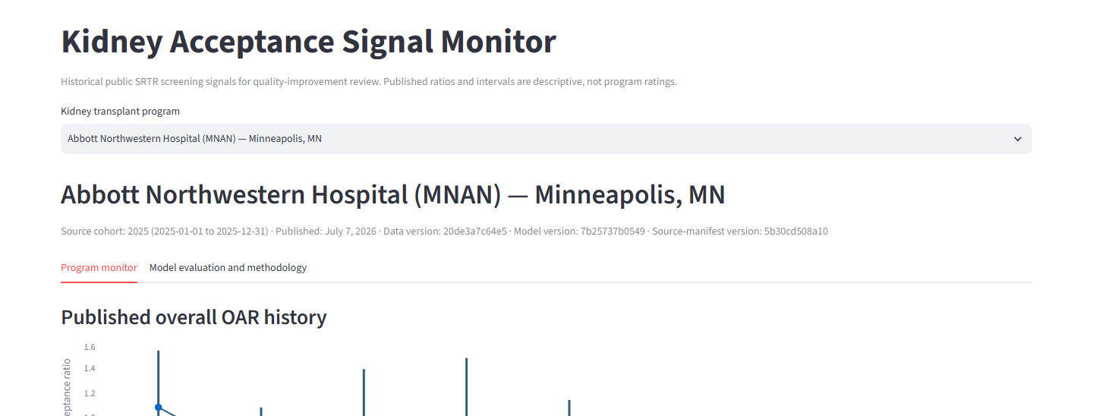
KIDNEY ACCEPTANCE SIGNAL MONITOR
The product is longitudinal context—not a leaderboard
Published points and SRTR 95% credible intervals stay distinct; gaps remain “Not reported,” never zero.
Example program view from the tracked offline release bundle
5
Notes:
35 seconds. Demonstrate the core product: choose one program, read its nine-year overall path and published uncertainty, then inspect donor-stratum context. Emphasize that color is not the only cue, missing values stay missing, and there is no national ranking surface.
[Sources]
- D:/Projects/Kidney Acceptance Signal Monitor/README.md
- D:/Projects/Kidney Acceptance Signal Monitor/docs/demo/program-monitor.png
- D:/Projects/Kidney Acceptance Signal Monitor/SPEC.md

Slide 6
KIDNEY ACCEPTANCE SIGNAL MONITOR
Ridge lowered error—but still missed the gate
PERSISTENCE
RIDGE
FAILED REQUIRED GATE
0.267
0.240
0.011 vs 0.009
2025 log-OAR MAE
2025 log-OAR MAE
absolute mean signed log error
ridge vs persistence
10.1% lower error
Paired bootstrap
−0.041 to −0.013
Ridge minus persistence absolute error;
10,000 resamples by program key
Decision: retain persistence and suppress the ridge band.
Frozen 2025 replay • n=229 • descriptive product-selection evidence
6
Notes:
50 seconds. This is the central result. Ridge improved MAE by 10.13%, and the paired program bootstrap favored it. But promotion required every frozen criterion. Ridge's absolute mean signed log error was 0.01145 versus 0.00885 for persistence, so the relative-bias criterion failed. The product therefore retains persistence. This replay is descriptive and retrospective, not independent or prospective validation.
[Sources]
- D:/Projects/Kidney Acceptance Signal Monitor/docs/model_card.md
- D:/Projects/Kidney Acceptance Signal Monitor/artifacts/release/modeling/frozen-replay/7b25737b054973386379088ccf27b66bfc9d5fd325dc4969d8449c80867f1ff1_5b30cd508a10e9cc24a6097f0eea868447c168b2744b50977aa56db43a6b86e5/replay_metrics.json

Slide 7
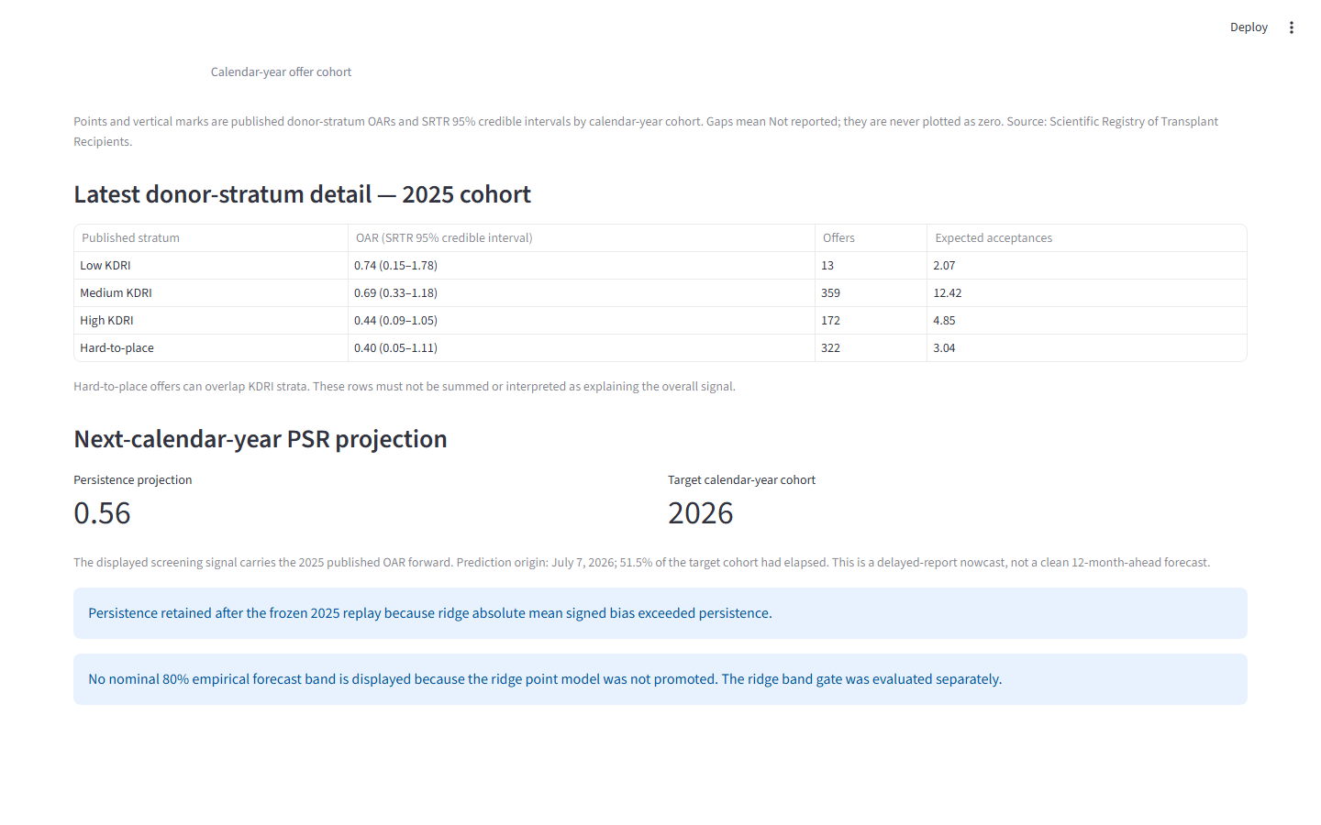
KIDNEY ACCEPTANCE SIGNAL MONITOR
The app makes the conservative decision visible
0.56
Persistence projection
2026
Target calendar-year cohort
51.5%
Target cohort elapsed at origin
No nominal 80% ridge band is shown: the point model was not promoted, even though the separate band gate passed.
Delayed-report nowcast • publication and cohort timing shown in-product
7
Notes:
30 seconds. The view layer does not reinterpret the model decision. It reads explicit forecast eligibility and the frozen selected model. The user sees persistence, the 2026 target cohort, and the July 7, 2026 prediction origin—when 51.5% of the target year had elapsed. That is why the product says delayed-report nowcast, not a clean 12-month-ahead forecast.
[Sources]
- D:/Projects/Kidney Acceptance Signal Monitor/README.md
- D:/Projects/Kidney Acceptance Signal Monitor/docs/demo/persistence-projection.png
- D:/Projects/Kidney Acceptance Signal Monitor/docs/model_card.md

Slide 8
WHAT THIS PROJECT DEMONSTRATES
The strongest product decision was refusing complexity that missed its gate
Science
Engineering
Judgment
Annual non-overlap
Leakage hard failures
Program-level resampling
Immutable verified inputs
Write-once replay
Offline, non-root delivery
Baselines before challenger
Point and band gates separated
Negative result shipped plainly
Limits stay attached to the claim
One retrospective replay • delayed public aggregate • marginal band coverage • no patient-level, causal, clinical, or regulatory claim • prospective evidence waits for the later 2026 PSR signal
Reproducible case study • evidence, engineering, and product restraint
8
Notes:
20 seconds. Close on the integrated story: scientific validity, reproducible engineering, and product judgment. The frozen result is useful precisely because the project does not overclaim it. If asked what comes next, answer: evaluate the fixed procedure prospectively when the calendar-year 2026 PSR outcome is later published.
[Sources]
- D:/Projects/Kidney Acceptance Signal Monitor/docs/model_card.md
- D:/Projects/Kidney Acceptance Signal Monitor/docs/reproduction_log.md
- D:/Projects/Kidney Acceptance Signal Monitor/SPEC.md

