Slide 1


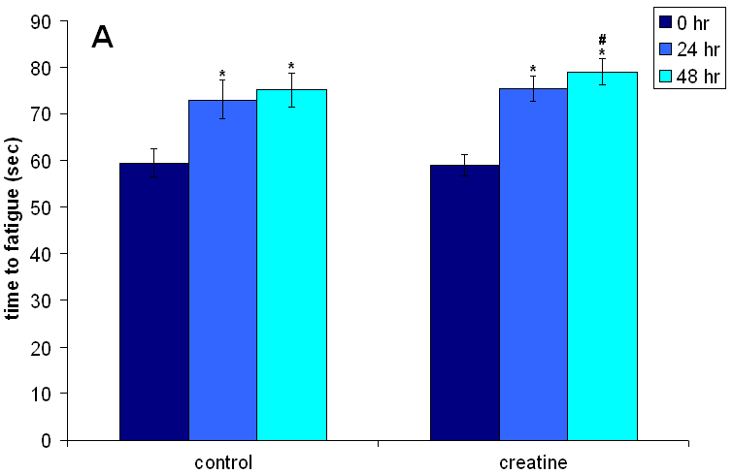
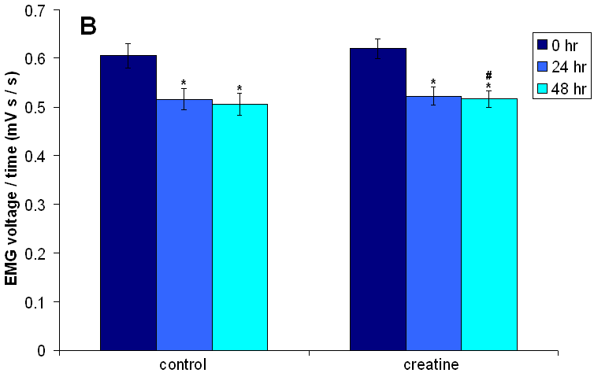

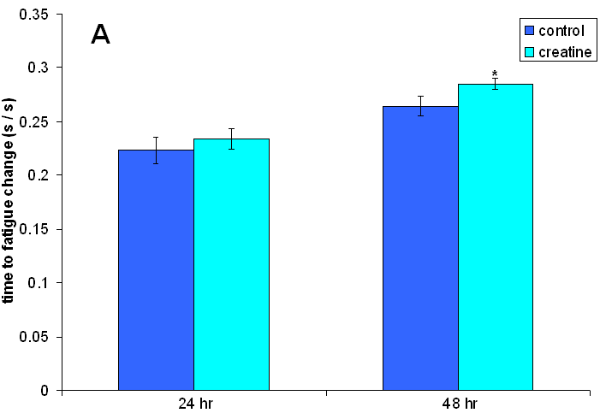
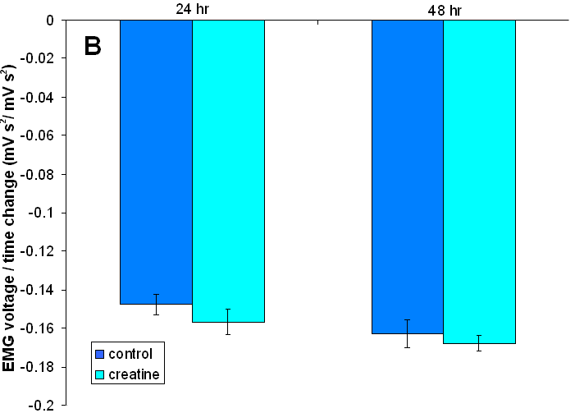
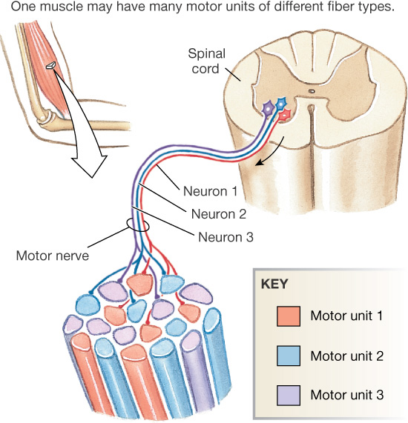
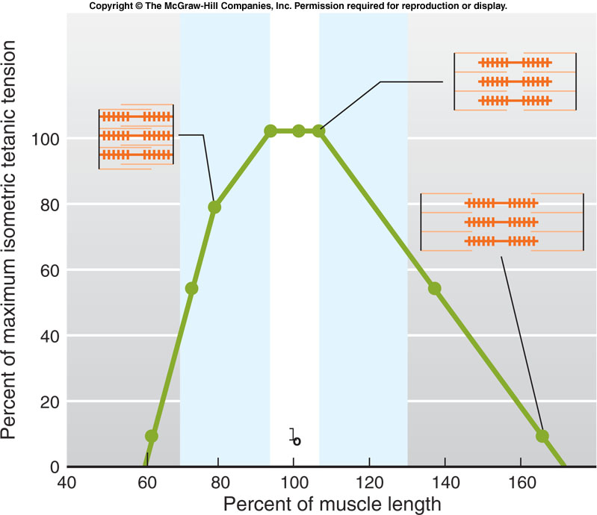
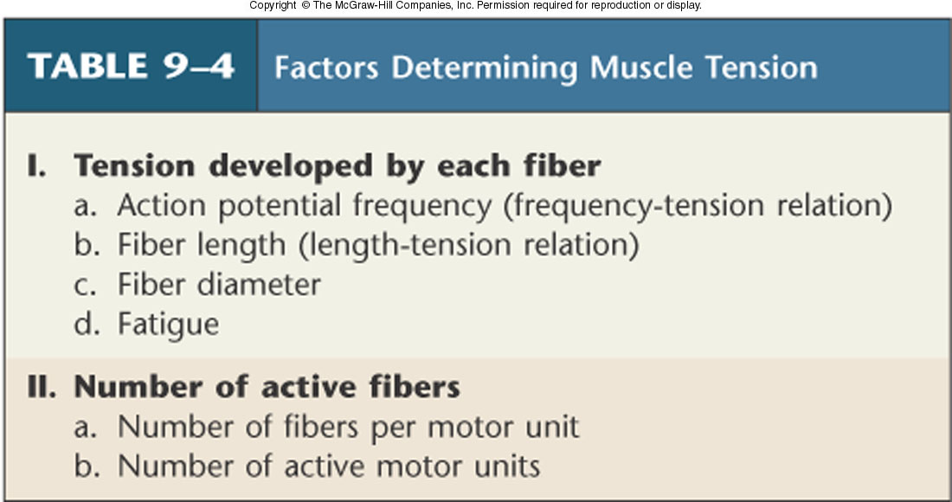
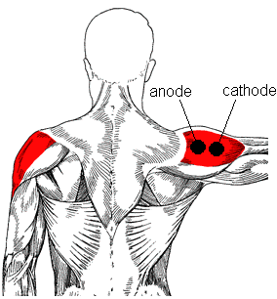

Characterization of Motor Unit Recruitment Following Short-term Creatine Loading via Surface Electromyogram Signal Analysis
Michael Chervonski and Alex Sealy
Wallace H. Coulter Department of Biomedical Engineering, Georgia Institute of Technology and Emory University, Atlanta, GA
ABSTRACT
RESULTS
DISCUSSION
Roughly $200M of the dietary supplementation industry is spent on creatine monohydrate – an ergogenic aid that has become increasingly popular since the 1990s [1]. Although the long-term ergogenic effects of creatine (Cr) supplementation are well characterized, little research has been conducted to identify the myoelectric response of skeletal muscle to Cr supplementation. This study examined the mechanoelectical response of the lateral deltoid muscle using electromyography (EMG) during fatigue-inducing isometric humeral abduction following short-term supplementation of creatine monohydrate. We hypothesized that Cr supplementation would suppress motor unit recruitment by allowing active motor units to work more efficiently and, thus, exhibit a decrease in surface EMG activity. The time to fatigue and total EMG activity were measured at 0, 24, and 48 hr following Cr administration. Results for time to fatigue, which were used to confirm the short-term ergogenic effect of Cr, demonstrated that Cr had a significant positive effect relative to the placebo group. Although a negative trend was observed for the time-standardized EMG activity, the trend was not significantly different from the control group. The observed myoelectrical response of the lateral deltoid was inconclusive due to insufficient evidence and further investigation is recommended to determine the electrical response directly.
Cr and placebo groups exhibited significant increase in time to fatigue after 24 hr. However, only the Cr group demonstrated a significant difference in time to fatigue at 48 hr. In support of the hypothesis, the results suggested – though not overwhelmingly – that creatine monohydrate has capacity to provide an ergogenic enhancement on such a short-term basis. Although direct evidence was not available, it was inferred that the observed ergogenic effect occurred by augmentation of available energy reserves via phosphocreatine.
Results for EMG activity showed that both control and placebo groups demonstrated a significant decrease 24 hr after treatment. However, only the Cr group showed further decrease in EMG activity 48 hr after treatment. Thus, although some evidence exists for Cr-induced suppression of electrical activity, the placebo group offered similar evidence of myoelectric suppression, reducing the significance of the observed Cr-induced effects. Although a Cr-induced effect on EMG activity is possible, the exhibited time-dependent trends in myoelectrical suppression are attributed to more efficient recruitment of motor units that is characteristic of neuromuscular adaptation rather than increased efficiency of existing motor units [8]. In addition to the motivational drive of subjects, the former explanation can also account for the observed increase in the time to fatigue of the control group.
A, The Cr and control groups exhibited an increase in time to fatigue after 24 hr. The Cr group also exhibited a significant time to fatigue increase after 48 hr. B, Cr and control groups exhibited a decrease in standardized EMG activity after 24 hr. The Cr group also exhibited a significant decrease in EMG activity at 48 hr. * - p<0.05 0 hr v. 24 hr or 48 hr for a particular treatment, # - p<0.05 24 hr v. 48 hr for a particular treatment.
INTRODUCTION
Strength and flexibility are key goals for many exercise programs. The effects of stretching before and after exercise, however, have long been disputed by coaches and physical therapists. It has been thought that stretching prevents injury, muscle soreness and may even enhance performance, however, such claims lack scientific evidence. Moreover, it is unclear how to
incorporate stretching into exercise programs.
Although past studies have demonstrated
prolonged stretching (30 minutes) reduces
muscle performance, these studies don’t
accurately reflect stretching conditions in an
athletic context (0-5 minutes). [3]
Several experimental limitations and sources of error were encountered. A larger than anticipated subject dropout and loss of data due to computer malfunction led to a sample size that was smaller than originally determined by power analysis. Likewise, due to the nature of the study, only a single measurement (n=1) could be obtained per subject at each time point. In addition, subjects reported fatigue in the forearm muscle group from having to actively hold the weight during abduction. This may have caused premature fatiguing. Lastly, subject diet and aerobic ventilation capacity could not be regulated well between subjects. The bias engendered by these limitations could have been reduced by using a larger sample size to more accurately reflect Cr-induced effects directly.
Excitation-contraction Coupling Contraction of muscle fibers occurs in response to electrical excitation propagated along the plasma membrane. The excitation signal provides the necessary stimulus for the mechanical activity of contraction to proceed.
The mechanical energy of contraction is generated by myosin-actin cross-bridges by harvesting the energy contained in ATP via ATPase activity of myosin. Typically, consumption of ATP is partly responsible for physical fatigue during prolonged contraction [2].
During muscular exertion, motor units are recruited in an orderly manner such that a sufficient number of muscle fibers are activated to sustain contraction [3].
Asynchronous recruitment:
  To prevent fatigue in sustained contraction
  Nervous system modulates the firing rates of motor neurons - alternation allows motor units to rest
  only works in submaximal contraction
CONCLUSION
The short-term ergogenic effects of creatine were confirmed; however, despite encouraging trends, there was insufficient evidence to conclude that creatine monohydrate causes a decrease in gross myoelectrical activity. Based on the results, the hypothesis that creatine allows less motor units to be activated for a given task was not proven. We propose that further studies be conducted, after modification to the presented limitations, to provide better evidence for the role of Cr and its mechanism for suppressing motor unit recruitment.
A, The Cr group demonstrated a significant increase in time to fatigue from initial measurements at 48 hr relative to the control group. B: A trend in decreasing standardized EMG activity relative to initial measurements is evident; however, significance was not found. * - p (paired) <0.05 change in creatine v. change in control for a particular time.
EXPERIMENTAL METHODS
A randomized, blind study was conducted to determine the myoelectric effects of creatine monohydrate loading:
  Subject Inclusion criteria: male, ages 19-22, have not stretched for 2 days prior to experiment
  Subject Exclusion criteria: regular consumption of creatine monohydrate/creatine ethyl ester or other ergogenic aids, known allergy to creatine monohydrate, consumption of energy supplements including caffeine (< 6 hr) prior to testing
  Treatment: Calf raise EMG after no stretching, 30 seconds stretching, 2 minutes stretching, and 5 minutes stretching
  Group assignment: 30 males were selected for group, with 4 trials conducted on each subject
ACKNOWLEDGEMENT
The authors would like to thank Dr. Michelle LaPlaca and Dr. Kyla Ross for their excellent instruction on the background of this study, Randy Ankeny, for his guidance on the preliminary planning of the study, Dr. Essy Behravesh for managing the UA Whitaker laboratories, and our subjects for their time and participation in the study.
REFERENCES
Stern, Pizarro, and Rios. Local control model of excitation-contraction coupling in skeletal muscle. J Gen Physiol, Oct 1997. 110(4): 415-440.
Fallentin, Jørgensen, and Simonsen. Motor unit recruitment during prolonged isometric contractions. Eur J Appl Physiol, Oct 1993. 67(4): 335-341.
3. Avela, J., H. Kyrolainen, and P.V. Komi, Altered reflex sensitivity after repeated and prolonged passive muscle stretching. J Appl Physiol, 1999. 86(4): p. 1283-91.
2. de Weijer, V.C., G.C. Gorniak, and E. Shamus, The effect of static stretch and warm-up exercise on hamstring length over the course of 24 hours. J Orthop Sports Phys Ther, 2003. 33(12): p. 727-33.
3. Fowles, J.R., D.G. Sale, and J.D. MacDougall, Reduced strength after passive stretch of the human plantarflexors. J Appl Physiol, 2000. 89(3): p. 1179-88.
4. Nicholas Institute of Sports Medicine and Athletic Trauma. (2007). Runner's Resource Guide: Basic Stretching Exercises. Retrieved October 21, 2007, from <http://www.nismat.org/traintip/runner/stretch.html>.
5. Surface ElectroMyoGraphy for the Non-Invasive Assessment of Muscles. (2007). Recommendations for sensor locations in lower leg or foot muscles. Retrieved October 21,2007, from <http://www.seniam.org>.
RESEARCH GOALS
Objectives
To demonstrate the effect of stretching on the motor unit recruitment of the medial gastrocnemius muscle.
To determine the trend in surface EMG activity generated by the medial gastrocnemius muscle, given a constant contraction and load, following different stretch periods.
Hypotheses
Mean integrated electromyogram (EMG) amplitude of the medial gastrocnemius muscle after no stretching will not differ significantly from that after 30 seconds of stretching.
Mean EMG amplitude after 120 seconds of stretching will be lower than that after 30 seconds of stretching.
Mean EMG amplitude after 300 seconds of stretching will be lower than that after 120 seconds of stretching.
  Measured Task: Isometric contraction of the gastrocnemius using calf raises with added resistance of 10 lb barbell in each hand for optimal balance
  Measurement Methodology: Measurements were made using the BIOPAC EMG apparatus and software; EMG electrode leads were placed at the proximal and distal position of the lateral deltoid, the ground lead was placed near the ankle; time to fatigue and total EMG activity were measured – EMG activity was standardized to time to fatigue per subject
Statistical analysis performed using two-way additive repeated measures ANOVA

