Slide 1


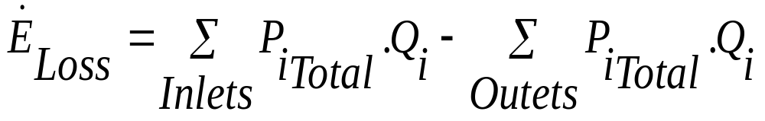
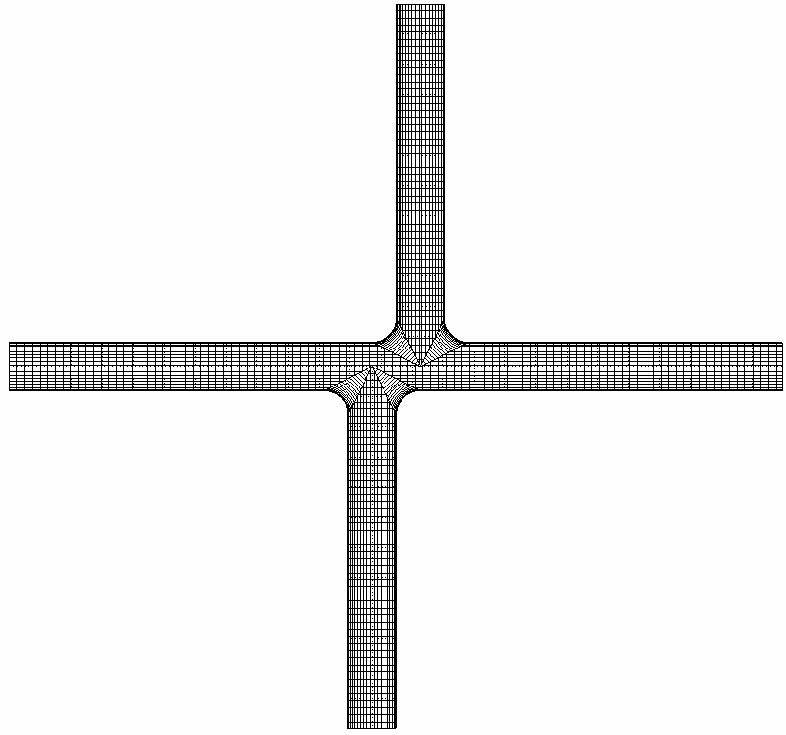
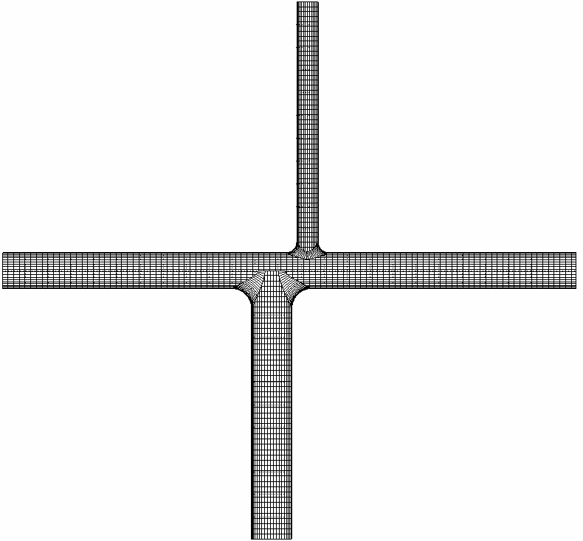
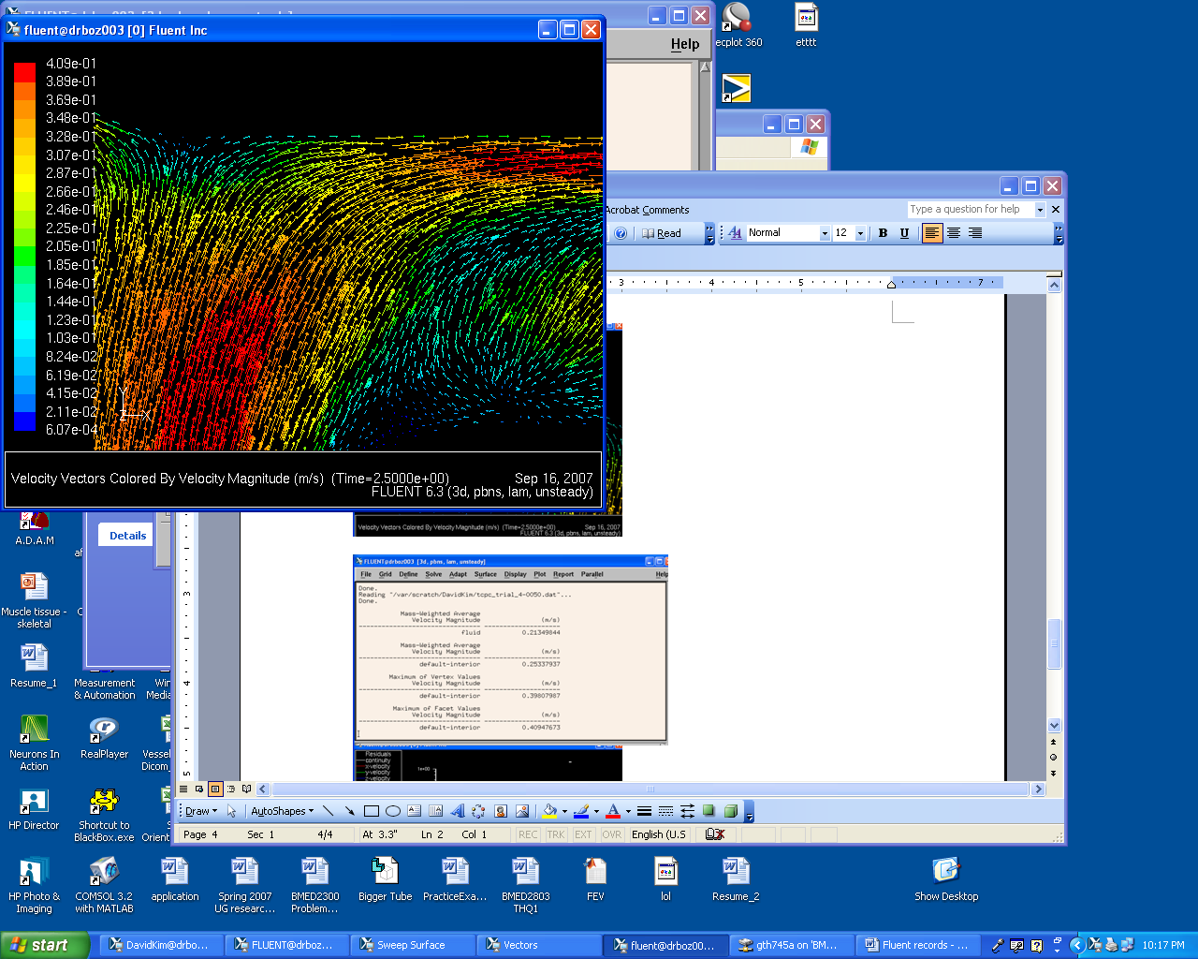
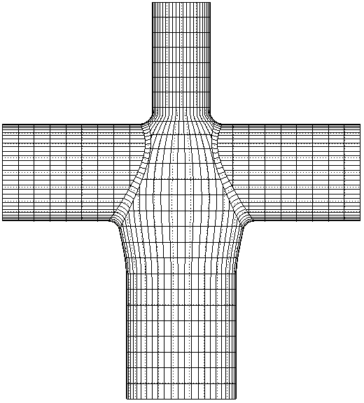
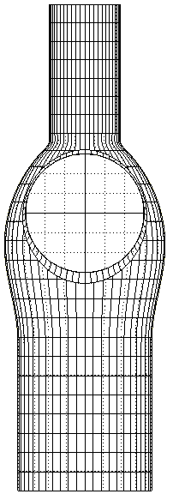
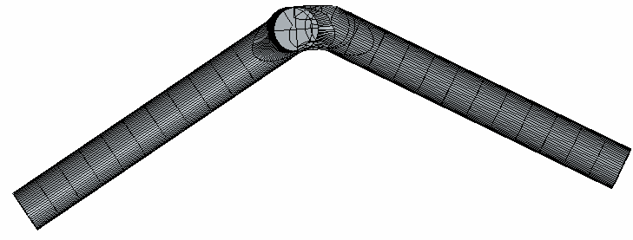
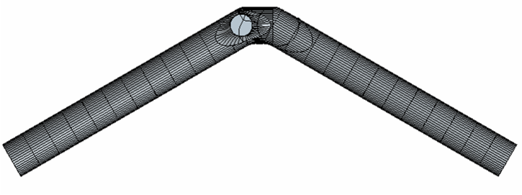
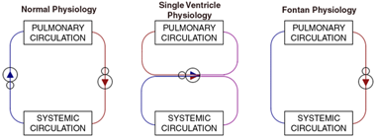
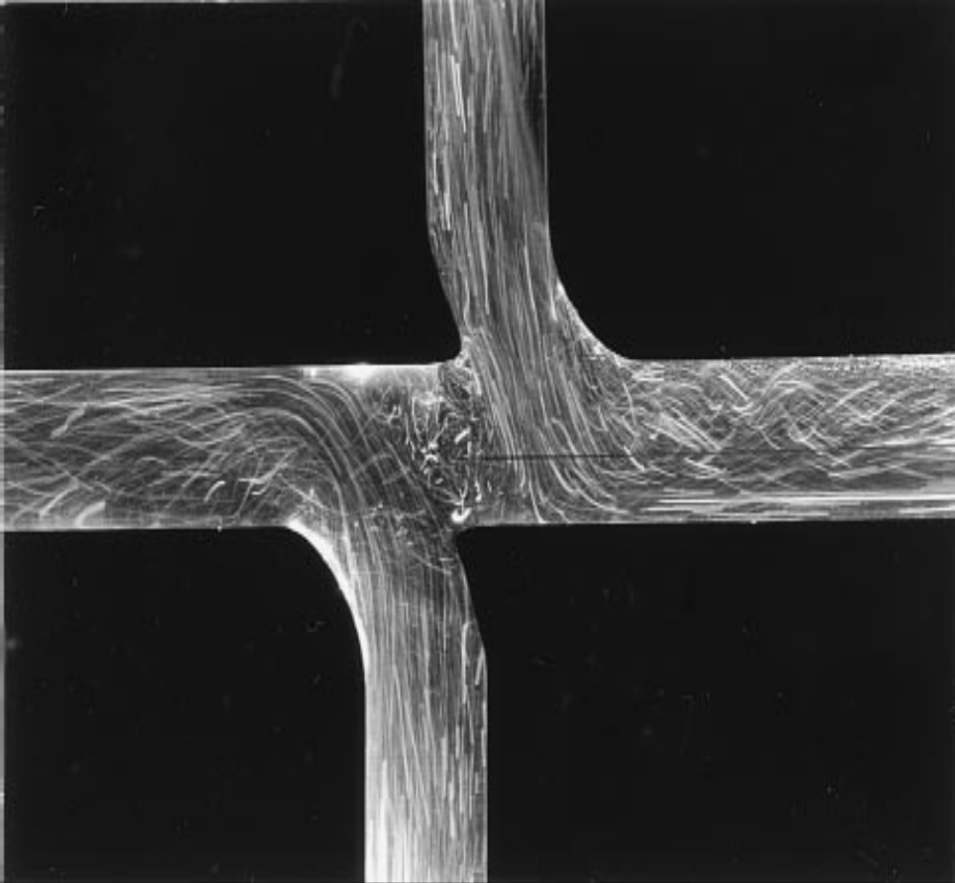
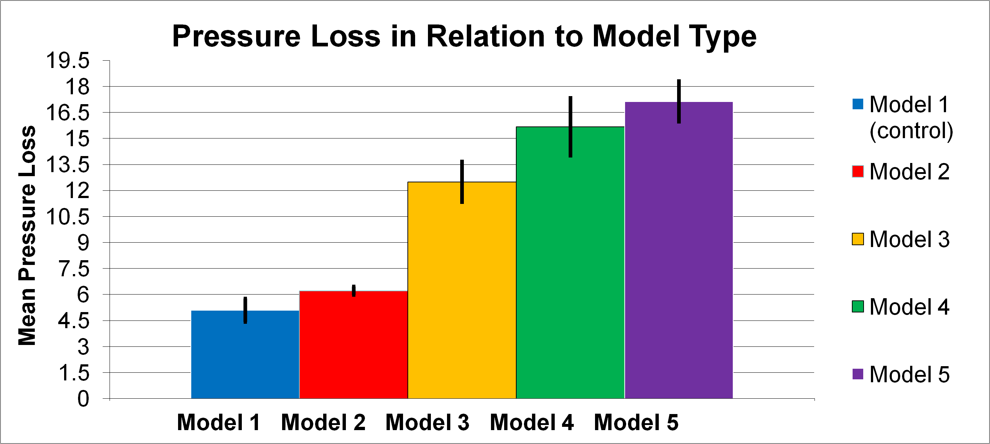
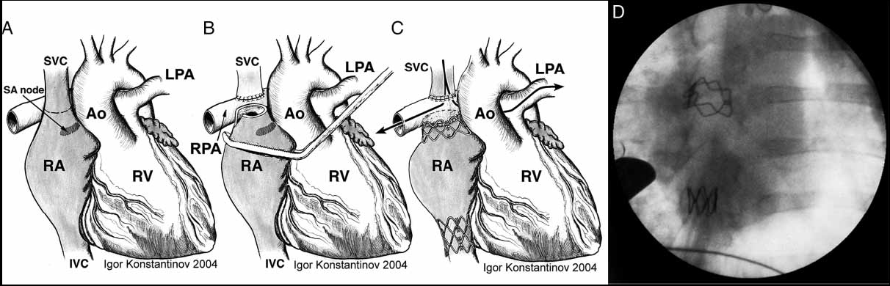
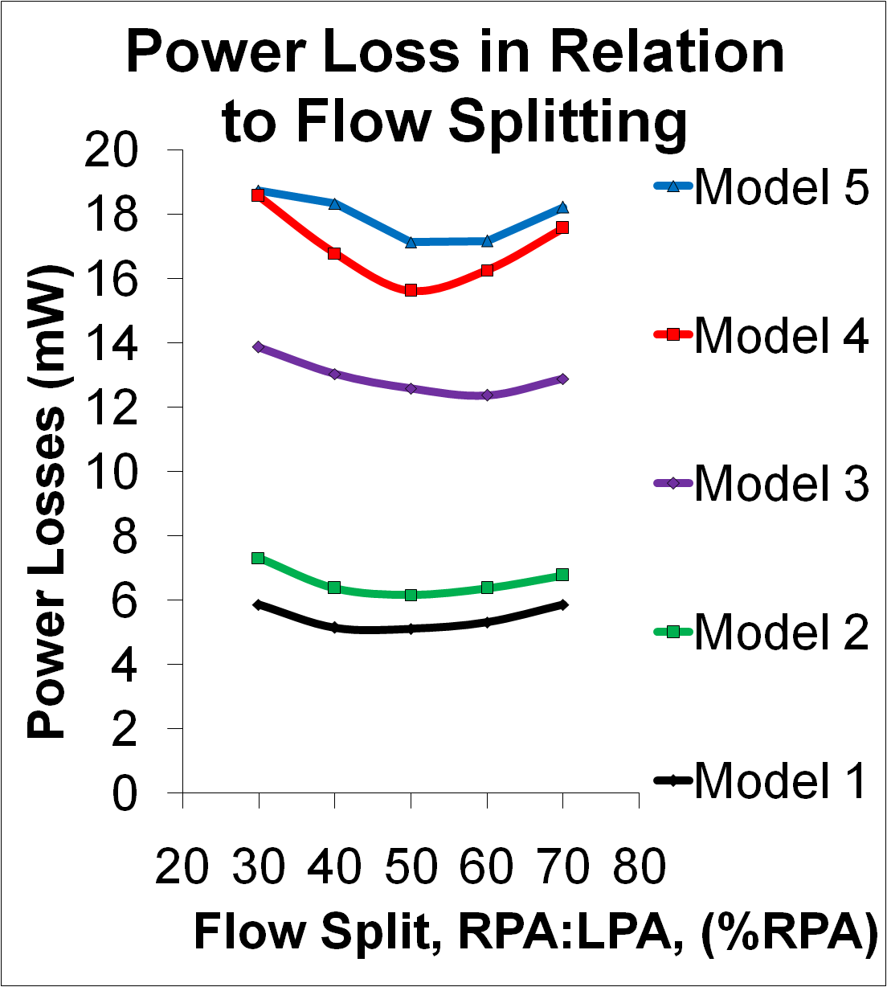
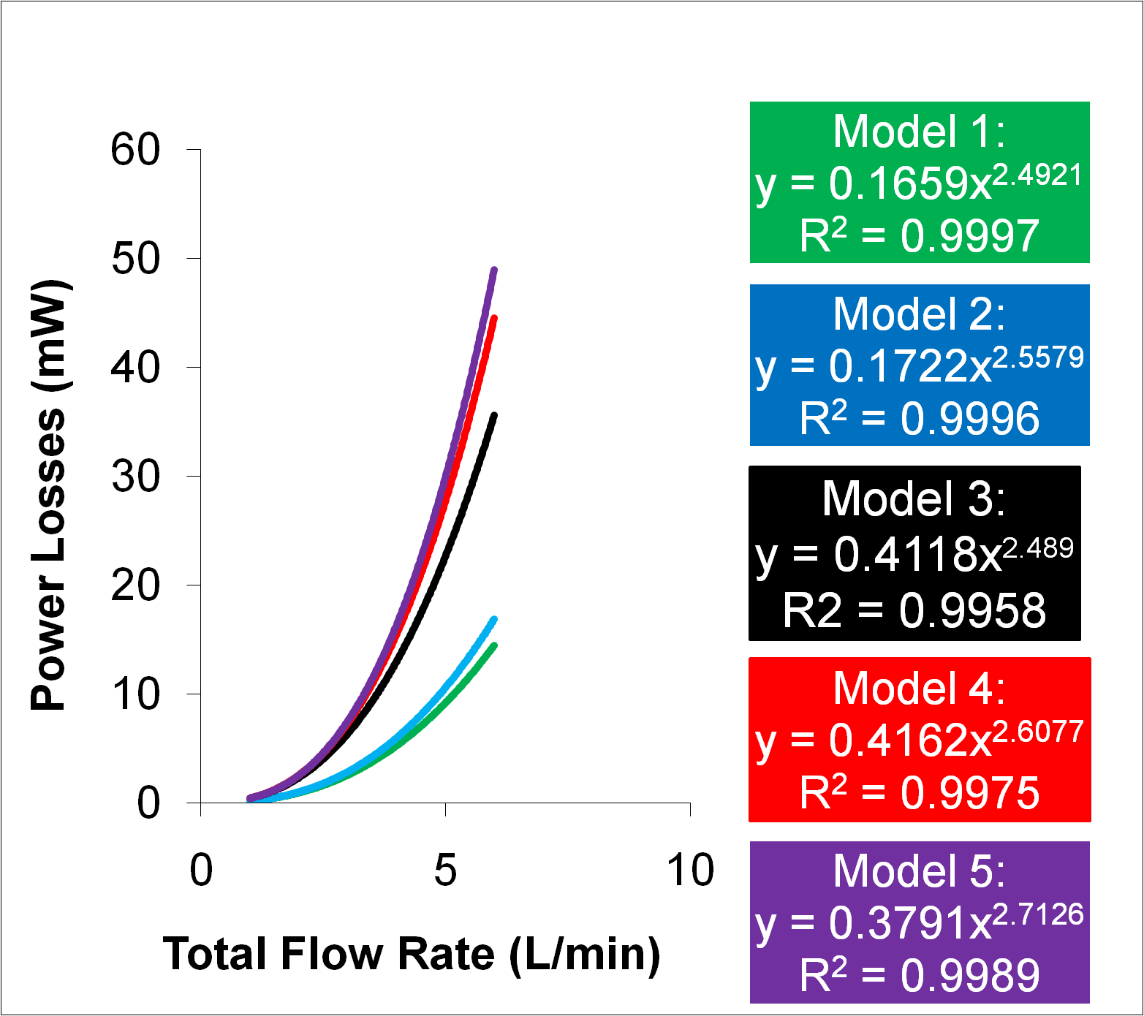
Fontan Surgery
Christopher Lacey, David Kim, Phillip and Young Seon Park
Wallace H. Coulter Department of Biomedical Engineering, Georgia Institute of Technology and Emory University, Atlanta, GA
ABSTRACT
EXPERIMENTAL METHODS
DISCUSSION
Single ventricle congenital heart defects, which affect 2 out of 1000 newborns, is a serious condition, which results in the mixing of deoxygenated and oxygenated blood. The Fontan procedure, which implements a total cavopulmonary connection (TCPC), seeks to correct this defect. However, this procedure introduces unwanted power loss because of increased friction. Thus, ways to minimize power loss through varying connection designs are being researched to aid surgeons. This study found that power loss is lowest when there is a 50-50 flow split between the right pulmonary artery (RPA) and the left pulmonary artery (LPA). Also, power loss increased as the blood flow velocity increased. Considering that the TCPC introduces power loss, as confirmed by this study, future studies should focus on testing TCPC variations and discovering the most efficient way to conduct this surgery.
  Five glass models were constructed for testing as shown
    Model 1: Uniform diameters of 13.3 mm
    Model 2: Pulmonary arteries set at 120˚ angle
    Model 3: Physiologic diameters
    Model 4: Model 2 combined with Model 3
    Model 5: Model 4 with TCPC
  Models were connected to flow loop with blood analog simulating blood flow
    Set to run at 1-6 L/min with 30-70% cardiac output coming out of the RPA
  Pressure transducers were used to measure static pressure at the wall of each vessel
    15 trials conducted for each model
  Power loss was then found by using the flow rate and pressure differences:
¾”
Sample size: 15 observations were made for all 5 models providing a Cohen effect size of 4.933763 with a power of 100% assuming a type I error of 5%. The effect size was calculated in G Power software, using each model’s mean power loss and standard deviation.
1-way ANOVA: A one-way analysis of variances statistically rejected the proposed null hypothesis that all models had equal mean power losses, given a constant cardiac output of 4L/min and equal flow splitting between the RPA and LPA with a p value of 0.
Tukey Comparison Test: A Tukey’s q studentized critical value of 1.1480 was calculated for 75 subjects with an error degree of freedom of 70 assuming a type one error of 5%. According to the data, mean pressure loss for model one (control) and two do not differ significantly from each other. All other means, however, differ significantly from each other. This supports the conclusion that, model 2 is the most efficient. The power lost from model 2 does not significantly differ from the power lost from implementation of a glass model (control). Model 5 has the largest mean pressure drop.
½”
½”
½”
½”
R_{LPA}
R_{RPA}
R_{TOT}
R_{IVC}
PUMP
INTRODUCTION
Steady flow loop used in experiment
1
2
3
A/D Board
Heart disease: Single ventricle congenital heart defects affect approximately two out of 1000 newborns. In this defect, a single ventricle must pump the blood out to the body and the lungs. As a result, both oxygenated and deoxygenated blood mix, ultimately leading to death.
Fontan procedure: The Fontan operation involves a series of three palliative procedures aimed at separating the systemic and pulmonary circulations and reducing the long term effects of chronic hypoxia and ventricular volume overload. The total cavopulmonary connection (TCPC) is completed in the final stage of the surgery with the anastomosis of the inferior vena cava (IVC) to the TCPC.
Fontan problems :
Blood mixing is prevented at the expense of higher pressure drops
Inefficient single ventricle must pump to entire body
As a result, minimizing the power loss is crucial.
Monitoring Power loss: The major factor that influences the power loss is the varying geometries of different TCPC models which includes the diameters of four vessels of TCPC, the length of offset, and angles of PA curvature.
Model
Carrier demodulators
Trigger generator
T1
Ø 13.3mm
Ø 13.3mm
T2
Power Loss & Varying Flow Rate: Power is lost because of blood flow against an imperfect surface. Heat energy is generated because of fluid friction. To characterize this, power loss was calculated for each model and plotted as a function of blood flow. As flow rate increases, power loss exponentially increases. As expected, model 5 has the fastest increasing slope in power loss as blood flow increases. Squares of the Pearson correlation coefficient are given for each approximated exponential trend line. All trend lines have R squared values greater than 0.99. Thus, the exponential trend lines given accurately fit the data.
T3
Transducers
Ø 13.3mm
Ø 8.0mm
Experimental set-up for the pressure drop measurements
Ø 13.3mm
SVC
Ø 13.3mm
Ø 13.3mm
SVC
Ø 13.3mm
RPA
LPA
RPA
LPA
Ø 8.0mm
Ø 13.3mm
Ø 15.0mm
SVC
IVC
IVC
Ø 13.3mm
Ø 13.3mm
Model 1
(Control)
Model 3
RPA
LPA
120º
Ø 18.0mm
120º
Model 2
Model 4
Ø 15.0mm
Simplified Glass models 1 to 4, varying VC diameters and PA curvature
IVC
Model 5
Simplified glass models 5 incorporating TCPC
RESULTS
Power Loss & Varying Flow Splits: The power loss due to varying model curvature is assessed by a percentage of blood passing through both the IVC and SVC as well as the RPA and LPA. Overall, the minimum power loss for all models appears to be at equal splitting of blood flow between the RPA and LPA. Model 5, however, appears to have minimal power loss at approximately 58% RPA blood flow.
Future Improvements: Several 1-way and 2-way ANOVA tests could be implemented examining the interaction effects of changing models on power loss for varying rates of blood flow and varying splits in blood flow. These points would be plotted along with variation whiskers, enabling researchers to better understand power loss as a relation of flow rate and as a relation of changes in model curvature.
The difference in blood flow mechanism of the normal heart, congenitally defected heart, and defected heart that has gone through Fontan procedure
Particle flow visualization of a curved 0.5 diameter offset model with flow splits: IVC:SVC 5 60:40 and RPA:LPA 5 70:30
CONCLUSION
This study served to illustrate the manifestations of power loss in the human heart and more importantly in the TCPC. It was seen that power loss increased as the simplified glass model was modified to simulate the conditions in the human heart. As expected, the power loss increased when the TCPC pouch-like connection was made. It was also seen that power loss increased as flow rate increased, due to increased friction. In general, the least power loss occurred at 50-50 flow split between the RPA and LPA. These findings can be used to help surgeons plan future surgeries. Future studies can experiment with models with different curvatures/diameters to discover the most efficient way to perform the Fontan surgery.
Power loss in relation to model type for a constant cardiac output (4L/min) taken for splits:
IVC:SVC 50:50
Power Loss in Relation to Total Flow Rate and Model Type
ACKNOWLEDGEMENT
The authors would like to thank Dr. Brani Vidakovic for his excellent instruction on the statistical background, Dr. Ajit P. Yoganathan for managing the cardiovascular fluid mechanics laboratory and Diane De Zelicourt for her guidance.
Superior vena cava (SVC) is mobilized and transected high above the sino-atrial (SA) node (A). SVC is anastomosed to the right pulmonary artery (RPA). With the right atrium (RA) cross-clamped below the SA node, the proximal end of the SVC is enlarged (B) and anastomosed blindly to unopened RPA (C). After establishing of the bidirectional cavopulmonary shunt, two stents are placed around the atrio-caval junctions (C). Both stents are visible on fluoroscopy (D). Ao-aorta, LPA-left pulmonary artery, RV-right ventricle
REFERENCES
[1] Ann E. Ensley, et al., “Toward Designing the Optimal Total Cavopulmonary Connection: An In Vitro Study,” The Society of Thoracic Surgeons. 1999.
[2] Diane A. de Zelicourt, et al., “In Vitro Flow Analysis of a patient-Specific Intraatrial Total Cavopulmonary Connection,” The Society of Thoracic Surgeons. 2005.
[3] Konstantinov, I.E., et al, “Intracardiac covered stent for transcatheter completion of the total cavopulmonary connection: Anatomical, physiological an technical considerations” Scandinavian Cardiovascular Journal. 2007.
Power loss in relation flow splitting for all 5 model types given a constant cardiac output of 4 L/min
Power loss in relation to model type and cardiac output (L/min) taken for all splits

