Slide 1
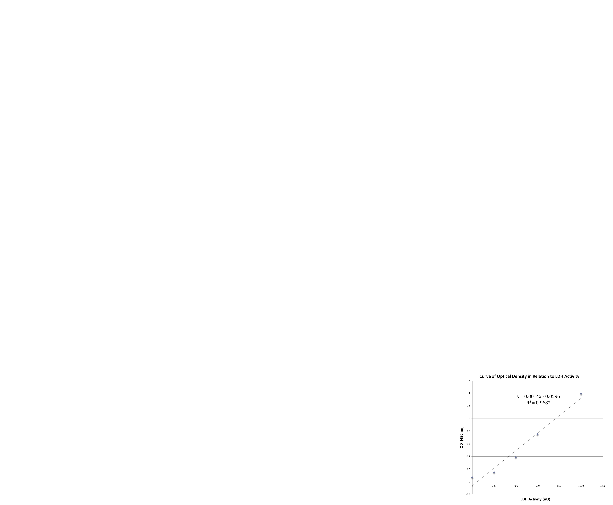


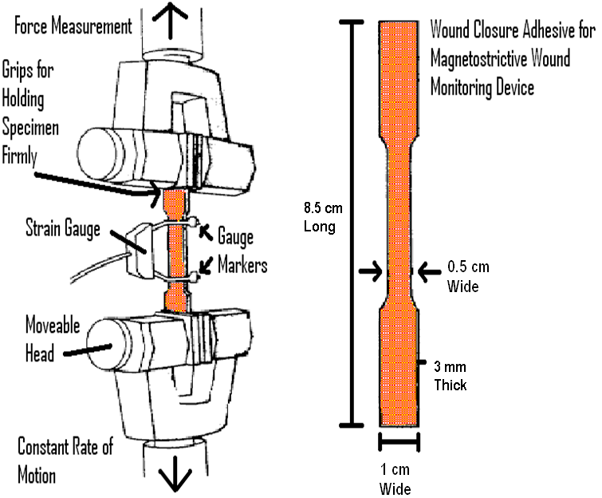
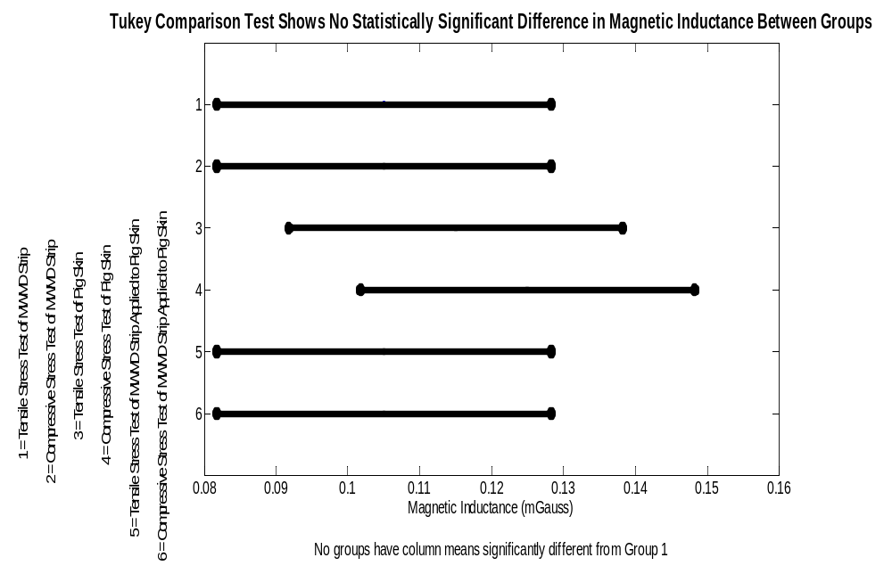
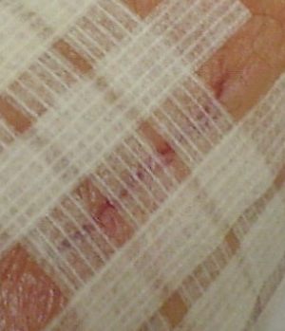
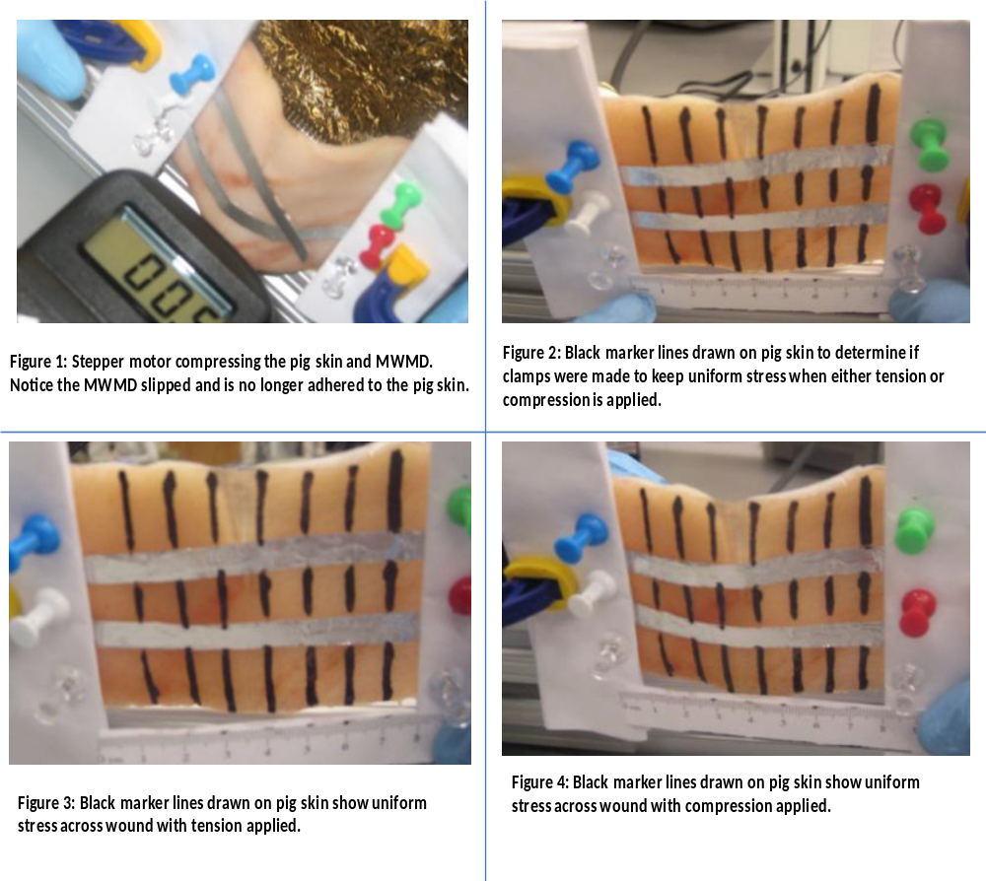
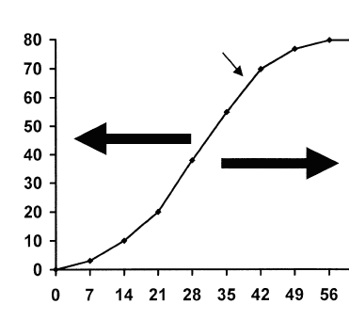
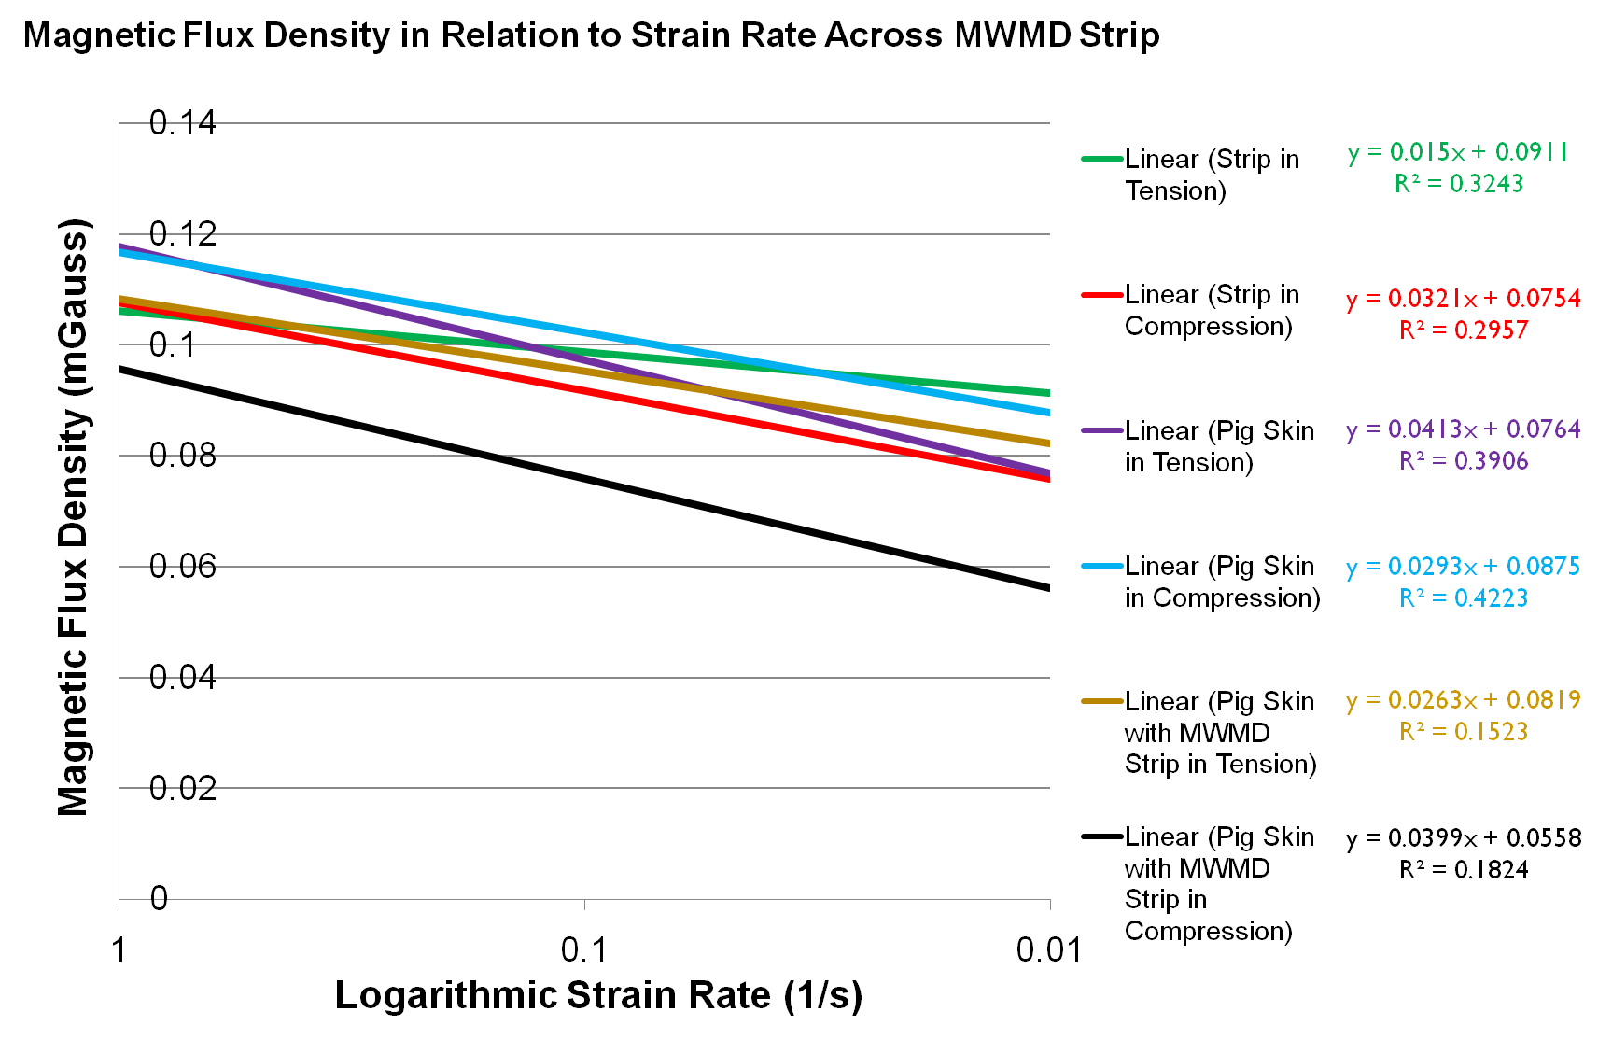
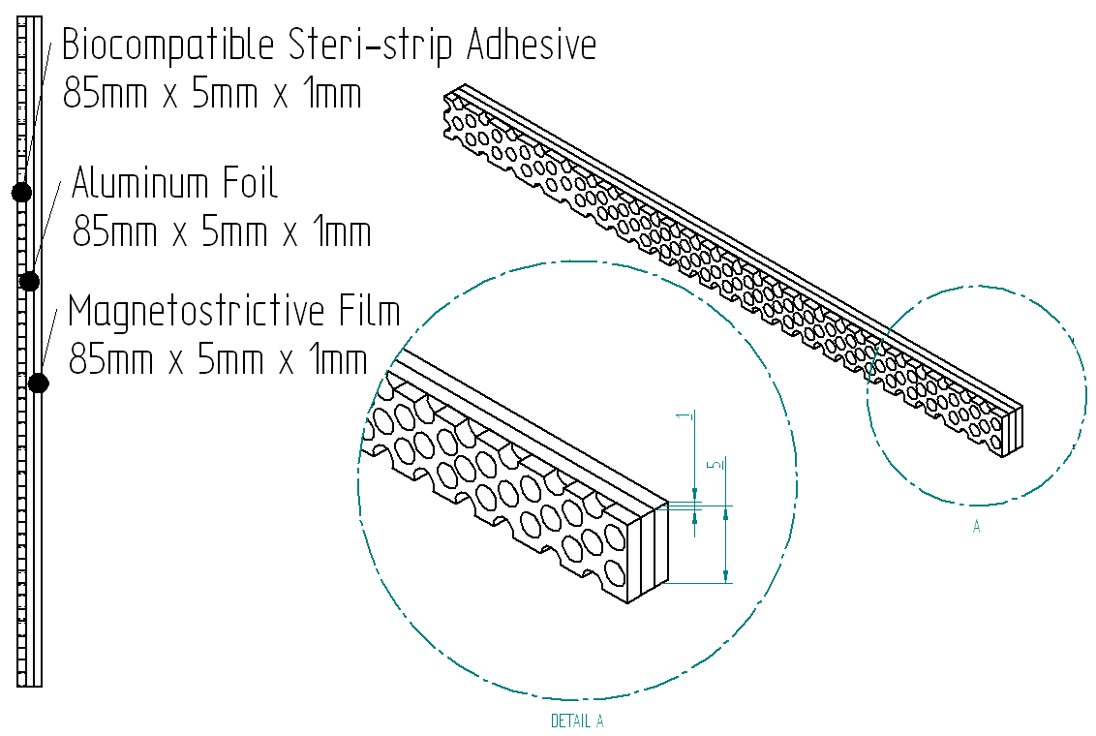
Magnetostrictive Wound Monitoring Device
BMED 4601. Senior Design II. Fall Semester 2008
Team Members: Sochetra Kong, Christopher Lacey, Sean Lynch, Vanessa Yip
Project Brief
Testing
Results
Nearly 50 million surgical procedures are performed in the U.S. each year.¹ An expensive and major complication during healing is wound dehiscence, occurring in 3% of patients. A device that monitors wound healing in acute wounds up to 5cm in length¹ by measuring
I. Proof of Concept Test
  Stepper motor and clamp are affixed longitudinally to a single MWMD
  Clamps pulls the strip at varying strain rates
    0.01/s, 0.1/s and 1/s
    Total Strain: 0.0588
  EMF meter (Lutron EMF-822A) measures changes in EMF
Tukey comparison test after ANOVA
Shows no statistical significance between the mean magnetic inductance associated with either bench test (stresses applied at 0.01s⁻¹ strain rate)
tensile stress across a wound’s edges is needed. The device will use a magnetostrictive bilayer as the sensor for measuring tensile stress via the Villari effect & Faraday’s law while adhesively attached to a support layer of biocompatible adhesive tape such as Steri-Strips.
change of MWMD affixed to pig skin
Engineering Design Specifications
II. Performance Test
  10cm x 15cm pig skin was cut with scalpel to form 4cm laceration
  Laceration was closed using MWMD
  Pig skin closed with MWMD is affixed to stepper motor and clamps
  Clamps pulls the strip at varying strain rates
    0.01/s, 0.1/s and 1/s
    Simulates wound dehiscence
  EMF meter measures the EMF
I. Expected Functional Parameters & Engineering Characteristics
  Records tensile stress while placed along acute wound up to 4 cm long & normal to longest direction of laceration
  Using an electromotive force meter, the clinician will access the state of healing by recording the EMF change due to stress,
LDH Cytotoxicity Assay
MWMD is biocompatible
Paired T-test H₀: u₁ = u_{2,} H_{A} : u₁ ≠ u₂
P-Value | T- Value | CI | Alpha | Beta
0.44 | 0.95 | 95% | 0.05 | 0.80
Discussion
II. Human factors and considerations
  Size: 8.5 cm by 1 cm
  Max weight: <20g to prevent sliding²
  Must utilize biocompatible biomaterials
Comparison Chart of Testing Results against Design Specifications
% Breaking Strength of Unwounded Tissue
Normal Healing
Design Criteria to Satisfy Customer Requirements: | Magnetostrictive Bilayer Sensor | Comments
Expected Functional Parameter: Measures Tensile Stress | 0 / 26 | At best, there is a 0.32 and 0.3 R² value for 5882 MPa, which should have produced an amplified magnetic inductance response.
Ergonomics: | 13 / 13 | The Steri-Strip adhesive layer is comfortable and slips along the skin.
Size: | 12 / 12 | The prototype’s size suites its deemed use for simply approximated lacerations up to 5 cm in length.
Material Properties: | 12 / 13 | Magnetostrictive sensors have been shown to be biocompatible.
Compatibility with Past Products / Manufacturability: | 6 / 6 | There was no problem with integrating each part of the prototype (the Steri-Strip, Magnetostrictive Alloy, and Aluminum Foil) via Epoxy-resin adhesive. No slip along these boundaries was observed during testing.
Education: | 5 / 5 | The design comes with an easy to use brochure and is quite intuitive to use.
Ethics: | 9 / 9 | There are no ethical concerns.
Standards: | 12 / 16 | There is less magnetic inductance across the MWMD’s wound closure strips than that measured across a computer monitor. Therefore, this device meets all electromagnetic compatibility constraints deemed important by the FDA. Meets biocompatibility requirements.
Total | 69 | N/A
III. Metrics for customer satisfaction
  Measuring tensile stress, ergonomics,
  size, material properties, biocompatibility, education, ethics & standards
Ideal Healing
Impaired Healing
III. Biocompatibility Test
  LDH cytotoxicity assay was performed
  Samples were placed into testing wells in triplicate
    Reaction mixture
    Reaction mixture and pig skin cells
    Reaction mixture, pig skin cells, and small strip magnetostrictive alloy
  Incubated for 48 hours
  Absorbance values were measured
Days
IV. Constraints
  The device is limited to use for acute wounds. The MWMD cannot be used with wounds that are rough edged, deep wounds, and wounds occurring in non-flexible and non-elastic areas.
  Compatible with FDA approved adhesive support layer
Design Solution and Prototype
Consists of three layers bonded by epoxy resin adhesive
  Steri-Strip support layer
  Fe-based magnetostrictive alloy film (2605SA3)
  Aluminum foil counter layer
Results
Magnetic inductance (mGauss) in relation to strain rate (0.01, 0.1, 1/s) during both a constant tensile and compressive stress test (5882 MPa)
Conclusion and Recommendations
During the healing, each layer undergoes strain and bending
  Strain causes an induced magnetic permeability
Prototype failed to achieve a passing score of 75 dictated by EDS.
Recommended design solution: WS FGM-3D2TN EMF meter- more sensitive
Alternative wound closure support layer- medical staples, sutures
change in the alloy
Clinician will use an EMF
meter to access the state of
healing using data relating EMF and tensile stress.
References
[1] Hoath, Steven B., Donnelly MM, and Raymond BE. Sensory Transduction and the Mammalian Epidermis. Biosens Bioelectron. 1990; 5:351-366.
[2] Mehnen L., Pfutzner H., Kaniusas E. Magnetostrictive Amorphous Bimetal Sensors. Journal of Mag and Mag Materials. 2000;215-216:779-781.
Figure 2: Solid edge model illustrating the prototype. Distances shown above are in millimeters (mm).

