Slide 1

Inhaled medications at all children’s hospital
Christopher Lacey

Slide 2
objectives
To recognize, name, recall, and arrange inhalation medications within the pharmacy.
To answer questions pertaining to drug indication, mechanism of action, and dosing of inhalation medications dispensed at All Children’s Hospital pharmacy.
To explain the special procedures associated with inhalation medications compounded and dispensed from All Children’s Hospital pharmacy.

Slide 3

PREVIEW
Introduction & Problem Statement
Inhalation medication confusion
Disease States
Asthma
Cystic Fibrosis
Respiratory Infection
Drug Name / Item Description
Drug Classification
Therapeutic Indication
Mechanism of Action
Dosing
Special Procedures, Labeling, Storage Conditions
Impact & Significance
Enhanced pharmacy workflow

Slide 4
Introduction & Problem Statement
Numerous Inhalation Medications in the Pharmacy
Confusion
Education on Inhalation Medications is Necessary

Slide 5
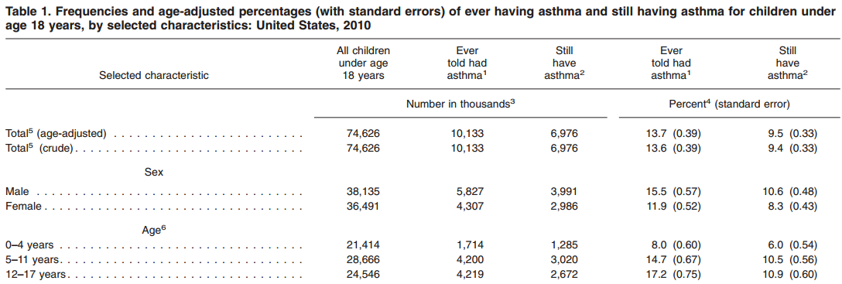
Asthma
10 million U.S. children aged 17 years and under (14%) have had an asthma diagnosis
7 million children still have asthma (10%)
Annual direct ($50.1 billion) and indirect cost ($5.9 billion) sums to a total of $56 billion dollars
http://www.cdc.gov/nchs/data/series/sr_10/sr10_250.pdf
Notes:
Disease state prevalence - CDC
Cost statistic - Journal of Allergy and Clinical Immunology

Slide 6
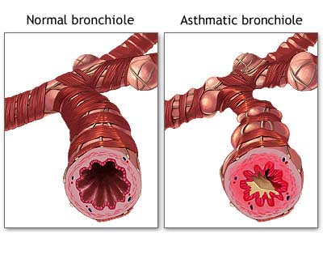
Asthma
Pathogenesis of Asthma
Inflammatory disorder of the conducting airways
Narrowed airways lead to:
Wheezing
Chest tightness
Rapid or shallow breathing
Treatment Includes:
Opening the airway
Suppressing Inflammation
www.bio.davidson.edu
Notes:
Asthma is a disease in which blocked or narrowed airways cause trouble breathing and shortness of breath.
The most common symptoms are shortness of breath, or rapid, shallow breathing, cough, wheeze and chest tightening.
On the left you see a normal airway with relaxed muscles and very little mucus in the lumen. On the right you see the 2 hallmarks of asthma the muscles squeezing the outside of the airway (bronchoconstriction) and the increased mucus produced by inflammation.
Inflammation can swell the airways, tighten the airway muscles, and increase the amount of mucus that the airways produce.
During bronchconstriction, the “smooth muscle that surrounds the airway tenses and squeezes.”⁴ This action leads to the narrowing of the airways, therefore making it hard to breathe.

Slide 7
Asthma Medication list
Meter Dose Inhaler
Nebulized
Mast-Cell Stabilizer
CROMOLYN SODIUM
Short-Acting
Ventolin
Proventil
Steroid
QVAR-40
QVAR-80
Flovent HFA 220 mcg / puff
Flovent HFA 110 mcg / puff
Flovent HFA 44 mcg / puff
Short-Acting
Accuneb 2.5 / 0.5 mL
Accuneb 1.25 / 3 mL
Accuneb 0.63 / 3 mL
S2 INHALANT
Albuterol 5 mg / mL solution
Steroid / Long-Acting Combinations
ADVAIR HFA 230
ADVAIR HFA 115
ADVAIR HFA 45
SYMBICORT 160
SYMBICORT 80
Antimuscarinic / Short-Acting Combination
ATROVENT HFA
COMBIVENT RESPIMAT

Slide 8
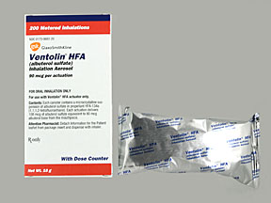
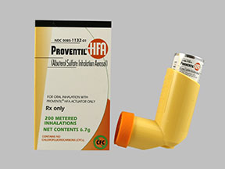
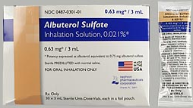
Albuterol
VENTOLIN 90 mcg / puff aerosol 8 g inhaler
PROVENTIL HFA 90 mcg / puff aerosol 6.7 g inhaler
ALBUTEROL 0.63 mg / 3 mL solution
Drug Class
Short-Acting Respiratory Beta-Agonist
Indication
Asthma attack
Mechanism of Action
Relaxes bronchial smooth muscle

Slide 9
Albuterol MDI
VENTOLIN 90 mcg / puff aerosol 8 g inhaler
PROVENTIL HFA 90 mcg / puff aerosol 6.7 g inhaler
Dosing
Asthma attack: 4 - 8 puffs Q 20 min for up to 4 Hr, then every 1 Hr
Maintenance: 2 puffs Q 4 - 6 Hr prn
Special Procedures, Storage Conditions, Labeling
Discard when counter reads 0000 or 12 months after removal from protective pouch
Store with mouthpiece down

Slide 10
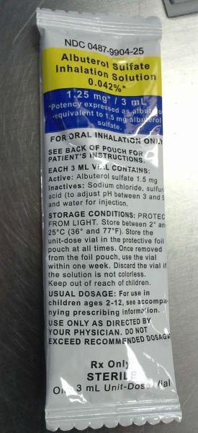
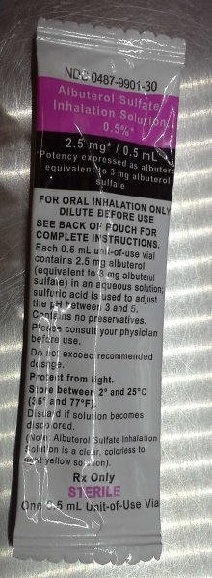
Albuterol Nebulized
Accuneb 0.63 mg / 3 mL solution
Accuneb 1.25 mg / 3 mL solution
Ventolin 2.5 mg / 0.5 mL solution
Dosing
0.63 - 2.5 mg dose Q 4-6 Hr for ≤ 5 years old
1.25 - 2.5 mg dose for ≥ 5 years old Q 4-8 Hr
Special Procedures, Storage Conditions, Labeling
Store at 2 - 25° C
Do not use if solution changes color or becomes cloudy
Use within 1 week of opening foil pouch

Slide 11
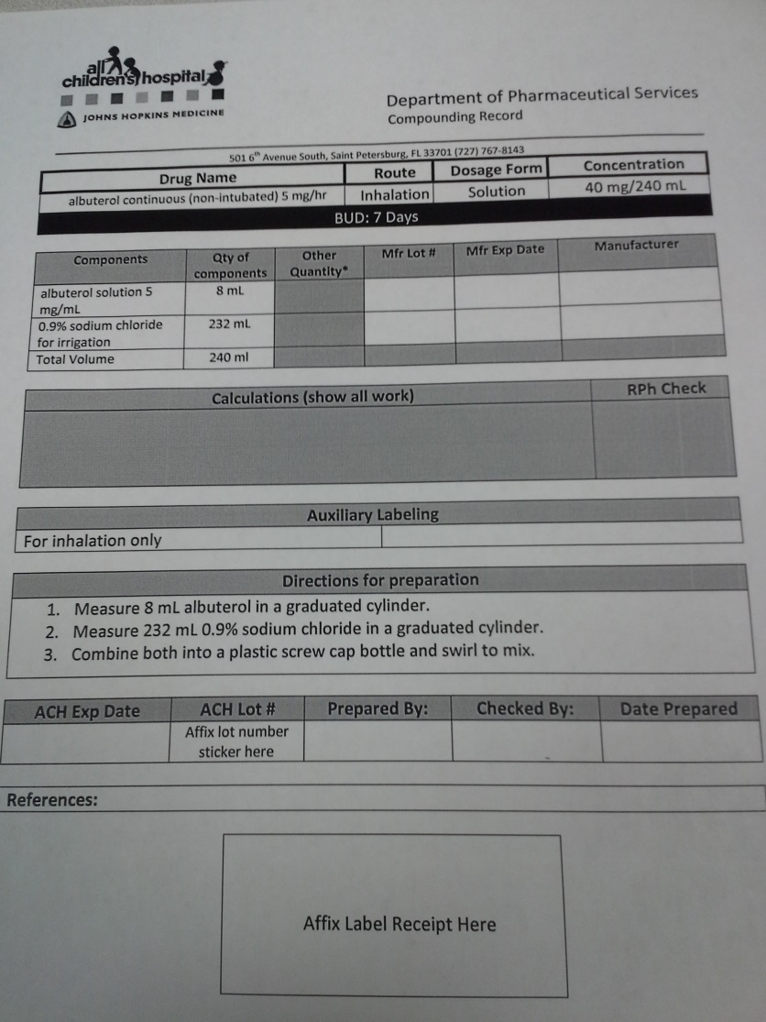
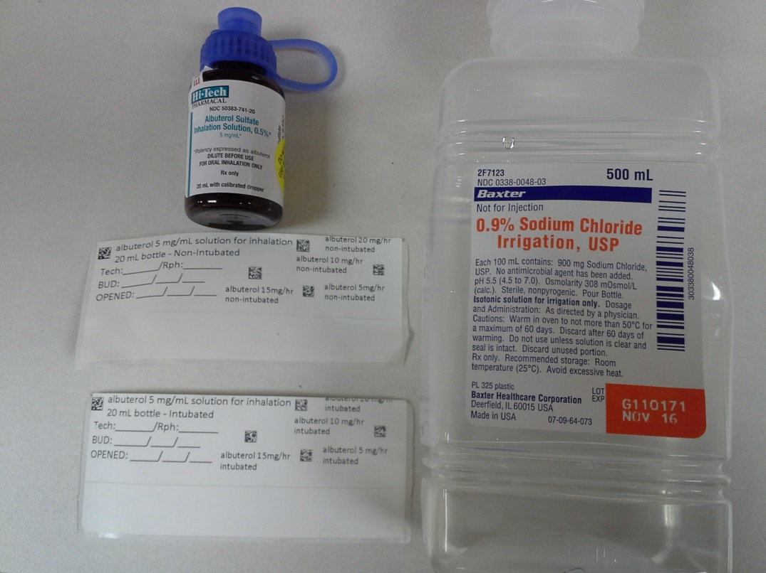
Compounding Concentrated Albuterol Nebulized
ALBUTEROL 5 mg/mL solution for inhalation 20 mL bottle
Continuous albuterol for asthma attack

Slide 12
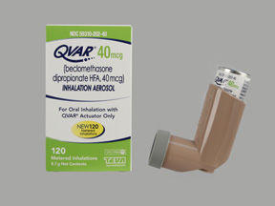
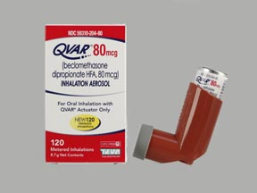
Beclomethasone
QVAR-40, 40 mcg / puff aerosol 8.7 g inhalation
QVAR-80, 80 mcg / puff aerosol 8.7 g inhalation
Drug Class
Orally Inhaled Corticosteroid (ICS)
Indication
Long-term control of asthma
Not for asthma attack
Mechanism of Action
Depresses the migration of white blood cells
Stabilizes & controls inflammation

Slide 13
Beclomethasone
QVAR-40, 40 mcg / puff aerosol 8.7 g inhalation
QVAR-80, 80 mcg / puff aerosol 8.7 g inhalation
Dosing
80 – 320 mcg / day for 5 – 11 years old
Max 480 mcg / day for ≥ 12 years old
Special Procedures, Storage Conditions, Labeling
Store at room temperature

Slide 14
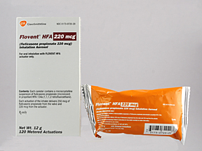
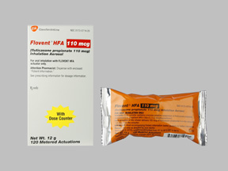
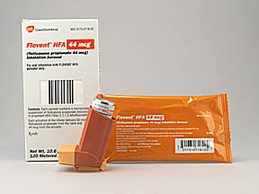
FLuticasone
FLOVENT HFA 220 mcg / puff aerosol 12 g inhaler
FLOVENT HFA 110 mcg / puff aerosol 12 g inhaler
FLOVENT HFA 44 mcg / puff aerosol 10.6 g inhaler
Drug Class
Orally Inhaled Corticosteroid (ICS)
Indication
Long-term control of asthma
Not for asthma attack
Mechanism of Action
Vasoconstrictive & anti-inflammatory
Direct Local effects

Slide 15
FLuticasone
FLOVENT HFA 220 mcg / puff aerosol 12 g inhaler
FLOVENT HFA 110 mcg / puff aerosol 12 g inhaler
FLOVENT HFA 44 mcg / puff aerosol 10.6 g inhaler
Dosing
88 mcg BID for 4 – 11 year olds
Max 440 mcg twice daily for ≥ 12 years old
Special Procedures, Storage Conditions, Labeling
Store at room temperature

Slide 16
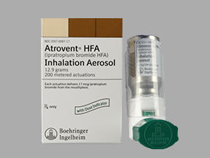
Ipratropium Bromide
ATROVENT HFA 17 mcg / puff aerosol 12.9 g inhaler
Drug Class
Respiratory Antimuscarinic
Indication
Asthma attack
Exercise-induced bronchospasm
Mechanism of Action
Blocks receptors resulting in relaxation of smooth muscle & opening up the airways
Produces a local effect
Notes:
3 A.

Slide 17
Ipratropium Bromide
ATROVENT HFA 17 mcg / puff aerosol 12.9 g inhaler
Dosing
Asthma attack: 4 – 8 inhalations Q 20 min prn for up to 3 Hr
Maintenance: 2 – 3 inhalations Q 6 Hr
Max 12 inhalations / day
Special Procedures, Storage Conditions, Labeling
Store at room temperature
Valve holding chamber and face mask for children < 4 years old

Slide 18
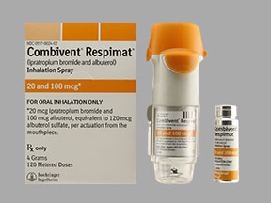
Albuterol-ipratropium
COMBIVENT RESPIMAT aerosol 4 g inhaler
Albuterol 100 mcg - Ipratropium 20 mcg per
inhalation
Drug Class
Respiratory Antimuscarinic / Short-Acting Respiratory Beta-Agonist Combination
Indication
Asthma attack
Chronic bronchitis
Mechanism of Action
Albuterol binding causes relaxation of bronchial smooth muscle
Ipratropium prevents an increased tone of bronchial smooth muscle

Slide 19
Albuterol-ipratropium
COMBIVENT RESPIMAT aerosol 4 g inhaler
Albuterol 100 mcg - Ipratropium 20 mcg per inhalation
Dosing
1.5 mL Q 20 min for 3 doses, then prn
Special Procedures, Storage Conditions, Labeling
Store at room temperature

Slide 20
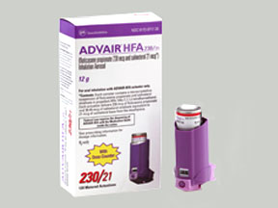
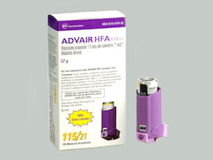
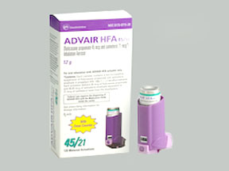
Fluticasone-salmeterol
ADVAIR HFA 230 mcg – 21 mcg / puff aerosol 12 g inhaler
ADVAIR HFA 115 mcg – 21 mcg / puff aerosol 8 g inhaler
ADVAIR HFA 45 mcg – 21 mcg / puff aerosol 8 g inhaler
Drug Class
Respiratory Corticosteroid / Long-Acting Beta-Agonist Combination
Indication
Maintenance management of asthma
Not for asthma attack
Mechanism of Action
Combination more effective than either drug alone
Fluticasone blocks allergic response to allergens and is anti-inflammatory
Salmeterol relaxes smooth muscle opening up airways

Slide 21
Fluticasone-salmeterol
ADVAIR HFA 230 mcg – 21 mcg / puff aerosol 12 g inhaler
ADVAIR HFA 115 mcg – 21 mcg / puff aerosol 8 g inhaler
ADVAIR HFA 45 mcg – 21 mcg / puff aerosol 8 g inhaler
Dosing
2 inhalations BID ≥ 12 years old
Max of 920 mcg Fluticasone / 84 mcg salmeterol daily
Special Procedures, Storage Conditions, Labeling
Store at room temperature
Store in a dry place out of direct heat or sunlight

Slide 22
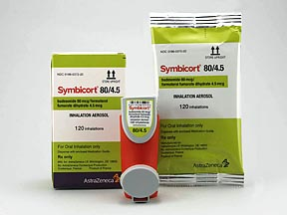
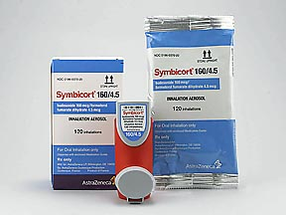
Budesonide-formoterol
SYMBICORT, 80 mcg – 4.5 mcg / puff aerosol 60 dose inhaler
SYMBICORT, 160 mcg – 4.5 mcg / puff aerosol 60 dose inhaler
Drug Class
Respiratory Corticosteroid / Long-Acting Beta Agonist Combination
Indication
Maintenance management of asthma
Not for asthma attack
Mechanism of Action
Budesonide depresses white blood cell migration and controls inflammation
Formoterol relaxes bronchial smooth muscle with a long-acting effect

Slide 23
Budesonide-formoterol
SYMBICORT, 80 mcg – 4.5 mcg / puff aerosol 60 dose inhaler
SYMBICORT, 160 mcg – 4.5 mcg / puff aerosol 60 dose inhaler
Dosing
2 puffs BID
Max 4 puffs / day
Special Procedures, Storage Conditions, Labeling
Store at room temperature

Slide 24
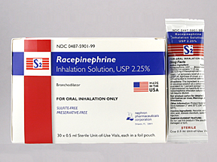
RACEPinephrine
S2 INHALANT, 2.25 % solution inhalation
Drug Class
Inhalation sympathomimetic Bronchodilator Agent
Indication
Asthma attack (not routine)
Airway edema
Mechanism of Action
Stimulates receptors resulting in relaxation of smooth muscle
Large doses may produce constriction of other muscles
Notes:
National Asthma Education and Prevention Program (NAEPP), 2007 doesn’t recommend this drug for routine management of asthma patients

Slide 25
RACEPinephrine
S2 INHALANT, 2.25 % solution inhalation
Dosing
0.5 mL diluted with 3 – 5 mL of NS
Nebulized over 15 min Q 3-4 Hr
Special Procedures, Storage Conditions, Labeling
Store at room temperature
Protect from light and excessive heat

Slide 26
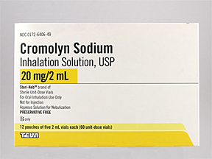
Cromolyn
CROMOLYN SODIUM 20 mg solution 2 mL inhalation
Drug Class
Mast-Cell Stabilizer
Indication
Chronic control of asthma
Prevention of allergen or exercise-induced bronchospasm
Mechanism of Action
Prevents the mast cell release of inflammatory mediators
Notes:
National Asthma Education and Prevention Program (NAEPP), 2007 doesn’t recommend this drug for routine management of asthma patients

Slide 27
Cromolyn
CROMOLYN SODIUM 20 mg solution / 2 mL inhalation
Dosing
20 mg QID ≥ 2 years old
Special Procedures, Storage Conditions, Labeling
Protect from light and heat
Nebulization solution is compatible with beta-agonists, antimuscarinic solutions, acetylcysteine, and NS
Incompatible with alkaline solutions, Ca, Mg salts
Store oral concentrate ampuls in foil pouch until ready for use
Compatible with 20% acetylcysteine solution for at least 1 hour after their admixture
Notes:
- ipratropium or salmeterol compatible

Slide 28
Review Asthma Medication list
Meter Dose Inhaler
Nebulized
Mast-Cell Stabilizer
CROMOLYN SODIUM
Short-Acting
Ventolin
Proventil
Steroid
QVAR-40
QVAR-80
Flovent HFA 220 mcg / puff
Flovent HFA 110 mcg / puff
Flovent HFA 44 mcg / puff
Short-Acting
Accuneb 2.5 / 0.5 mL
Accuneb 1.25 / 3 mL
Accuneb 0.63 / 3 mL
S2 INHALANT
Albuterol 5 mg / mL solution
Steroid / Long-Acting Combinations
ADVAIR HFA 230
ADVAIR HFA 115
ADVAIR HFA 45
SYMBICORT 160
SYMBICORT 80
Antimuscarinic / Short-Acting Combination
ATROVENT HFA
COMBIVENT RESPIMAT

Slide 29

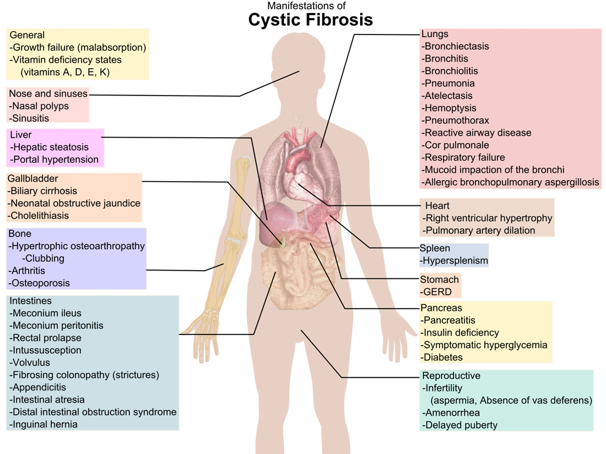
Cystic fibrosis
Mutations of the CFTR gene located on chromosome 7
Decreased secretion of Cl
Increased Na absorption
Thick airway secretions
Notes:
Disease state prevalence - CDC
Cost statistic - Journal of Allergy and Clinical Immunology

Slide 30
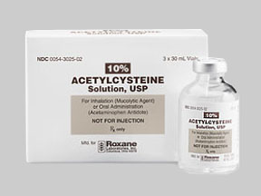
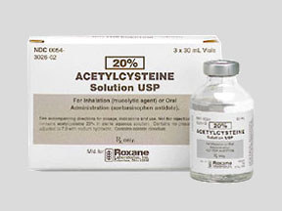
Acetylcysteine
Mucomyst 100 mg / mL, 10% solution for inhalation 4 mL bottle
Mucomyst 200 mg / mL, 20% solution for inhalation 30 mL vial
Drug Class
Mucolytic agent
Indication
Mucous secretions in bronchopulmonary diseases
Complications of surgery
Cystic fibrosis
Mechanism of Action
Sulfhydryl groups in acetylcysteine react with mucoproteins
Exerts action by lowering mucous thickness
Notes:
National Asthma Education and Prevention Program (NAEPP), 2007 doesn’t recommend this drug for routine management of asthma patients

Slide 31
Acetylcysteine
Mucomyst 100 mg / mL, 10% solution for inhalation 4 mL bottle
Mucomyst 200 mg / mL, 20% solution for inhalation 30 mL vial
Dosing
10%: 2 - 20 mL Q 2 – 6 Hr
20%: 1 – 10 mL Q 2 – 6 Hr
Special Procedures, Storage Conditions, Labeling
Store unopened vials at room temperature
Refrigerate opened vials and use within 96 Hr
Color change may occur in opened vials (light purple), but does not affect the safety or efficacy
Contact with rubber, Cu, Fe, and cork may inactivate the drug
May be further diluted with NaCl or Sterile Water
Notes:
hours. Color change may occur in opened vials (light purple) and does not affect the safety or efficacy. Contact with rubber, copper, iron, and cork may inactivate the drug. May be further diluted with NaCl or Sterile Water for inhalation

Slide 32
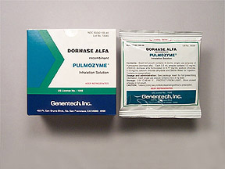
Dornase alfa solution
PULMOZYME 2.5 mg solution for inhalation 2.5 mL ampule
Drug Class
Respiratory enzyme
Indication
Management of cystic fibrosis
Mechanism of Action
Gene technology that cuts DNA resulting in reduced mucous thickness & enhanced airflow

Slide 33
Dornase alfa solution
PULMOZYME 2.5 mg solution for inhalation 2.5 mL ampule
Dosing
1.25 – 2.5 mg QD
Special Procedures, Storage Conditions, Labeling
Refrigerate 2 – 8° C
Protect from light
Unopened vials left at room temperature > 24 Hr should be discarded
Discard solution if discolored or cloudy
Very expensive
Made from Chinese hamster ovary cells
Notes:
hours. Color change may occur in opened vials (light purple) and does not affect the safety or efficacy. Contact with rubber, copper, iron, and cork may inactivate the drug. May be further diluted with NaCl or Sterile Water for inhalation

Slide 34

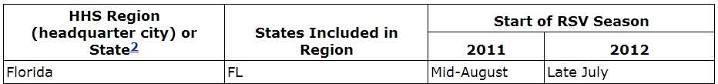
Pulmonary infection
Respiratory syncytial virus (RSV)
Most common cause of bronchiolitis (inflammation of the small airways in the lung)
Pneumonia in children under 1 years old
Runny nose, coughing, sneezing, fever
No effective vaccine
Notes:
http://www.cdc.gov/rsv - synergis (Palivizumab)

Slide 35
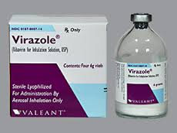
Ribavirin
VIRAZOLE 1 g / 16.7 mL solution for inhalation
Drug Class
Antiviral Agent, Inhalation Therapy
Indication
RSV Infection
Mechanism of Action
Inhibits viral protein synthesis resulting in decreased replication of virus

Slide 36
Ribavirin
VIRAZOLE 1 g / 16.7 mL solution for inhalation
Dosing
190 mcg / L of air Q 12 Hr
Special Procedures, Storage Conditions, Labeling
Store in dry place at room temperature, chemo room on RX4
Hazardous agent, prepare in MIC hood
Dilute 6 g vial with 100 mL SW
Don’t mix with other aerosolized medications
If metal rim removed, rubber stopper comes out
Dispense each dose in small plastic bottle for continuous albuterol
Label with yellow sticker “For Inhalation Only”
Deliver to patient-specific yellow bin in med room
Notes:
hours. Color change may occur in opened vials (light purple) and does not affect the safety or efficacy. Contact with rubber, copper, iron, and cork may inactivate the drug. May be further diluted with NaCl or Sterile Water for inhalation

Slide 37
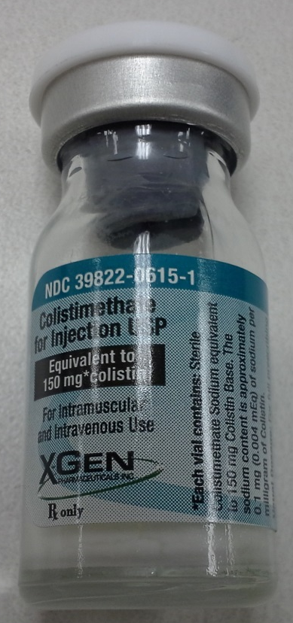
Colistin Base
COLYMYCIN 37.5 mg / mL for inhalation
Drug Class
Antibiotic, Miscellaneous
Indication
Nebulized solution for the treatment of pneumonia (off-label)
Prevents infection in cystic fibrosis
Mechanism of Action
Acts as a detergent & damages the bacterial membrane causing cell death
Notes:
Prophylaxis in patients colonized with P. aeruginosa

Slide 38
Colistin Base
COLYMYCIN 37.5 mg / mL for inhalation
Dosing
4 mg / kg / dose Q 12 Hr for ventilator associated pneumonia in neonates
3 – 5 mg / kg / dose Q 8 Hr in CF with max of 100 mg / dose
Special Procedures, Storage Conditions, Labeling
Refrigerate at 2 - 8° C or store at room temperature
For inhalation, use reconstituted solution immediately after preparation (within 6 Hr)
Notes:
hours. Color change may occur in opened vials (light purple) and does not affect the safety or efficacy. Contact with rubber, copper, iron, and cork may inactivate the drug. May be further diluted with NaCl or Sterile Water for inhalation

Slide 39
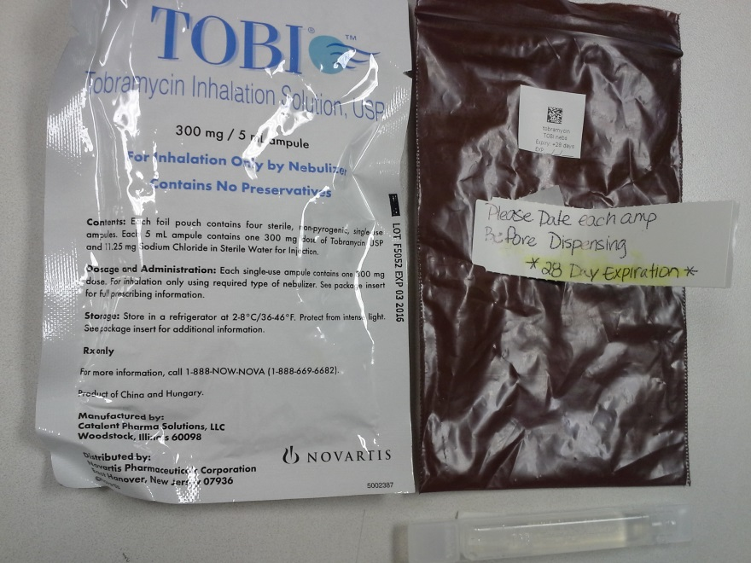
Tobramycin
TOBI 60 mg / mL solution for inhalation
Drug Class
Antibiotic, Aminoglycoside
Indication
Pulmonary infection
Cystic fibrosis
Mechanism of Action
Interferes with bacterial protein synthesis resulting in a defective bacterial cell membrane

Slide 40

Tobramycin
TOBI 60 mg / mL solution for inhalation
Dosing
300 mg Q 12 Hr, administer in repeat cycles of 28 days on drug, followed by 28 days off drug
Special Procedures, Storage Conditions, Labeling
Refrigerate at 2 - 8° C or store at room temperature for up to 28 days
Do not use if cloudy or contains particles
Incompatible with dornase alfa (may precipitate)
Yellow solution does not indicate loss of potency
Notes:
hours. Color change may occur in opened vials (light purple) and does not affect the safety or efficacy. Contact with rubber, copper, iron, and cork may inactivate the drug. May be further diluted with NaCl or Sterile Water for inhalation

Slide 41
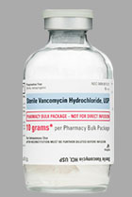
Vancomycin in 0.9% NACL
VANCOCIN 100 mg / mL solution for inhalation
Drug Class
Antibiotic, Miscellaneous
Indication
Nebulized solution for the treatment of pneumonia (off-label)
Prevents infection in cystic fibrosis
Mechanism of Action
Inhibits bacterial cell wall synthesis by binding precursor molecule
Notes:
Prophylaxis against infection in Cystic Fibrosis patients colonized with P. aeruginosa

Slide 42
Vancomycin in 0.9% NACL
VANCOCIN 100 mg / mL solution for inhalation
Dosing
Max 400 mg / day
Special Procedures, Storage Conditions, Labeling
Store vials at room temperature prior to reconstitution
Refrigerate after reconstitution up to 14 days
Upon further dilution with NS or D5, may refrigerate and use within 96 Hr
Notes:
hours. Color change may occur in opened vials (light purple) and does not affect the safety or efficacy. Contact with rubber, copper, iron, and cork may inactivate the drug. May be further diluted with NaCl or Sterile Water for inhalation

Slide 43
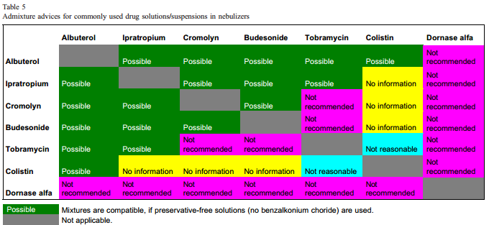
Admixture Chart for nebulized Solutions & Suspensions
http://ac.els-cdn.com/S1569199306000415/1-s2.0-S1569199306000415-main.pdf?_tid=44fc0de4-b532-11e3-a8f9-00000aab0f6c&acdnat=1395871506_6a4480adce1107069781f95dfd5c6705
Notes:
hours. Color change may occur in opened vials (light purple) and does not affect the safety or efficacy. Contact with rubber, copper, iron, and cork may inactivate the drug. May be further diluted with NaCl or Sterile Water for inhalation

Slide 44
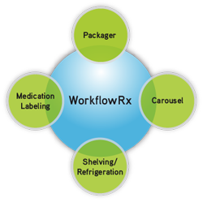
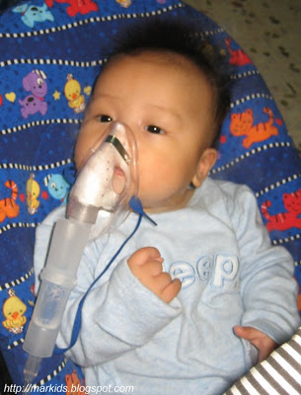
Impact & Significance
Drug class
Special procedures
High cost
Storage
Labeling
Pharmacy Knowledge
Reduced Treatment Failures

Slide 45
SUMMARY
Introduction & Problem Statement
Inhalation medication confusion
Disease States
Asthma
Cystic Fibrosis
Respiratory Infection
Drug Name / Item Description
Drug Classification
Therapeutic Indication
Mechanism of Action
Dosing
Special Procedures, Labeling, Storage Conditions
Impact & Significance
Enhanced pharmacy workflow

Slide 46
Resources
National Health Interview Survey. Center for Disease Control and Prevention website. Available: http://www.cdc.gov/nchs/data/series/sr_10/sr10_250.pdf Accessed March 25, 2014.
Barnett SB, Nurmagambetov TA. Costs of Asthma in the Unites States: 2002-2007. Journal of Allergy and Clinical Immunology. 2011; 127:145-52.
CDC. Morbidity and Mortality Weekly Report. Respiratory Syncytial Virus Activity—United States, July 2011-January 2013. MMWR. 1 March 2013:141-144
Kamin W., Schwabe A., Kramer I., “Which one are allowed to be mixed? Physico-chmical compatiblity of drug solutions in nebulizers.” Journal of Cystic Fibrosis 5 (2006) 205-213.
Elsevier Inc. Clinical pharmacology website. Available: http://www.clinicalpharmacology-ip.com.lp.hscl.ufl.edu/Forms/Monograph/monograph.aspx?cpnum=7&sec=monmech&t=1. Accessed March 25, 2014.
Elsevier Inc. Clinical pharmacology website. Available: http://www.clinicalpharmacology-ip.com.lp.hscl.ufl.edu/Forms/Monograph/monograph.aspx?cpnum=7&sec=monmech&t=1. Accessed March 25, 2014.

