Slide 1
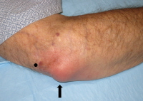
Case Presentation
Bacteremia
Christopher Lacey
Pharm. D. Candidate 2015
University of Florida
Morton Plant Hospital
September 23, 2015

Slide 2
Objectives
Patient case
Be able to understand the etiology of bacteremia
Treatment options for bacteremia based on infecting organism & source
Clinical course & critique

Slide 3
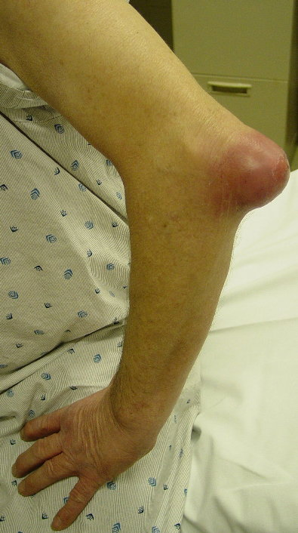
Chief Complaint
The patient was admitted to the hospital on 09/14/2014 with right arm swelling and pain, especially around the elbow
http://earlstevens58.files.wordpress.com/2011/08/olecranon_infected_bursitis_sm.jpg

Slide 4
History of Present Illness
EB is a 97 year old white female
Pain over her Rt upper ext
Disoriented
Review of Symptoms:
  Denies shaking chills or fever
  No headache, dizziness, nasal congestion, sore throat
  No SOB, cough or chest pain
  No N&V or abdominal pain
  No change in bowel habits
  No urinary frequency or dysuria
  Swelling in legs and right wrist (stable over past year)
  Not aware of having any rash or pruritus
Notes:
High light positive symptoms

Slide 5
Past Medical History
Hypertension
Hypothyroidism
Paroxysmal atrial fibrillation
Sick sinus syndrome with pacemaker
Thalassemia
Depression
Dementia
Baker cyst in right leg

Slide 6
Social History
Patient indicated that she is married
Lives with daughter & 5 cats
No smoking or drug use
Drinks an occasional alcoholic beverage
Family History:
Non-contributory

Slide 7
Allergies & Medications
Allergies: PCN, SULFA, clarithromycin, terazosin, lisinopril, Hytrin, Norvasc
  PCN listed as rash, N&V from SULFA
  No documentation on other allergies
Medications:
  Sotalol 80 mg tab 1 po QDaily
  Metoprolol 100 mg ER 1 po QDaily
  Felodipine 10 mg ER 1 po QDaily
  Aspirin 81 mg EC tab 1 po Qdaily
  Trazodone 50 mg 1 po Qhs
  Levothyroxine 50 mcg tab 1 po QAM
  Famotidine 20 mg tab 1 po ac breakfast
  Calcium Carbonate 500 mg tab 1 po QDaily
  Acetaminophen 325 mg 2 tab po Q6Hr prn pain
  Multivitamin with minerals 1 po QDaily
  Cyanocobalamin injections 1000 mcg IM QMonthly

Slide 8
Physical Examination
Vital Signs
  Afebrile since admission, HR: 86, BP: 123/65, RR: 16
  Weight: 69.2 kg, IBW: 50kg, BMI: 27.9 kg/m²
General: No acute distress, not alert and oriented, confused
HEENT: Normocephalic
Respiratory: Lungs clear to auscultation
Cardiovascular: Normal rate, Regular rhythm
Musculoskeletal:
  Edema, erythema & warmth of her Rt upper ext
  Dry scab over Rt forearm
  Tenderness to touch & movement
Integumentary:
  Warm, dry, pink, grossly intact with scratches
Notes:
Highlight the musculoskeletal

Slide 9
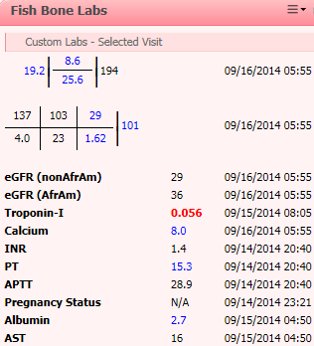
Labs
Labs
CrCl: 18 mL/min (Cockcroft-Gault; adj wt: 58kg)
SCr: 1.62 mg/dL on 9/16
PCT: 1.25 ng/mL (H) on 9/14, PCT: 1.82 ng/mL (H) on 9/16
UA: Normal
Notes:
Add creatinine clear, Pro cal

Slide 10
Imaging
Forearm x-ray:
Olecranon bursitis without evidence of bony abnormalities
Chest x-ray impression:
No acute cardiopulmonary disease
Mild left base atelectasis and/or infiltrate
Ultrasound of legs:
Negative for DVT

Slide 11
Blood Gas
Blood gas on Room Air
pH/PT corr: 7.420
PaCO2/PT corr: 39
PaO2/PT corr: 79 (L)
pH: 7.42
Hgb: 8.6 (L)
SaO2%: 96.9
%CO Hb 1.7
BE calc 0.9
Notes:
Room air, base excess (acidosis?)

Slide 12
Cultures & Susceptibilities
Blood Culture (9/15):
Gram negative rods seen in gram stain of aerobic & anaerobic bottles
Peripheral source
Notes:
Check wound cultures

Slide 13
Source of Bacteremia?

Slide 14
Initial Assessment
Gram negative bacteremia
Abdominal exam is unrevealing
CXR: no acute cardiopulmonary disease
  Rule out pneumonia
Urinalysis is clean
  Not originating from a UTI
Colonic source Differential:
    Diverticulitis / diverticular abscess
    Ischemic bowel
    Colonic mucosal abnormality
Notes:
No acute cardiopulmonary disease

Slide 15
Initial Plan
Vancomycin 1g IV Q36 Hr (discontinue if no GPC)
Aztreonam 1g IV Q8Hr (renally dosed)
  PCN allergy
  No documentation of recent cephalosporin
Single dose of tobramycin 180 mg (2.5mg/kg)
  While waiting for blood culture
CBC with manual differential to be obtained tomorrow
Serial PCT
CT of abdomen and pelvis with oral contrast
Notes:
Include actual doses
put antibiotics first

Slide 16
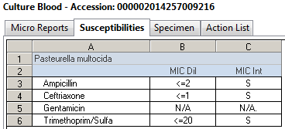
Cultures & Susceptibilities
Blood Culture (9/17):
Pasteurella multocida in aerobic & anaerobic bottle

Slide 17
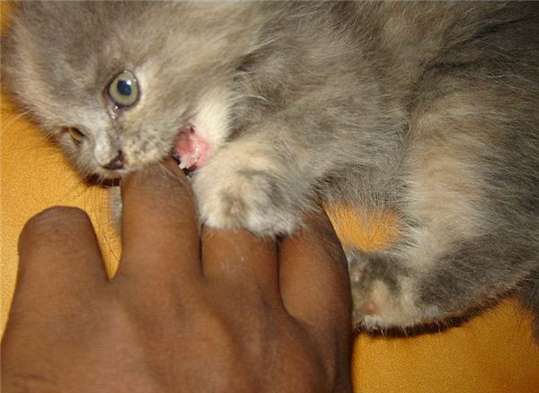
How did the patient get Pasteurella multocida?

Slide 18
Background
Notes:
Add garfield cat

Slide 19
Cat Bite Wounds
Skin pathogens:
Staph aureus (MSSA)
Cat oral flora:
Eikenella corrodens
Capnocytophaga canimorsus
Pasteurella multocida
  >50% incidence of infection
  Cats’ teeth slender & sharp
  Penetrate into bones and joints
  P. multocida isolated in 50% of cases
Notes:
Antibiotics should be used in the treatment of overtly infected bite wound. Agent selected to be active against both the aerobic and anaerobic normal oral flora of the biting animal, against the skin flora of the victim, and any likely environmental contaminants

Slide 20
Pathophysiology
Usually follows a break in the skin (fissure, cut)
Organisms on the skin enters dermis
Infection & spread through the lymphatic tissue to bloodstream
Nonpurulent wounds:
  Staphylococci & streptococci
Purulent bite wounds & abscess: polymicrobial
  Mixed aerobes & anaerobes
Pasteurella species found:
  nonpurulent & purulent wounds
  With & without lymphangitis
  Abscesses

Slide 21
Epidemiology
Approximately 5 million animal bites are reported annually
5 - 10% (cat bites) & 85 - 90% (dog bites)
Infection occurs more than 50% of the time in cat-related bites
60 - 80% of cat bites involve P. multocida
Notes:
http://emedicine.medscape.com/article/224920-overview#a0199

Slide 22
Risk Factors
Age
Immunocompromised
Peripheral vascular disease
Cracks, peeling skin or open wound
Diabetes
Drug use
Surgery
Notes:
Highlight risks factors that she has

Slide 23
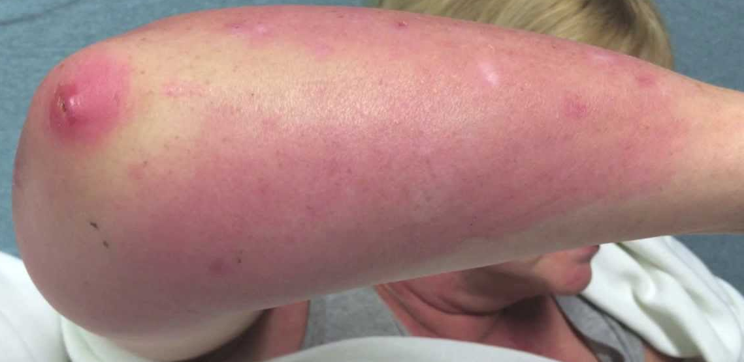
Signs and Symptoms
Signs
  Erythema and edema of the skin
  Tenderness
  Lesions are nonelevated & have poorly defined margins
Symptoms
  Patients often experience fever, chills, or malaise
  Affected area feels hot & painful
http://i.ytimg.com/vi/R3lEuEph5KU/maxresdefault.jpg

Slide 24

Tests and Diagnosis
Physical examination
Blood and tissue cultures
CBC
Erythrocyte sedimentation rate
C-reactive protein
Imagining
  CT
  X-ray
  Ultrasound
http://www.midlandsexams.com/_media/_photos/physical-exams1.jpg
Notes:
Didn’t take a sedimentation rate !

Slide 25
Pathogen Specific Therapy
Pathogen | 1st Line Agent | 2nd Line Agent
Eikenella corrodens | Amox-clavulanate Ampicillin-sulbactam Ertapenem Cefoxitin Fluoroquinolone | Cefuroxime Tetracycline TMP-SMX
Pasteurella multocida | Amox-clavulanate Fluoroquinolone Penicillin/Amoxicillin | Cefuroxime Cefoxitin Tetracycline TMP-SMX
Capnocytophaga canimorsus | Penicillin/Amoxicillin Cefoxitin Tetracycline Fluoroquinolones Azithromycin Clarithromycin Clindamycin
Staph aureus (MSSA) | Amox-clavulanate Cefuroxime Dicloxacillin Cephalexin | Fluoroquinolones TMP-SMX
Notes:
Look for article including bacteremia treatment options, treatment duration? Pasturella is resistant to clinda + 1st gen (need to use a 2nd, 3rd, 4th gen cephalosporin)
Pasteurella is resistant to clindamycin & 1st generation cephalosporins
Need to use a 2nd, 3rd, or 4th generation
Macrolides should be avoided due to variable activity

Slide 26
Pathogen Specific Therapy
Pathogen | 1st Line Agent | 2nd Line Agent
Eikenella corrodens | Amox-clavulanate Ampicillin-sulbactam Ertapenem Cefoxitin Fluoroquinolone | Cefuroxime Tetracycline TMP-SMX
Pasteurella multocida | Amox-clavulanate Fluoroquinolone Penicillin/Amoxicillin | Cefuroxime Cefoxitin Tetracycline TMP-SMX
Capnocytophaga canimorsus | Penicillin/Amoxicillin Cefoxitin Tetracycline Fluoroquinolones Azithromycin Clarithromycin Clindamycin
Staph aureus (MSSA) | Amox-clavulanate Cefuroxime Dicloxacillin Cephalexin | Fluoroquinolones TMP-SMX
What about treatment duration?
  Depends on the wound
Notes:
Look for article including bacteremia treatment options, treatment duration? Pasturella is resistant to clinda + 1st gen (need to use a 2nd, 3rd, 4th gen cephalosporin)
Macrolides should be avoided due to variable activity against P multocida and fusobacteria

Slide 27
Patient Case
Recap:
  97 yo WF with bacteremia
  Lives at home with daughter & 5 cats
  Edema, erythema & warmth of her Rt upper ext
  Dry scab over Rt forearm
  Tenderness to touch & movement
  Initial plan:
  Vancomycin (discontinue if no GPC)
  Aztreonam renally dosed
  Single dose of tobramycin

Slide 28
Cultures & Susceptibilities
Blood Culture (9/17):
Pasteurella multocida in aerobic & anaerobic bottle
Notes:
Ampicillin is sensitive
The reason ampicillin was tested is that it is a gram negative and penicillin is not on the gram negative panel
No testing of ciprofloxacin was done
Vitek2 gram neg panel does not test for pencillin susceptibilites
They do the tests for levo blood isolate, but do not report it. Don’t report organisms that are intrinsically resistant, only report out Clinical laboratory standards Institute susceptible drugs

Slide 29
Antibiotic Course
Vancomycin 1g IV Q36Hr, received 2 doses (9/14 - 9/16)
Tobramycin 180mg (2.5 mg/kg), received 1 dose (9/15)
Aztreonam 1g Q8Hr, received 6 doses (9/15 – 9/17)
Metronidazole 500 mg IV Q12Hr, received 2 doses (9/15 - 9/16)
Levofloxacin 750mg 1 tab PO Q48Hr, received 2 doses (9/16 & 9/17)
Notes:
Metronidazole: Concern for anaerobes was legitimate, it was discontinued as soon as murali took over for bercuson

Slide 30
Clinical Course
Impression & plan
Rt upper ext cellulitis, leukocytosis & bacteremia due to cat scratch or bite
Oral levofloxacin at 750mg Q48 Hr x 14 days
Discontinue all other antibiotics
Notes:
Vancomycin 1g IV Q36Hr, received 2 doses (9/14 & 9/16)
Tobramycin 180mg (2.5 mg/kg) (9/15)
Levofloxacin 750mg 1 tab PO Q48Hr

Slide 31
Critiques
Levofloxacin for bacteremia treatment
Streamline to an oral drug to send home sooner
  Cellulitis vs bacteremia
  CLSI does not report susceptibilities for drugs not indicated for bacteremia
  Dosed to achieve high enough concentrations to treat bacteremia
  No repeat PCT
Interactions & side effects
High dose in poor renal function
Glucose homeostasis affected
CNS effects
Interaction with sotalol
  QT 478 on 9/15 discharged on levofloxacin
  Readmitted 9/23/14 with QT 502
Notes:
If levofloxacin is used, anaerobic coverage with either clindamycin or metronidazole should be added (empiric therapy)
Look at the QT time line
Interactions & side effects
High dose in poor renal function
Interaction with sotalol (QT 478 on 9/15) discharged on levofloxacin
Readmitted 9/23/14 with QT 502
High doses associated with CNS effects
Glucose homeostasis affected

Slide 32
Allergy Influences on
Antibiotic Selection
PCN less expensive
Use of less effective agents
Increase resistant patterns
Adverse effects
  Clostridium difficile
Drug interactions
Increased:
  LOS
  Readmissions & health care cost
  Mortality
Notes:
Ceph are first line agents for prophylaxis and most clinicians recognize a potential for cross reactivty between beta-lactams Given the low rate of infection in many surgical procedures and the low occurrence of adverse effects with short term use, the risk:benefit ratio of using a second line agent may well be justified
Use of expensive antimicrobial/s
Use of ineffective antimicrobial/s
Increase in antimicrobial resistance
Increase in Health Care $$

Slide 33

Questions?

Slide 34
References
Stevens D., et. Al. Practice Guidelines for the Diagnosis and Management of Skin and Soft Tissue Infections: 2014 Update by the Infectious Diseases Society of America. Oxford University Press IDSA. DOI: 10.1093/cid/ciu296
Goldstein E., Bite Wounds and Infection. Clinical Infectious Diseases 1992; 14:633-40
Talan DA, Citron DM, Abrahamian FM, et al. Bacteriologic analysis of infected dog and cat bites. Emergency Medicine Animal Bite Infection Study Group. N Engl J Med; 1999; Vol. 340; pp. 85-92
Thomas N., Brook I., From Expert Review of Anti-Infective Therapy Animal Bite-associated Infections, Expert Rev Anti Infect Ther. 2011;9(2):215-226.

Slide 35
References
Stell IM. Septic and non-septic olecranon bursitis in the accident and emergency department--an approach to management. J Accid Emerg Med. Sep 1996;13(5):351-3.
Ho G Jr, Tice AD. Comparison of nonseptic and septic bursitis. Further observations on the treatment of septic bursitis. Arch Intern Med. Nov 1979;139(11):1269-73.

Slide 36
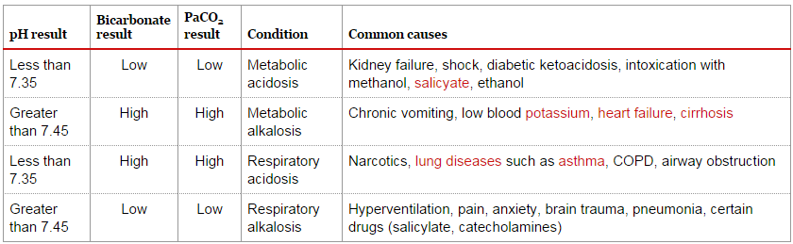

Slide 37
Drug Comments
Drug | Recommendations
Amoxicillin | Active against: Pasteurella, Capnocytophaga & Eikenella. Some oral anaerobes are resistant & most S. aureus (from the skin) are resistant
Amoxicillin / Clavulanate | Adds improved S. aureus (except MRSA) and anaerobic coverage
Cefuroxime & Cefuroxime axetil | Active against Pasteurella, Capnocytophaga, Staph intermedius, Eikenella, & MSSA. Probably adequate for oral anaerobes when used prophylactically.
Doxycycline | Active against Pasteurella, Capnocytophaga, Staph intermedius & Eikenella. Variable activity against anaerobes & S. aureus.
Moxifloxacin | Correct spectrum of activity, but published experience is low. In vitro activity includes oral flora of most animals and is active against MSSA.
Notes:
Put at the end

